Slide 1
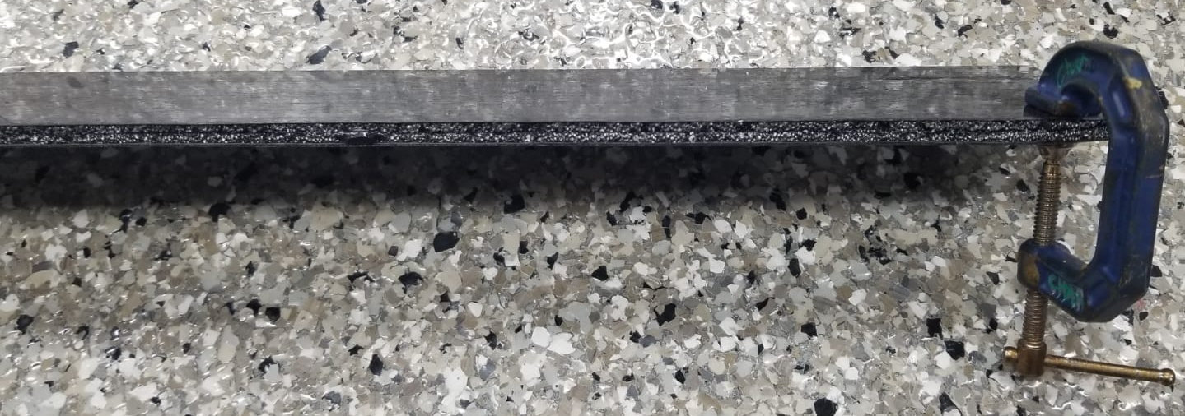
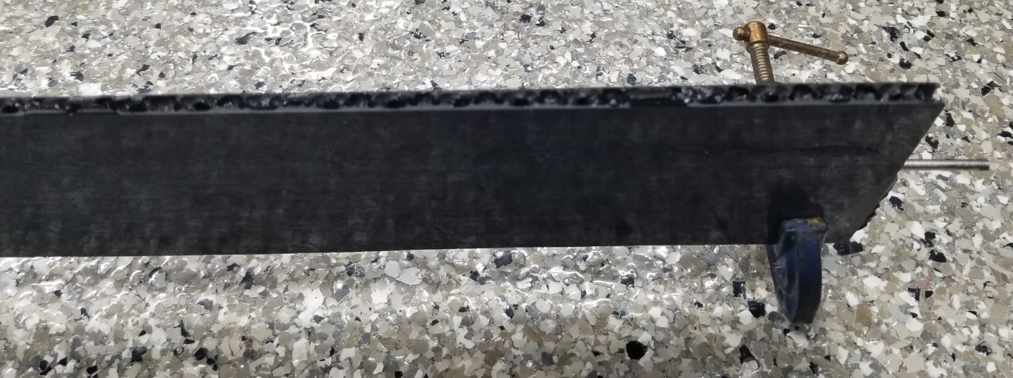
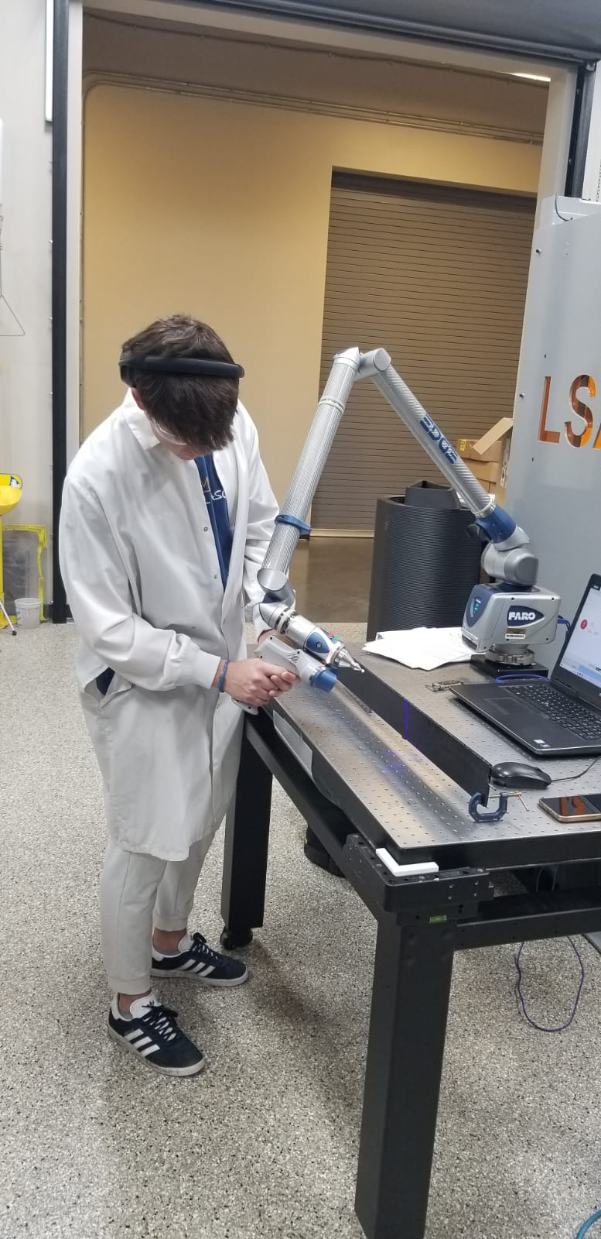
Flex PCB R&D
LFHCAL Flexes assembled by vendor, will be included in CERN HGCROC Test campaign
Not yet tested, on their way back
First barrel TOF mechanics test structures produced at Purdue
Next step: co-cure Kapton flex into 12” carbon fiber structure, bond sensors and Si-heaters onto structure
Designing test flex for co-curing:
LV, HV, maybe some temperature sensors
2 layers first, multi layer for exploration later
Produce in different stackups to test mechanical stability and precision (12” within reach of all standard manufacturers)
Ideally produced with peel-off kapton film on top to keep ENIG pads clean from resins etc.

