Slide 1
SiPM Prototype Board

Slide 2
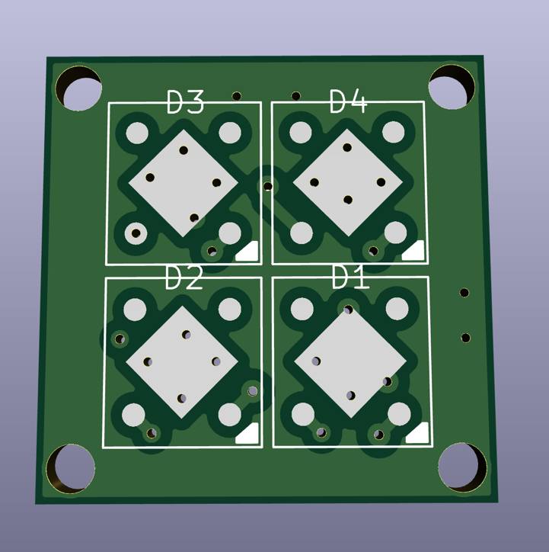

Slide 3
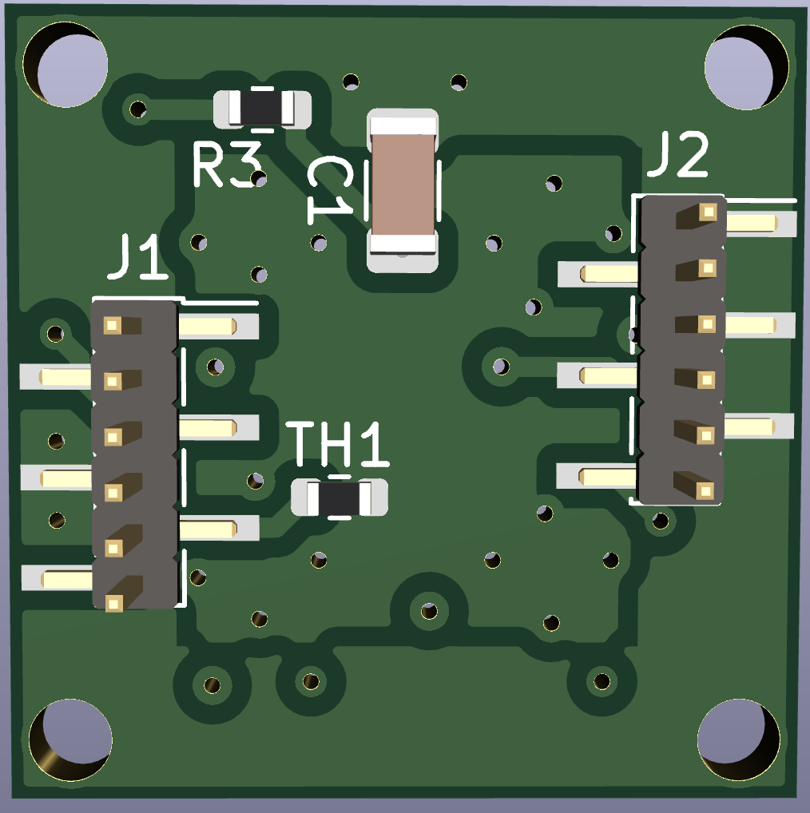

Slide 4
6010/6015 Boards
Unfortunately I have not had success getting a good IV curve from these boards.
Still debugging issues
1 board is shorted between Vbias and ground
3 boards do not have Vbias shorted, but I don’t see any change in current going up to Vop. I suspect output is shorted to something or not connected.

Slide 5
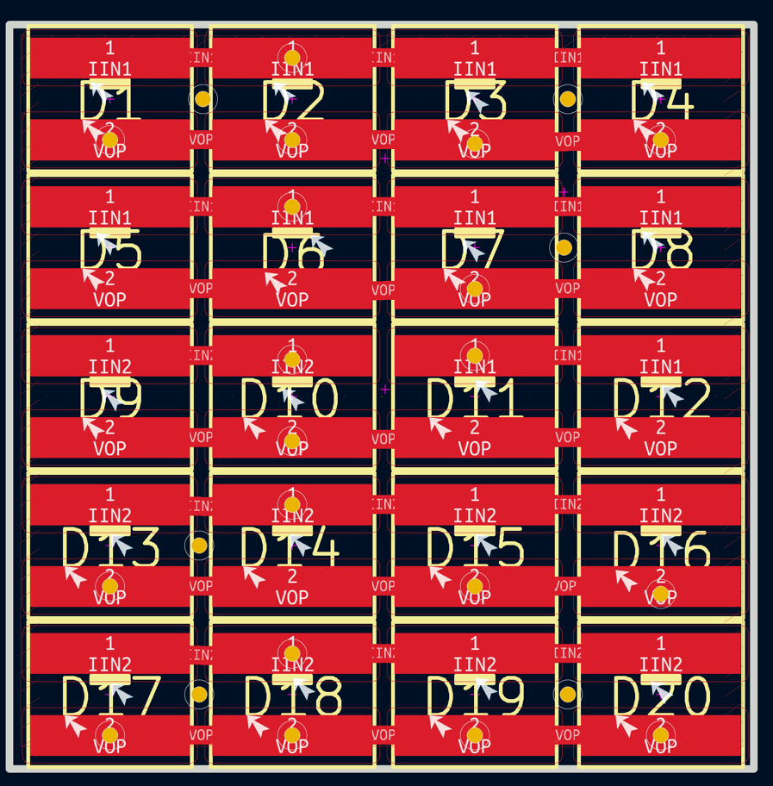

Slide 6
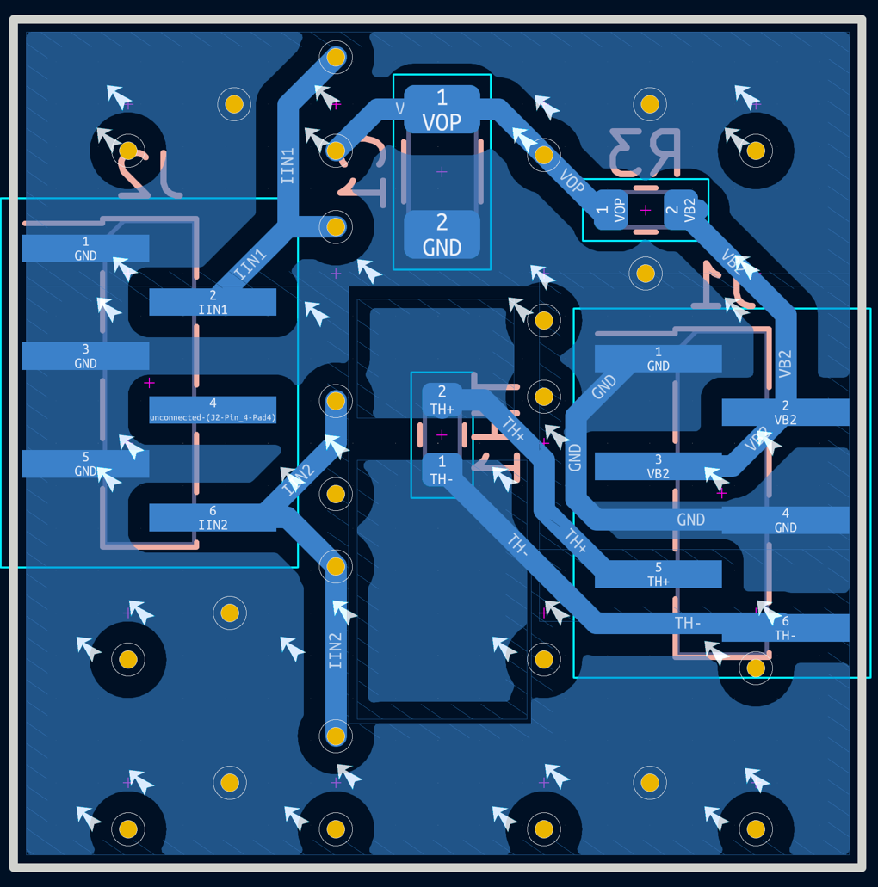

Slide 10
Trial 4 and 5 are separated by about 5 minutes

Slide 11
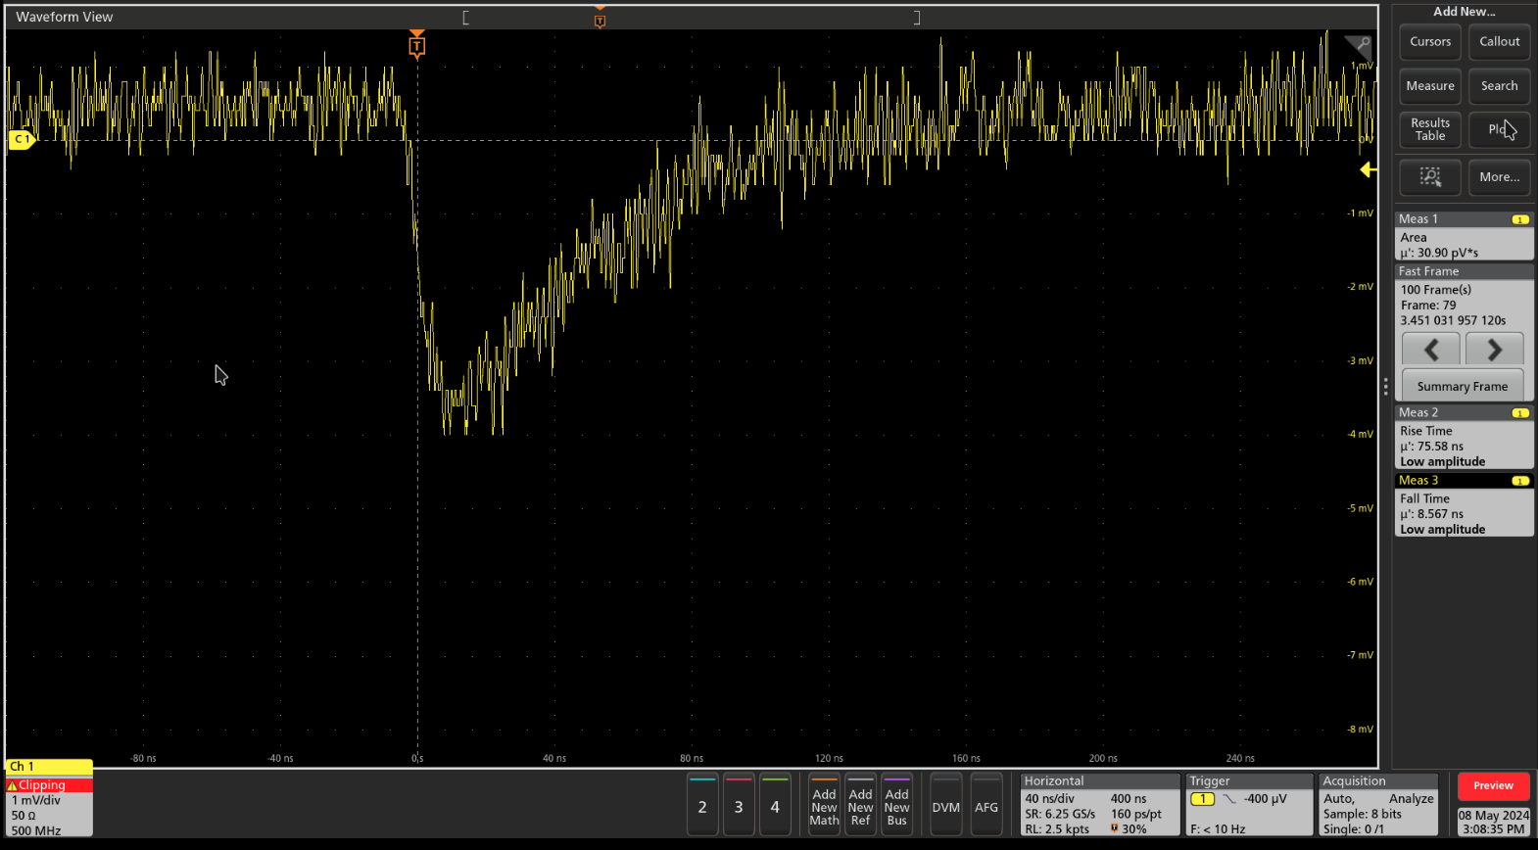

Slide 12
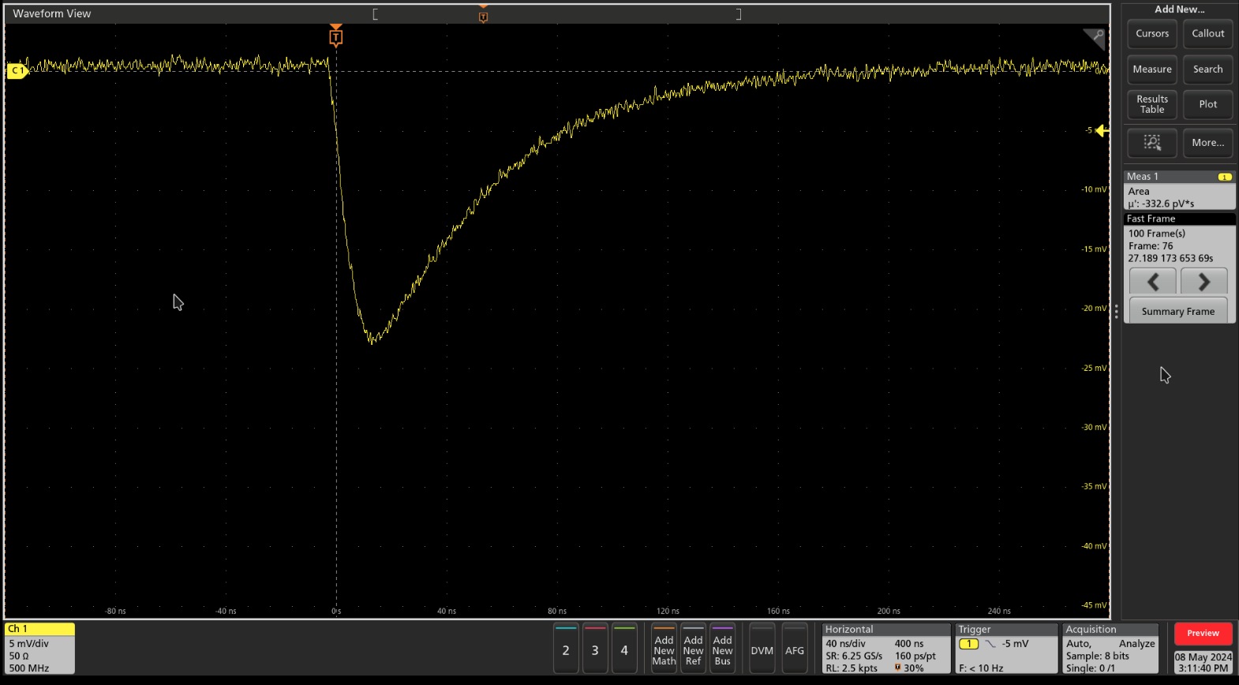
10% to 90%
Fall time: 9.5 ns Rise time: 98.5 ns

Slide 13
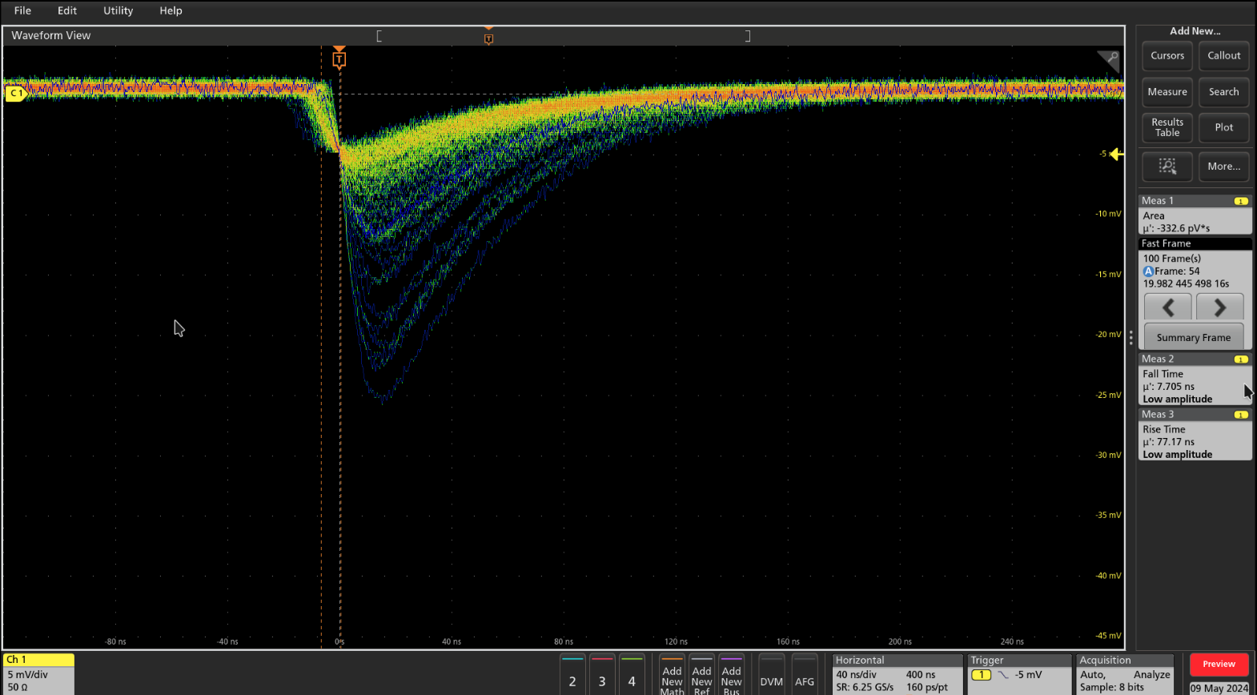

Slide 14
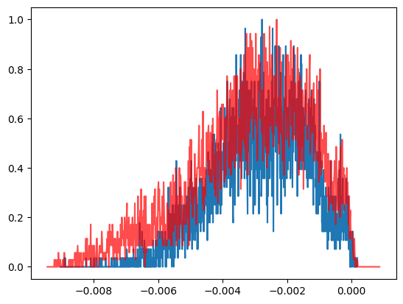
8x8x40 mm LYSO crystal array
Created a 2x2x2 array of LYSO crystals each crystal is 4x4x20 mm in size. I placed a ~0.1µCi Co60 source on top of the crystal array.
Lu176 in LYSO creates many gammas and electrons mostly with energy below 300keV
I see the excess for the 2 Co60 gammas but didn’t take enough data to tell if we can resolve them.

Slide 15
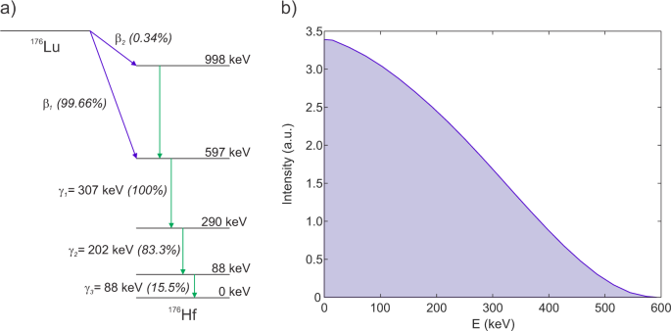
LYSO crystal decays

