Slide 1
Updated Priorities for the Simulation WG
Continue to support the detector design and integration with services.
Evaluate the differences between the engineering and simulation designs and lead the discussion on how to address these differences, in conjunction with the TIC.
Continue to support the development of background modeling and implement its timing structure in physics and detector simulations, together with the Background Task Force.
Embrace streaming readout in simulation, using it as the default data format and enabling the capability to stream the continuous readout of the detector.
Geant4 validation through test-beam studies.
Comparison of Geant4 physics lists.
Advanced detector simulations, such as projects to accelerate simulations.
Updates to the ePIC geometry repository, particularly from reviews.

Slide 2
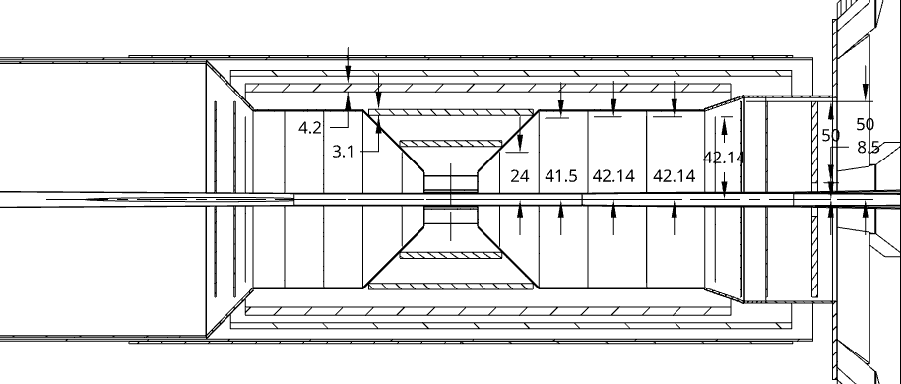
New Priority
Evaluate the differences between the engineering and simulation designs and lead the discussion on how to address these differences, in conjunction with the TIC
Simulation WG provides
CAD model converted from the DD4Hep model (OnShape)
Thin slices of the front/side views
Annotations on the dimensions
DSCs will be asked to
Compare the CAD models
Approve or complain

Slide 3
WG Meeting Schedule
Resume the regular bi-weekly discussion on 1st and 3rd weeks
Plan to invite DSC liaisons to the meeting
Discuss on the design evaluation in the following meetings
More general discussion on the simulation support

