Slide 1


Using CAD in Detector Simulations
Dr. Sam Henry, University of Oxford
Tuna Tasali, University of Oxford
UK

Slide 2
Importing CAD Designs

Slide 3
Conversion Everything Is Automated!
Except…
UK
Conversion Script
FreeCAD API
.STL (mesh)
.gdml (mesh)
sensitive=«true»
Set automatically by the .gdml file name.
.STL (mesh)
.gdml (mesh)
.STEP
.FCStd
silicon_barrel.xml
.STL (mesh)
.gdml (mesh)
Sensitive volume handled differently by
Open and save in FreeCAD
(Will be fully automatd soon.)
.STL (mesh)
.gdml (mesh)
Define dictionary/YAML for file names with properties.
BarrelTrackerOuter_geo_standardized.cpp
.xml File generated from GDML files automatically

Slide 4
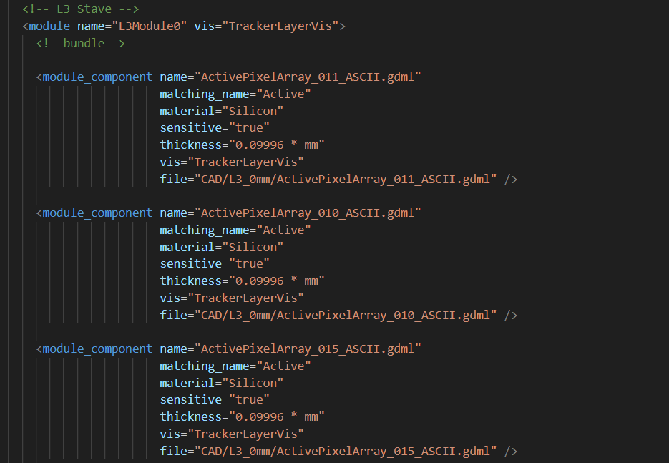
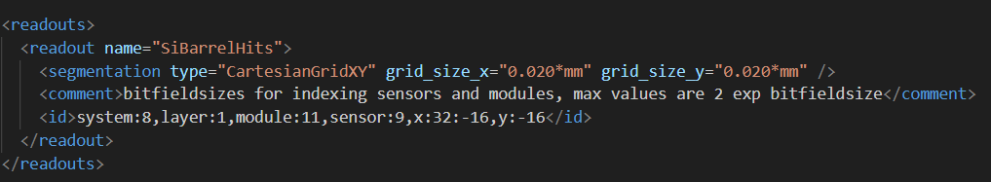
Compact: silicon_barrel.xml
UK
<detector/>
  <module #n/>
    <module_component file=PATH_TO_GDML_File/>
  <layer #n/>
    Where binning and placement paremeters belong
Max number of <module_component/> per <module/> determined in the python script generating the .xml file. But why?

Slide 5
Sensitive Components
UK
Instead of importing a mesh as dd4hep::TessellatedSolid
  Extrude appropiate faces of the mesh to construct a curved sensitive surface
  Allows us to attach ACTS surfaces to each mesh for reconstruction?
Notice no overlap between extruded prisms for convex surface, but how do we decide which facet to extrude, in what direction?

Slide 6
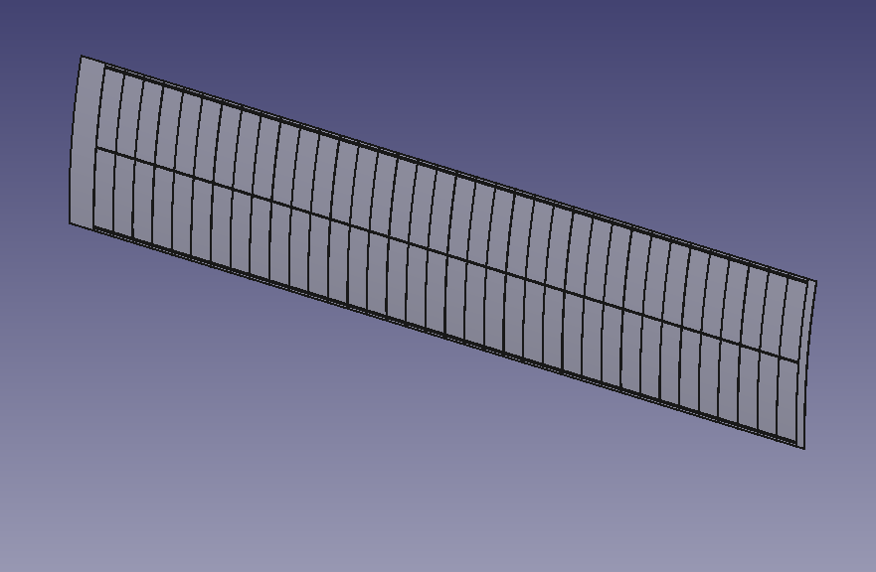
Sensitive Components
UK
Looking from this side

Slide 7




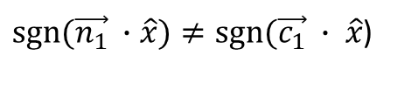

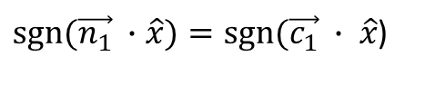


Sensitive Components
UK
Facet 1
$$\vec{n_{1}}$$
$sgn⁡(\vec{n_{1}} ∙$ $\hat{x})=sgn⁡(\vec{c_{1}} ∙ \hat{x}$)
$$\vec{c_{1}}$$
Don’t Extrude this Facet
$$\hat{x}$$
$$\hat{y}$$
$$O$$
$sgn⁡(\vec{n_{1}} ∙$ $\hat{x})≠sgn⁡(\vec{c_{1}} ∙ \hat{x}$)
Extrude this Facet in the direction opposite to the normal
$$\vec{c_{2}}$$
It should also work if the silicon was curved the other way, equivalent to a y-> -y transformation which keeps x invariant!
(Please correct me if I am wrong.)
$$\vec{n_{2}}$$
Facet 2

Slide 8
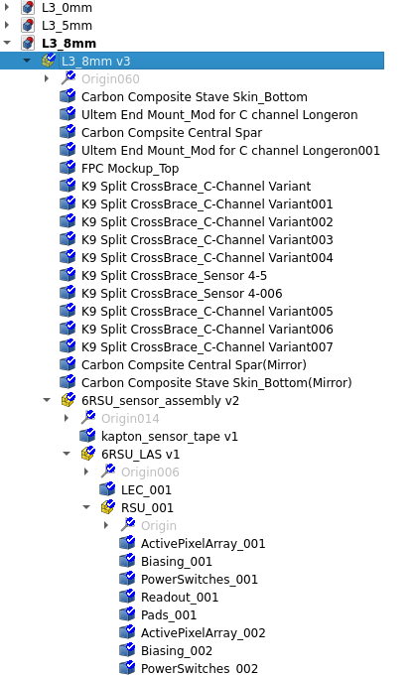
New Method: Everything Is Automated!
Except… Dictionary/YAML?
UK
Suppose we have a design like this

Slide 9
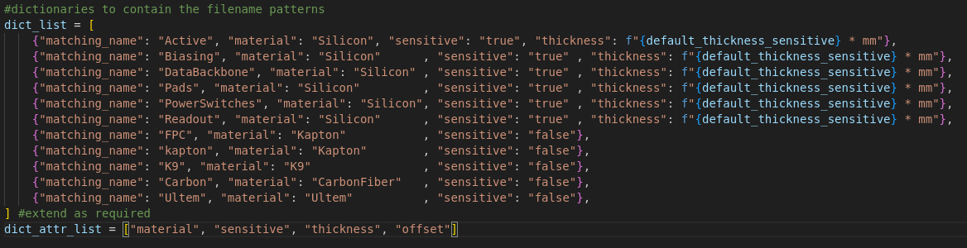
New Method: Everything Is Automated!
Except… Dictionary/JSON?
UK
Suppose we have a design like this

Slide 10
New Method: Everything Is Automated!
Except… Dictionary/JSON?
UK
Not the best way to keep the dictionary in the Python script, will move this to a YAML file later…

Slide 11
Applications

Slide 12

Setup
SVT L0 & L1
UK
SVT L2
SVT L3
Note that only barrel envelopes are shown (except for MPGD Outer Barrel)
SVT L4
MPGD Inner Barrel
ToF Barrel
MPGD Outer Barrel
Note: The viewer is only able to render ENVELOPES and not the volumes themselves.
Note: Setup includes the same detectors as in Long’s design.
Beam Pipe

Slide 13
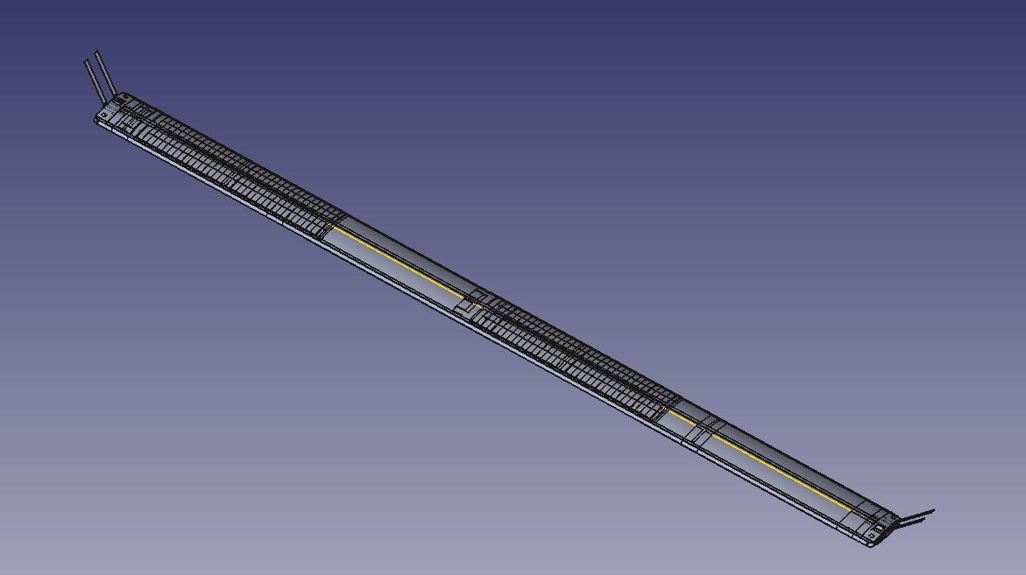
Stave Design: L3
UK

Slide 14
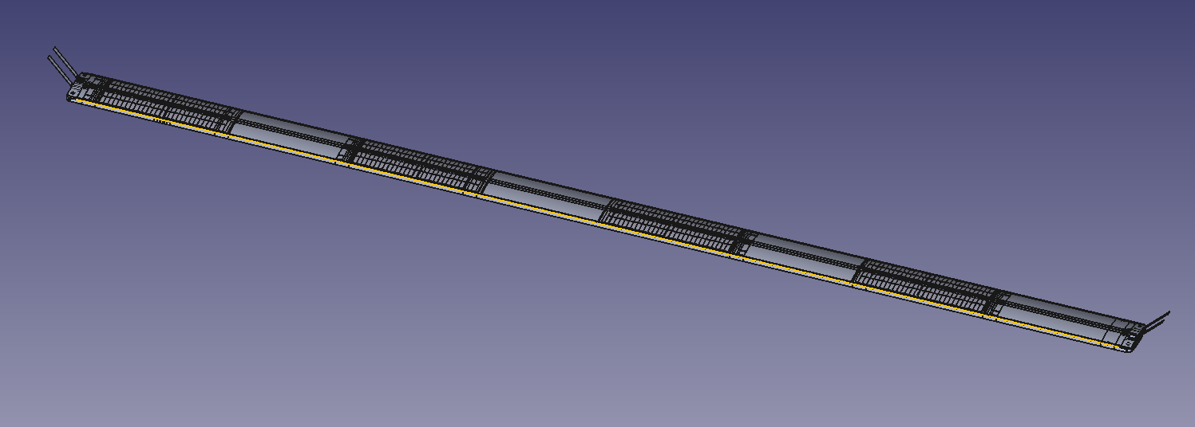
Stave Design: L4
UK

Slide 15
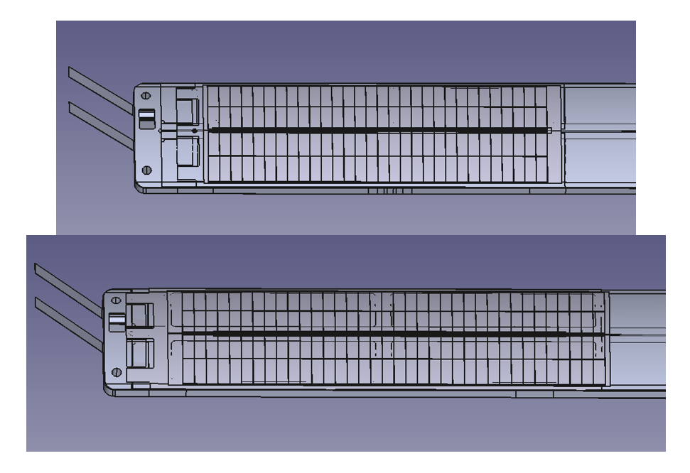
6RSUvs5RSU LAS
UK
LAS on L4 Stave
LAS on L3 Stave: Longer due to size constraints that is the length of the L3 stave. (optimal overlap)

Slide 16
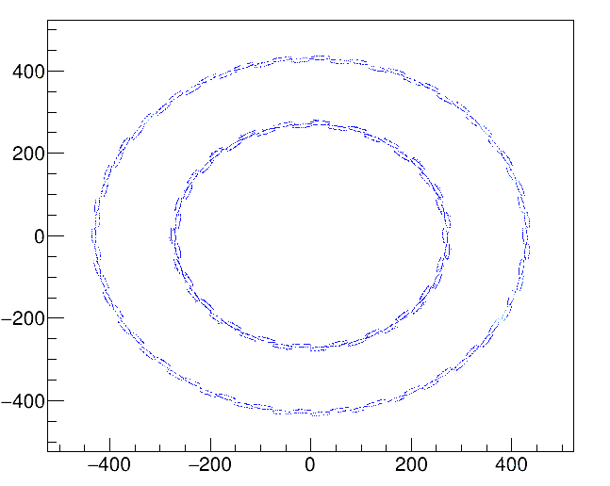
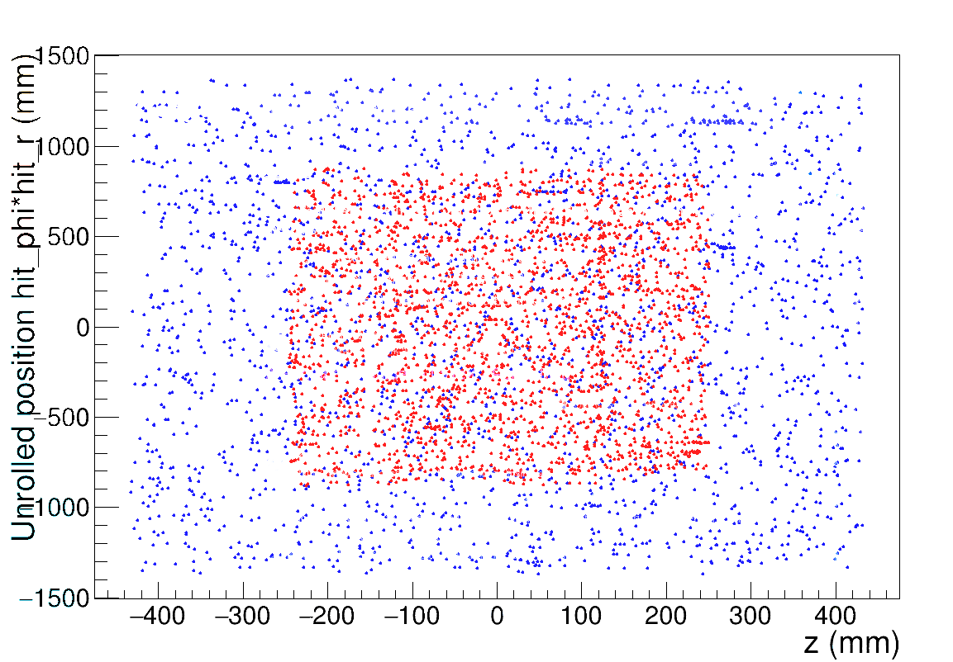
To veryify correctly imported geometry: Hit Plots
(from L3 8mm overlap, p=10GeV/c)
UK
y (mm)
Red: L3 Hits
Blue: L4 Hits
x (mm)

Slide 17

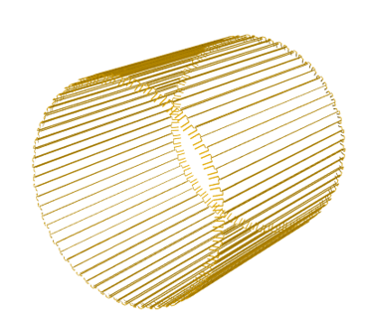
To verify correctly imported geometry: Visualisation
UK
Note: The viewer crashes when trying to render all staves, this rendered only 20 of them with the carbon fiber supports only
The best the viewer could do to model a barrel (Only FPC cables rendered, at least shows that we have the correct barrel structure)

Slide 18
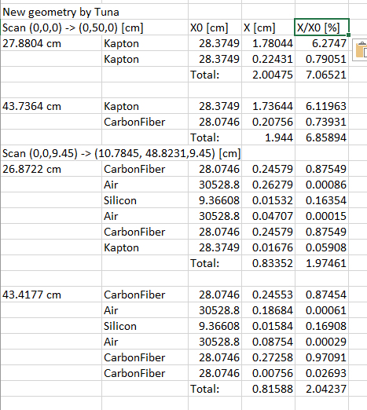
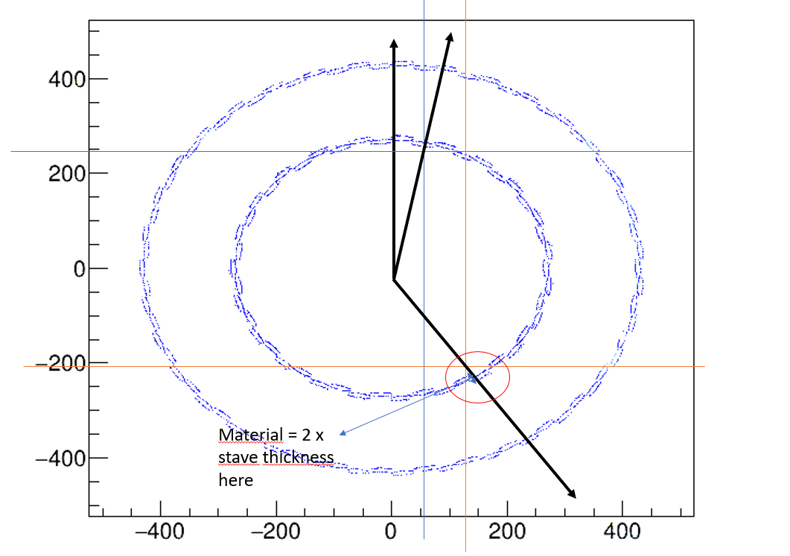
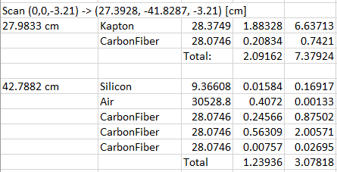
To verify correctly imported geometry: materialScan
UK
Something is wrong here, too high of a material budget…

Slide 19
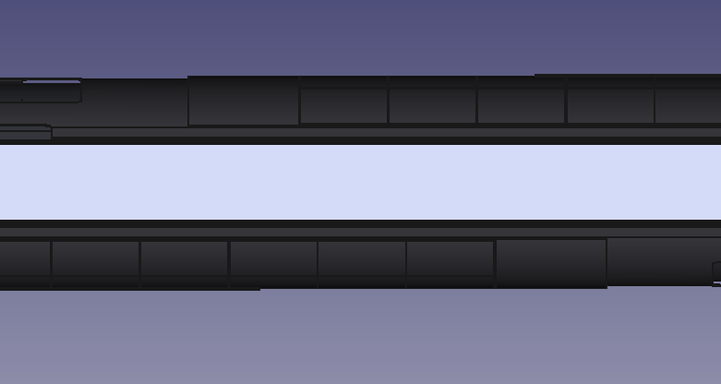
Overlap Study (in L3 only):
UK
Overlap (in this case 8mm)
Inactive Silicon
Side view of the L3 Stave.
Inactive Silicon

Slide 20
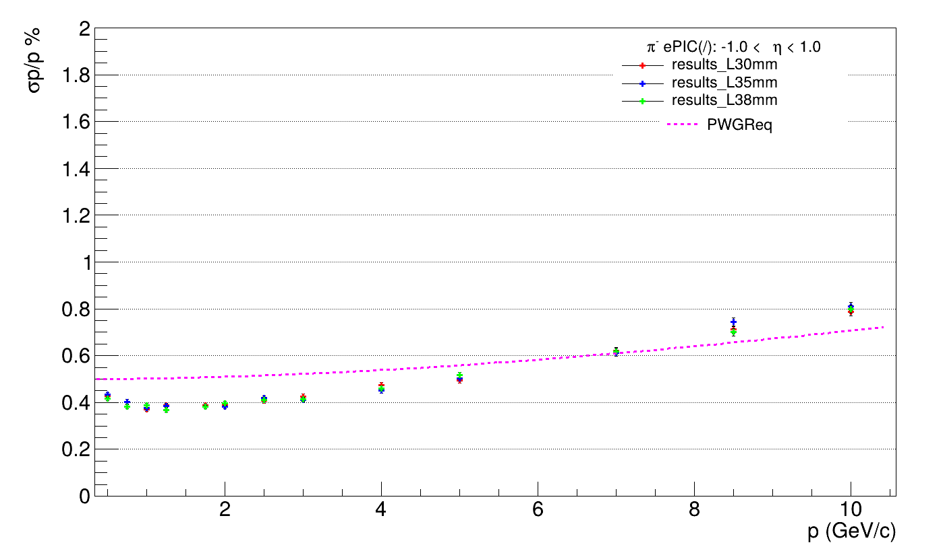
Overlap Study (in L3 only): deltap/p
UK
Pion momentum:
0.5-10GeV/c

Slide 21
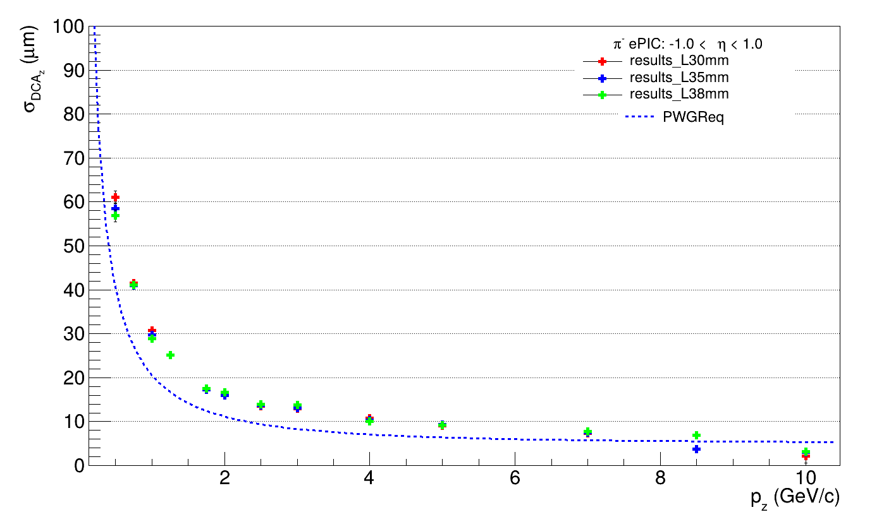
Overlap Study (in L3 only): dca_z
UK
Some missing datapoints here and there due to empty recon data, perhaps a fault/error/bug?

Slide 22
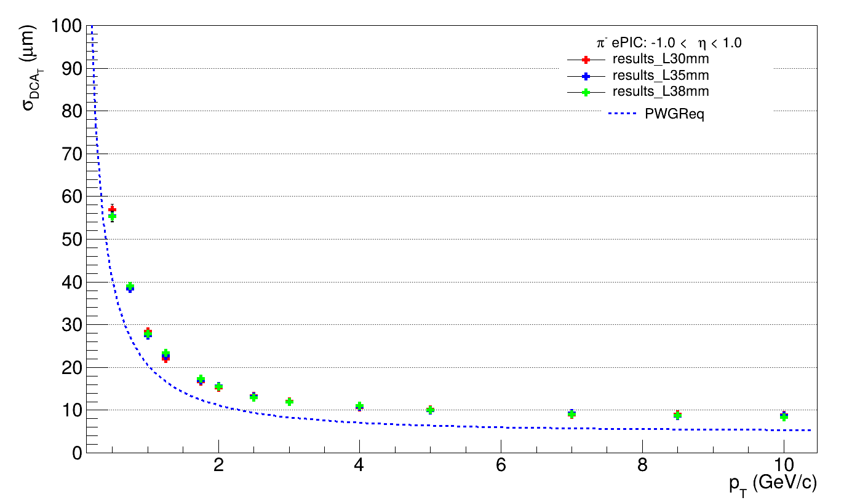
Overlap Study (in L3 only): dca_T
UK

Slide 23
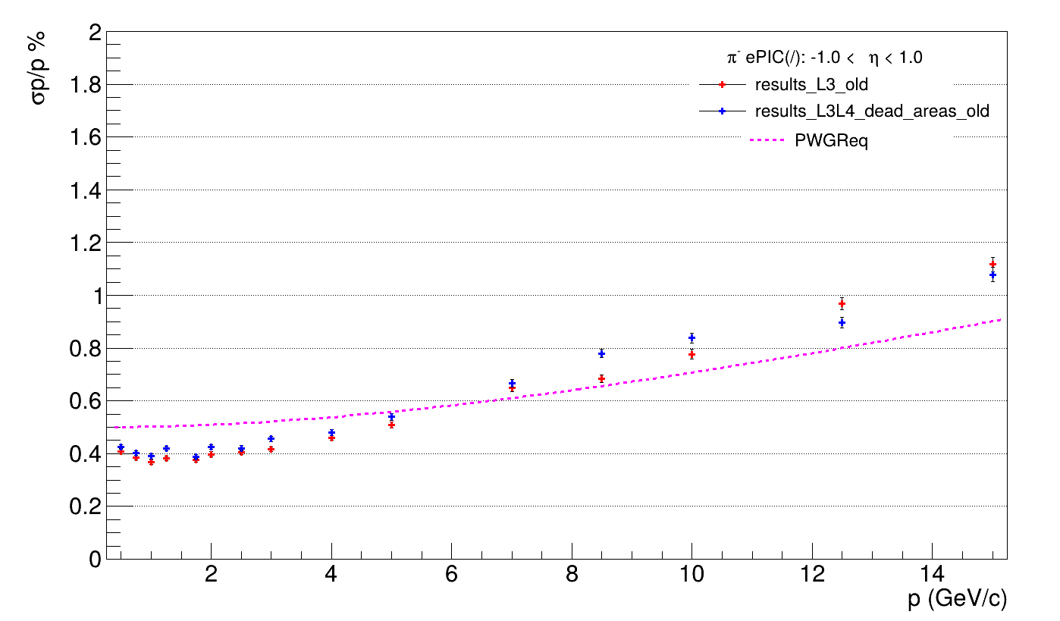
Sensitive Area Study (both layers)
UK

Slide 24
Sensitive Area Study (both layers)
UK
A flipped trend?
(I double checked that I didn’t enter the data wrong.)

Slide 25
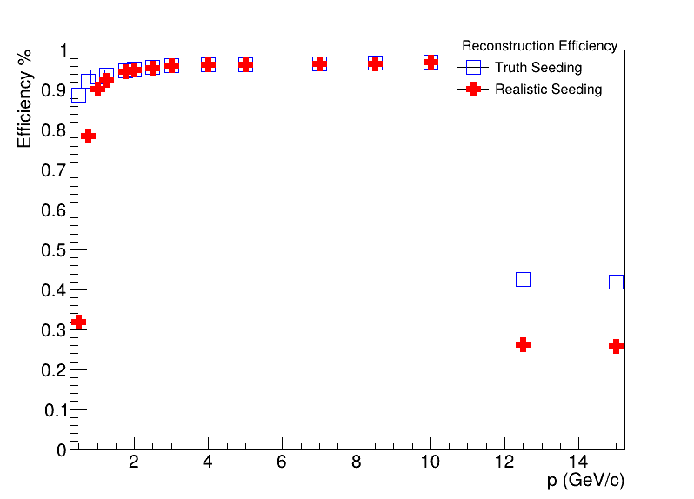
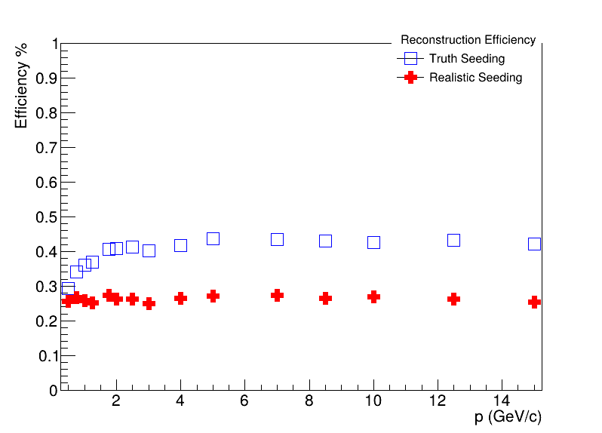
Sensitive Area Study: Bad News
UK
There seems to be an unexplained drop in recon efficiency especially with the old design??
Diagnosis: Draw Hit plots for these faulty runs as well (had no time for this)
New Design with Dead Areas
Old Design with No Dead Areas
I remember generating these data points on a separate run, hence it might it be something to do with the run and not the old design.

