Slide 1
ATF Science Planning Workshop 2024 Logistics & Opening Remarks
Mary Jane Ilardi
June 20, 2024

Slide 2
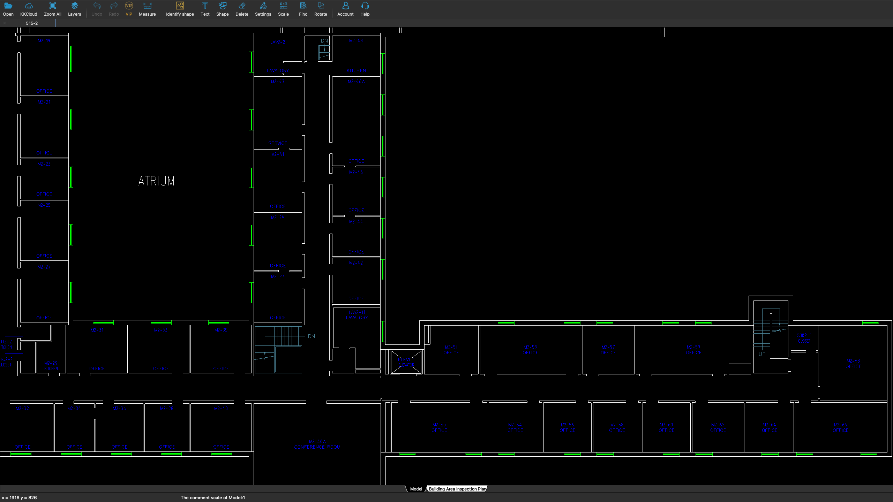
Safety First
Closest building exit is just down the stairs and out the front door.
Additional stairwells at ends 2 hallways
We are here
2

Slide 3
Logistics for the Meeting
Thursday
ATF Tours starting at 11:15 PM
Lunch on your own
No Host Dinner at Cooperage Inn 6:40 PM
Friday
Lunch on your own

Slide 4
Lunch at Berkner
On-site option is the Pop-Up Café at Berkner
Grab & Go or Pre-Order
Berkner seating area is open

Slide 5
No Host Dinner
Cooperage Inn
6pm this evening
2218 Sound Ave Baiting Hollow, NY 11933
Lab main entrance

