Slide 1

ATF Science Planning Workshop
Previous Workshop and ATF Response
Navid Vafaei-Najafabadi
Accelerator Facilities Division
June 20, 2024

Slide 2
Synthesis
Priority research direction (PRDs) for the facility are determined through science planning workshops
The PRDs in turn define a set of core capabilities as targets for investment
Previous workshop focused on PRDs in the areas of
  Long-Wave Infrared (LWIR) Driven Science
  Electron-Beam-Driven Science
  Laser Electron Beam Interactions
In response to the workshop, major laser infrastructure upgrades have been carried out at ATF to facilitate high-impact experiments, but electron beam facility upgrade is also needed to take full advantage of its capability in beam-driven and integrated experiments
This workshop’s goal is to gather community input on the next step in this process

Slide 3
ATF Science Planning Process
Goals:
  Determine the Priority Research Directions (PRDs) that can be leveraged to establish a priority-based upgrade path for the facility.
  Determine the set of parameters to best support the PRDs and enable the exploration of new Physics
Strategy
  Refine and update the PRDs using the community input through a series of Science Planning Workshops
  Determine a set of core capabilities and upgrades required for ATF facilities to best serve the research
2019 Report Editors:
  Navid Vafaei-Najafabadi (Stony Brook University)
  Michael Downer (University of Texas at Austin)
  David Sutter (University of Maryland)
  Gerard Andonian (University of California, Los Angeles)
  Aakash Sahai (University of Colorado)
2019Report: https://www.bnl.gov/atf/docs/ATF%20Science%20Workshop%20Report%202019.pdf

Slide 4
Overview of Previous Priority Research Directions
Long-Wave Infrared (LWIR) Driven Science.
Electron-Beam-Driven Science
Laser Electron Beam Interactions

Slide 5
Overview of Previous Priority Research Directions
Long-Wave Infrared (LWIR) Driven Science.
  LWIR Laser-Driven Plasma Ion Acceleration
  LWIR Laser-Driven Plasma Electron Acceleration
  Basic Plasma Physics Research in Novel Regimes
  LWIR Laser Technology Development
Electron-Beam-Driven Science
  Advanced Acceleration Research
  Beam Phase Space Optimization
  Low Emittance Source Development
  Novel and Efficient Terahertz Radiation Generation
Laser Electron Beam Interactions
  Basic Research of Laser-Plasma Charged-Lepton-Beam Production
  Electron Acceleration Techniques Driven by the Combination of Electron Beam and LWIR Laser
  Radiation Generation

Slide 6
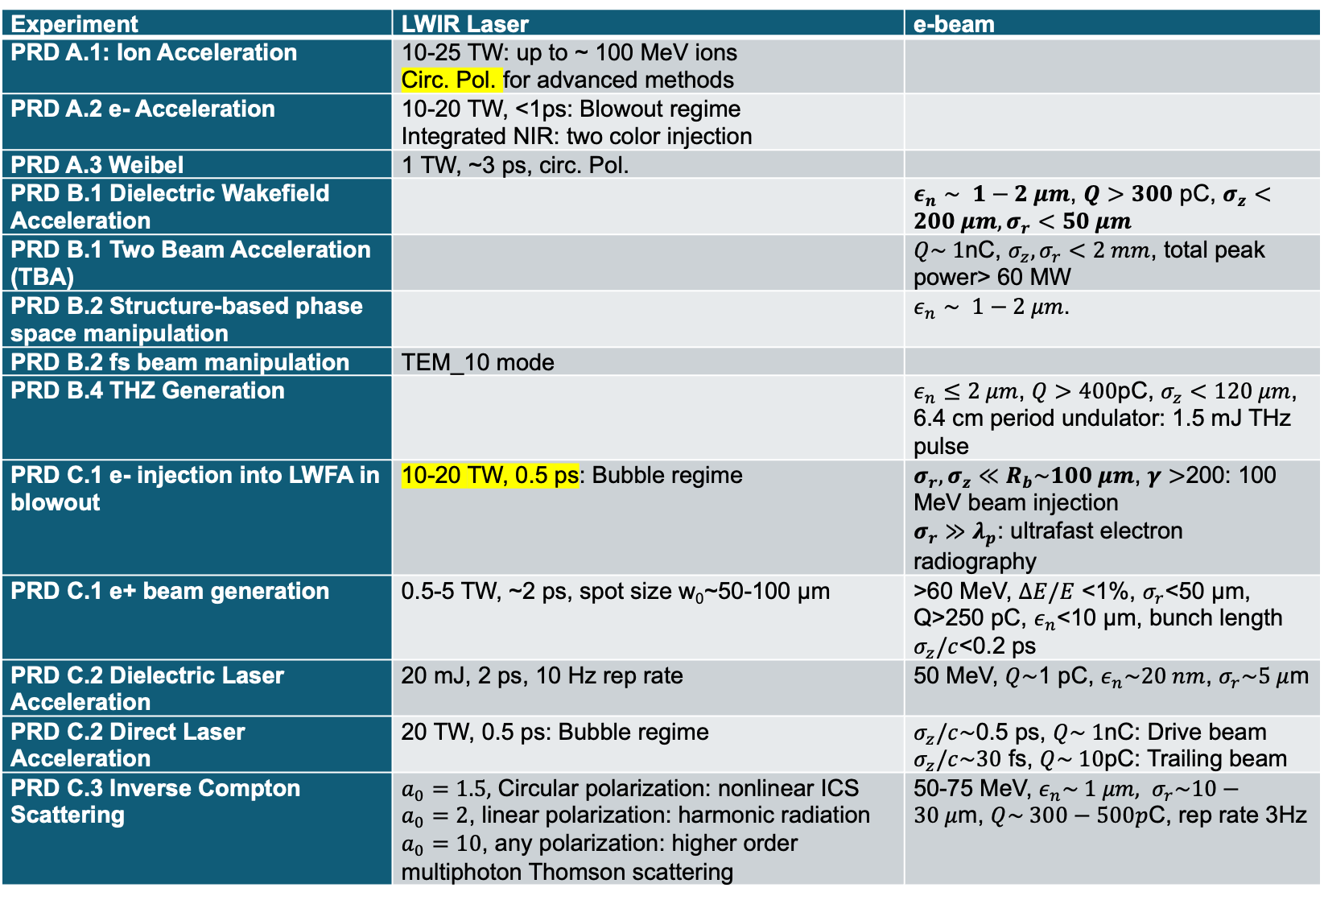
Review: Facility Needs
Experiment | LWIR Laser | e-beam
PRD A.1: Ion Acceleration | 10-25 TW: up to ~ 100 MeV ions Circ. Pol. for advanced methods
PRD A.2 e- Acceleration | 10-20 TW, <1ps: Blowout regime Integrated NIR: two color injection
PRD A.3 Weibel | 1 TW, ~3 ps, circ. Pol.
PRD B.1 Dielectric Wakefield Acceleration |  | $ε_{n}∼ 1−2 μm$, $Q>300$ pC, $σ_{z}<200 μm, σ_{r}<50 μm$
PRD B.1 Two Beam Acceleration (TBA) |  | $Q\sim 1$nC, $σ_{z}, σ_{r}<2 mm$, total peak power> 60 MW
PRD B.2 Structure-based phase space manipulation |  | $ε_{n}∼ 1−2 μm$.
PRD B.2 fs beam manipulation | TEM_10 mode
PRD B.4 THZ Generation |  | $ε_{n}≤2 μm$, $Q>400$pC, $σ_{z}<120 μm$, 6.4 cm period undulator: 1.5 mJ THz pulse
PRD C.1 e- injection into LWFA in blowout | 10-20 TW, 0.5 ps: Bubble regime | $σ_{r},σ_{z}≪R_{b}\sim 100 μm$, $γ>$200: 100 MeV beam injection $σ_{r}≫λ_{p}$: ultrafast electron radiography
PRD C.1 e+ beam generation | 0.5-5 TW, ~2 ps, spot size w₀~50-100 µm | >60 MeV, $ΔE/E$ <1%, $σ_{r}$<50 µm, Q>250 pC, $ε_{n}$<10 µm, bunch length $σ_{z}/c$<0.2 ps
PRD C.2 Dielectric Laser Acceleration | 20 mJ, 2 ps, 10 Hz rep rate | 50 MeV, $Q\sim$1 pC, $ε_{n}\sim 20 nm$, $σ_{r}\sim 5 μ$m
PRD C.2 Direct Laser Acceleration | 20 TW, 0.5 ps: Bubble regime | $σ_{z}/c\sim$0.5 ps, $Q\sim 1$nC: Drive beam $σ_{z}/c\sim 30$ fs, $Q\sim 10$pC: Trailing beam
PRD C.3 Inverse Compton Scattering | $a_{0}=1.5,$ Circular polarization: nonlinear ICS $a_{0}=2$, linear polarization: harmonic radiation $a_{0}=10$, any polarization: higher order multiphoton Thomson scattering | 50-75 MeV, $ε_{n}\sim 1 μm, σ_{r}\sim 10−30 μ$m, $Q\sim 300−500p$C, rep rate 3Hz

Slide 7
Review: Diagnostic Needs
Expanded Experimental Diagnostic Capabilities
  Plasma Diagnostics (interferometry, shadowgraphy,etc)
  Prepulse contrast diagnostics better than 4 orders of magnitude
  Characterization of high quality e-beams requires full e-trajectory recovery within a magnetic spectrometer’s energy-dispersion plane, e-beam polarimeters based on Møller e-e scattering from polarized ferromagnetic targets, and CTR-based 6D profiling of e- bunches.
  Radiation detectors, including KBr, MCPs, x-ray CCDs, and CsI scintillators with CCD, flux measurements, Crystal Si or CdTe average flux energy spectrometer, Single Shot Double differential diagnostic, Curved bent multi layer or Si & Quartz spectrometer, liquid scintillator detector in combination with single photon count PMT, and Compton magnet spectrometer
  Achievable through collaboration with users
Beam characterization: Transverse deflective cavity (T- CAV), 2 THz interferometry from coherent transition radiation (CTR), coherent diffraction/edge/Cerenkov radiation (CDR/CER/CCR)
Alignment and Synchronization Requirements for Multi-Beam Experiments
  Implementation of computer-based optimization technologies and accompanying high repetition rate are needed for achieving and maintaining high precision alignment and synchronization between the beams
Expanded Computational Capabilities
  Availability of user-friendly simulation codes for modelling short/long-term plasma dynamics, radiation production, and machine-learning tools for beam diagnostics and steering will be a great asset for users

Slide 8
ATF Response: Major Infrastructure Upgrades to Facilitate High-Impact Experiments

Slide 9
Investments in Capability Upgrades
In response to the scientific plan, the facility has focused on development of capabilities with highest scientific payoff:
  R&D in LWIR laser technologies to achieve 20 TW, <1 ps pulse
  Integration of laser and beam sources for multi-beam experiments
  Implementation of integrated femtosecond (Ti:Sapphire) laser for enabling key experiments in accelerator science and plasma physics
Investment in stability and diagnostics for the electron beam are required to fully take advantage of its capability as a science driver as well as multi-beam integrated experiments

Slide 10
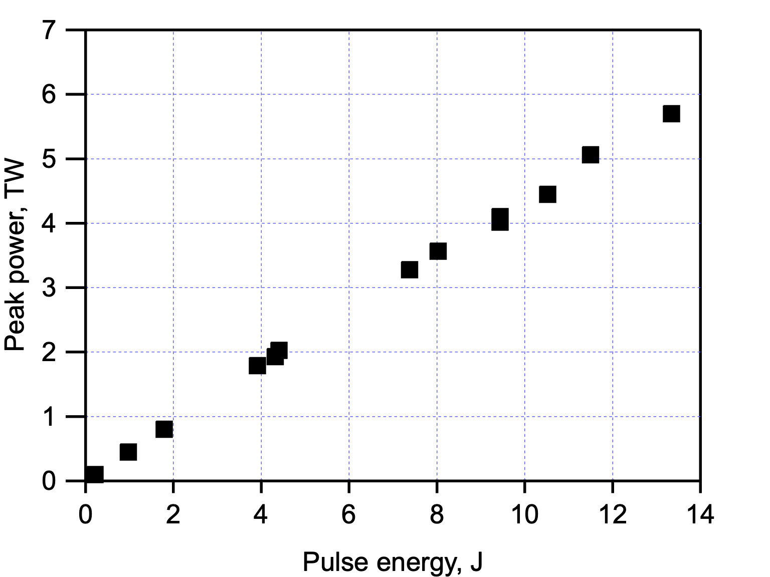
Current Status and Future LWIR R&D
Science plan shows the promise of high-impact results at ~20 TW, <1ps laser pulse
Aggressive R&D program has been put in place to meet this milestone, including
  Vacuum transport to enable delivery of 5 TW to user IPs
  Development of solid-state seed (~10 mJ) enabling better use of CO₂ gain bandwidth
  Research in novel nonlinear pulse compression methods to reach 100s of fs
  R&D in plasma optics (user collaboration) to overcome the gradual long-term degradation of compressor gratings
March 2019: 5 TW
2018: 2 TW
M. N. Polyanskiy, I. V. Pogorelsky, M. Babzien, M. Palmer, "Demonstration of a 2 ps, 5 TW long-wave infrared laser based on chirped-pulse amplification with mixed-isotope CO₂ amplifiers," (Submitted to “OSA Continuum”, Oct. 2019).

Slide 11


NonLinear Pulse Compression (NLPC)
Experiment
$$τ=0.625τ_{auto}= 675 fs$$
$$P_{out}=1.55 TW$$
measured within a central portion of the beam containing 30% of the total energy
Pogorelsky et al. – Front. Phys. 12:1390225 (2024)
Most powerful long-wave infrared
sub-picosecond pulse ever obtained

Slide 12
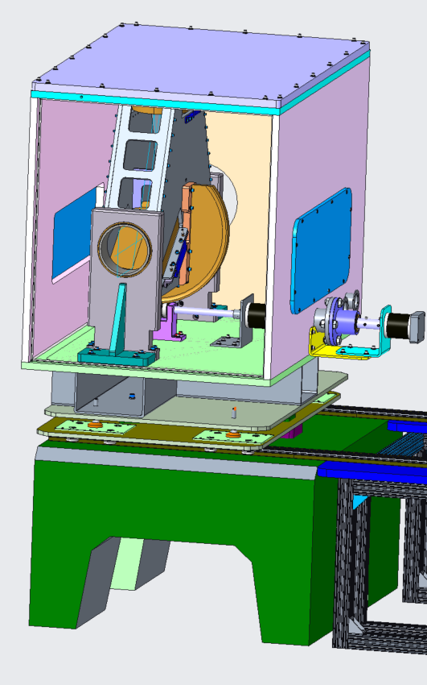
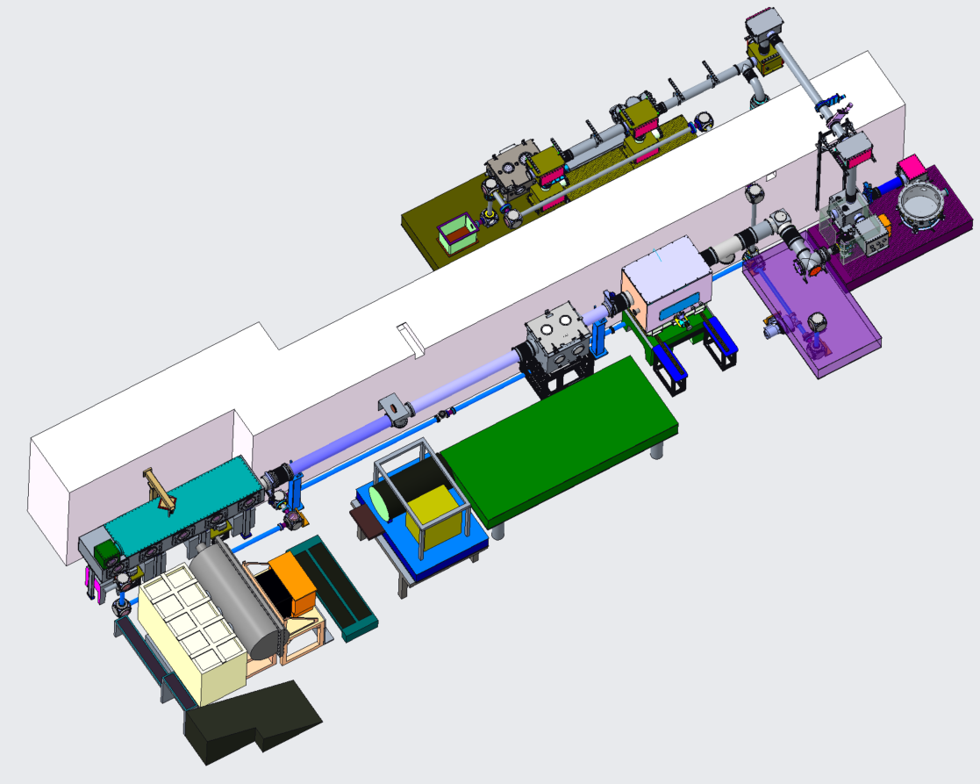
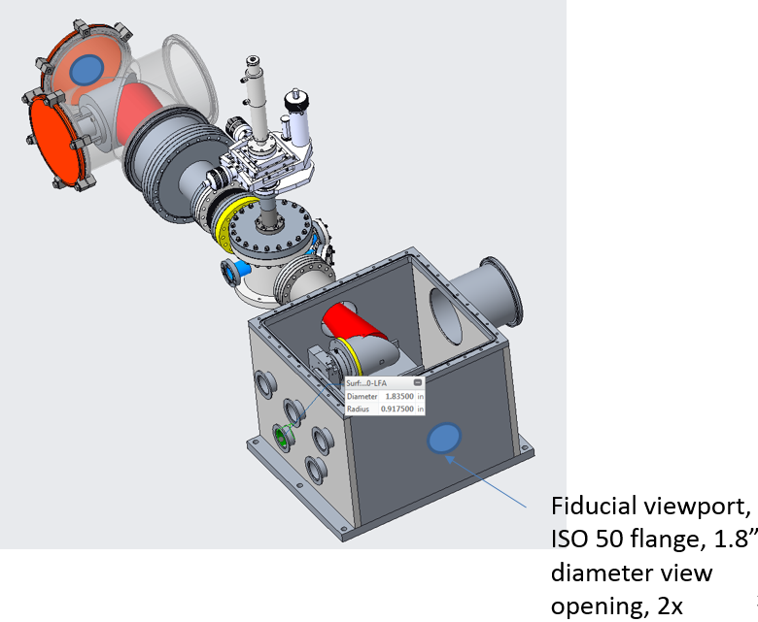
LWIR laser infrastructure upgrade enables multi-beam experiments
Flexible polarization rotator (FPR)
Nonlinear pulse compressor
Test chamber
Experimental Hall
FEL Room
Compressor
Shielding wall
CO₂
Seed Laser Table
YAG
YAG
CO₂
plasma
Final amplifier
CO₂ Room
Plasma shutter

Slide 13
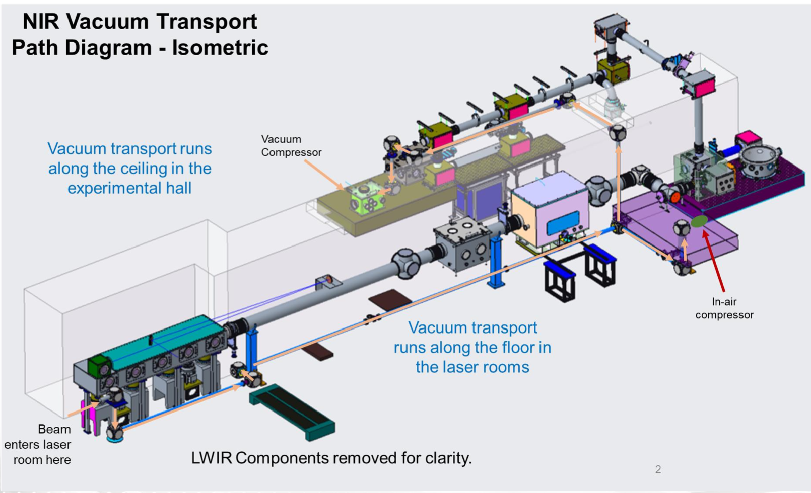
Two Compressors Enable Integration of the Ti:Saph at User IPs

Slide 14
Integration of Ti:Saph at ATF
Parameter | Value | Comments
Energy (compressed) | >15 mJ (@1.5 Hz) | Compressed on target. <5% std long-term variation To be increased to 100 mJ @ 12 Hz
Energy (stretched) | >200 mJ | Out of 4-pass amplifier <8% std long-term variaiton
Duration | <70 fs | FWHM
Focused spot size | <4 µm FWHM | With F/1.5 OAP <1µm std pointing stability (~25µrad std)
Polarization | Vertical | Horizontal available upon request
Synchronization | Synchronized to the facility 81.6 MHz master clock | Rough timing (ns) by SRS delay generators. Fine adjustments (~10fs) by phase tuning the oscillator (Coherent Vitara+Synchrolock)
Transport line+ compressor transmission | 60%
Peak intensity | >10¹⁸ W/cm²
Beam size in transport | <1.5” | Limited by aperture of vacuum line between Nd:YAG and Gun Hutch rooms
Addition of Ti:Saph is represents an important upgrade in the capabilities of ATF

Slide 15
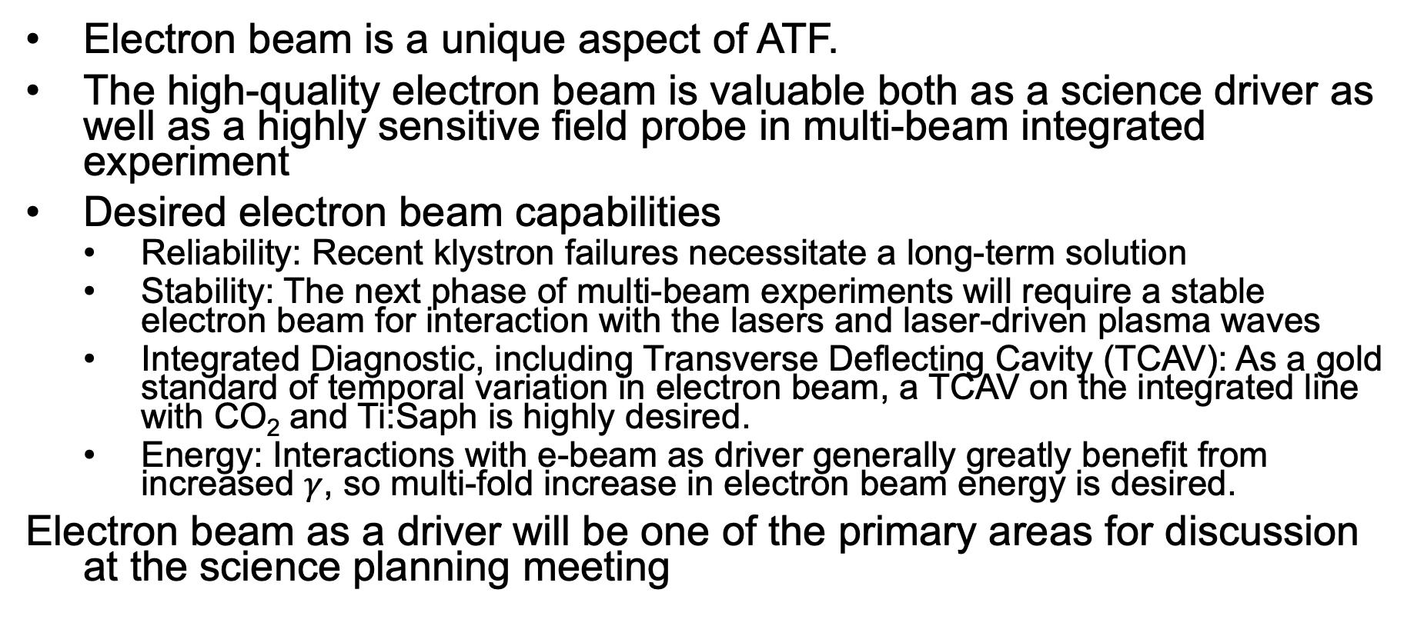
Electron Beam Facility Upgrades Required for Maintaining its Role as a Science Driver
Electron beam is a unique aspect of ATF.
The high-quality electron beam is valuable both as a science driver as well as a highly sensitive field probe in multi-beam integrated experiment
Desired electron beam capabilities
  Reliability: Recent klystron failures necessitate a long-term solution
  Stability: The next phase of multi-beam experiments will require a stable electron beam for interaction with the lasers and laser-driven plasma waves
  Integrated Diagnostic, including Transverse Deflecting Cavity (TCAV): As a gold standard of temporal variation in electron beam, a TCAV on the integrated line with CO₂ and Ti:Saph is highly desired.
  Energy: Interactions with e-beam as driver generally greatly benefit from increased $γ$, so multi-fold increase in electron beam energy is desired.
Electron beam as a driver will be one of the primary areas for discussion at the science planning meeting

Slide 16
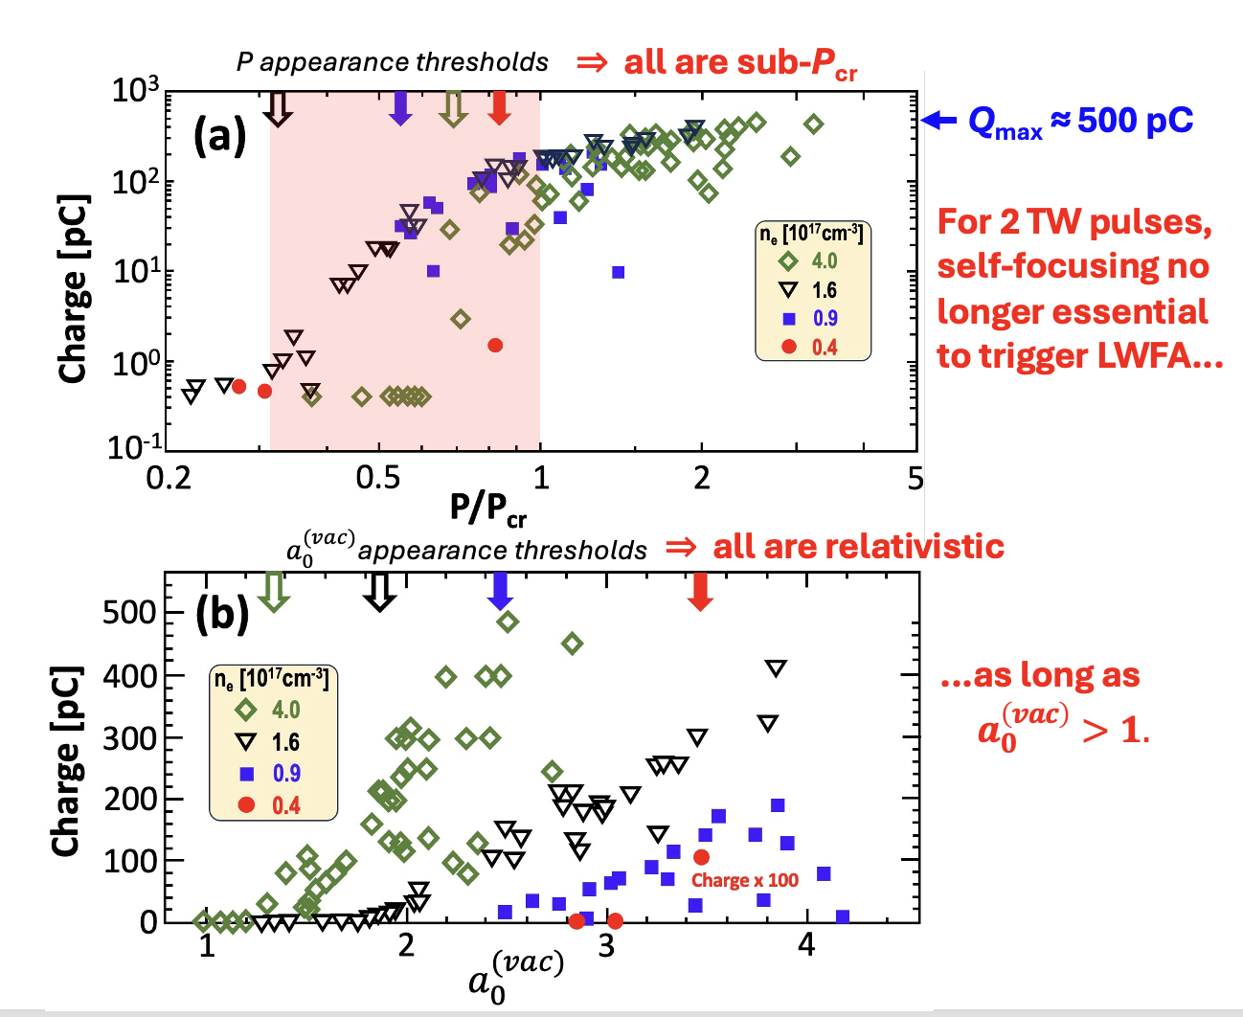
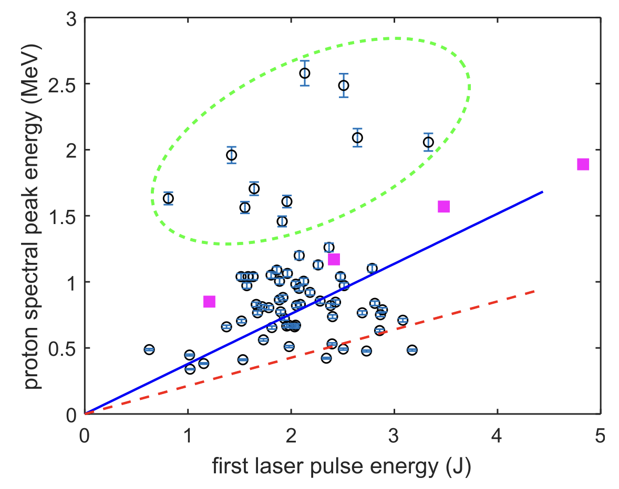
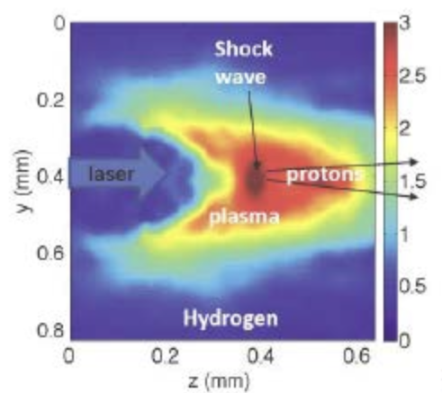
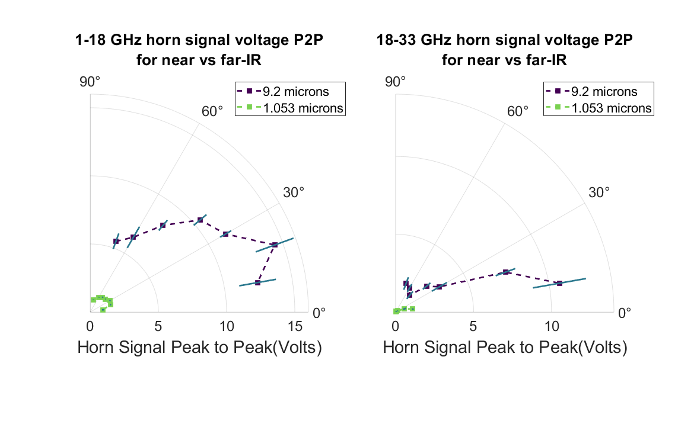
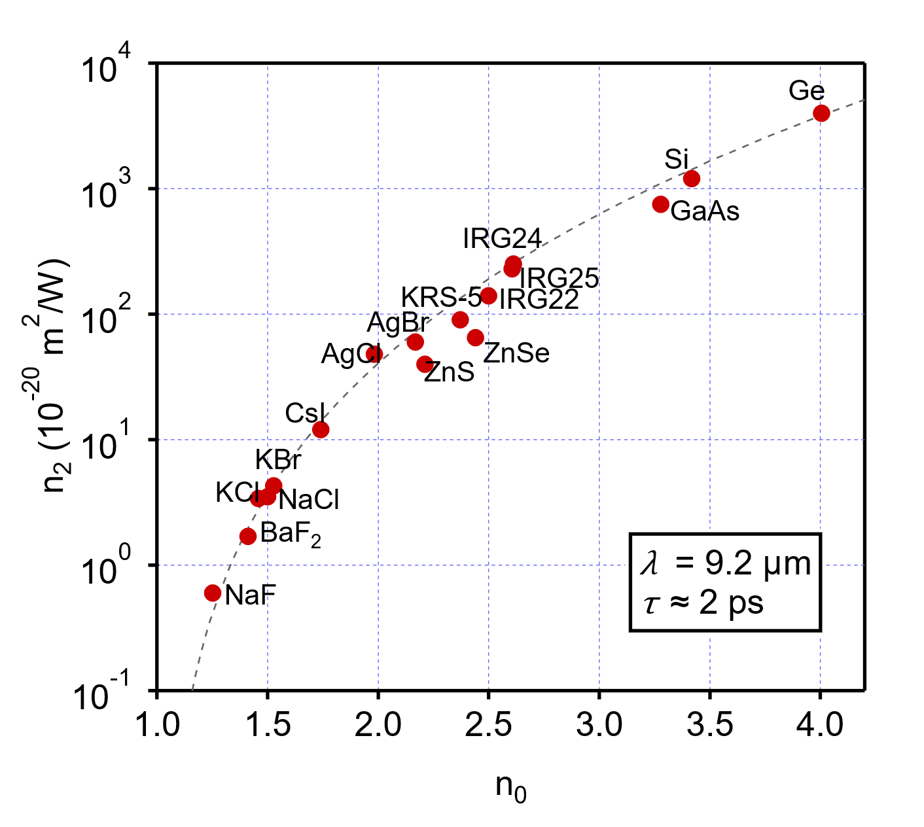
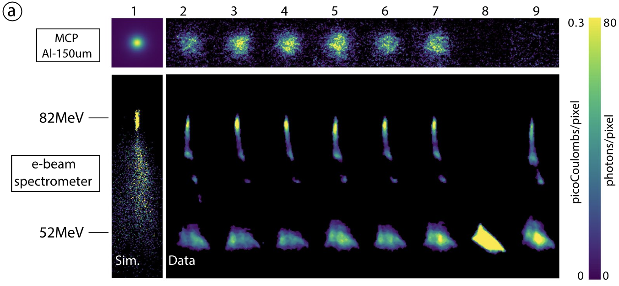
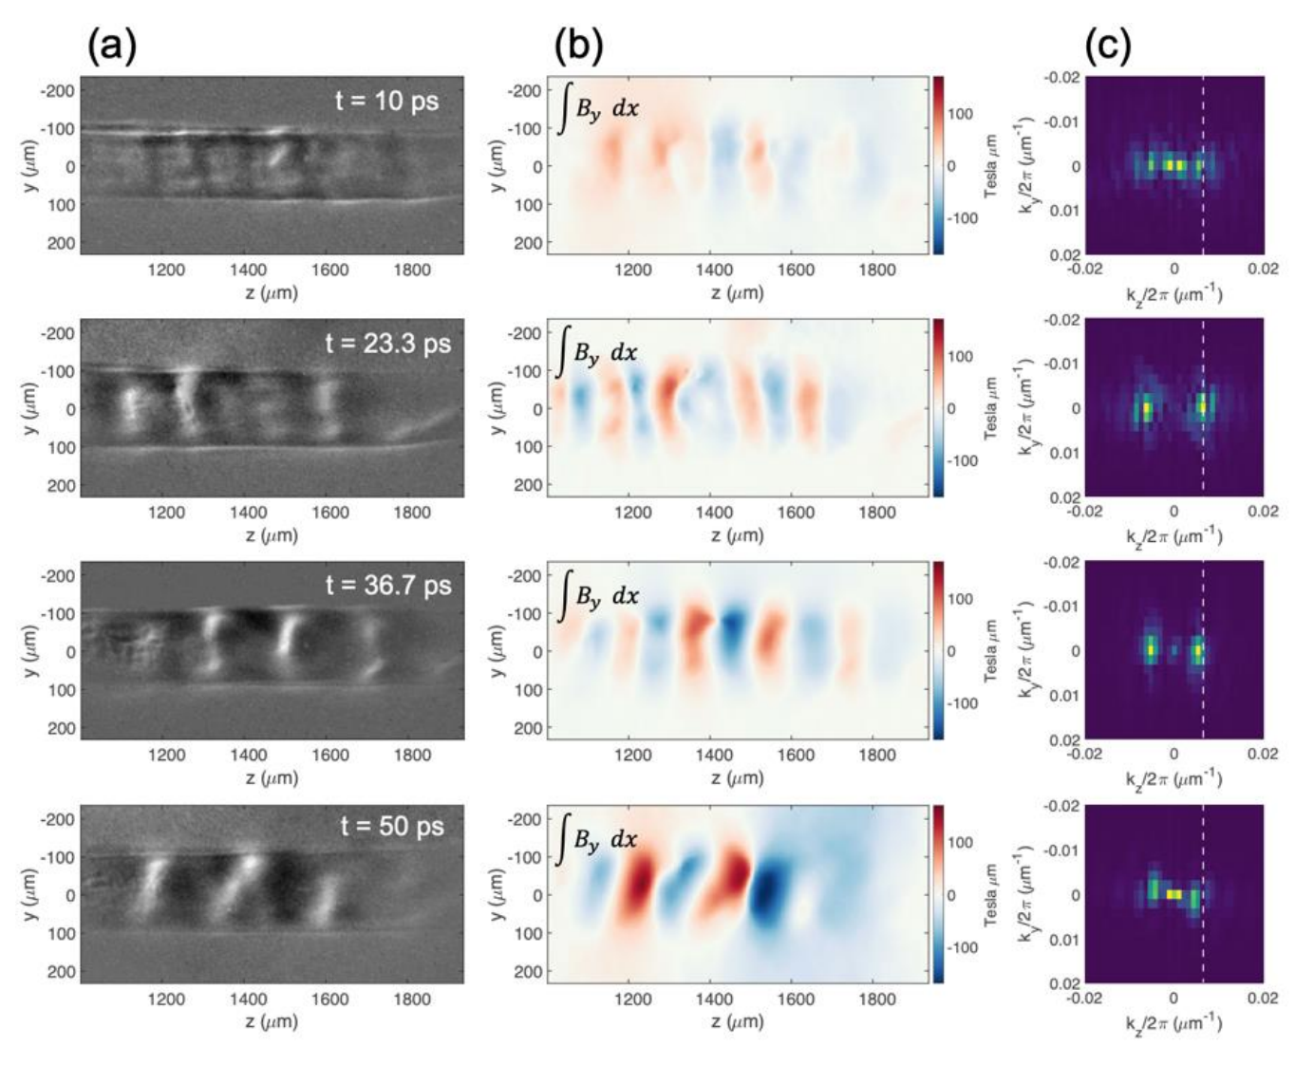
Selection of Recent Highlights at ATF
Radio waves from currents
induced by laser filaments
in AE119
Critical plasma density shockwave for ion acceleration in AE 100
Chen, Phys. Plasmas 30, 053106 (2023)
Plasma electron acceleration driven by
a long-wave-infrared laser, by AE95
Zgadzaj, Nat. Comm.15: 4037 (2024)
Remote detection of a radioactive source in AE126
Characterization of nonlinear index of materials in AE101
Polyanskiy et al. Opt. Mater. Express 14, 696 (2024)
Polyanskiy Sci. Data 11, 94 (2024)
IFEL driven Compton scattering x-ray source
Gadjev, Sci. Reports. 9:532 (2019)
Evolution of Weibel instability in AE98/99
Zhang, PNAS, 119 (50) e2211713119 (2022)

Slide 17
Integrated Multi-Beam Experiments
Integration of LWIR laser, NIR lasers and the e-beam simultaneously, allows any beam to be used as driver or diagnostic. This has enabled novel research, including
  Study of two-color ionization injection to enable an all-optical, high-brightness “photoinjectors”
  Visualization and field mapping inside LWIR-driven wakefield
  External injection of e-beam into LWIR-driven wake for frontier LWFA research
  Study of Inverse Compton Scattering in novel regimes
  Investigation of “laboratory astrophysics”, e.g. instabilities in plasma that also seed the magnetic fields in outer space plasma

Slide 18
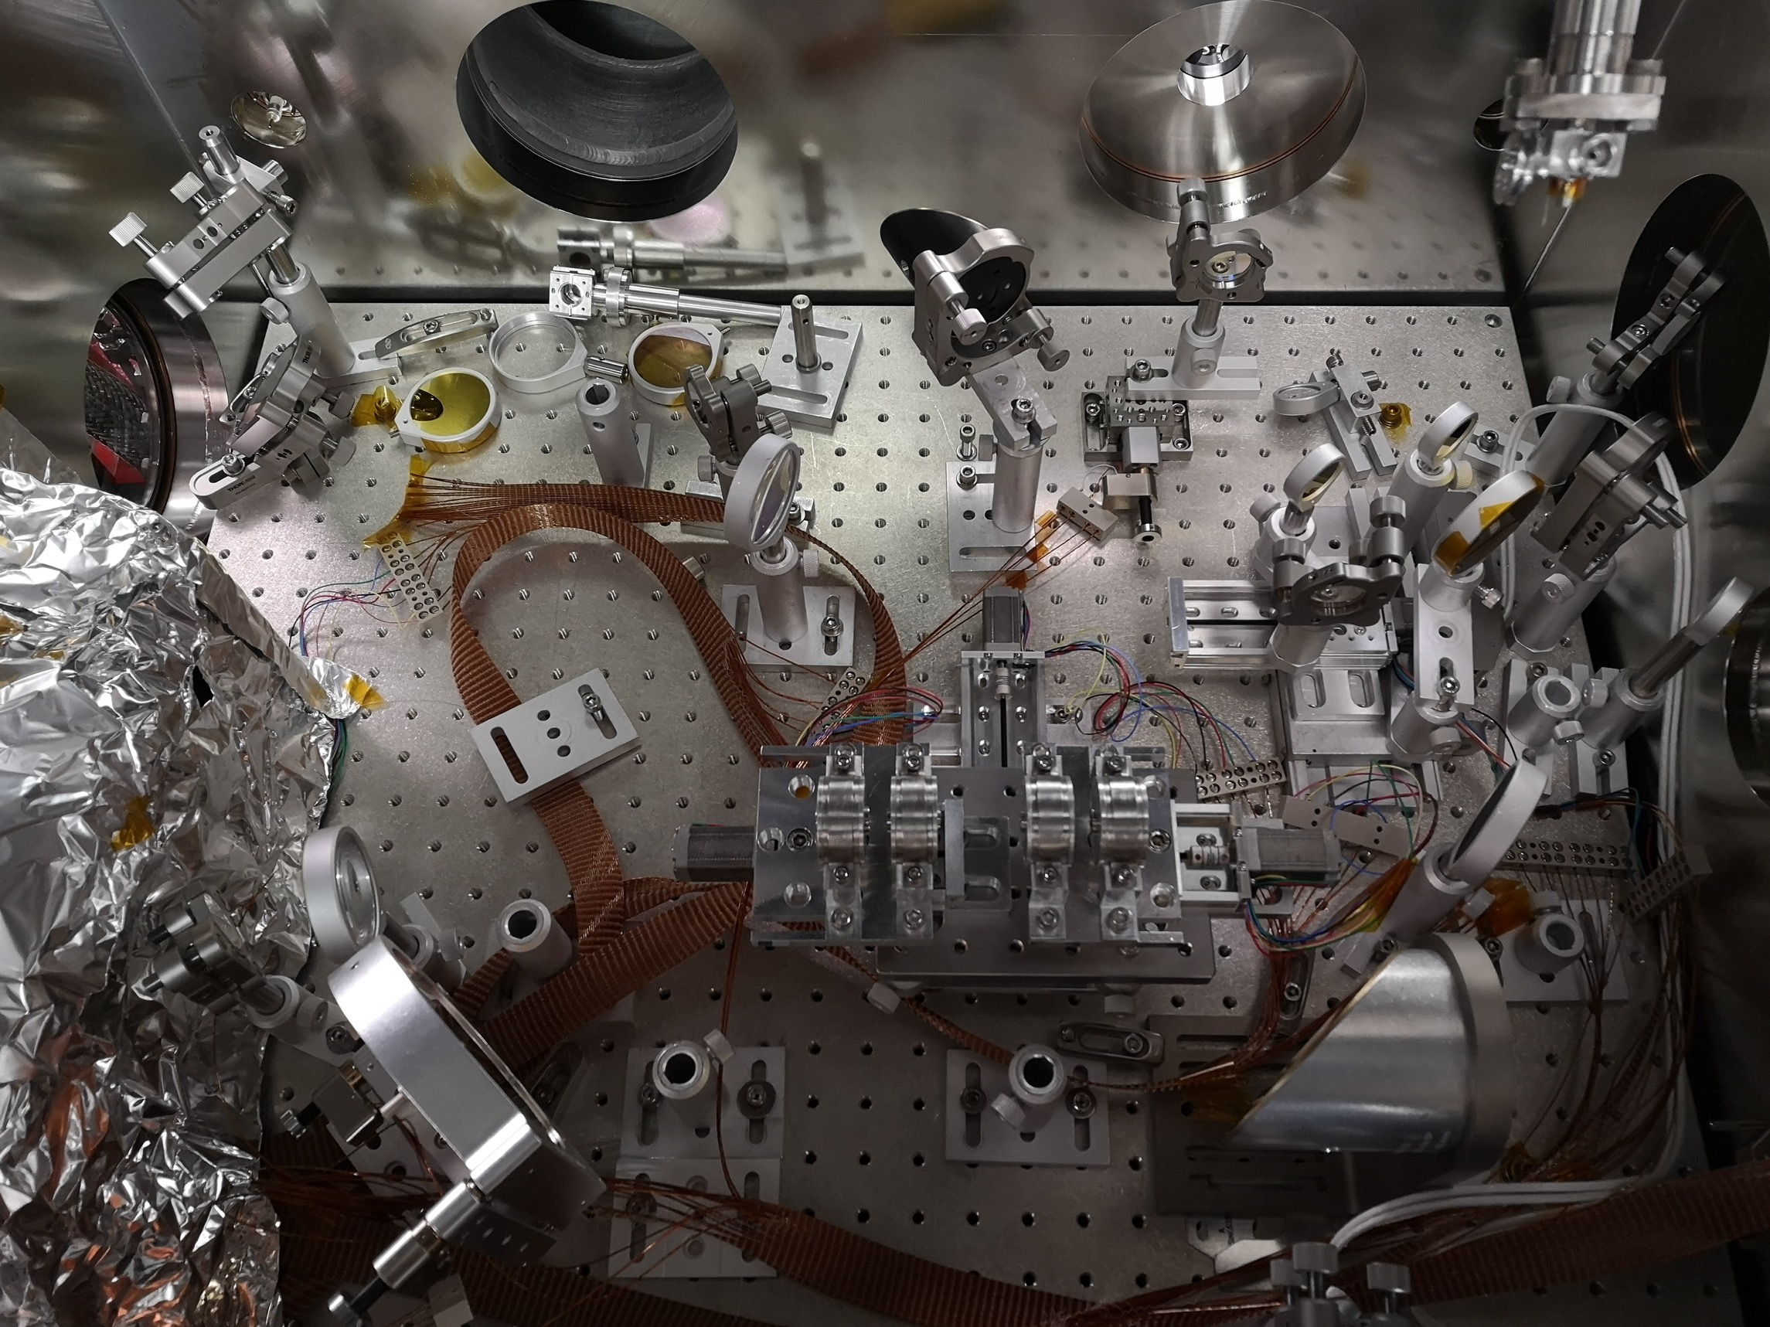
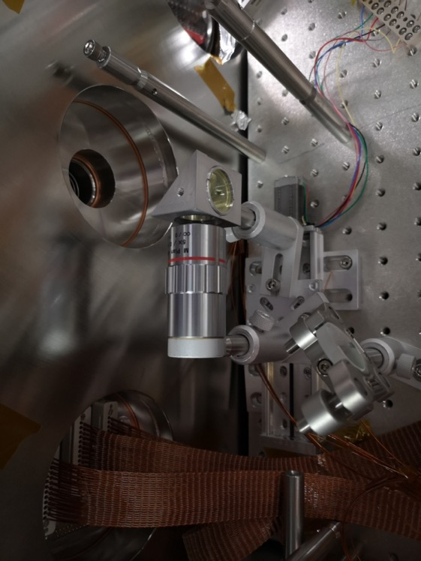
Experimental Setup for Magnetostatic Mode Visualization
CO2 focus diag.
(Pyrocam IV)
CO2 laser, ~1 mJ to avoid ionizing H2
Ti:S main beam (~10 mJ, 80 fs)
Ti:S probe beam (<0.5 mJ, 80 fs)
shadowgraphy
100 µm YAG:Ce
5x obj
IP
e- beam
(50.5 MeV, ~0.2% energy spread
motorized PMQs
camera lens
CCD (GPOP10)
Ti:S focus diag.

Slide 19
Weibel instability in the bounded plasma
Calculating magnetic fields and plasma currents

Slide 20
Key Issues to Explore During This Workshop
Review beam parameters for achieving science and technology goals for use community (updates?)
Critical apparatus in terms of chambers, combination of beamlines, etc to support the research activity?
Laser only chamber?
Larger chambers?
Synchronization level required?
Specialized diagnostics?
Dedicated facility to address the PRDs in Basic Research Needs in Laser Technology?
Is ATF well-suited to address this type of work?
Which technology development could ATF support?
What is needed in terms of user facility? What Sources needed?

Slide 21
The End

Slide 22
Research Area A Facility Needs
Experiment | LWIR Laser | e-beam
PRD A.1: Ion Acceleration | 10 TW: ~ 10 MeV ions 25 TW: ~ 100 MeV ions Circ. Pol. For advanced methods (RPA, etc)
PRD A.2 e- Acceleration | 10 TW, 1ps: Blowout regime 20 TW, 0.5 ps: Bubble regime Integrated intense NIR: two color injection
PRD A.3 Weibel | 1 TW, ~3 ps, circ. Pol.
Expanded Diagnostic Capabilities
  Plasma Diagnostics (interferometry, shadowgraphy,etc)
  Prepulse contrast diagnostics better than 4 orders of magnitude
  Ultrafast electron radiography (See research area C for more discussion)
  Accurate synchronization and alignment diagnostics for multiple beams (See research area C for more discussion)

Slide 23
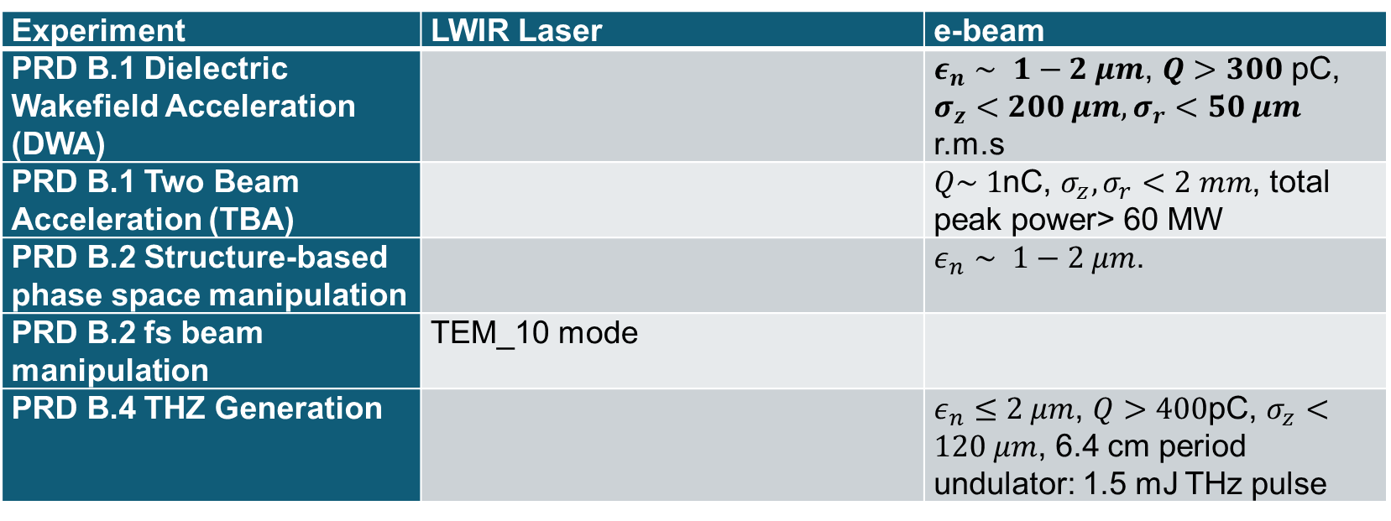
Research Area B Facility Needs
Experiment | LWIR Laser | e-beam
PRD B.1 Dielectric Wakefield Acceleration (DWA) |  | $ε_{n}∼ 1−2 μm$, $Q>300$ pC, $σ_{z}<200 μm, σ_{r}<50 μm$ r.m.s
PRD B.1 Two Beam Acceleration (TBA) |  | $Q\sim 1$nC, $σ_{z}, σ_{r}<2 mm$, total peak power> 60 MW
PRD B.2 Structure-based phase space manipulation |  | $ε_{n}∼ 1−2 μm$.
PRD B.2 fs beam manipulation | TEM_10 mode
PRD B.4 THZ Generation |  | $ε_{n}≤2 μm$, $Q>400$pC, $σ_{z}<120 μm$, 6.4 cm period undulator: 1.5 mJ THz pulse
Required Diagnostic Capabilities
  Beam characterization: Transverse deflective cavity (T- CAV), 2 THz interferometry from coherent transition radiation (CTR), coherent diffraction/edge/Cerenkov radiation (CDR/CER/CCR)

Slide 24
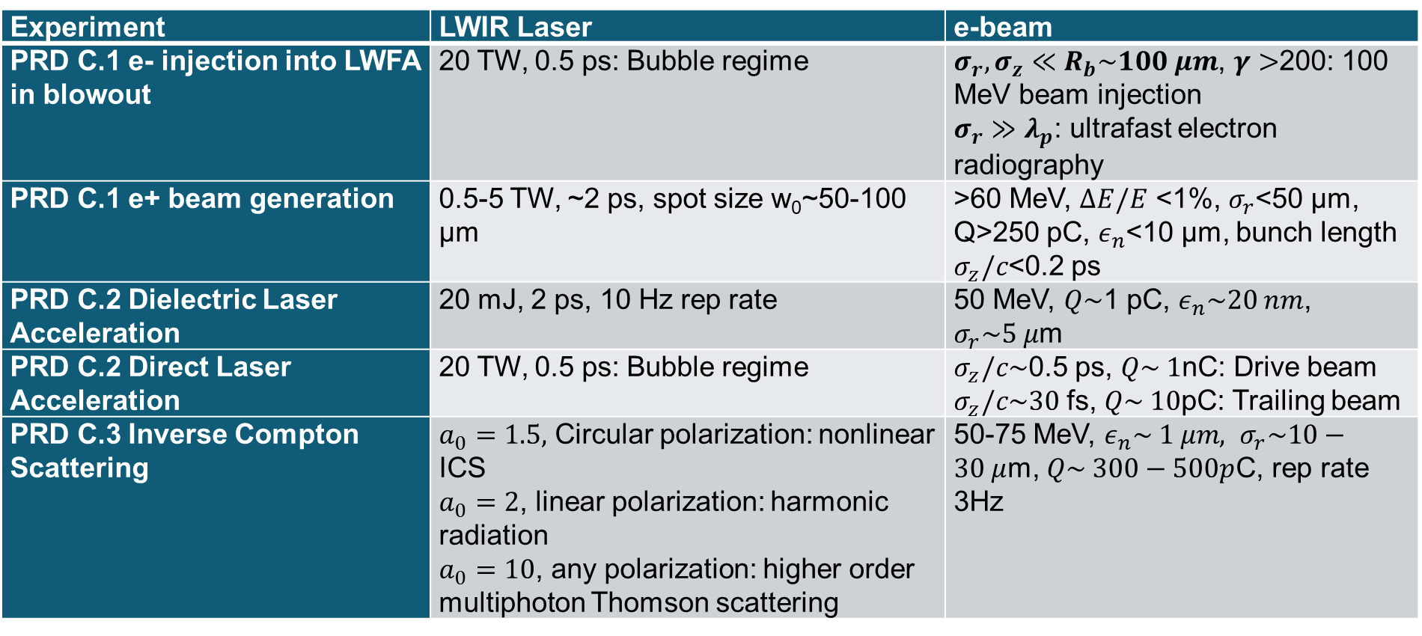
Research Area C Facility Needs
Experiment | LWIR Laser | e-beam
PRD C.1 e- injection into LWFA in blowout | 20 TW, 0.5 ps: Bubble regime | $σ_{r},σ_{z}≪R_{b}\sim 100 μm$, $γ>$200: 100 MeV beam injection $σ_{r}≫λ_{p}$: ultrafast electron radiography
PRD C.1 e+ beam generation | 0.5-5 TW, ~2 ps, spot size w₀~50-100 µm | >60 MeV, $ΔE/E$ <1%, $σ_{r}$<50 µm, Q>250 pC, $ε_{n}$<10 µm, bunch length $σ_{z}/c$<0.2 ps
PRD C.2 Dielectric Laser Acceleration | 20 mJ, 2 ps, 10 Hz rep rate | 50 MeV, $Q\sim$1 pC, $ε_{n}\sim 20 nm$, $σ_{r}\sim 5 μ$m
PRD C.2 Direct Laser Acceleration | 20 TW, 0.5 ps: Bubble regime | $σ_{z}/c\sim$0.5 ps, $Q\sim 1$nC: Drive beam $σ_{z}/c\sim 30$ fs, $Q\sim 10$pC: Trailing beam
PRD C.3 Inverse Compton Scattering | $a_{0}=1.5,$ Circular polarization: nonlinear ICS $a_{0}=2$, linear polarization: harmonic radiation $a_{0}=10$, any polarization: higher order multiphoton Thomson scattering | 50-75 MeV, $ε_{n}\sim 1 μm, σ_{r}\sim 10−30 μ$m, $Q\sim 300−500p$C, rep rate 3Hz

