Slide 1
Context for the 2024 ATF
Science Planning Workshop
M. Palmer, AS&T Department Chair
June 20, 2024
ATRO – Accelerator Science & Technology Dept

Slide 2
Welcome
Thank you to all who are participating in these discussions!
  We require your input and feedback on how the ATF should proceed
  We must deliver a clear set of priorities to guide the future of the facility
  We need support from the research community that relies on the capabilities provided by the ATF to secure

Slide 3
Context for this Workshop
The ATF Science Planning Workshop series is the primary mechanism for the ATF Team to interact with the ATF User Community to set priorities for the facility
  Goal: Update plans for the facility roughly every 3 years
    Past Workshops in 2017 and 2019
    This workshop has been twice delayed
      COVID
      ATF IRR/ARR Preparations
  Important to integrate the continuing evolution of the facility
    ATF Capabilities at B820 do not look like they did in 2018!
      3 distinct capabilities offered: e-beam, LWIR beam, NIR beam(s)
      Most recently, 40% of ATF user experiments request simultaneous use of all 3
      First steps for delivering 10s of TW peak power at 9.2 μm
    But there is still a great deal left to do…

Slide 4
Facility Directions
Since 2018:
  Laser Systems
    Implementation of the 2 ps, 5TW CPA
    configuration of the CO₂ Laser
    Implementation of in-vacuum operation
    for the 9.2 μm CO₂ Laser
    Addition of NIR Ti:Sapph laser system for users
    Implementation of in-vacuum
    transport and local compression
    capabilities for experiments
    requiring NIR
  Electron Beam
    Improved Experimental Hall layout
    and utilities configuration
    Remedial maintenance to keep the
    RF system in operation
    Now is an opportunity to re-direct
    more effort towards e-beam updates

Slide 5
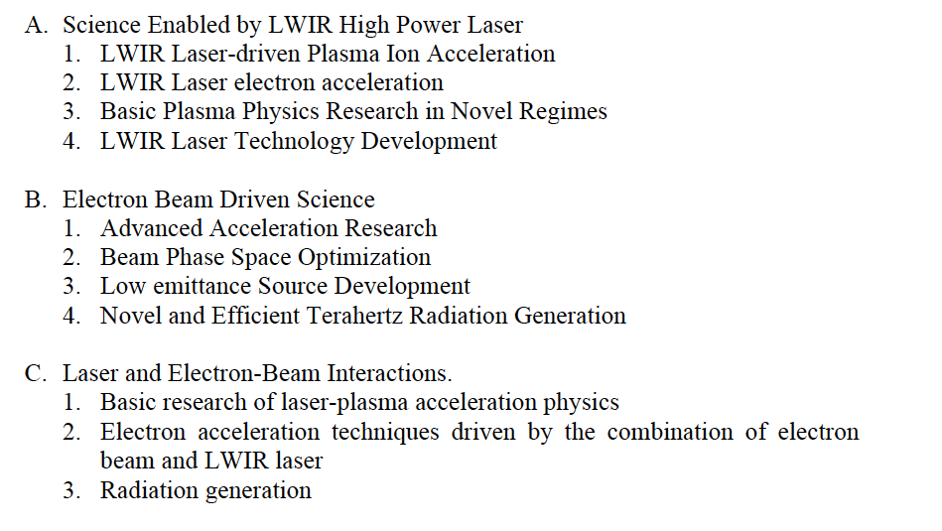
The Near-Term
2019 ATF SNW Report PRDs
ATF Priorities for the next 3 years:
  Complete the ATF ARR process by
  the end of CY2024
    Eliminate the ongoing load and
    limitations that this imposes on the user
    program
  Continue our remedial maintenance
  program
    Ongoing work:
      B820 Infrastructure (Electrical, HVAC)
      Control System transition to eliminate CAMAC systems that can no longer be supported a VME64x
      Replace broad range of hardware past its nominal end-of-life
    Major focus now shifts to Electron Beam and Timing Improvements
      Have started detailed planning and long-lead procurements to replace critical E-Beam hardware. Goals:
        Deliver reliable and stable compressed beams that match the O(100fs) pulse envelopes of our laser systems
        Look at fully utilizing the design specifications of the ATF RF cavities to deliver 110-120 MeV beams

Slide 6
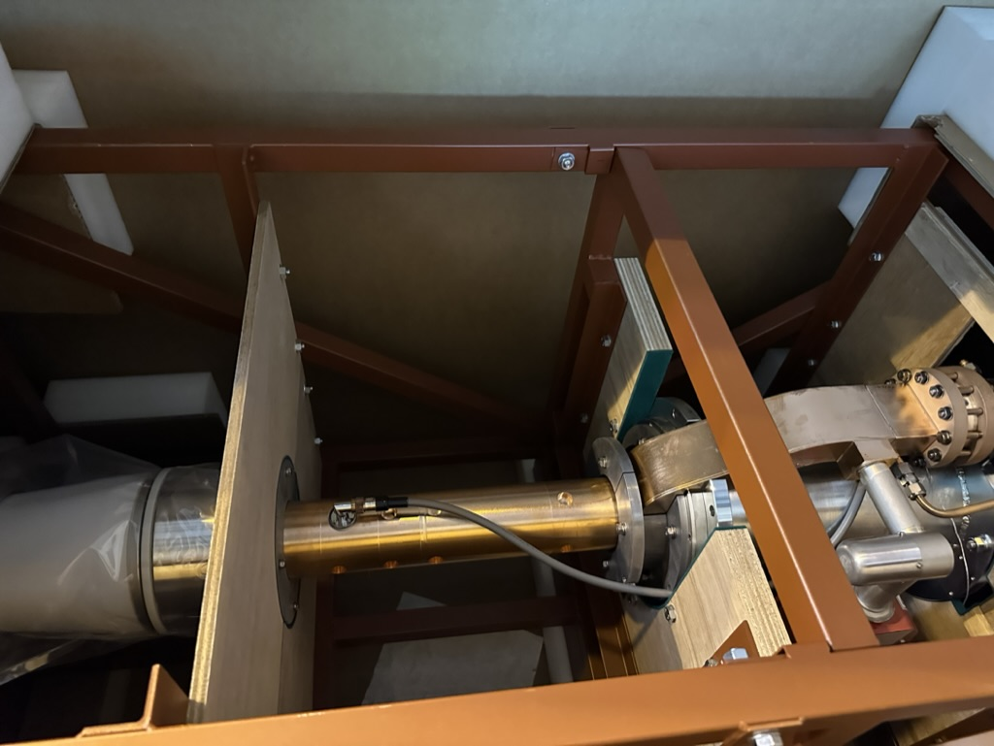
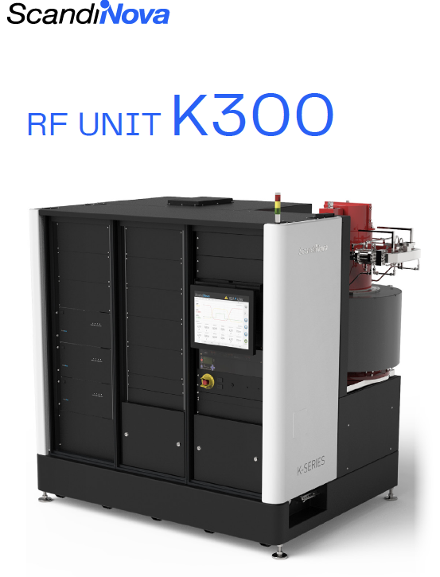
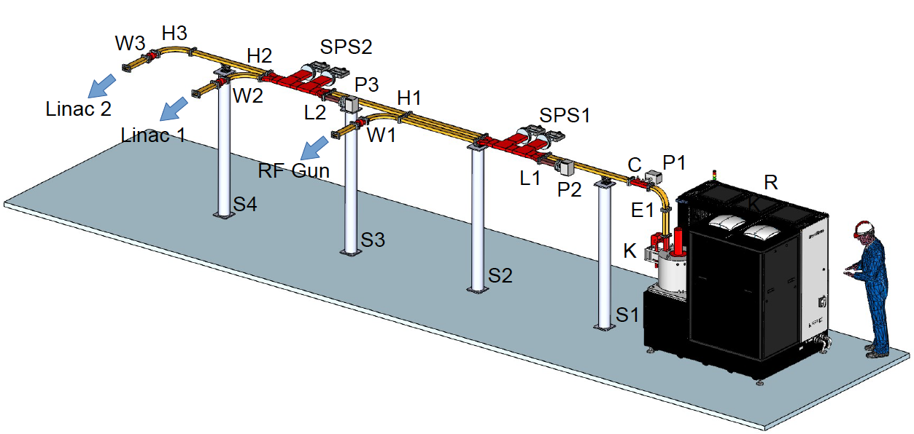
The Near-Term (cont’d)
Toshiba E3730A
50MW S-band
Klystron
ATF Priorities:
  Electron Beam Improvements
    Replace existing XK-5 (gun) and Thales (LINAC) x-band klystron configuration
      Configuration implemented in response to failure of original ATF hardware
      Has preserved nominal (but continually degrading) electron beam operation
    Configuration shown would allow delivery of current beam parameters with a modern modulator and klystron (50MW) system
      Alternative:
      2 modulators/klystrons
        Would allow operation up to
        120 MeV (original design spec
        for ATF LINAC)
      Stable and reliable e-beam
      operation for multi-beam
      experiments
  Modular Timing System

Slide 7
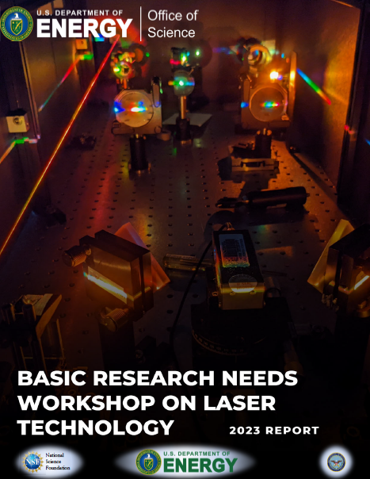
The Mid-Term
The ATF aims to submit an upgrade
proposal to continue to address accelerator
and laser Stewardship Program efforts
  Response to the BRN Workshop on Laser Technology Report
    PRD 2: Transform Mid-IR Sources for Science from THz to X-Rays
  Continue to broaden our user community
    Address security needs in addition to our traditional basic
    science community
    Address a broader range of technology development
    support as part of our Stewardship mission
  Continue to implement elements of our LWIR
  R&D program to deliver un-match LWIR beams
    Few-cycle, 10s of TW, CO₂ laser capabilities
    Carry out the R&D to transform these capabilities from
    parameters only suitable for research to those required for
    a broad range of applications
  We aim to
    Develop a consortium of closely affiliated teams to deliver on a broad stewardship vision
    Utilize infrastructure originally developed for the terminated
    ATF-II project, to ensure cost-effective implementation

Slide 8
The Long-Term
Many of the research thrusts described represent multi-year, if not decade-scale, development efforts
  The ATF has now operated for over 3 decades
  Our goal is to lay out a broad research program that enables advancement for all communities that can benefit from the Stewardship Program
    Basic Science
    Early-stage Technology Development
    Security
    Industry
    Academia
  The input received at this meeting along with the discussions will shape our approach to delivering on these goals
    Discussions and refinement will be ongoing
    Looking for more than just users, but partners in this effort

Slide 9
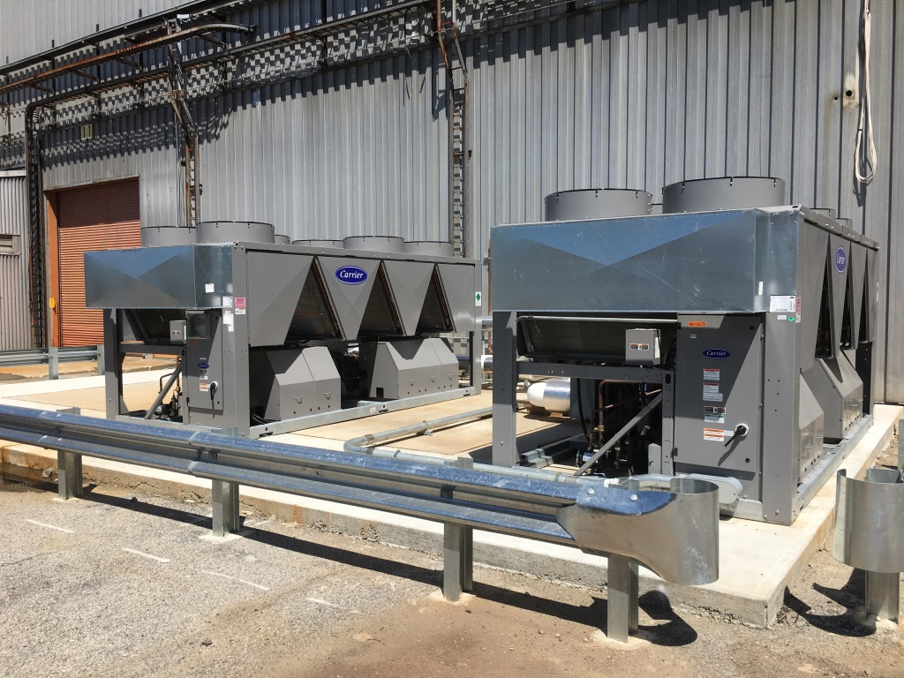
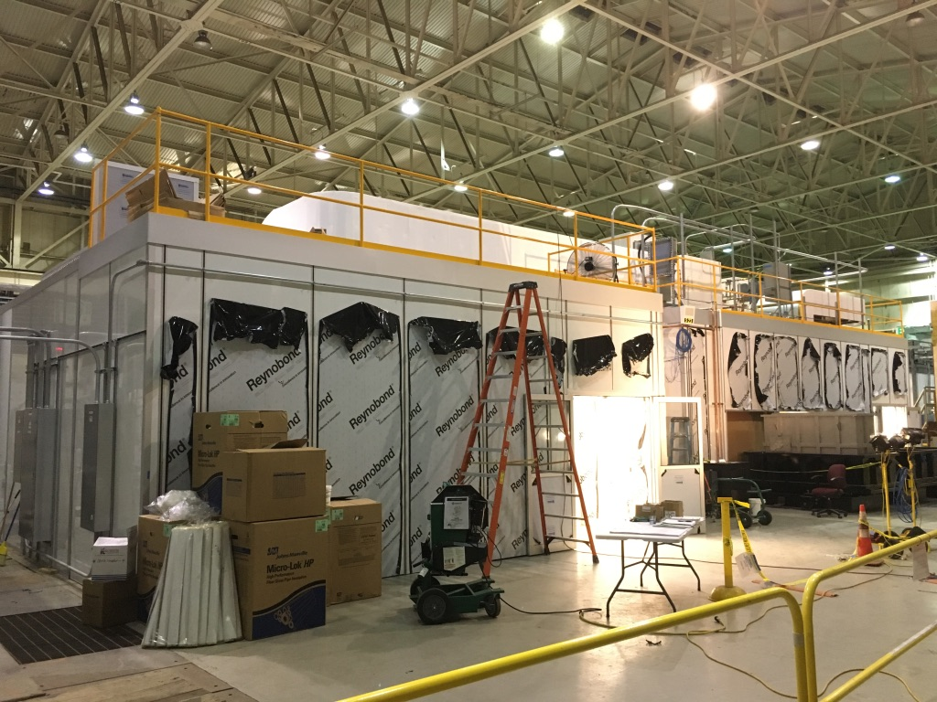
Conclusion
The ATF Team is looking forward to the presentations from and discussions with our
user community over the next 2 days
We are counting on your ongoing involvement to ensure that we have can deliver a compelling and high-impact future for the facility and its users
Now:
  Some time for discussion
  Followed by tours at B820 and B912

