Slide 1
ATF Scientific Needs Workshop,
20-21 June 2024
CO₂-laser-driven plasma acceleration
of externally-injected electrons
Mike Downer, University of Texas at Austin
University of Texas at Austin:
Faculty: M. C. Downer
Research Scientist: R. Zgadzaj
PhD students: Y. Cao, B. Dinh,
T. Araujo
Stony Brook University:
Faculty: Navid Vafaei-Najafabadi
Roman Samulyak
V. N. Litvinenko
Postdoc: N. Pathak
PhD Students: A. Cheng, A. Gaikwad,
B. Romasky, E. Trommer
Brookhaven NL:
ATF Director: M. A. Palmer
Research Scientists: M. Babzien,
M. Fedurin, R. Kupfer, K. Kusche,
W. Li, I. V. Pogorelsky,
M. N. Polyanskiy
UCLA:
Faculty: C. Joshi
ATF is uniquely positioned to demonstrate a new generation of laser-plasma accelerators
that deliver electron bunches with the ultra-low emittance and energy spread required
to drive free-electron lasers.
1

Slide 2
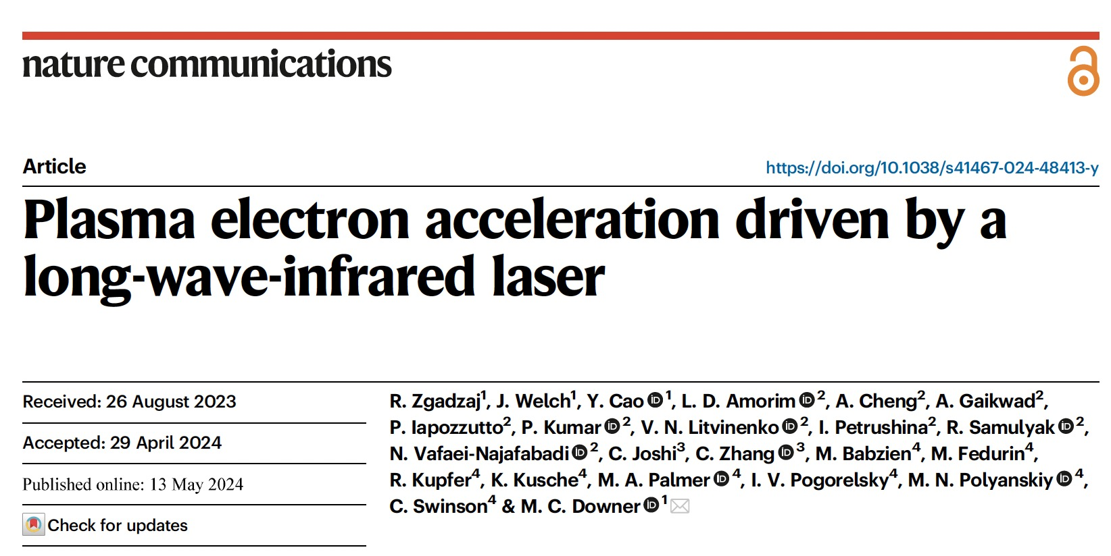
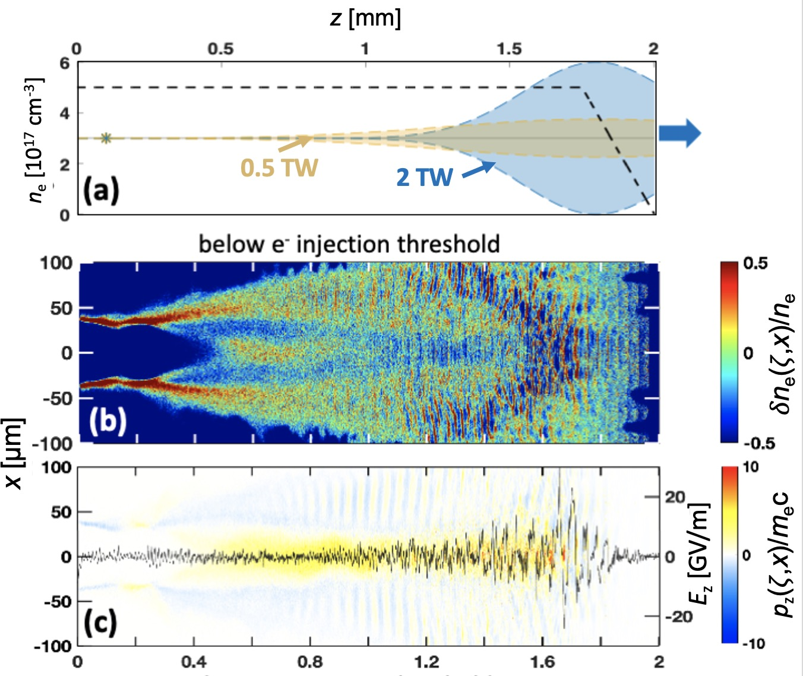
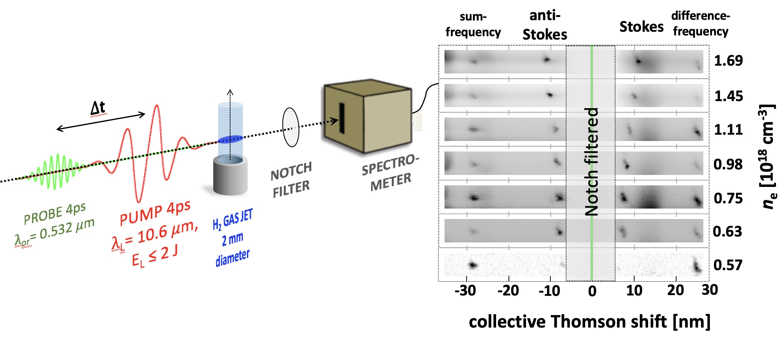
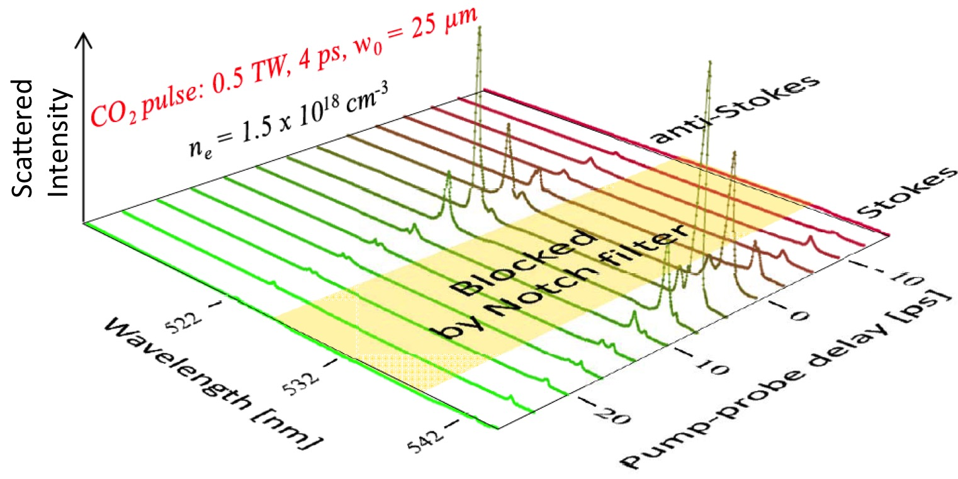
Nat Comms 15, 4037 (2024)
Simulations for P_{L} = 0.5 TW (2 J, 4 ps)
CO₂ pulses (A. Cheng, R. Samulyak)
internally-injected
Only p_{z} attributable to
wake itself are observed.
n_{e} = 5 × 10¹⁷ cm⁻³
(∆t = 0, P_{L} = 0.5 TW, n_{e} variable)
Collective Thomson Scatter
Experiments to observe wakes
(n_{e} = 1.5 × 10¹⁸ cm⁻³ , P_{L} = 0.5 TW = 3.75 P_{cr} , ∆t variable)
2

Slide 3
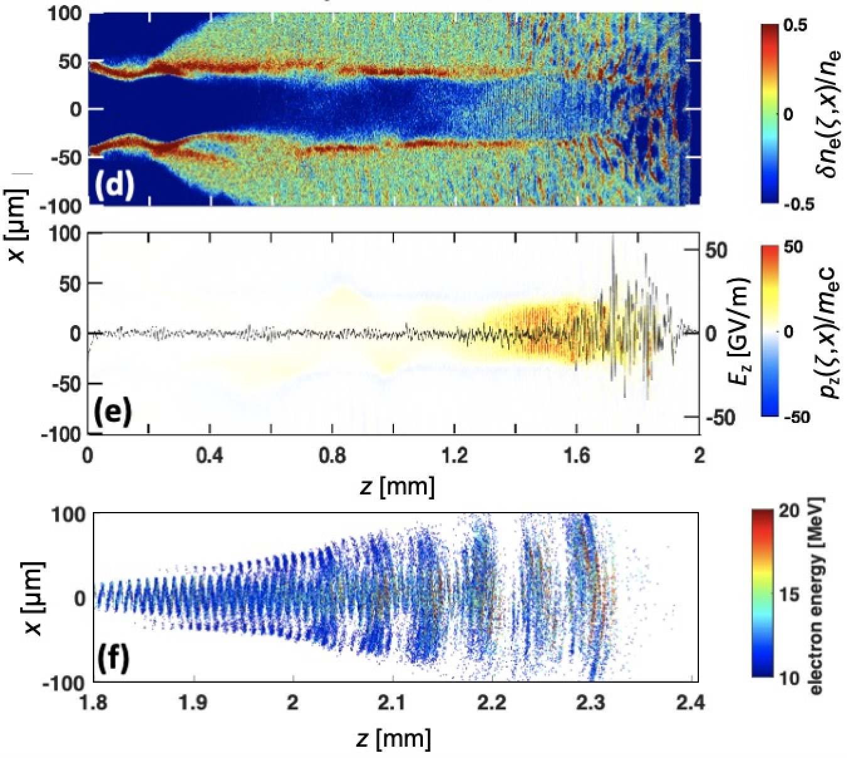
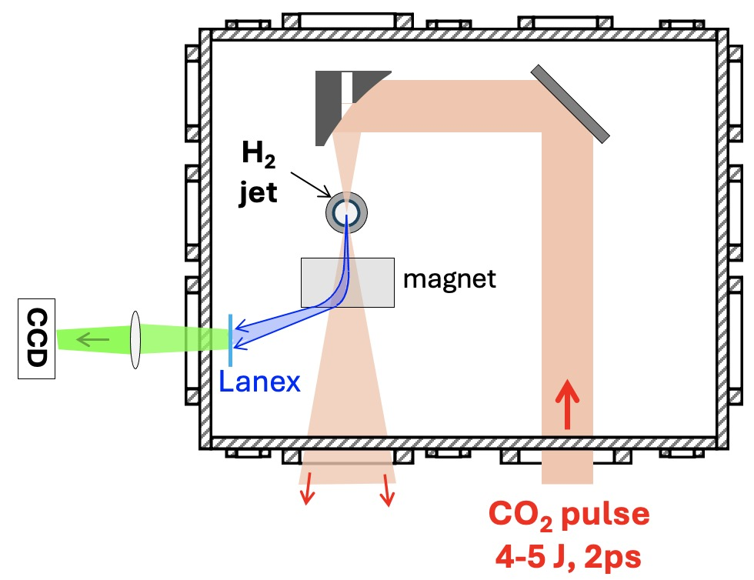
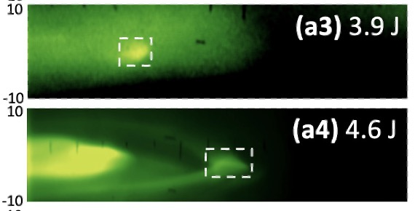
Simulations for P_{L} = 2 TW (4 J, 2 ps)
CO₂ pulses (A. Cheng, R. Samulyak)
Nat Comms 15, 4037 (2024)
internally-injected
p_{z} from trapped,
accelerated e- observed
n_{e} = 5 × 10¹⁷ cm⁻³
e⁻ output
$\left\langle E_{e}\right\rangle ≈8$ MeV
Q ≈ 50 pC
Electron energy (MeV)
Collimated quasi-monoenergetic
e-spectral features (observed on
90% of shots) signify transition:
n_{e} = 4 × 10¹⁷ cm⁻³
Angle from e-beam axis (mrad)
SM-LWFA ⟹ bubble regime
3

Slide 4
Significance of observing collimated,
quasi-monoenergetic electrons
*
• Transitioning from SM to bubble regime (a.k.a. “forced” LWFA. )
a₀^{(vac)} ≈ 4
for w₀ = 65 µm
• 3-10 plasma periods within 𝜏_{L} when these features observed
⇒ pulse energy channels preferentially into single plasma period as it self-steepens.
• The next ATF upgrade could usher in the full bubble regime @ n_{e} ~ 10¹⁶ cm⁻³
⇒ no uncontrolled background injection (main origin of energy spread, spin depolarization)
⇒ bubbles large enough for precise injection of ∆E_{e}/E_{e} < .01, high Q, spin-polarized bunches
from an external linac, given tolerances on pointing, timing jitter, bunch compression.
Forced LWFA
4 × 10¹⁷ cm⁻³
3 × 10¹⁶ cm⁻³
~10¹⁶ cm⁻³
2 ps
4-6 J
2 ps
4-6 J
~ 0.5 ps
~ 10 J
10 wake periods
3 wake periods
~1/2 wake period
*
(cf. Malka et al., “Electron acceleration by a wake field forced by an intense ultrashort laser pulse” Science 298, 1596 (2002)
4

Slide 5
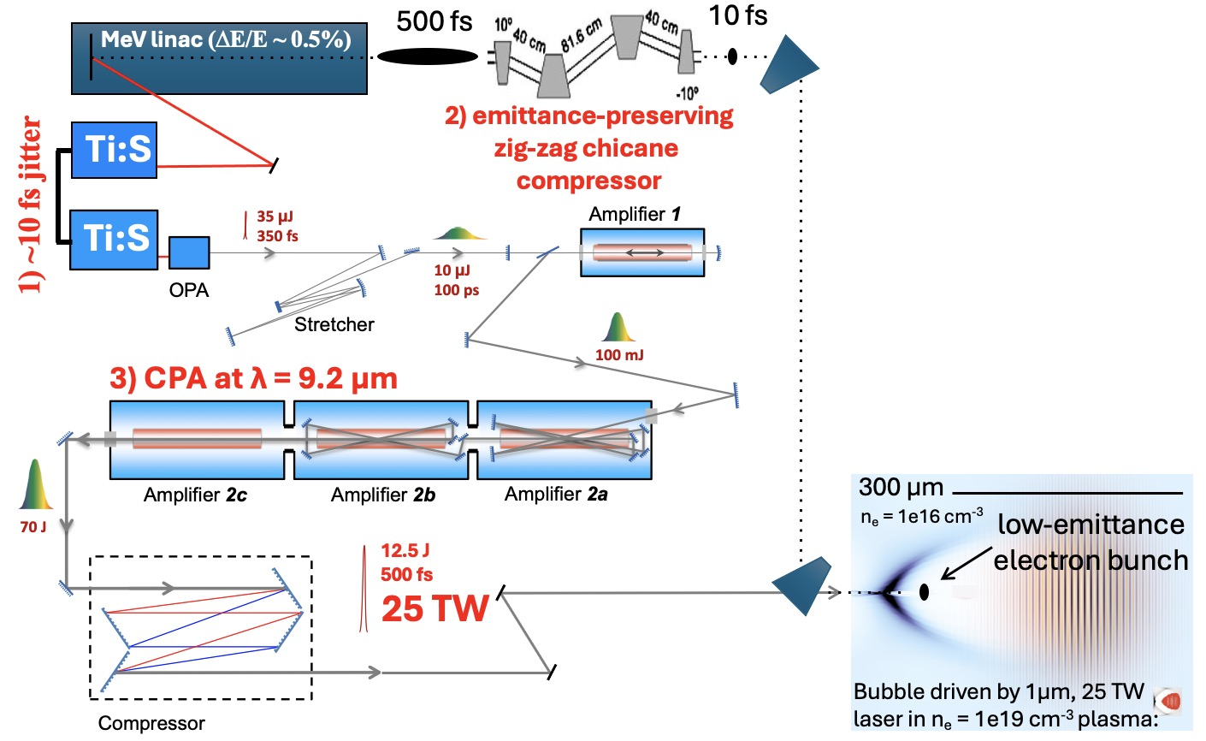
Next-generation ATF experiments will inject
~ 70 MeV electrons from linac into large LWFA
Dream parameters:
1) 10 fs laser-e-beam rms jitter
2) e-bunch compression to 10 fs
3) 20-25 TW CO₂ pulse
Actual parameters will depend
on status of laser and linac
development.
Simulations are in progress to define experimental parameters

Slide 6
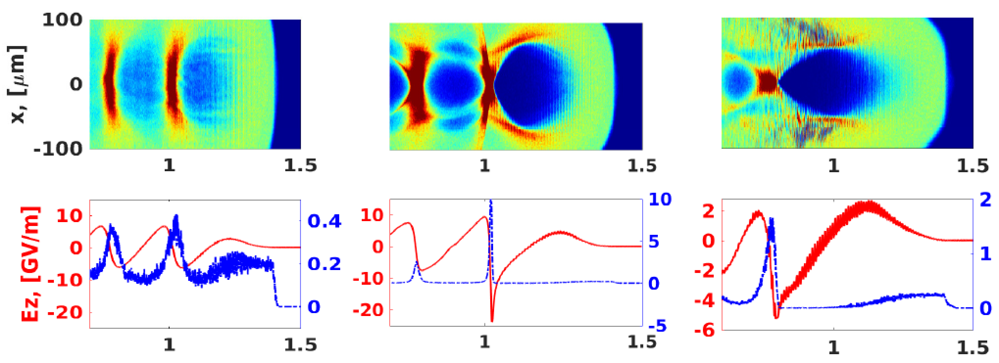
Simulations validated by experiments in SM regime
can be trusted to predict bubble regime accurately
Kumar, Phys. Plasmas 28, 013102 (2021)
matched
unmatched
unmatched
δn/n
laser
incomplete blowout
complete blowout
complete blowout
longitudinal distance z [mm]
P = 20 TW, τ = 0.5 ps
w₀ = 117 µm, a₀ = 2.4
P = 20 TW, τ = 0.5 ps
w₀ = 74 µm, a₀ = 3.8
P = 20 TW, τ = 1 ps
w₀ = 74 µm, a₀ = 3.8
n_{e} = 2 x 10¹⁶ cm⁻³
n_{e} = 2 x 10¹⁶ cm⁻³
n_{e} = 2.3 x 10¹⁶ cm⁻³
• Multiple ways to reach bubble regime
• no self-injection for z < 2.5 mm
• no e-laser overlap for τ ≲ 0.5 ps
21

Slide 7
There are near-term scientific opportunities
even for currently available 2 ps pulses
OSIRIS* simulations courtesy N. Vafaei-Najafabadi
CO₂ laser parameters: 10 J, 2 ps, 5 TW, w₀ = 40 µm, a₀^{(vac)} = 3.56
n_{e} = 10¹⁶ cm⁻³
n_{e} = 10¹⁴ cm⁻³
* Fonseca et al., PPCF 55, 124011 (2013)

Slide 8
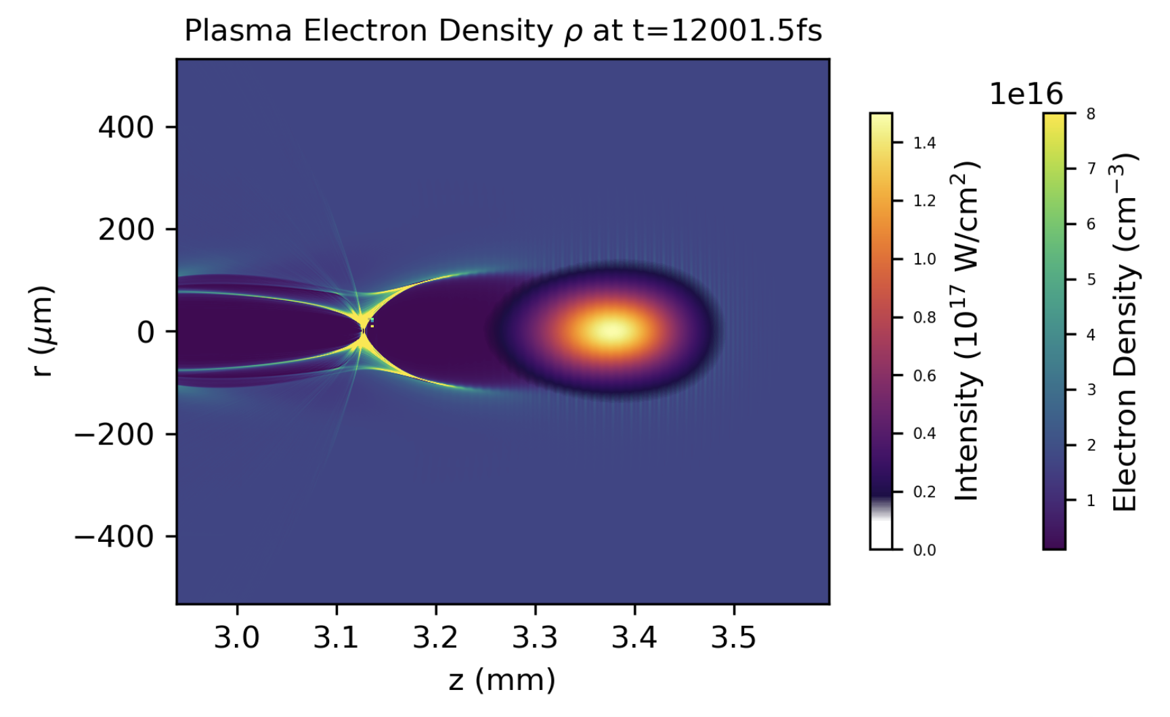
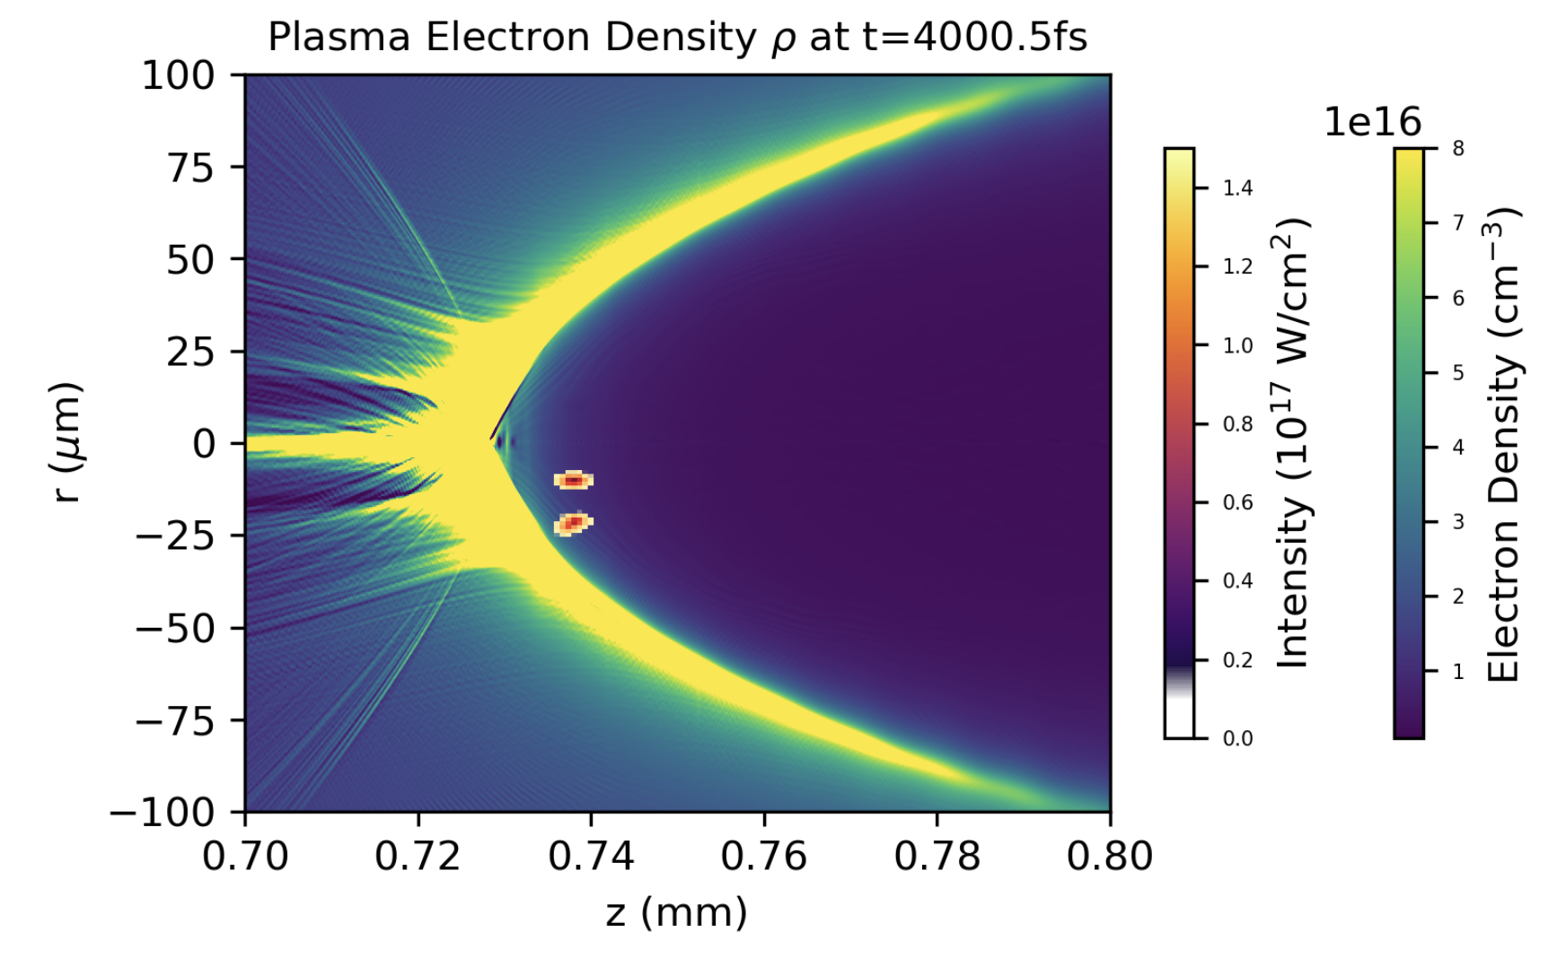
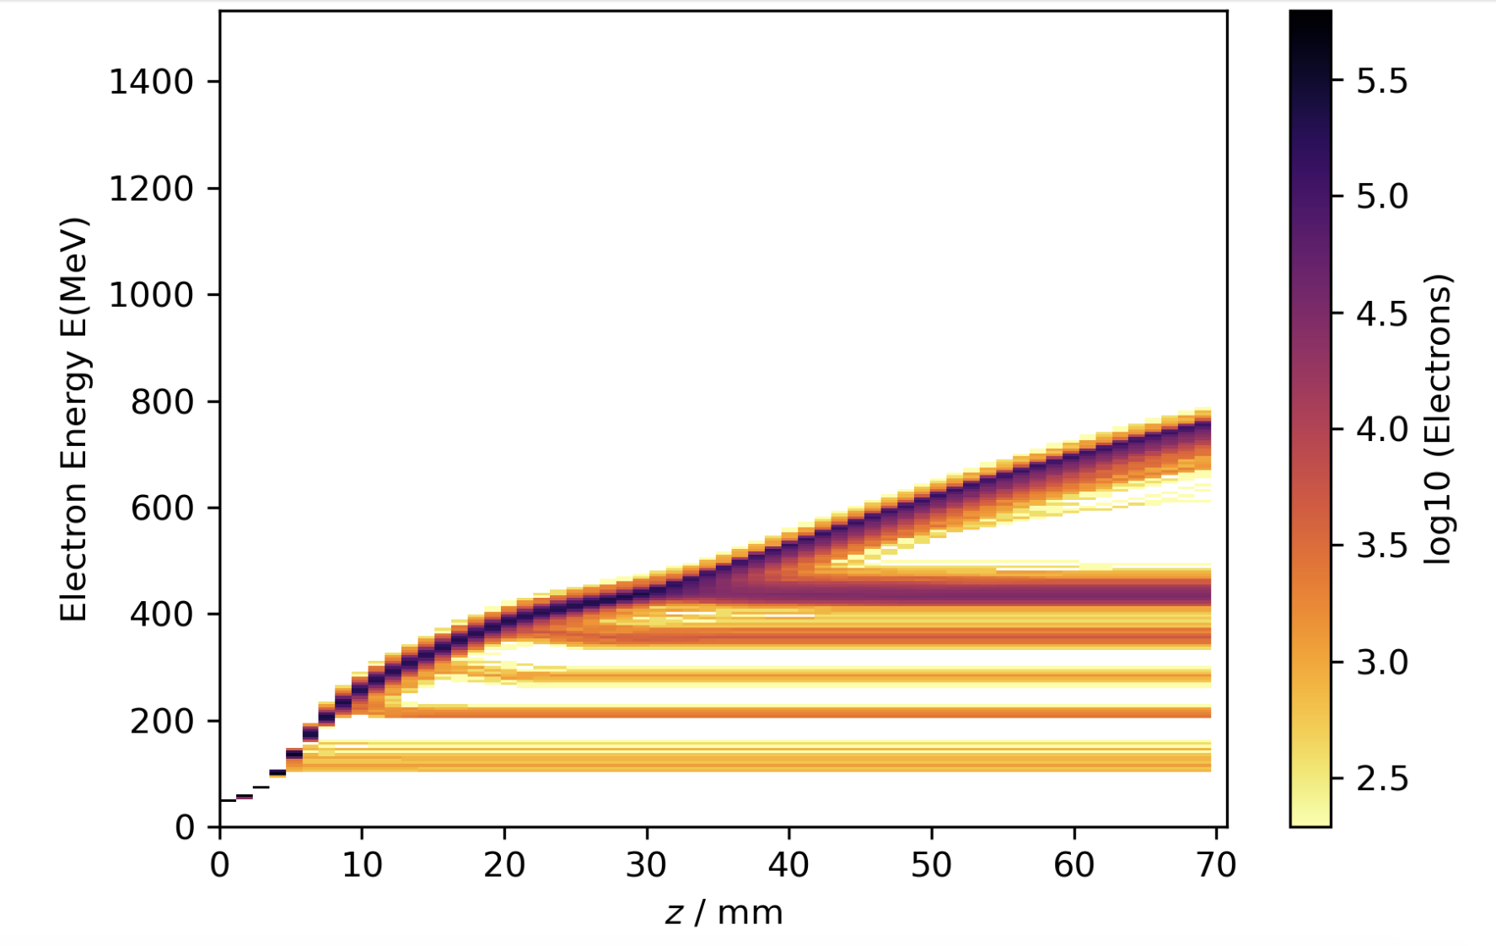
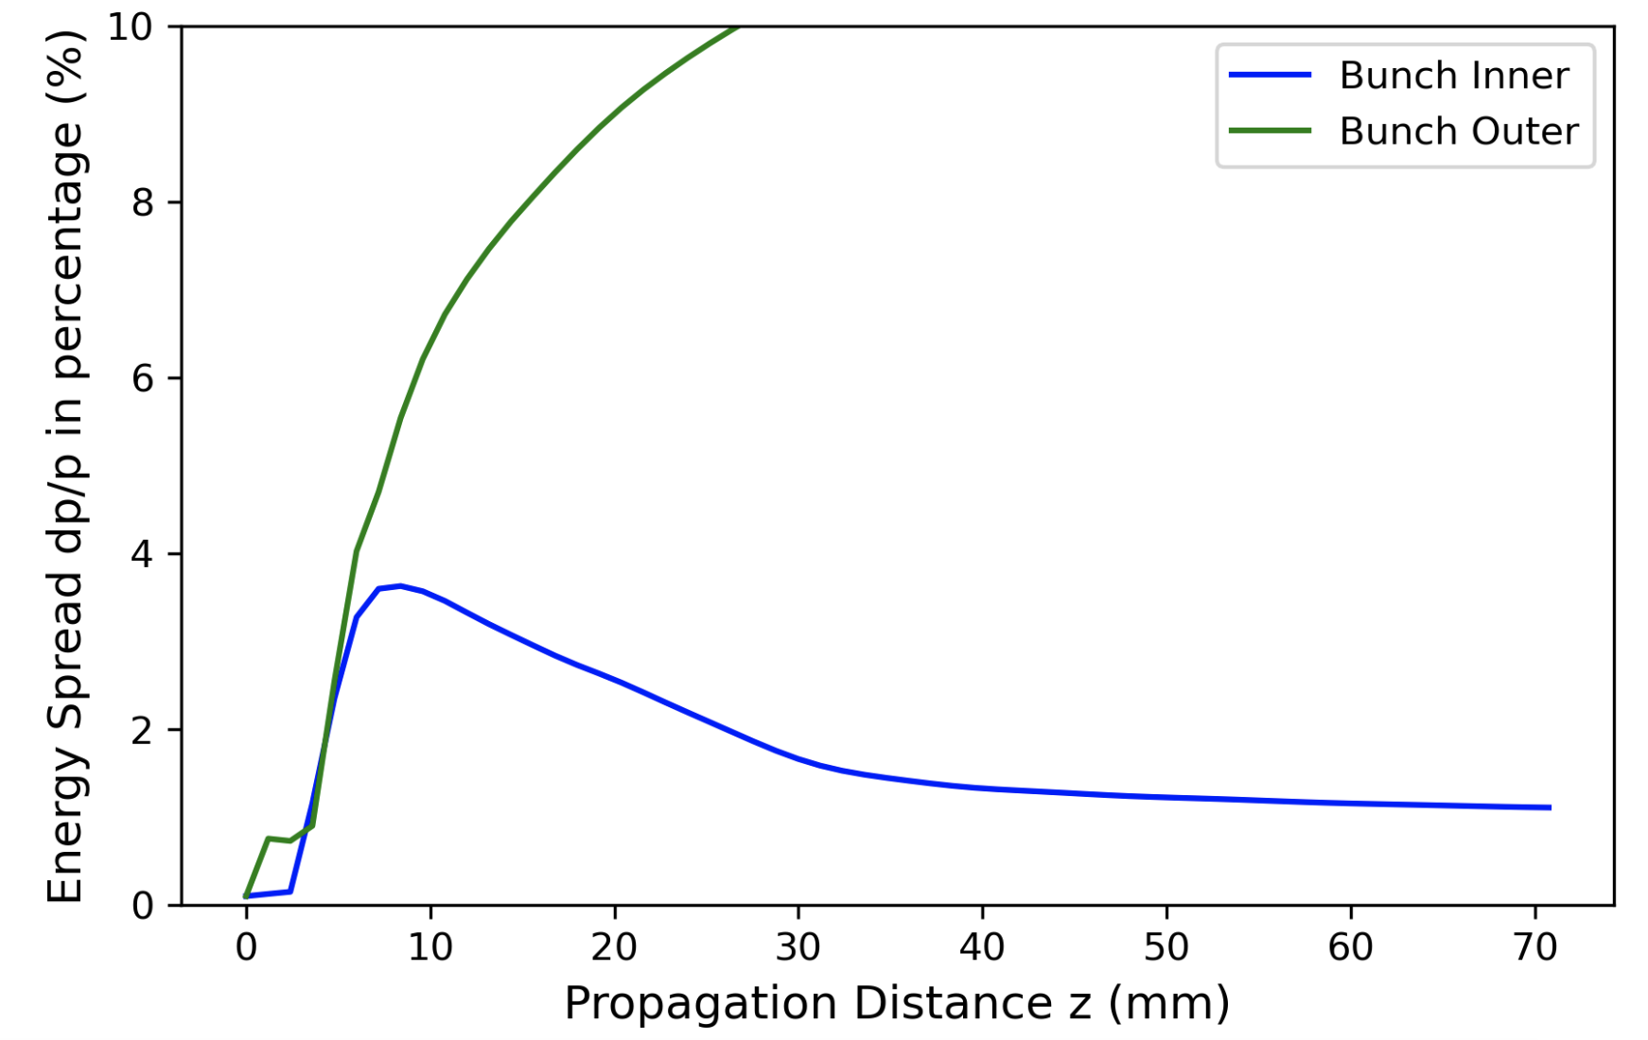
Simulations of growth of ∆E_{e}/E_{e} and emittance
of externally injected e-bunches in large bubbles.
FB-PIC simulations by Y. Cao
(a) n_{e} = 10¹⁶ cm⁻³
(b)
2 externally
injected
e-bunches
0.5 ps CO₂ pulse
(c) Electron Energy
(d)
Evolution of
Energy Spread (%)
7

Slide 9
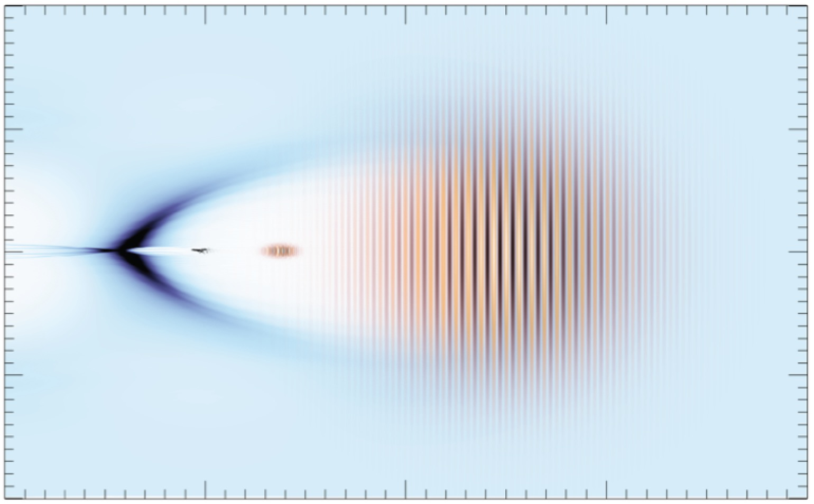
OSIRIS* quasi-3D simulations show that large bubbles preserve energy spread
& spin polarization of strategically injected e-bunches during acceleration
Simulations by Z. Nie, F. Li and W. B. Mori (UCLA)
after acceleration
spin-polarized
injected e-bunch
slightly depolarized
accelerated e-bunch
injection point
∆E/E ≈ 0.25%
s_{z}
s_{z}
E = 65 MeV,
∆E = 0.5 MeV
injected e-bunch
E = 330 MeV,
∆E = 0.8 MeV
accelerated e-bunch
s_{y}
s_{y}
0.07
s_{x}
s_{x}
electron energy
[GeV]
0.34
1.0
1.0
electron energy
[GeV]
s_{z}
0.33
∆E
0.06
0.32
0.8
0.3
0.6
1
0.8
0
2
z [mm]
50
100
-7.0
-6.5
-6.0
-7.0
-6.5
-6.0
longitudinal distance
z – ct [c/ω_{p}]
longitudinal distance
z – ct [c/ω_{p}]
• Depolarization due to spin precession is ~ few %
Simulation
parameters:
• Depends on coordinates of injection point
• Occurs predominantly from γ = 1 →10, constant thereafter
*
Fonseca et al., PPCF 55, 124011 (2013)

Slide 10
Centimeter-long LWFAs have progressed
steadily toward multi-GeV electron energy...
drive FELs,
probe reso-
nant particle
interactions
probe nuclear
spin states,
parity
violation
high
luminosity
at collider
IP
electron
energy
“bubble”
regime
discovery
E-beam quality*, not energy,
is the concern of the HEP
research community.
E_{e} (GeV)
∆E_{e}/E_{e}
Π_{spin}
Q (nC)
10
10⁰
1.0
10⁰
quasi-monoenergetic
all
research
acceler-
ators
most RF
accelerators
HEPAP
2015
10⁻¹
10⁻¹
ATF
oppor-
tunity
5
0.5
10⁻²
10⁻²
10⁻³
0
10⁻³
Report of Accelerator R&D Subpanel
0
*energy spread, spin pol^{n}, emittance
preservation, beam stability & control,
high rep-rate, peak current, staging,...
2000
2010
2020
Year
conventional RF
accelerator capability
...but are stuck at 10% energy spread,
unpolarized spins
, tens pC charge

Slide 11
New compact TW-scale MIR/LWIR
CPA laser technologies are emerging ...
A bird in the hand...
Gain medium | 𝜆 [µm] | anticipated fs/mJ/TW | references
Cr: ZnSe | 2.5 | 100/100/1 | Y. Wu et al., Sci. Rpts. 10, 7775 (2020)
Fe: ZnSe | 4 - 5 | 100/100/1 | Y. Wu et al., in Emerging Laser Technol. for High-Power Ultrafast Science, ed. F. Légaré (IOP, 2021)
optically-pumped CO₂ | ~10 | 500/500/1 | D. Tovey et al., Opt. Express 29, 31455 (2021)
discharge-pumped CO₂ | 9.2 | 500/10000/20 | Polyanskiy et al., Photonics 8, 101 (2021)
...to drive future LWFAs in the super-bubble regime.
But for now, this is the only game in town!
11

Slide 12
Quad Chart
Scientific/Technical Outcomes
Lasers/e-beam parameters required
• Create a fully blown-out plasma bubble in n_{e} ~ 10¹⁶ cm⁻³
plasma, diagnose it with transverse electron radiography
and/or transverse MIR optical probing.
• CO₂ pulse (on target): 9.2 µm; initially 5 J, 10-15 J by yr. 3;
initially 2 ps, ultimately < 1ps; M² ~ 2; linear pol. initially,
later circular if possible; focus 30 < w₀ < 100 µm depending
on plasma density under study; harmonics of split-off
portions of beam generated in e.g. AgGaSe₂ for use as
optical probes.
• Co-propagate compressed, synchronized e-bunch with
CO₂ pulse, inject into plasma bubble, develop strategies
for diagnosing overlap & injection location.
• e-beam: 50-65 MeV, adjust charge for shortest length,
lowest emittance achievable; compression to ~ 100 fs
initially, ~10 fs or as short as possible ultimately; synchro-
nized to CO₂ pulse w. ~100 fs jitter initially, ~10 fs or as
little as possible ultimately.
• Measure growth in energy spread and emittance of
injected e-bunch after acceleration.
ATF Facilities Upgrade Roadmap
Beyond the Current Roadmap
• High-resolution magnetic spectrometer to measure
energy & energy spread of accelerated e-bunch.
• A cooled InGaAs or InSb CCD camera for detecting
wake-modulated CO₂-harmonic probe pulses will be
needed.
• Gas cell will be needed for acceleration lengths in the
range 1 cm < L < 10 cm.
• An e-beam compressed and synchronized to ~10 fs
is desirable for the highest-impact results.
• Accurate diagnostics of emittance of injected and
accelerated e-bunches, e.g. COTR spectroscopy & imaging.

Slide 13
SUMMARY
• Plasma e⁻ acceleration driven by LWIR laser demonstrated at ATF
• Peak laser power: 2-3 TW
• Plasma density: 3e16 ≲ n_{e} ≲ 4e17 cm⁻³
• Accelerated electrons: 5-10 MeV, plasma-injected,
quasi-monoenergetic features ⇒ “forced” LWFA
Zgadzaj et al., Nat Comms 15, 4037 (2024)
record
• An upgraded ATF laser is poised to demonstrate low-∆E_{e}/E_{e}, low-
emittance acceleration of electrons injected from the ATF linac.
• Injected e⁻: synchronized, compressed to fs scale
• Plasma: n_{e} ≲ 10¹⁶ cm⁻³
• CO₂ laser: 0.5 ≲ 𝜏_{L} ≲ 2 ps; ℇ_{L} ~ 10 J
• Plasma physicists need not re-invent cathodes made of plasma.
Use plasma for what God intended: compact particle acceleration.

