Slide 1




Electron Beam Probing and Hosing Studies
Navid Vafaei-Najafabadi

Slide 2
Synthesis
The electron beam constitutes an ideal probe for the fields of the wakefield
Three configuration with potentially high-impact results are
  Transverse probing of focusing fields within a ‘cylindrical’ LWFA
  Longitudinal probing of individual slices within a ‘spherical’ LWFA
  Longitudinal interaction of e-beam to study hosing effects at various efficiencies inside the LWFA
These experiments significantly benefit from precise control over the properties of the e-beam as well as diagnostics for 6D characterization of the beam.

Slide 3
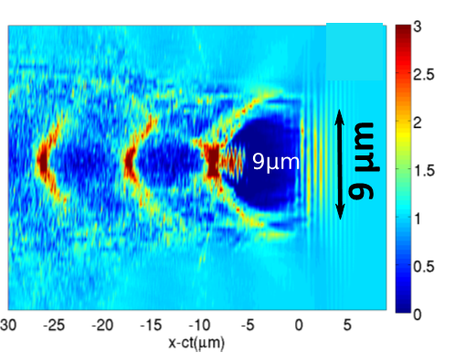
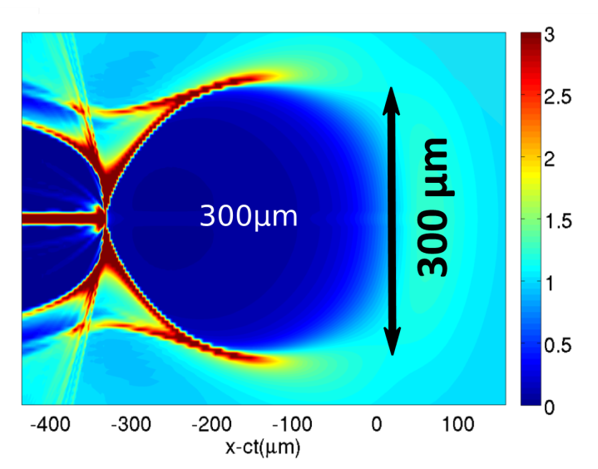
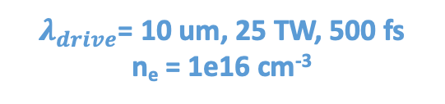
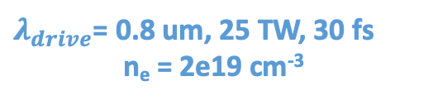
Motivation: Using e-beam as Plasma Wave Diagnostics
$λ_{drive}$= 0.8 um, 25 TW, 30 fs
n_{e} = 2e19 cm⁻³
$λ_{drive}$= 10 um, 25 TW, 500 fs
n_{e} = 1e16 cm⁻³
Courtesy of Gennady Shvets
Courtesy of Gennady Shvets
Diagnostic tools are needed to characterize the fields inside such structures
How is LWFA diagnostic usually done?
Use optical methods—lasers.
These methods rely on the index of refraction of plasma.
Optical methods have been extensively studied and have successfully demonstrated the ability to capture shadowgraphs of the plasma wakes.
BUT: difficult at low plasma densities.

Slide 4
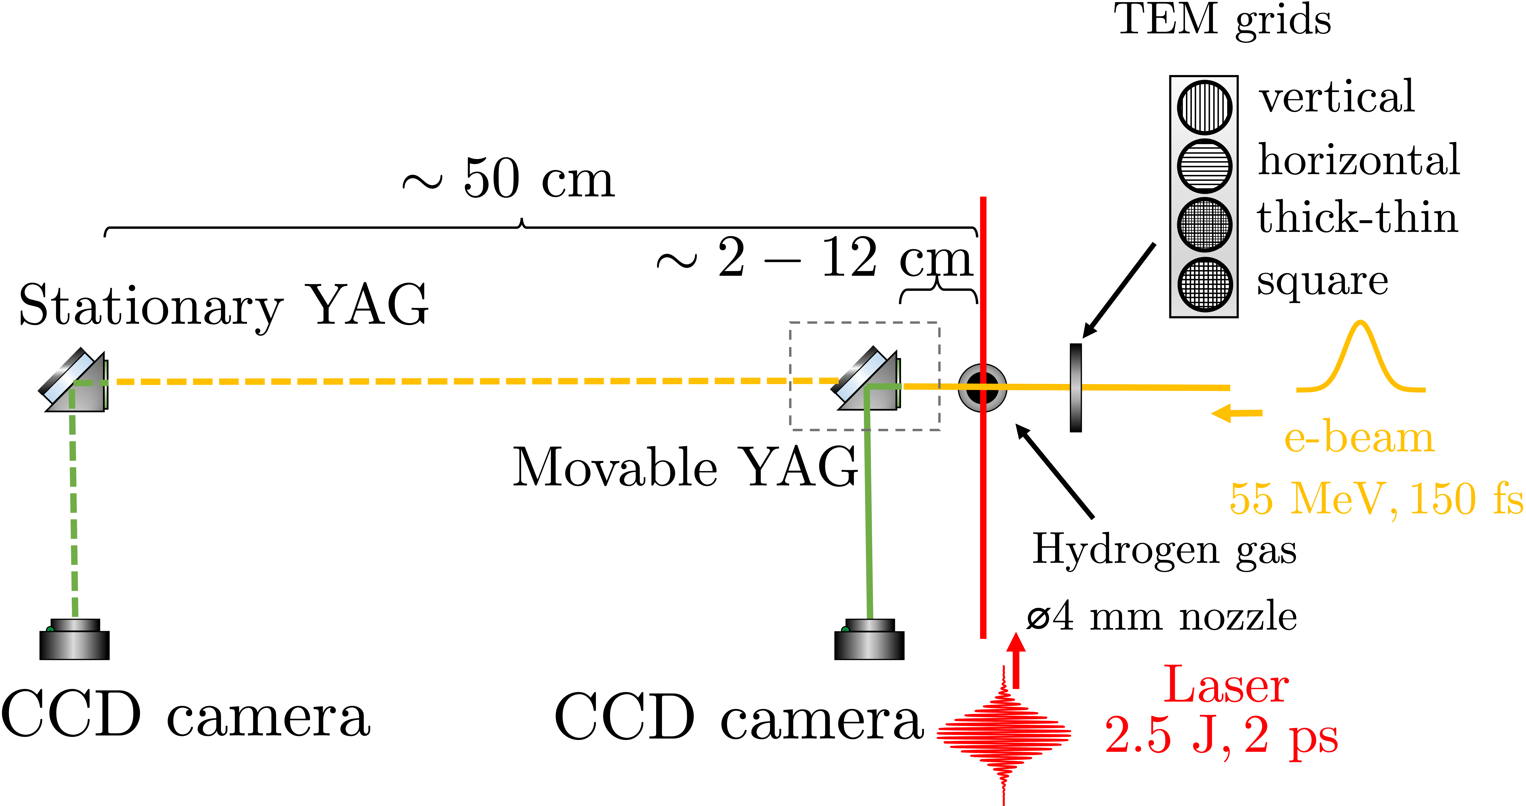
BPMs as Transverse Electron Diagnostics

Slide 5
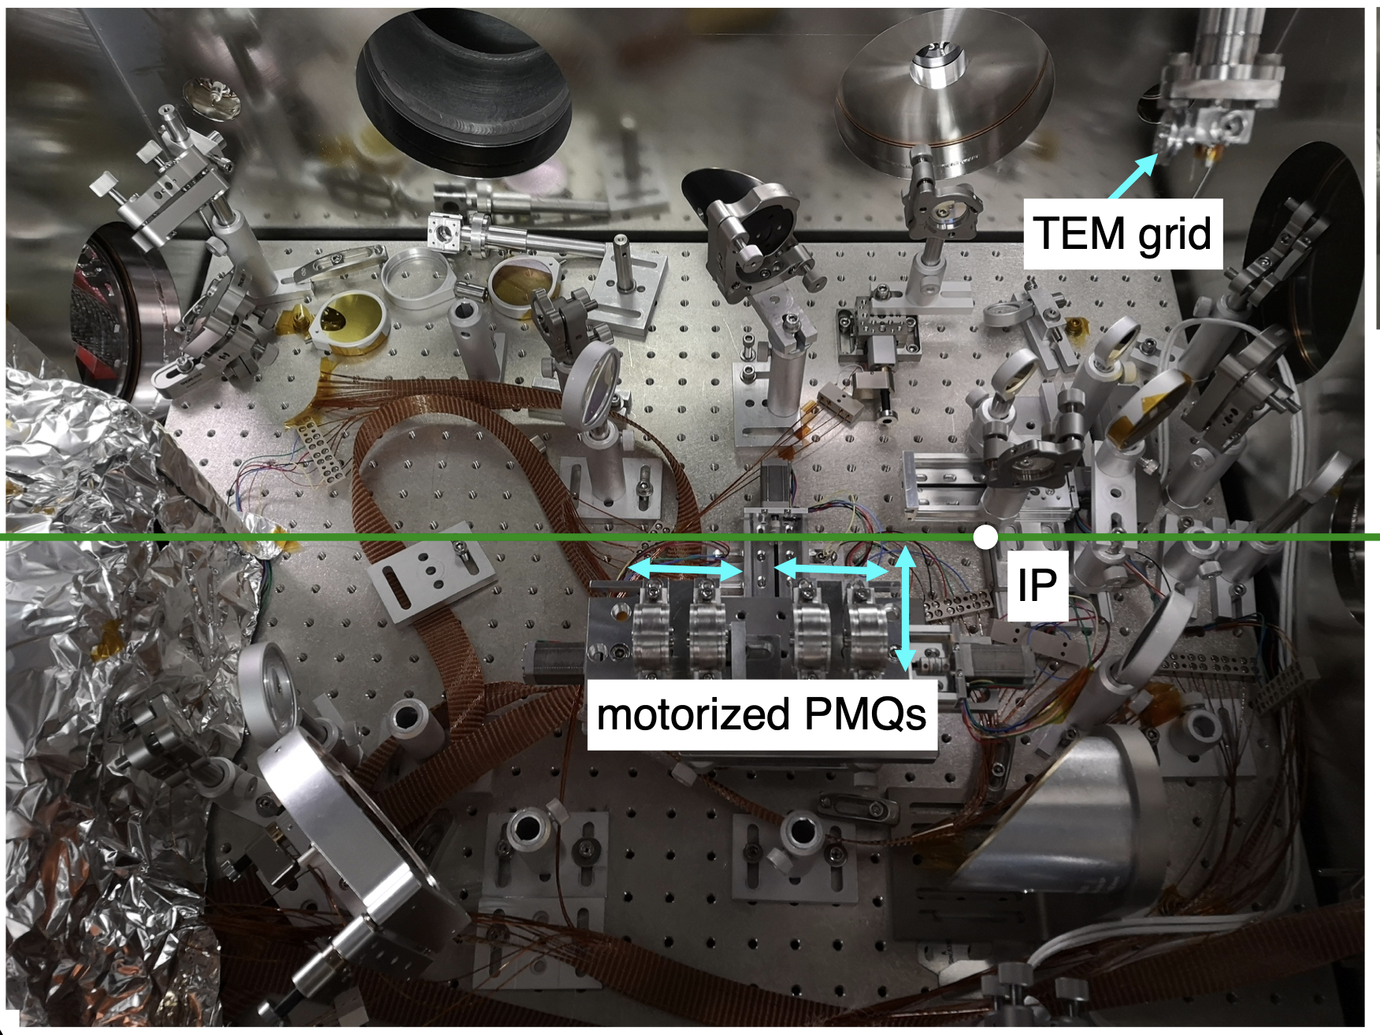
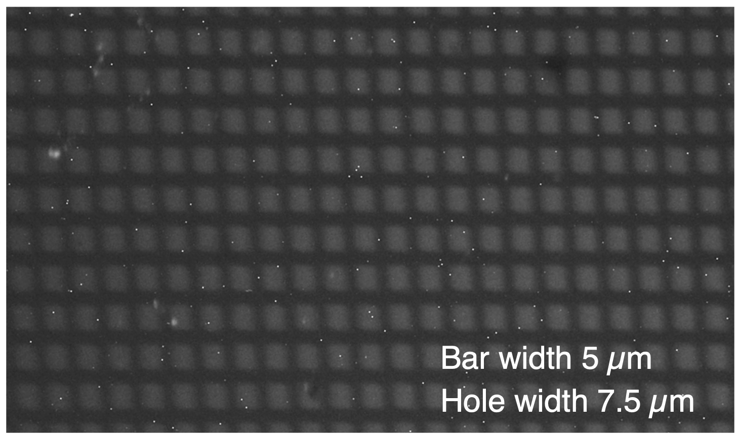
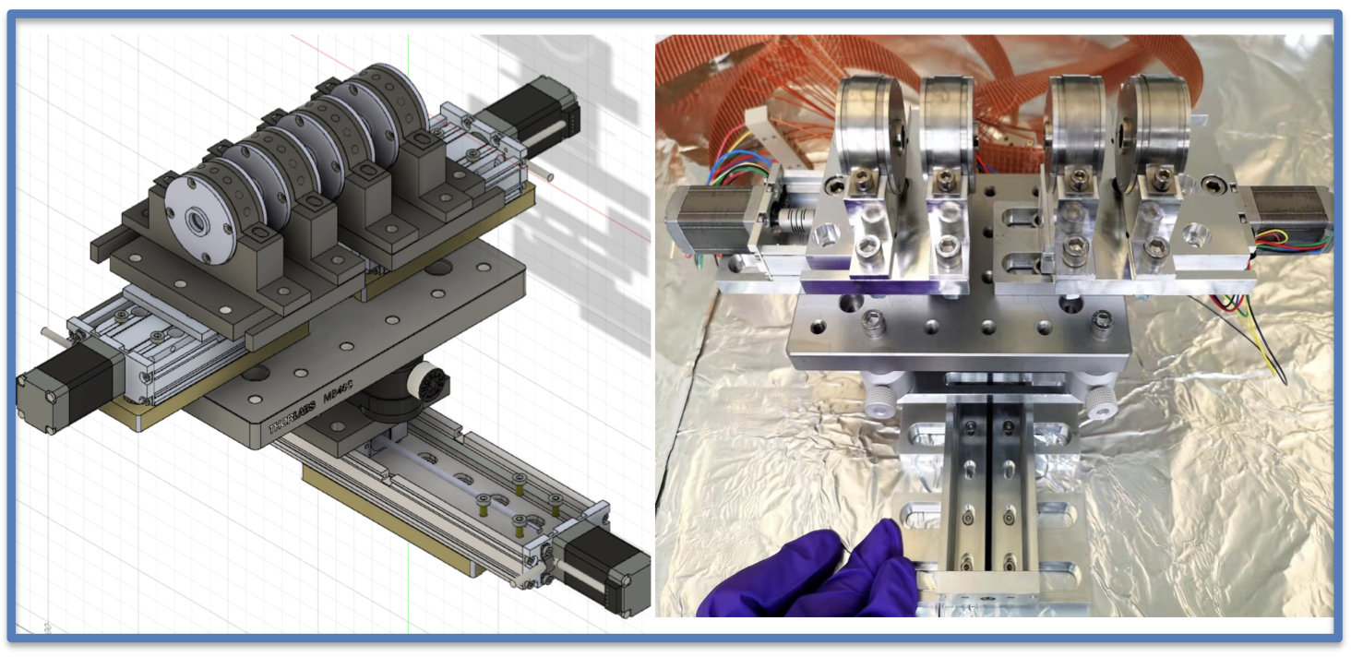
PMQ-based Imaging as Transverse Electron Diagnostics
Object plane: 0-25 mm from plasma, allows imagine close to plasma
Courtesy of Yipeng Wu, UCLA

Slide 6
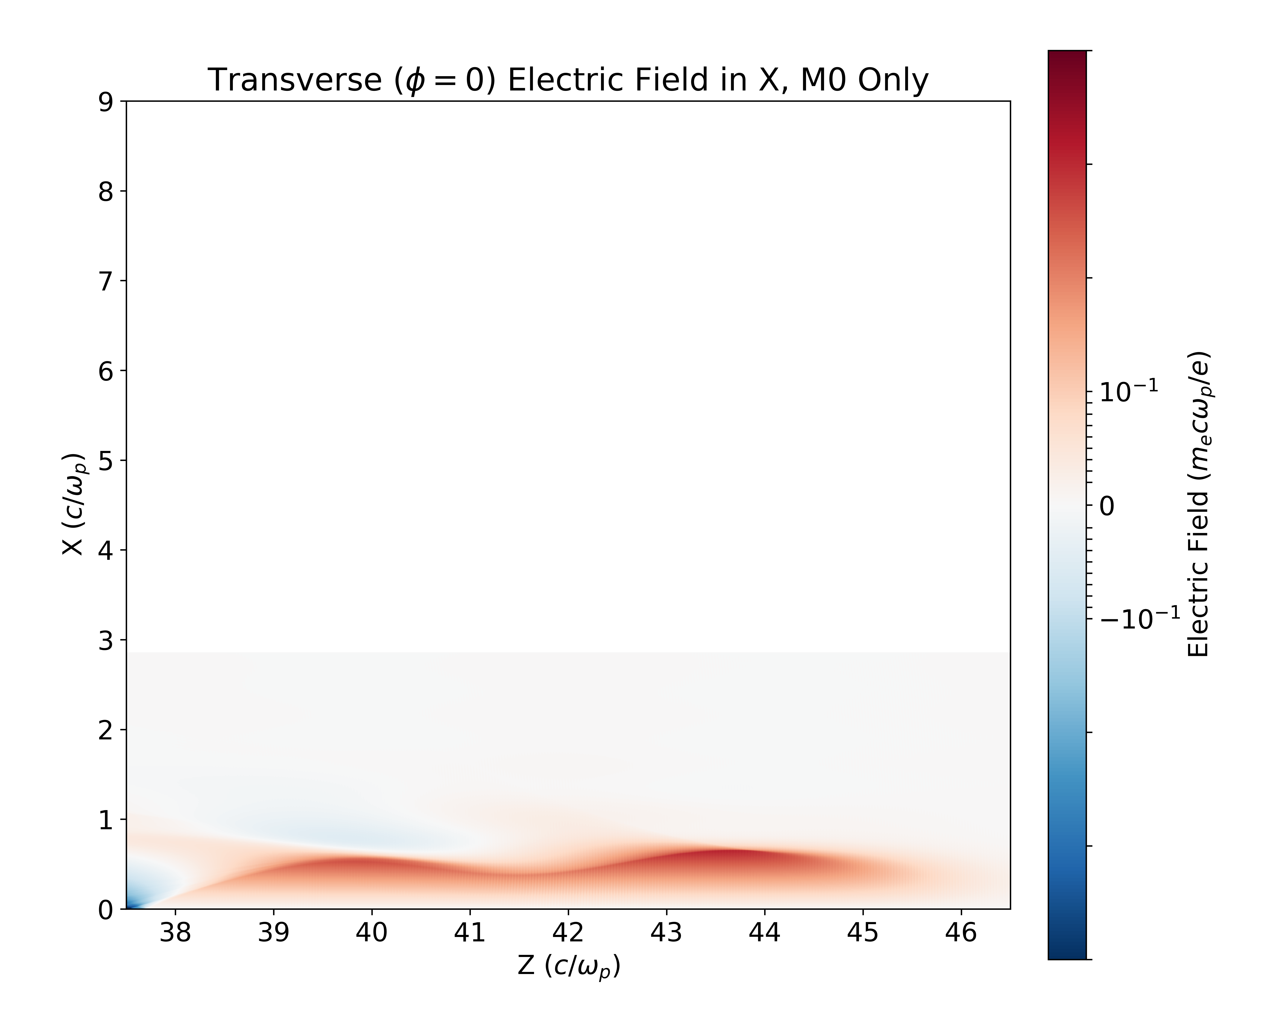
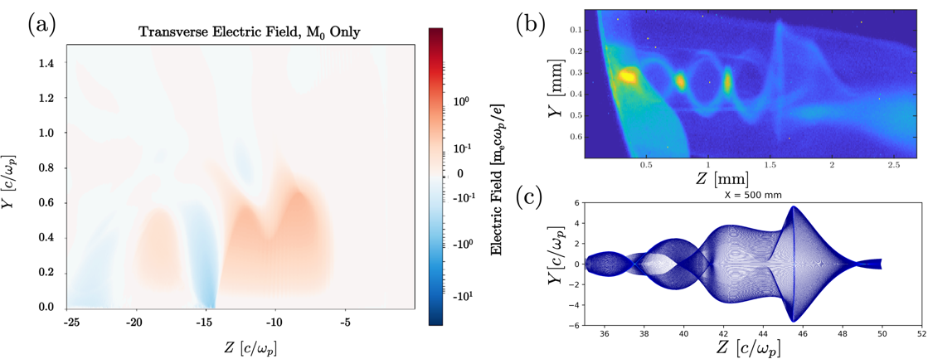
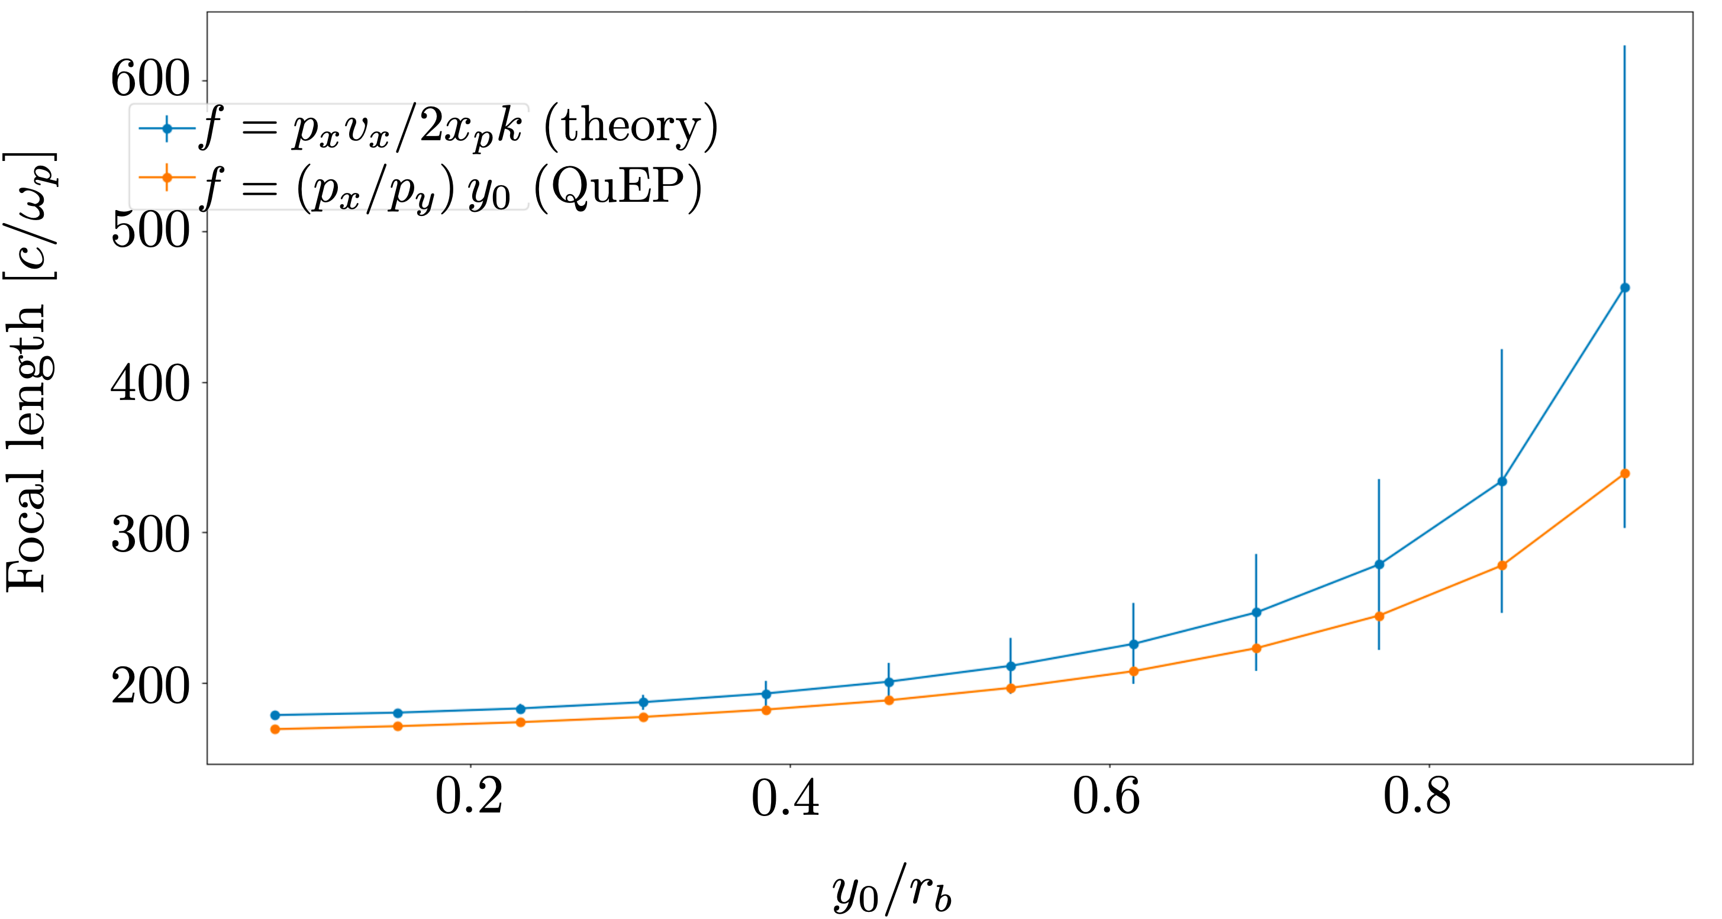
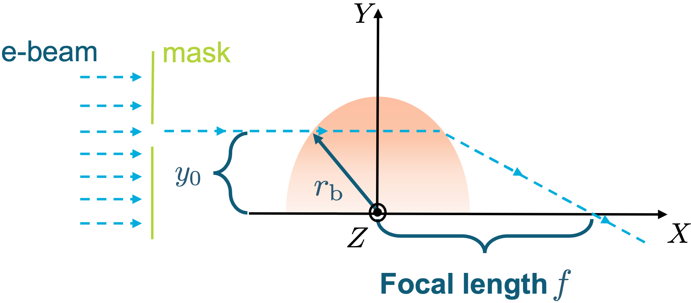
Current 2ps pulse with $a_{0}>3$ Leads to Cylindrical Wakefield
Linear focusing force in a bubble: (wakefield theory suggests )
, where
Focal length
Depth of field
We can characterize the field inside the plasma structure by measuring the focal length

Slide 7
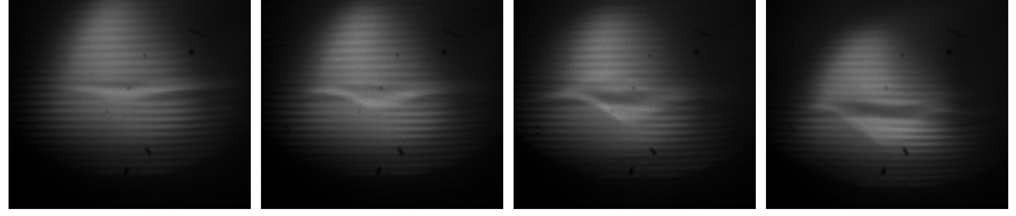
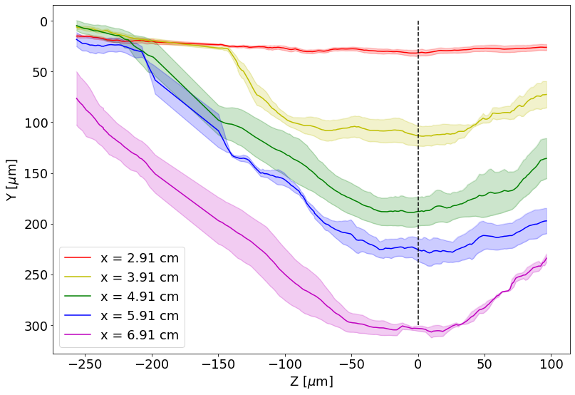
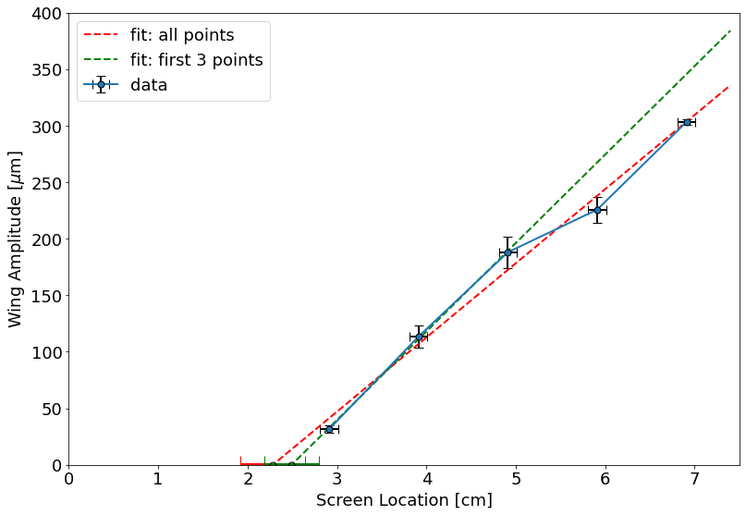
Measurement of Focal Length Using Movable BPMs
#211: E_{L} = 2.8 J, x = 4.66 cm
#204: E_{L} = 2.8 J, x = 6.66 cm
#220: E_{L} = 3.1 J, x = 2.66 cm
#216: E_{L} = 2.3 J, x = 3.66 cm
Ted Pella TEM parallel bar grids have $22 μm$ opening and $40 μm$bar width
Backing pressure of jet ~ 30 psi, 2” away from nozzle, estimated density $3×{10}^{15}$ cm⁻³.

Slide 8
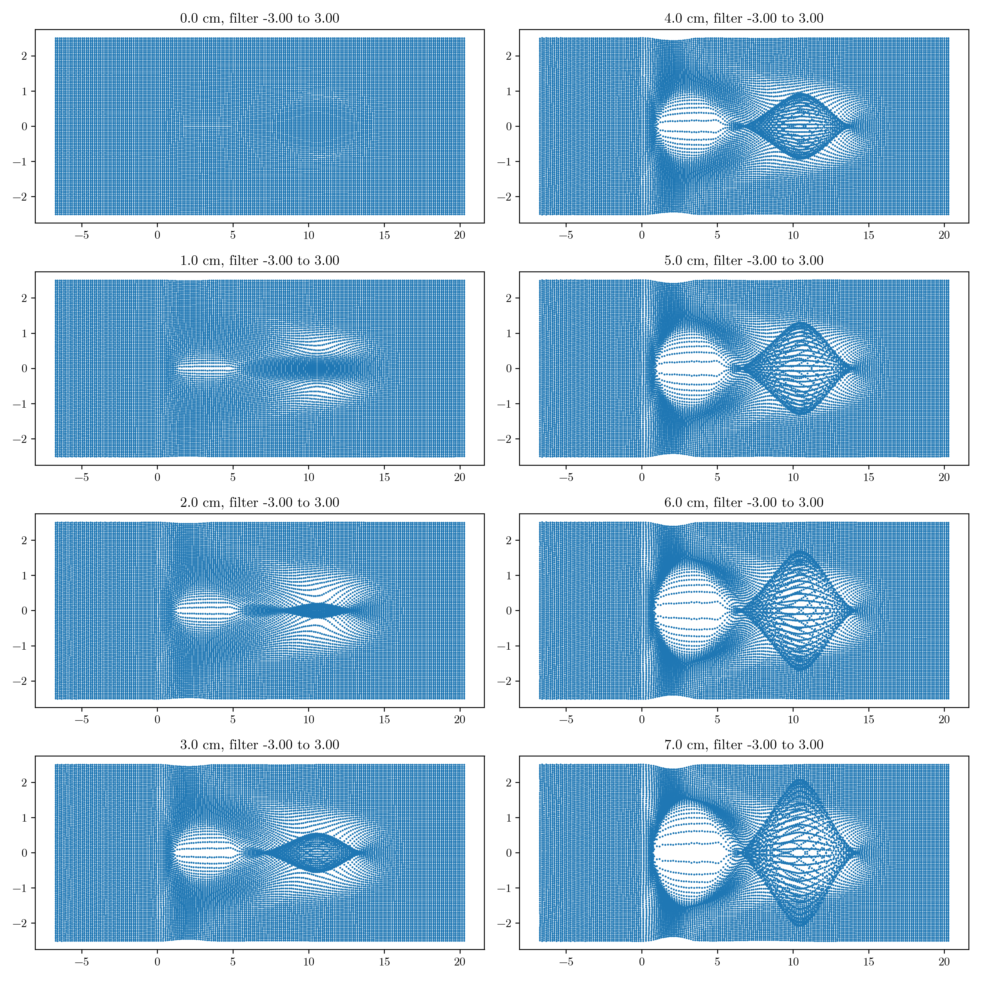
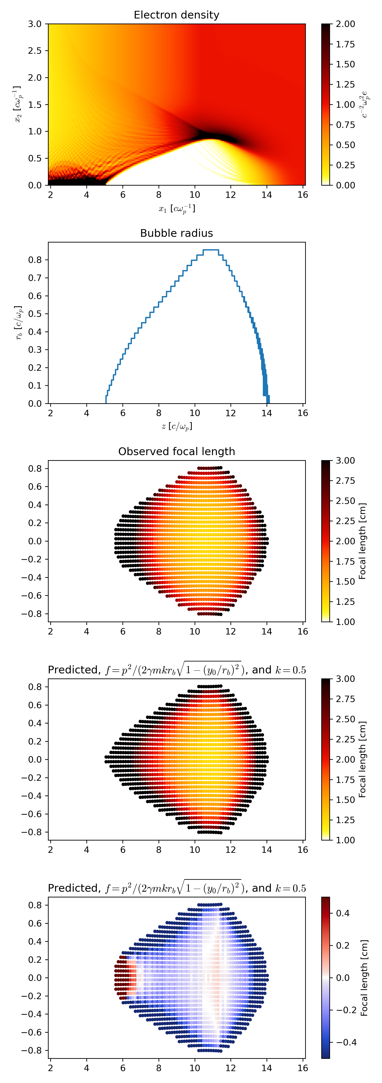
Comparison With Quasi-3D OSIRIS Simulations
3
cm
Simulation Focal Length
1
3
cm
Theoretical Focal Length
1
Simulation agree reasonably well with the theoretical model and experiment
Courtesy of Kyle Miller, University of Rochester

Slide 9
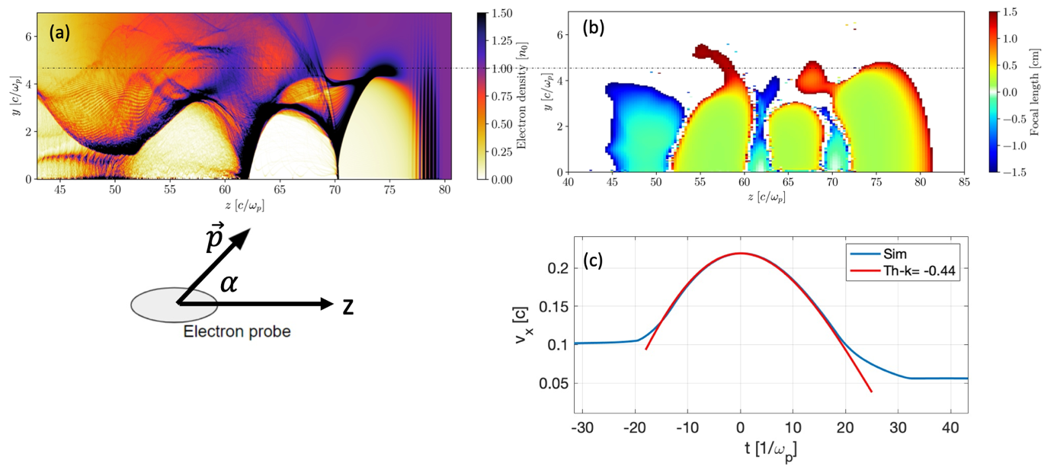
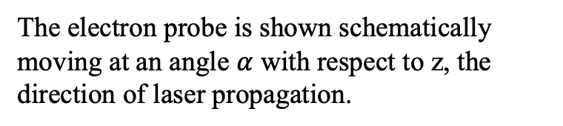
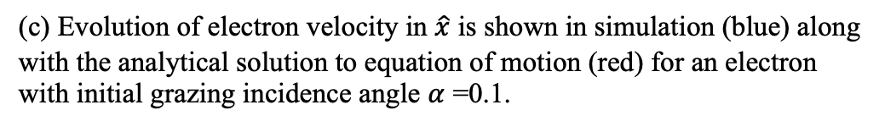
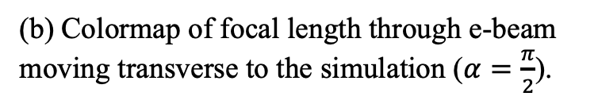
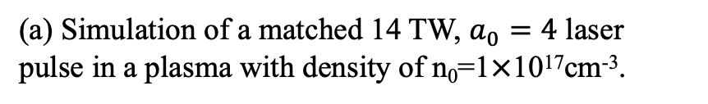
Longitudinal Probing Allows for Matching the Wake Velocity
(a) Simulation of a matched 14 TW, $a_{0}=4$ laser pulse in a plasma with density of n₀=1$×$10¹⁷cm⁻³.
(b) Colormap of focal length through e-beam moving transverse to the simulation ($α=\frac{π}{2}$).
The electron probe is shown schematically moving at an angle $α$ with respect to z, the direction of laser propagation.
(c) Evolution of electron velocity in $\hat{x}$ is shown in simulation (blue) along with the analytical solution to equation of motion (red) for an electron with initial grazing incidence angle $α$ =0.1.

Slide 10
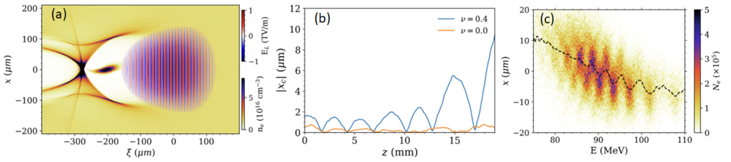
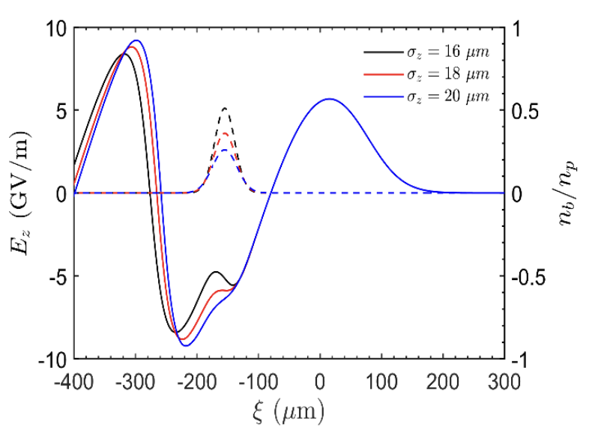

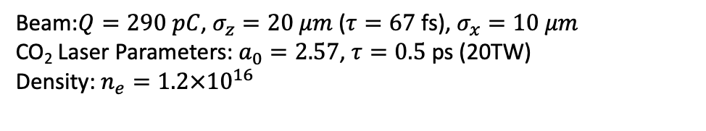
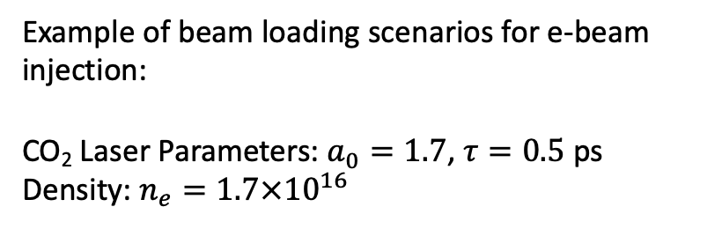
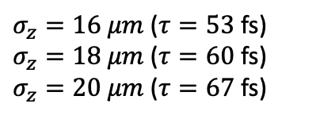
Misaligned Injection of the e-beam Also Enables Transverse Beam-Breakup Studies at Various Beam Loading Scenarios
Growth of the beam with and initial angle, $x_{c}=ν(ξ−ξ_{0})$
Beam:$Q=290 pC$, $σ_{z}=20 μm$ ($τ=67$ fs), $σ_{x}=10 μm$
CO₂ Laser Parameters: $a_{0}=2.57$, $τ=0.5$ ps (20TW)
Density: $n_{e}=1.2×{10}^{16}$
Example of beam loading scenarios for e-beam injection:
CO₂ Laser Parameters: $a_{0}=1.7$, $τ=0.5$ ps
Density: $n_{e}=1.7×{10}^{16}$
$σ_{z}=16 μm$ ($τ=53$ fs)
$σ_{z}=18 μm$ ($τ=60$ fs)
$σ_{z}=20 μm$ ($τ=67$ fs)
$$Q=90 pC$$

Slide 11
Quad Chart
Scientific/Technical Outcomes ATF e-beam is valuable both as longitudinal and transverse probe It can enable complete characterization of fields inside the LWFA It can also be used to address the physics of BBU and its scaling with efficiency | Lasers/e-beam Parameters Required Compressed e-beam to tens of fs is required for accurate transvers probing Longitudinal e-beam diagnostic, i.e. TCAV or electro-optic sampling required for longitudinal beam probing CO₂ laser with >10TW, <1 ps required for driving plasma wakefield in nonlinear regime
ATF Facilities Upgrade Roadmap Current plans for compressing e-beam to below 100 fs is highly suitable for these experiments Low jitter e-beam-CO₂ synchronization is highly desired | Beyond the Current Roadmap Control of the initial beam profile is required for hosing studies Additional diagnostics for constructing 6D profile of the e-beam allows for accurate characterization of beam-plasma interaction: In particular, characterizing energy and position for longitudinal beam slices would be very valuable to these experiments.

Slide 12
The End

Slide 13
Longitudinal Grazing Incidence Angle Probing

Slide 14
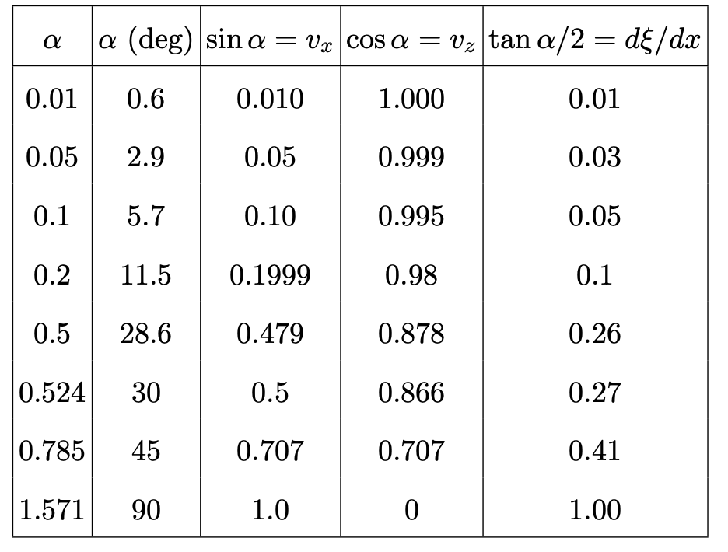
Longitudinal and Transverse Velocities for Various Incidence Angles for 55 MeV e-beam

