Slide 1

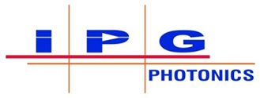













High-power MWIR/LWIR ultrafast lasers for high-energy physics
Sergey Mirov
University Professor of Physics
¹Department of Physics, University of Alabama at Birmingham,
4100 East Science Hall, 902 14th Street South, Birmingham, AL 35294, USA
e-mail address: mirov@uab.edu
D. Martyshkin,¹ V. Fedorov,¹ K. Karki,¹ I. Moskalev², S. Vasilyev², M. Mirov², S. Ya. Tochitsky,³ C. Joshi³, J. J. Pigeon⁴, Z. Cheng⁵, I. Pogorelsky⁵, M. Polyanskiy⁵, K. Zavilski⁶, J. Jesenovec⁶,
K. Vodopyanov⁷
²IPG Photonics - Southeast Technology Center, 100 Lucerne Ln, Birmingham, Al 35211, USA
³University of California,
⁴University of Rochester
⁵University of Ottawa
⁶Brookhaven National lab
⁶BAE Systems
⁷University of Central Florida
Outline
Cr:ZnSe and Cr:ZnS lasers.
Fe:ZnSe lasers.
Optically pumped CO₂ systems.
Cr:ZnSe lasers pumped ZGP OPCPA.
The work reported here partially involves intellectual property developed at the University of Alabama at Birmingham (UAB). This intellectual property has been licensed to the IPG Photonics Corporation. The UAB co-authors declare competing financial interests.
Funding:

Slide 2
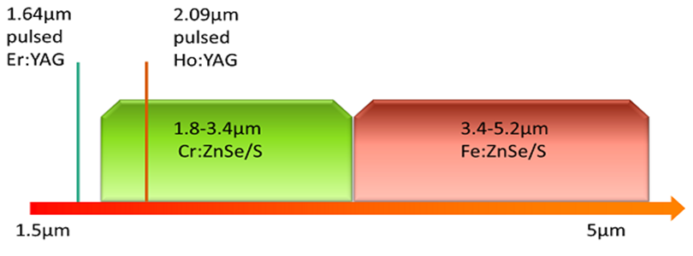
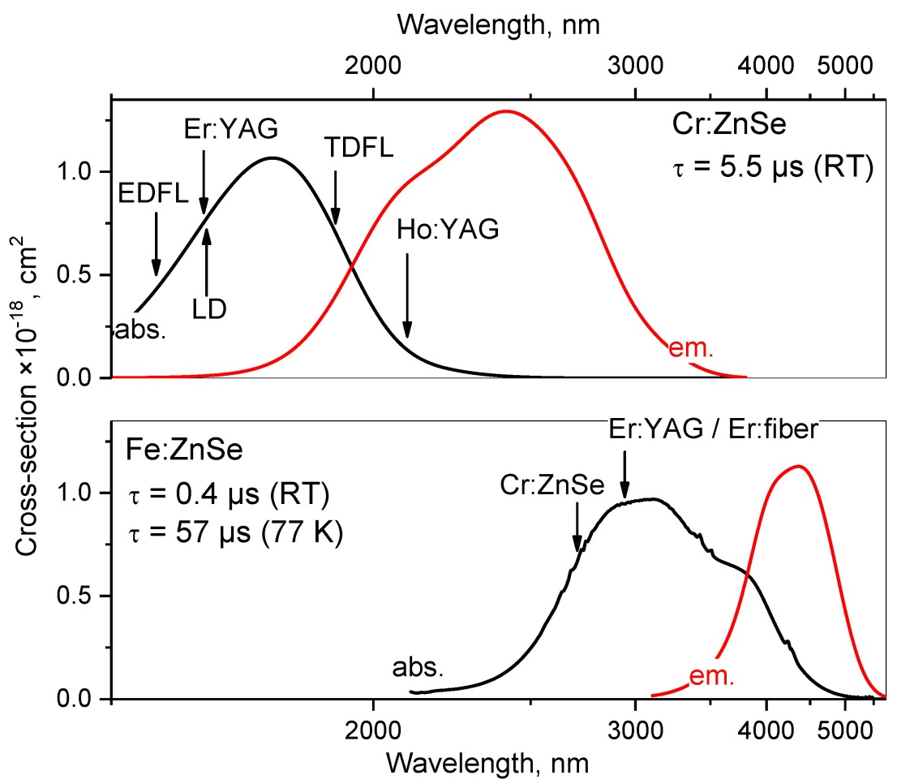
TM:II-VI laser materials: main properties
Cr²⁺-doped ZnSe and ZnS
Broad tuning range (1.8 – 3.3 µm)
Convenient pumping by fiber and bulk lasers, and laser diodes with up to 60% pump conversion
Room temperature operation
Fe²⁺-doped ZnSe and ZnS
Tuning range (3.5 – 5.2 µm)
Pumping at 2.7 – 3 µm
Excellent energy storage capabilities at 77 K
Cr:ZnS/Se and Fe:ZnSe are the “Ti:sapphires of the middle-infrared” !
Absorption and emission spectra of Cr- and Fe-doped ZnSe

Slide 3
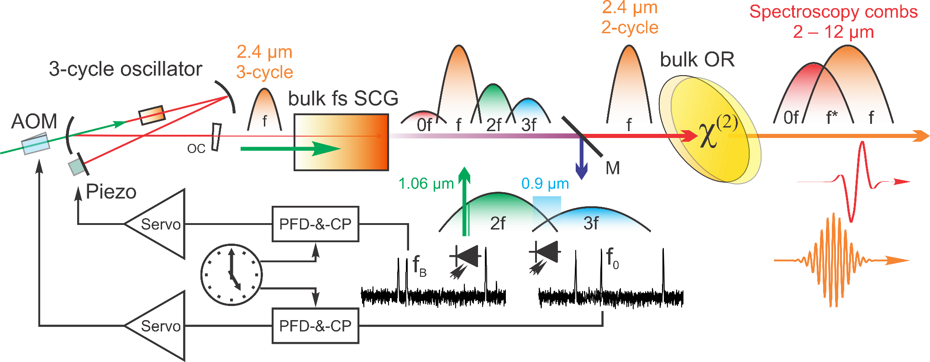
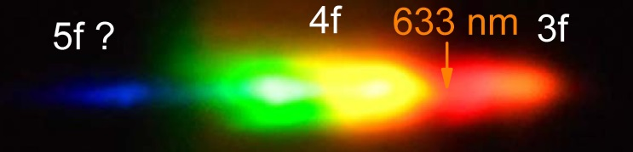
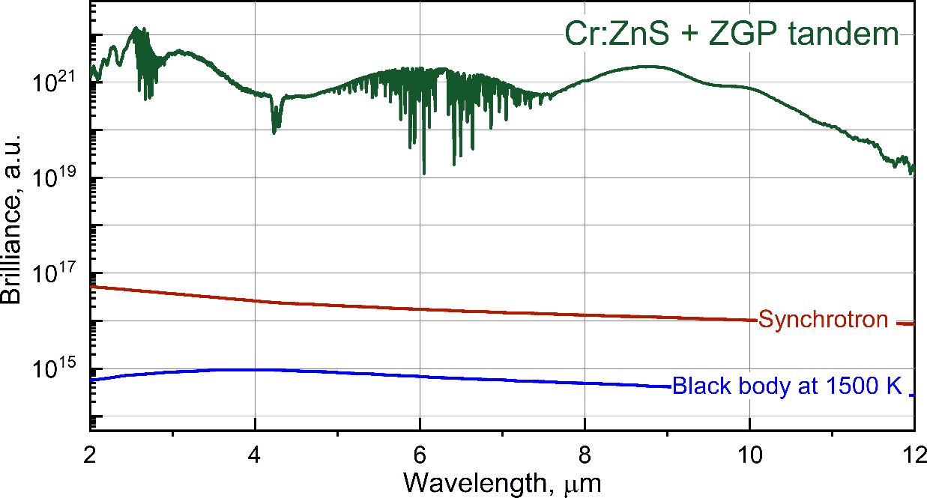
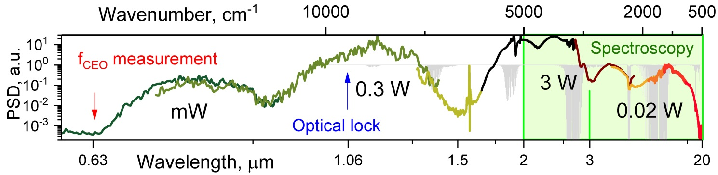
Cr:ZnS lasers – a unique front end for 2-10 µm high energy systems
Middle IR comb is referenced with low cost near-IR detectors! Compatible with all available optical frequency standards at 1.06, 1.5 µm!
▲ Referencing of the broadband IR frequency comb ▲
Desktop Synchrotron!
125×225×425 mm³
↑ VIS part of the continuum ↑
↑ Obtained 5-octave spectrum ↑
▲ Measured spectrum of the source ▲

Slide 4

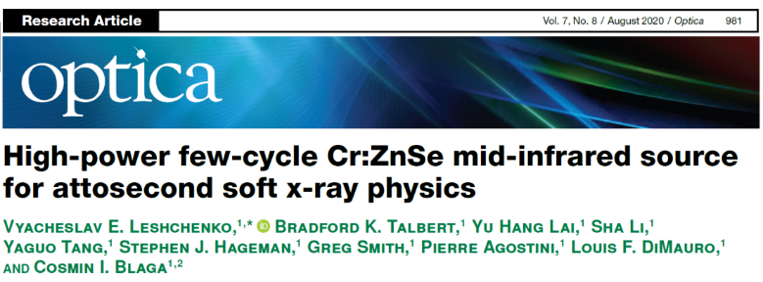
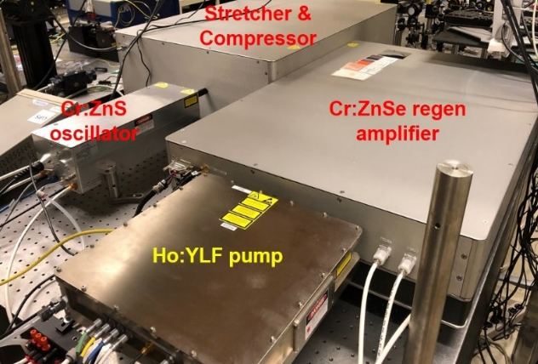
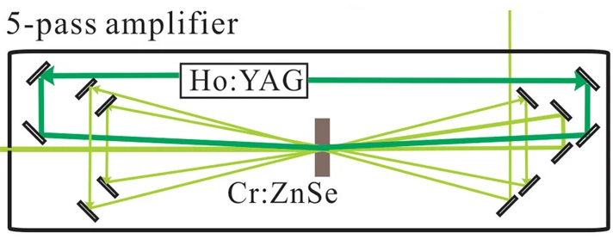
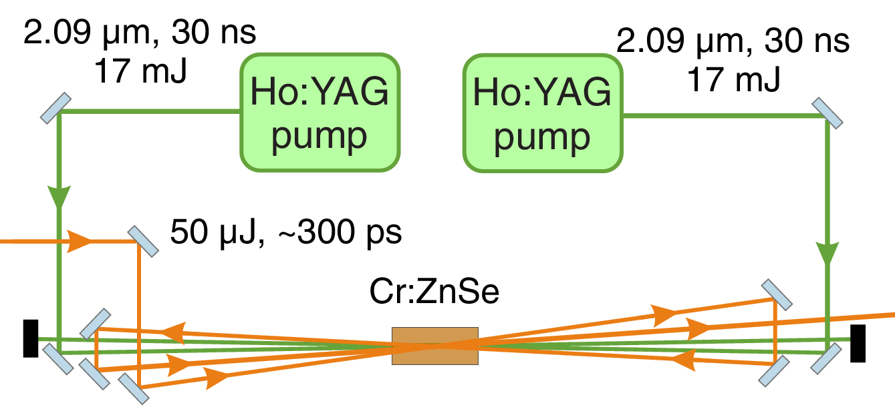
Ultrafast Cr:ZnS and Cr:ZnSe amplifiers: Energy amplifiers
1 kHz Multi-pass amplifier at CREOL
Seed pulses: 1 µJ, few-cycle pulses from BIBO-based IDFG driven by a 1.5 mJ, 30 fs Ti:Sapphire CPA
Öffner stretcher
DAZZLER
Treacy compressor
4 mJ, 44 fs (6-cycles), >90 GW output
1 kHz Multi-pass amplifier at the Ohio State
Seed pulses: 50 µJ, 80 fs pulses from BBO-based OPA driven by a 4 mJ 80 fs Ti:S CPA
Martinez stretcher
Treacy compressor
Multi-plate-like nonlinear
post-compression
6.2 mJ, 39 fs (4.8-cycles), 115 GW output
IPG Cr:ZnSe CPA:
1-kHz, 1.5-mJ, 9.5-GW Seeded by: 12.5 nJ, 30 fs Kerr-lens mode-locked Cr:ZnS laser

Slide 5
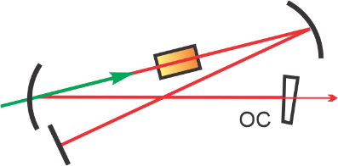
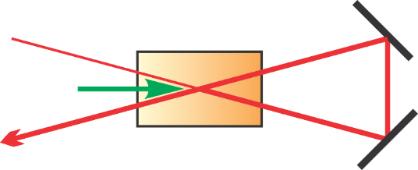
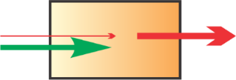
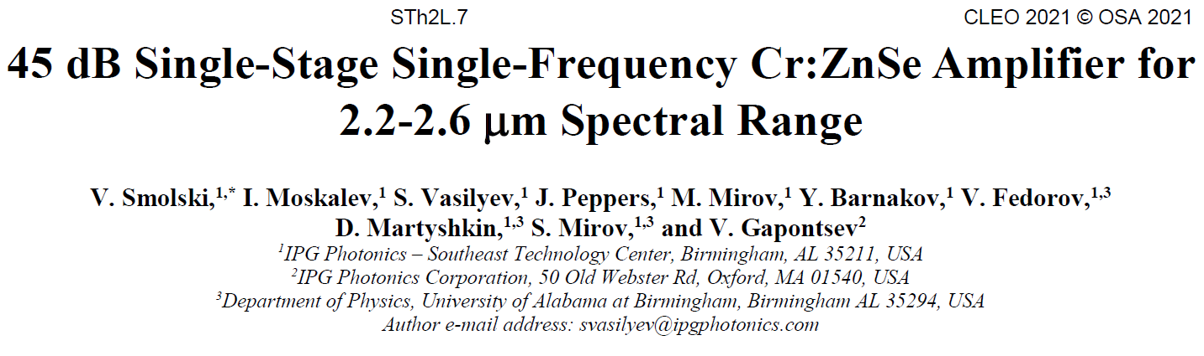
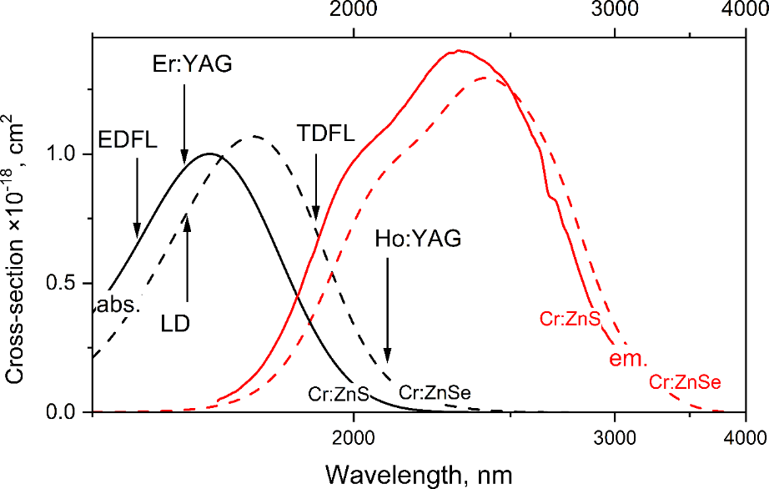
New Vision of Ultrafast Cr:ZnS and Cr:ZnSe Energy Amplifiers
+
+
New vision of Cr:ZnS(Se) CPAs
Pumping by Q-switched Er:YAG laser
High-gain (30 – 40 dB) single-pass preamplifier
Multi-pass main amplifier and booster (s)
Post compression
The optical layout of 1 TW Cr:ZnSe CPA

Slide 6
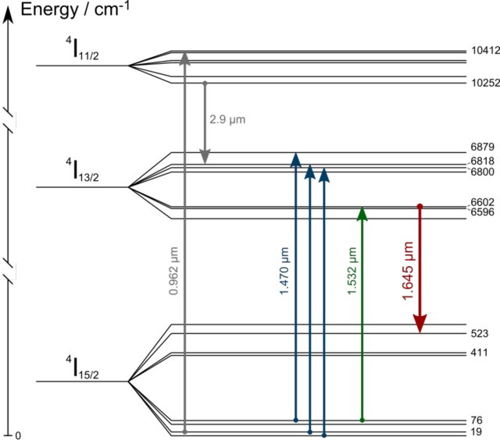
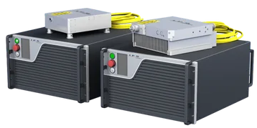
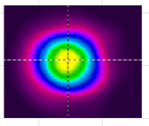
1.645 µm Er:YAG pump lasers for Cr:ZnSe/S CPAs. Current status and future outlook
MAJOR PROPERTIES
Quasi-4 level system
To minimize ground state absorption use small Er concentration ~0.5% and long ~4-5 cm crystals
Small up-conversion for low concentrated Er:YAG
Small quantum defect ~ 7%, no need for water cooling
High-brightness 1532 nm frequency stable sources are required to provide long collimated gain regions
To achieve gain the ground state absorption should be bleached – soft-aperture effect – TEM₀₀
Hybrid (fiber-bulk) systems combine high efficiency of CW fiber lasers with high pulse energies of bulk materials
FUTURE WORK
Scale up energy of 1645 nm Er:YAG with the use of large-mode unstable cavity (see OL 2013) and the use of multimode 1532 nm Er-fiber pump.
IPG has up to 1 kW commercial 1532 nm multimode Er-fiber lasers
10 ms
Er

Slide 7
A 1-TW, Cr:ZnS-based system with a repetition rate of 1 Hz.
Combined Cr:ZnS elements to obtain high absorption of the pump laser.
TPL inside the Cr:ZnS elements was effectively suppressed by using the ink-cladding technique.
Via two stages of amplification, the pulse energy was amplified to over 200 mJ.
The pulse was compressed to 127.6 fs at an energy of 147.1 mJ.

Slide 8
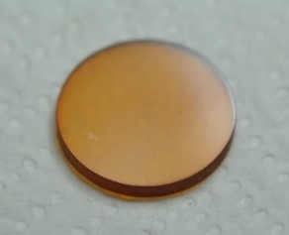
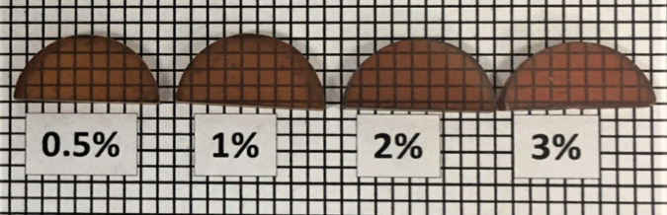
Fe:ZnSe material features and current state-of-the-art
φ 40x3mm
Fe doped ZnSe – Ti-S of the infrared
φ 15x3mm
Key Advantages
Access to 3.4 – 5.2 µm range
Other Features
Pumping at 2.94/2.8 µm by Er:YAG/YSGG
Pumping at 2.7 µm by HF lasers
Supports all laser regimes
cw, ms, µs at T < 220 K
ns at room temperature
mode-locked
60 μs lifetime – high energy storage capability
Q-switching and amplification of ns-fs pulses in the mid-IR
Fe:ZnSe prepared via post-growth diffusion. S. Mirov et al., IEEE JSTQE 24, 1601829 (2018)
Fe:ZnSe hot-pressed ceramics
K. Karki et al., OMEX, (2020)
Fe:ZnSe lasers: state-of-the-art
Regime of operation | Output characteristics | Reference
CW (Cr:ZnSe 2.9 µm pumping) | 9.2 W; η=40%; T=77K | S. Mirov, et al., IEEE, JSTQE, 24, 1601829, 2018
Long Pulse, High Power (free running 2.94 µm Er:YAG) | 35 W, 4.1 µm, 100 Hz, 150 µs; η=35%; T=77K | S. Mirov, et al., IEEE, JSTQE, 24, 1601829, 2018
Long pulse, High Energy (free running 2.94 µm Er:YAG) | 10.6J, 4.1 µm, single pulse, η=53%; T=87K | V. Kozlovsky et. al., J. Physics (2016)
Gain-switched ns pumping (HF 2.7 µm laser) | 1.43J, 4.4 µm, 10 Hz, η=53%; T=300K | A. Dormidonov, et al., Appl. Phys. B 122, 211 (2016)
Nanosecond MOPA (Q-switched 2.94 µm Er:YAG) | 60 mJ, 4.4 µm, 10 Hz, η=30%; T=300K | D. Martyshkin, S. Mirov et. al., Opt. Express 29, 2387 (2021)
Multipass amplification of ultrashort pulses (Q-switched 2.85 µm Cr: Yb: Ho: YSGG) | 3.5 mJ, 150 fs, 4.3 µm, T=300K | E. Migal, et. al., Opt. Lett. 44, 2550 (2019)
Room-temperature cross-sections of emission of
(i) Cr:ZnS, ii) Cr:ZnSe ; iii) Fe:ZnS, iv) Fe:ZnSe, v) Fe:Cd_{0.75}Mn_{0.25}Se, vi) Fe:CdTe, vii) Fe:Zn_{0.5}Cd_{0.5}Te, and viii) Fe:Cd_{0.5}Mn_{0.5}Te
UAB Physics and industrial collaborator IPG Photonics are the world leaders in Cr/Fe doped II-VI materials and lasers
Notes:
Here we change gears and move to a description of Fe:ZnSe LWFA driving laser. We start with Fe:ZnSe materials properties and current state-of-the-art output characteristics. Fe:ZnSe crystals are often called Ti-sapphire of middle infrared. Fe:ZnSe provides access to a 3.4-5.2 um spectral range with cross-sections of 10^-18 cm2. It can be pumped by radiation of 3 um Er based lasersor 2.7 um of HF lasers. Fe:ZnSe supports all laser regimes of operation: cw, ms, µs at T < 220 K, ns at room temperature, as well as mode-locked regime. It features ~60 us lifetime at up to 150K and is the only available solid-state material with high energy storage capability in MWIR. It can serve as an effective MWIR amplifier at low temperatures under free-running 3 um Er laser excitation, or at room temperature under Q-switched 3 um Er laser excitation. The table depicts Fe:ZnSe lasers stat-of-the-art with 35 W of output power, in excess of 10 J of output energy in long pulse, 1.4 J short pulse lasing under ns 2.7 pump radiation of HF laser, 60 mJ nanosecond broadly tunable MOPA and 3.5 mJ, 150 fs multipass amplifier of ultrashort pulses. The technology of fabrication of Fe:ZnSe gain media is mature and ready for reaching 1TW level of power.

Slide 9
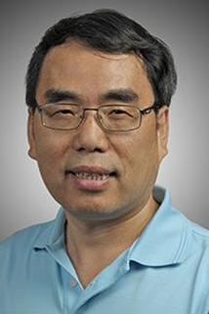
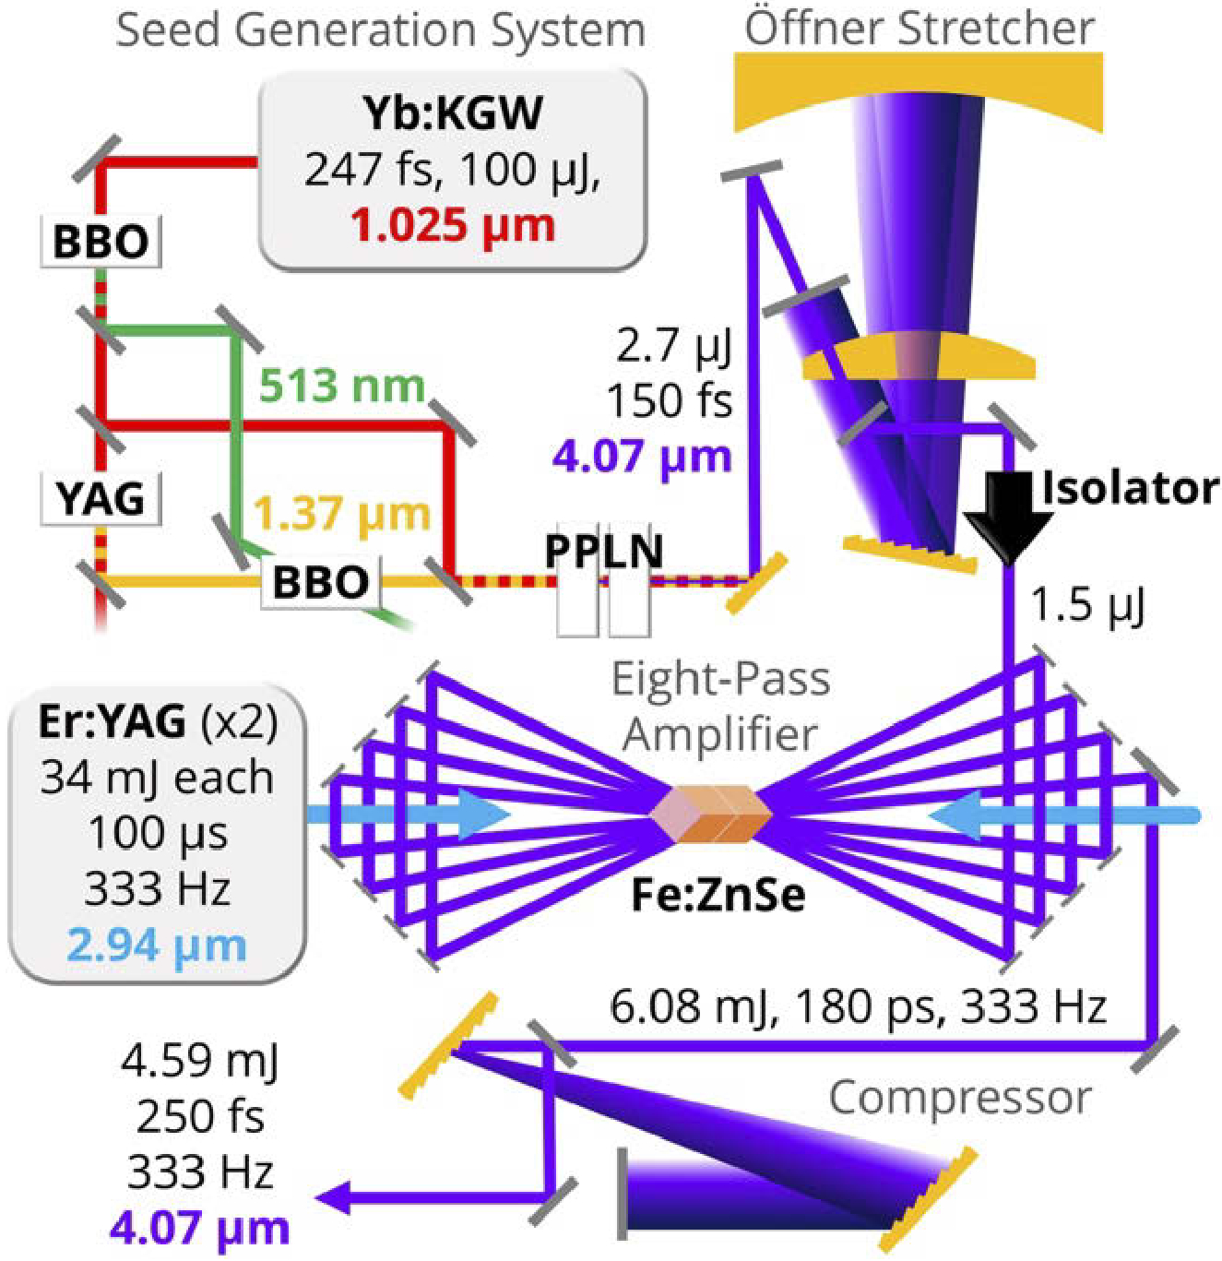
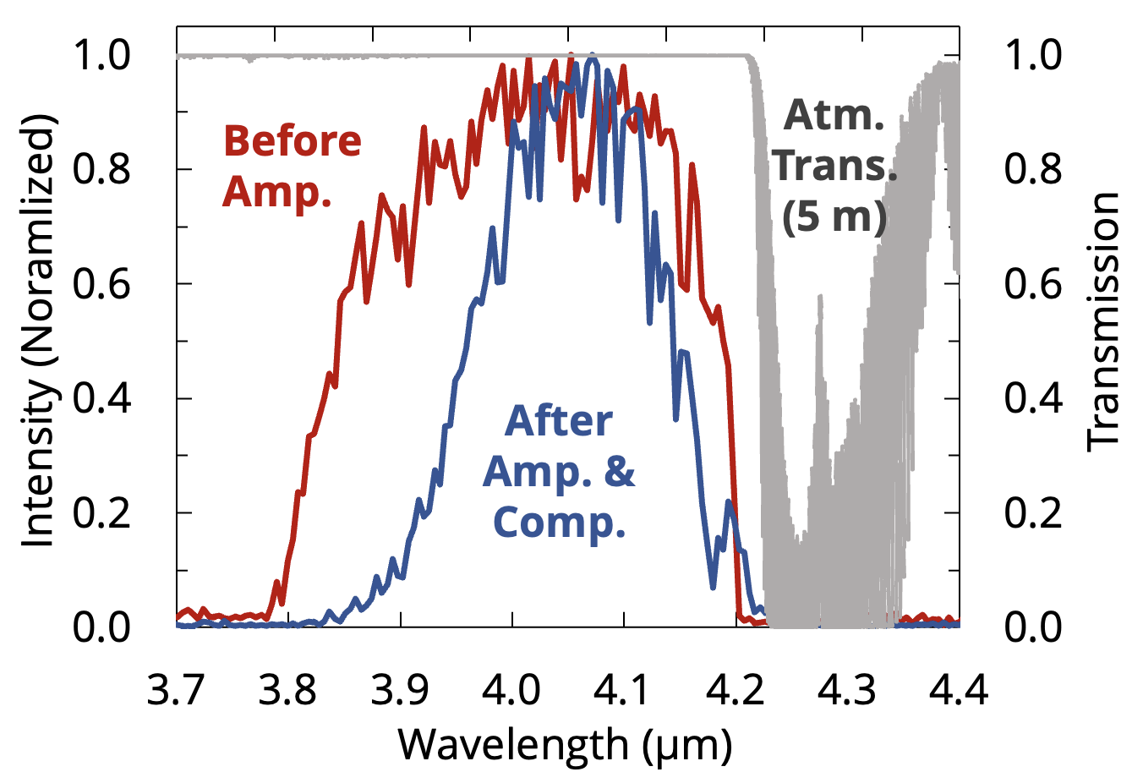
Fe:ZnSe CPA at 4.1 mm
Fe:ZnSe gain crystal:
Large stimulated emission cross section
Long upper state lifetime at cryogenic temperature
Can be pumped by free-running Er:YAG at 2.94 µm
Current status: Z. Chang. Opt. Express 31, 13447 (2023)
4.6 mJ, 250 fs, 333 Hz at 4.1 µm
Notes:
Here we show the current status of Fe:ZnSe 4.1 um CPA developed by the Zenghu Chang group. It is based on cryogenic 8 pass Fe:ZnSe CPA pumped by radiation of free running 3um radiation of diode pumped Er:YAG. Fe:ZNSe is seeded by a stretched radiation of a broadband optical parametric generator based on LGS nonlinear crystal pumped by 1 um pump from Yb KGW and broadband signal from YAG supercontinuum generator. It delivers 3.7 mJ at 247 fs, 5 mJ in 130 ps before compression at 300 Hz at 4 µm.

Slide 10
Future RT Fe:ZnSe Terawatt System
Kerr Mode-Locked laser
1W Cr:ZnS@2.35 μm
75MHz, 50fs
Pulse Stretcher
Pulse Picker
5 μJ@4.0 μm, 100fs
Single Pass Cr:ZnSe Amplifier
15 μJ@2.35 μm, 100fs
OPG-OPA ZGP
Er:YAG@1.645 μm
10mJ, 50 ns
2 µJ@4.0 μm, 300ps
Er:YSGG@2.7 μm
400mJ, 50 ns
Multi Pass Fe:ZnSe(S) Amplifier
2 mJ@4.0 μm, 300ps
Er:YSGG@2.7 μm
50mJ, 50 ns
3 stage Double Pass
Fe:ZnSe Amplifier
120 mJ@4.0 μm,
300ps
Pulse
Compressor
100 mJ@4.0 μm,
100fs

Slide 11
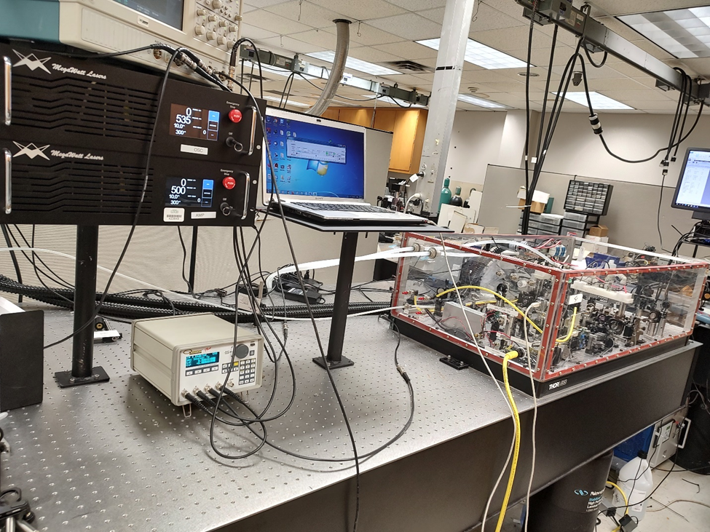
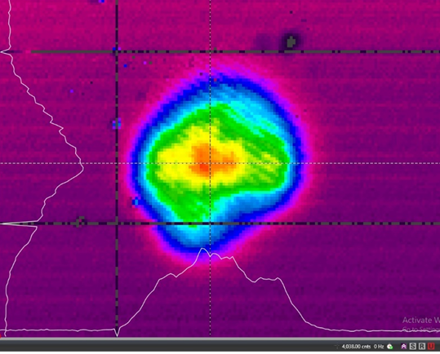
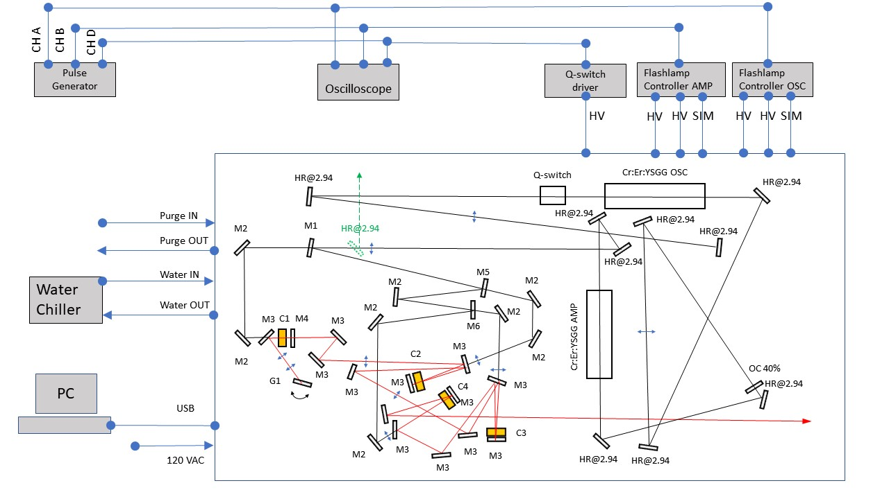
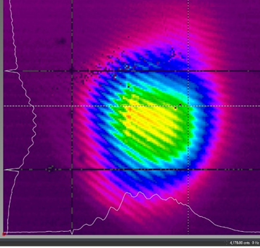
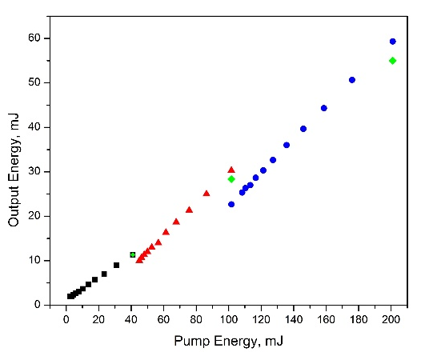
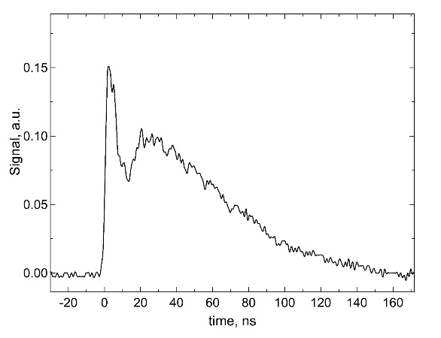
Triggerable Fe:ZnSe gain-switched ns amplifier
Cr:Er:YSGG, EO Q-switched, 100ns, MOPA
2.79 um, 260 mJ Pump
Fe:ZnSe MOPA 4.4 um
80 ns output
Fe:ZnSe MOPA 4.4 um
Pulse duration
4.4 um, 60 mJ Fe:ZnSe
spatial profile

Slide 12
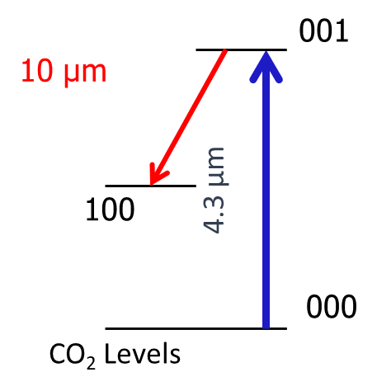
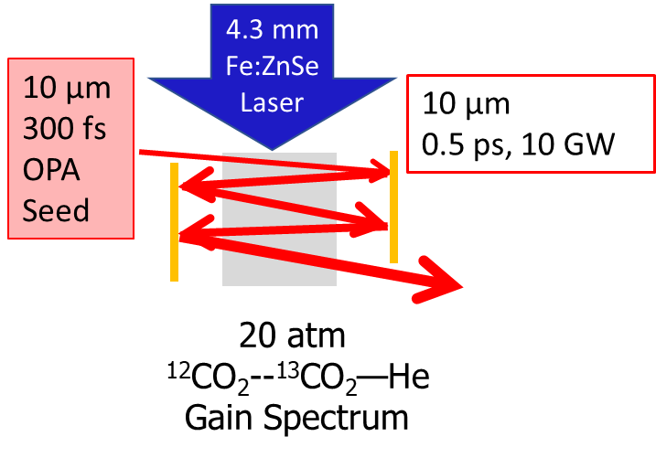
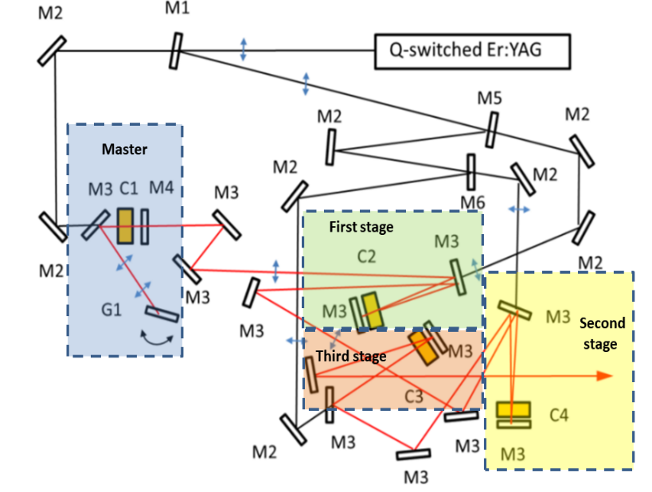
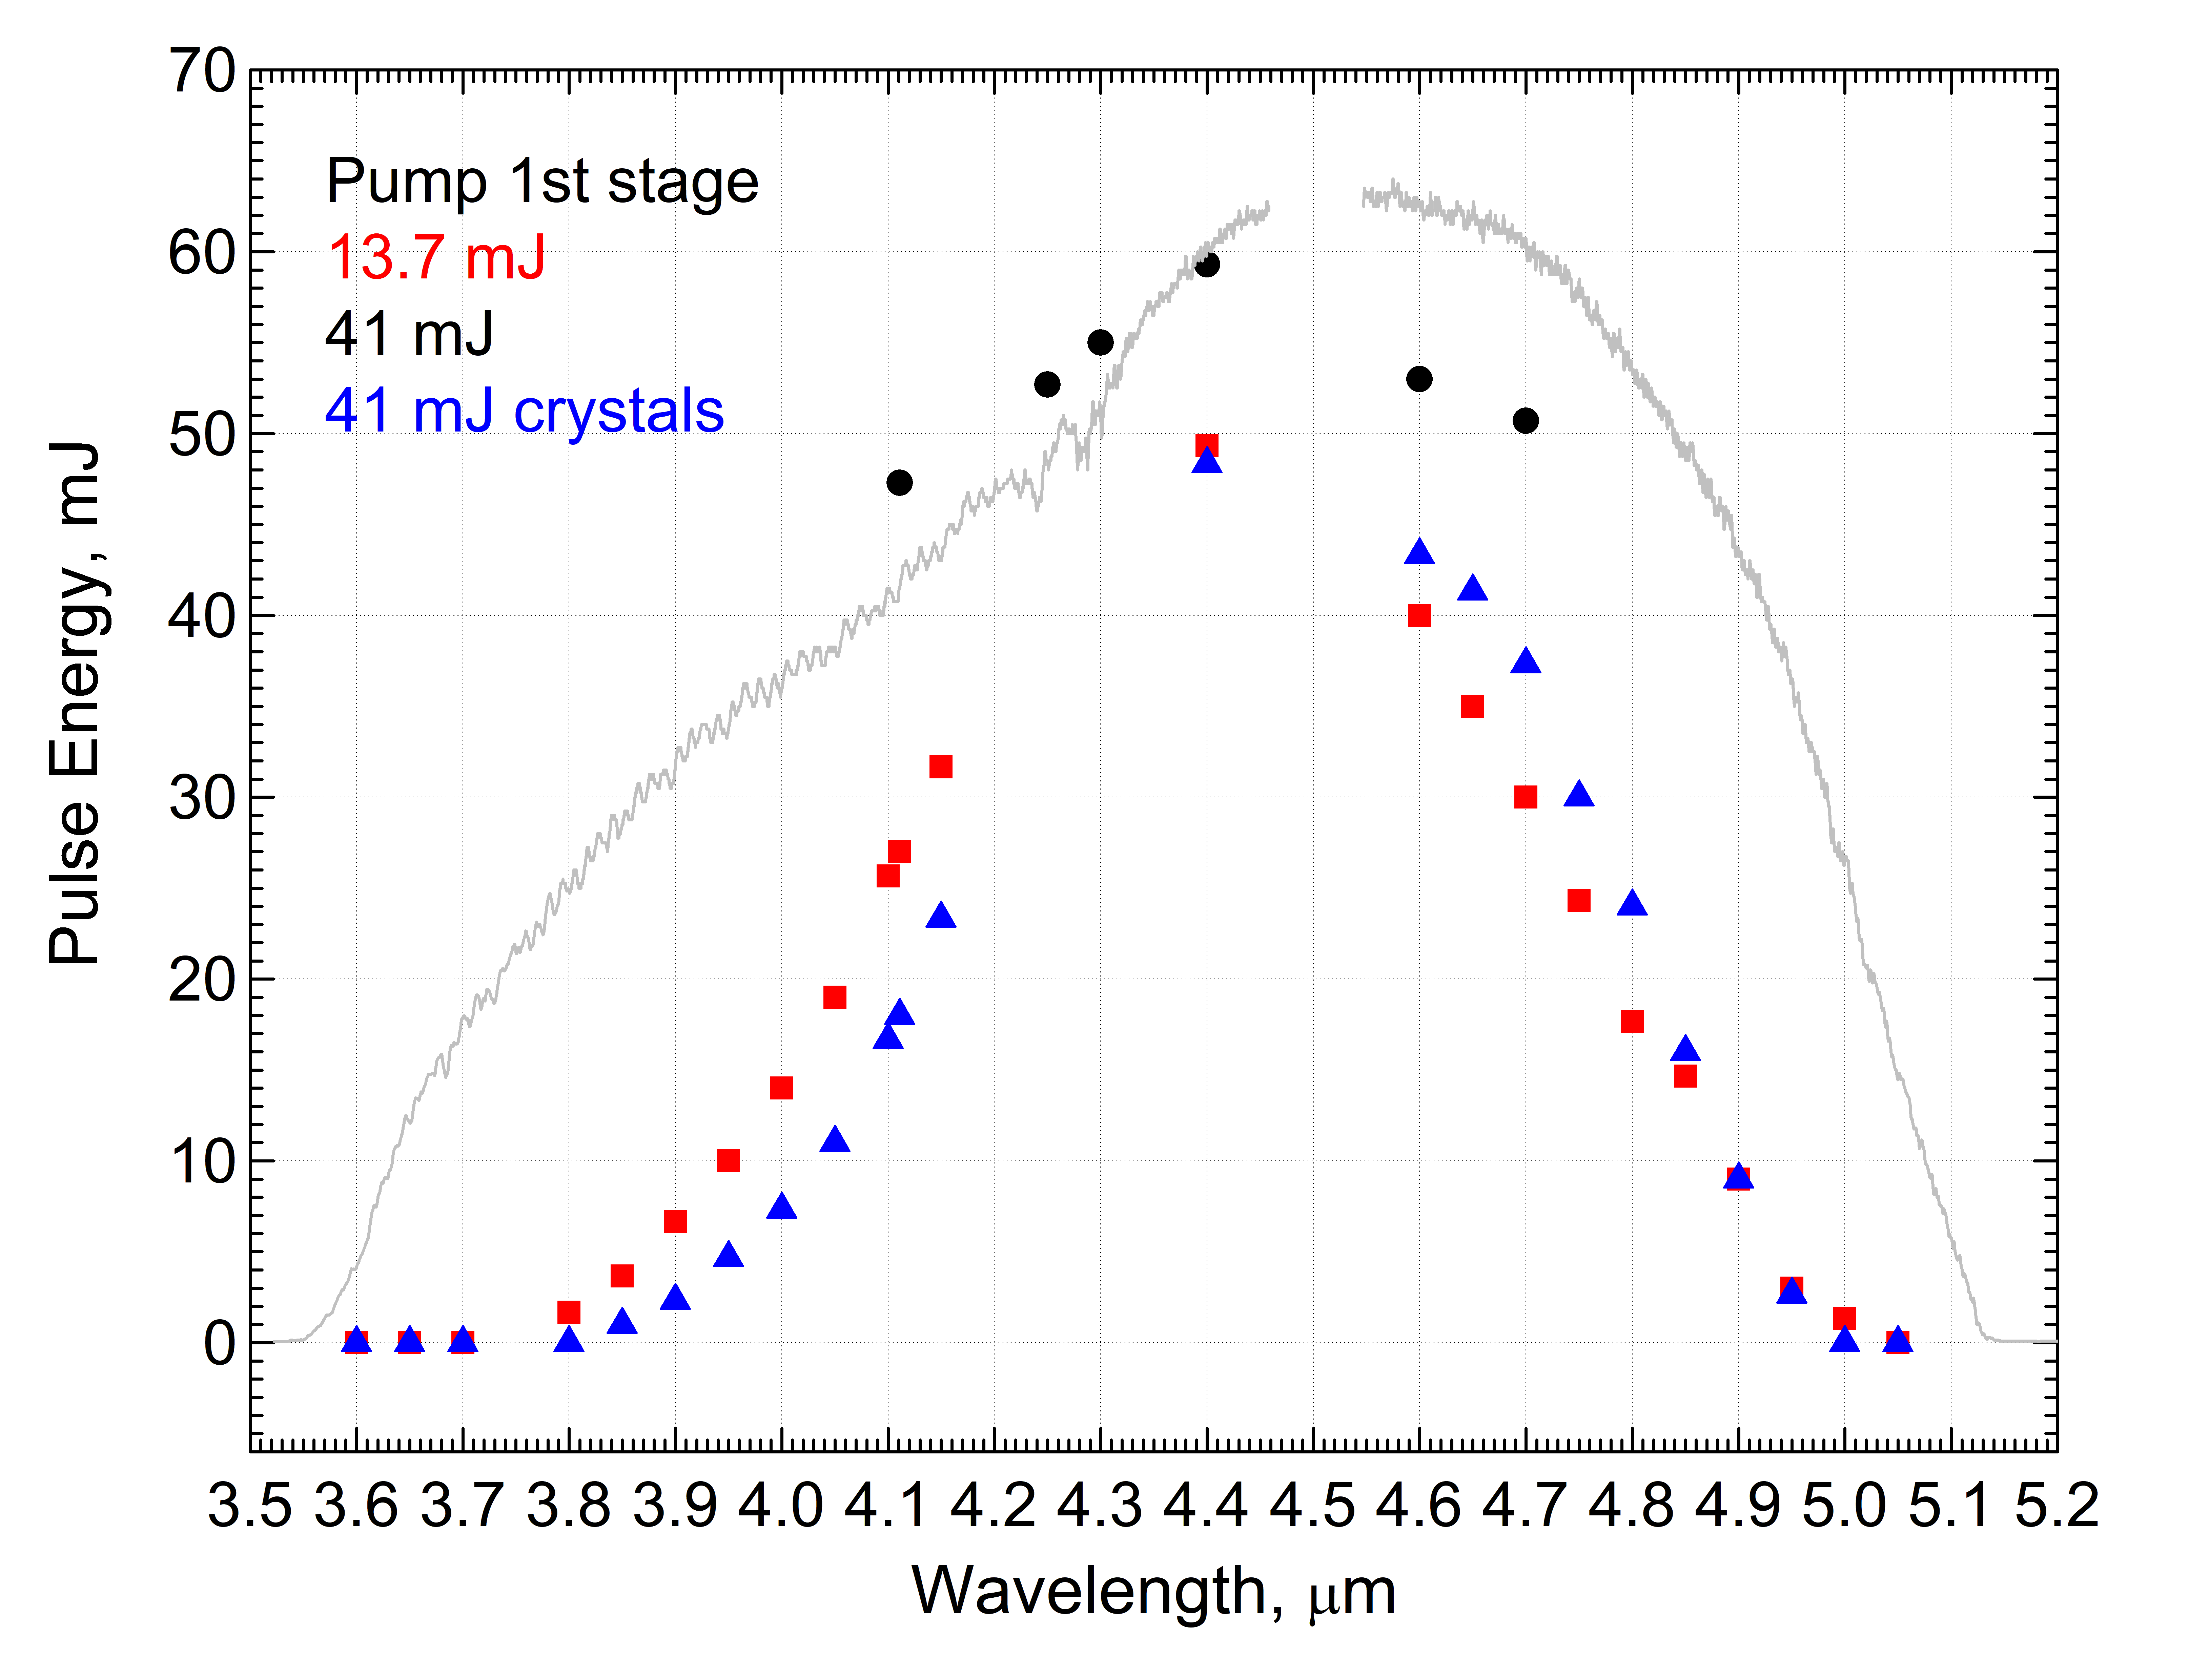
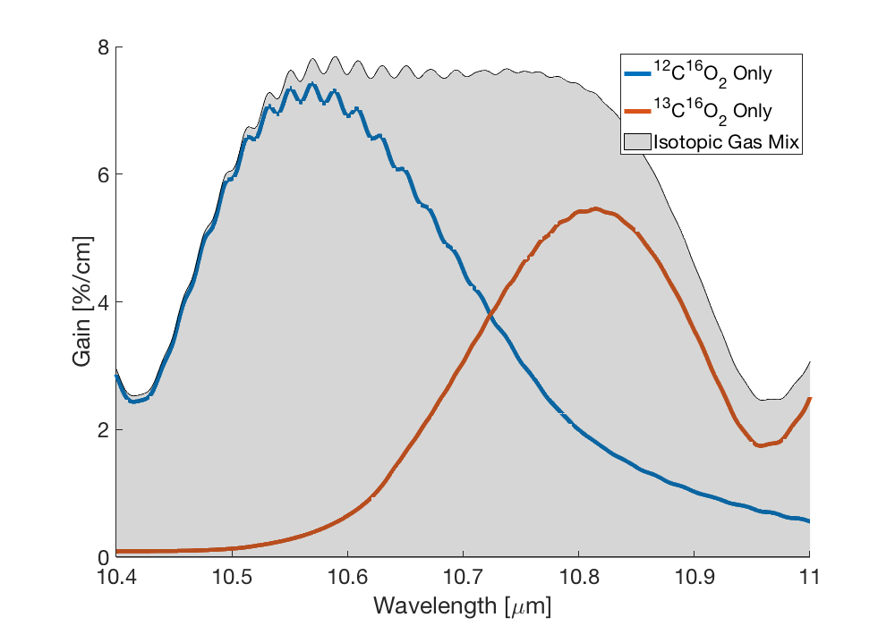
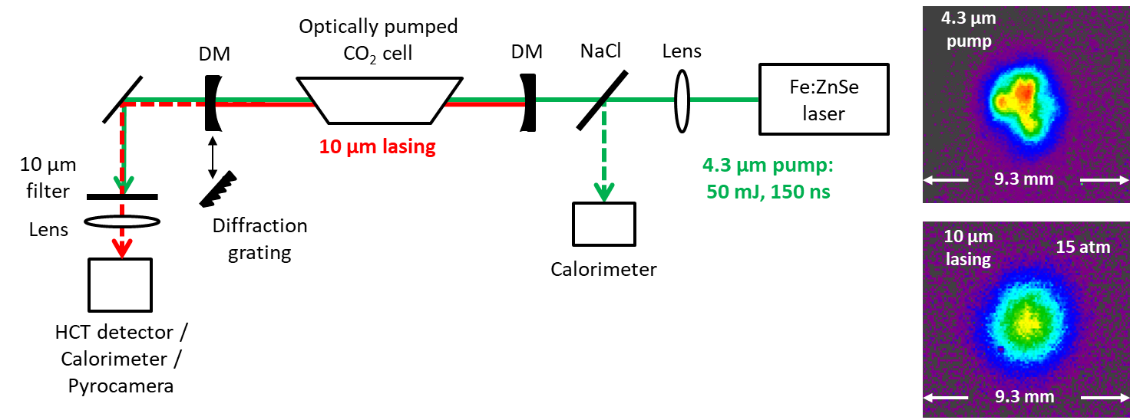
High-Pressure Optically Pumped CO₂ Laser
Physics challenges in a gas active medium at high-pressure ≤20 atm
Status
Goal: increase the upper-state lifetime to >1 ms and mitigate nonlinear refraction effect for the 4.3 mm pump. Gain tailoring using various CO₂ isotopes to reach many THz bandwidth in a cm-scale cell.
Leveraged seed funding from the DOE Accelerator Stewardship program: a 2 mJ and then 60 mJ Fe:ZnSe pump was built and used for proof-of-existence experiments at UCLA.
Turn-key operation RT Fe:ZnSe MOPA tunable over 3.8-5.0 μm (60 mJ)
The first 10 µm lasing in a ≤15 atm optically pumped CO₂ cell
30% and 10% efficiencies at 1 and 7 atm cells, respectively
Collaboration between UCLA/BNL/UAB, modeling Applied Optics, 58, 5786 (2019)
Notes:
Here we change gears again and describe a new platform of high-pressure optically pumped CO2 lasers and amplifiers. We propose to use high pressure CO2 cells with gain tailoring using various CO2 isotopes to achieve many THz bandwidth supporting amplification of sub-ps pulses. OP CO2 multipass amplifier is seeded by radiation of 10 um 300 fs DFG and resonantly pumped to the upper 001 level by ns Fe:ZnSe laser radiation. On the right side of the slide, one can see the current status of developed at the UAB turn-key RT Fe:ZnSe MOPA tunable over 3.8-5.0 um with output energy up to 60 mJ at 200 ns pulses. At the bottom right corner, the first 10 um lasing in 15 atm optically pumped cell is demonstrated.

Slide 13

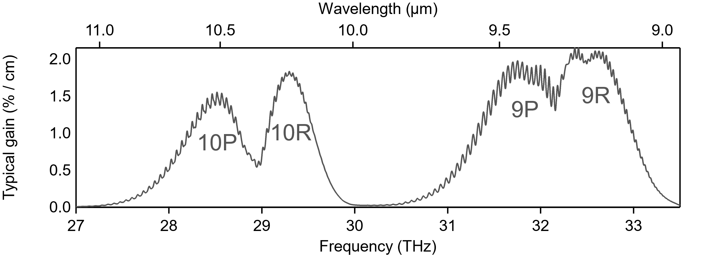
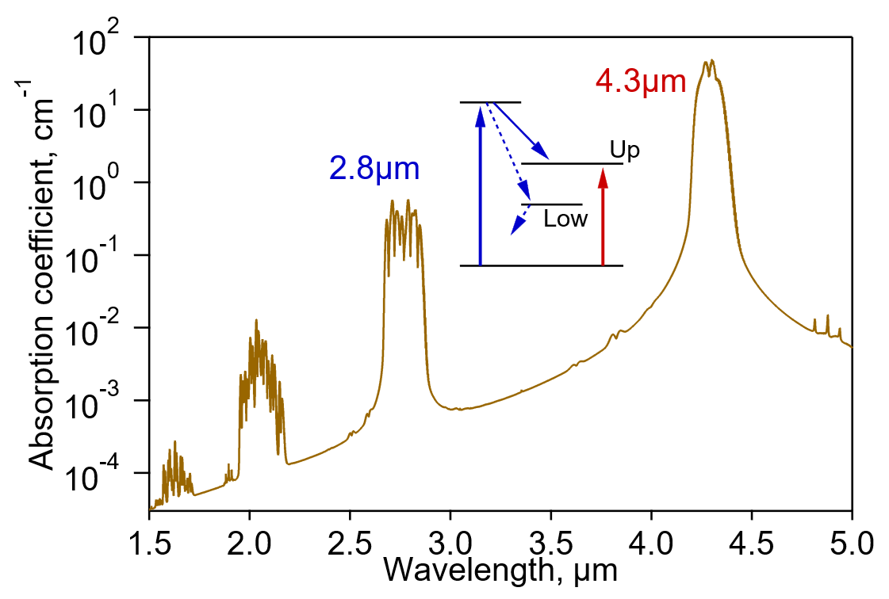
Ultrafast CO₂ amplifiers
State of the art (BNL)
Perspectives
Mixed-isotope ¹⁶O:¹⁸O
High-pressure 10 atm
= Ultrafast-ready spectrum
1) Better use of gain spectrum (9R+9P)
2 ps → 500 fs (15 TW)
Need ~10 mJ seed pulse @ 9.3 μm
2) Post-compression
500 fs → 100 fs (25 TW)
Two-bulk-material scheme [KCl+BaF₂] demonstrated for longer pulses
Relies on negative GVD (typical for LWIR)
3) Optical pumping
Improved rep. rate, compactness, reliability
Need 4.3 μm (ideally) or 2.8 μm pump for CO2 pumping
2 ps
5 TW
Polyanskiy et al. Photonics 8, 101 (2021)

Slide 14
High-energy long-wave infrared sources for seeding CO₂ amplifiers
1) OP (Fe:ZnSe or Cr:Er:YSGG) CO₂ or 2) Cr:ZnSe pumped ZGP OPCPA
Need for ZGP e-irradiation with
integral e-beam fluence of
~ 1.5x10¹⁷ cm ⁻² to suppress
losses for λ<2.5 µm range
9. Stretcher
@3.14 μm 300ps
Signal Seed
@3.14 μm
1.fs Cr:ZnS laser
2.35 μm
30 fs, 10nJ
80 MHz
2.Pulse picker, 100 Hz
30 mJ Pump
@2.35 μm
10. 2-stage ZGP
pre-amplifier
9.3 μm, 3 mJ, 300 fs, 100 Hz
5. Pulse shaper
@3.14 μm
3.Cr:ZnSe
pre-amp
SC generation
(100 μJ, 100fs )
2-3.5 μm
4. Er:YAG @1.6μm
10 mJ , 50 ns
6. Stretcher
@3.14 μm 300ps
130 mJ Pump
@2.35 μm
12. Multi Pass
Cr:ZnS Booster
100 Hz, 100mJ, 2.35um
13. ZGP
Power amplifier
9.3 μm, 10mJ, 300 fs, 100 Hz
7. Multi Pass
Cr:ZnS Amplifier
50mJ, 300 ps
8. 4x Er:YAG
@1.6μm 30mJ ,
50 ns
11. 8x Er:YAG
@1.6μm 30mJ ,
50 ns
"Room temperature tunable color center lasers", T.T. Basiev, S.B. Mirov, Laser Science & Technology book Ser., 16, 1-160, V.S. Letokhov, C.V. Shank, Y.R. Shen, H. Walter, Eds., Gordon and Breach Science Publ./Harwood Acad. Publ. (1994).

Slide 15
Quad Chart
Scientific/Technical Outcomes Polycrystalline TM:II-VI is enabling laser technology Enable development of a new generation of high-power, tabletop, ultrafast infrared TW level lasers By far the best few-cycle lasing in the 2 – 5 µm By far the simplest hardware for optical frequency comb generation. Effective gateway to LWIR, THz, XUV, X-ray Promising for direct electrical excitation | Lasers/e-beam Parameters Required Need 10 MeV electron beam with pulse energy 10-20J, 10-100 Hz rep rate to improve optical quality of ZGP, ZnSe, and optical damage of the gain elements facets
ATF Facilities Upgrade Roadmap Optically pumped (4.3 µm Fe:ZnSe or 2.8 µm Er:YSGG) high-pressure multi-TW CO₂ lasers Develop 10 mJ 9.2 µm seed for CO₂ preamp either by OP CO₂ or Cr:ZnSe pumped ZGP OPCPA. Develop mid-IR 1-3 TW level Cr:ZnS/Se (2.5 µm) and and Fe:ZnSe (4-5 µm) CPA systems at BNL and integrate them with CO₂, e-beam, and Ti-S. | Beyond the Current Roadmap Need energy scaled up (1-2J) 3 µm Q-switched Er:YSGG pump laser development for pumping Fe:ZnSe or directly CO₂. Need energy scaled up (0.5-1 J) 1.645 µm Q-switched Er:YAG with the use of large-mode unstable cavity and the use of multimode 1.532 µm Er-fiber pump (for pumping Cr:ZnS/Se CPA) Need J level 100 ns Fe:ZnSe development for pumping CO₂.

Slide 16
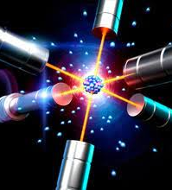

Thank you for your attention!
Dr. Sergey Mirov
University Professor of Physics
(205) 934-8088; mirov@uab.edu

