Slide 1
Architecture for next generation LWIR laser
Misha Polyanskiy
June 21, 2024
ATF Science Planning Workshop

Slide 2
DOE Basic Research Needs Workshop on Laser Technology Report (2023)
Z. Chang et al. “Intense infrared lasers for strong-field science” Adv. Opt. Photonics 14, 652 (2022)

Slide 3
ATF: 9.2 µm
NIR 0.75–1.4 µm
S-WIR 1.4–3 µm
M-WIR 3–8 µm
L-WIR 8–15 µm
FIR 15–1,000 µm
2023 BRN workshop report definition
Mid-IR: 2–10 µm

Slide 4
“CO₂” → “LWIR”
Optical pumping @ 2.8 µm
(to be done)
High-pressure CO₂: 1995
Isotopic CO₂: 2010/2018
(preamp / full-scale)
2014
compression
Post-
2021/2023
(PoP / TW demo)
2014/2019
(preamp / full-scale)
Polyanskiy “Next-generation ultrashort-pulse 10-micron laser”
Early Career Research Proposal (2012)

Slide 5
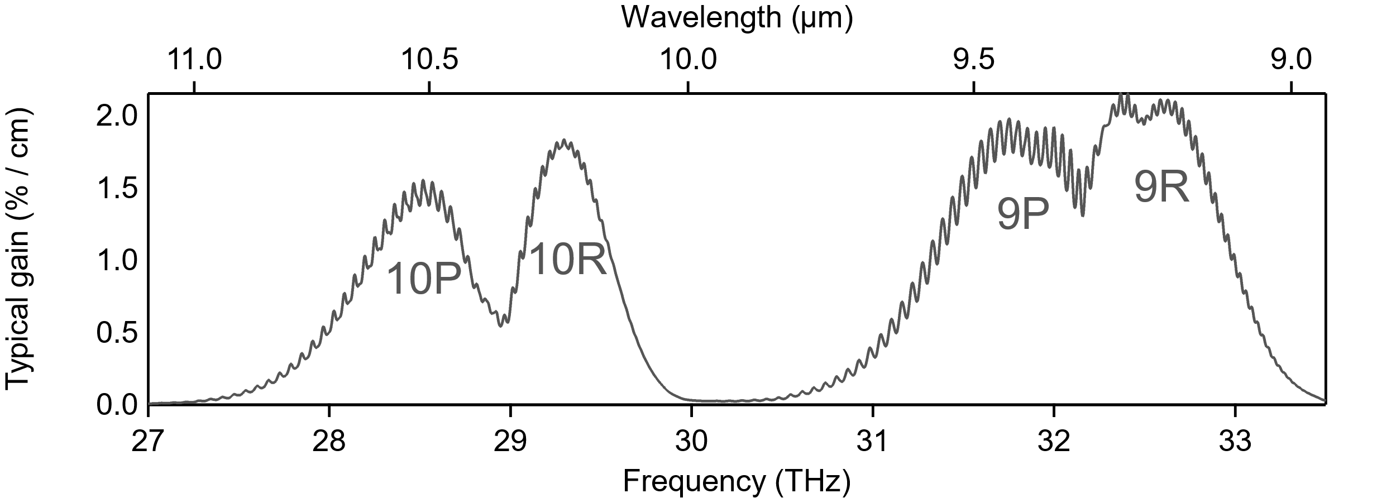
LWIR laser technology
State of the art
Next generation
Mixed-isotope ¹⁶O:¹⁸O
High-pressure 10 atm
= Ultrafast-ready spectrum
1) Better use of gain spectrum
2) Post-compression
3) Optical pumping
2–3 yrs
2 ps → 500 fs (15 TW)
2 ps
3–5 yrs
500 fs → 100 fs (25 TW)
2 ps → 500 fs (5 TW)
2025
5 TW
High rep. rate, compactness, reliability
5–10 yrs

Slide 6
State of the art
Gas
Solid
state
Polyanskiy et al. OSA Continuum 3, 459 (2020)

Slide 7
Gas
State of the art
Solid
state
Seed
Pre-amp.
Final amp.
2 ps
5 TW
10 μJ 10 mJ 10 J
Next-generation: 1) Better use of gain spectrum
Seed
Final amp.
500 fs
15 TW
10 mJ 10 J

Slide 8
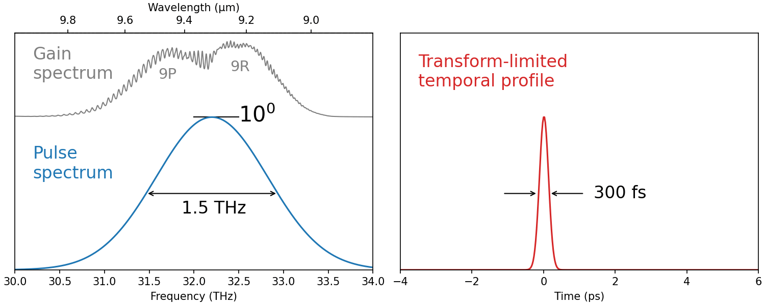
Gain narrowing in amplification from μJs to Js

Slide 9

Amplification from mJs to Js

Slide 10
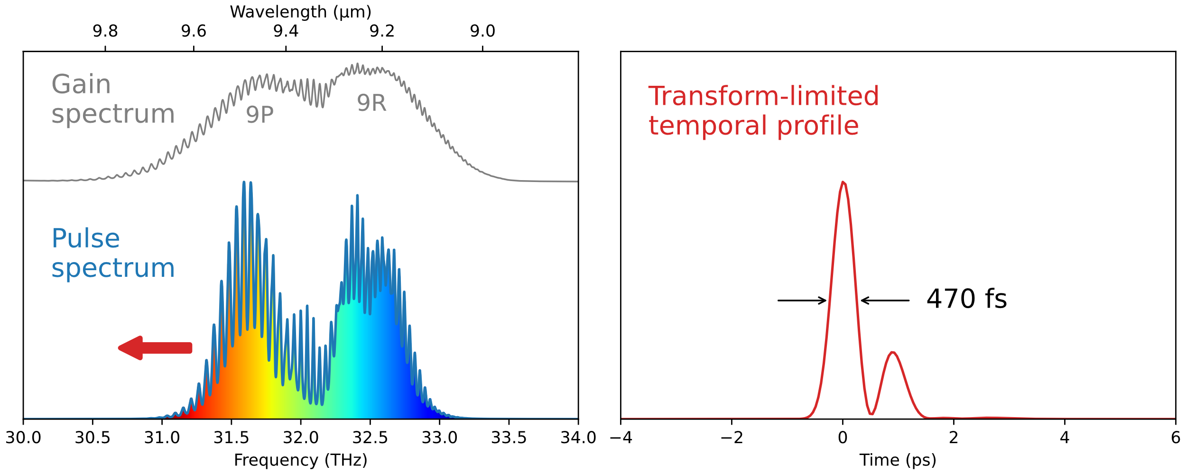
Chirped-pulse amplification from mJs to Js
Polyanskiy et al. Photonics 8, 101 (2021)

Slide 11
1 µm 2 µm 4 µm 8 µm…
10% 10% 10% …
Ti:S
@ 0.8 µm
Frequency converter
λ × 12
5 mJ 10 µJ @ 9.2 µm
Cr:ZnSe @ 2.4 µm
Ho:YLF @ 2.1 µm
Freq conv
λ × 4
200 mJ 10 mJ @ 9.3 µm
Yin et al. Sci. Rep. 7, 45794 (2017)

Slide 12
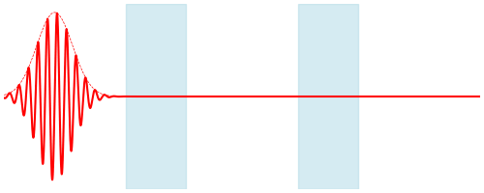
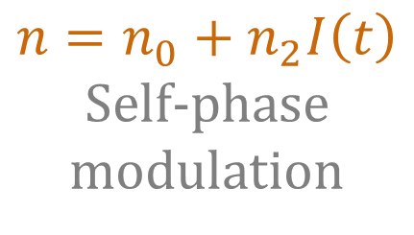
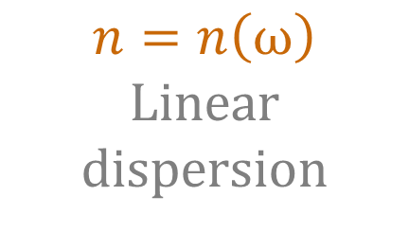
Next generation: 2) Post-compression
$$n=n_{0}+n_{2}I\left(t\right)$$
Self-phase modulation
$$n=n\left(ω\right)$$
Linear dispersion

Slide 13
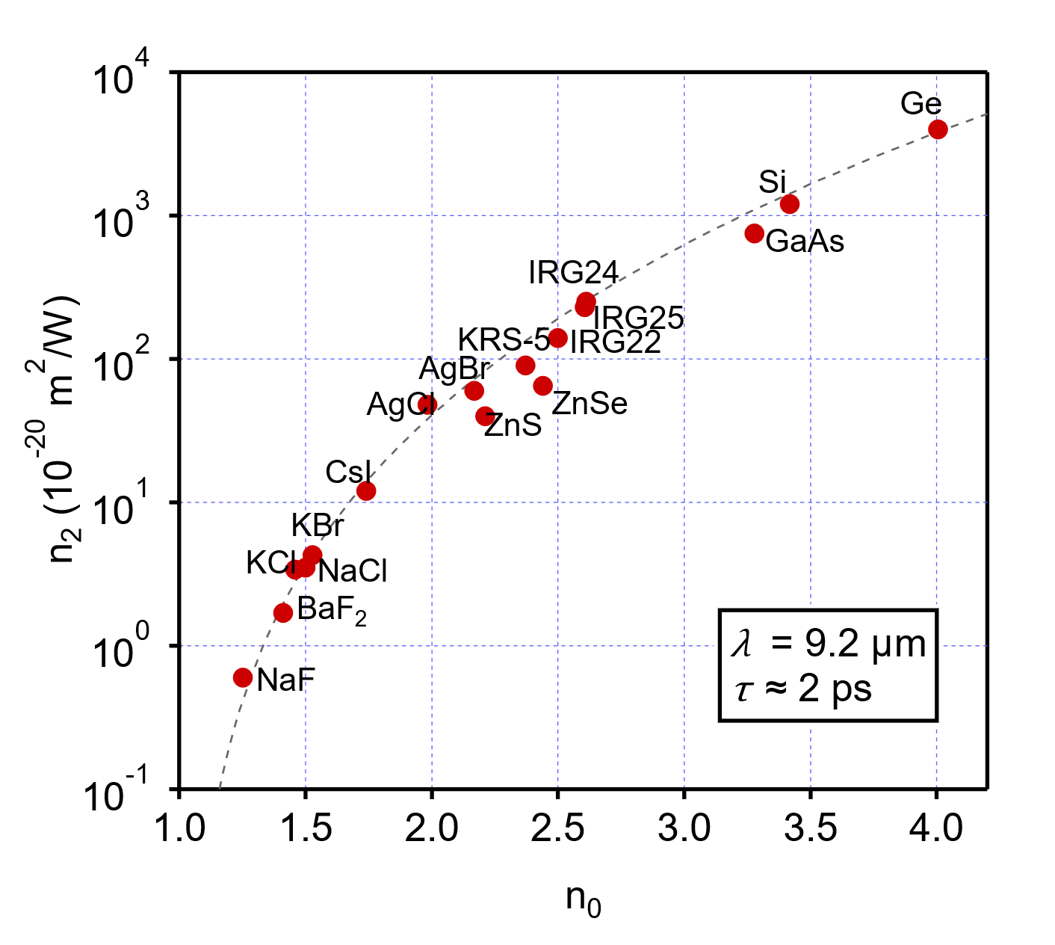
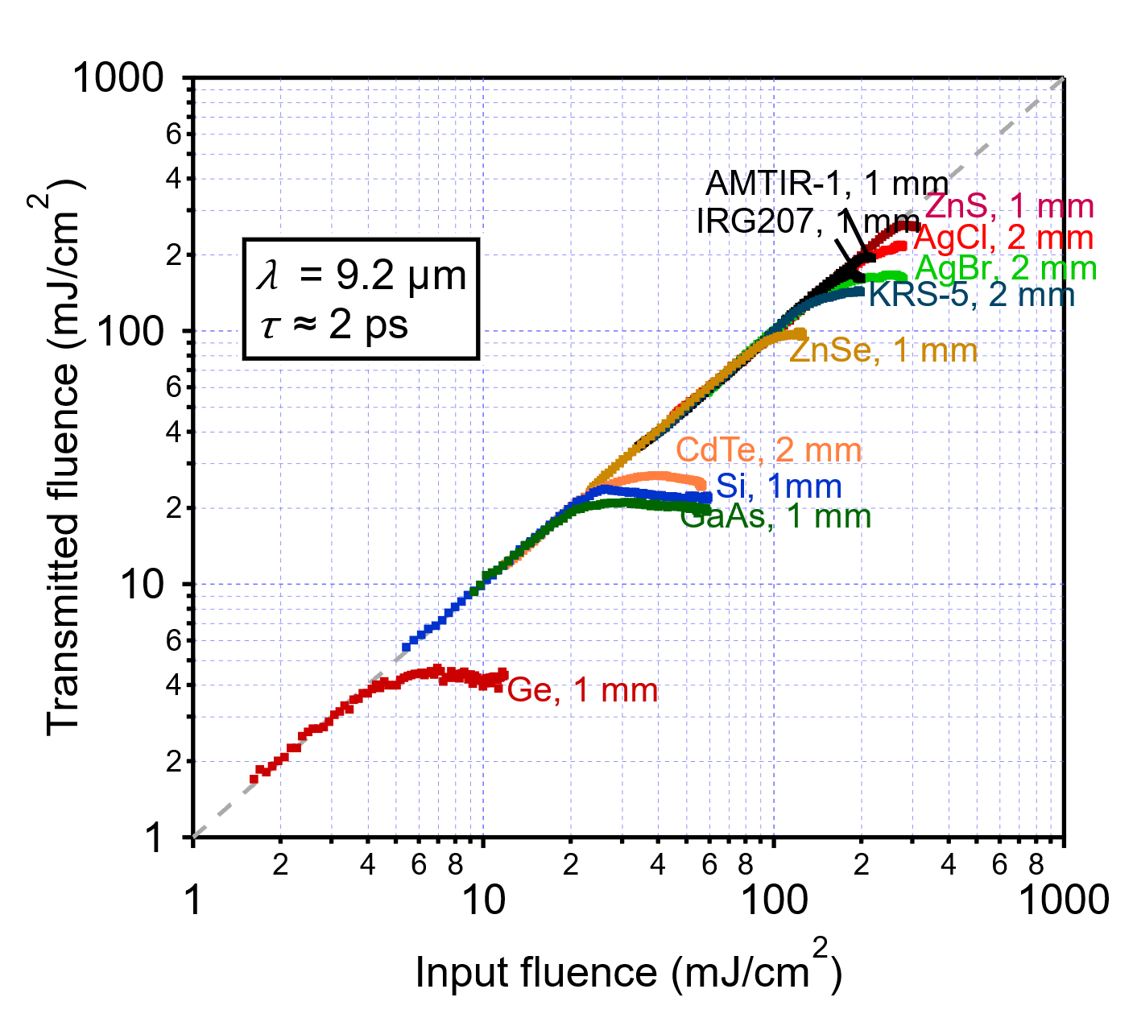
Characterization of LWIR materials
Nonlinear Refraction
Nonlinear Absorption
Funding: US Department of Energy Accelerator Stewardship Program Grants
Polyanskiy et al. Opt. Mater. Express 14, 696 (2024)
Polyanskiy Sci. Data 11, 94 (2024)

Slide 14
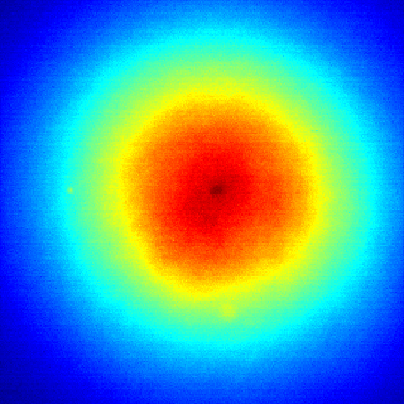
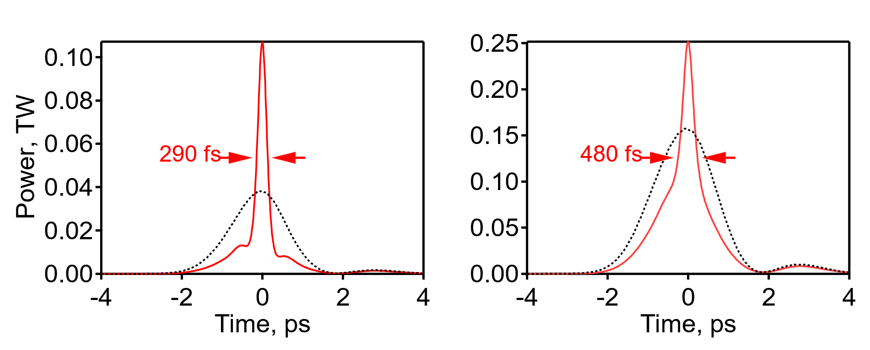
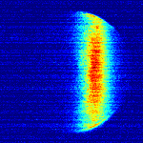
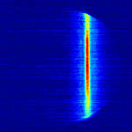
Proof of principle
Polyanskiy et al. Opt. Express 29, 31714 (2021)
2 ps
5 mm dia.
beam center
Whole beam
In
Out
out
out
2 ps
290 fs
in
in
Autocorrelation
278 mJ

Slide 15
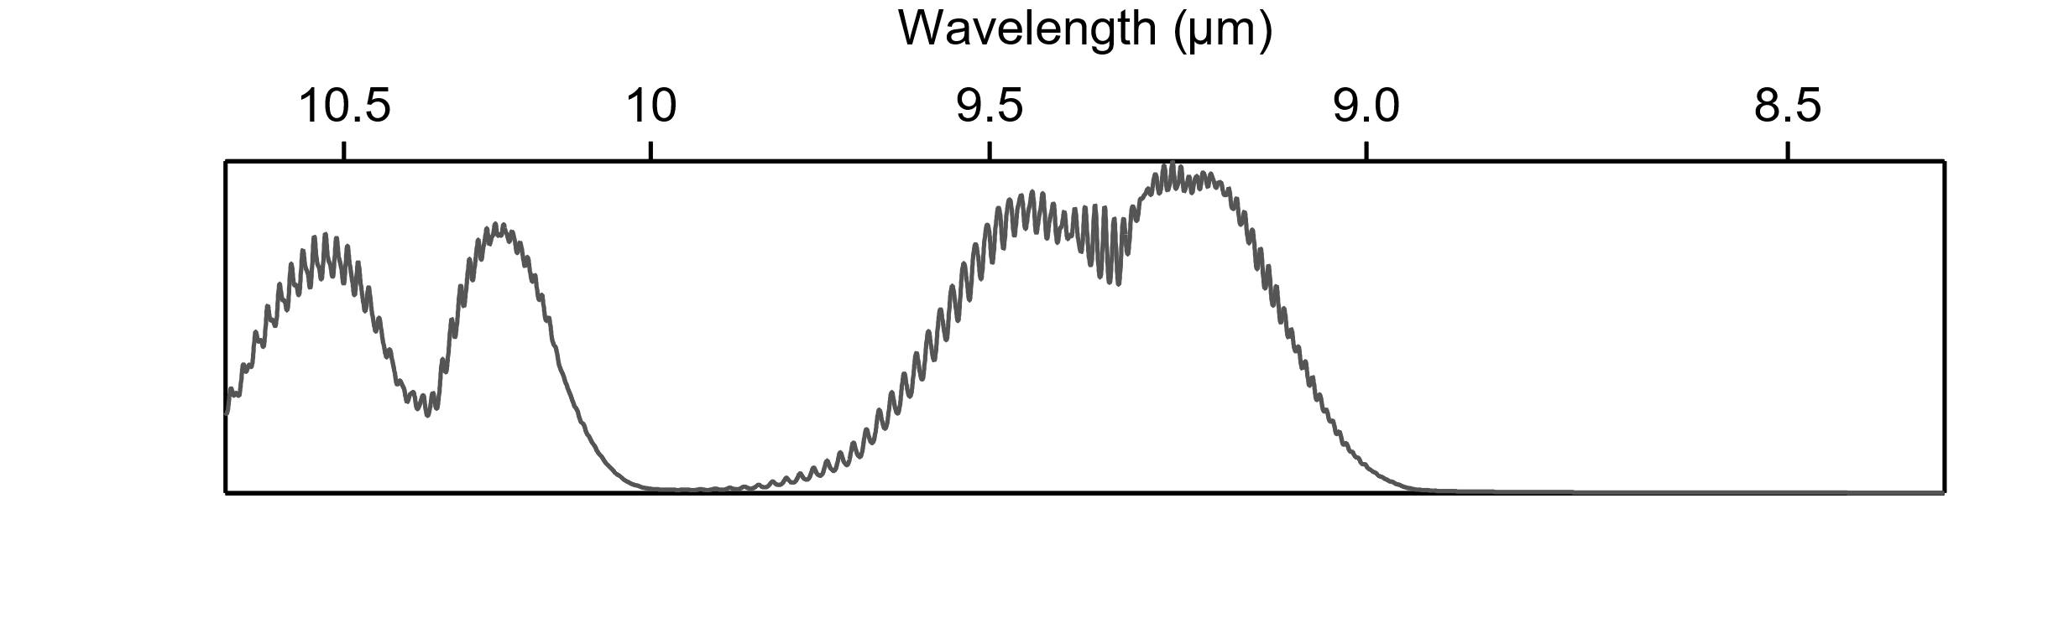
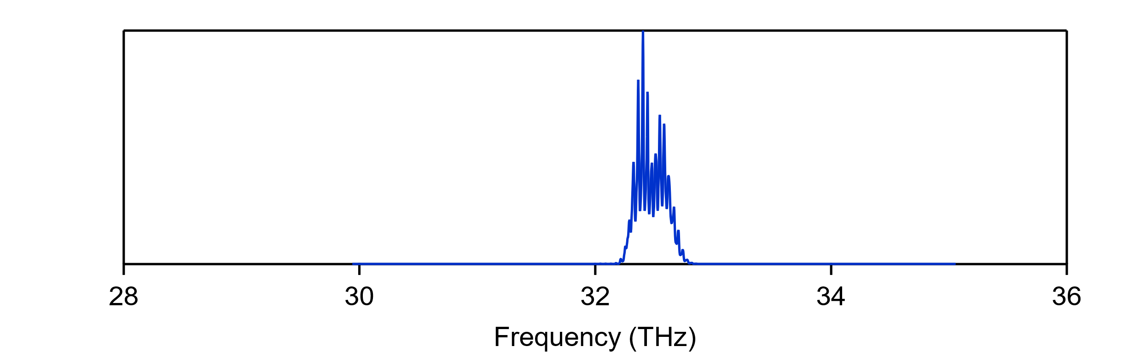
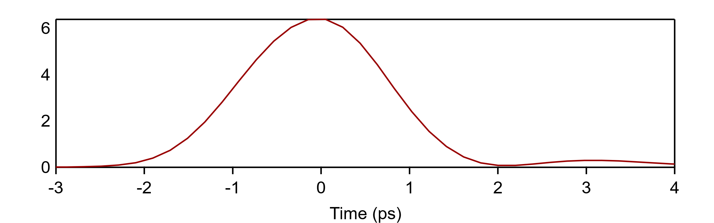
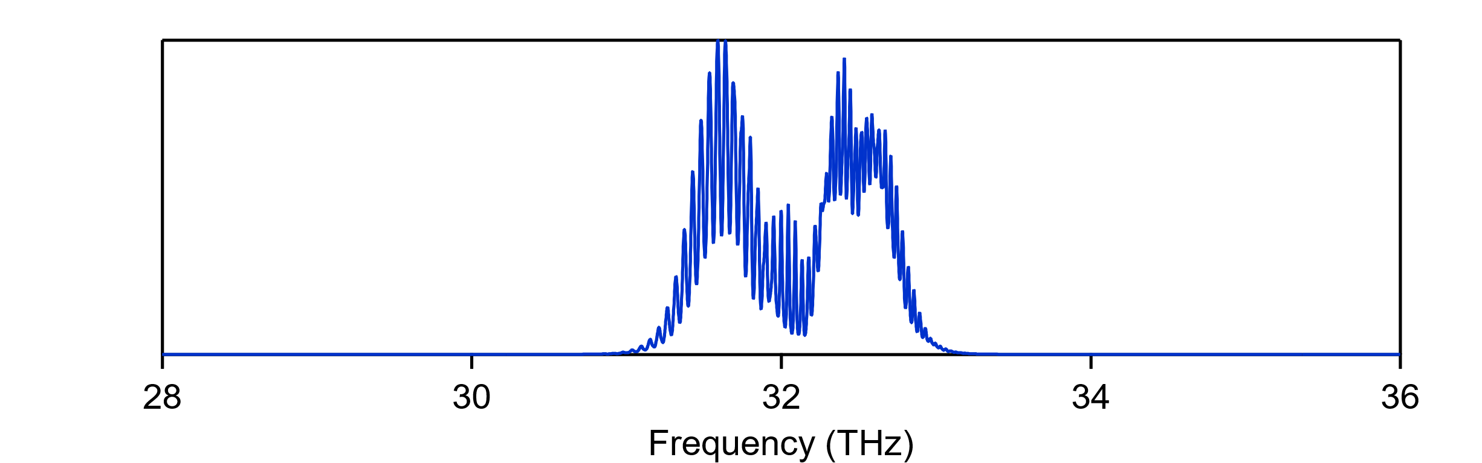
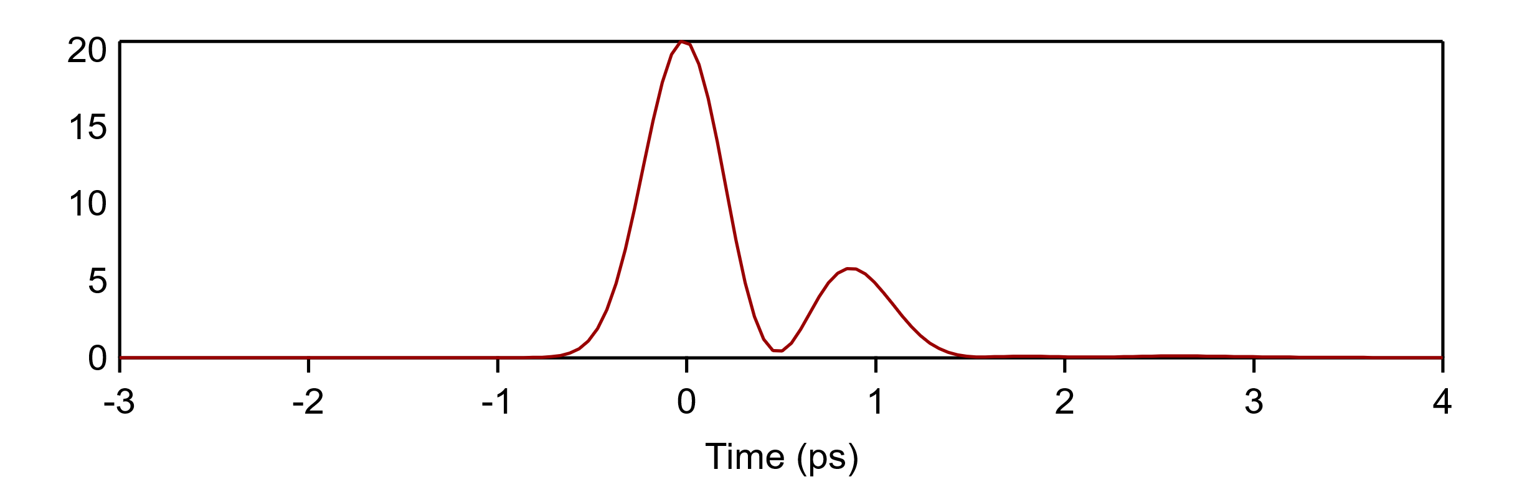
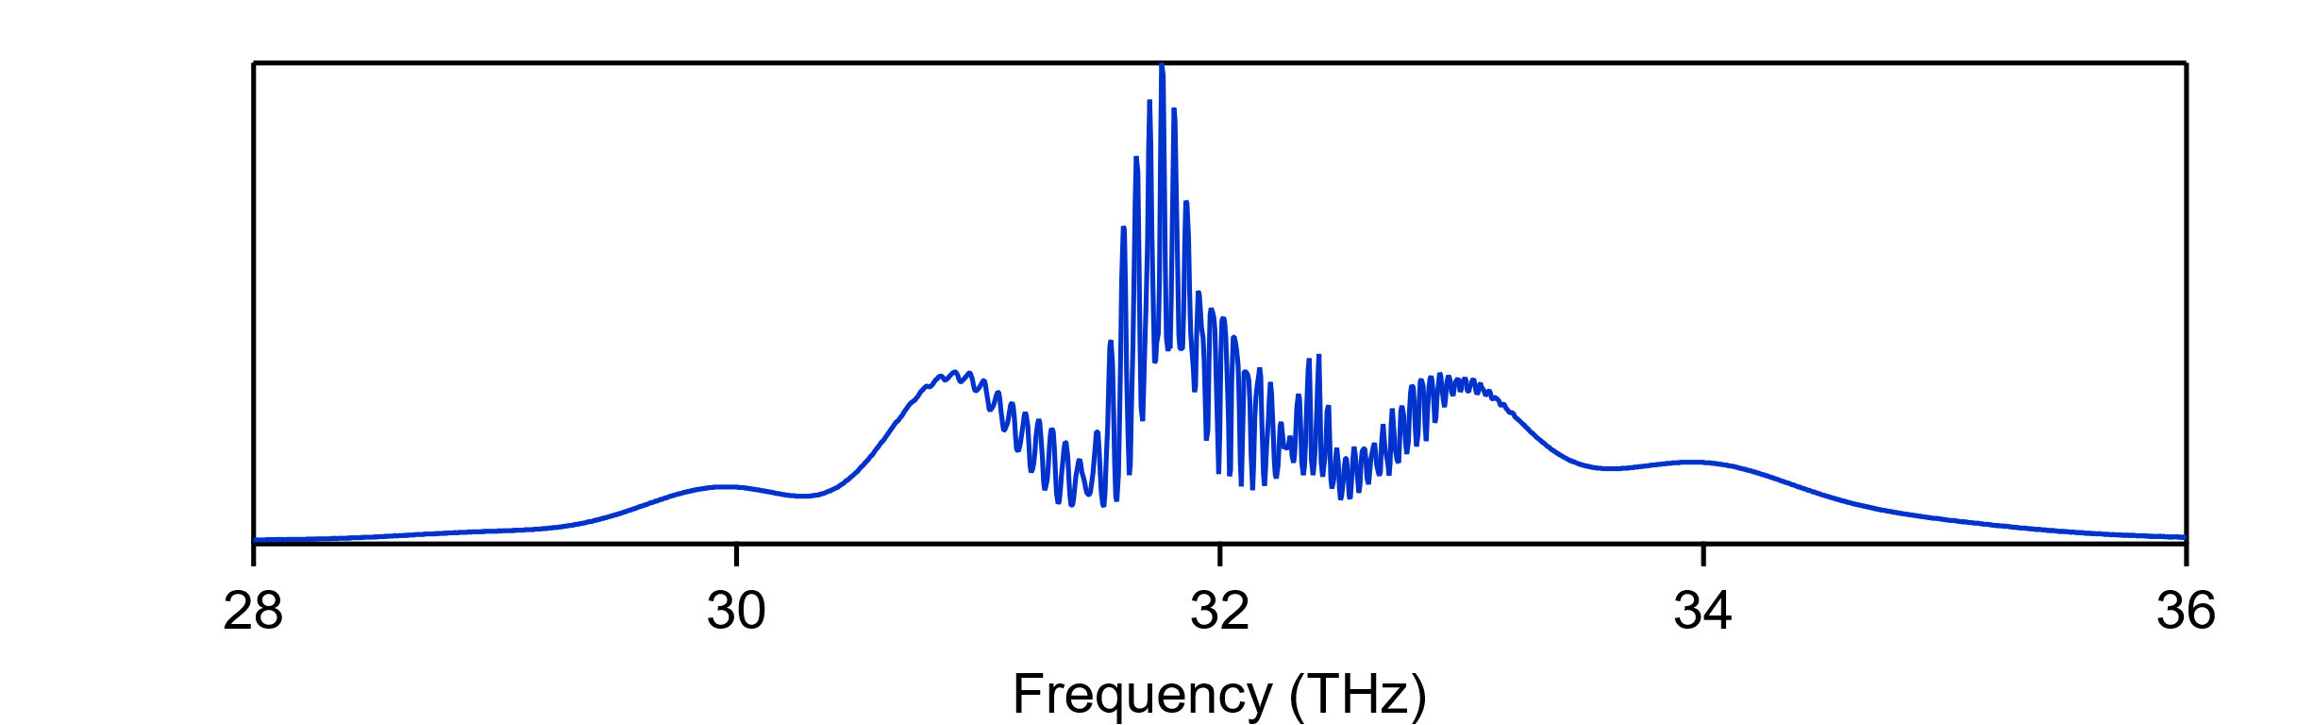
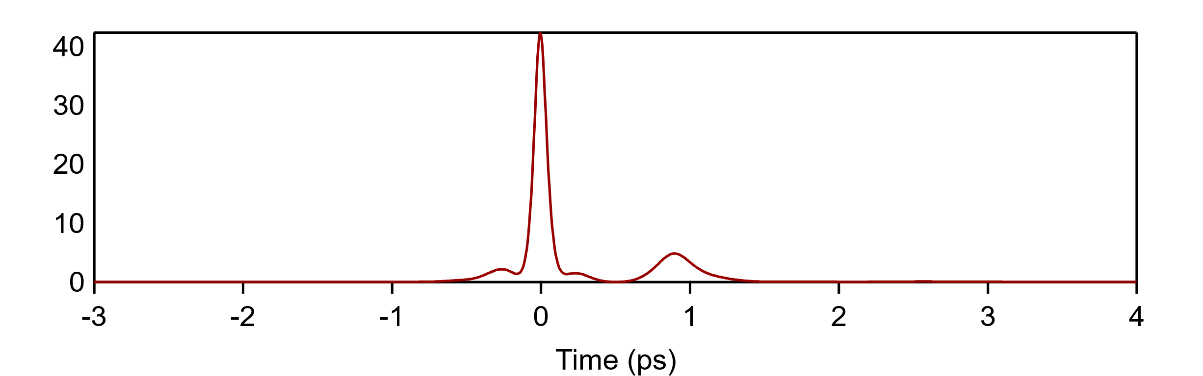
Next-generation: (1) & (2)
9R
Gain spectrum
With 20% contingency
9P
State
of the art
2 ps
5 TW
1) Better use of gain spectrum
500 fs
15 TW
Power (TW) Power (TW) Power (TW)
2) Post-compression
100 fs
25 TW
1 optical cycle = 31 fs

Slide 16
Next-generation: 3) Optical pumping
Practical repetition rate (100–1000 Hz)
24/7 reliability
“Black-boxable”

Slide 17
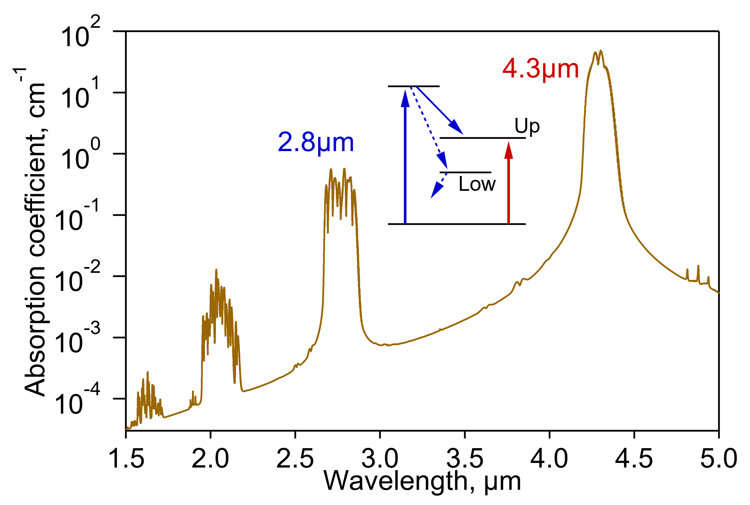
Optical pumping of CO₂ amplifiers
4.3 µm: Fe: ZnSe
2.8 µm: Er,Cr:YSGG
GaSb diode
9 bar He
1 bar CO₂ (50% ¹⁸O)
Polyanskiy et al. Photonics 8, 101 (2021)

Slide 18
Pumping requirements
≤ ~1 µs
R&D (GWs): ~1 J
Full-scale (TWs): ~1 kJ
Polyanskiy et al. Photonics 8, 101 (2021)

Slide 19
LWIR laser technology
Next generation
Kevin Zawilski (BAE)
Sergey Mirov (UAB)
William Li (ATF)
Igor Pogorelsky (ATF)
Sergei Tochitsky (UCLA)
Leon Shterengas (SBU)
1) Better use of gain spectrum
2) Post-compression
3) Optical pumping
2–3 yrs
2 ps → 500 fs (15 TW)
3–5 yrs
500 fs → 100 fs (25 TW)
2 ps → 500 fs (5 TW)
2025
High rep. rate, compactness, reliability
5–10 yrs
19

Slide 20
We need your help to make it happen!

Slide 21
Backup material

Slide 22
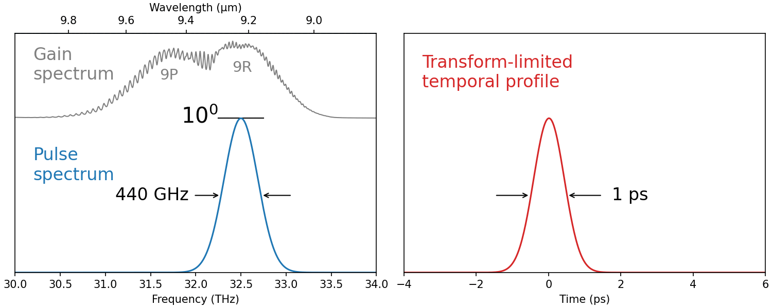
Amplification on 9R branch (10¹¹x)

Slide 23
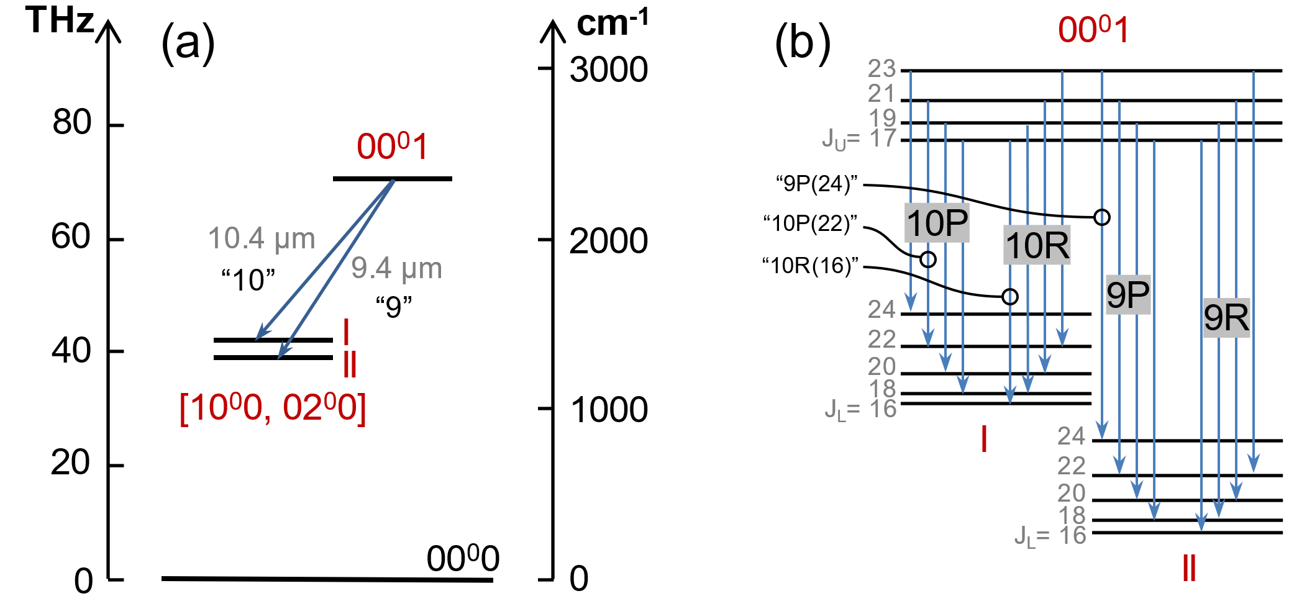
CO₂ laser levels

Slide 24
Pumping requirements
Polyanskiy et al. Photonics 8, 101 (2021)

