Slide 1
Prospective pathways for generating high energy LWIR seeds
William Li, ATF Science Planning Workshop
June 21st, 2024

Slide 2
Outline
Motivation for high energy LWIR seed
Overview of schemes in literature
Raman conversion + DFG
ZGP-based OPCPA
Nd:YAG pumped BGGSe DFG

Slide 3
LWIR laser at the Accelerator Test Facility
Polyanskiy et al. OSA Continuum 3, 459 (2020)

Slide 4
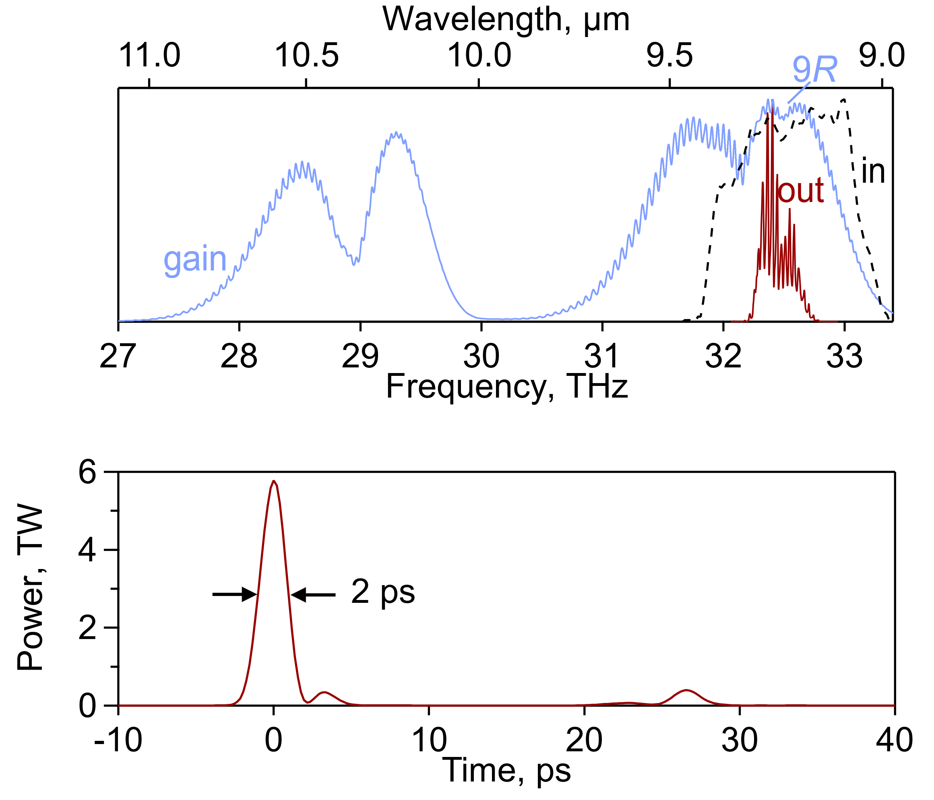
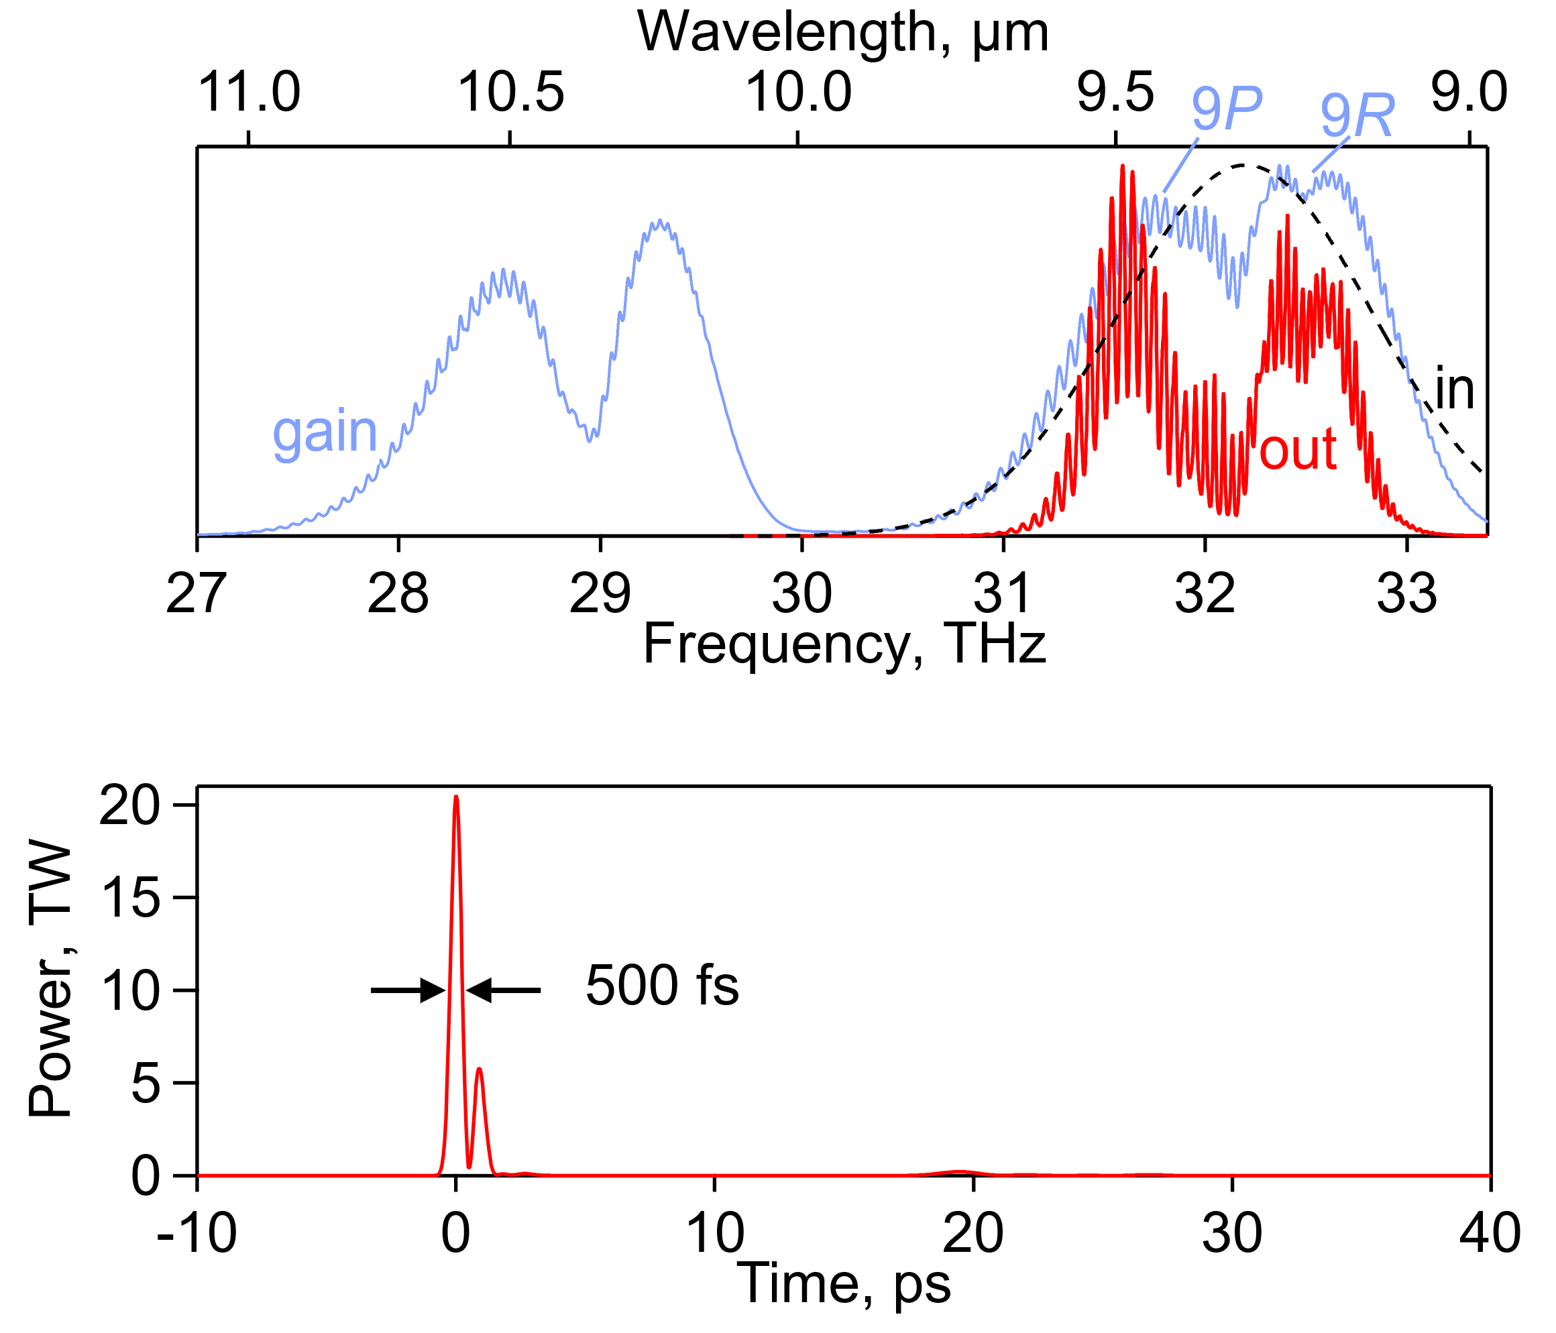
Higher pump energy
Seed: 2 µJ
Two CO₂ amplifiers
Amplification ~10¹¹
Seed: 10 mJ
Single CO₂ amplifier
Amplification ~10³
Polyanskiy, et al. Photonics 8, 101 (2021)

Slide 5
Raman + DFG
Use Raman scattering to generate frequency shift equal to desired final frequency
Mix original pump laser with Raman shifted beam to produce desired final color
Welch, Opt. Express 26, 5143-5163 (2018)
Relatively simple setup
Small footprint
Typical Raman shifts in solids are on order of 1000 cm⁻¹
Good match for LWIR
Hard to tune

Slide 6
Raman conversion in calcite
Note: could potentially switch to MIR pump
simulated

Slide 7
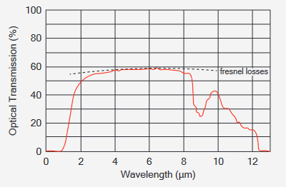
ZGP-based OPA
Chemical formula: ZnGeP₂
Broad transmission spectrum (.74 – 12 um)
High nonlinear coefficient (75 pm/V)
Broad tunability
Complicated setup
Plot and picture of crystal from Inrad Optics

Slide 8
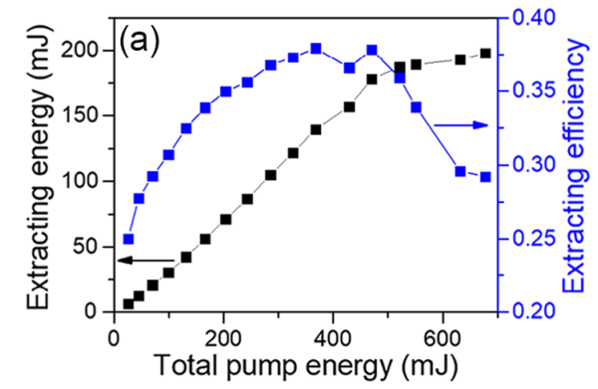
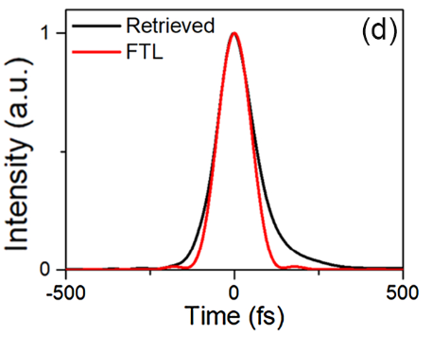
Cr:ZnSe/ZnS pumped OPA
Yin, Sci. Reports 7, 45794 (2017)
Recently, 200 mJ, sub-ps pulses demonstrated with Cr:ZnS amplifer
Lu, Optica 10, 1567-1570 (2023)

Slide 9
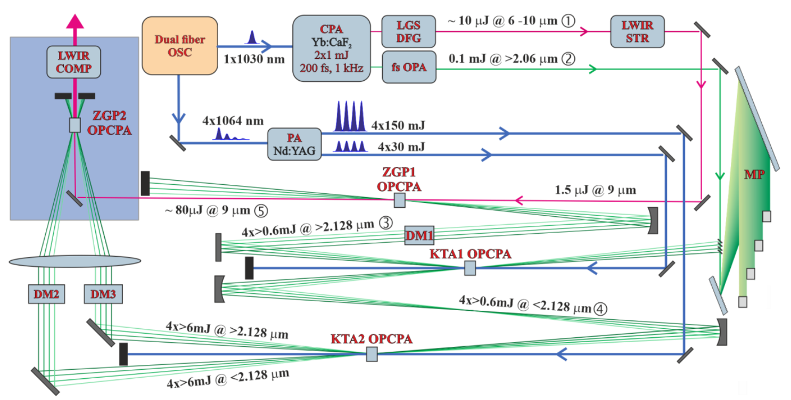
Non-collinear OPCPA
10 mJ projected output
Jutas, CLEO 2024

Slide 10
Test of ZGP OPO amplification in CO₂
Zhu, Photonics 11, 154 (2024)

Slide 11
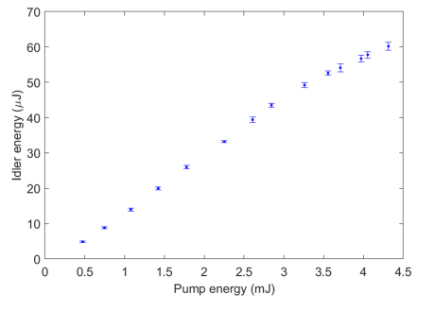
Nd:YAG DFG in BGGSe
Convenient sources
Yang, Opt. Express 32, 11182 (2024)
Hard to tune
Relatively untested

Slide 12
Conclusion
Several promising pathways to generating 10 mJ LWIR seeds
Need community to push this effort forward
 | Raman + DFG | ZGP OPCPA | Nd:YAG BGGSe DFG
Ease of setup | Relatively simple | Complex | Complex
Tunability | Low | High | Low
Size | Small | Large | Medium
Enabling technologies | BGS/BGSe crystal growth (Cr:ZnS/ZnSe lasers) | Cr:ZnS/ZnSe lasers ZGP crystal growth | BGGSe crystal growth

