Slide 1

3rd ATF Science Planning Workshop
Nonlinear Pulse Compression
Igor Pogorelsky
June 21, 2024
Accelerator Facilities Division

Slide 2
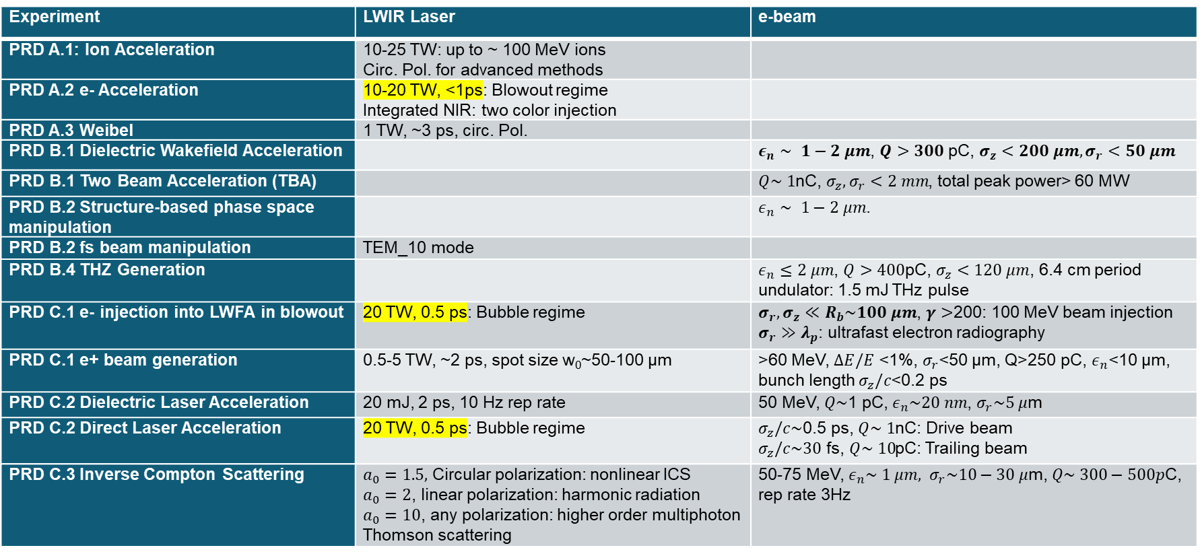
Priority Directions from 2nd ATF SP Workshop
2019Report: https://www.bnl.gov/atf/docs/ATF%20Science%20Workshop%20Report%202019.pdf
Experiment | LWIR Laser | e-beam
PRD A.1: Ion Acceleration | 10-25 TW: up to ~ 100 MeV ions Circ. Pol. for advanced methods
PRD A.2 e- Acceleration | 10-20 TW, <1ps: Blowout regime Integrated NIR: two color injection
PRD A.3 Weibel | 1 TW, ~3 ps, circ. Pol.
PRD B.1 Dielectric Wakefield Acceleration |  | $ε_{n}∼ 1−2 μm$, $Q>300$ pC, $σ_{z}<200 μm, σ_{r}<50 μm$
PRD B.1 Two Beam Acceleration (TBA) |  | $Q\sim 1$nC, $σ_{z}, σ_{r}<2 mm$, total peak power> 60 MW
PRD B.2 Structure-based phase space manipulation |  | $ε_{n}∼ 1−2 μm$.
PRD B.2 fs beam manipulation | TEM_10 mode
PRD B.4 THZ Generation |  | $ε_{n}≤2 μm$, $Q>400$pC, $σ_{z}<120 μm$, 6.4 cm period undulator: 1.5 mJ THz pulse
PRD C.1 e- injection into LWFA in blowout | 20 TW, 0.5 ps: Bubble regime | $σ_{r},σ_{z}≪R_{b}\sim 100 μm$, $γ>$200: 100 MeV beam injection $σ_{r}≫λ_{p}$: ultrafast electron radiography
PRD C.1 e+ beam generation | 0.5-5 TW, ~2 ps, spot size w₀~50-100 µm | >60 MeV, $ΔE/E$ <1%, $σ_{r}$<50 µm, Q>250 pC, $ε_{n}$<10 µm, bunch length $σ_{z}/c$<0.2 ps
PRD C.2 Dielectric Laser Acceleration | 20 mJ, 2 ps, 10 Hz rep rate | 50 MeV, $Q\sim$1 pC, $ε_{n}\sim 20 nm$, $σ_{r}\sim 5 μ$m
PRD C.2 Direct Laser Acceleration | 20 TW, 0.5 ps: Bubble regime | $σ_{z}/c\sim$0.5 ps, $Q\sim 1$nC: Drive beam $σ_{z}/c\sim 30$ fs, $Q\sim 10$pC: Trailing beam
PRD C.3 Inverse Compton Scattering | $a_{0}=1.5,$ Circular polarization: nonlinear ICS $a_{0}=2$, linear polarization: harmonic radiation $a_{0}=10$, any polarization: higher order multiphoton Thomson scattering | 50-75 MeV, $ε_{n}\sim 1 μm, σ_{r}\sim 10−30 μ$m, $Q\sim 300−500p$C, rep rate 3Hz

Slide 3
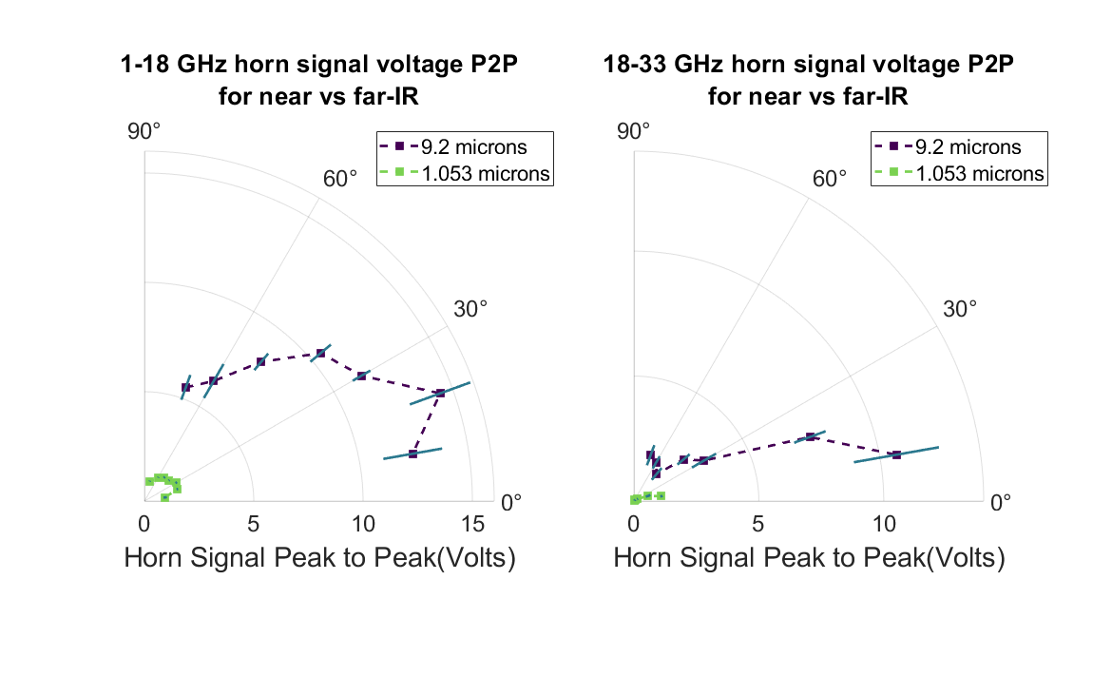
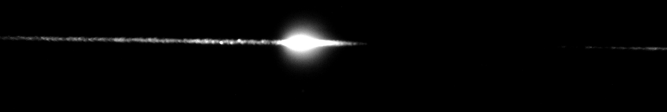
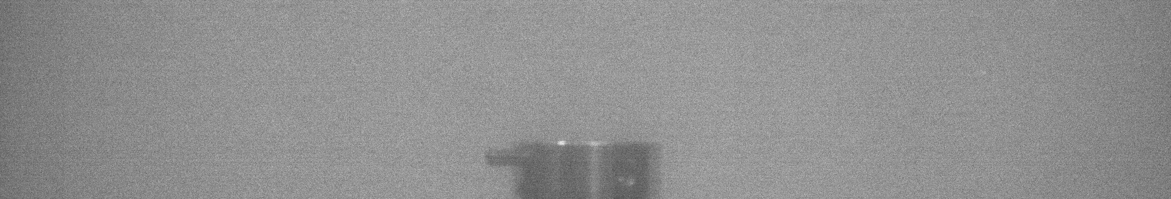
Recent highlights
Remote detection of a radioactive source in AE126
Radio waves from currents
induced by laser filaments
in AE119
Po-210
Plasma electron acceleration driven by
a long-wave-infrared laser, by AE95
Mapping the self-generated magnetic fields due to
thermal Weibel instability, by AE98
Published in Proc. of National Acad. Of Sci
Published in Nature Communications
Post-compression of
TW LWIR Pulses in AE101
NaCl
700 fs
BaF₂
KCl
Published in Frontiers in Physics
2 ps
Supported by LDRD and DOE grants
Accelerator Facilities Division

Slide 4
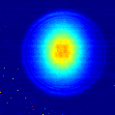
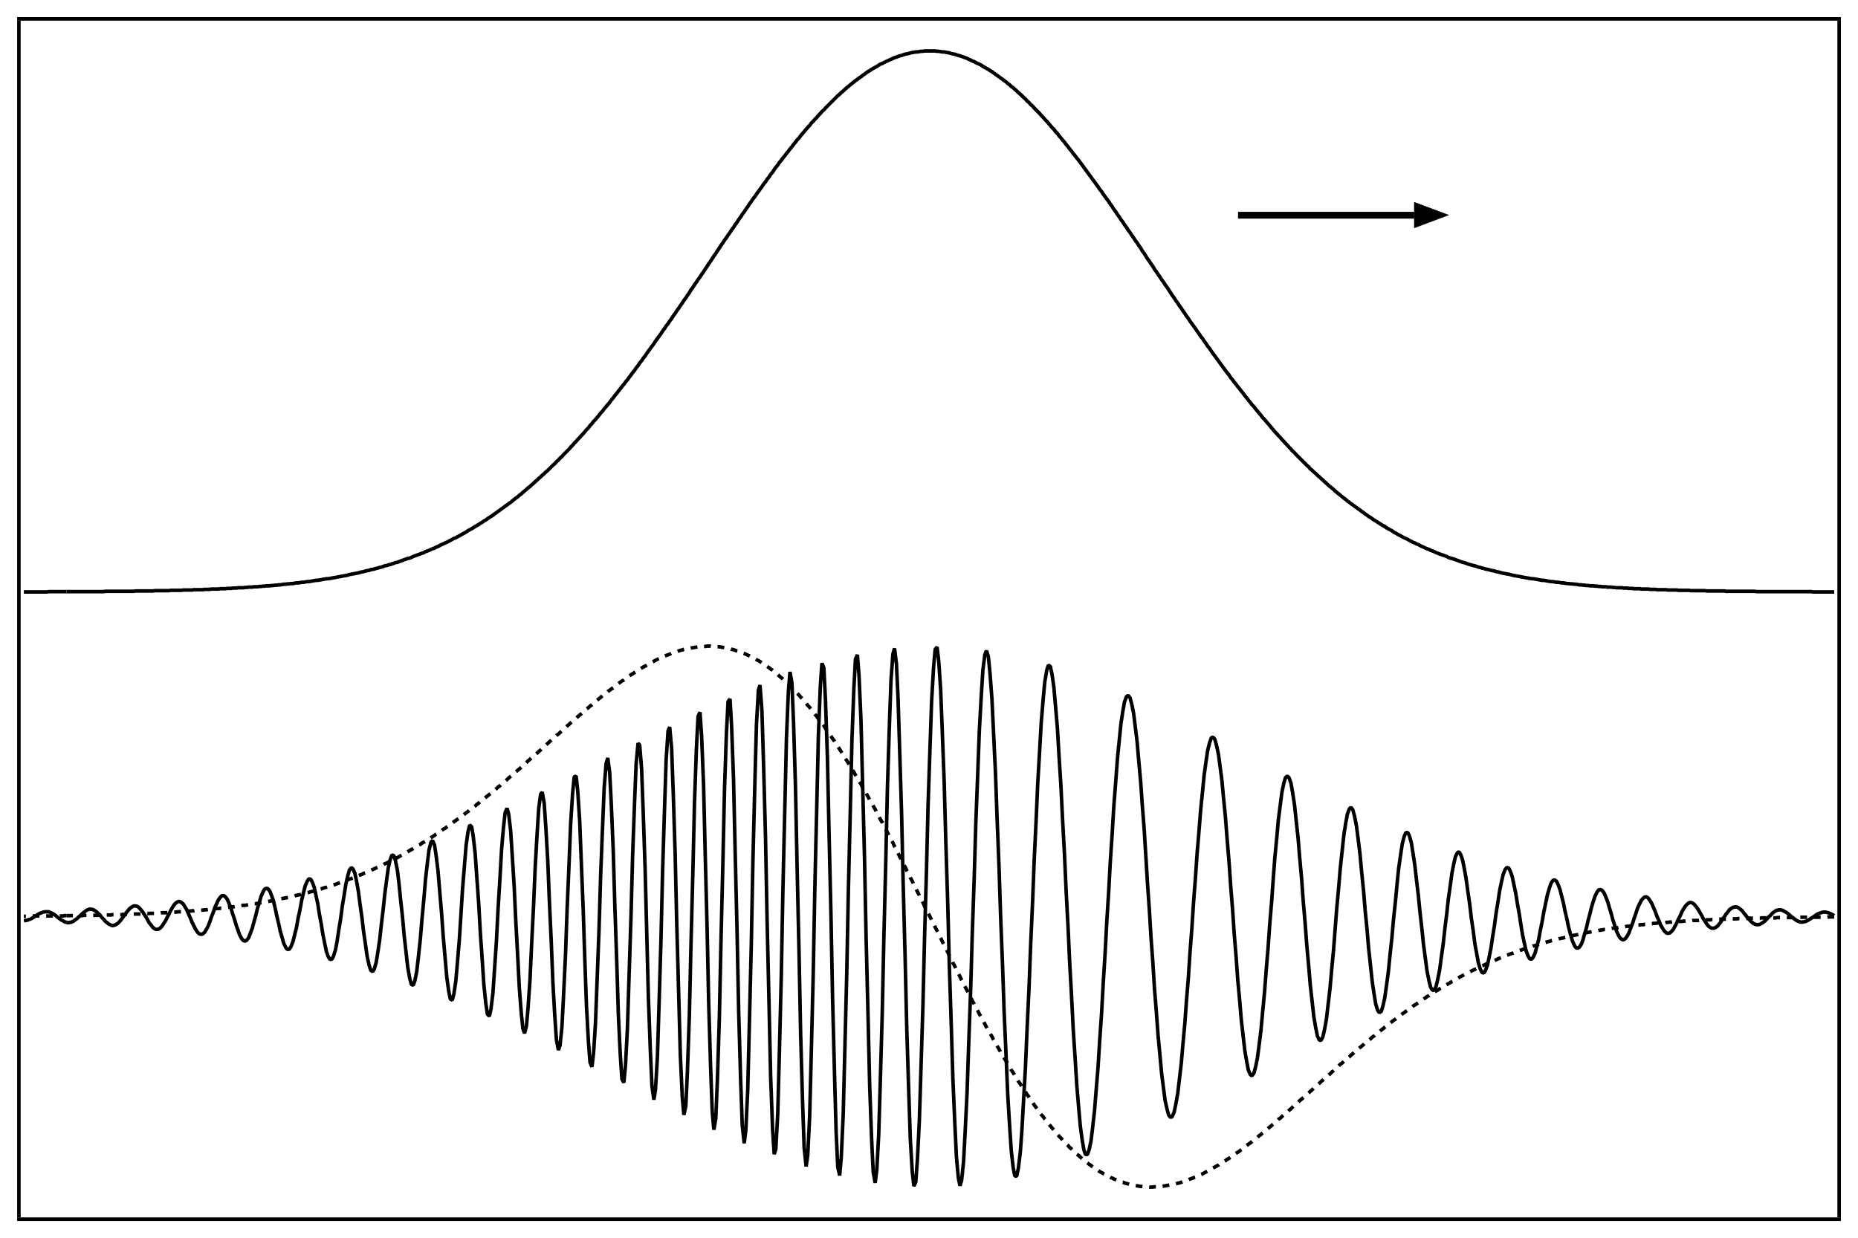


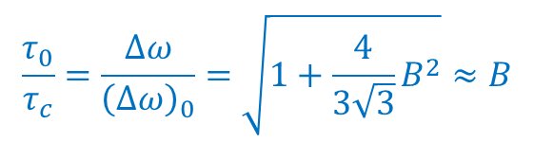

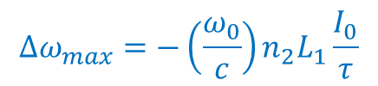

Post-compressor Setup
700 fs
Spatial filtering for improving beam quality
Newly obtained material properties
2 ps
n(t) = n₀ + n₂I(t)
Self-phase
modulation
$$τ_{0}$$
Dispersive compression
$$τ_{c}$$
$$∆ω_{max}$$
= $B×λ$
Spectral broadening and maximum, compression are proportional to B-integral
$$∆ω_{max}=−\left(\frac{ω_{0}}{c}\right)n_{2}L_{1}\frac{I_{0}}{τ}$$
$$\frac{τ_{0}}{τ_{c}}=\frac{∆ω}{{\left(∆ω\right)}_{0}}=\sqrt{1+\frac{4}{3\sqrt{3}}B^{2}}≈B$$

Slide 5

Observed Spectral Broadening and Pulse Compression
Spectrometer
Autocorrelator
$$τ_{c}=0625τ_{auto}= 675 fs$$
$$P=1.55 TW$$

Slide 6
Limitations due to Restricted Acceptance Aperture of Diagnostics
Pyro-camera images of the beam profile at different input energies
Azimuthally averaged beam radial profiles
Integrated pyro-camera signals plotted against the input energy
1.55 TW in 675 fs measured within a central portion of the beam containing 30% of the total energy

Slide 7
Simulations for Experiment Conditions
Restricted central portion of the beam fitting to the autocorrelator
Entire beam
Now, our model is benchmarked with experiment and can be used for predicting what is happening with the entire beam

Slide 8
Simulated Post-Compressor Optimum Setup
500 fs
2 ps
We used our model to optimize the setup and predict much better performance using similar optical components

Slide 9
Sanity Check
Compression due to group velocity dispersion shall correlate with spectral stretching
Condition for optimum compression:
B_{ideal} = 6.18
B_{act} = 3.19
~ 1/B
= - 1170 fs²
= - 2140 fs²
Bottomline:
It is explainable why our actual compression is twice below of the “optimum” case.
We benchmarked simulations adding to our confidence in planning for the next improved stage of the post-compressor development

Slide 10
Near-term Post-compression Upgrade
3.5 TW in 150 fs = 5 optical cycles

Slide 11
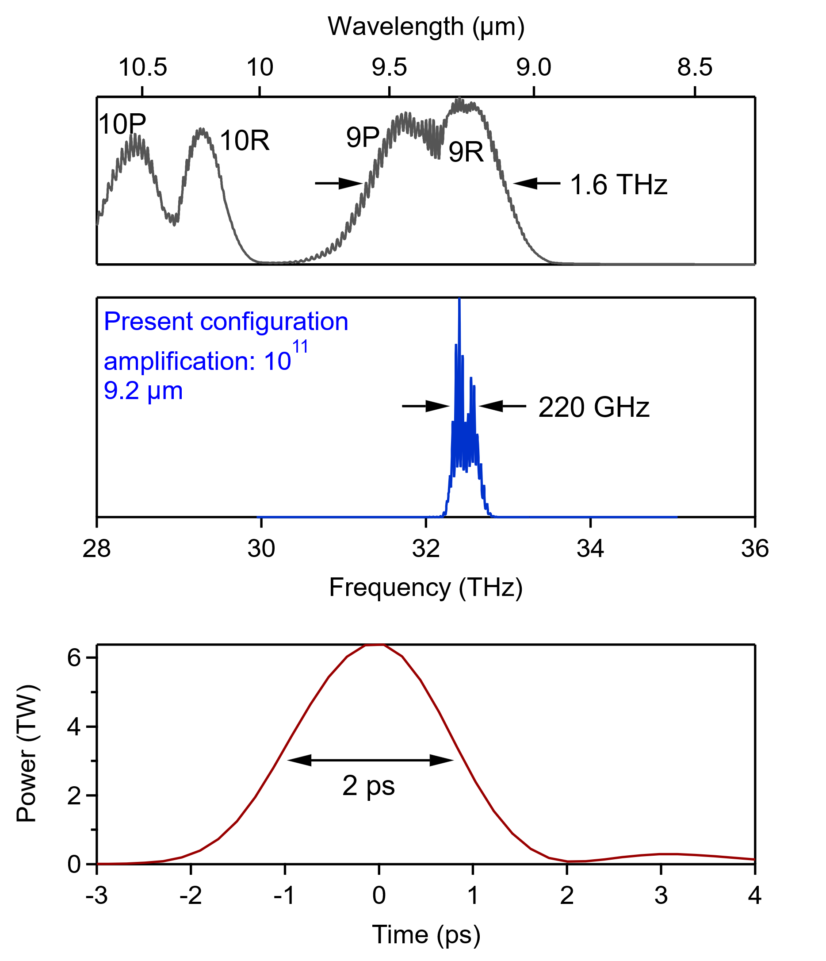
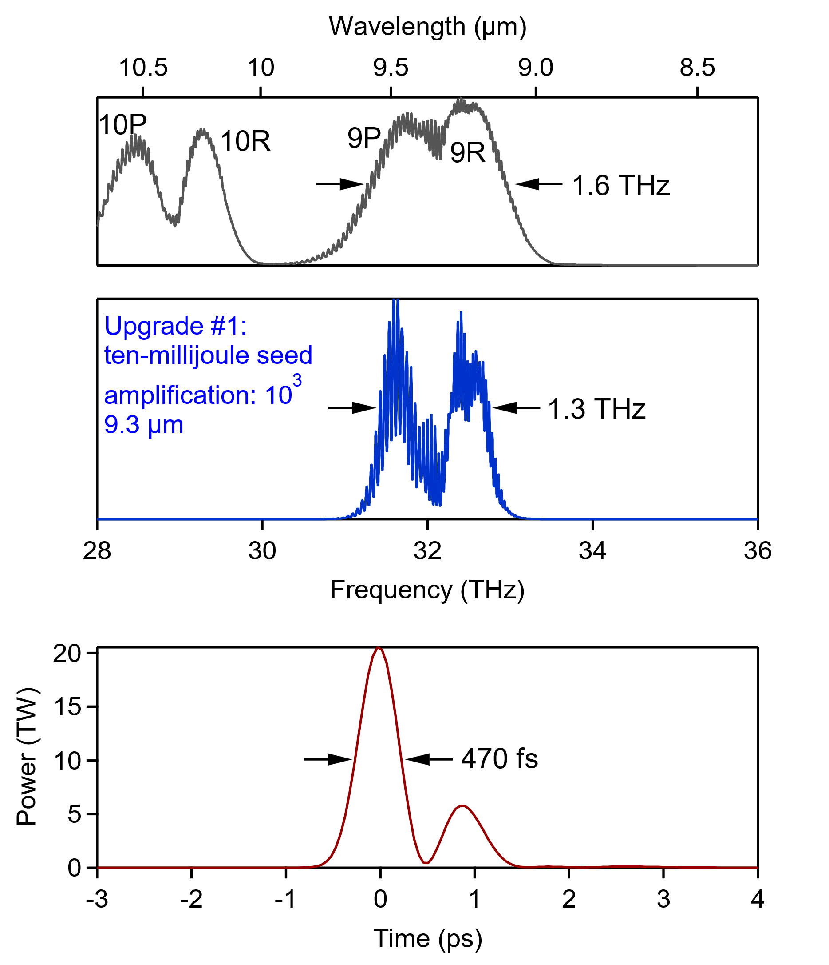
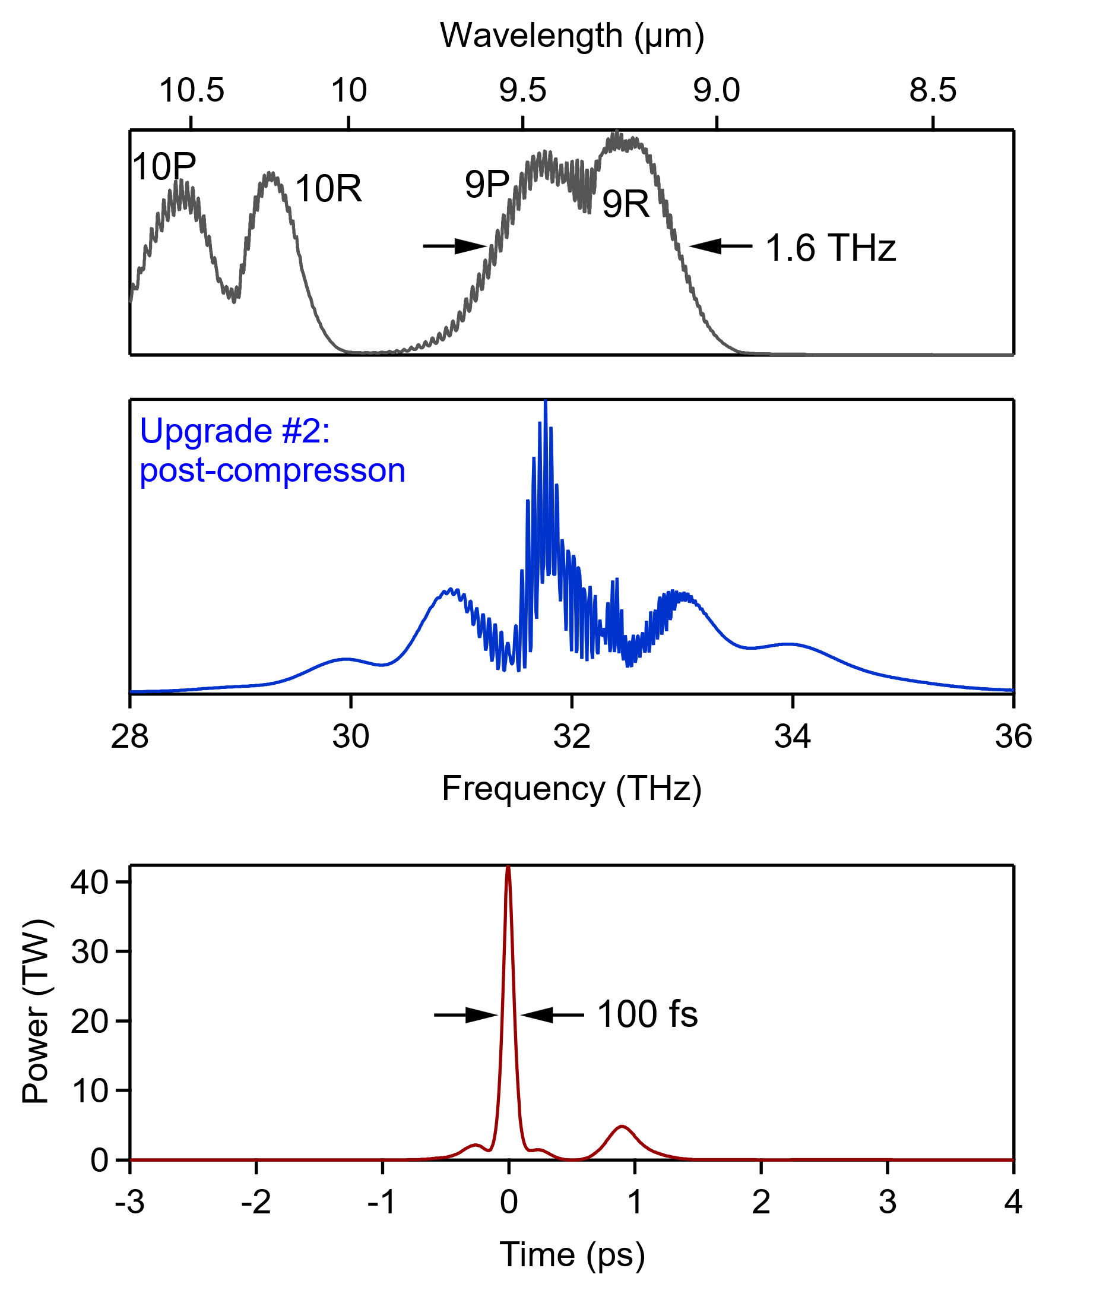
Longer-term Upgrade
10 mJ from
seed laser
mJ+
5 TW
*isotopes, CPA,
µJ seed*
15 TW
*10 mJ seed*
25 TW
*post-compression*
Approach:
  Reduce spectral gain narrowing by implementing higher energy femtosecond injector reaching 500 fs after CPA compressor.
  Post-compression is complementary to “Strong Front End” approach.

Slide 12
Summary
In our first full-scale post-compression experiment at 9.2 μm, we demonstrated FWHM 700 fs pulses at 1.5 TW selected from the paraxial portion of the beam.
Our simulations benchmarked by the experiment allow extrapolation to the entire beam resulting in 2.5 TW, 1.2 ps (starting from 3 TW, 2 ps).
We applied simulations to optimize the post-compression setup to obtain
5 TW in 500 fs and even down to 150 fs at 3.5 TW.
In a longer run, post-compression combined with a strong front end will allow femtosecond pulses at and above 20 TW.
Results published in: Frontiers in Physics, April 2024 DOI:10.3389/fphy.2024.1390225

Slide 13
Questions?
Accelerator Facilities Division

