Slide 1

3rd ATF Science Planning Workshop
Mid-IR Proposal
Igor Pogorelsky
June 21, 2024
Accelerator Facilities Division

Slide 2
MIR advantages for accelerators, x-ray sources and energy transport
Plasma accelerators:
same ponderomotive effect at less intensity ~ 1/λ²
critical plasma density ~ 1/λ²
Inverse Compton sources:
number of laser photons ~ λ
Directed energy:
self-focusing power threshold P_{cr}~ λ²

Slide 3
CO₂ lasers are the only choice for delivering TW power in MIR
High-power CO2 laser technology is the primary focus of ATF's efforts in serving users from the AAC community and other research areas.

Slide 4
Addressing priorities in the BRNW report
Recently raised interest in developing and applying broader MIR technologies highlighted by the BRNW on Laser Technology calls for dedicated user facilities.
We propose that BNL's unique expertise in MIR technology and applications makes it the ideal site for establishing such a facility, and we are now seeking community input and recommendations.

Slide 5
ATF Credentials and Current Engagements in broader LWIR research
High Peak Power | High Repetition Rate | Few-cycle
Operational 5-TW, 2-ps CPA CO₂ laser
Ongoing studies of pulse compression below 1 ps
Plans to reach 20 – 100 TW
Possibility to scale to sub-PW
OPA
Proposed collaboration on OPCPA
LDRD on Roman conversion
Proposed faster switches for gas-discharge lasers
Research on optical pumping of CO₂ lasers
Proposed pulse train regime
Ongoing studies of pulse compression down to 100 fs (3 cycles)
Proposed collaboration on OPCPA

Slide 6
New facility can support following BRNW PRDs:
PRD 1 Revolutionize Laser Power, Energy, and Precision Control
PRD 2 Transform Mid-IR Sources for Science from THz to X-Rays
PRD 3 Revolutionize Approaches to Frequency Conversion and Field Control Science and Technology Impact
PRD 4 Reinvent Materials and Optics for Intense Laser Science
in magenta - where ATF can be actively engaged

Slide 7
Proposed MIR Frontier User Facility
Source Development
Addresses: PRD 2 and PRD 3
Equipped with workstations and beam transports for user experiments in frequency conversion
Develops novel MIR radiation sources (OPCPA, Raman scattering, optically pumped CO₂, etc.)
May add new capabilities to Laser Facility “toolbox”, consequently used for Material Research, or to improve high-power ATF CO₂ laser system
Laser Facility
Enables user research in
Source Development
and Applications
Equipped with state-of-the-art MIR (2-10 μm) sources:
Ho-, Cr-dopped lasers ~ 2.-3 μm
Fe-dopped laser~ 4.1 μm
High-rep CO2 laser ~ 10 μm
OPCPA and other R&D products from “Source Development” ~ 2-10 μm
Material Research, Field Control, Other Applications
Addresses: PRD 3 and PRD 4
Equipped with workstations and beam transports for user experiments in testing new materials, optical components and coatings,
fields control and other science and technology applications

Slide 8
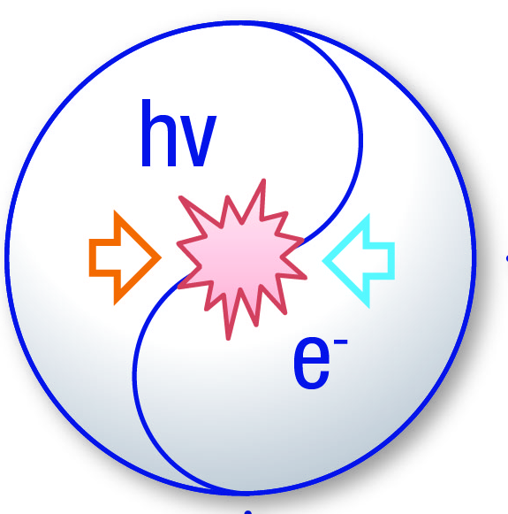
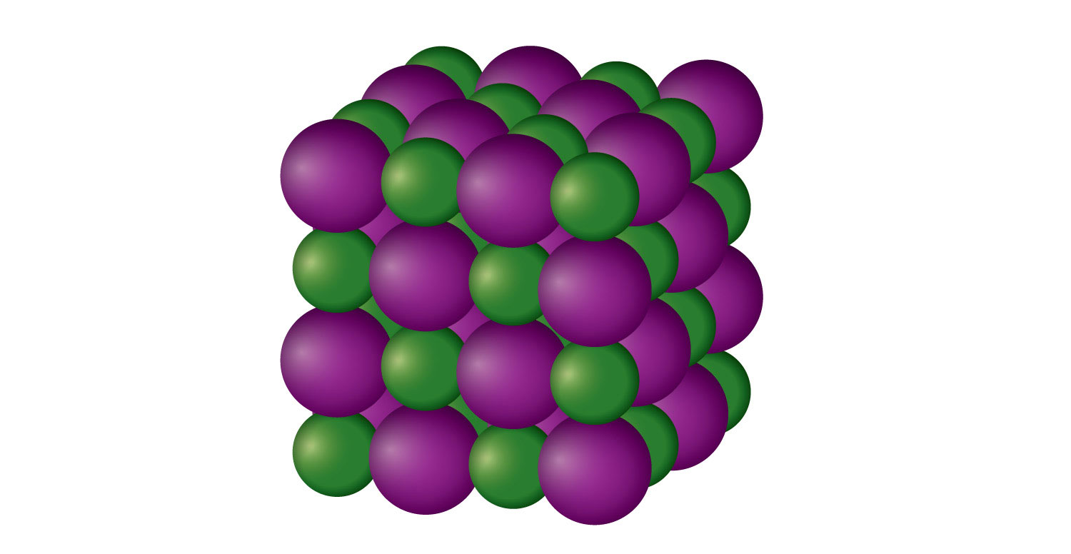


Proposed engagement to broader MIR research
Present ATF
Proposed MIR Facility
LINAC
MIR Laser Facility
h$ν$
λ
h$ν$
NIR Lasers
λ
Source Development
User Research
Applied Studies
User Research
High-Power
CO₂ Laser

Slide 9
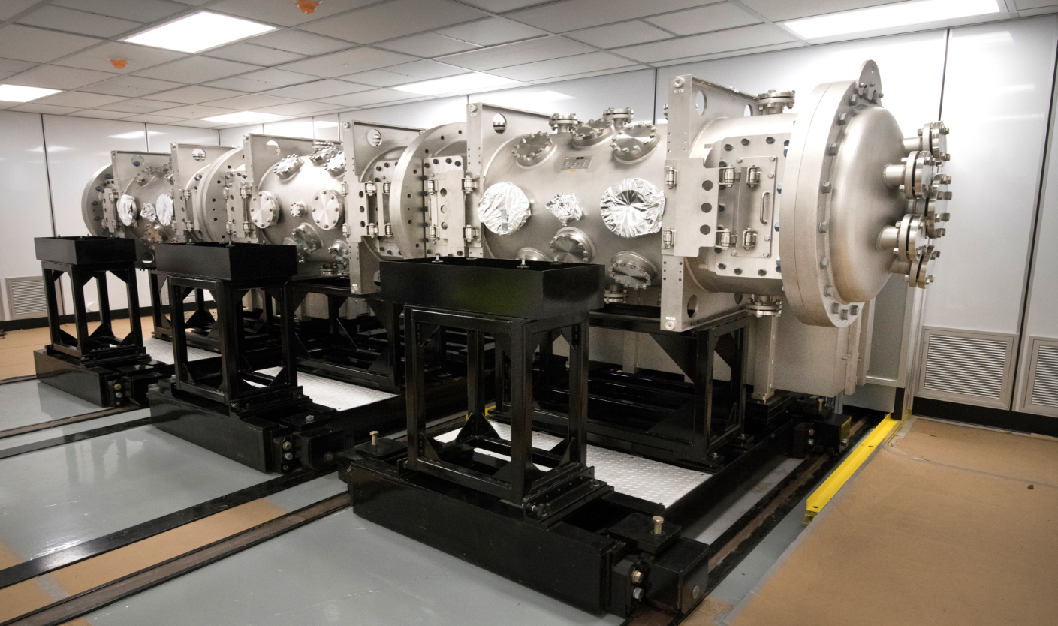
Clean Rooms in bldg. 912
71’
38’
30’
20’

Slide 10
BRNW PRDs addressed by ATF Workshop talks
PRD 2 Mid-IR Sources for Science from THz to X-Rays
Sergey Mirov - High-power MWIR/LWIR ultrafast lasers for high-energy physics
Robert Riedel - High-power femtosecond lasers based on advanced nonlinear technologies
Mikhail Polyanskiy - Architecture for next generation LWIR laser
Sergei Tochitsky - Novel high-power mid-IR sources based on optically pumped CO2 laser technology
Leon Shterengas - High Peak Power 2.8 µm Diode Laser Arrays for Optical Pumping of CO2 Gas and Fe:ZnSe
PRD 3 Frequency Conversion and Field Control
Zenghu Chang - Enhancing keV high harmonic signals generated by long-wave infrared lasers
William Li - LWIR front end Development
Konstantin Vodopyanov - Comb spectroscopy: from 1 THz to 1 PHz
Paul Corkum - Producing and Measuring “Flying-Doughnut” Pulses
PRD 4 Materials and Optics
Kevin Zawilski - Non-linear Optical Materials and Systems for Generating Mid-IR Light
Daniel Gordon - Plasma optics & Raman amplification
Julia Mikhailova and Matthew Edwards - Plasma Optics for Steering and Shaping LWIR Laser Pulses

Slide 11
Proposed Expansion of ATF MIR Research Capabilities
Extend the ATF Accelerator Stewardship mission to MIR Frontier Research
Open a new multi-clean-room facility for user-driven and internal research in MIR laser technology and multidisciplinary applications
Equip facility with a selection of MIR lasers, diagnostics, and workstations accessible to users
Establish close collaboration with business and university experts in supporting newly acquired MIR laser equipment and its updates
Hire new research and engineering staff and postdocs in support of new capabilities and expanded user programs
Integrate the MIR facility into the existing ATF operating format as a proposal-driven, peer reviewed National User Facility.
Proceed with MIR capabilities and research directions updates by soliciting the input from stakeholders through User Meetings and Science Needs Workshops.

Slide 12
Questions?
Accelerator Facilities Division

Slide 13
Recent ATF initiatives in MIR research
mJ-class OPCPA at 9 um to seed fs multi-TW CO₂ amplifiers (LWFA application).
Pulse-burst high-average-power CO₂ amplifiers (for HHG and ICS).
HHG at 10 um (record high harmonic numbers and wavelength optimization studies).
CO₂ optical pumping with lasers and diodes.
Generating and application of exotic waveforms with record-high longitudinal electric and magnetic fields upon focusing.

Slide 14
MIR Sources Unlock Multiple Research Directions
DFG: difference frequency generation
HHG: high-harmonic generation
OHG: optical harmonic generation
OR: optical rectification
RDW: resonant dispersive wave generation
sHHG: solid-state HHG
Initiation and probing the fastest electron dynamics in complex molecules
Collective excitation of charge, lattice, and spin degrees of freedom in solids
High-intensity laser plasmas
Notes:
MIR pulses can directly drive the molecular and collective modes that play key roles in chemistry and solid-state phenomena.
MIR is a gateway for tabletop access to ultrashort pulses that span an extraordinary range of the spectrum.
MIR pulses are ideally suited for both up-conversion to far higher frequencies in the extreme ultraviolet (XUV) and X-ray ranges through high harmonic generation (HHG) and down-conversion to much lower frequencies in the THz range through difference frequency mixing or optical rectification.

Slide 15
Performance Targets for Laser Classification
Magenta – where ATF can be engaged

