Slide 1





Two-color Ionization injection of high-quality electrons
Navid Vafaei-Najafabadi

Slide 2
Synthesis
Plasma accelerators create accelerating gradients that are hundreds of times higher than conventional accelerators
A “plasma photoinjector” for a collider application needs to create
  Low emittance (<100 nm)
  High charge (order of nC)
  Trapezoidal shape for low energy spread in subsequent accelerating plasma stages
By applying the spatiotemporal pulse shaping to two-color ionization injection, such plasma photoinjector can be demonstrated at ATF

Slide 3
Dream of Compact & Efficient Plasma Collider
Slide Courtesy of Dr. J. L. Shaw, LLE, Rochester
SLAC
Gradient: 10-20 MV/m
Plasma
Gradient: 10+ GV/m
Plasma-Based Acceleration
Gradient: 20 GV/m
Notes:
Talking Point:
-My work has focused on improving the electron beam and x-rays from LWFA.

Slide 4
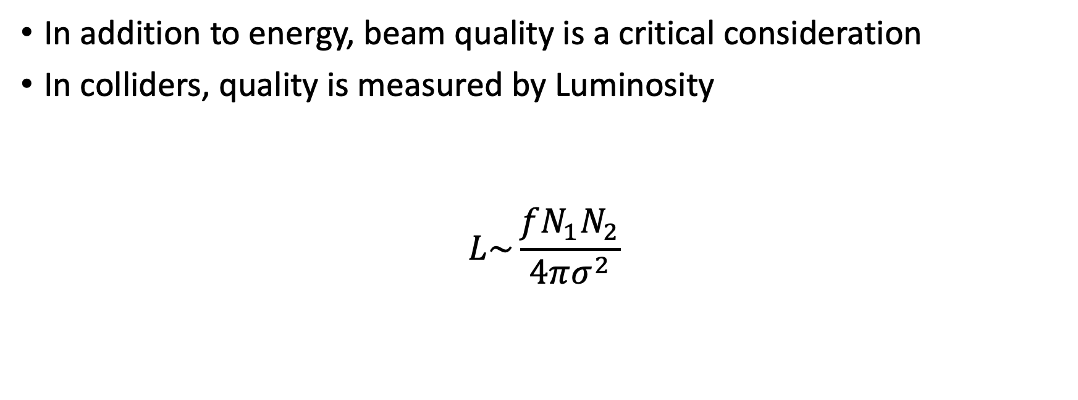
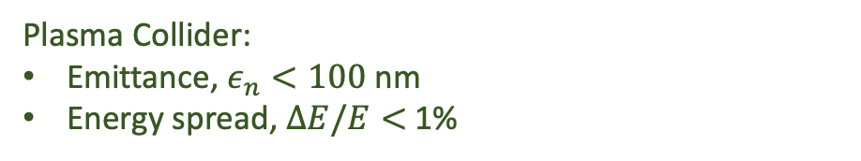


Luminosity
In addition to energy, beam quality is a critical consideration
In colliders, quality is measured by Luminosity
$$L\sim \frac{fN_{1}N_{2}}{4πσ^{2}}$$
Beam collision rate $⟹$High rate
Beam charge $⟹$High charge
Plasma Collider: $f\sim 50$kHz
Plasma Collider:$Q\sim 200$ pC , ${10}^{9} e^{−}$
Focusability $⟹$ low emittance and energy spread
Plasma Collider:
Emittance, $ε_{n}<100$ nm
Energy spread, $ΔE/E<$ 1%
$L↑ ⟹ε_{n}↓$ & $ΔE/E↓$ & Q $↑$
C.B. Schroeder et al 2023 JINST 18 T06001
DOI 10.1088/1748-0221/18/06/T06001
Notes:
Having a high acceleration gradient is not enough, you also need a high quality beam
Luminosity determines number of events (collisions) per second

Slide 5
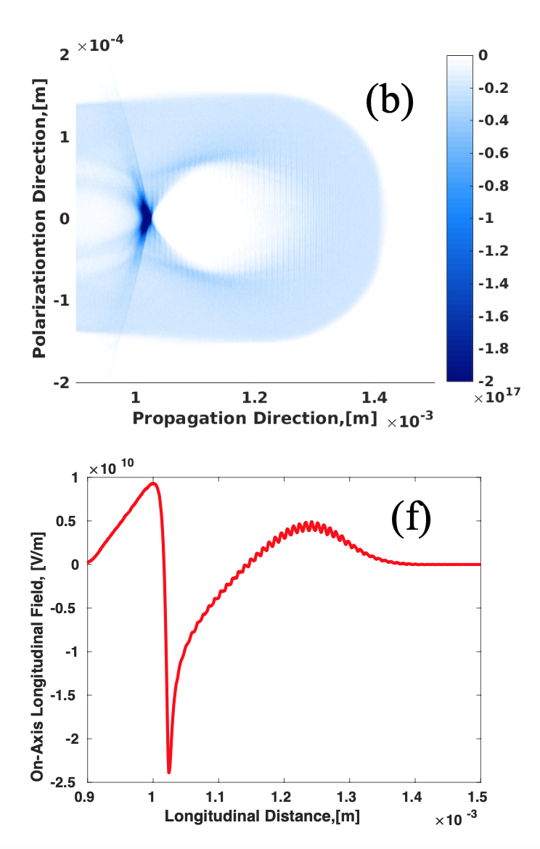

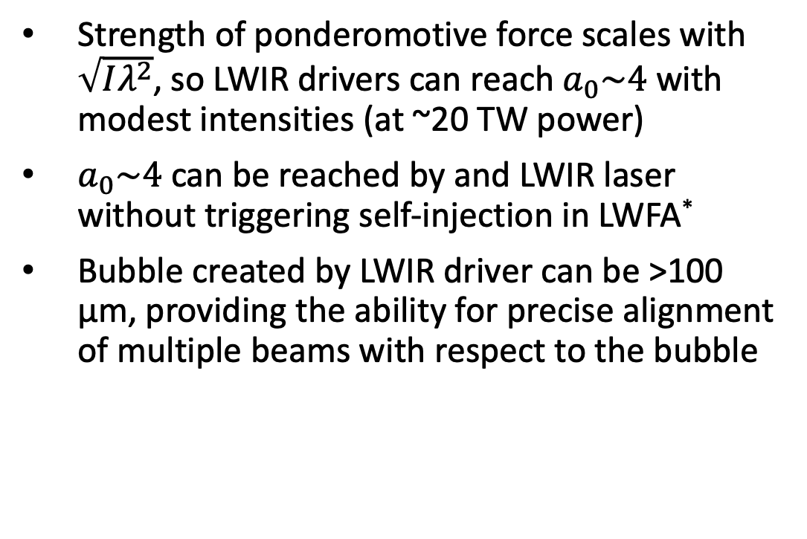
LWIR-driven laser wakefield acceleration
P. Kumar, Physics of Plasmas, 28, 013102 (2021)
Strength of ponderomotive force scales with $\sqrt{Iλ^{2}}$, so LWIR drivers can reach $a_{0}\sim 4$ with modest intensities (at ~20 TW power)
$a_{0}\sim 4$ can be reached by and LWIR laser without triggering self-injection in LWFA*
Bubble created by LWIR driver can be >100 µm, providing the ability for precise alignment of multiple beams with respect to the bubble
$a_{0}=3.8$,
P=20 TW,
𝜏=0.5 ps,
$n_{e}=2×{10}^{16}$cm⁻³
* See A. Jain, Proceedings of AAC 2022
Accelerator Facilities Division

Slide 6
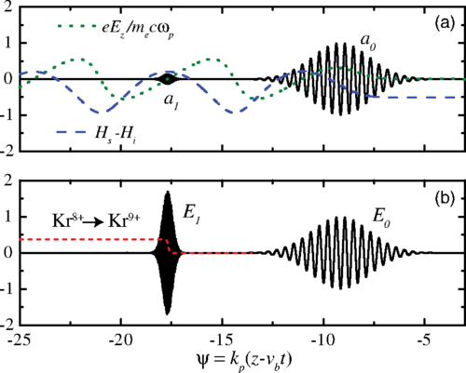
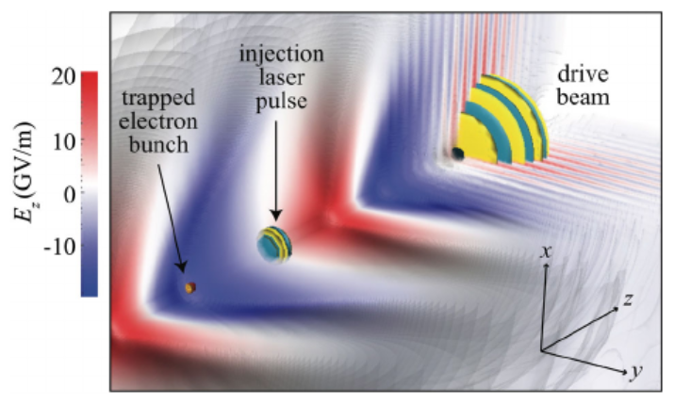
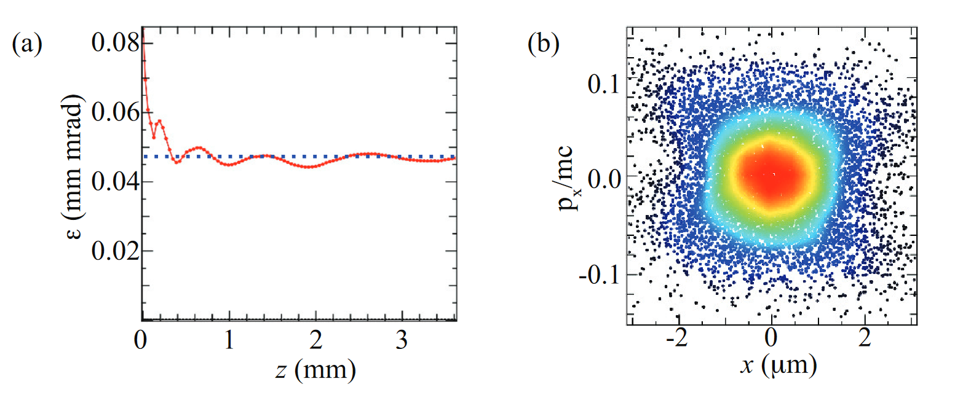
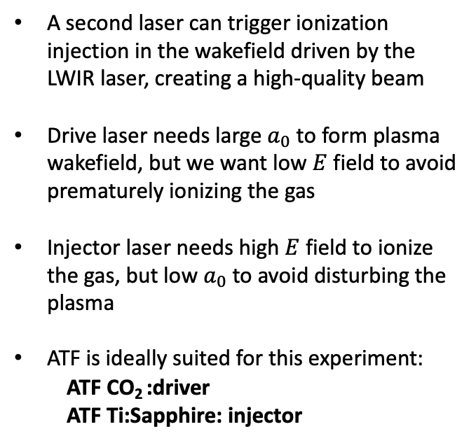
Two-color ionization injection
Very intense, small $a_{0}$
Less intense, large $a_{0}$
A second laser can trigger ionization injection in the wakefield driven by the LWIR laser, creating a high-quality beam
Drive laser needs large $a_{0}$ to form plasma wakefield, but we want low $E$ field to avoid prematurely ionizing the gas
Injector laser needs high $E$ field to ionize the gas, but low $a_{0}$ to avoid disturbing the plasma
ATF is ideally suited for this experiment:
  ATF CO₂ :driver
  ATF Ti:Sapphire: injector
Schroeder, PRSTAB 17, 101301 (2014)
Yu, PRL 112, 125001 (2014)
Excellent phase space
Low emittance
Schroeder, European Conference on Lasers and Electro-Optics (2015)
Accelerator Facilities Division

Slide 7
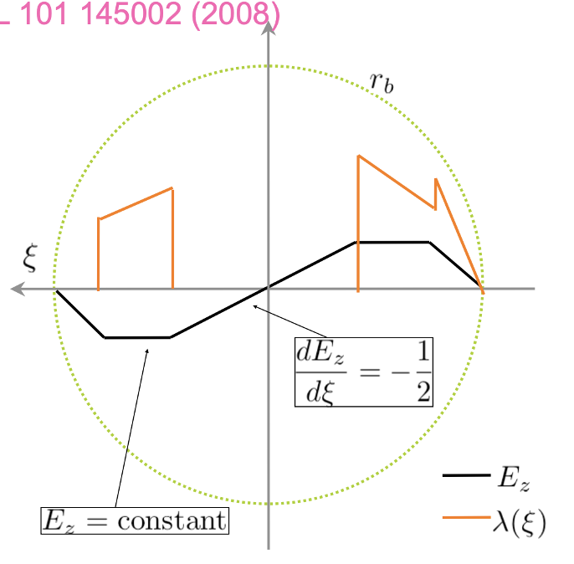
Shortcomings
The charge produced is low (3-30 pC)
Lack of beam loading results in relatively large energy spread (few %)
Solutions
Inject a trapezoidal beam and flatten the plasma wakefield through beamloading
M. Tzoufras, Phys. Rev. Lett. 101, 145002 (2008)

Slide 8
Varying the location of ionization is possible through spatiotemporal control of the ionizing laser
By varying the chirp, the region of peak intensity (focus) can be made to travel at any velocity

Slide 9
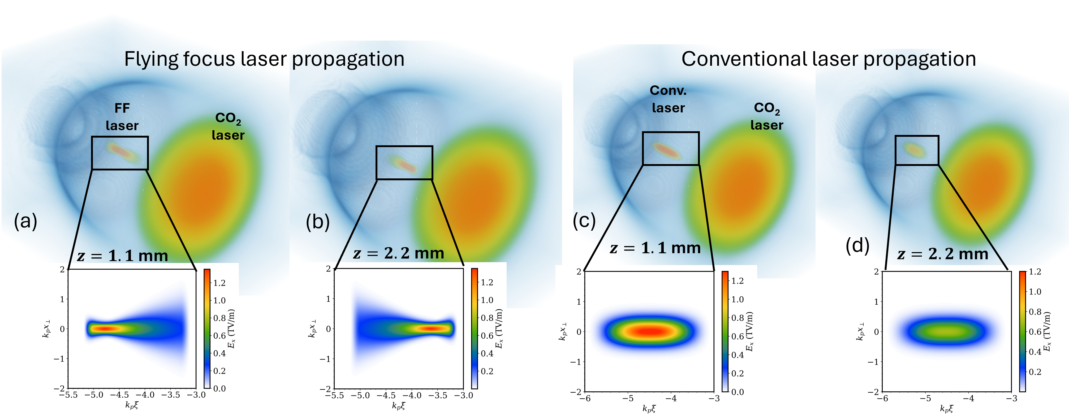
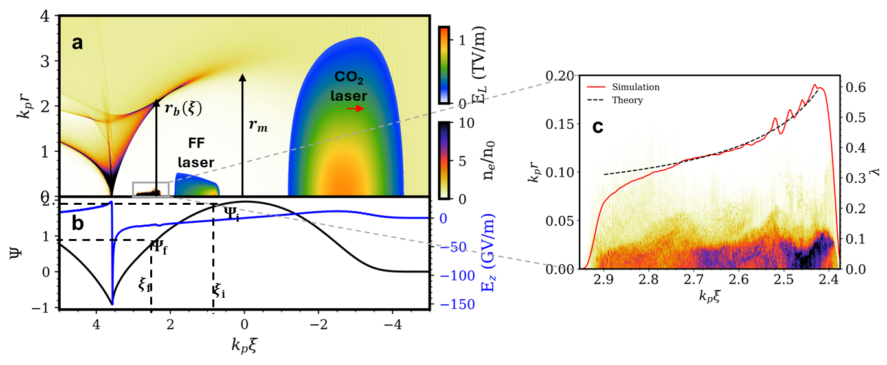
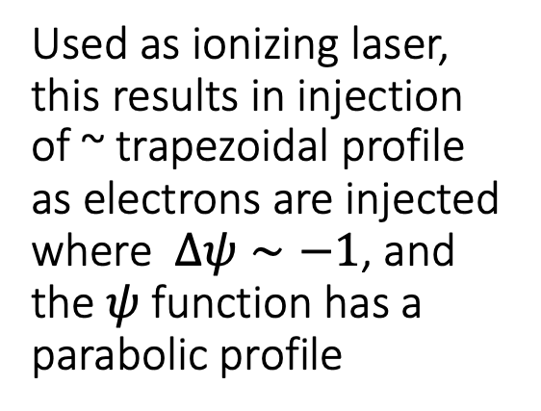
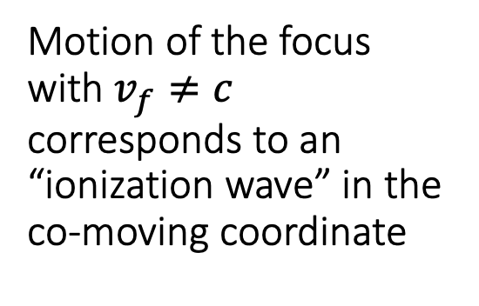
Motion of the focus with $v_{f}≠c$ corresponds to an “ionization wave” in the co-moving coordinate
Used as ionizing laser, this results in injection of ~ trapezoidal profile as electrons are injected where $Δψ∼−1$, and the $ψ$ function has a parabolic profile
A. Jain, in preparation

Slide 10
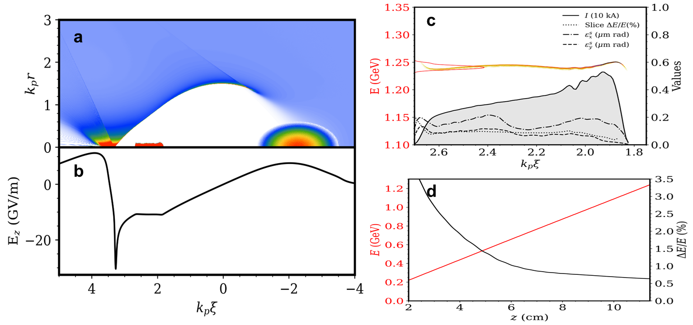
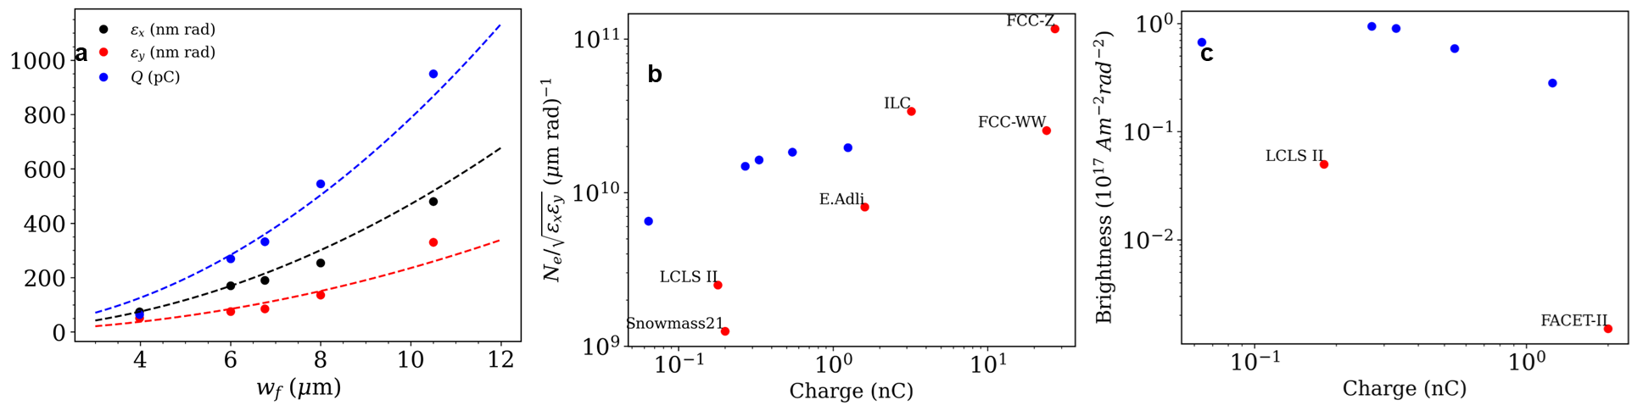
This “Photoinjector” produces an e-beam that is perfectly suited for acceleration in subsequent plasma wakefield “stages”
The luminosity value attributed to such a beam would be compatible with all proposed plasma wakefield collider schemes and competitive with conventional collider beams

Slide 11
Quad Chart
Scientific/Technical Outcomes Outcomes: Very bright, high-charge electron beams Approach: Spatiotemporal control over NIR laser to initiate ionization injection in a plasma wakefield driven by a CO₂ laser | Lasers/e-beam Parameters Required 20 TW CO₂ laser pulse ~ 25 mJ of (second harmonic of) Ti:Sapphire Need stable synchronization e-beam for alignment capability (transverse probe)
Facilities Upgrade Roadmap Upgrade CO₂ laser to enable 20 TW with pulse length <0.5 ps | Beyond the Current Roadmap N/A

Slide 12
Summary
Plasma accelerators create accelerating gradients that are hundreds of times higher than conventional accelerators
A “plasma photoinjector” for a collider application needs to create
  Low emittance (<100 nm)
  High charge (order of nC)
  Trapezoidal shape for low energy spread in subsequent accelerating plasma stages
By applying the spatiotemporal pulse shaping to two-color ionization injection, such plasma photoinjector can be demonstrated at ATF

Slide 13
The End

Slide 14
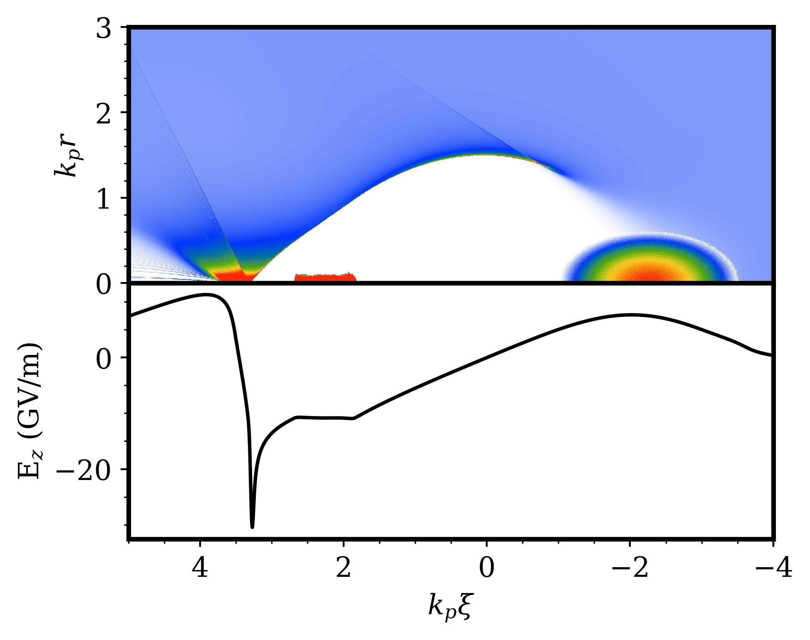
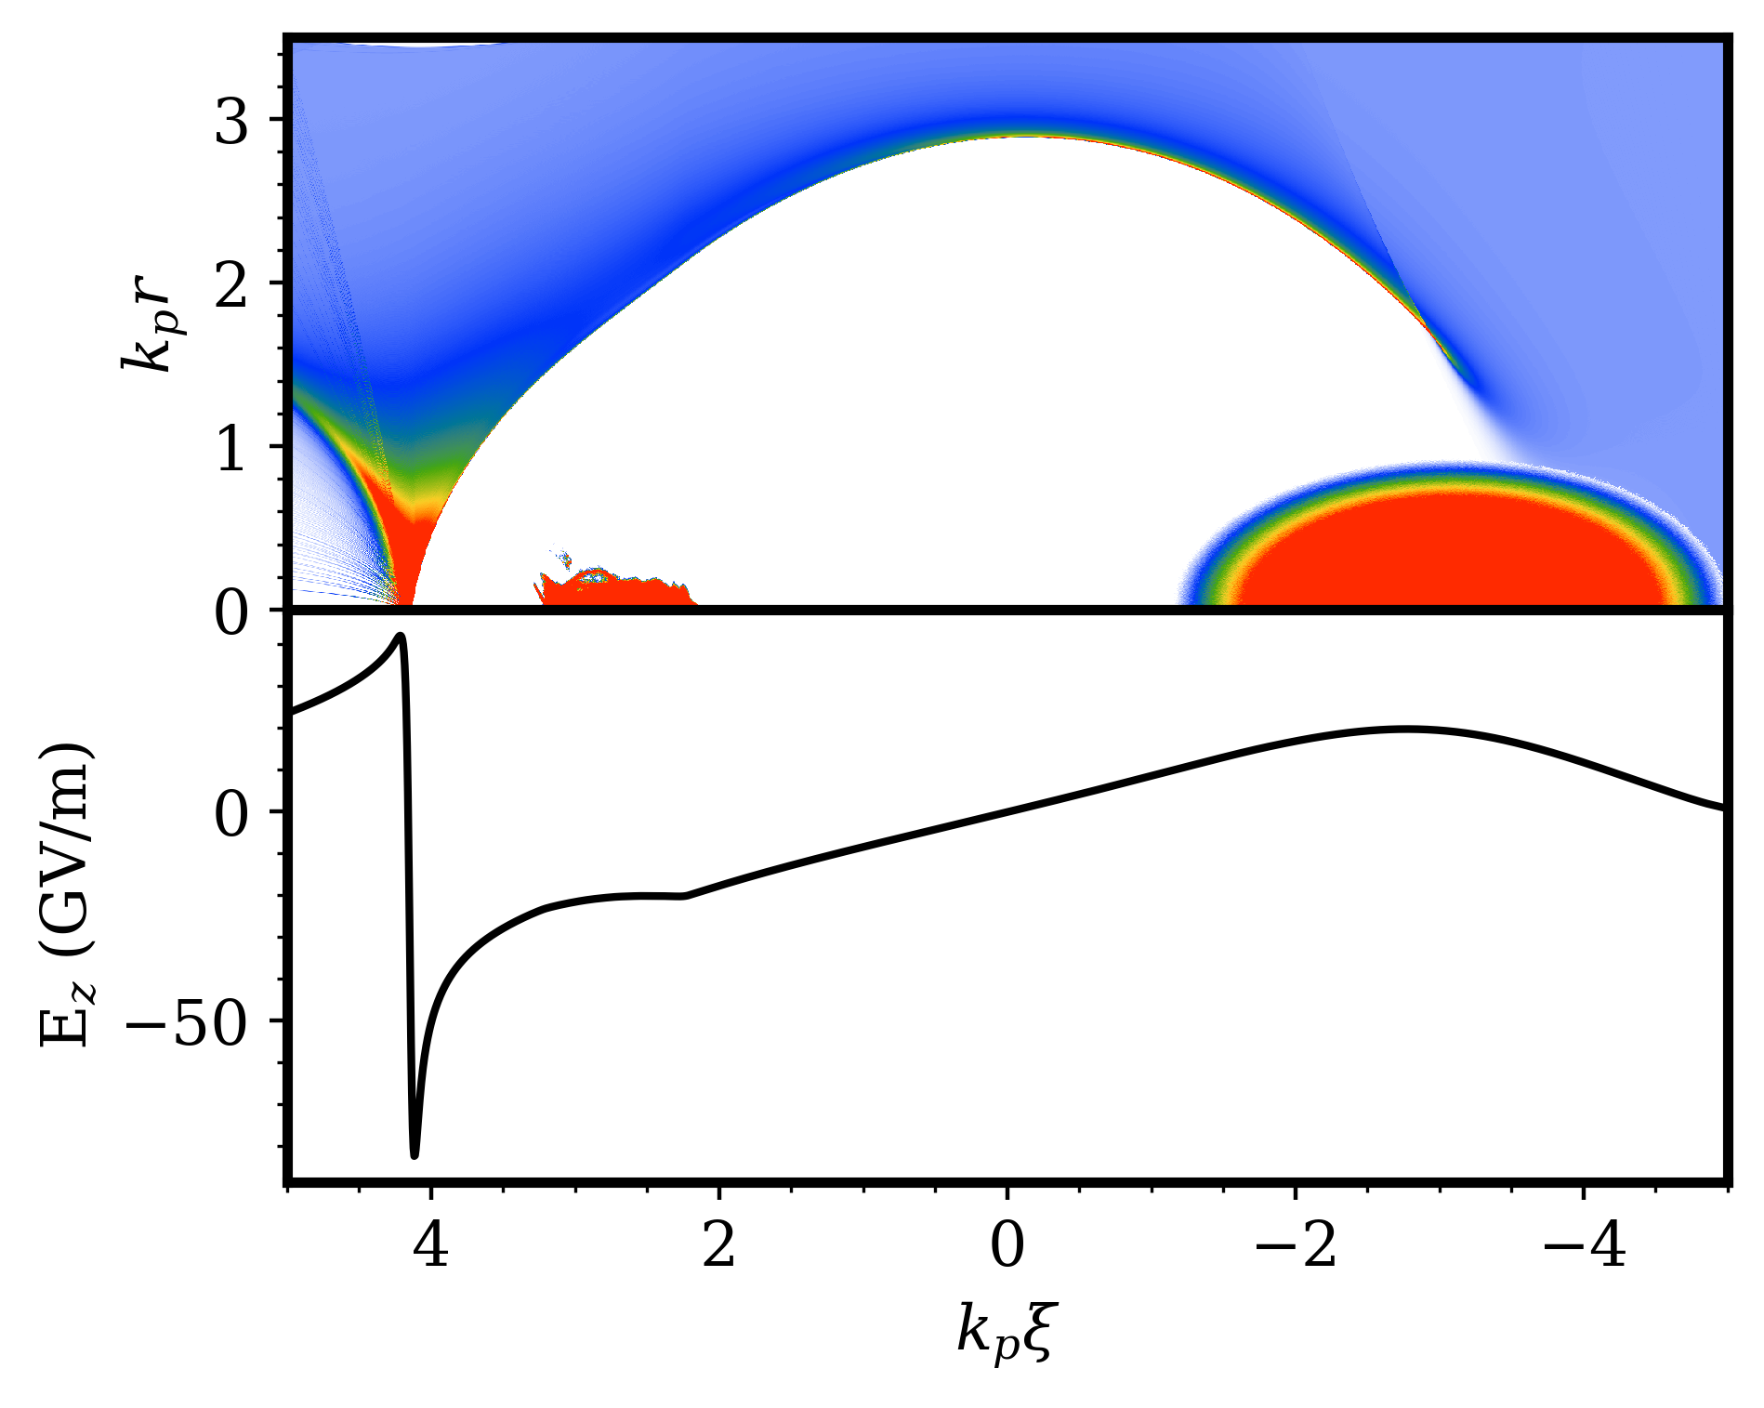
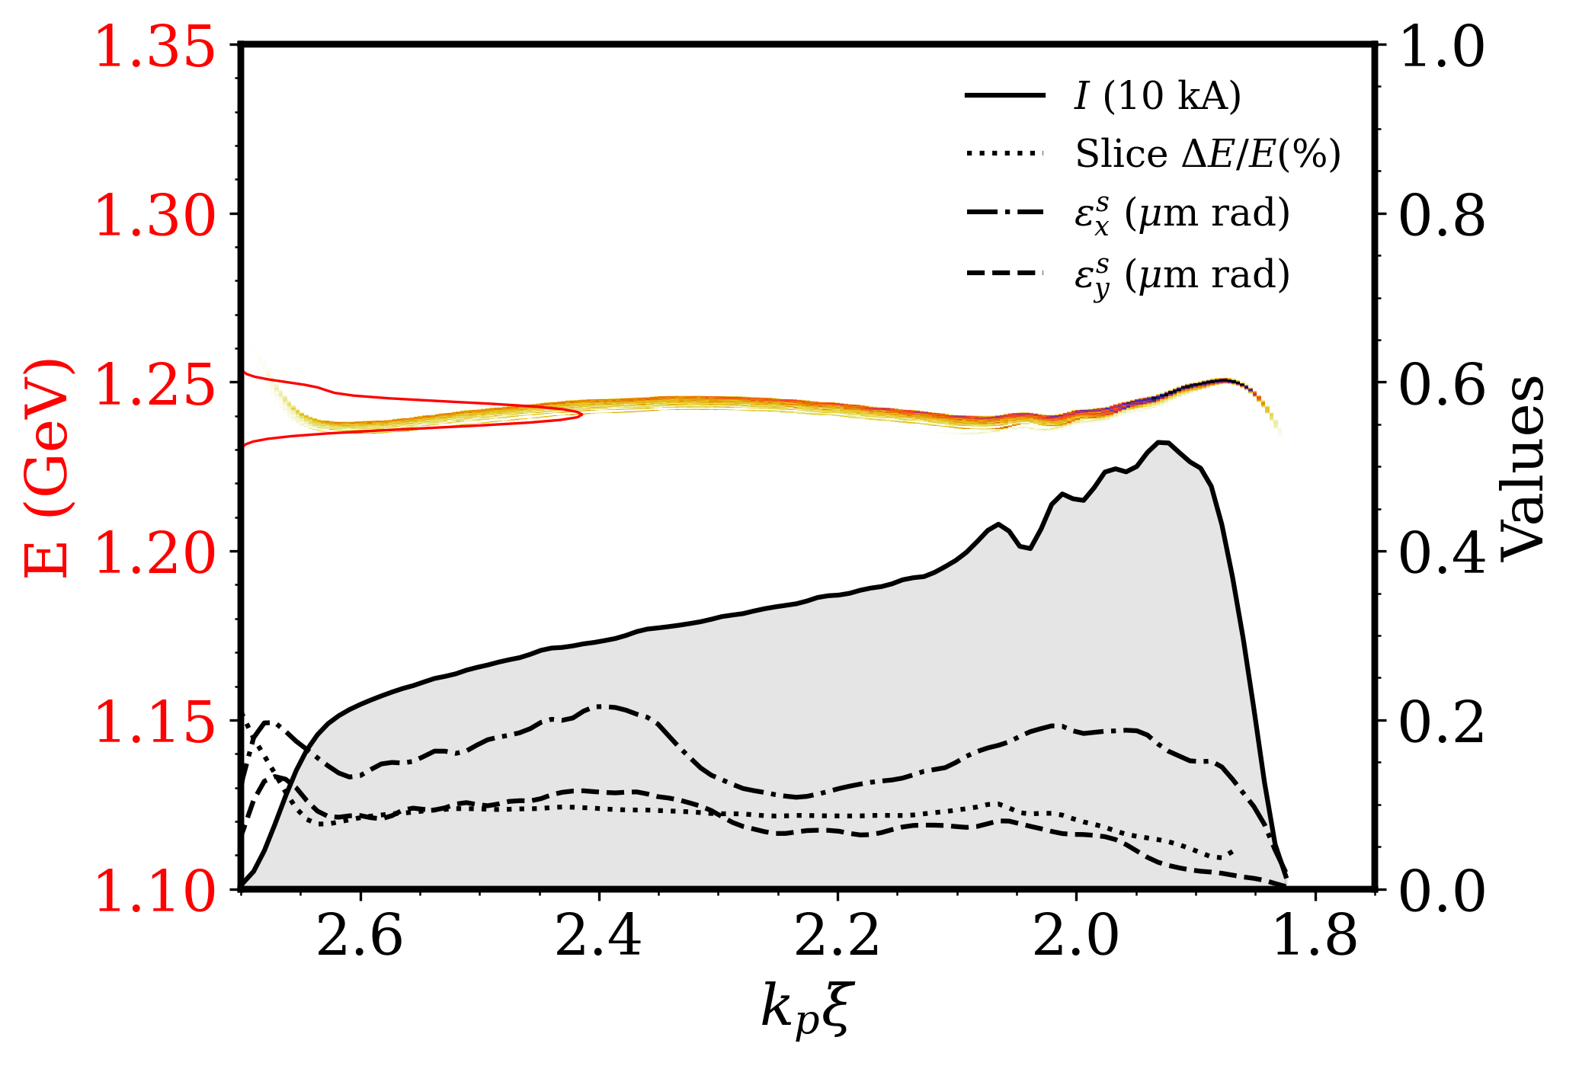
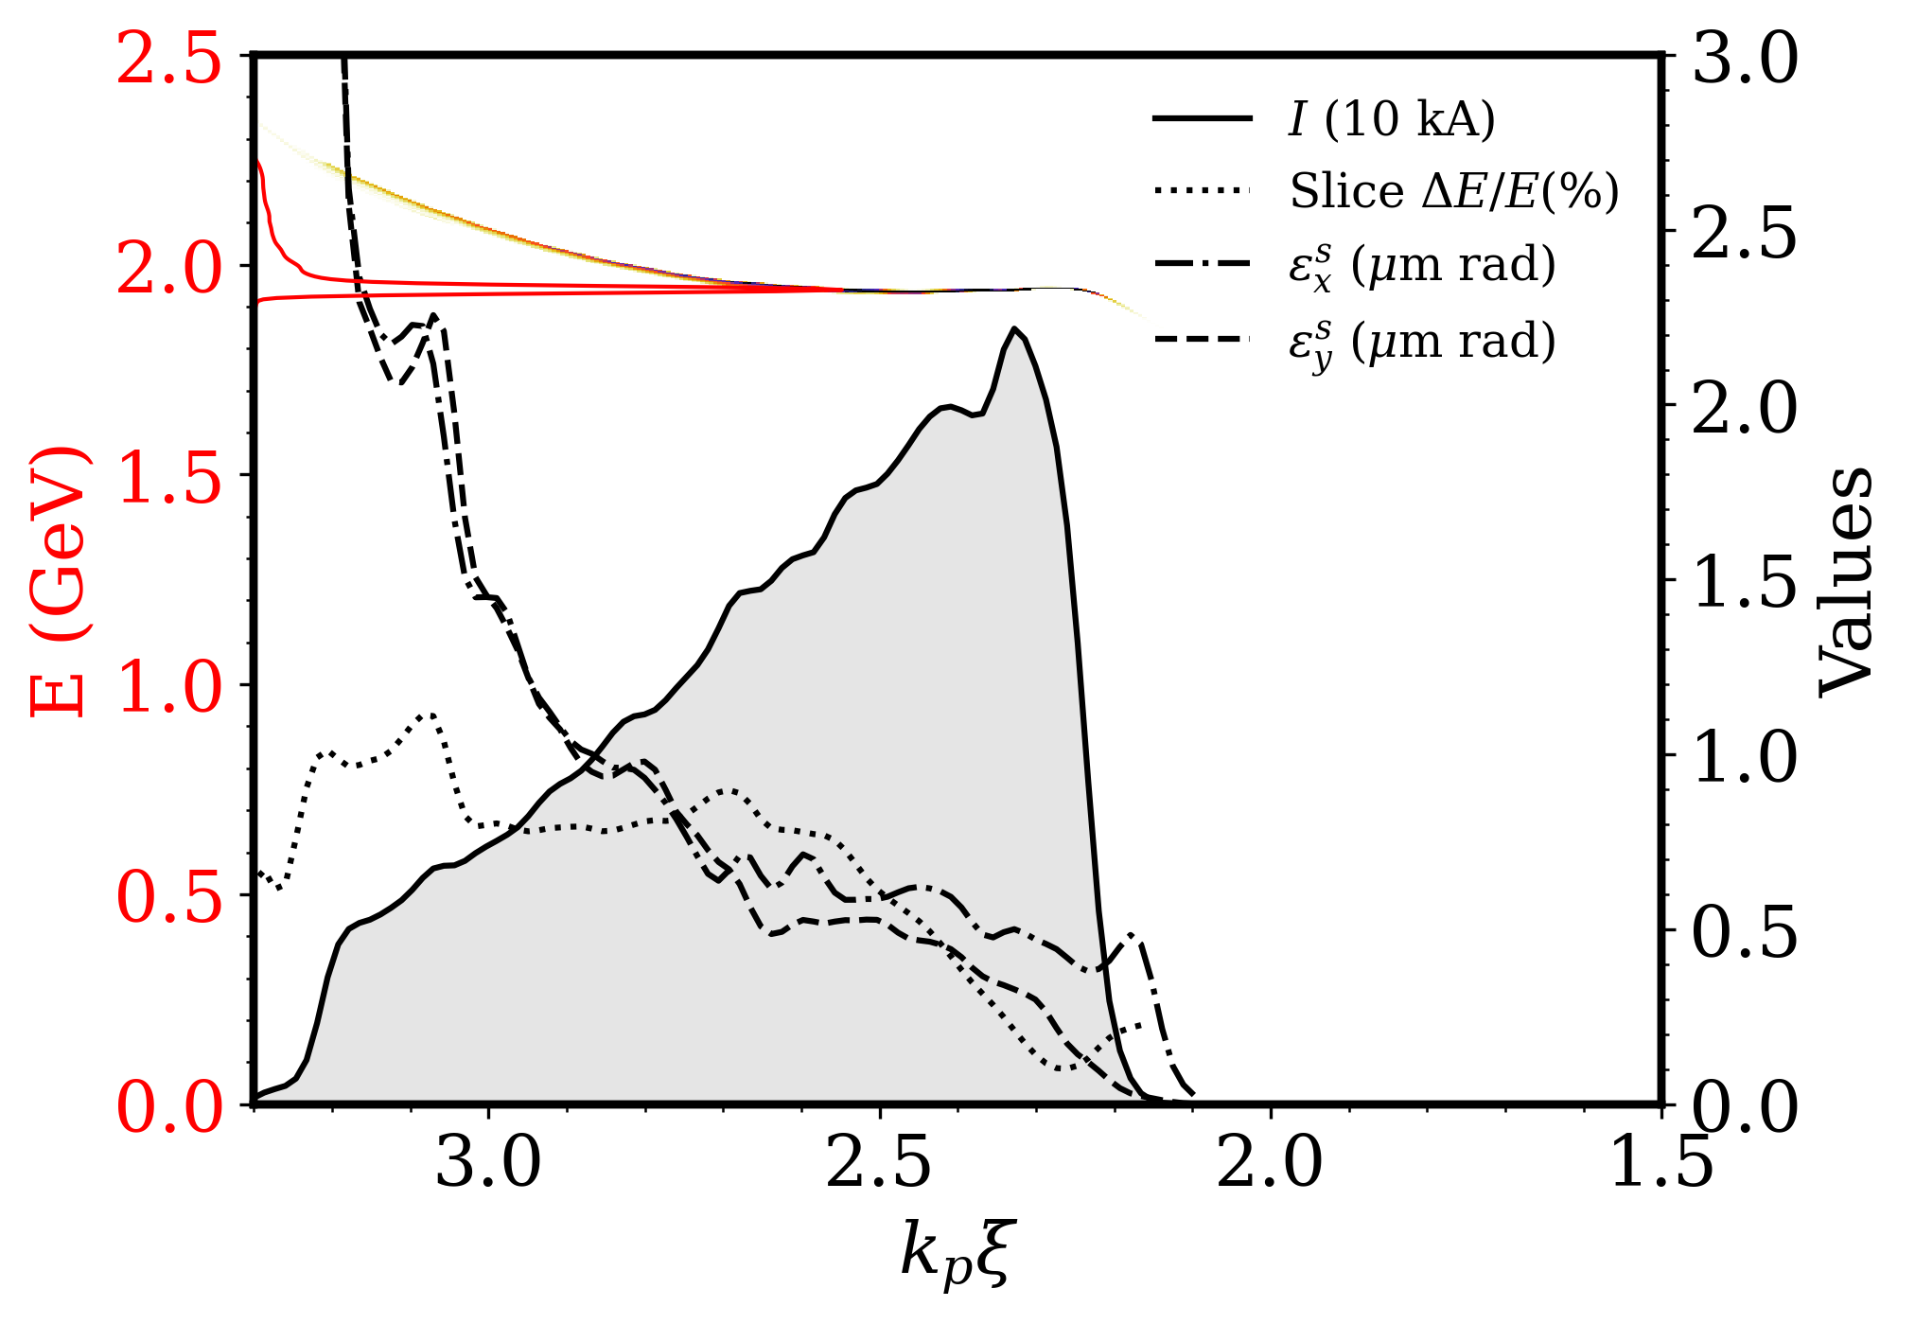
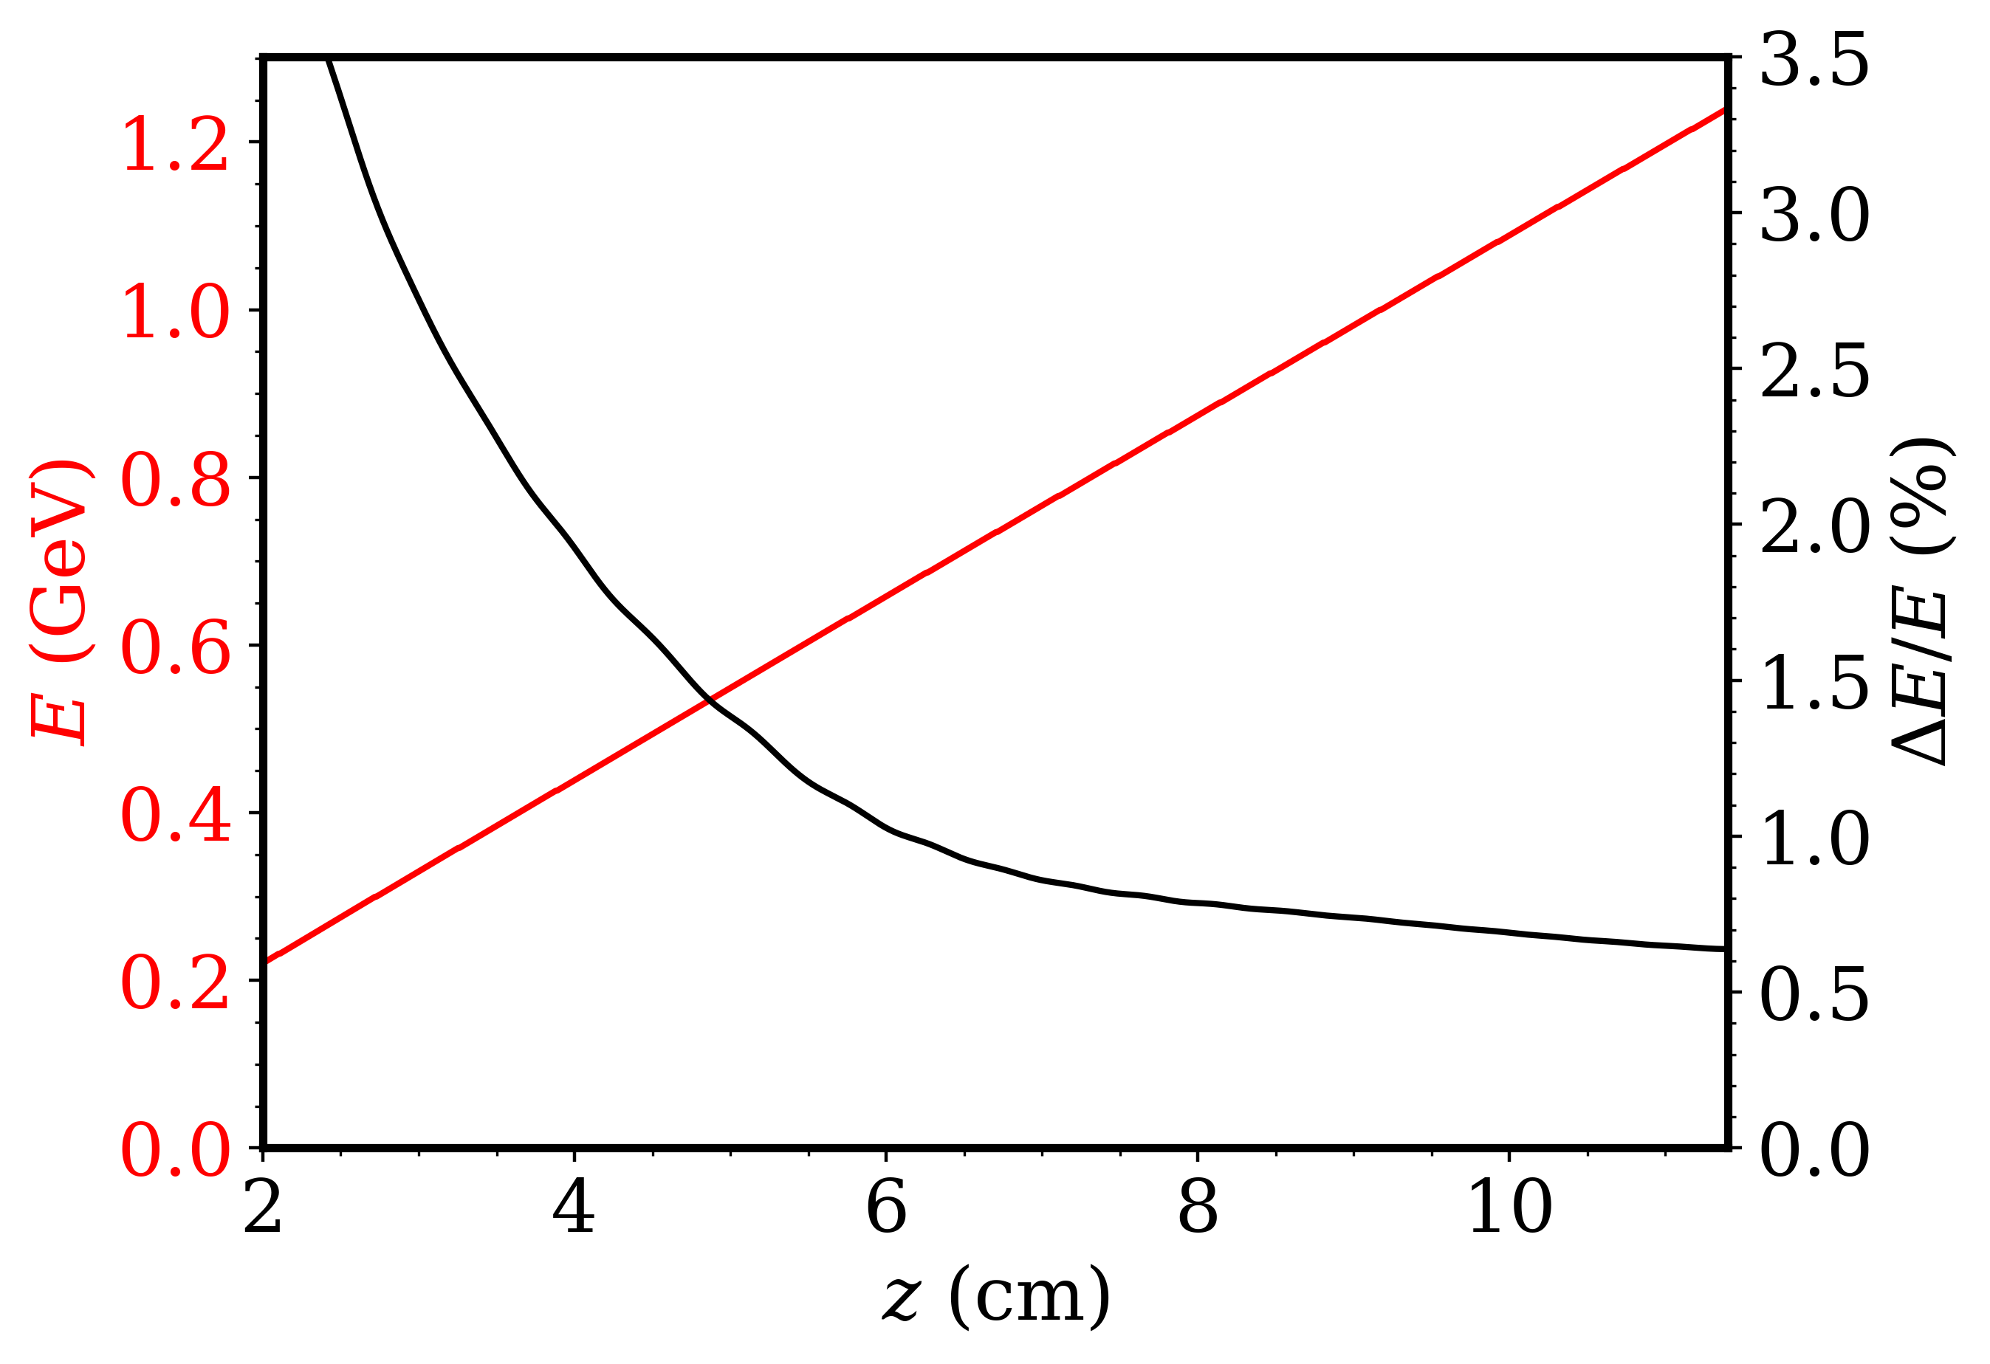
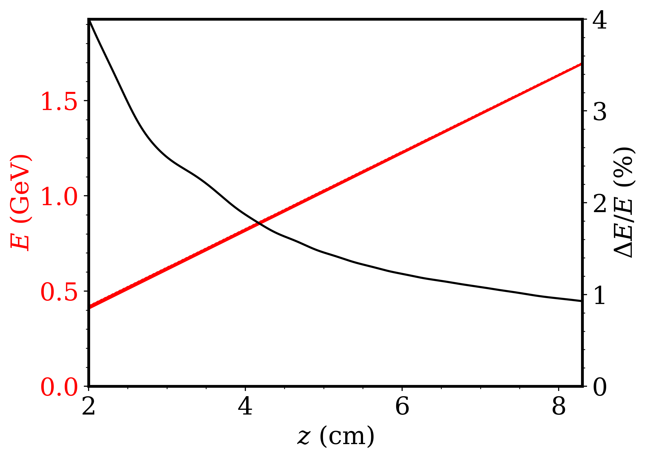


a
$Q= 220$pC
$Q= 1$nC
e
b
f
c
g
d
d

Slide 15
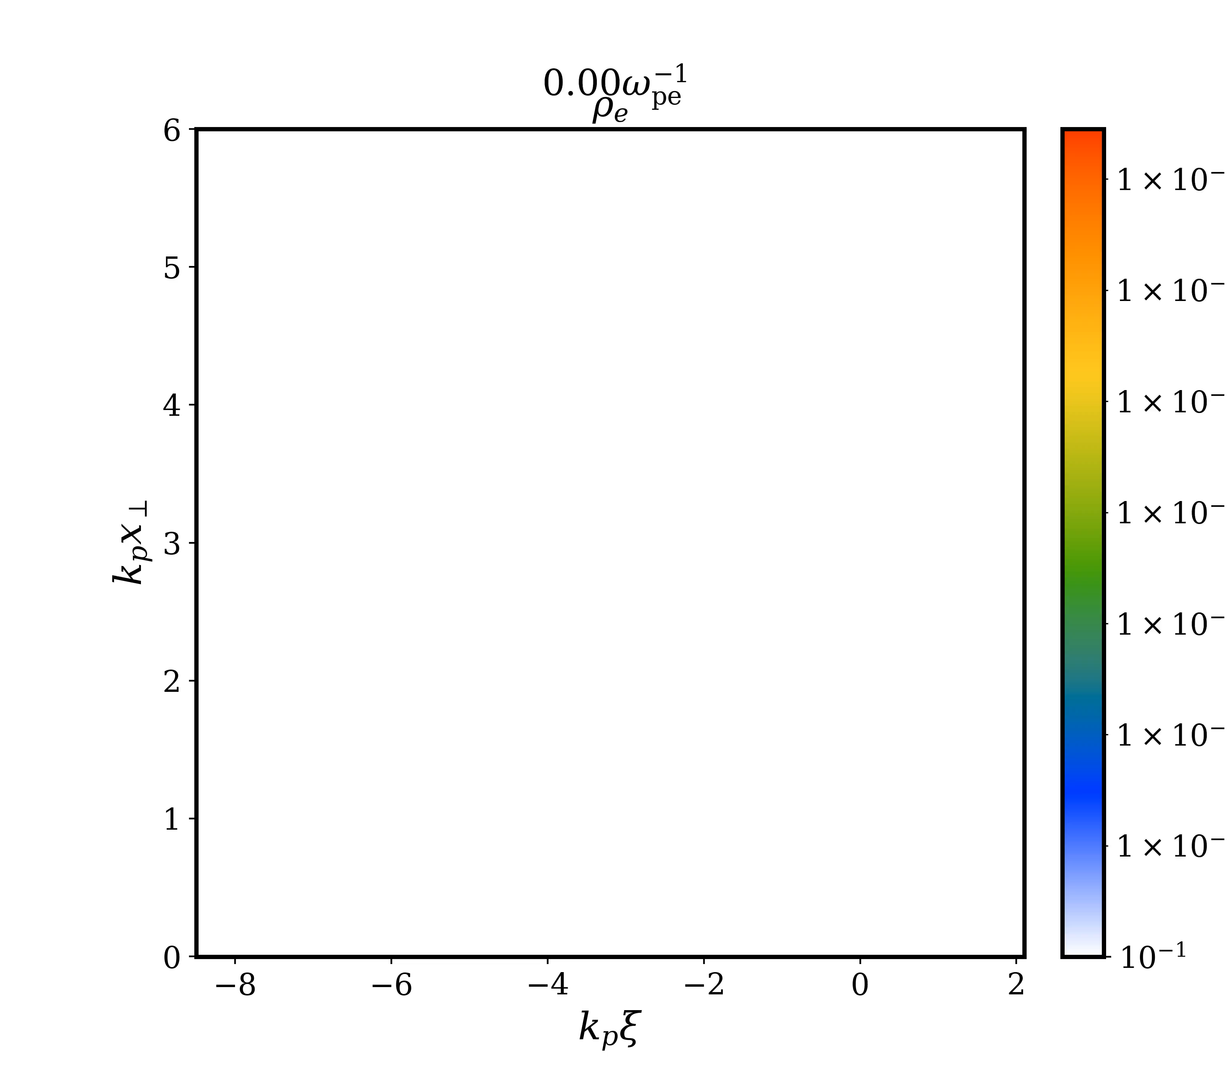
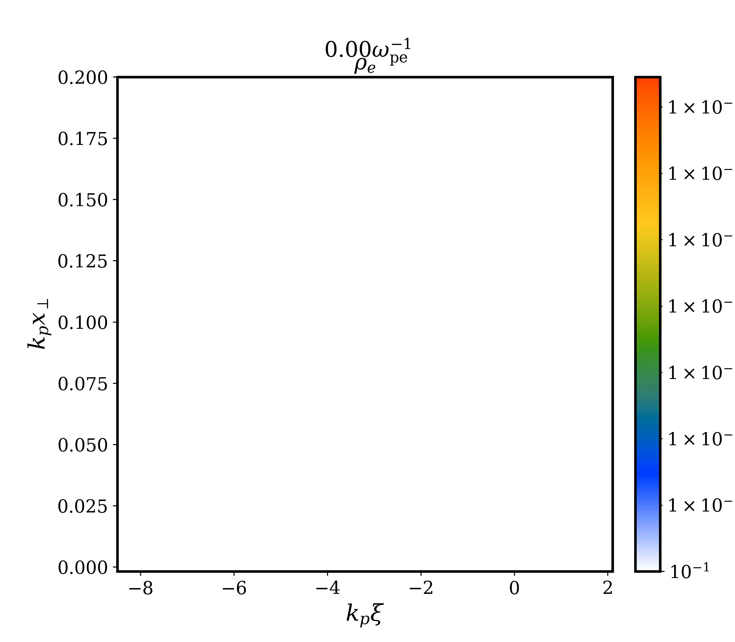
Injected Charge Evolution due to Flying Focus
CO2 laser- $a_{0}=2.7$, $w_{0}=105 μm$, $τ_{FWHM}=350 f$s, $λ_{0}=9.2 μm,$ $n_{0}=2×{10}^{16} cm^{−3}$, $\frac{1}{k_{p}}=37.6 μm$
ff laser- $v_{f}=1.04 c$, $w_{0f}=6.8 μm$/ 0.18, $λ_{0}=0. 4 μm, a_{0f}=0.17$

Slide 16
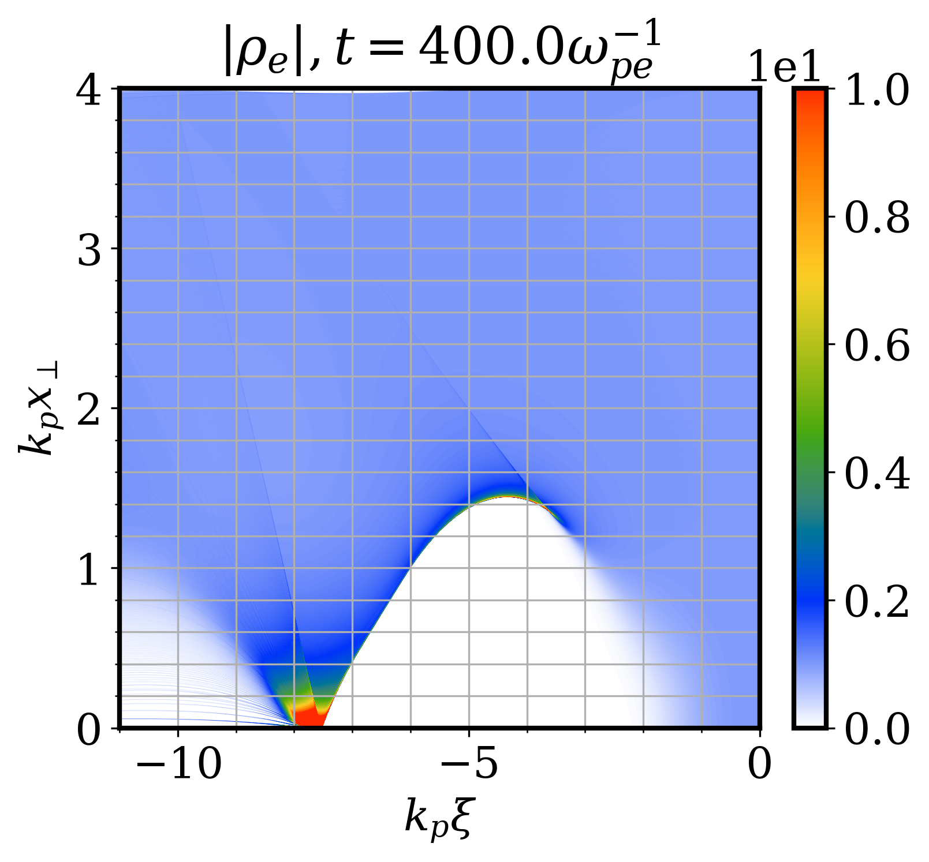
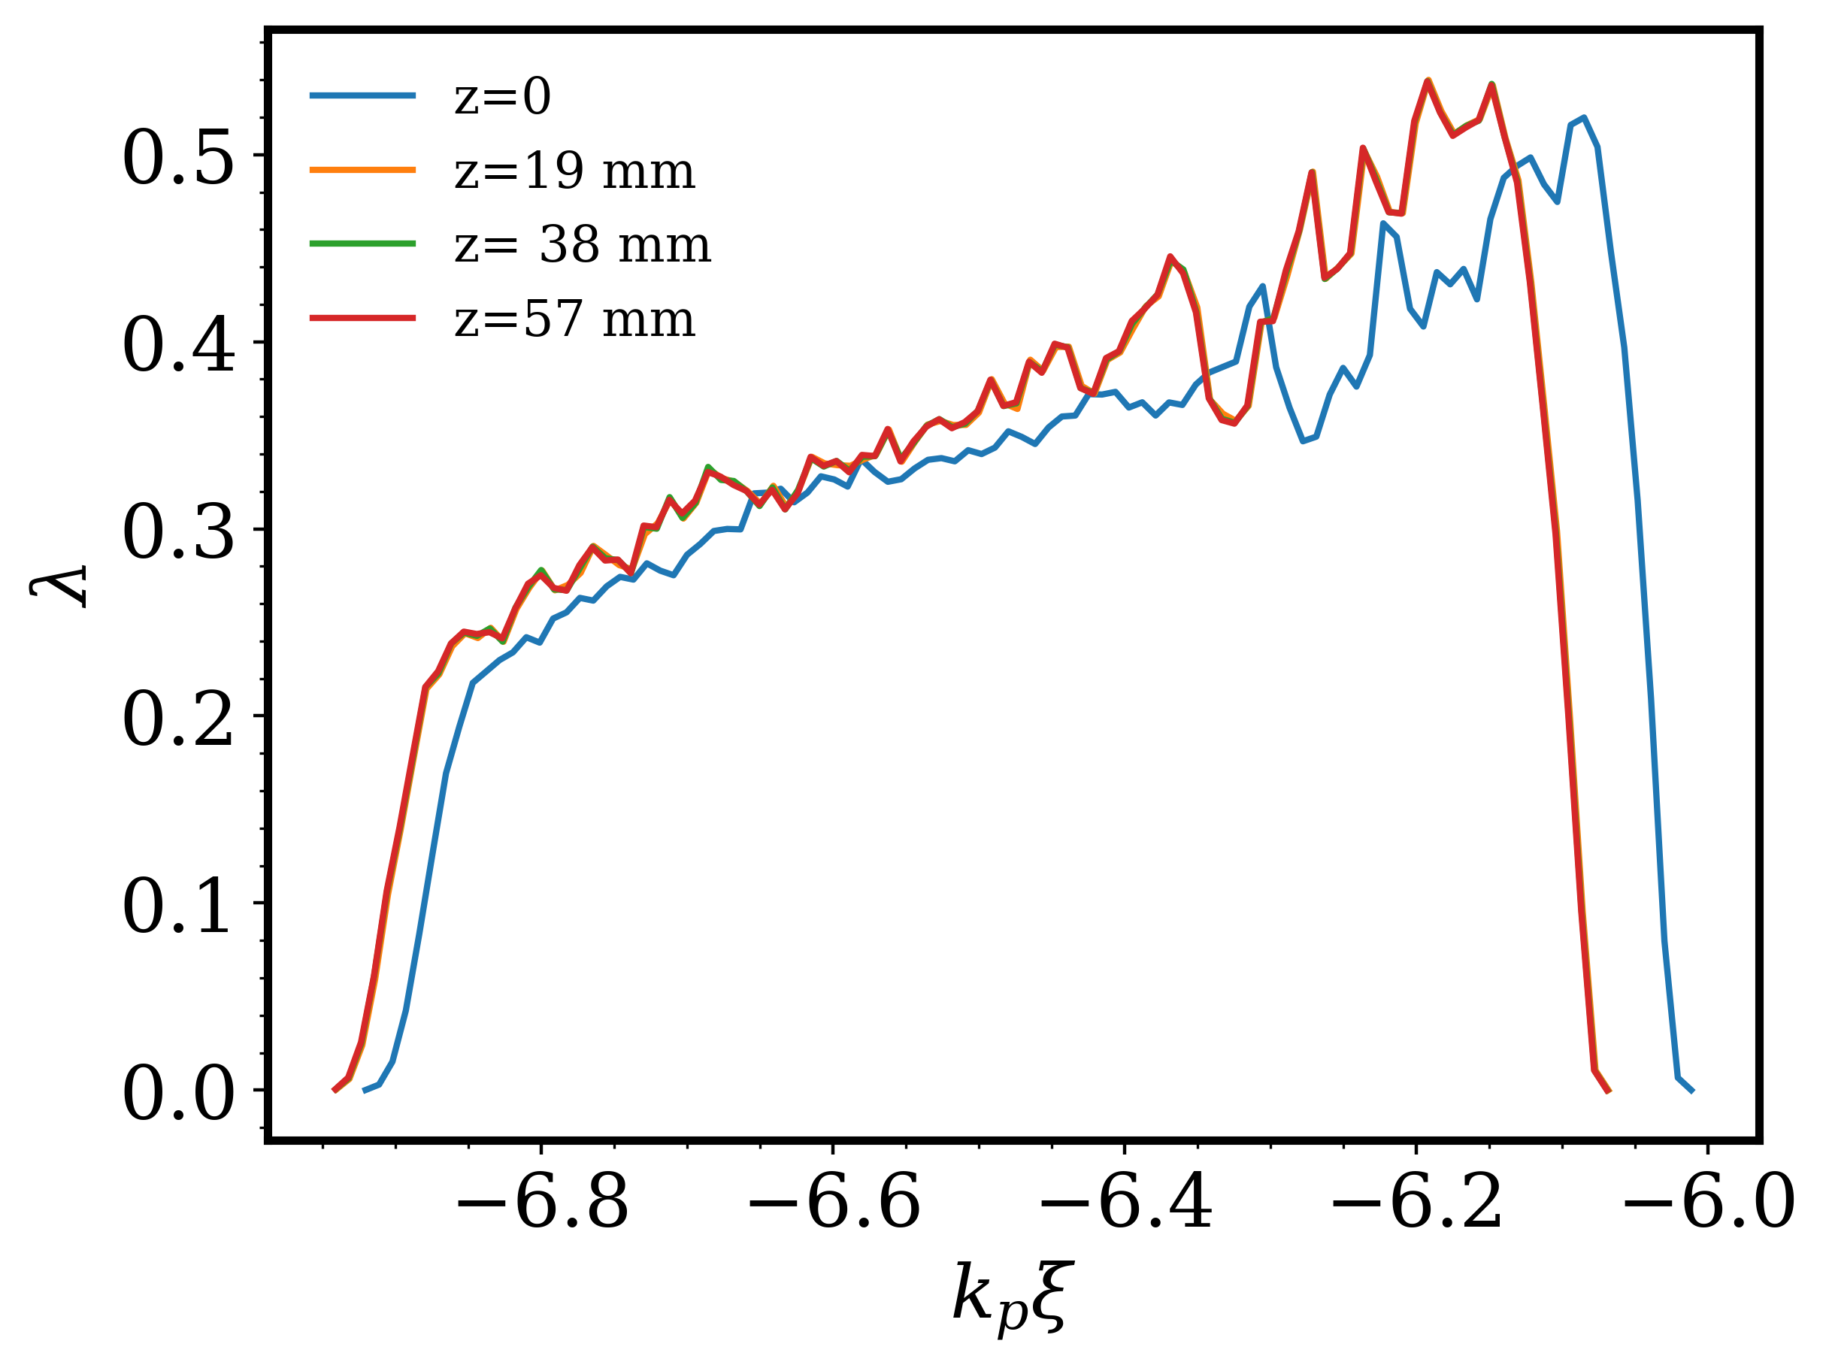
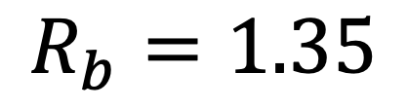
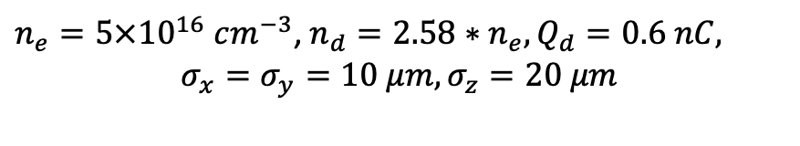
$$R_{b}=1.35$$
$n_{e}=5×{10}^{16} cm^{−3}$, $n_{d}=2.58∗n_{e}, Q_{d}=0.6 nC,$
$$σ_{x}=σ_{y}=10 μm, σ_{z}=20 μm$$
Slope= 0.22

Slide 17
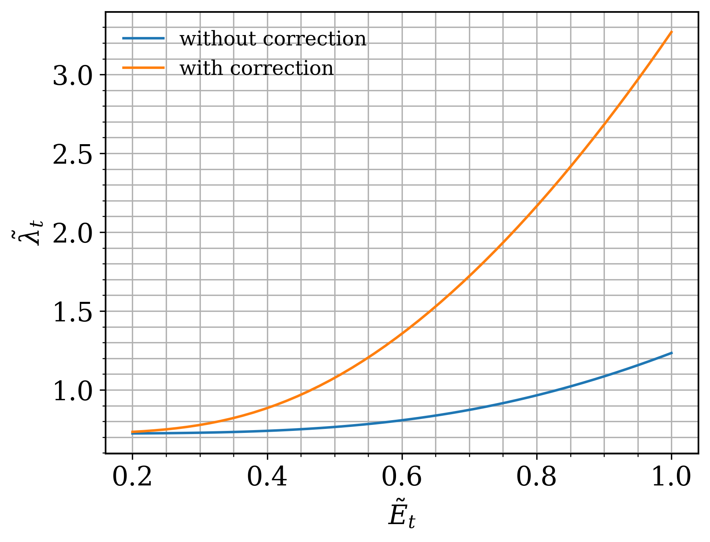
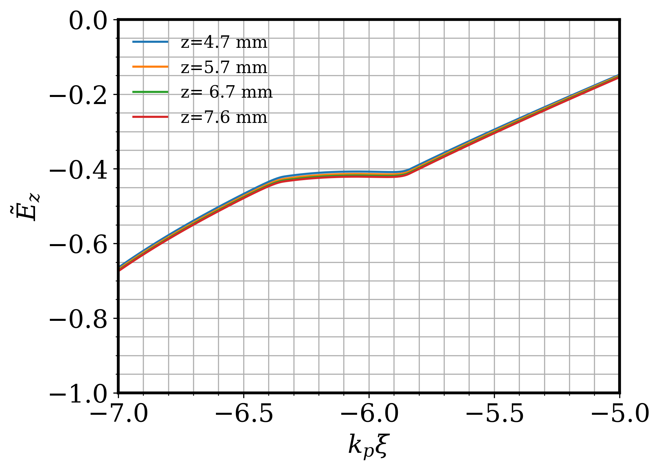
Beam Loading Physics

Slide 18
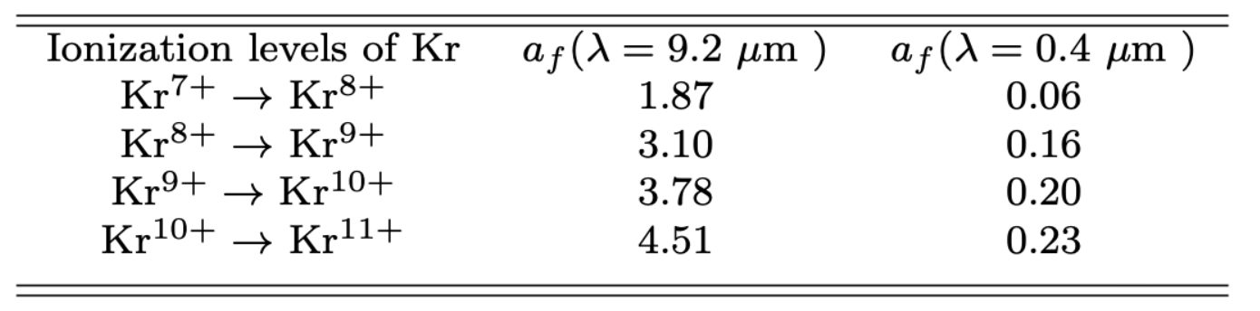
Krypton Ionization Rates

