Slide 1
LUT Update
Youqi and Brian
pfRICH General Meeting
May 9, 2024

Slide 2
Overview
Uploaded new set of LUTs to epic-data repository (https://github.com/eic/epic-data) on Monday, May 6th – should be included in the May simulation campaign
Updates to pfRICH model compared with previous LUTs
1.7 T Marco B-field map
Vertex smearing
Updated aerogel segmentation
Updated QE curve
Various geometry changes (mirror slopes, vessel size, etc)
Simulated 100M events in the range 0.1 < p < 15; -3.8 < eta < -1.4; -pi < phi < pi
37x20x120 bins in momentum x theta x phi
~1000 events per bin
Reconstruction probabilities derived from matrices relating thrown and reconstructed PID (next page)
Added an unreconstructed column for events with Npe < 3

Slide 3
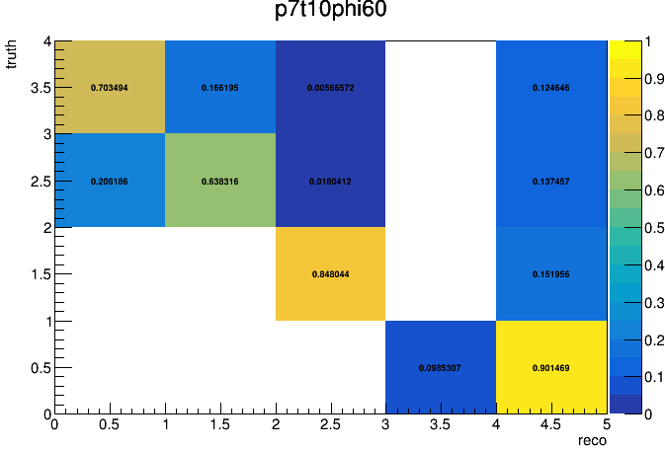
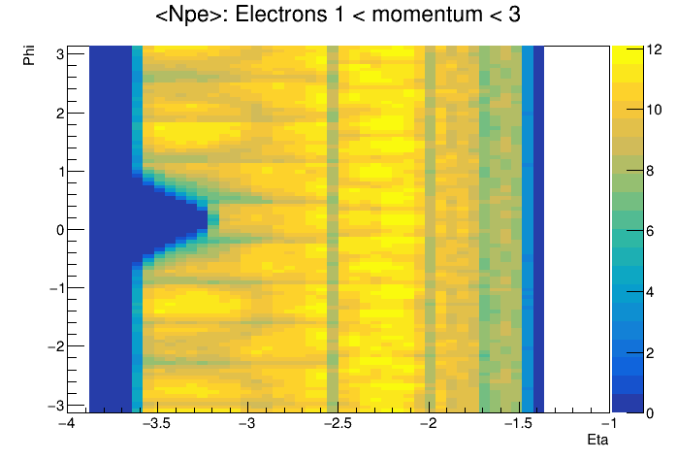
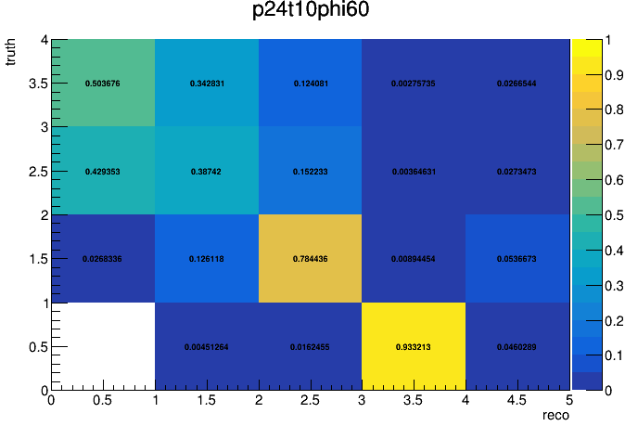
Example Plots
Example of a plot encoding thrown vs reconstructed PID for a specific eta and phi range 3.2 < p < 3.6 (top) and 10.0 < p < 10.4
Below: Average number of photons as a function of eta and phi for thrown electrons with momentum between 1 and 3 GeV. Structure of the aerogel wall is clearly visible
e
pi
K
P
Un

Slide 4
Next Steps
Develop more robust QA code and checks
Optimize binning
Investigate various features we see in the reconstruction matrices and Npe spectra (large number of events with 1 photon)
Change random number scheme to make simulation fully reproducible
Generate pi/k/p and e/h tables and generate opposite charge sign

