Slide 1
ANSYS Magnetostatic and Structural Analyses of the sPHENIX Magnet at Full Current John Cozzolino August 17, 2016

Slide 2
ANSYS Maxwell Analysis of sPHENIX Magnet
Final comparison of Maxwell axial and radial coil forces (7/28/16) to Wuzheng Meng’s 2D results from 6/17/15
Forces track acceptably (see following chart).
The 2D Maxwell axisymmetric simulation has functioned properly and generates valid results.

Slide 3
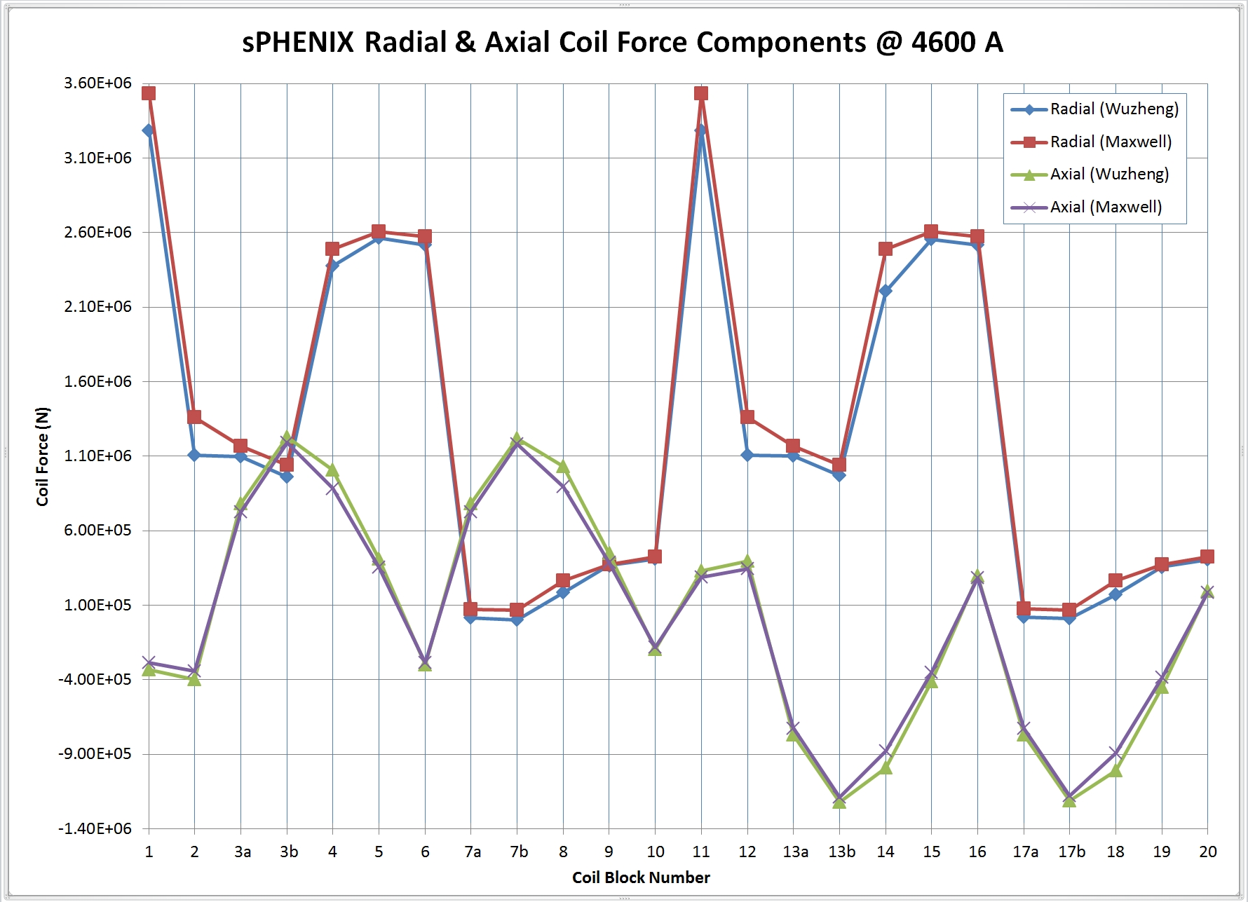

Slide 4
Labels on 24 Solenoid Coils (Not to Scale)
W. Meng, 6/17/15
Coil-package ctr.
3.0 cm
Rout=155.06cm
Rin=150.98cm
(solenoids/yoke/poles common Axis)
Z
(Yoke axial ctr.)
Z=0

Slide 5
ANSYS Maxwell Analysis of sPHENIX Magnet
3D magnetostatic FE analysis of the coil in the iron
Geometry is taken from the simplified Creo solid model.
The coil center is shifted 3cm north relative to the iron.
The iron weight is approximately 1,320,000 lb.
The fringe B field outside the iron is observed at 4600 A.
The simplified 3D FE model is used to compare end forces on the iron to Wuzheng’s calculations from 6/17/2015.

Slide 6
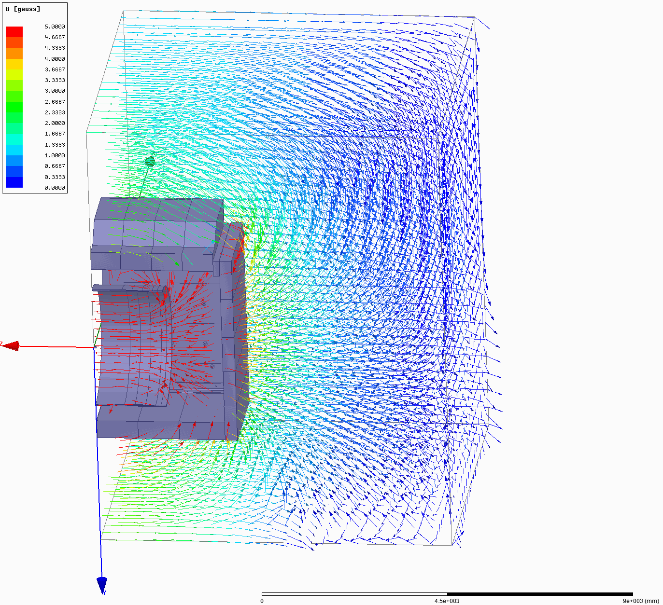
Static B field vector plot at 4600 A
Scale is 0 to ≥4.3 Gauss (red)
Axial limit of region is about 8m from magnet center.
The blue region does not exceed 1.7 Gauss.

Slide 7
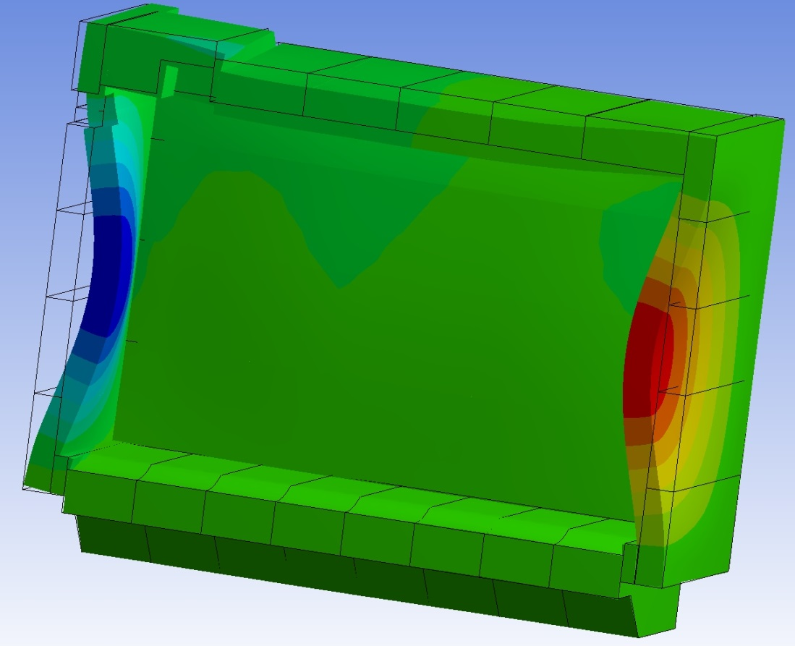
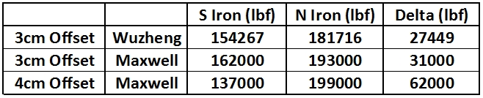
Axial Forces on sPHENIX Iron End Caps at 4600 A with 3 & 4 cm Coil Offsets North
South Iron
North Iron

Slide 8
ANSYS Maxwell Analysis of sPHENIX Magnet
3D magnetostatic and static structural FE analysis of the iron at 4600 A
Geometry is taken from the latest Creo solid model.
One side wall includes actual physical features and realistic contact conditions.
Therefore, deflections should better represent actual behavior.

Slide 9
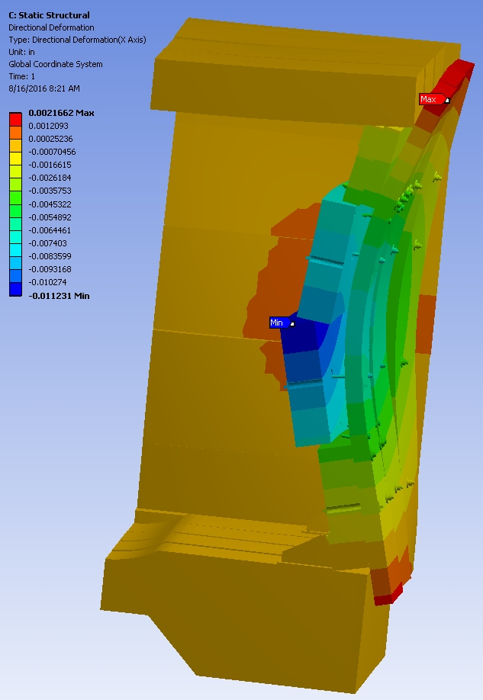
ANSYS Maxwell Analysis of sPHENIX Magnet
One side wall is modeled in detail.
Frictionless contact is applied where appropriate.
Bolts are in place but are not preloaded in the model.
Max inward deflection is .011 inch (blue).
Note: This model lacks some of the latest features such as heavy angle braces and additional fasteners.
The effect of such iron deflections on the cryostat via its support struts has not yet been studied.

Slide 10
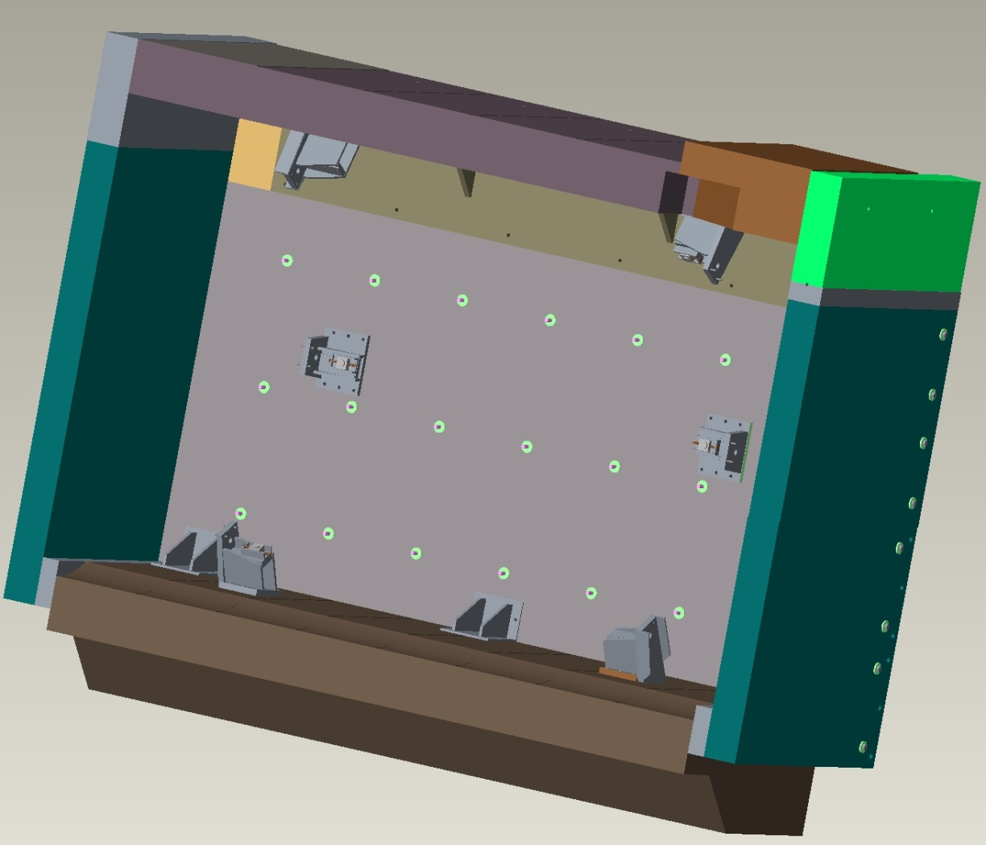
ANSYS Maxwell Analysis of sPHENIX Magnet
Structural FE analysis of the cryostat support system is the logical next step.
The yoke assembly should include all newly added relevant features including steel gussets, additional bracing, and doublers.
Effects of the 30,000 lbf axial load imbalance should be considered as well.
Consider verifying the axial location of the solenoid relative to the iron.

