Slide 1
Outer Barrel Layout
Adam Huddart - RAL

Slide 2
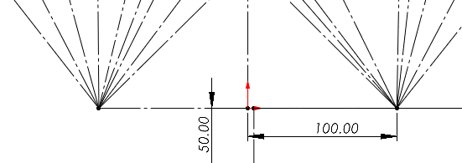
±100 mm Interaction Point Considered for Overlaps

Slide 3
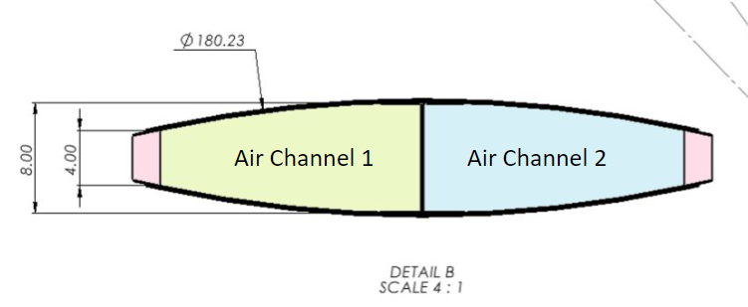
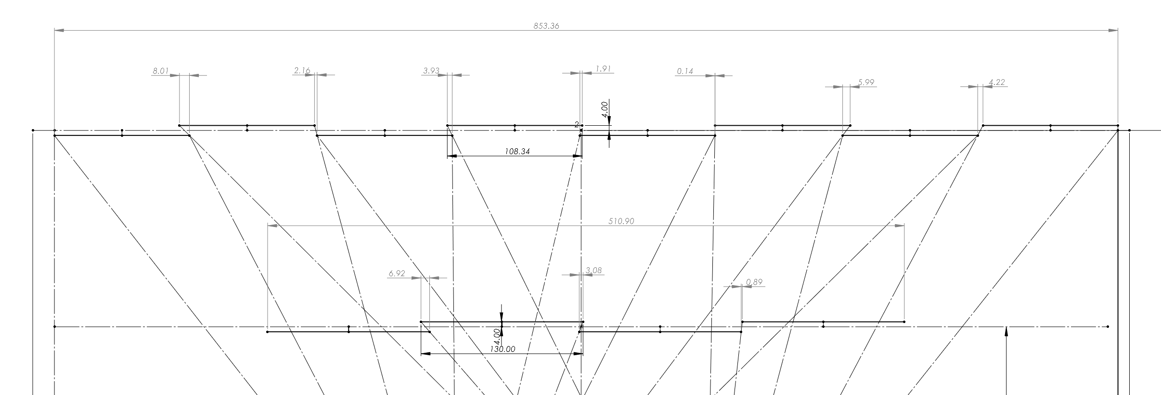
Sensor & Stave dimensions

Slide 4
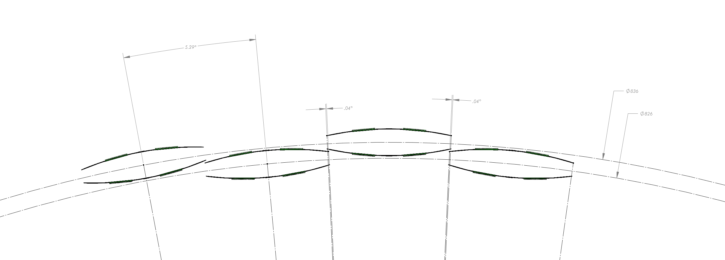
L4 – R418 & R413 QTY 68

Slide 5
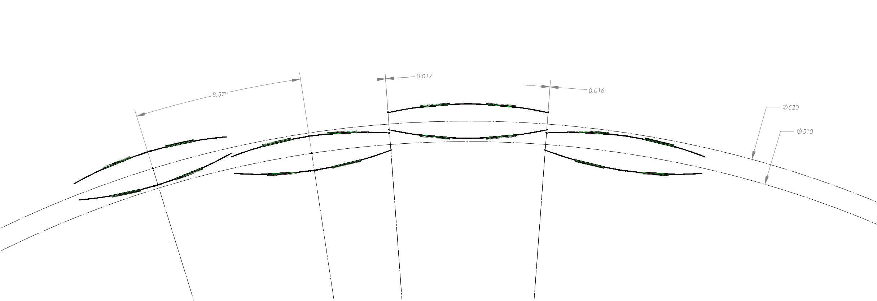
L3 – R260 & R255 QTY 42

Slide 6
