Slide 1
The Anomalous Magnetic Moment of the Muon
William Morse – BNL
July 22, 2024

Slide 2
Where does all this come from
I love physics.
I asked my professor in 1972: “Where does all this come from”.
He said “We don’t know!”
We still don’t know, but I will give some insights I have found since then.
Ask questions!

Slide 3
Matter Particles circa 1930s
Particle | Mass (MeV) | Spin (h)
Proton | 938.3 | 1/2
Neutron | 939.6 | 1/2
Electron | 0.511 | 1/2
Neutrino | ≈ 10⁻⁷ | 1/2

Slide 4
Spin = 1/2
In 1920s, two young physicists could understand the data if the electron was spinning.
Wrote a paper and submitted it to a journal.
As we will see, the reason the electron is spinning is so that we could be here to discover….

Slide 5
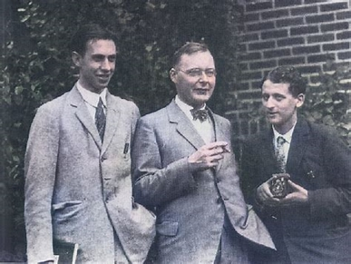
Goudsmit and Ulenbeck

Slide 6
Goudsmit’s memory
We had just written a short article in German and given to Ehrenfest, who wanted to send it to "Naturwissenschaften". Now it is being told that Uhlenbeck got frightened, went to Ehrenfest and said: "Don't send it off, because it probably is wrong; it is impossible, one cannot have an electron that rotates at such high speed and has the right moment". And Ehrenfest replied: "It is too late, I have sent it off already". But I do not remember the event, I never had the idea that is was wrong because I did not know enough. The one thing I remember is that Ehrenfest said to me: "Well, that is a nice idea, though it may be wrong. But you don't yet have a reputation, so you have nothing to lose". That is the only thing I remember.

Slide 7
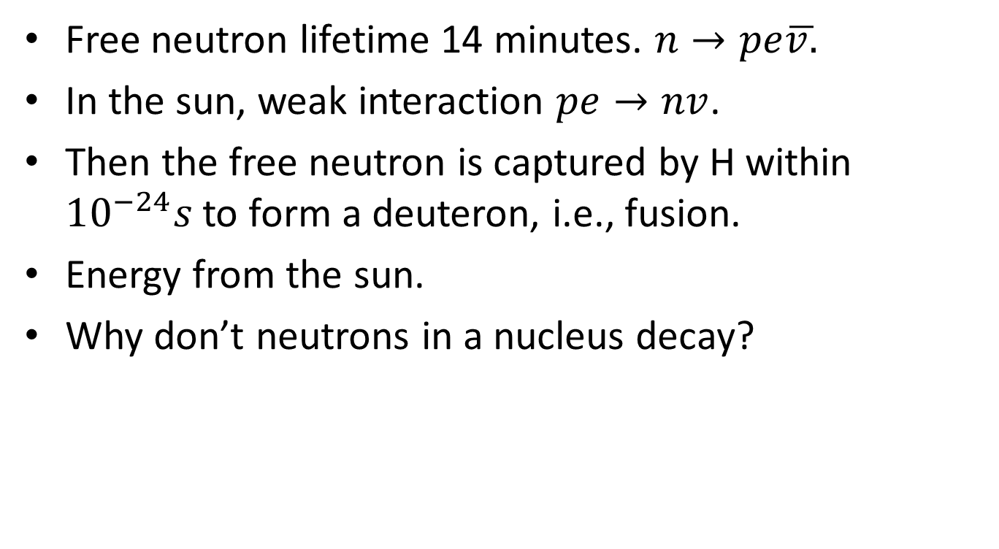
Weak Force
Free neutron lifetime 14 minutes. $n→pe\overline{v.}$
In the sun, weak interaction $pe→nv$.
Then the free neutron is captured by H within $10^{−24}s$ to form a deuteron, i.e., fusion.
Energy from the sun.
Why don’t neutrons in a nucleus decay?

Slide 8
Nuclear Physics
Binding energy of the deuteron = 2.2 MeV.
If neutron were 0.1% heavier, the deuteron would be radioactive!
If proton were heavier than the neutron, hydrogen would be radioactive!
Physics is exactly what it has to be in order for us to be here to ….

Slide 9
Quantum Mechanics
Developed 1910 – 1990 by:
Niels Bohr – “Anyone who thinks they understand QM, and is not deeply disturbed by it, doesn’t understand QM.”
Albert Einstein – “It’s spooky action at a distance”
Erwin Schrödinger – “I wish I never discovered these damn wave functions.”
I love QM! It is not trivial!
As we will see, without QM we wouldn’t be here to ….

Slide 10
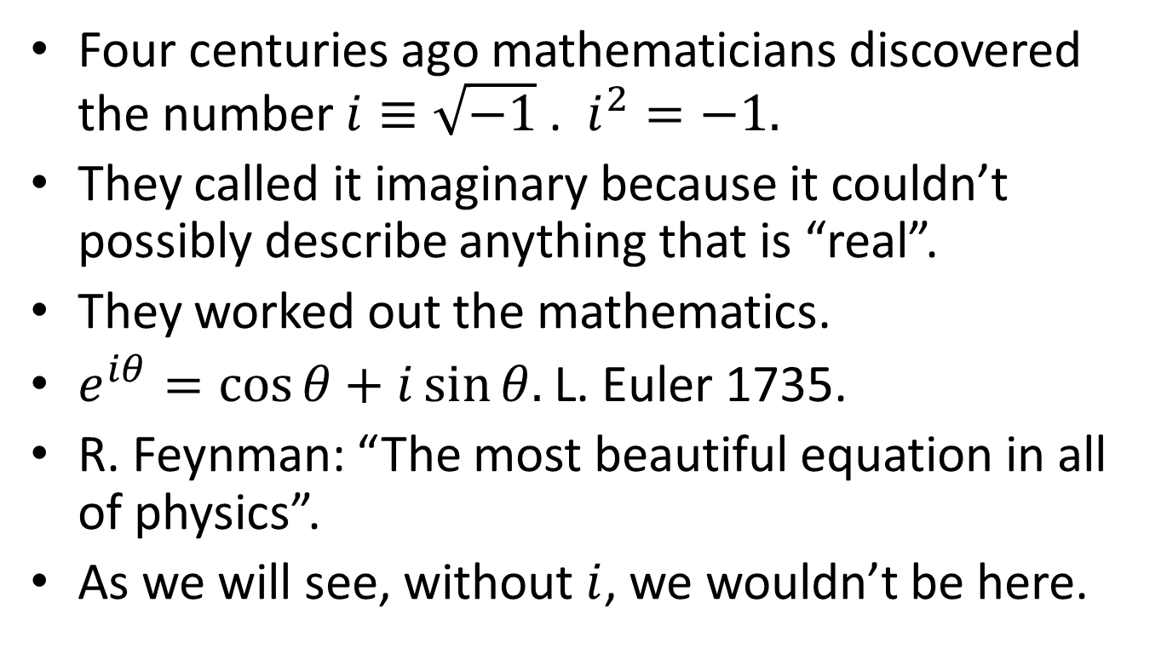
Imaginary Numbers
Four centuries ago mathematicians discovered the number $i≡\sqrt{−1}$ . $i^{2}=−1.$
They called it imaginary because it couldn’t possibly describe anything that is “real”.
They worked out the mathematics.
$e^{iθ}=\cos{θ}+i\sin{θ.}$ L. Euler 1735.
R. Feynman: “The most beautiful equation in all of physics”.
As we will see, without $i$, we wouldn’t be here.

Slide 11
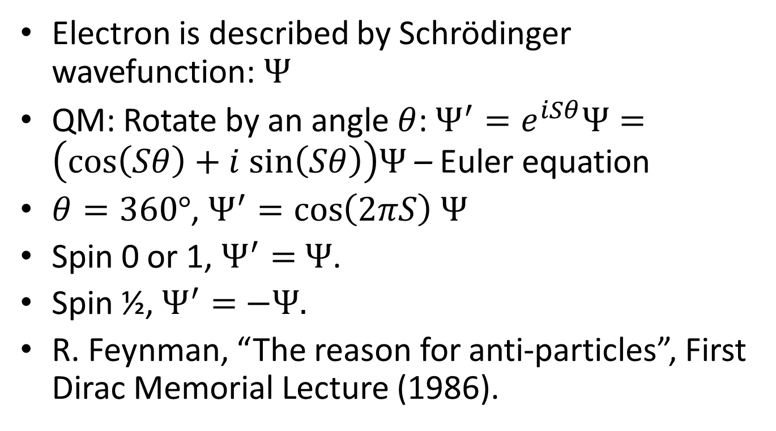
Quantum Mechanics
Electron is described by Schrödinger wavefunction: $Ψ$
QM: Rotate by an angle $θ$: $Ψ^{′}=e^{iSθ}Ψ=\left(cos\left(Sθ\right)+i sin\left(Sθ\right)\right)Ψ$ – Euler equation
$θ=360°$, $Ψ^{′}=\cos\left(2πS\right)$ $Ψ$
Spin 0 or 1, $Ψ^{′}=$ $Ψ$.
Spin ½, $Ψ^{′}=$ $−Ψ.$
R. Feynman, “The reason for anti-particles”, First Dirac Memorial Lecture (1986).

Slide 12
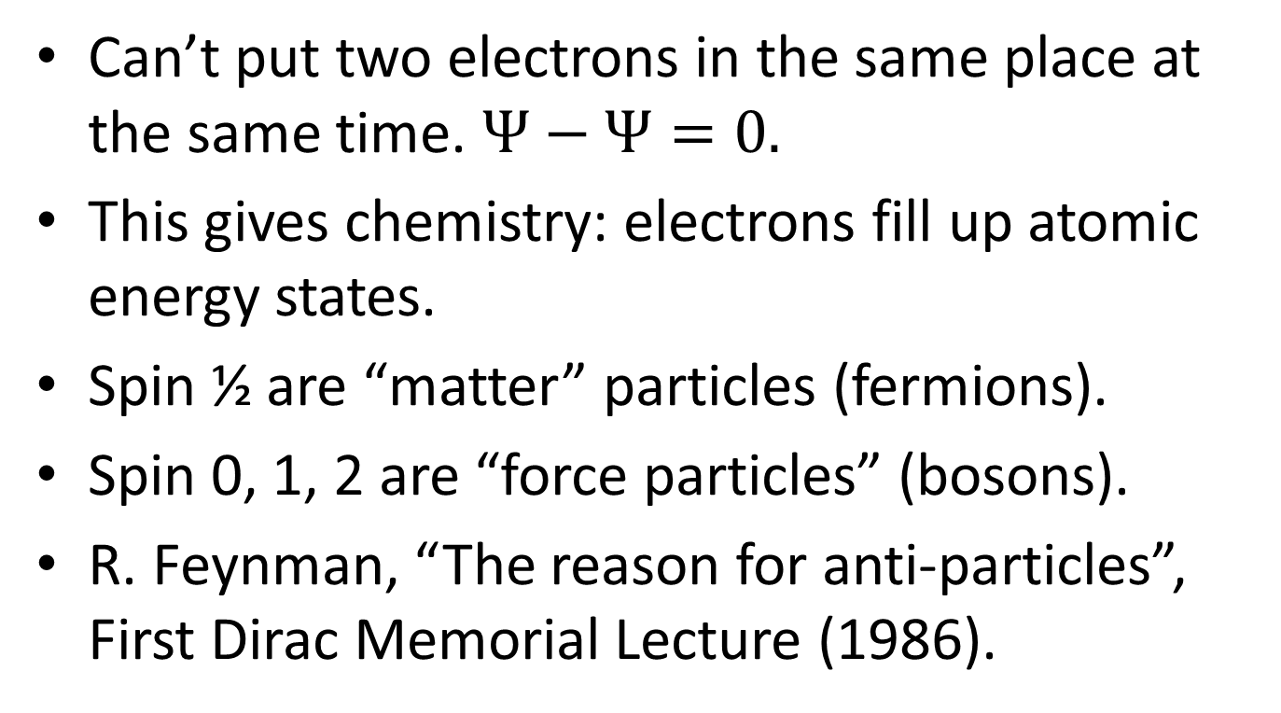
Quantum Mechanics
Can’t put two electrons in the same place at the same time. $Ψ−Ψ=0.$
This gives chemistry: electrons fill up atomic energy states.
Spin ½ are “matter” particles (fermions).
Spin 0, 1, 2 are “force particles” (bosons).
R. Feynman, “The reason for anti-particles”, First Dirac Memorial Lecture (1986).

Slide 13
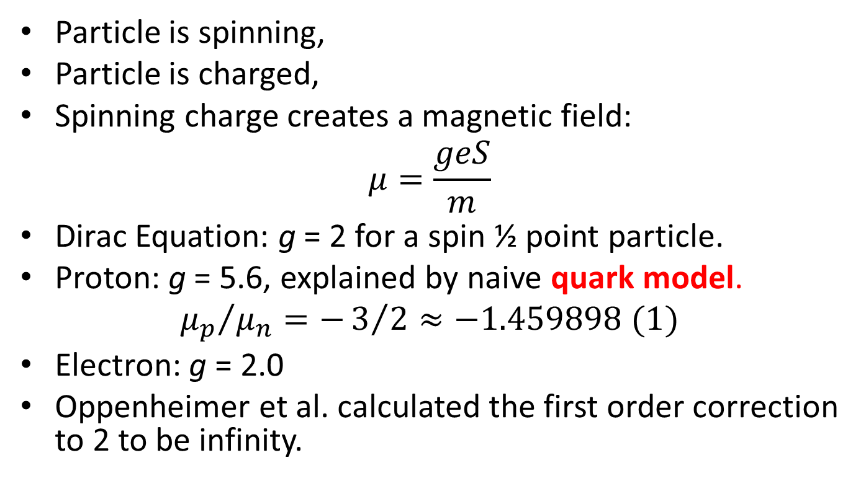
Magnetic Moment 1930s
Particle is spinning,
Particle is charged,
Spinning charge creates a magnetic field:
$$μ=\frac{geS}{m}$$
Dirac Equation: g = 2 for a spin ½ point particle.
Proton: g = 5.6, explained by naive quark model.
$${μ_{p}}/{μ_{n}=−3/2≈−1.459898 (1)}$$
Electron: g = 2.0
Oppenheimer et al. calculated the first order correction to 2 to be infinity.

Slide 14
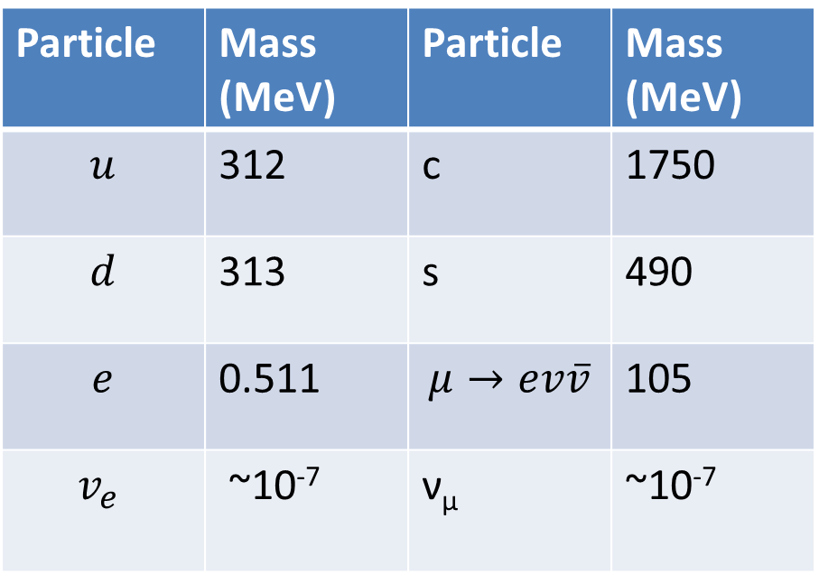
Spin ½ Particles 1940s – 1970s
I. Rabi “Who ordered that?”
Particle | Mass (MeV) | Particle | Mass (MeV)
$$u$$ | 312 | c | 1750
$$d$$ | 313 | s | 490
$$e$$ | 0.511 | $$μ→ev\overline{v}$$ | 105
$$v_{e}$$ | ~10⁻⁷ | ν_{µ} | ~10⁻⁷

Slide 15
Symmetries
C symmetry – changes particle to anti-particle.
P symmetry – changes x to –x.
T symmetry – changes t to –t.
Good symmetries for strong, and EM.
Discovered in 1950 – 60s: P, T, C are broken symmetries in the weak interaction.
As we will show, without the weak interaction broken symmetries, we wouldn’t be here …..

Slide 16
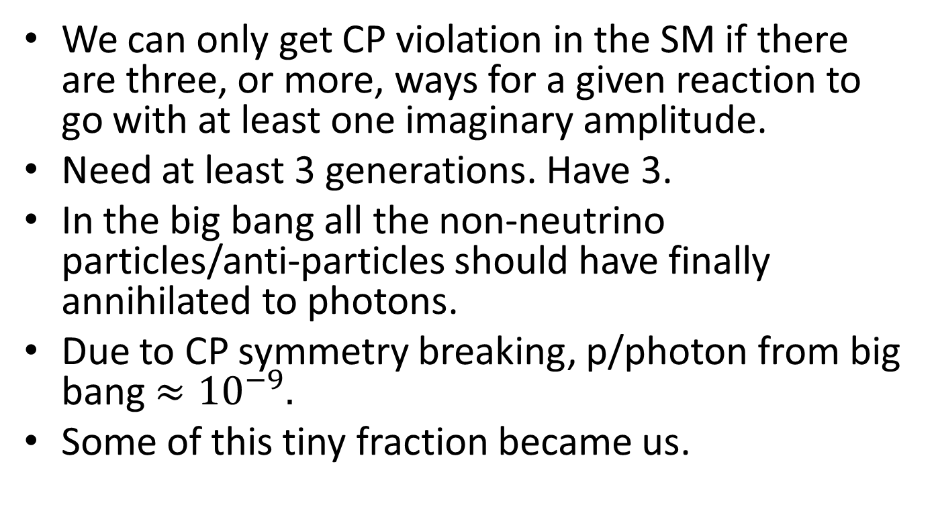
Theory 1970s
We can only get CP violation in the SM if there are three, or more, ways for a given reaction to go with at least one imaginary amplitude.
Need at least 3 generations. Have 3.
In the big bang all the non-neutrino particles/anti-particles should have finally annihilated to photons.
Due to CP symmetry breaking, p/photon from big bang $≈10^{−9}.$
Some of this tiny fraction became us.

Slide 17
Theory 1980 - 2024
Not enough CP symmetry violation in the SM Big Bang for us to be here.
Maybe super-symmetry (SUSY).
Symmetry between spin ½ and spin 1, for example.
SUSY electron is a “force” particle! SUSY photon is a “matter particle”!
I love super-symmetry, because I love symmetry.
Without this new physics, whatever it may be, we wouldn’t be here …

Slide 18
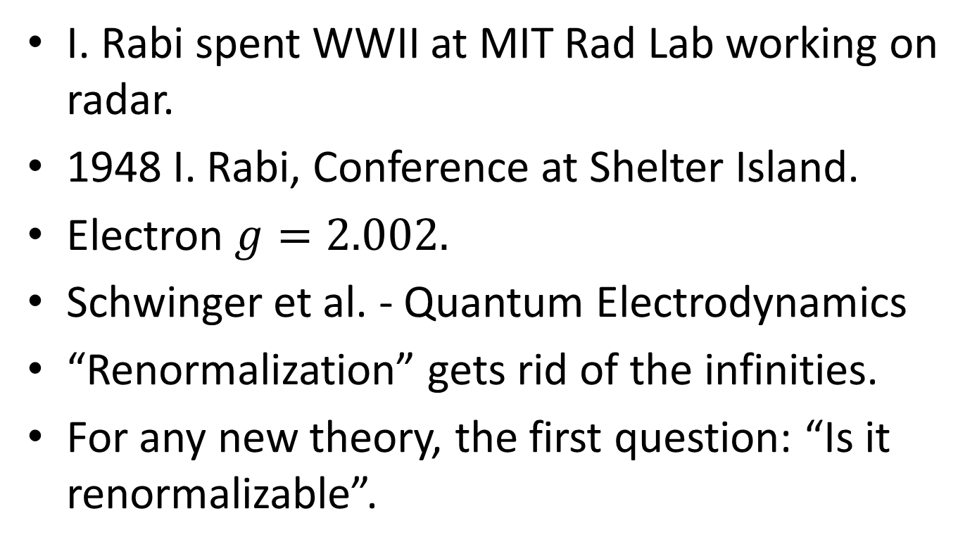

Dirac: Electron $g=2.0$
I. Rabi spent WWII at MIT Rad Lab working on radar.
1948 I. Rabi, Conference at Shelter Island.
Electron $g=2.002.$
Schwinger et al. - Quantum Electrodynamics
“Renormalization” gets rid of the infinities.
For any new theory, the first question: “Is it renormalizable”.

Slide 19
QED Renormalization
Renormalization is a collection of techniques in quantum field theory, the statistical mechanics of fields, and the theory of self-similar geometric structures, that are used to treat infinities arising in calculated quantities by altering values of these quantities to compensate for effects of their self-interactions.
For example, an electron theory may begin by postulating an electron with an initial mass and charge. In quantum field theory a cloud of virtual particles, such as photons, positrons, and others surrounds and interacts with the initial electron. Accounting for the interactions of the surrounding particles (e.g. collisions at different energies) shows that the electron-system behaves as if it had a different mass and charge than initially postulated. Renormalization, in this example, mathematically replaces the initially postulated mass and charge of an electron with the experimentally observed mass and charge.

Slide 20
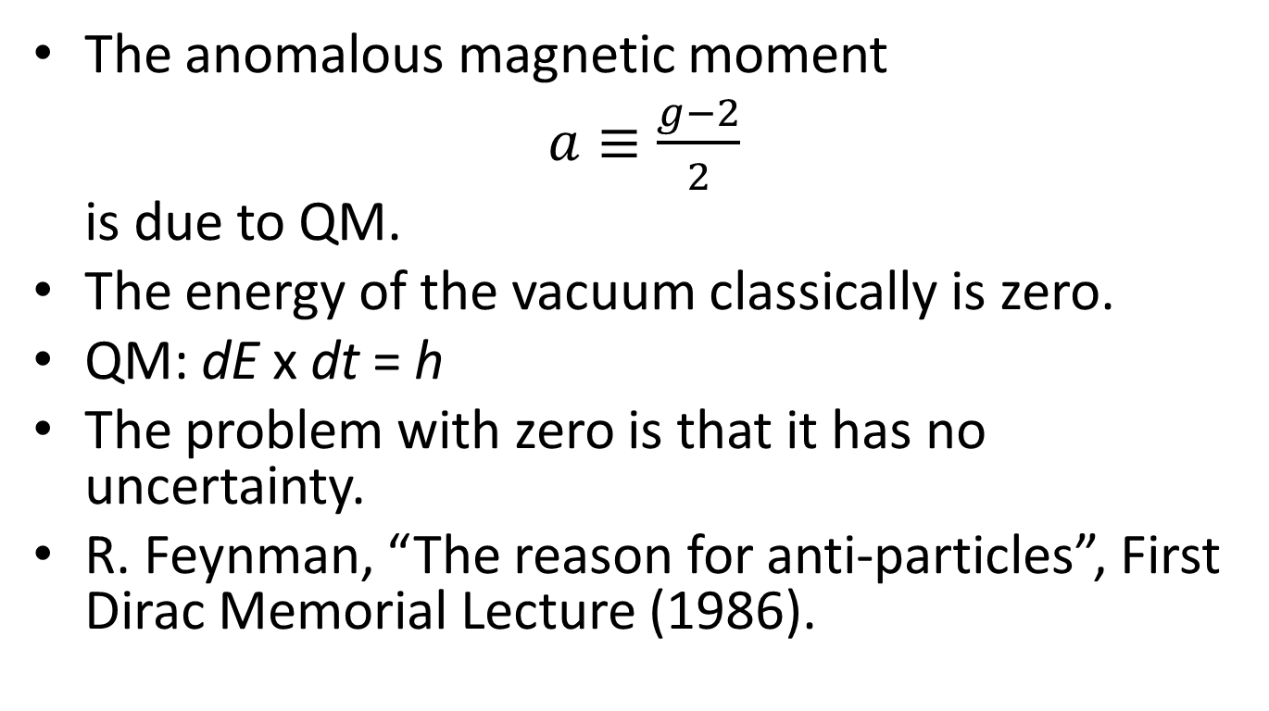
Quantum Mechanics
The anomalous magnetic moment
$a≡\frac{g−2}{2}$
is due to QM.
The energy of the vacuum classically is zero.
QM: dE x dt = h
The problem with zero is that it has no uncertainty.
R. Feynman, “The reason for anti-particles”, First Dirac Memorial Lecture (1986).

Slide 21
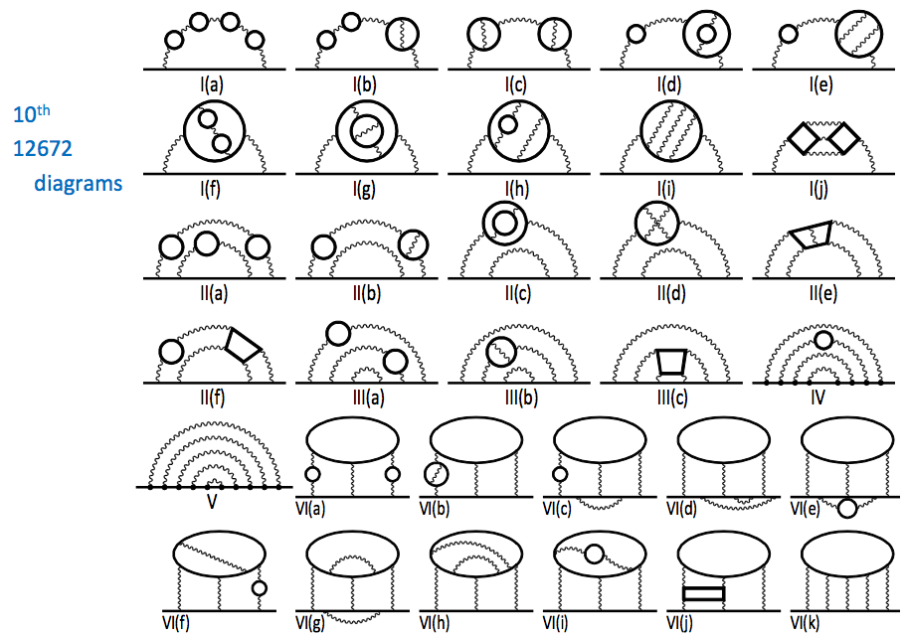
Quantum Electro-Dynamics
Not Boring!
Doesn’t this affect
Einstein’s
General
Theory
Relativity?
Cosmological constant!
dE x dt = h

Slide 22
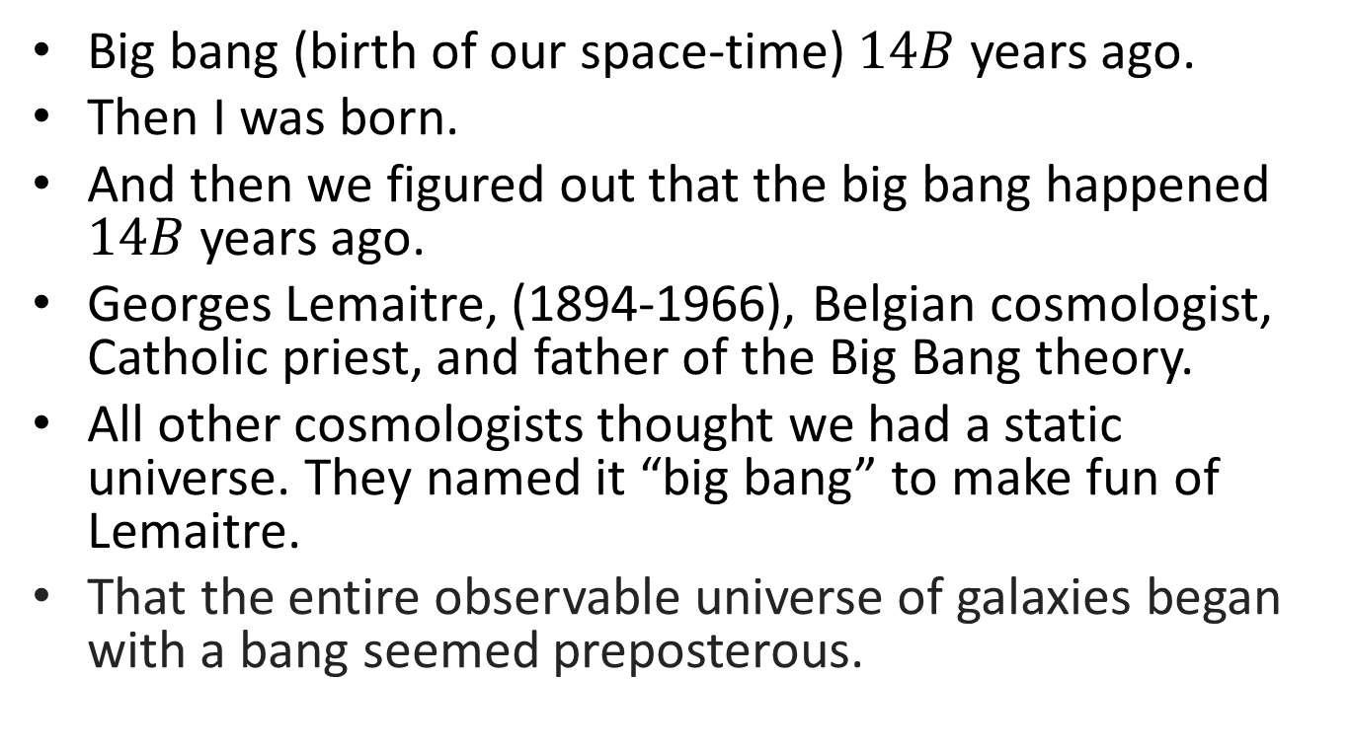
History of the Universe
Big bang (birth of our space-time) $14B$ years ago.
Then I was born.
And then we figured out that the big bang happened $14B$ years ago.
Georges Lemaitre, (1894-1966), Belgian cosmologist, Catholic priest, and father of the Big Bang theory.
All other cosmologists thought we had a static universe. They named it “big bang” to make fun of Lemaitre.
That the entire observable universe of galaxies began with a bang seemed preposterous.

Slide 23
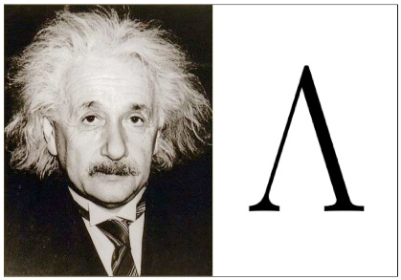
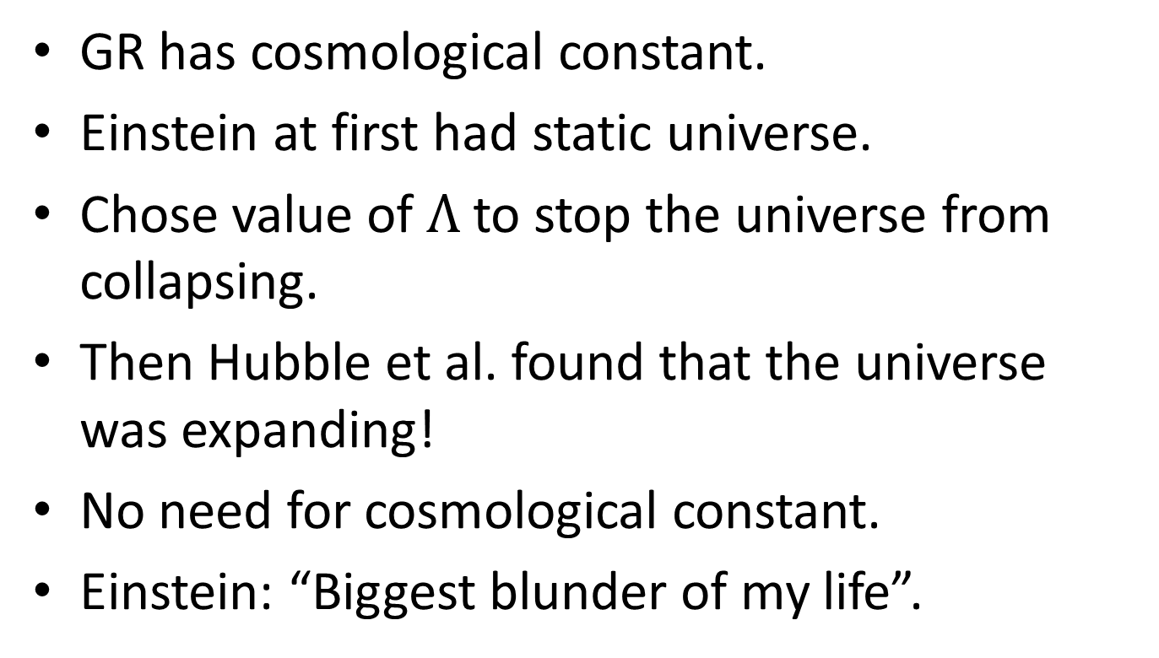
Einsteins’ Cosmological Constant
GR has cosmological constant.
Einstein at first had static universe.
Chose value of $Λ$ to stop the universe from collapsing.
Then Hubble et al. found that the universe was expanding!
No need for cosmological constant.
Einstein: “Biggest blunder of my life”.

Slide 24
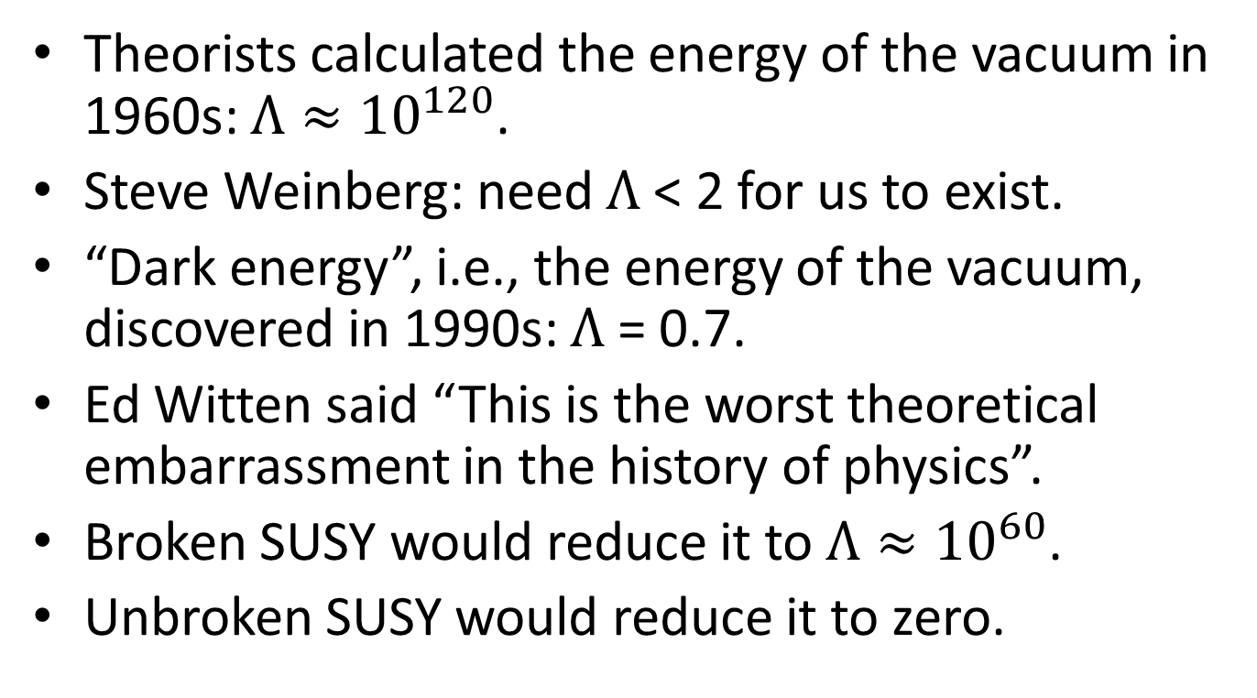
Energy of the Vacuum
Theorists calculated the energy of the vacuum in 1960s: ${Λ≈10}^{120}$.
Steve Weinberg: need $Λ$< 2 for us to exist.
“Dark energy”, i.e., the energy of the vacuum, discovered in 1990s: $Λ$= 0.7.
Ed Witten said “This is the worst theoretical embarrassment in the history of physics”.
Broken SUSY would reduce it to ${Λ≈10}^{60}$.
Unbroken SUSY would reduce it to zero.

Slide 25
Quantum Mechanics
All particles exist in the vacuum.
All particles contribute to the anomalous magnetic moment.
Are there new particles beyond the SM?
Are there new symmetries?
New CP violation sources? Yes!
BNL E821 1990 - 2010: measured anomalous magnetic moment to 0.5 parts per million (ppm).
Previous experiment uncertainty = 7.1ppm.
Theorists need to calculate to 0.5ppm.
Compare.

Slide 26
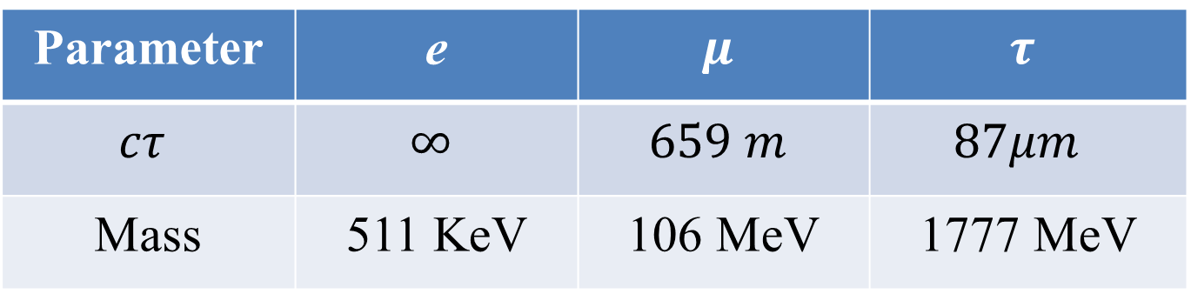

New Heavy Physics
Lepton sensitivity to new physics.
$\frac{da_{l}}{a_{l}}∝\frac{M_{l}^{2}}{M_{NP}^{2}}$
Parameter | e | $$μ$$ | $$τ$$
$$cτ$$ | $$∞$$ | $$659 m$$ | $$87μm$$
Mass | 511 KeV | 106 MeV | 1777 MeV

Slide 27


Measured $a_{l}$
$e 0.00115965218059(13)$
$μ 0.00116592059(22)$
$τ −0.052 to 0.013.$

Slide 28
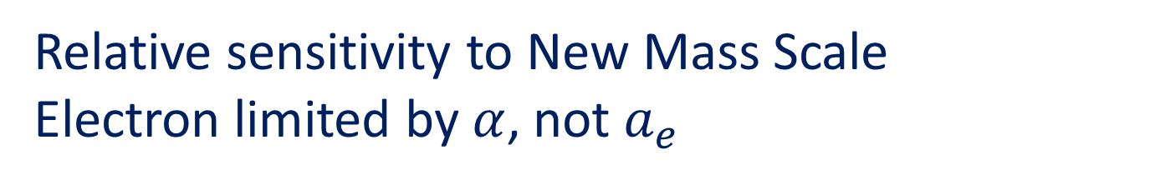
Relative sensitivity to New Mass Scale
Electron limited by $α$, not $a_{e}$
1 = electron, 2 = muon, 3 = tau

Slide 29


Measurements of $α$
Disagree by $5.5σ$
$5.5 σ$difference

Slide 30


Spin Precession
spinning top $μ$ magnetic moment
$G$ $B$
$$ω_{a}≈\frac{eaB}{m}$$

Slide 31
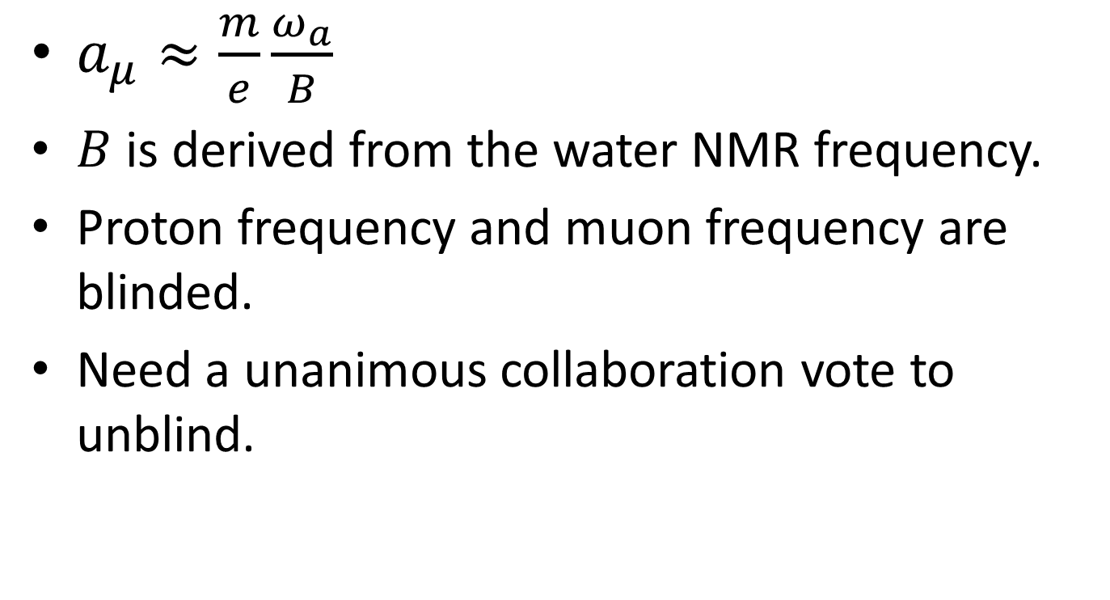
Blind Analysis
$a_{μ}≈\frac{m}{e}\frac{ω_{a}}{B}$
$B$ is derived from the water NMR frequency.
Proton frequency and muon frequency are blinded.
Need a unanimous collaboration vote to unblind.

Slide 32
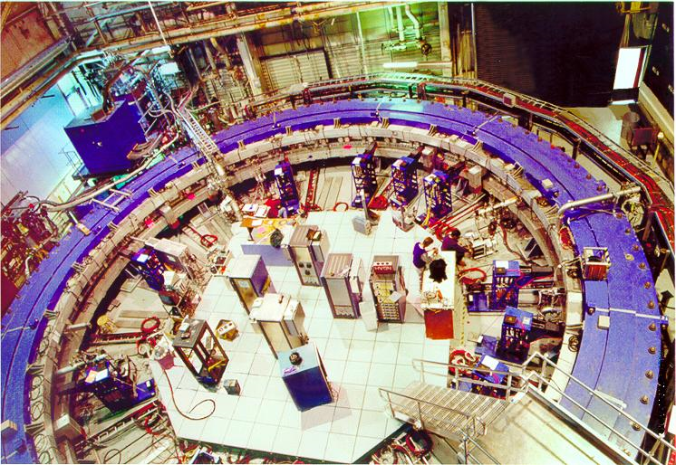
Muon Storage Ring at BNL
24 calos

Slide 33

Kicker
$x x′$ plot
Beam exits inflector mag.
Simple harmonic motion.
$x≈x_{0}+A\cos\left(Qs/R\right)$
$x_{0}=D dp/p$.
Ellipse in $x x′$ plot.
10mrad kick at 90 degree
betatron phase advance.
Storage ring Infector
storage region inflector

Slide 34

Kicker
$0.5\%$ higher $p$.
Equilibrium orbit $x_{0}=40.5 mm.$
Not stored, unless smaller kick.
Kicker-momentum correlation
Will give a systematic effect.

Slide 35
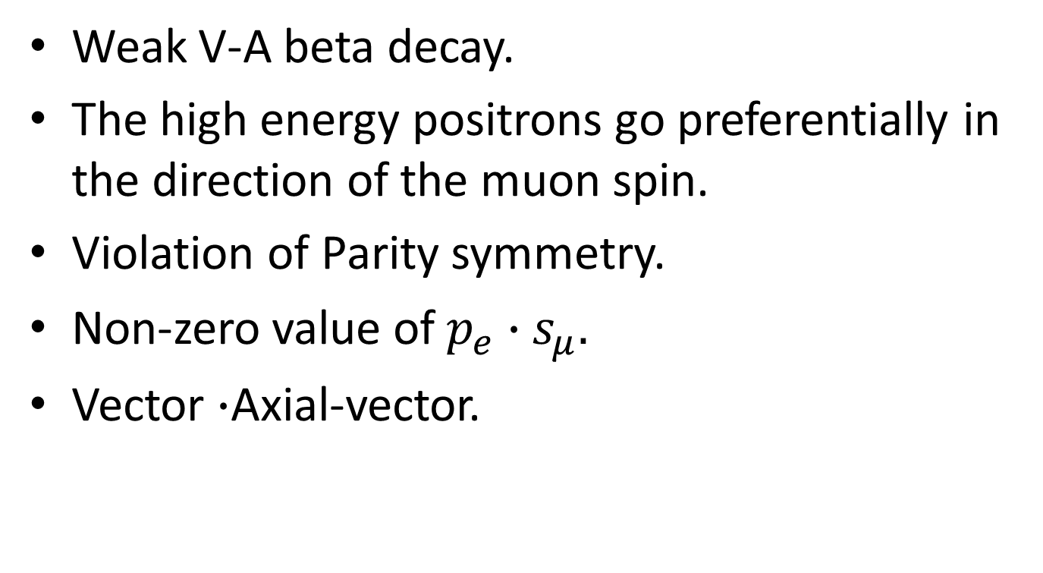

$$μ→ev\overline{v}$$
Weak V-A beta decay.
The high energy positrons go preferentially in the direction of the muon spin.
Violation of Parity symmetry.
Non-zero value of $p_{e}∙s_{μ}.$
Vector $∙$Axial-vector.

Slide 36
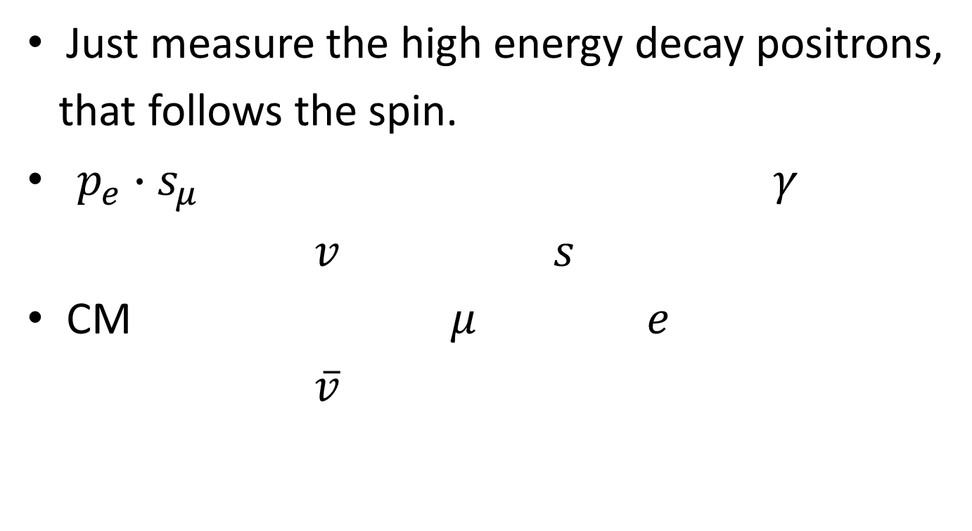
$$μ→ev\overline{v}$$
Just measure the high energy decay positrons,
that follows the spin.
$p_{e}∙s_{μ}$ $γ$
$v$ $s$
CM $μ$ $e$
$\overline{v}$

Slide 37
24 calorimeters around the ring
Decay positron curls into the calorimeter.
Calorimeter measures time and energy.

Slide 38
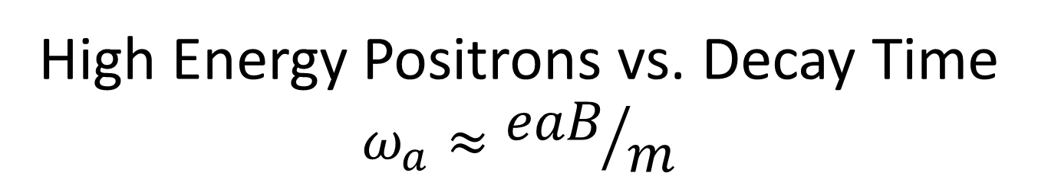
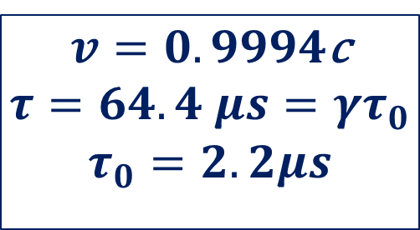
High Energy Positrons vs. Decay Time
$$ω_{a}≈{eaB}/m$$
$v=0.9994$c
$$τ=64.4 μs=γτ_{0}$$
$$τ_{0}=2.2μs$$

Slide 41
Long wavelength

Slide 42

$$2g≈\frac{L}{μ}$$

Slide 43
(1200)
short wavelength

Slide 44
Magnetic Field 1.45T

Slide 46

Adjust curents in ${10}^{2}$ wires on the poles

Slide 48
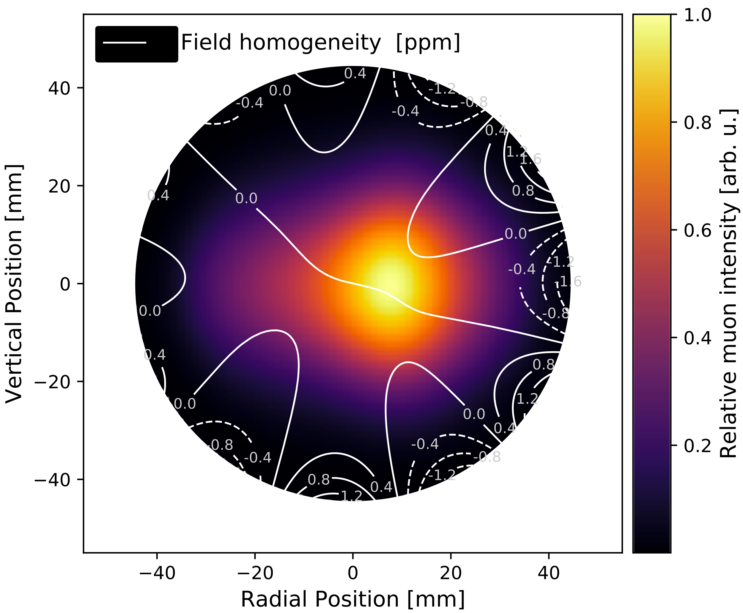
FNAL E989

Slide 49
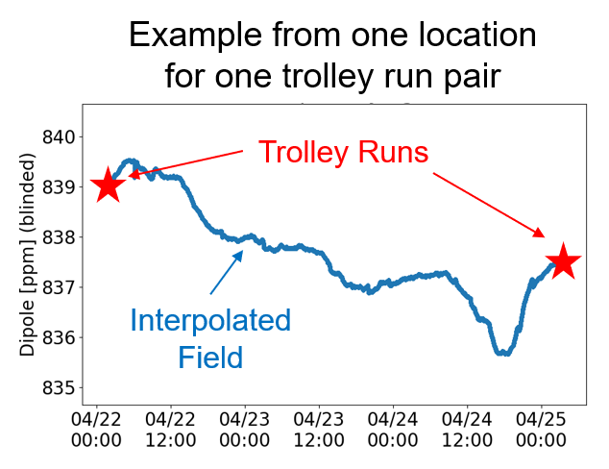
375 fixed nmr probes. 17 trolley nmr probes.

Slide 50
BNL E821 uncertainties
Dominated by statistical uncertainty
Quantity | Uncertainty
Statistical | 460 ppb
Systematic B | 170 ppb
Systematic fitting mu data | 210 ppb
Total | 533 ppb

Slide 51
Beam/Spin Systematic
The muon spin starts precessing as soon as it enters the storage ring.
The head of the bunch has more spin precession than the tail.
The kick is not uniform, so the average momentum is different for the head and the tail of the bunch.

Slide 52
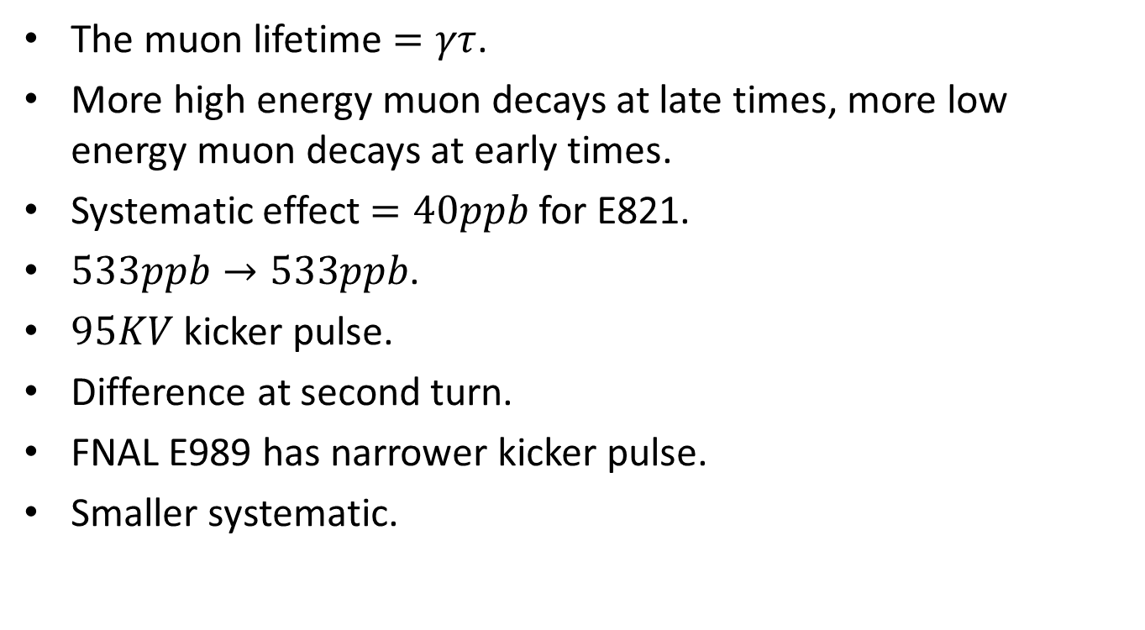
Beam/Spin Systematic Effect
The muon lifetime $=γτ$.
More high energy muon decays at late times, more low energy muon decays at early times.
Systematic effect $=40ppb$ for E821.
$533ppb→533ppb$.
$95KV$kicker pulse.
Difference at second turn.
FNAL E989 has narrower kicker pulse.
Smaller systematic.

Slide 53
“Theory Initiative”
Muon g-2 SM theory calculation team.

Slide 54
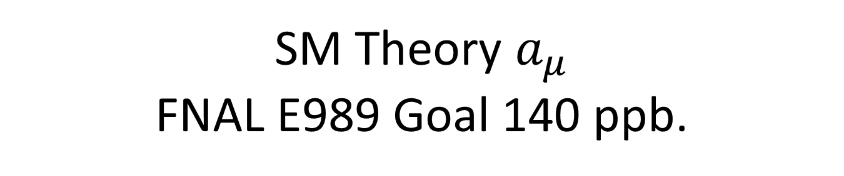
SM Theory $a_{μ}$
FNAL E989 Goal 140 ppb.

Slide 55

2004 BNL E821 vs. SM $3σ$
amu

Slide 56
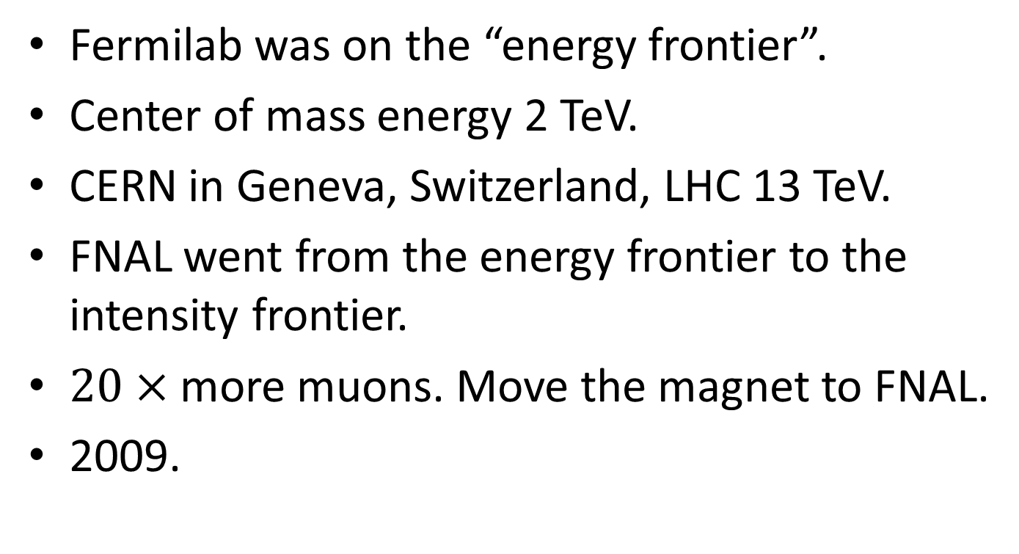
BNL to Fermilab
Fermilab was on the “energy frontier”.
Center of mass energy 2 TeV.
CERN in Geneva, Switzerland, LHC 13 TeV.
FNAL went from the energy frontier to the intensity frontier.
$20×$ more muons. Move the magnet to FNAL.
2009.

Slide 57
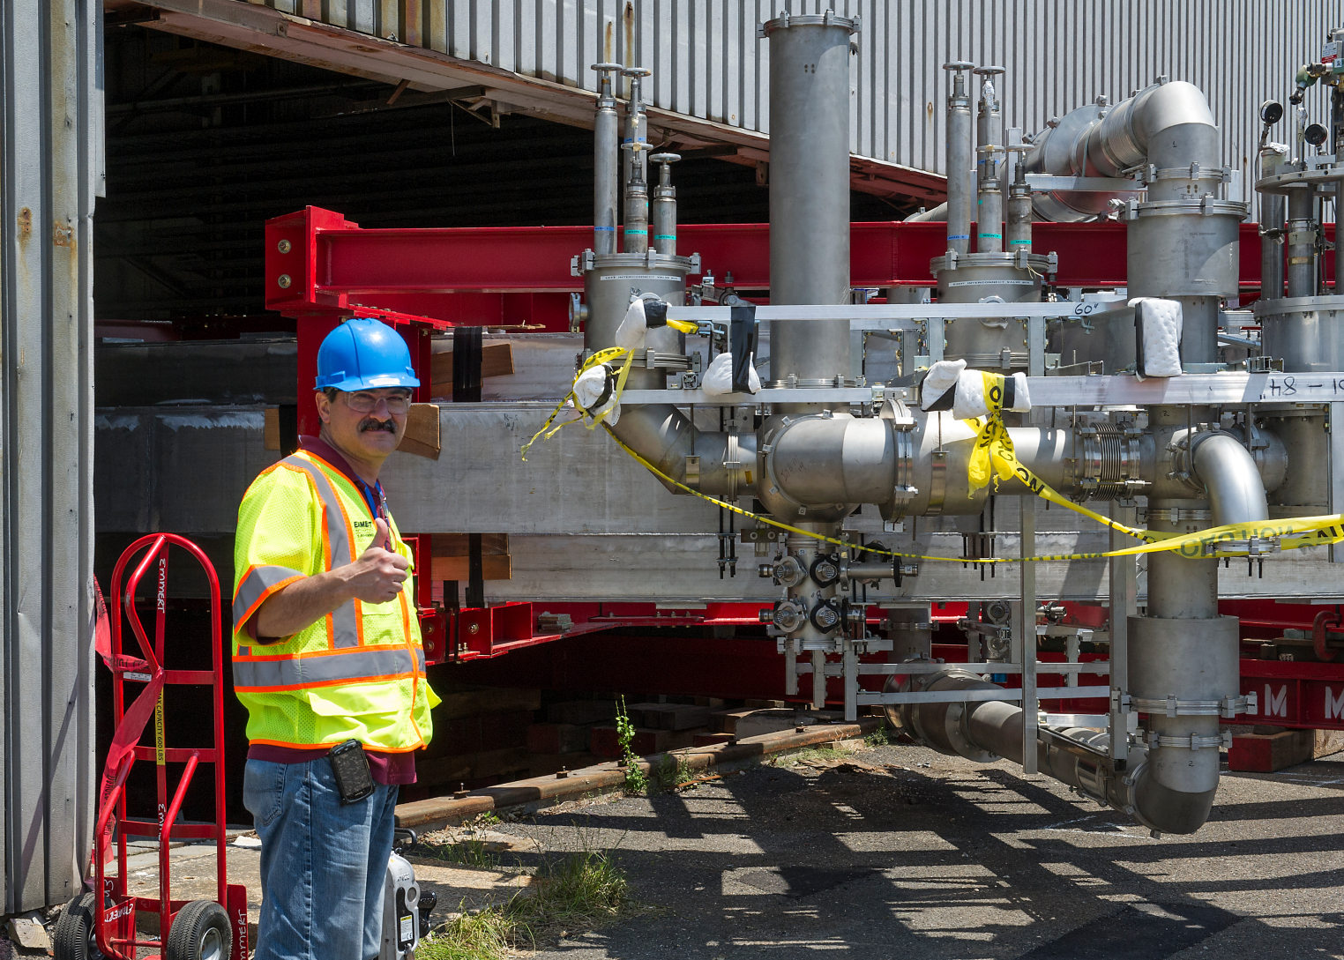
Move from BNL to FNAL

Slide 58
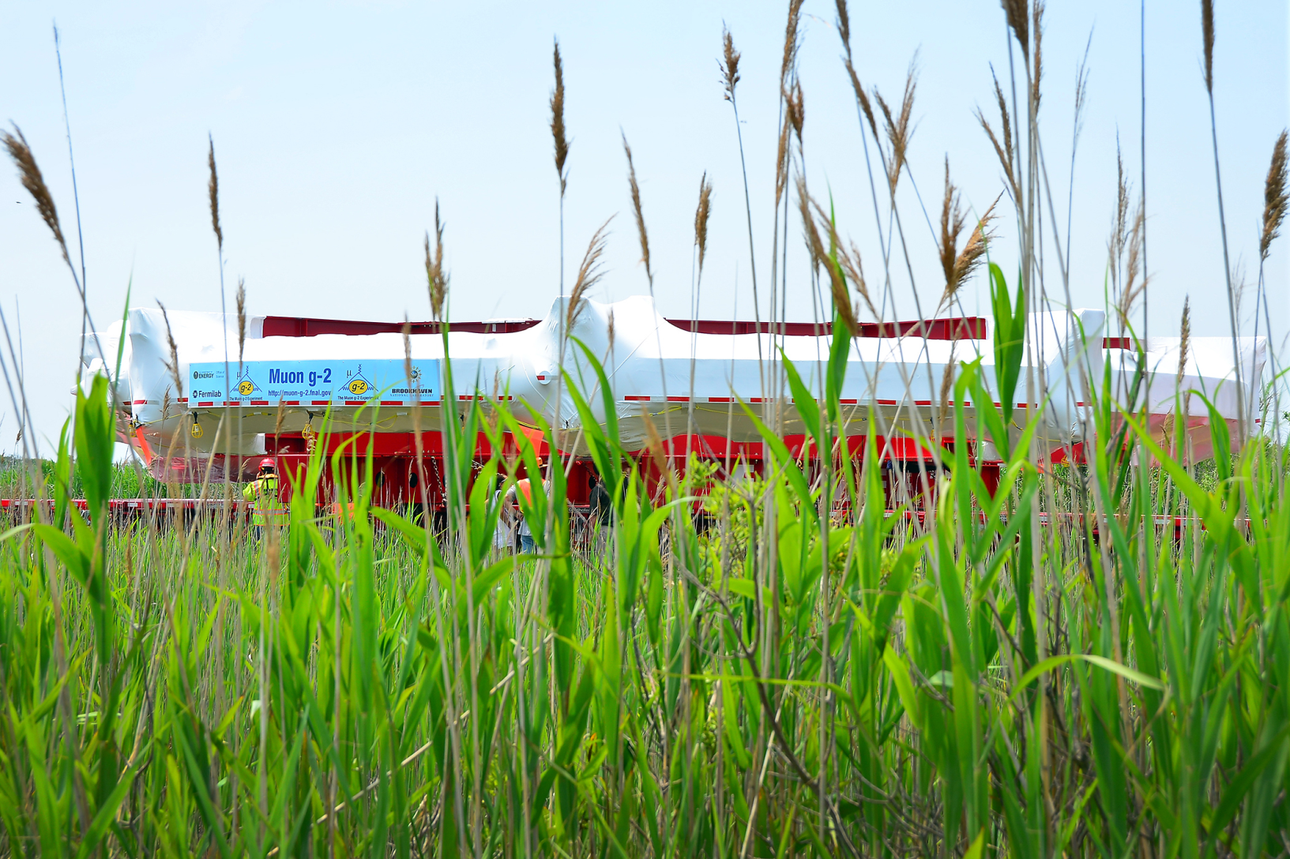
Smith Point Marina

Slide 59
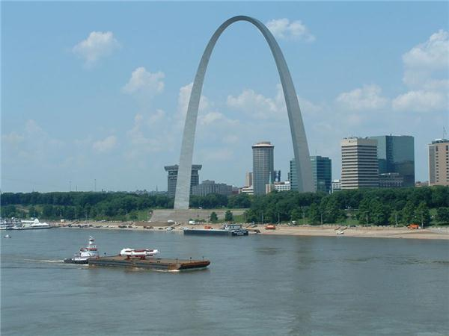
Around FL, and up Miss. River

Slide 60
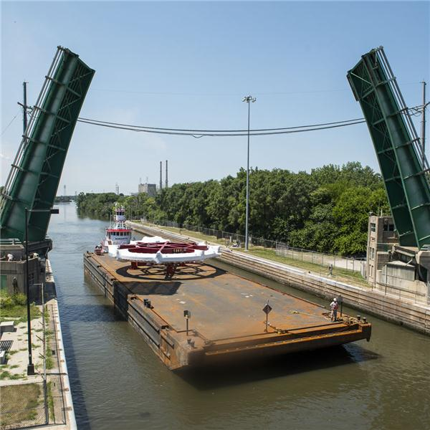
Up Illinois River

Slide 61
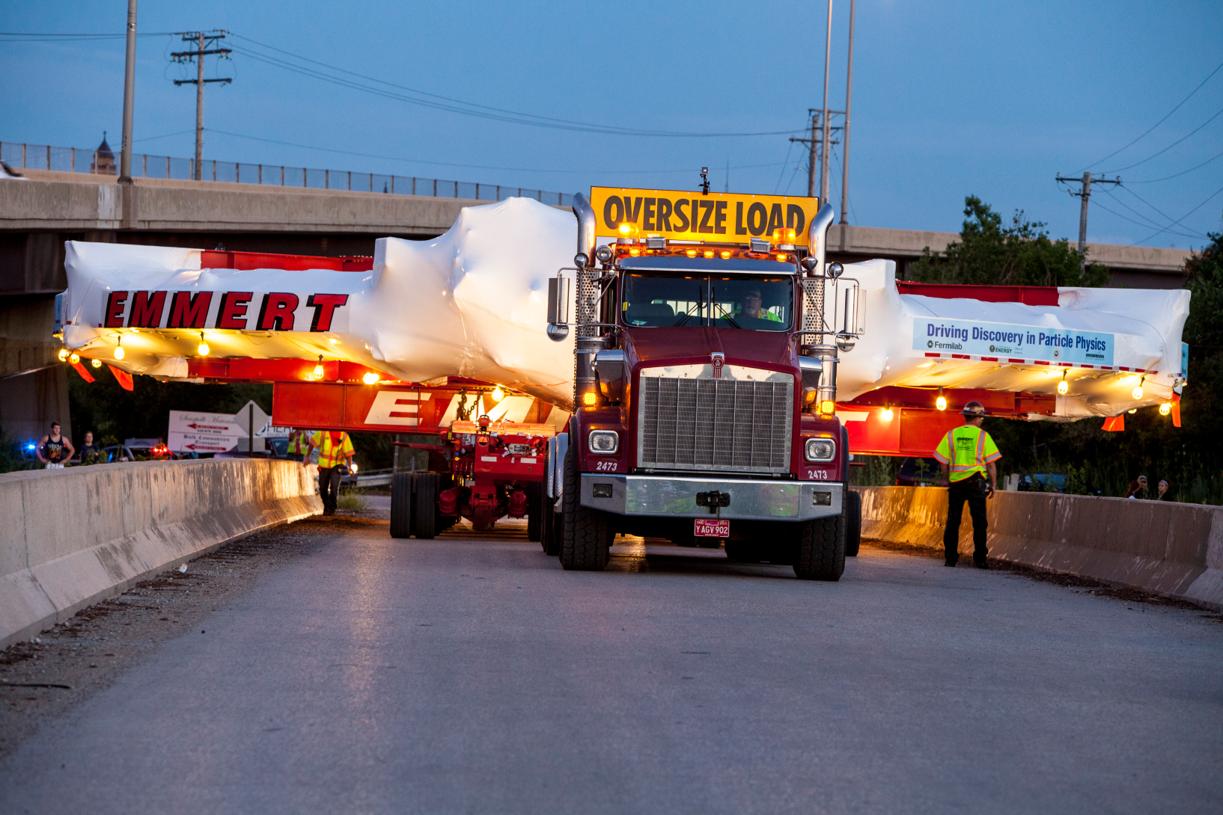
Entrance Ramp to Interstate 88

Slide 62
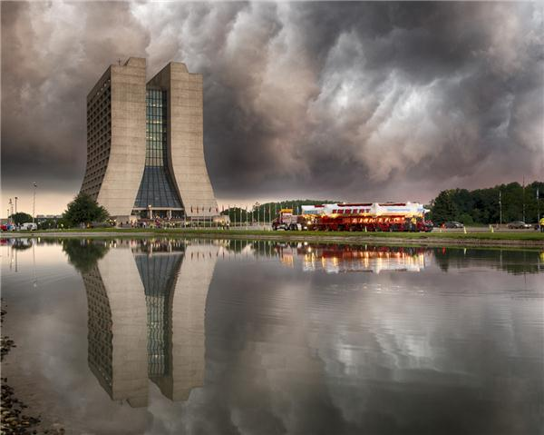
Arriving at FNAL 2013

Slide 64
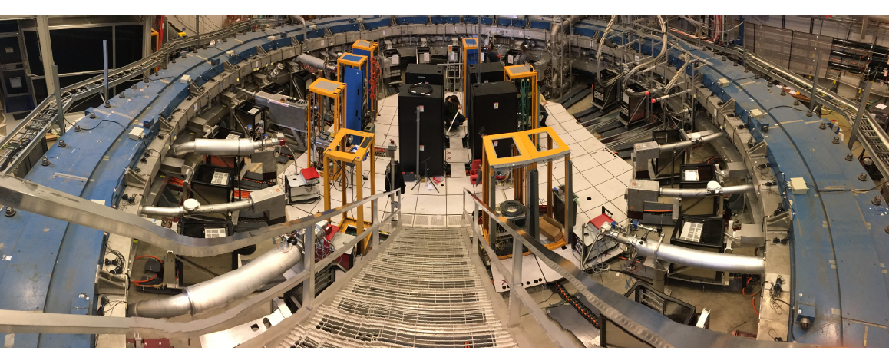
FNAL 2017

Slide 65
FNAL Run 1-3 Agrees with BNL!
Analyzing Runs 4-6 now (x4 muons)

Slide 66
Run 2/3 Uncertainties
systematic | ppb
Ce | 32
Cp | 10
Cml | 3
Cdd | 17
Cpa | 13
wa | 25
B | 52
mu' (T) | 11
total syst | 71
stat | 201

Slide 67

Experiment vs. SM $a_{μ}$

Slide 68
Lattice QCD
The gauge theory of the strong interaction is quantum chromo-dynamics (QCD).
QCD is very difficult to solve exactly.
Make a lattice with separation between the points = a.
Solve at the lattice points.
Extrapolate to a = 0.
Progress has been made lately using super-computers with ever smaller lattice spacing.

Slide 69
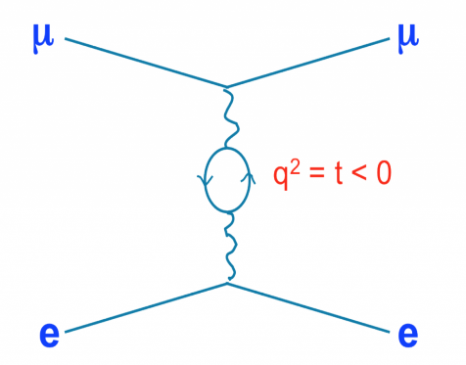
Future CERN Experiment
3rd way to measure HVP.
MUonE experiment at CERN to measure HVP.
Measures muon - atomic electron scattering.

Slide 70
Future JPARC Muon g-2 Experiment
Different systematics compared to BNL/FNAL.
0.3 GeV/c cold muon beam.

Slide 71
Very low emittance beam

Slide 72
Very small kick compared to BNL/FNAL

Slide 73
Tracking vs. calorimetry latetimes

Slide 74
Early times - 25 muon decays

Slide 75

JPARC E34, Phase 1: $±450ppb$

Slide 76
Joseph Pulitzer circa 1899
“Go west young man, go west”.
Muon g-2:
1970 – 1980s: CERN, Switzerland.
1990 – 2010s: BNL, N.Y.
2010 – 2025s: FNAL, Batavia, IL.
2020s – 2030s: JPARC, Japan.

Slide 77
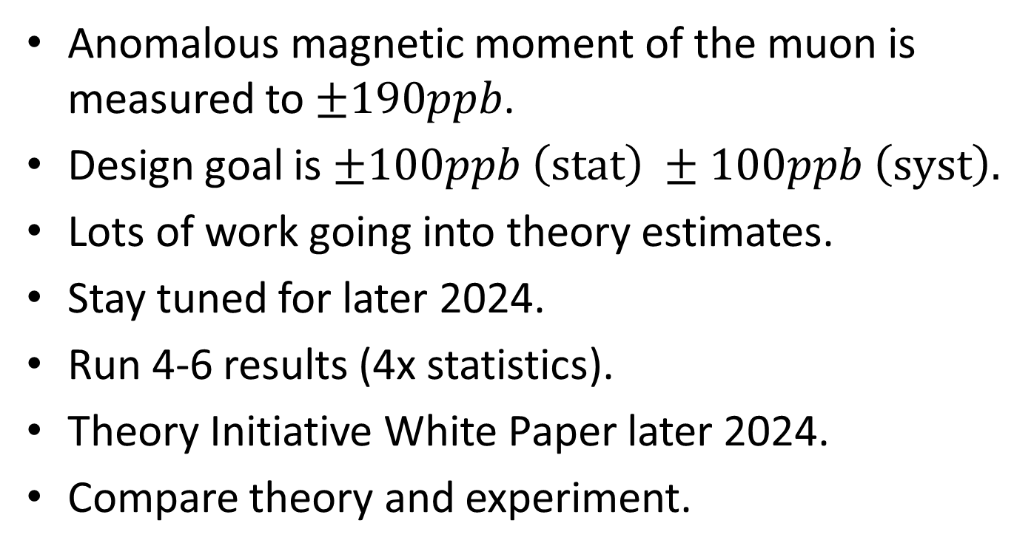
Conclusions
Anomalous magnetic moment of the muon is measured to $±190ppb$.
Design goal is $±100ppb \left(stat\right) ±100ppb \left(syst\right).$
Lots of work going into theory estimates.
Stay tuned for later 2024.
Run 4-6 results (4x statistics).
Theory Initiative White Paper later 2024.
Compare theory and experiment.

Slide 78
Extra

Slide 79
A typical free induction decay (FID) from a trolley probe. The zoomed inset shows the periodic behavior that is used to measure B.

Slide 80
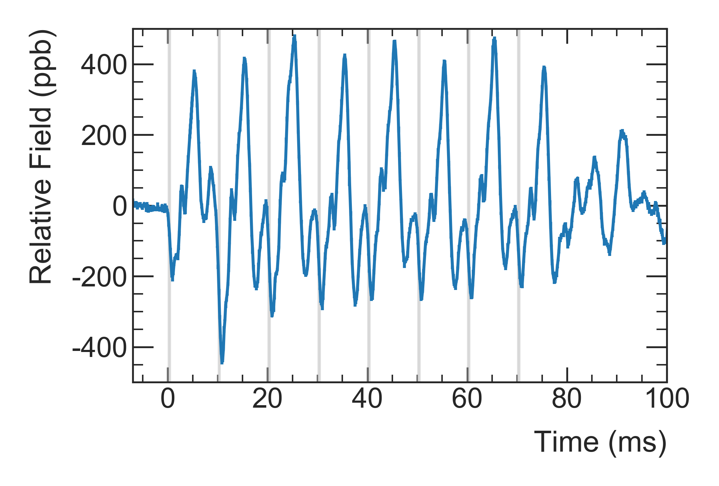
Field Change [ppb]
Muon fills

Slide 81
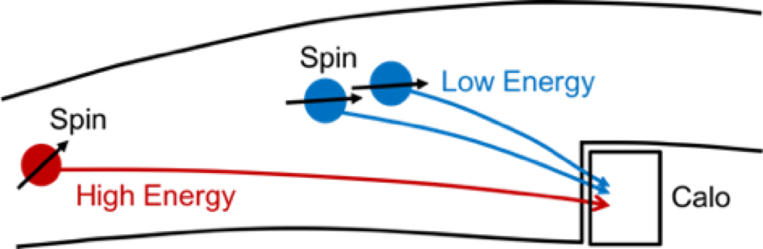
Pileup

Slide 82
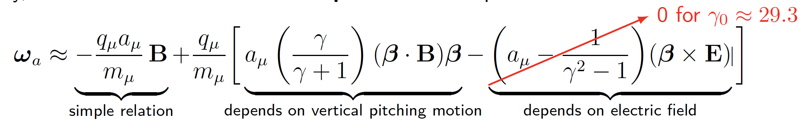

Slide 84
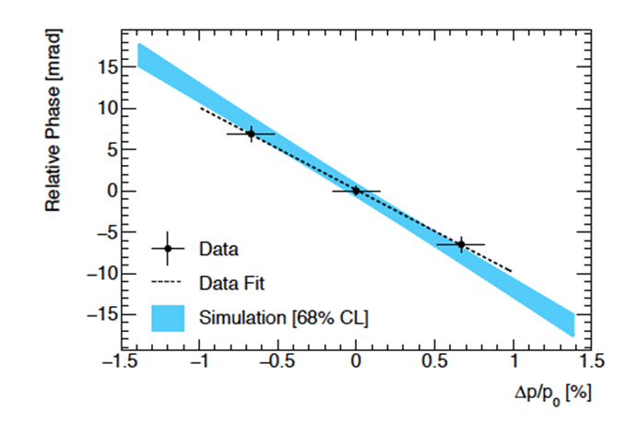
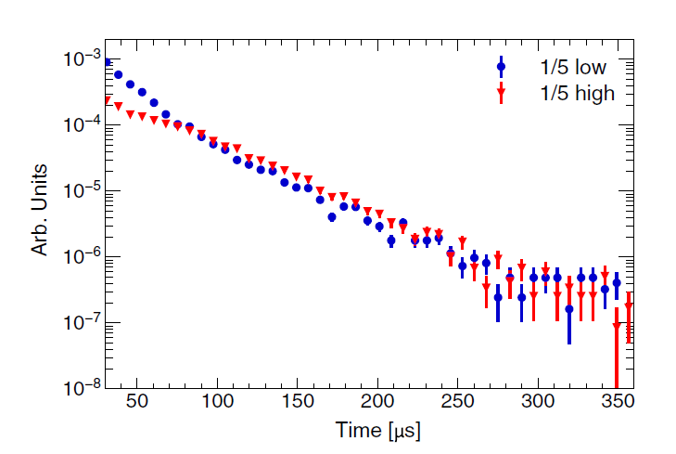
Lost Muons

Slide 85
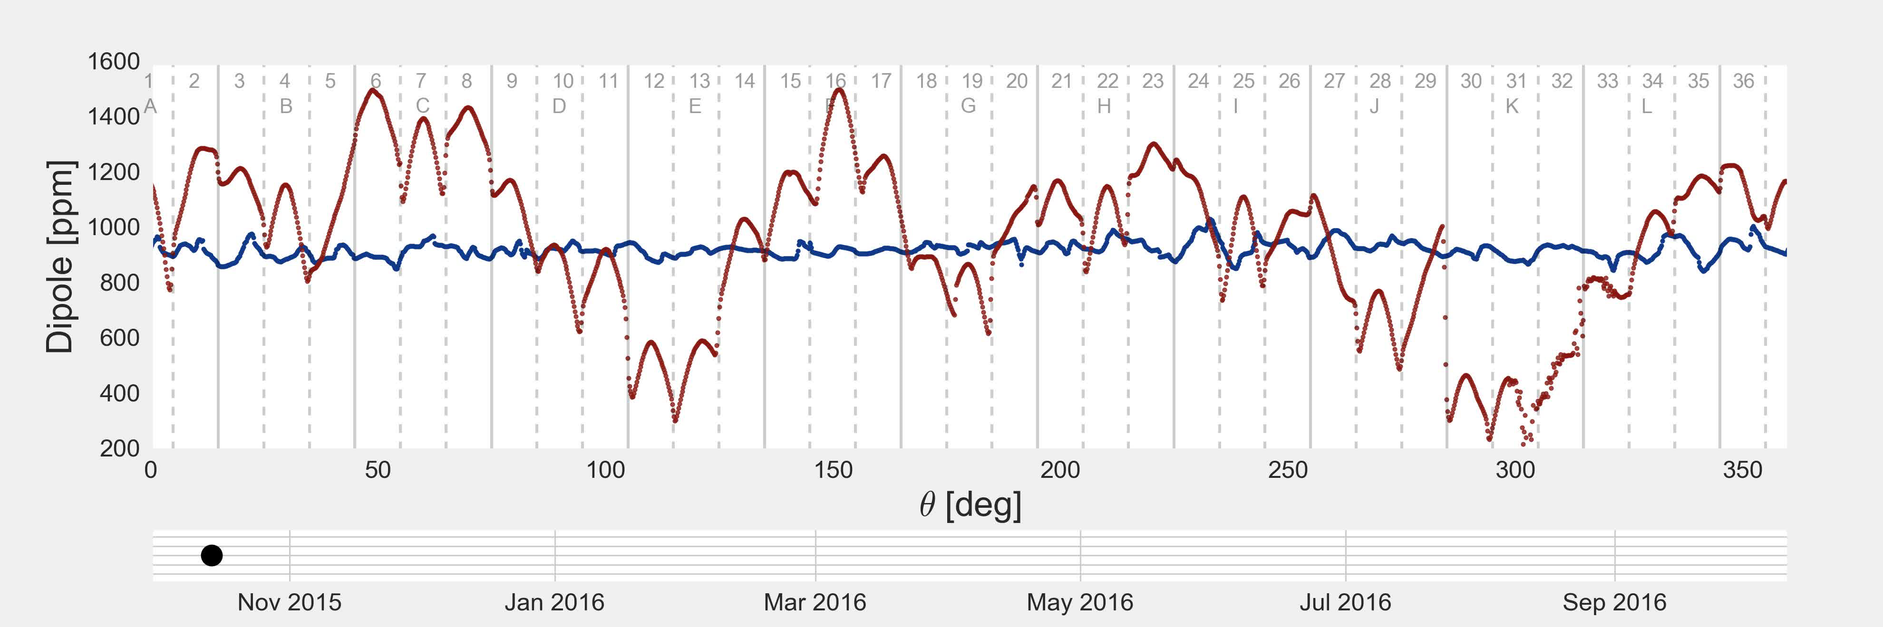

Slide 86
62MHz proton 1.45T

Slide 87
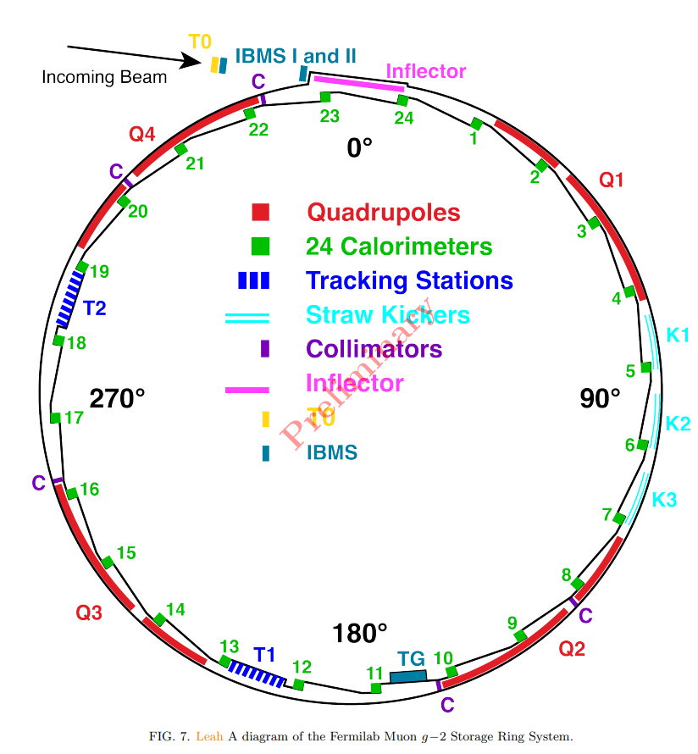

Slide 88


Slide 89


Slide 90
Phase Acceptance

Slide 93
BMT Equation

Slide 94
Imaginary numbers 1572
In the book that was published in 1572, Rafael Bombelli gave a comprehensive account of the algebra known at the time.
Before Bombelli delves into using imaginary numbers
practically, he goes into a detailed explanation of the
properties of complex numbers. Right away, he makes it
clear that the rules of arithmetic for imaginary numbers are
not the same as for real numbers. This was a big
accomplishment, as even numerous subsequent
mathematicians were extremely confused on the topic.

Slide 95


Slide 96


Slide 97
Lattice QCD results for the HVP contribution to the anomalous magnetic moments of leptons
S. Borsányi, Z. Fodor, B. Tóth
We present lattice QCD results by the Budapest-Marseille-Wuppertal (BMW) Collaboration for the leading-order contribution of the hadron vacuum polarization (LOHVP) to the anomalous magnetic moments of all charged leptons. Calculations are performed with u, d, s and c quarks at their physical masses, in volumes of linear extent larger than 6 fm, and at six values of the lattice spacing, allowing for controlled continuum extrapolations. All connected and disconnected contributions are
calculated for not only the muon but also the electron and tau anomalous magnetic moments. Systematic uncertainties are thoroughly discussed and comparisons with other calculations and phenomen-ological estimates are made.

