Slide 1
ProtoDUNE News
Wenqiang Gu

Slide 2
Collaboration meeting
May 20 – May 24
https://indico.fnal.gov/event/60082/
Submit your travel request to Tracy

Slide 3
Computing and data management
SL7 replaced by AlmaLinux
Samweb will be replaced by MetaCat & Rucio
See Elisabetta’s talk => want a summary?
POMS will be replaced by justIN for batch job
# Use SL7 container in AlmaLinux
$ /cvmfs/oasis.opensciencegrid.org/mis/apptainer/current/bin/apptainer shell --shell=/bin/bash -B /cvmfs,/exp,/nashome,/pnfs/dune,/opt,/run/user,/etc/hostname,/etc/hosts,/etc/krb5.conf --ipc --pid /cvmfs/singularity.opensciencegrid.org/fermilab/fnal-dev-sl7:latest
> source /cvmfs/dune.opensciencegrid.org/products/dune/setup_dune.sh
> setup dunesw v09_89_01d01 -q e26:prof
> setup_fnal_security # setup proxy if you want to access files

Slide 4
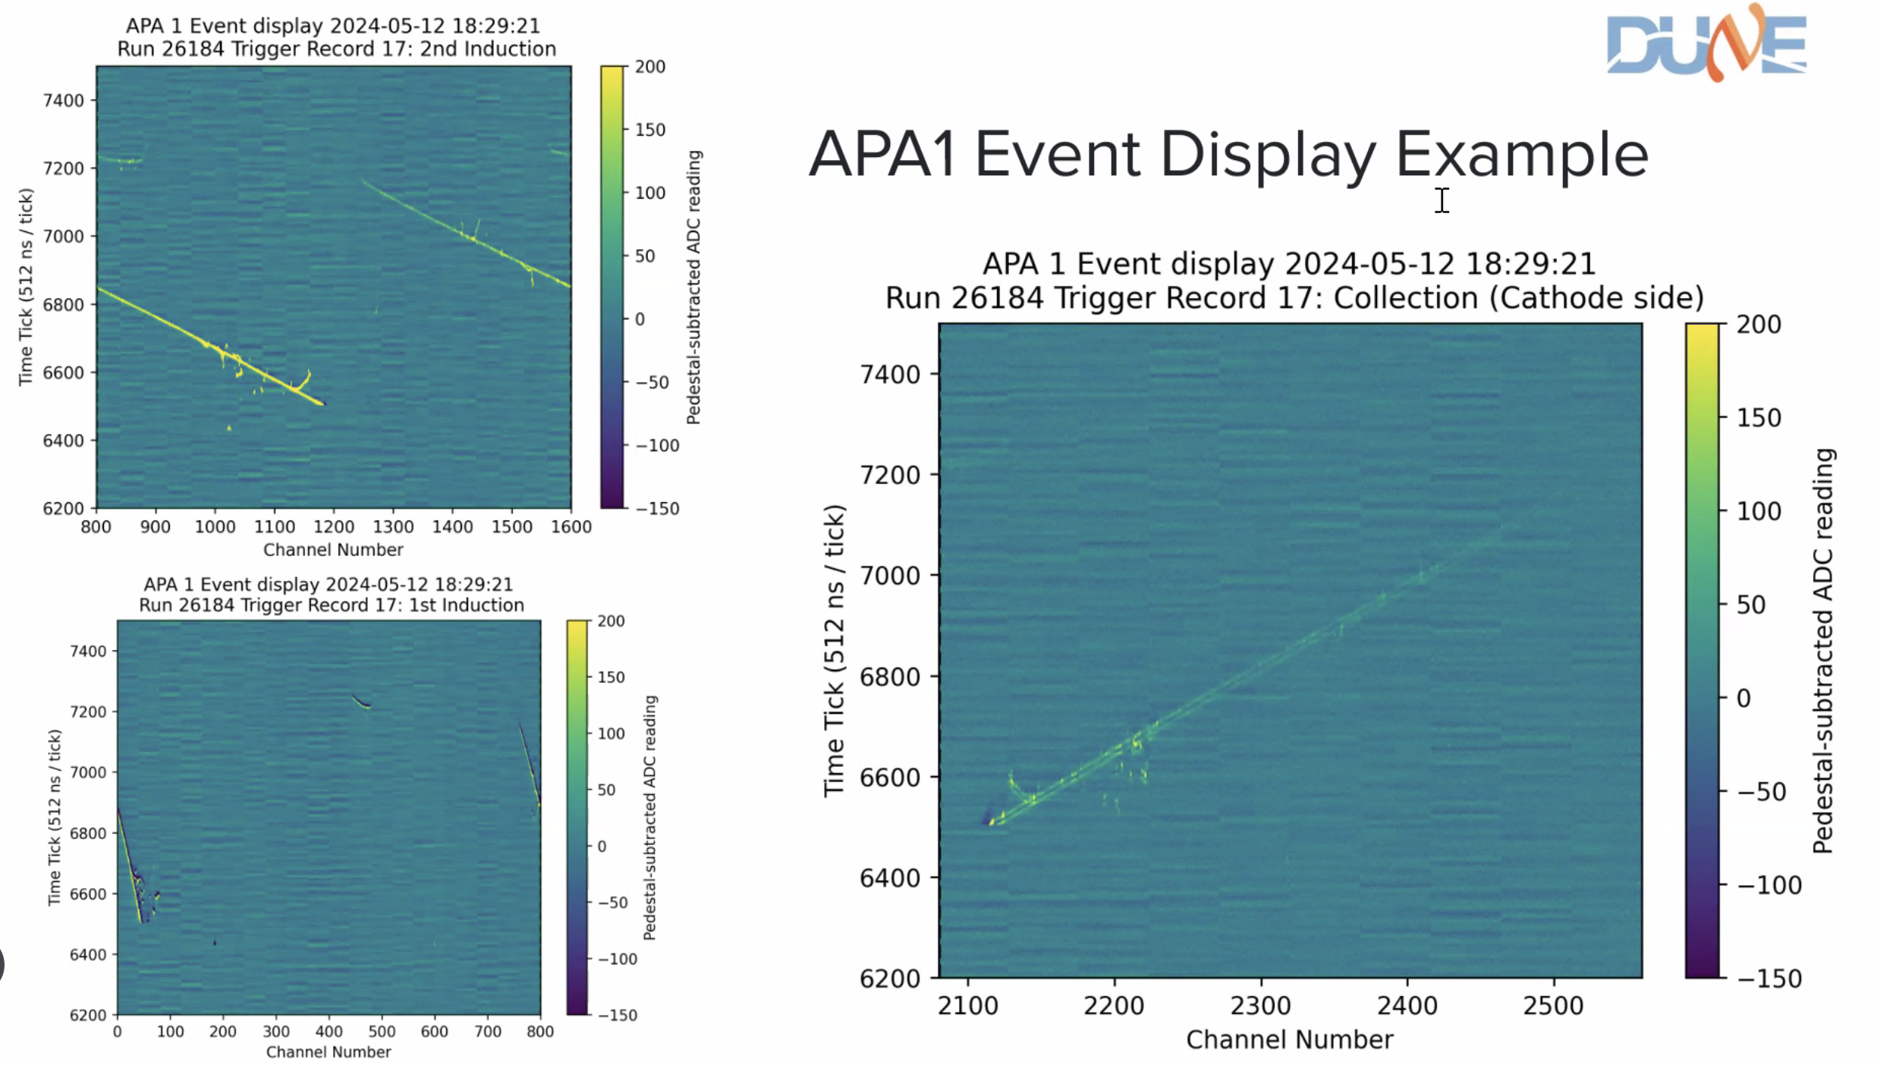
Unbiased collection plane in APA #1
V plane
Bias for the collection plane isn’t working for APA #1
Not a loose connection at flanges
Charges are mostly collected on V plane (2nd induction)
Schedule does not allow us to open the cryostat?
Is a 2-view reconstruction possible?
sigproc needs a different FR given the channel range
X plane
U plane

Slide 5
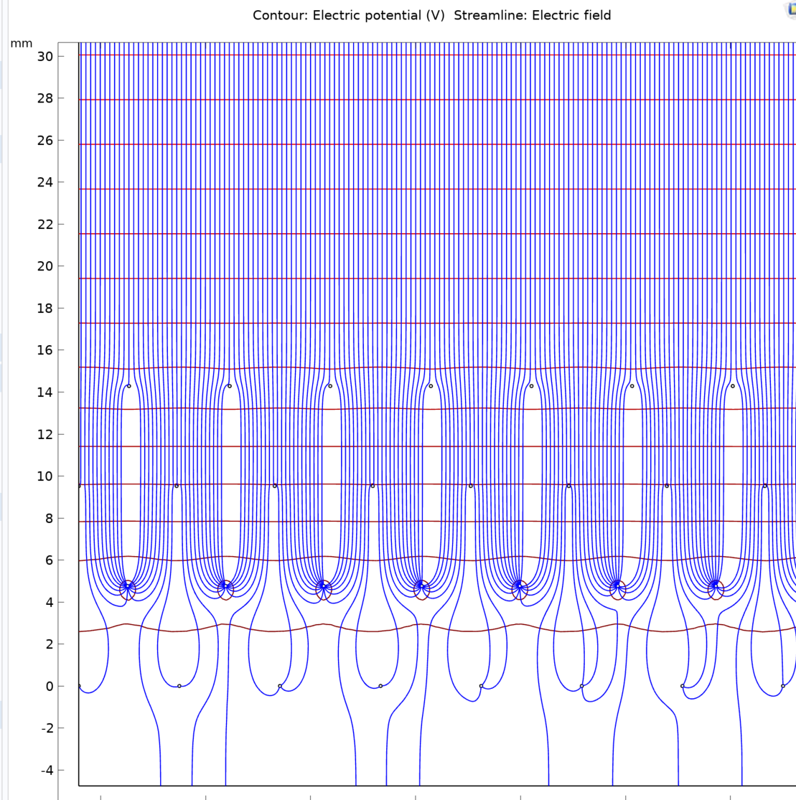
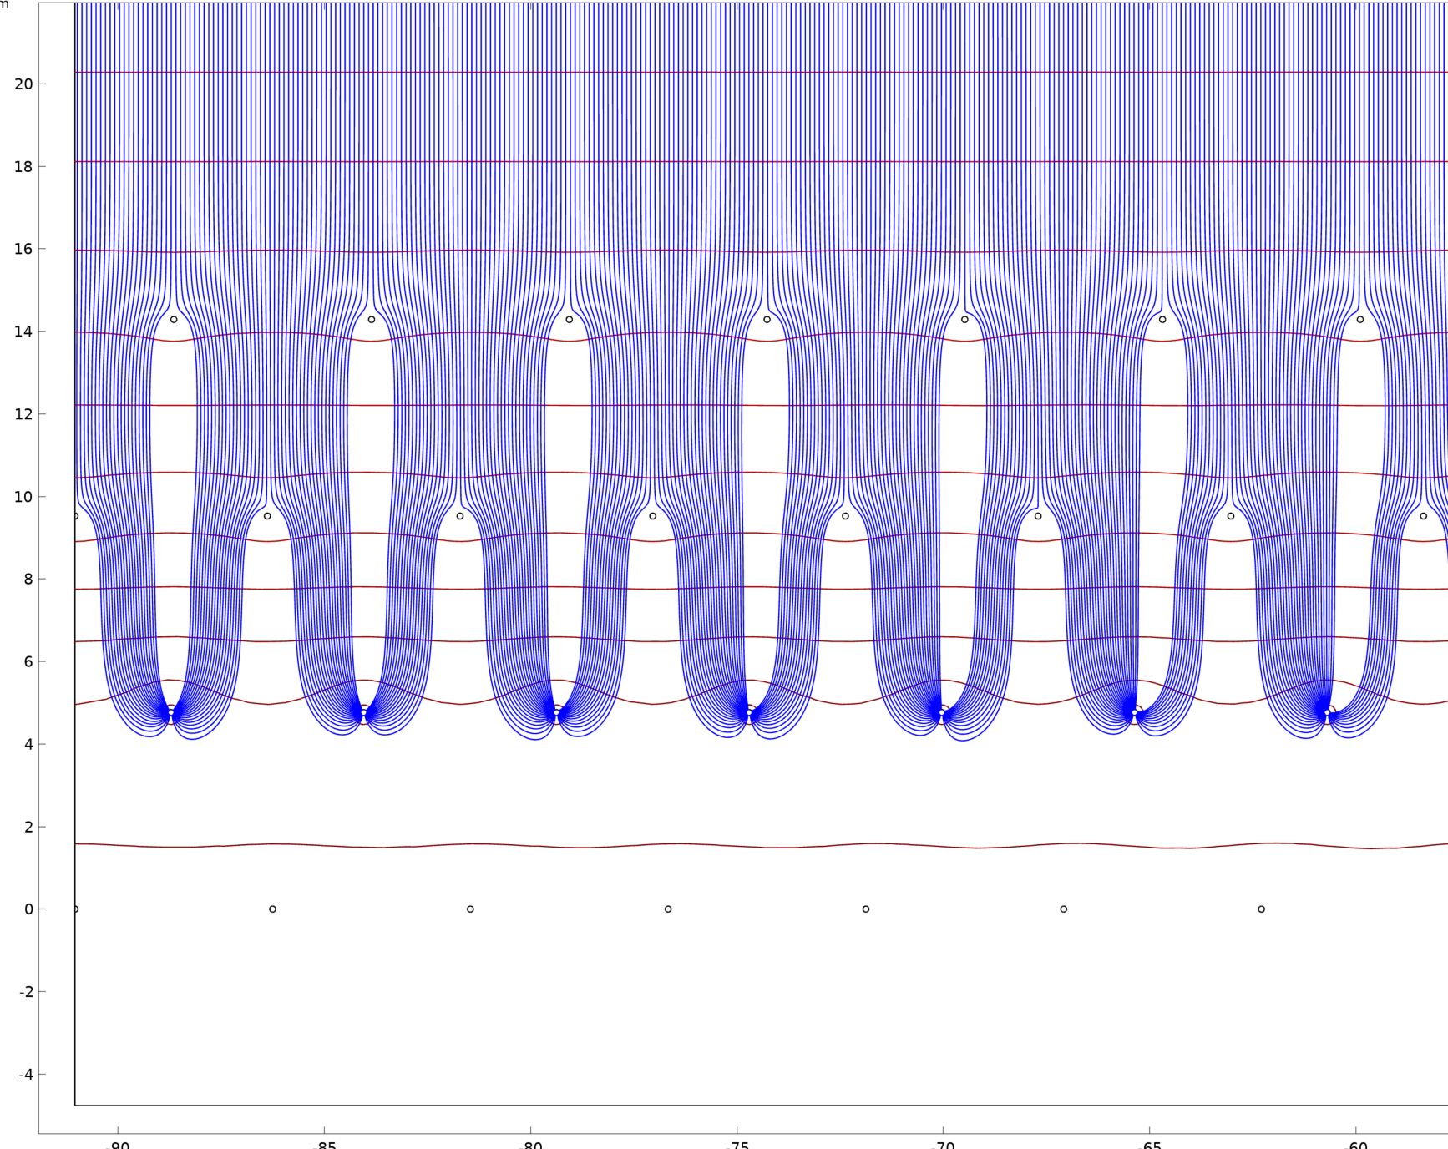
Full collection on V is possible
From Bo Yu.
Default wire bais
but Volt_X = 0
-200V more on grid and U plane

Slide 6
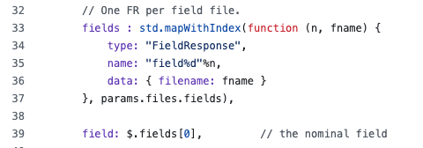

Signal processing: necessary updates in WCT
// common/tools.jsonnet
We can assign different FRs in the WCT configuration
// pdhd/sp.jsonnet
local anode_id = anode.data.ident,
field_response: wc.tn(tools.fields[anode_id)])

Slide 7
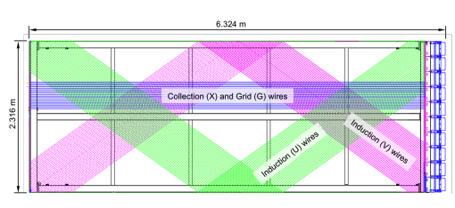
Two-view reconstruction
3D imaging => hit disambiguation?
improve hit-wire segment association => Input for Pandora
charge/light matching ?

