Slide 1
Integration, Installation and Infrastructure (Triple I Group)
TIC Update
Roland Wimmer
Rahul Sharma
Dan Cacace
John Tuozzolo
Nathaniel Speece-Moyer
Josh Harvey

Slide 2
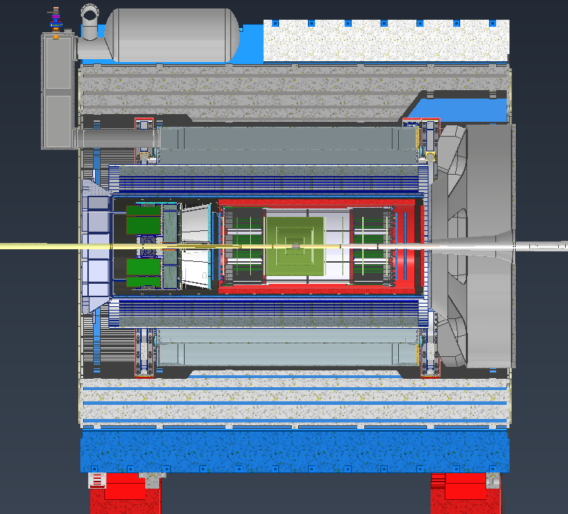
Detector Model Updates
RDO Placements
Endcap Update
Flux return Updates
Magnet simulations
EMCAL Interferences
HCAL Changes
Ring Magnet Installations
CFST

Slide 3
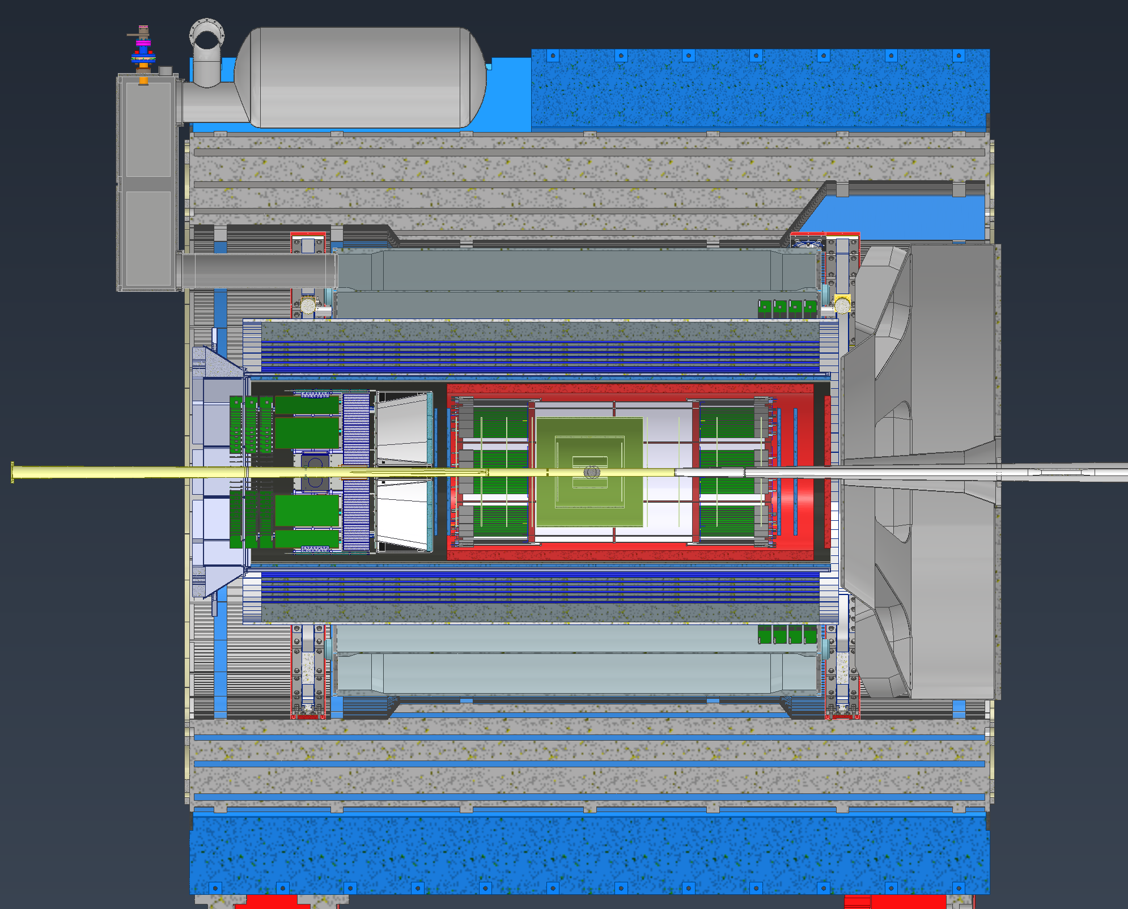
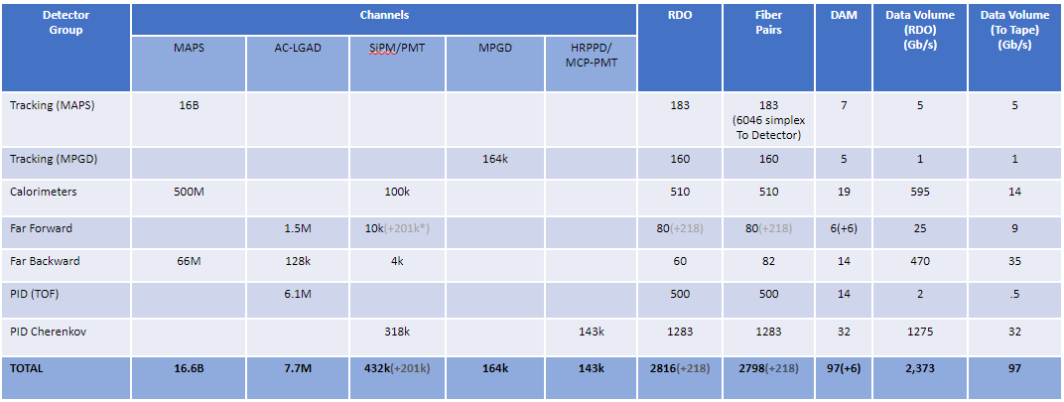
RDO Placements
Working with the EE group on possible RDO placement locations
Not many available locations for the amount of RDOs we have and most of the locations create other issues
RDOs
RDOs
~7m MPGD
~6.5m MPGD

Slide 4
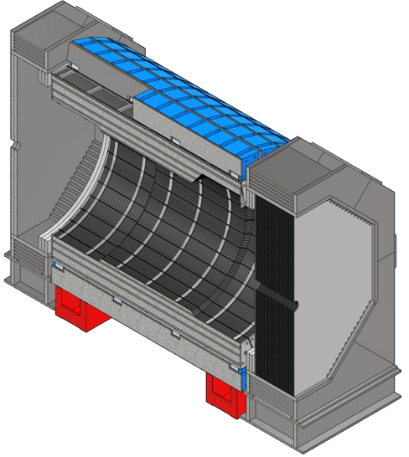
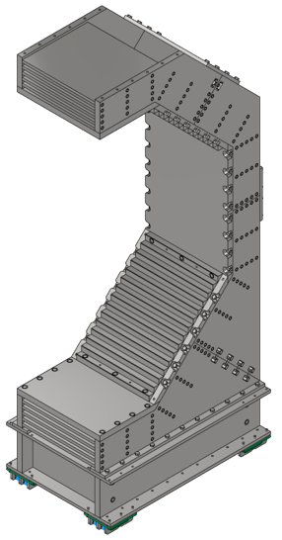
Endcap Updates
Changed the Endcap steel design for better manufacturability
Working with the magnet group to get simulations done to see what impact these changes have
Getting quotes

Slide 5
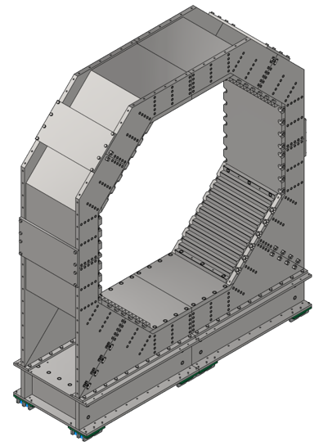
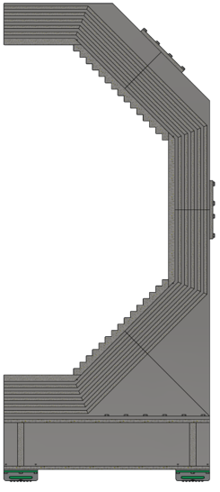
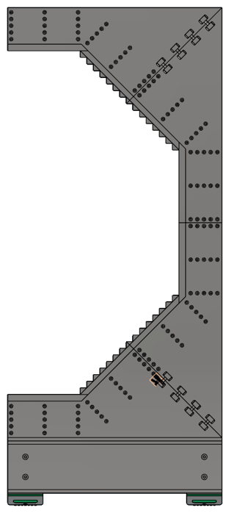
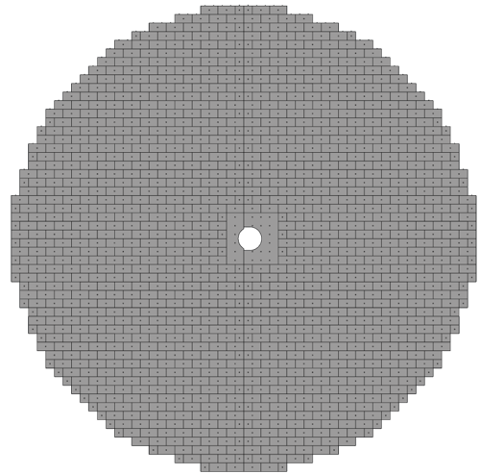
Endcap Updates

Slide 6
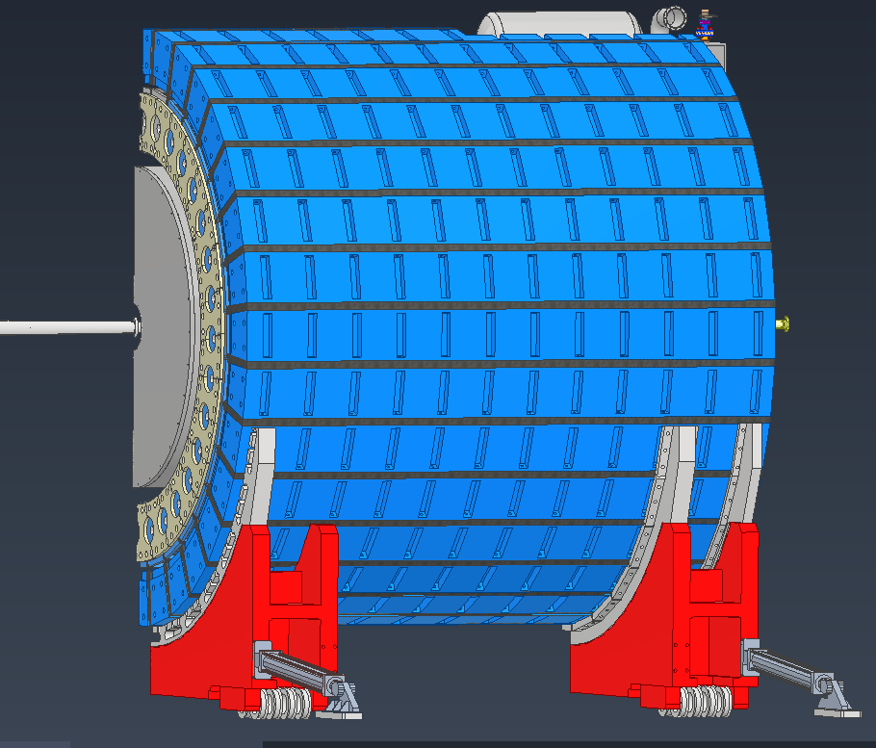
Flux Return Bars updates
Reusing 30 steel bars from STAR
STAR bars will be refurbished, and machined to fit EPIC
Currently running analyses to see if HCAL sectors can be individually supported from each flux return bar. This would make installation much simpler
Getting quotes for machine work needed

Slide 7
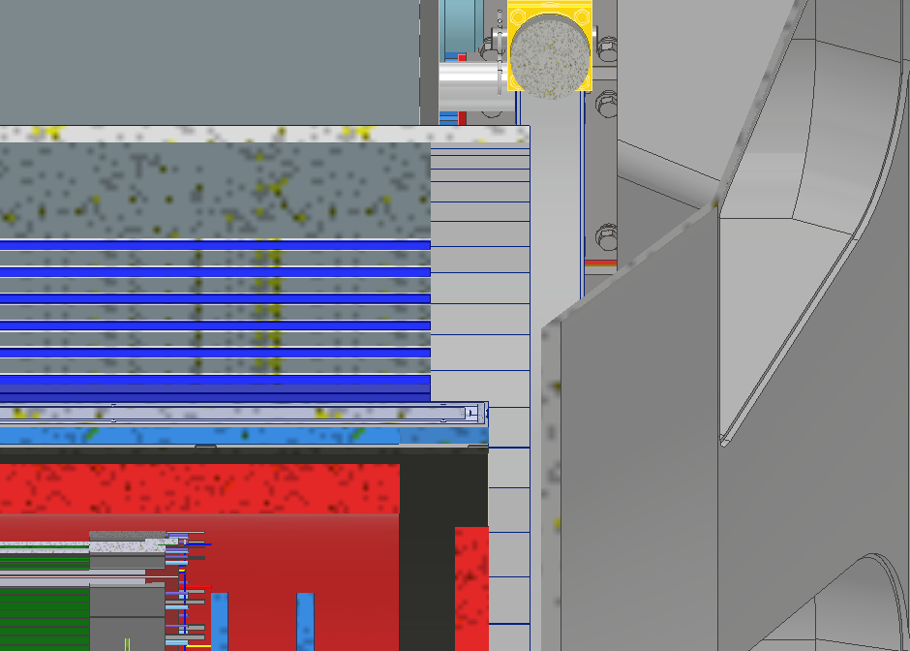
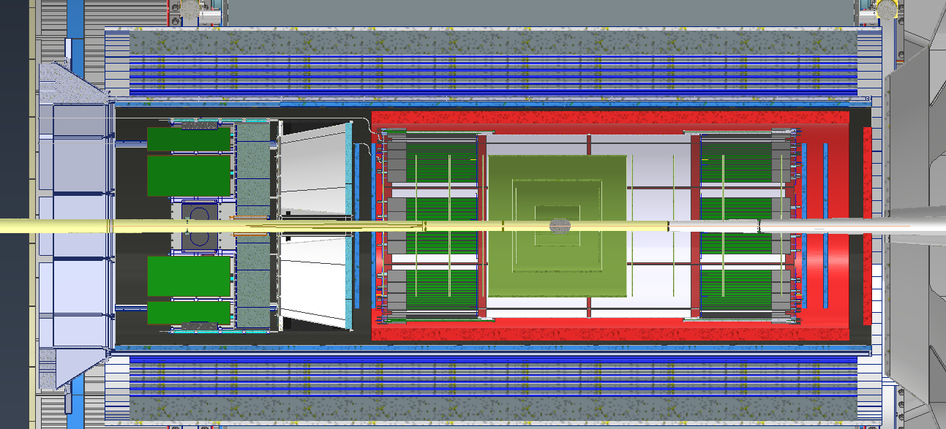
Barrel EMCAL
Barrel EMCAL electronics currently overlap with the DIRC Prism on the lepton end by ~2cm
The Electronics overlap with the services bundle on the Hadron side as well by ~6cm
Currently looking into
best ways to solve this

Slide 8
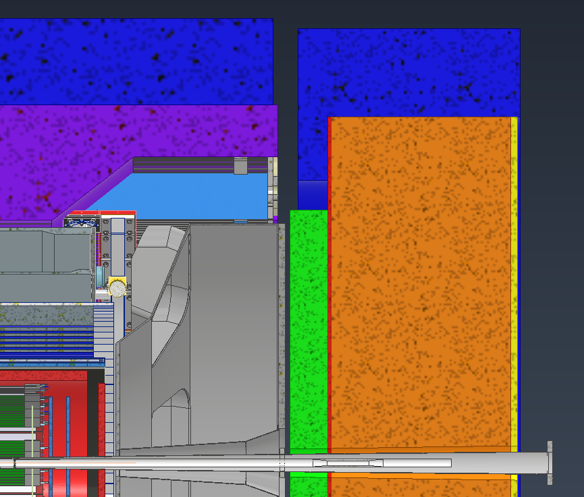
Hadron Endcap EMCAL
Emcal services overlap with the barrel service bundles coming out
Looking into ways to “push” the emcal out in Z
One option being looked at is to shorten the HCAL by a few plates and by ourselves the 6cm needed
Have some “extra” space where the HCAL electronics sat

Slide 9
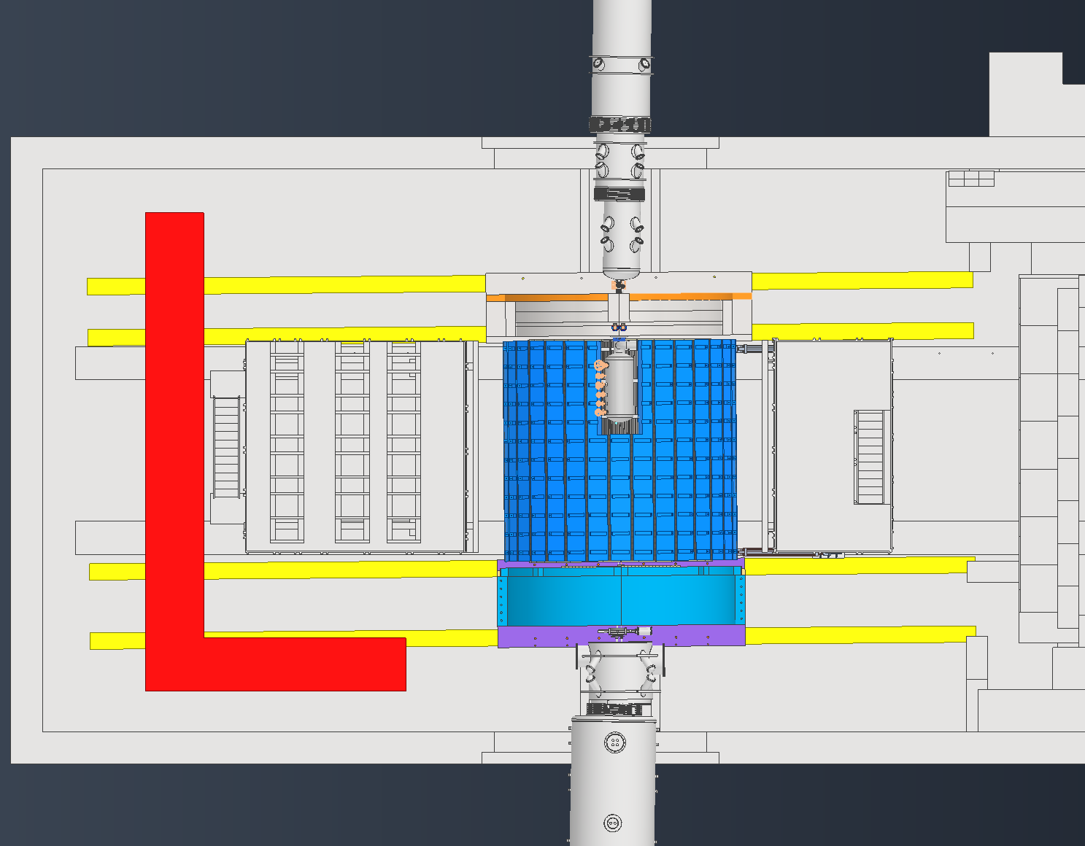
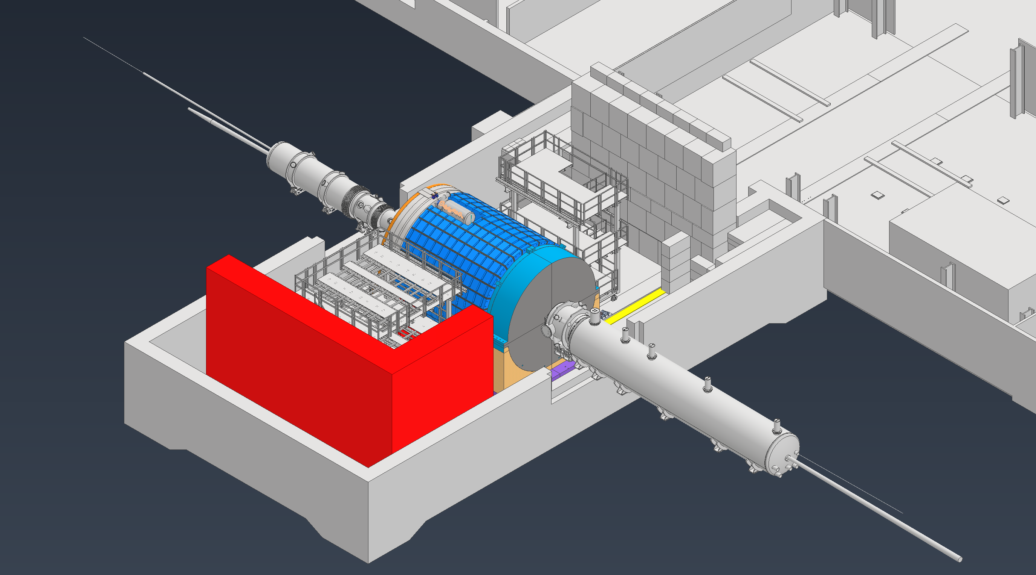
Ring Magnet Installations
Magnets for the RHIC ring will need to be installed while the detector is already assembled, these magnets are massive and require a lot of installation space

Slide 10
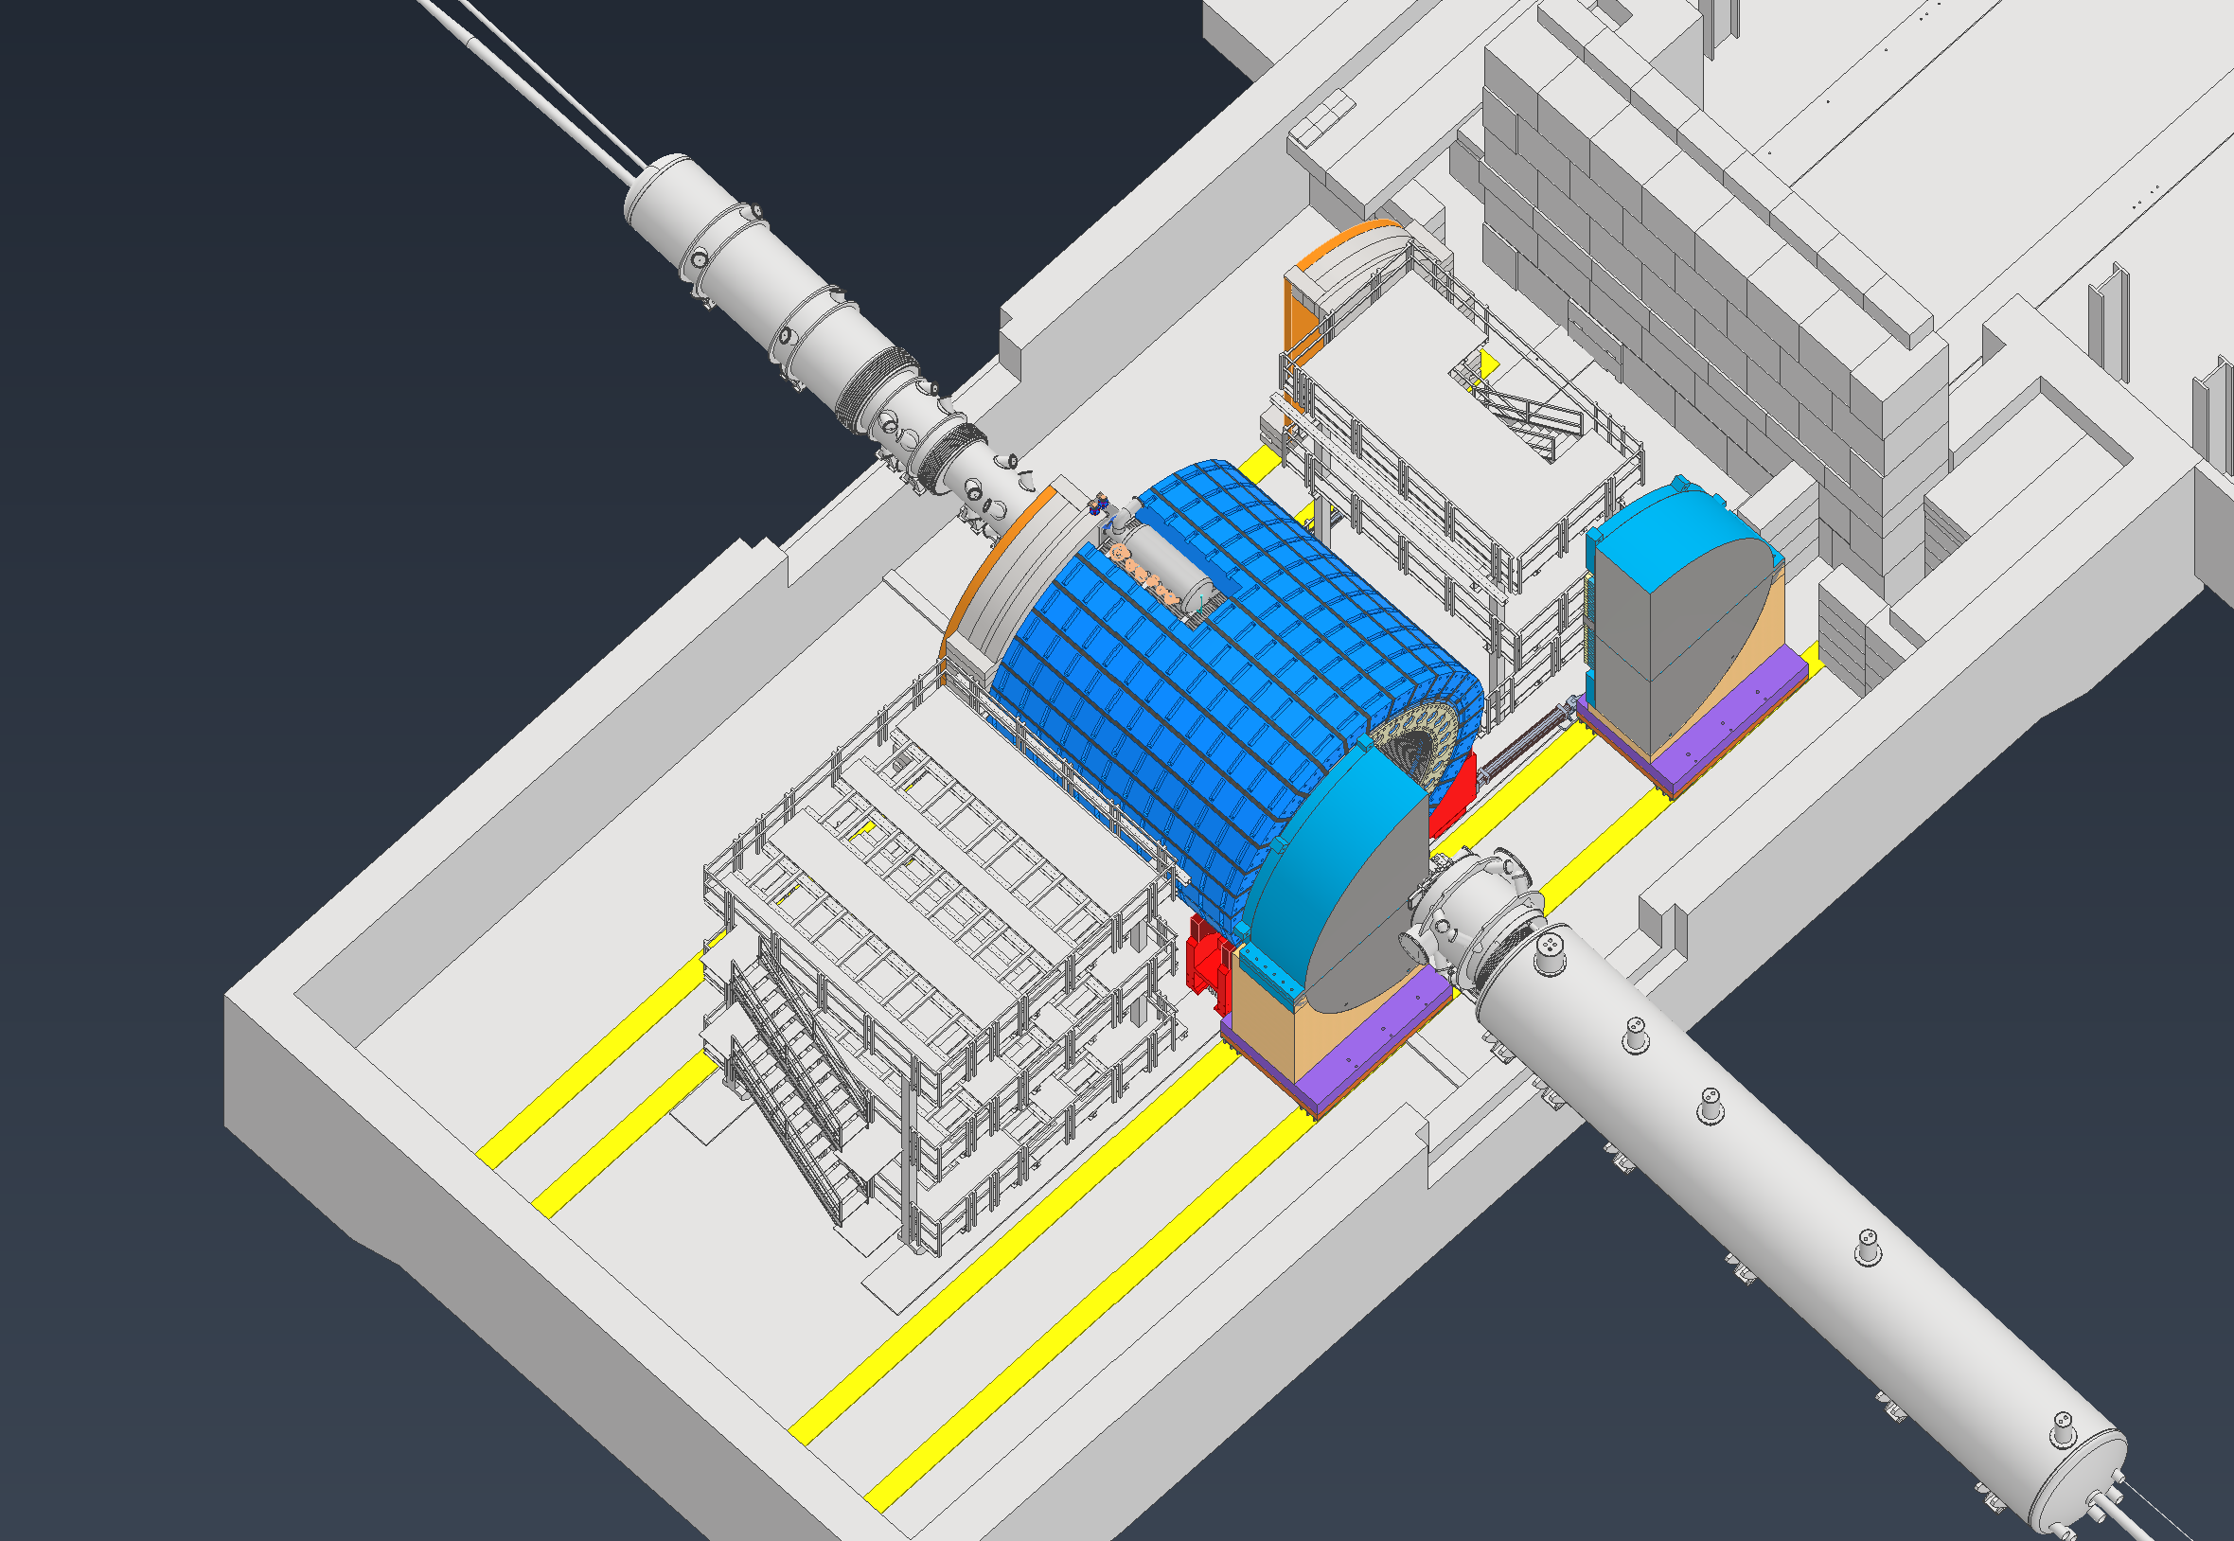
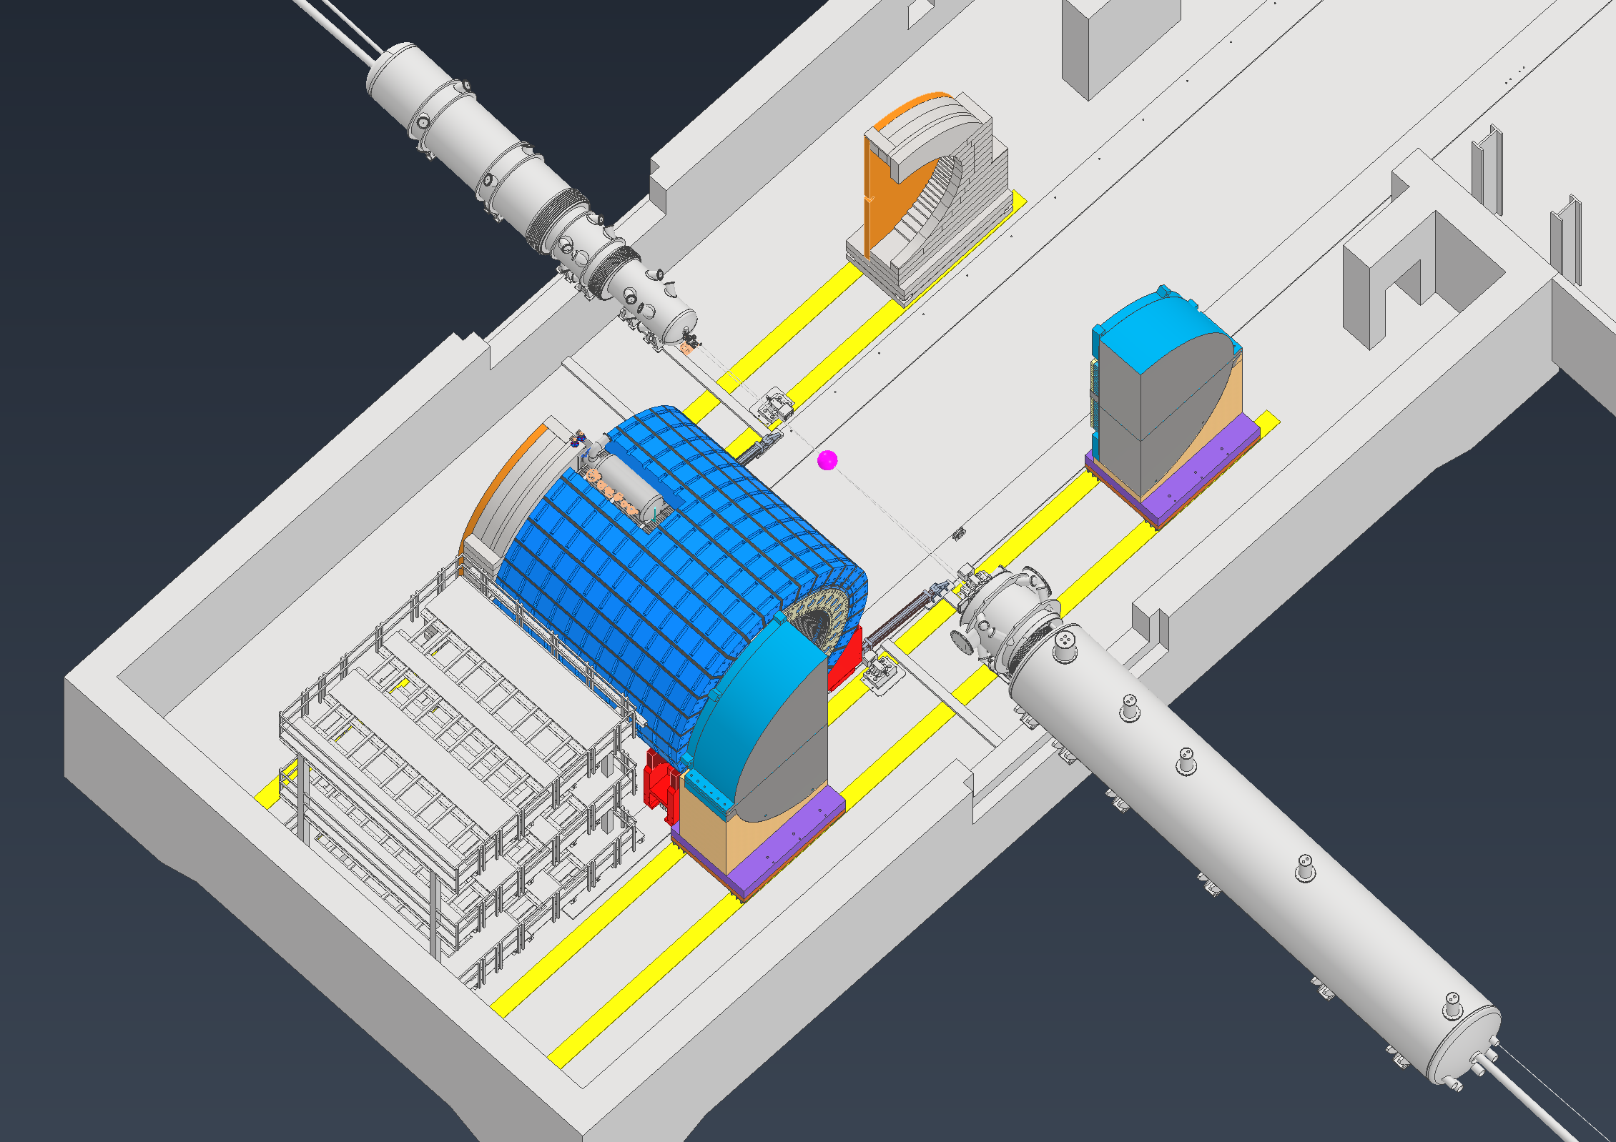
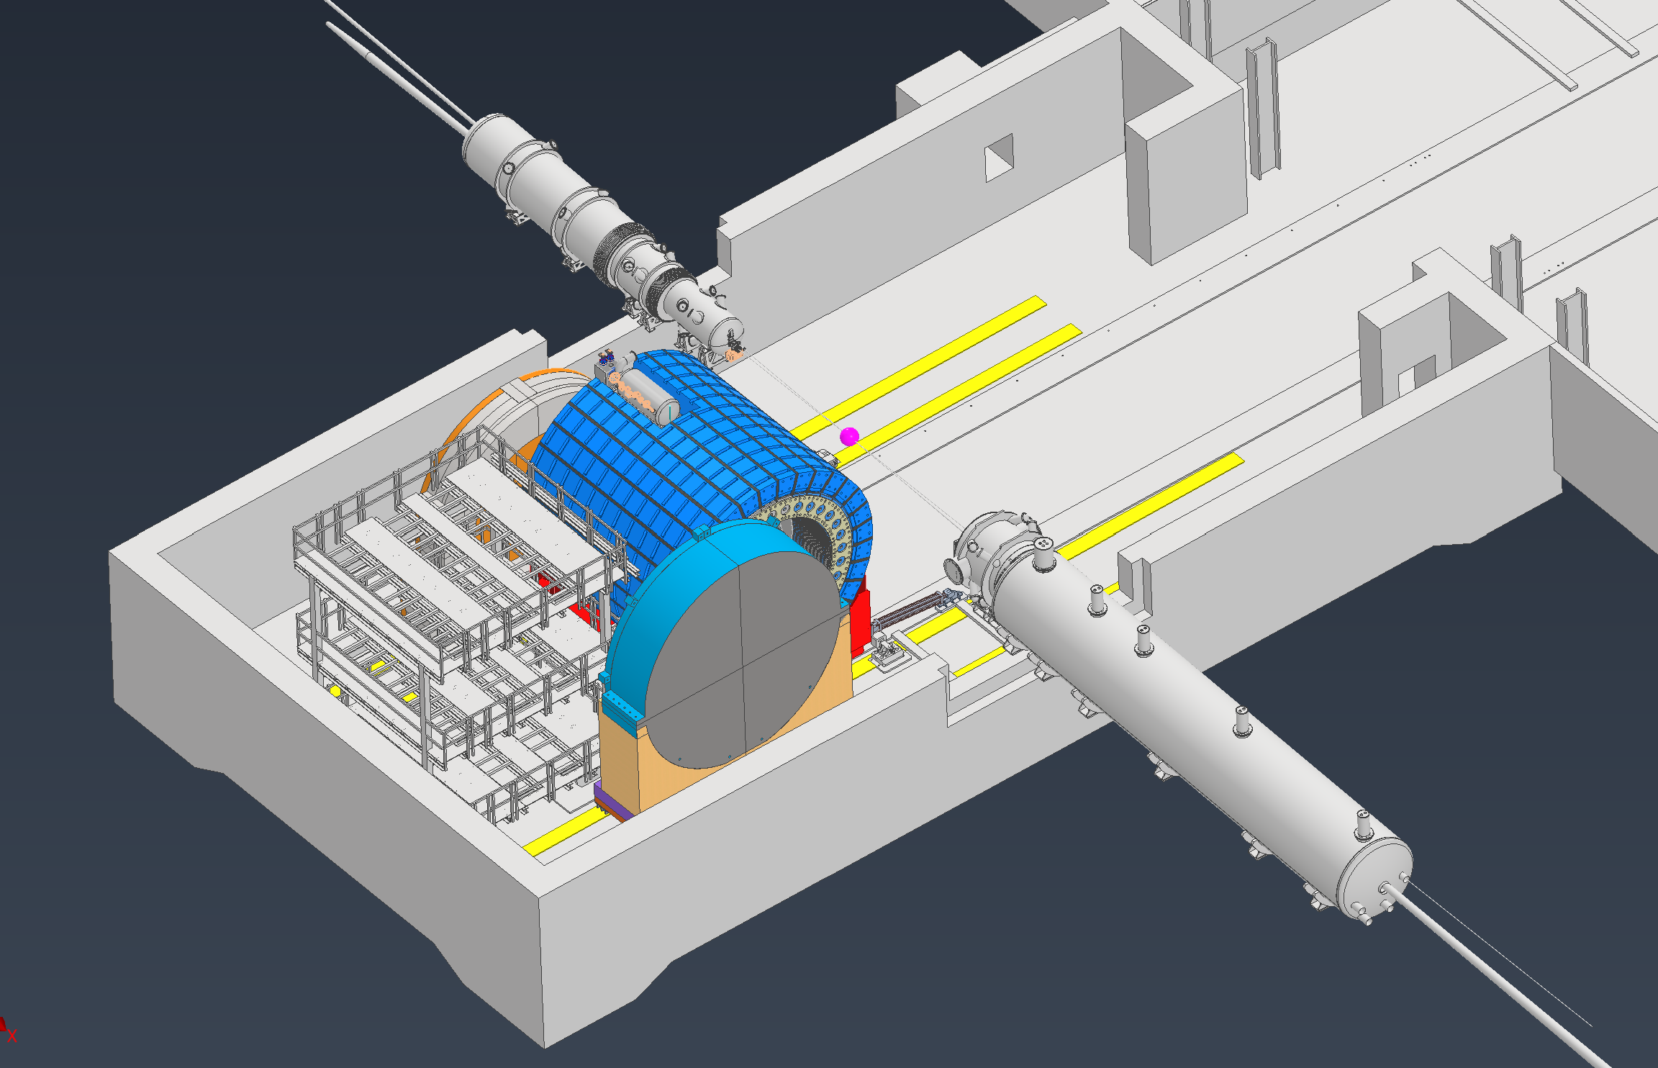
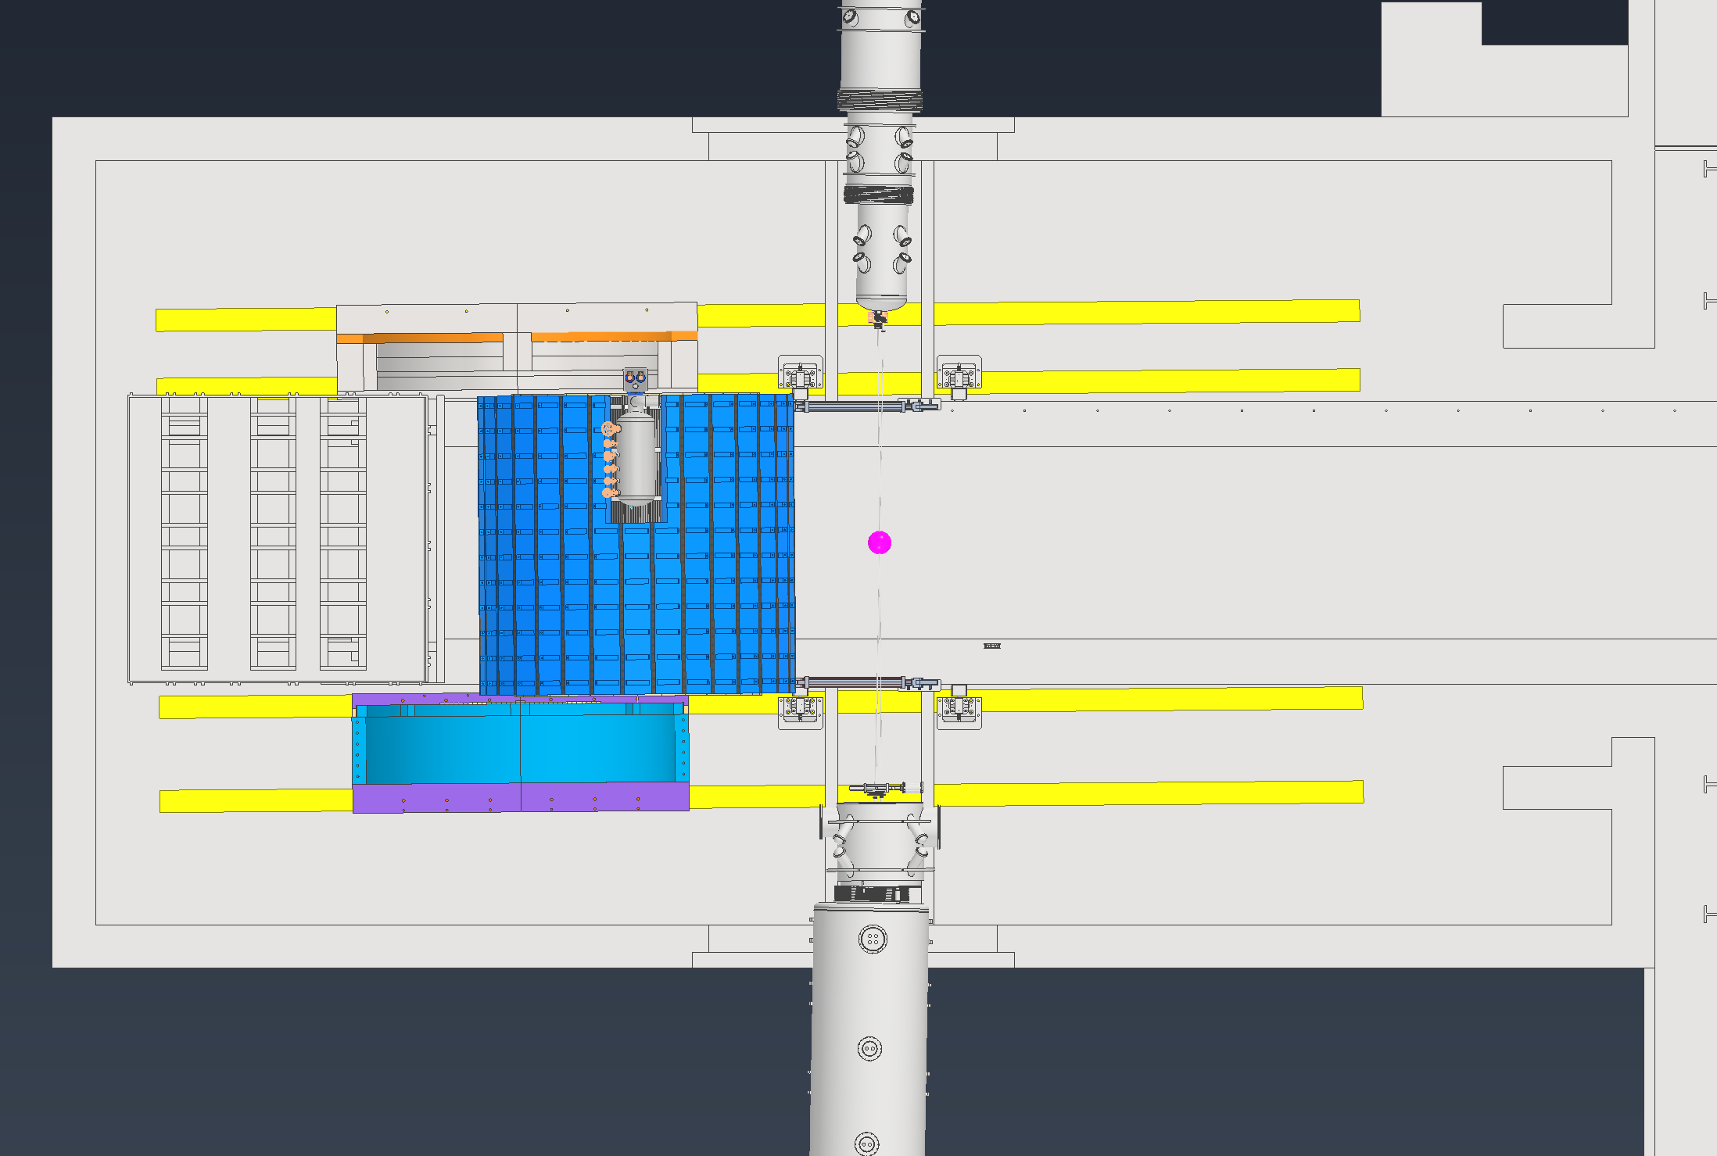
Ring Magnet Installations
Stair removal option
Endcap doors are opened up
Shield wall is moved to parking lot
North Platform is disconnected and slid as far north as possible
No building extension required
Detector and South platform are slid as far south as possible
Platform sits 24” off south wall if stairs are removed, 9” if stairs stay
South Endcap door is slid south, North doors can either be left on north side or slid south, must be investigated further
Weight Concerns

Slide 11
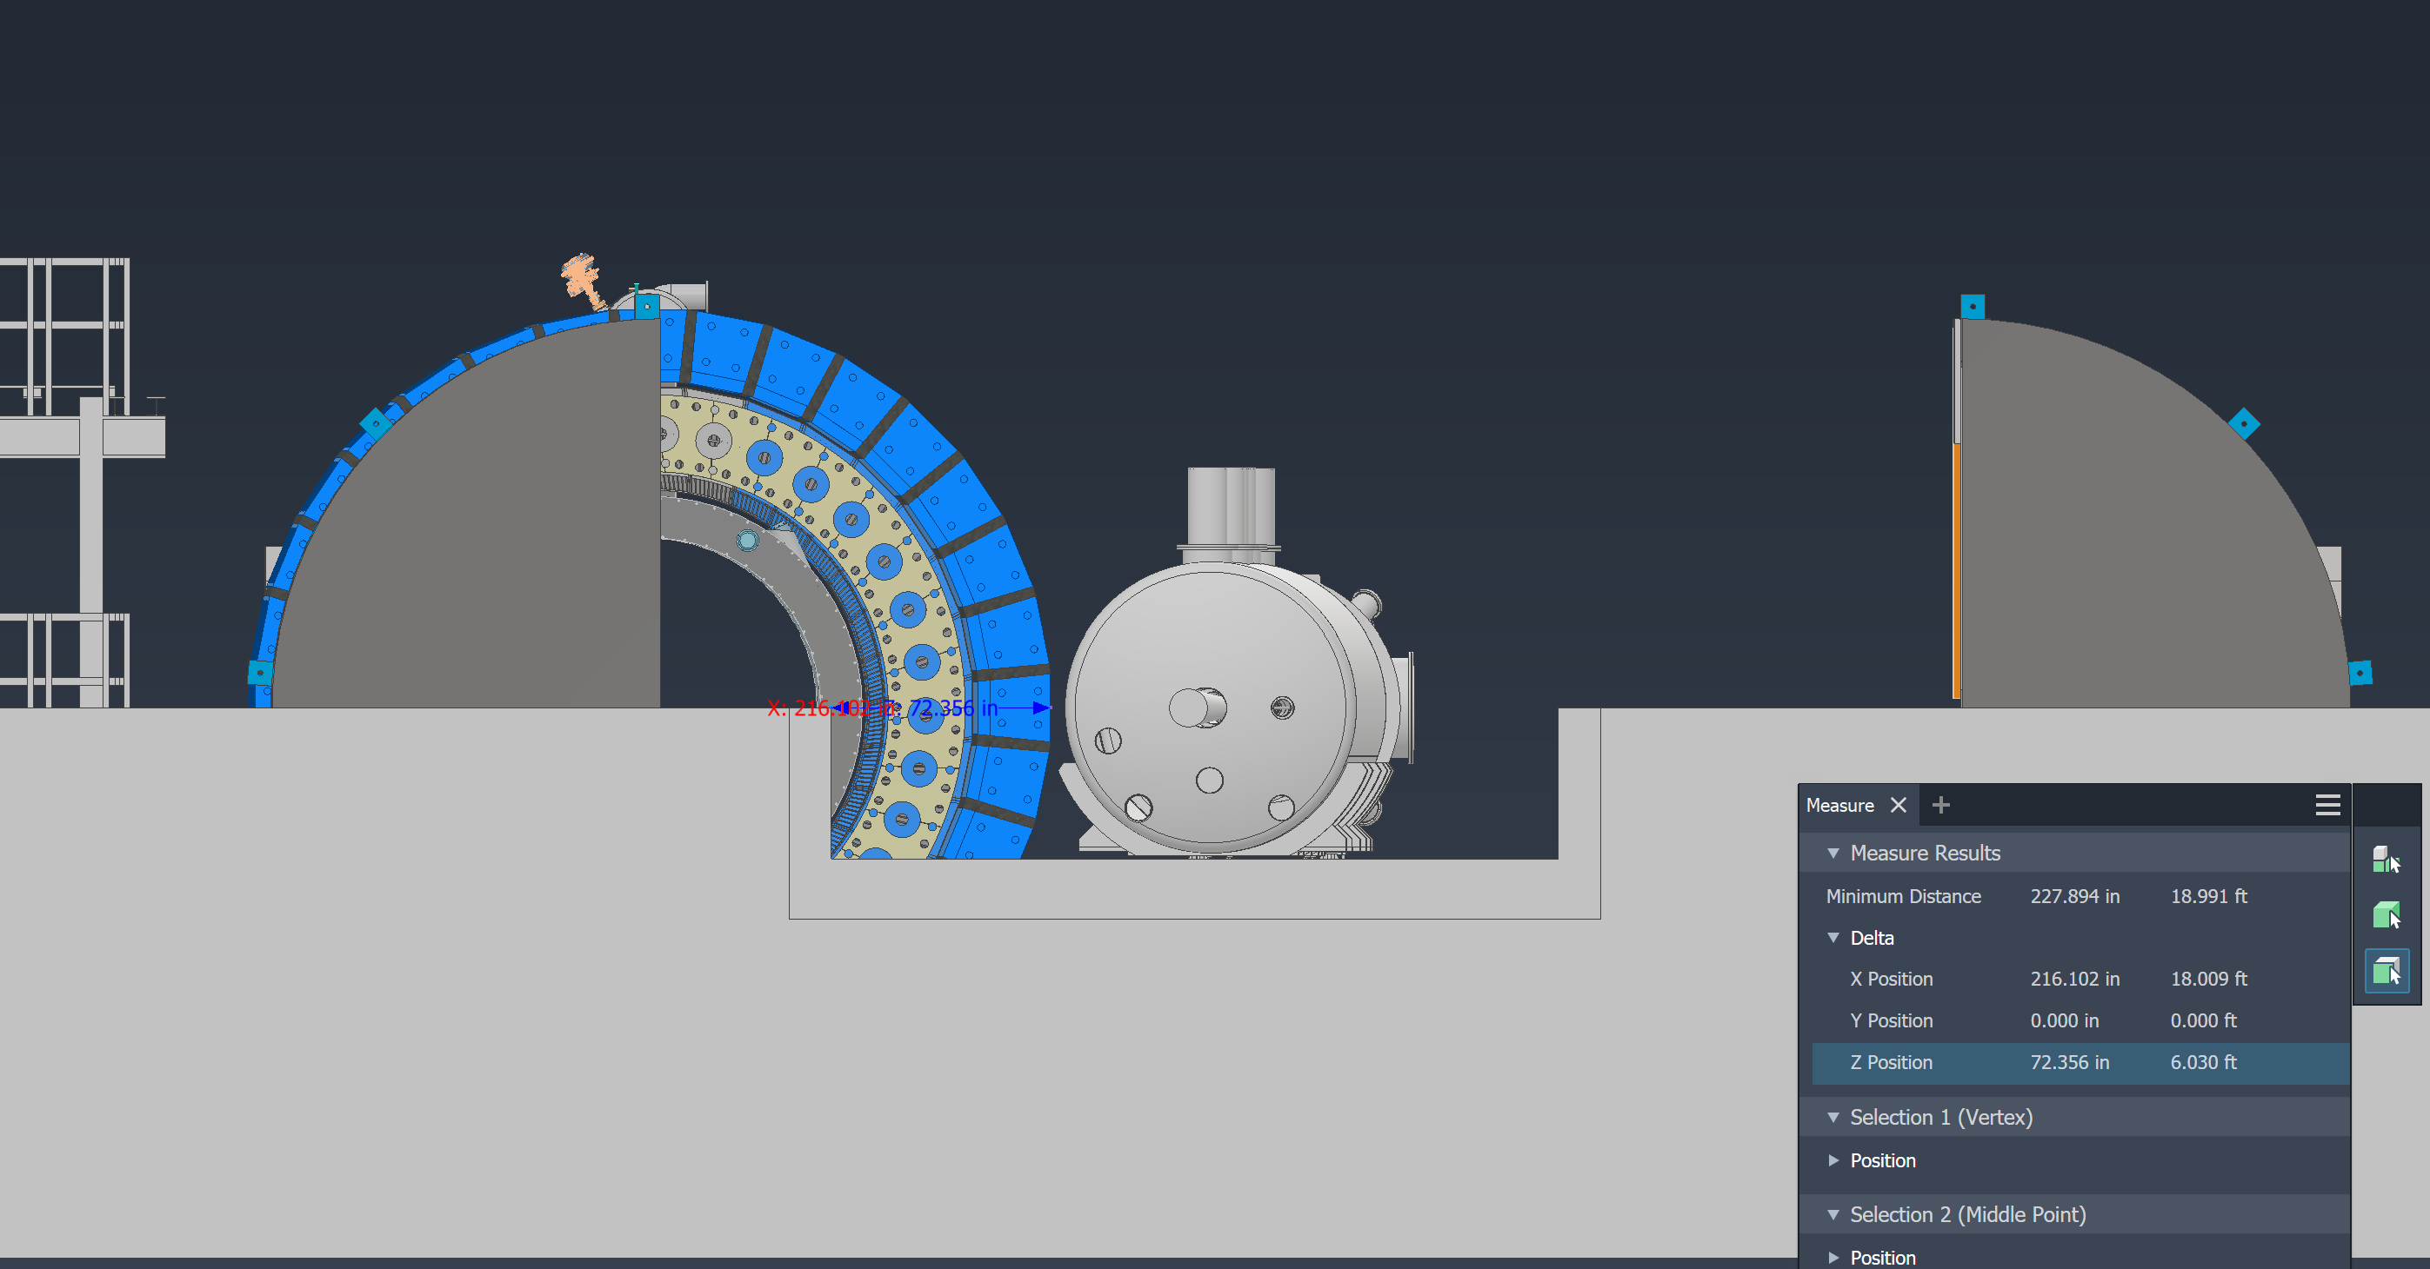
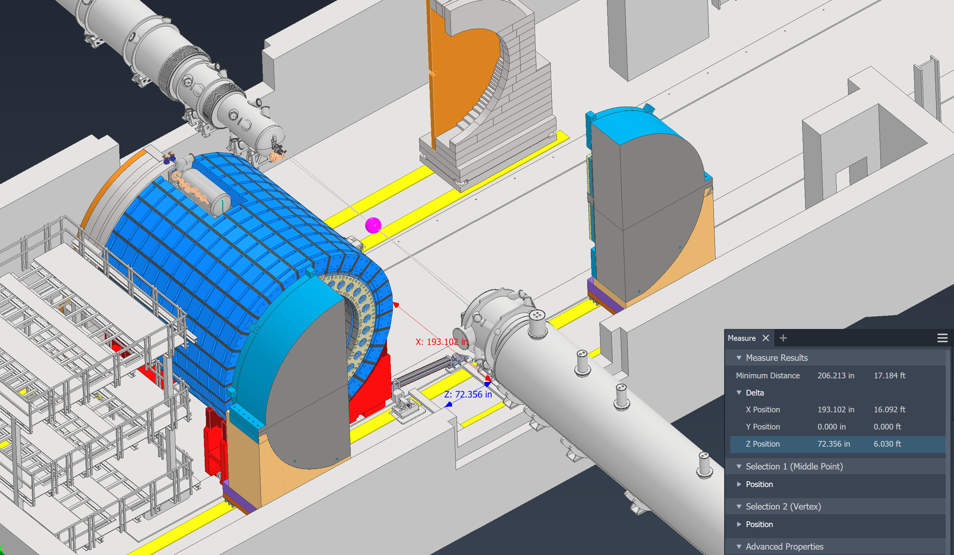
Ring Magnet Installations
Detector overlaps about 6ft of the tunnel, and sits about 16ft away

Slide 12
Backup Slides

Slide 13
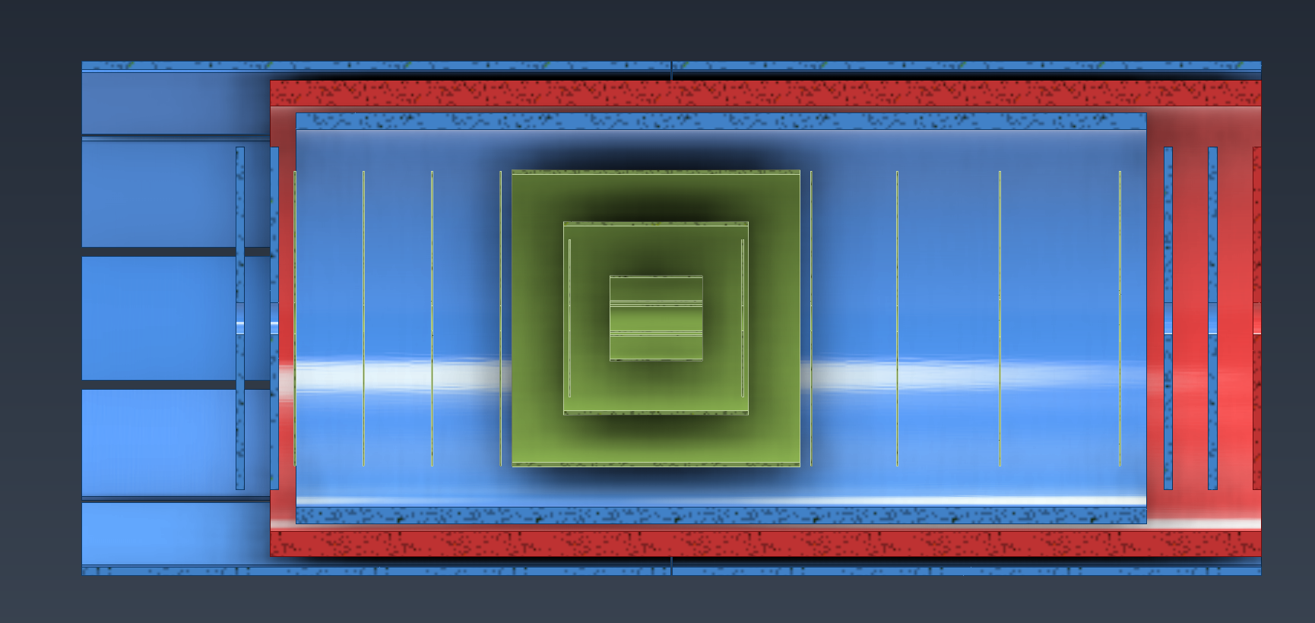
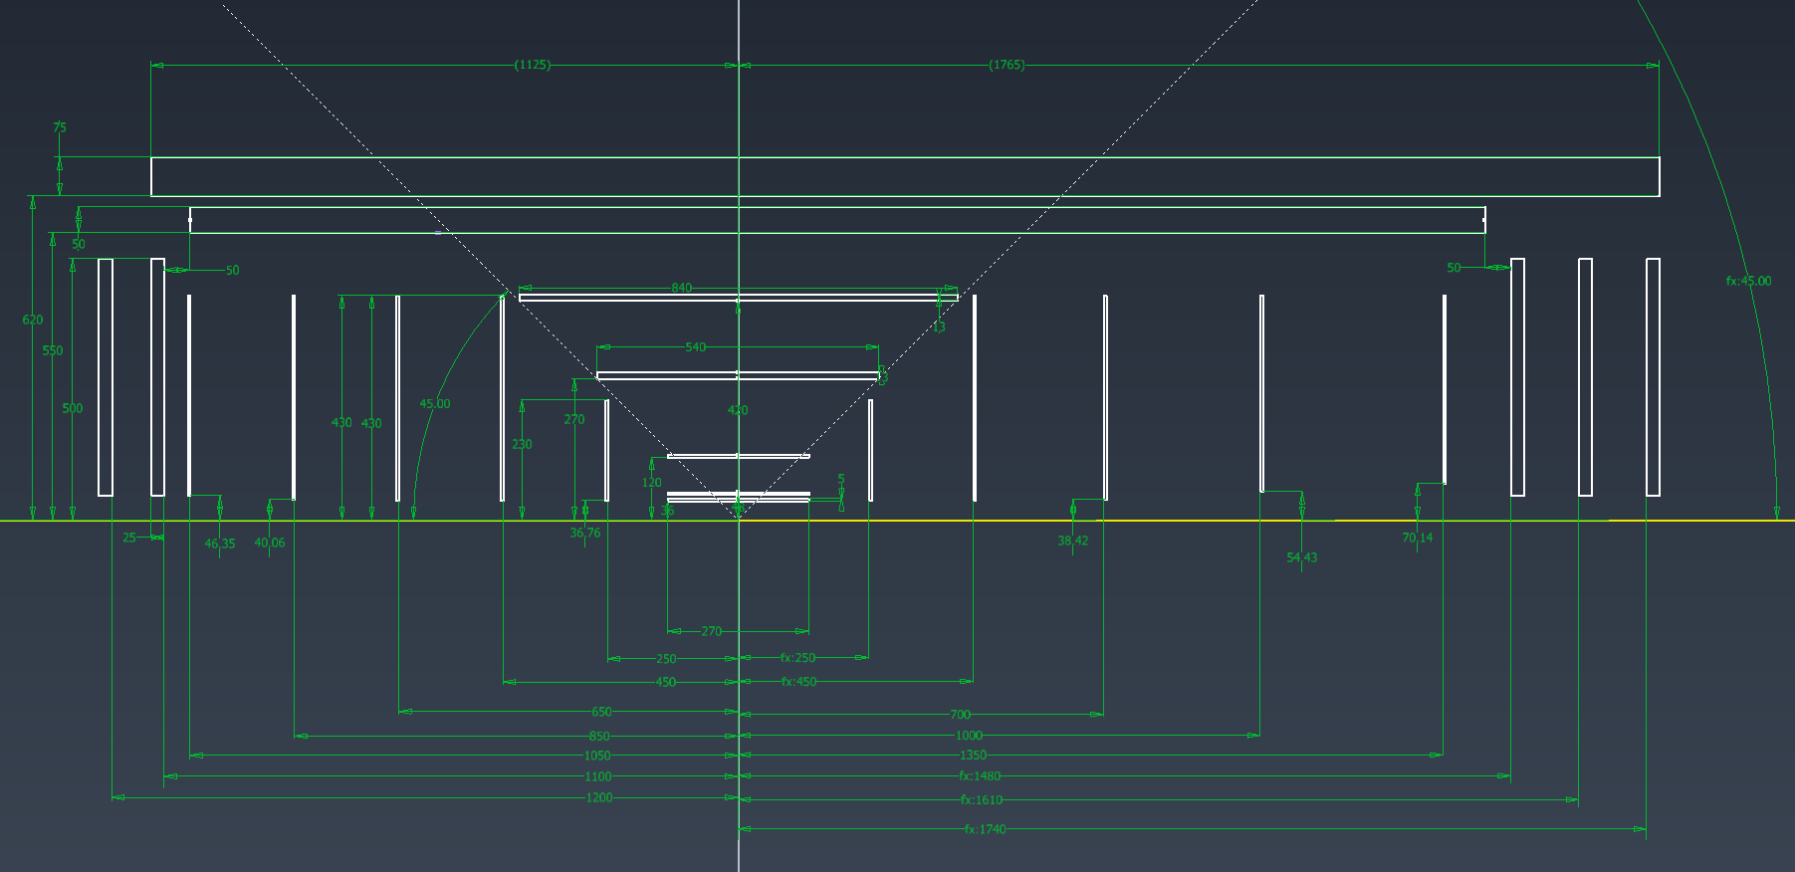
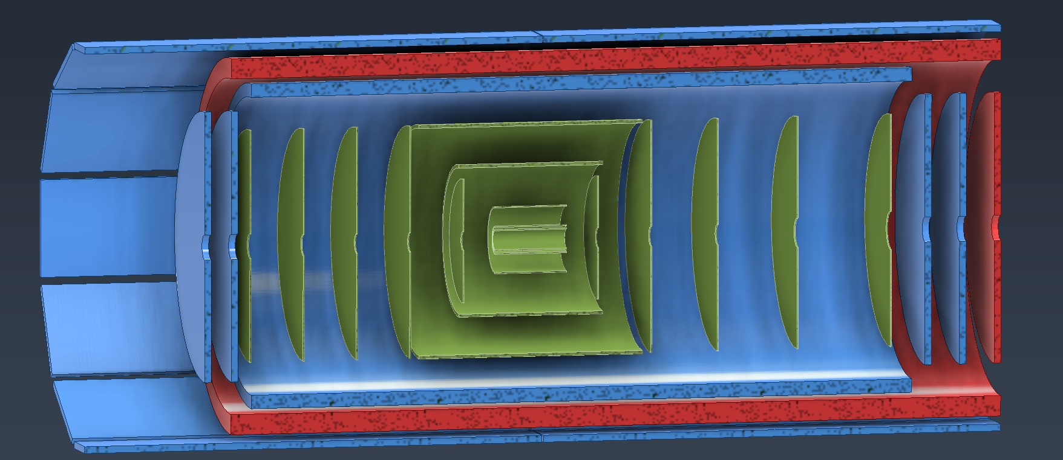
Inner Tracker Updates
Spoke with Andy during the engineering workshop and updated some Inner tracker dimensions
AC-LGAD adjusted, Inner MPGDs adjusted & MPGD disks adjusted
5
4
3
2
1

Slide 14
Updates from Tracker Meeting at Perdue

Slide 15
Inner Tracker Updates

Slide 16
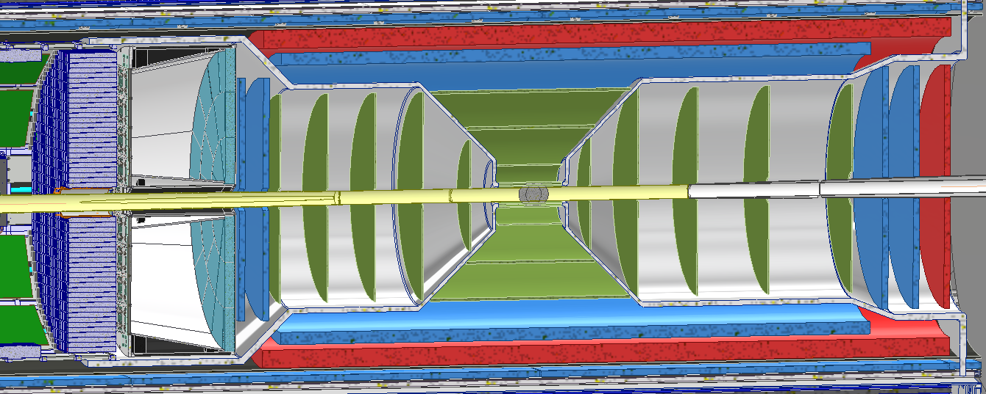
Inner Tracker Updates
Recently had an engineering workshop for the inner trackers last month
Discussed various topics from, most of which were cover in the last TIC meeting

Slide 17
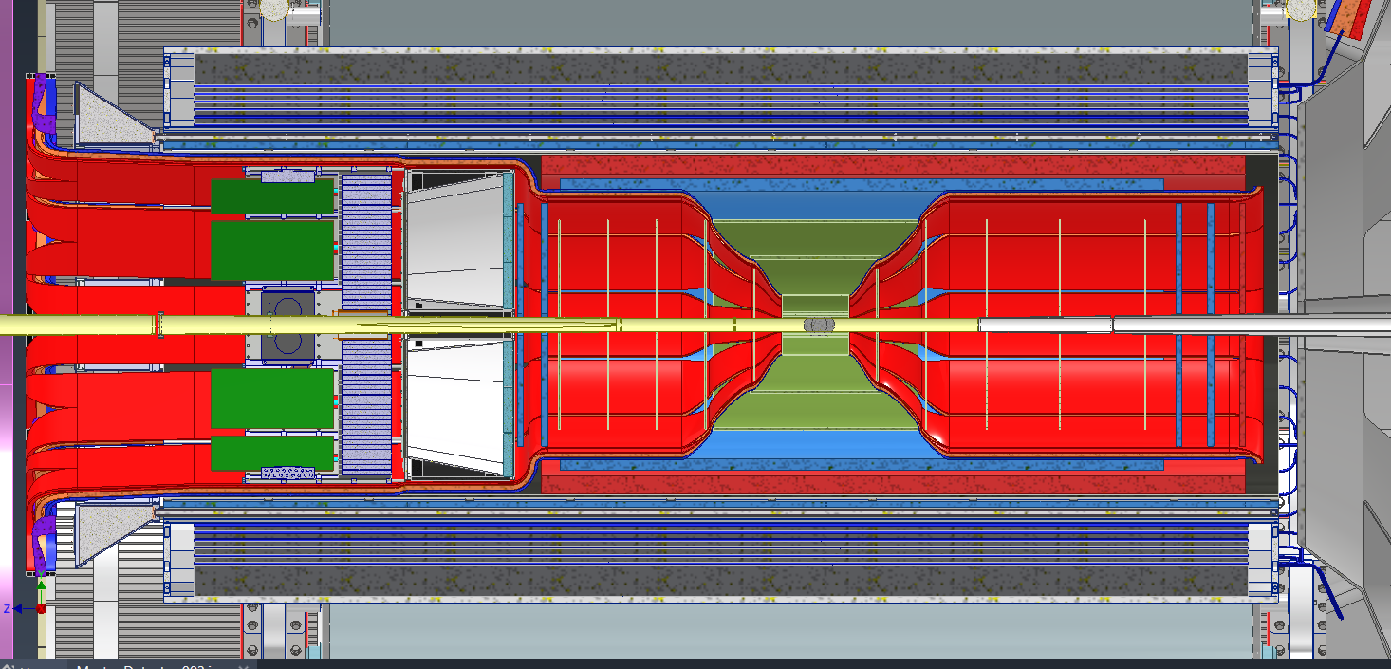
Services
Currently working on updating all services and creating new model for better viewing

Slide 18
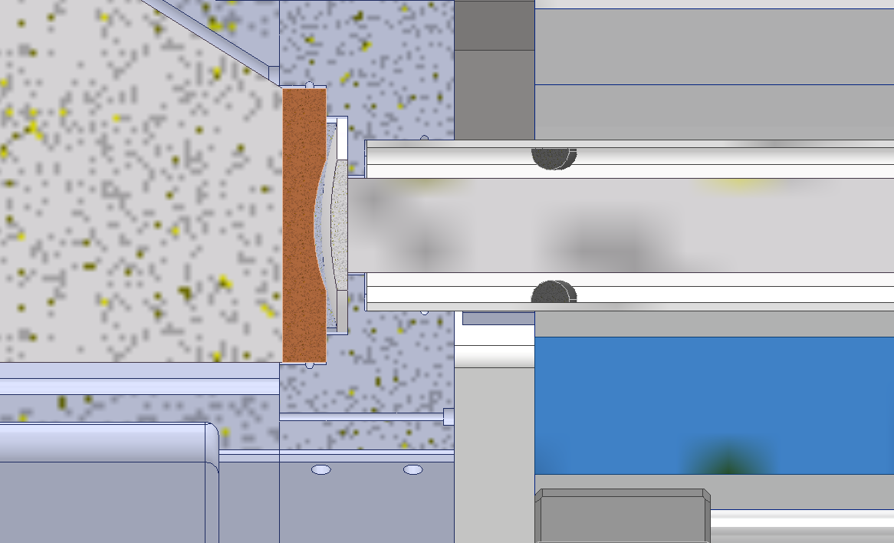
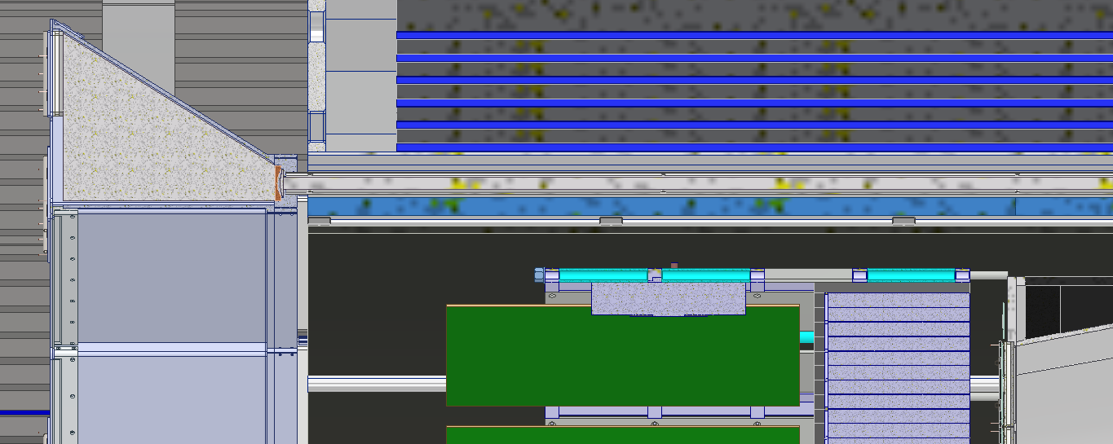
DIRC & Outer MPGD Interferences
Currently small overlap between the DRIC frame and the installation path of the Outer MPGDs
Exploring different options
Making it so that the Outer MPGD can still be installed and removed if the DIRC bars are pulled out
Setting up the Outer MPGDs such that both halves can be pulled out via the Hadron end

Slide 19
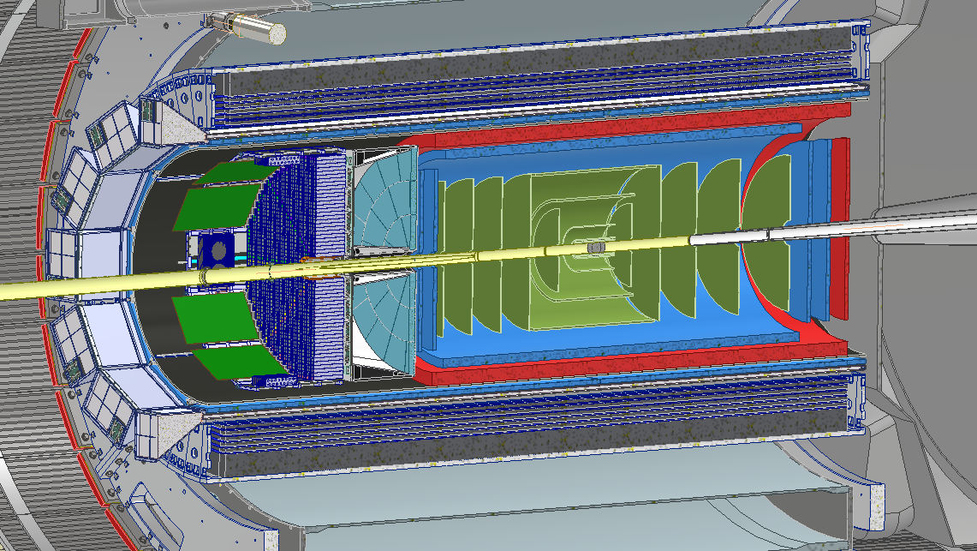
Barrel Emcal Updates
Spoke with the Barrel Emcal group to explore decreasing the weight of the detector so that we can use the crane in the hall
The space that the electronics occupied changed slightly, still working with the group to figure out exactly where they end on Hadron side

Slide 20
EIC Flux Return Bar Mechanical Design and Analysis
Preliminary mechanical analysis to guide the design strategy.
Main design strategies:
Re-using STAR flux return bars. ← Currently pursuing this option.
Heavier but lower material cost and lead time.
Will require additional machining/welding for attachment points.
Fabricating new flux return bars with air gap to reduce weight (bolt or weld together design).
Lower weight but long lead time.
Higher design, analysis, and fabrication complexity.
Self-supporting vs requiring support of barrel HCAL.
Self-supporting is expected to have minimal deflection (expected < 0.1 in). Pursuing this.
Cutout in the ring for cryostat chimney vs no cutout.
Either option appears to work mechanically.
Need to run magnetic simulations.

Slide 21
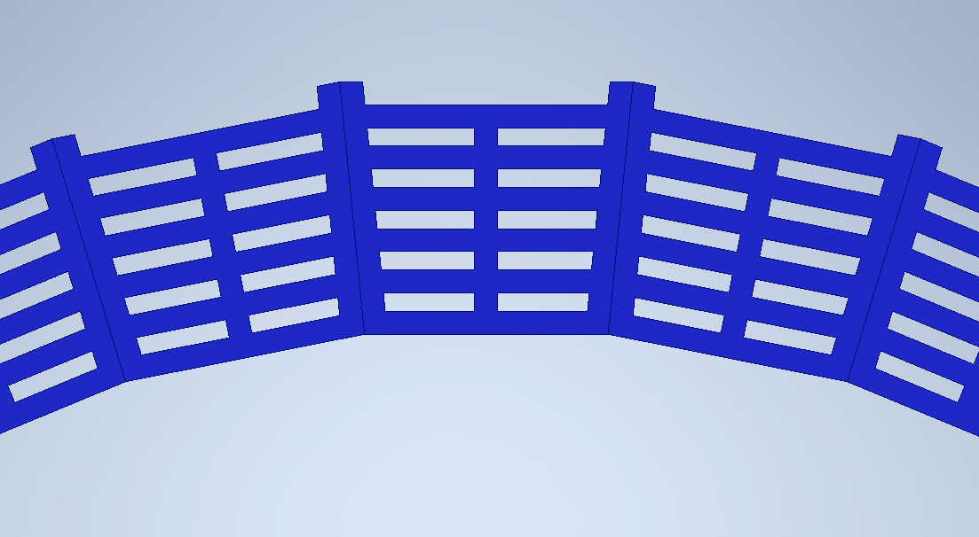
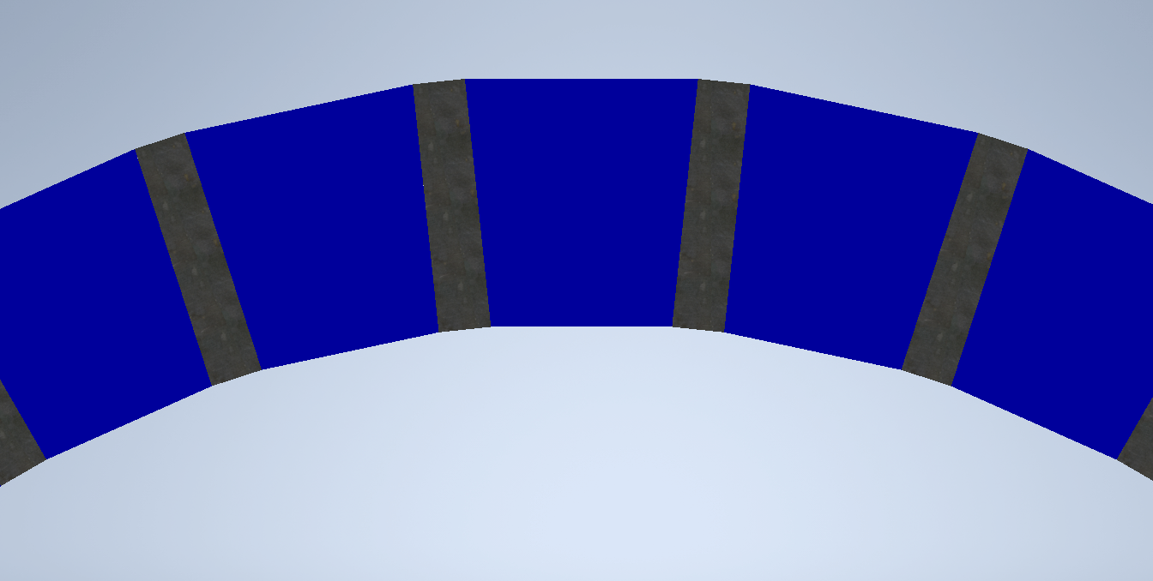
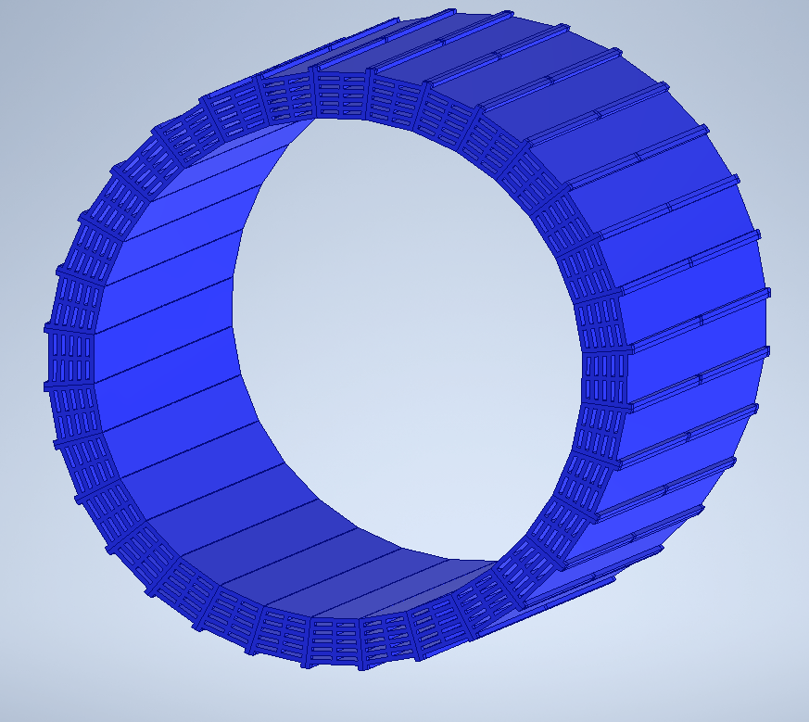
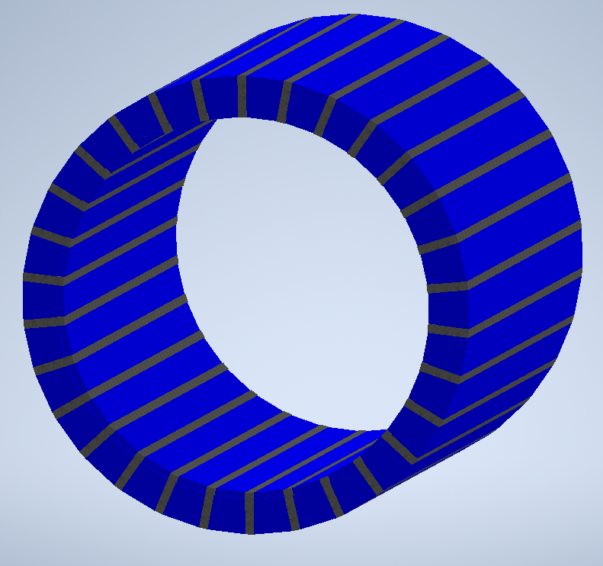
EIC Flux Return Bar Mechanical Design and Analysis
Flux return bar design with air gaps to reduce weight. Long lead time. Fabrication and analysis will be more difficult.
Currently not pursuing this option.
Flux return bar design reusing solid flux return bars from the STAR detector.
Requires additional flat plate spacers to make the assembly the right inner diameter.

Slide 22
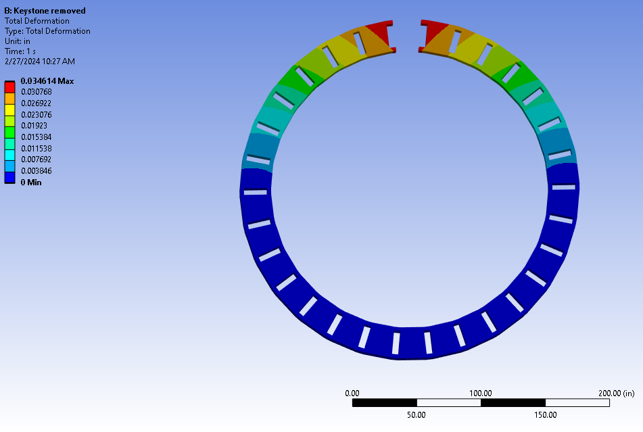
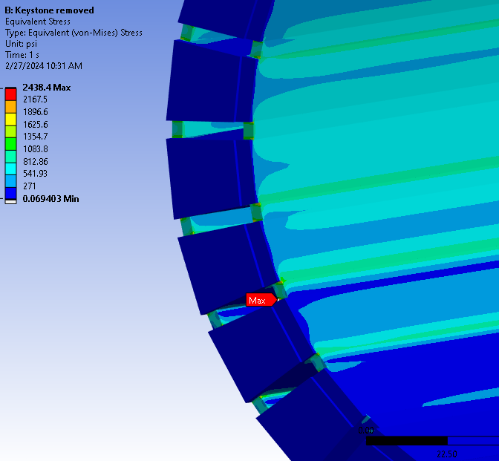
EIC Flux Return Bar Assembly
Looked at how the flux return bar ring would behave during assembly. Removing the top keystone will be the worst case for deflection and near worst case for stress.
The final design with bolted connections will have higher stresses and deflections than shown in this presentation, and further analysis is required.
With the top bar removed, the total deflection was calculated to be ~0.035 in.
The highest uniform stresses were < 2,000 psi. 1020 steel yield strength is 30,00 to 50,000 psi, depending on processing. This has enough margin to proceed with further iterations.
22

Slide 23
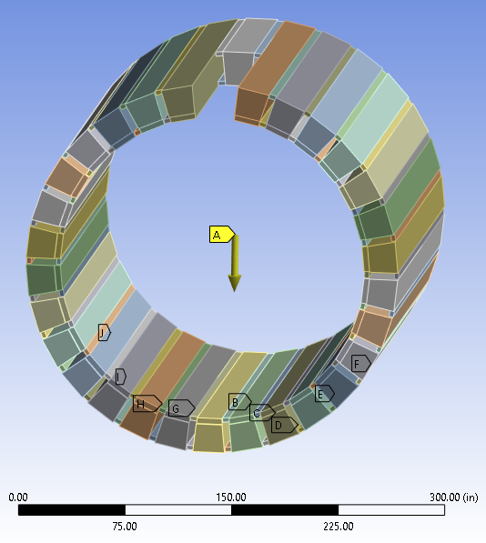
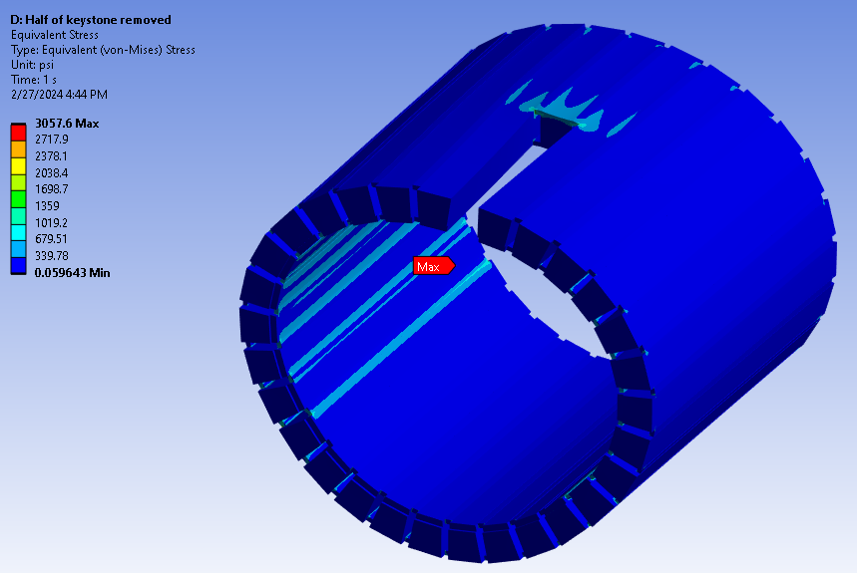
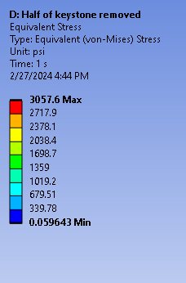
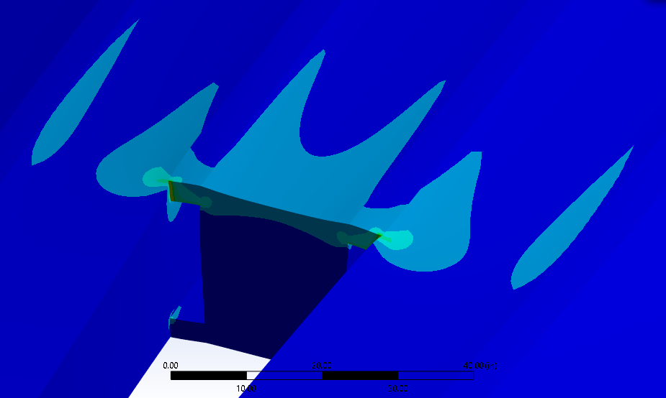
EIC Flux Return Assembly with Chimney Cutout
Ran a simulation to determine stress and deflection with a cutout for the cryostat chimney.
Removed only part of the topmost bar. Worst case for analysis with a cutout.
The maximum total deflection was 0.007 in.
The highest uniform equivalent stress around the cutout was less than 2,000 psi. 1020 steel yield strength is around 30,00 to 50,000 psi, depending on processing.
Based on deflection and stress, it appears that having a cutout for the chimney is a viable option mechanically.
Exaggerated deflection
23

Slide 24
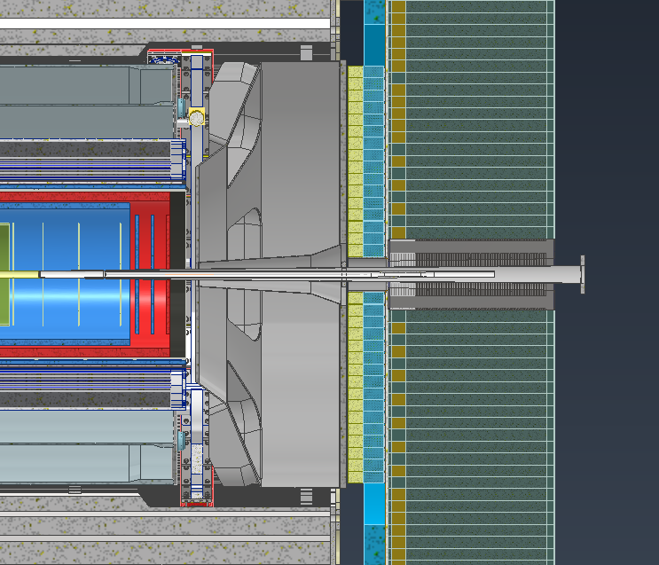
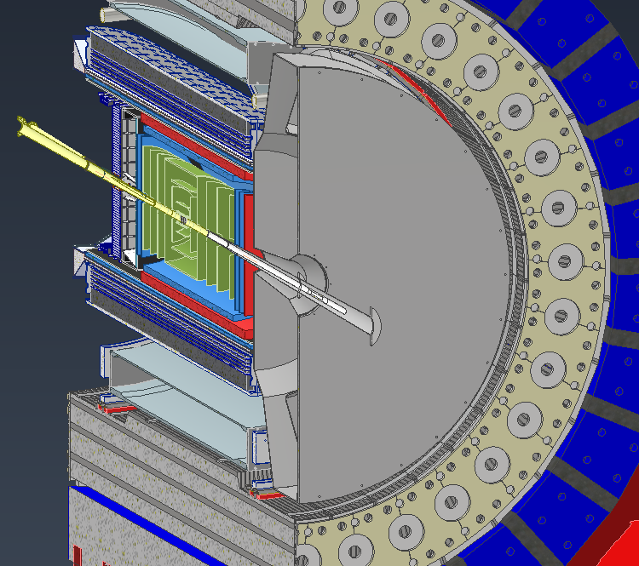
dRICH Decisions
Looking into ways to make maintenance in the experimental hall more feasible
Being able to pull the dRICH in and out in the experimental hall means access to many different systems and electronics
Splitting the dRICH into two pieces would have different implications on this.

Slide 25
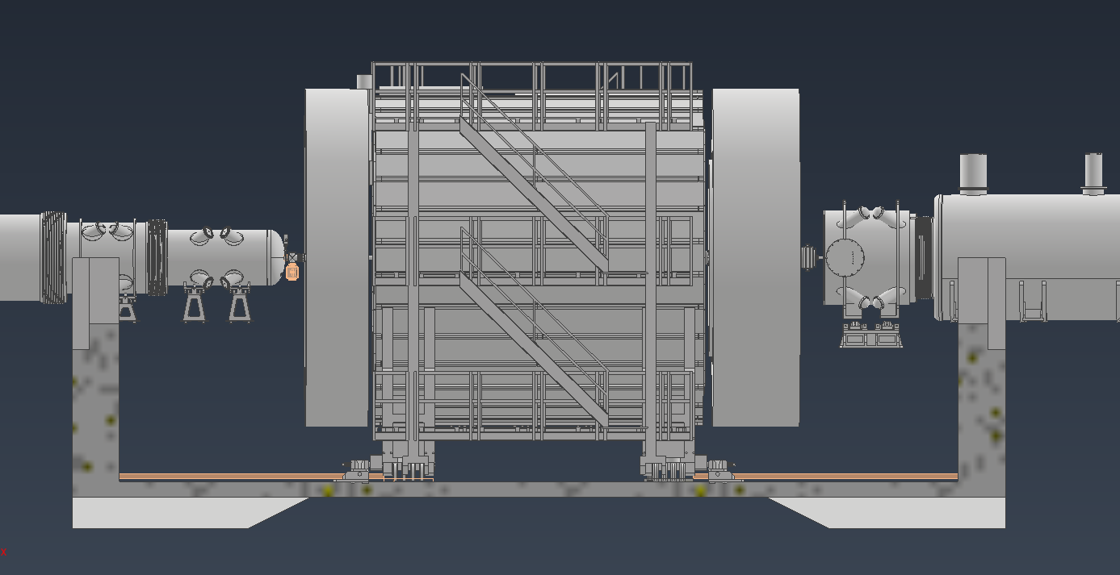
Platform work
Looking into platforms in the hall

