Slide 1
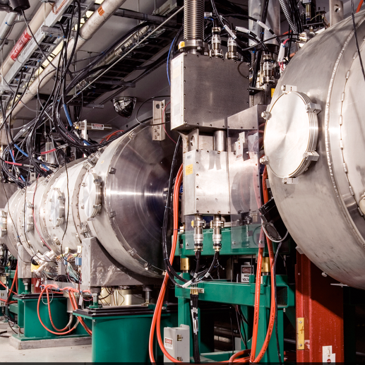
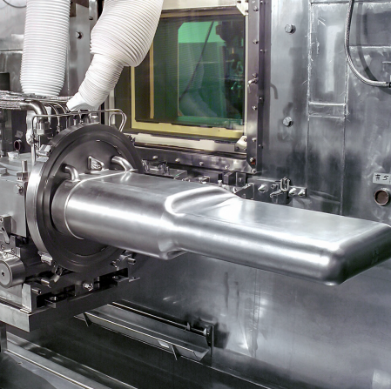
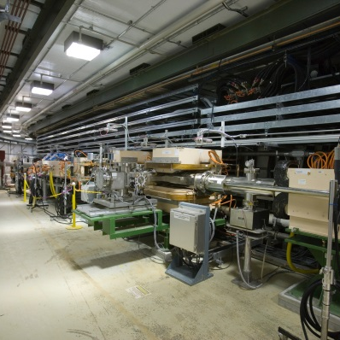

ePIC
Forward Hadronic Calorimeter
LFHCal Mechanical Design Update
Eliott Fountain
May 29, 2024

Slide 2
Mechanical Design Update
Contents:
  LFHCal Design Overview
  LFHCal Component Designs
  Fabrication Progress
  Scintillator Integration (CERN Test Setup)
  Structural Analysis (Compression & Lifting)
  Seismic Evaluation
  Next Steps

Slide 3
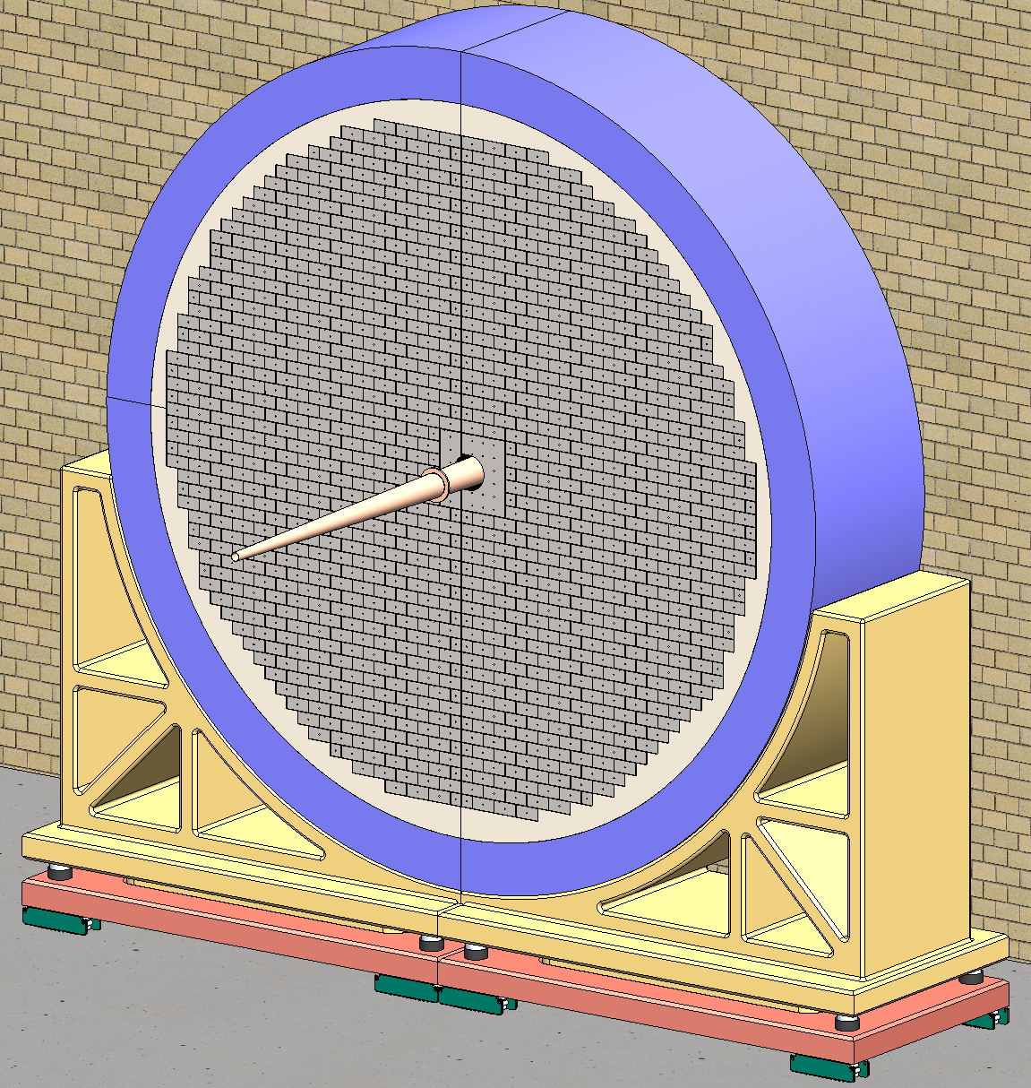
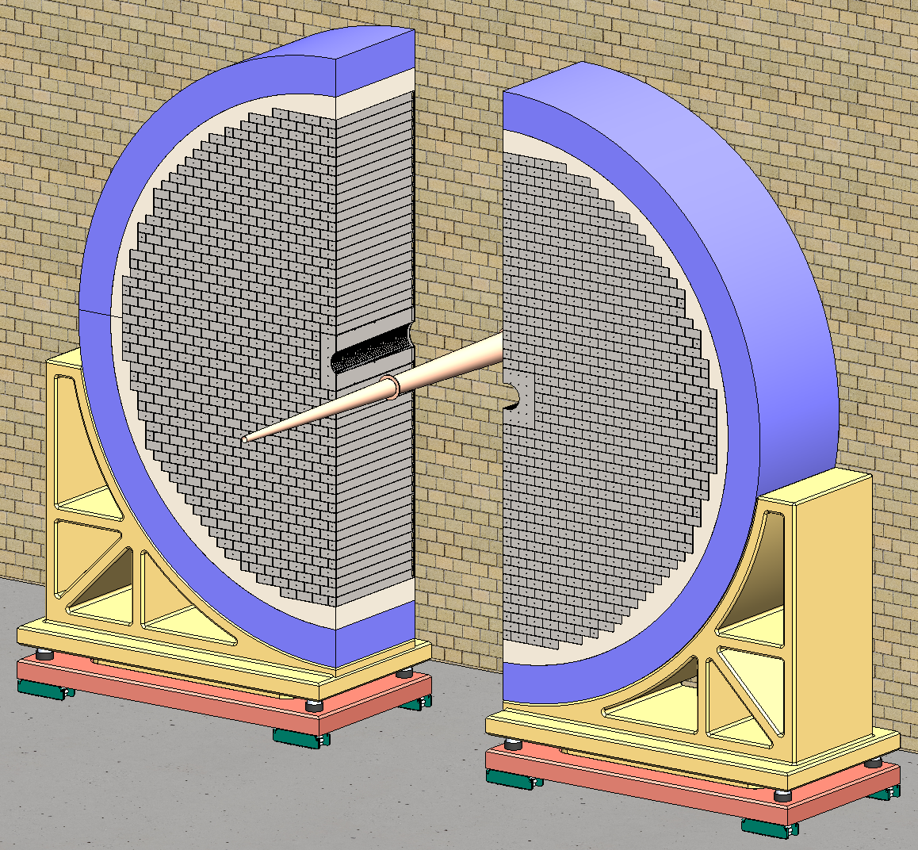
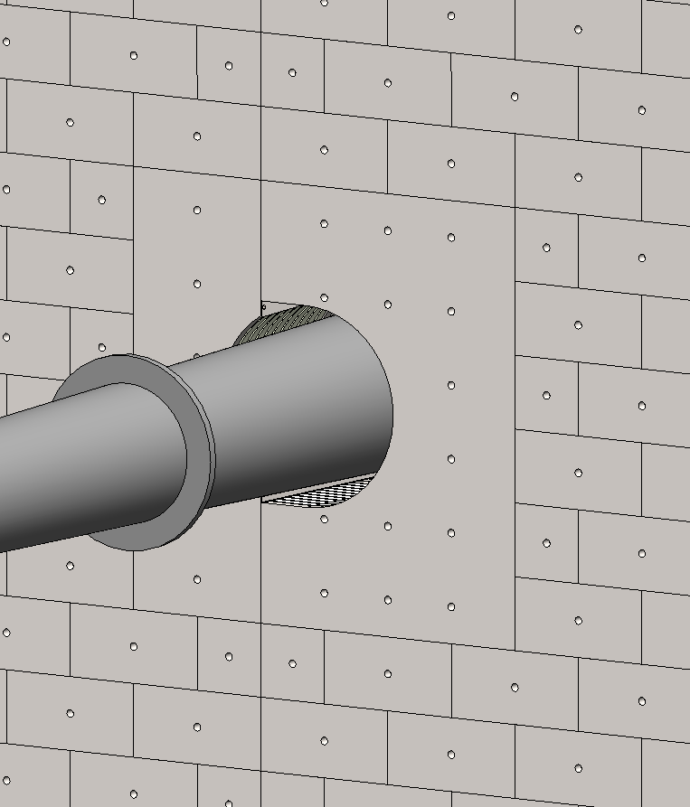
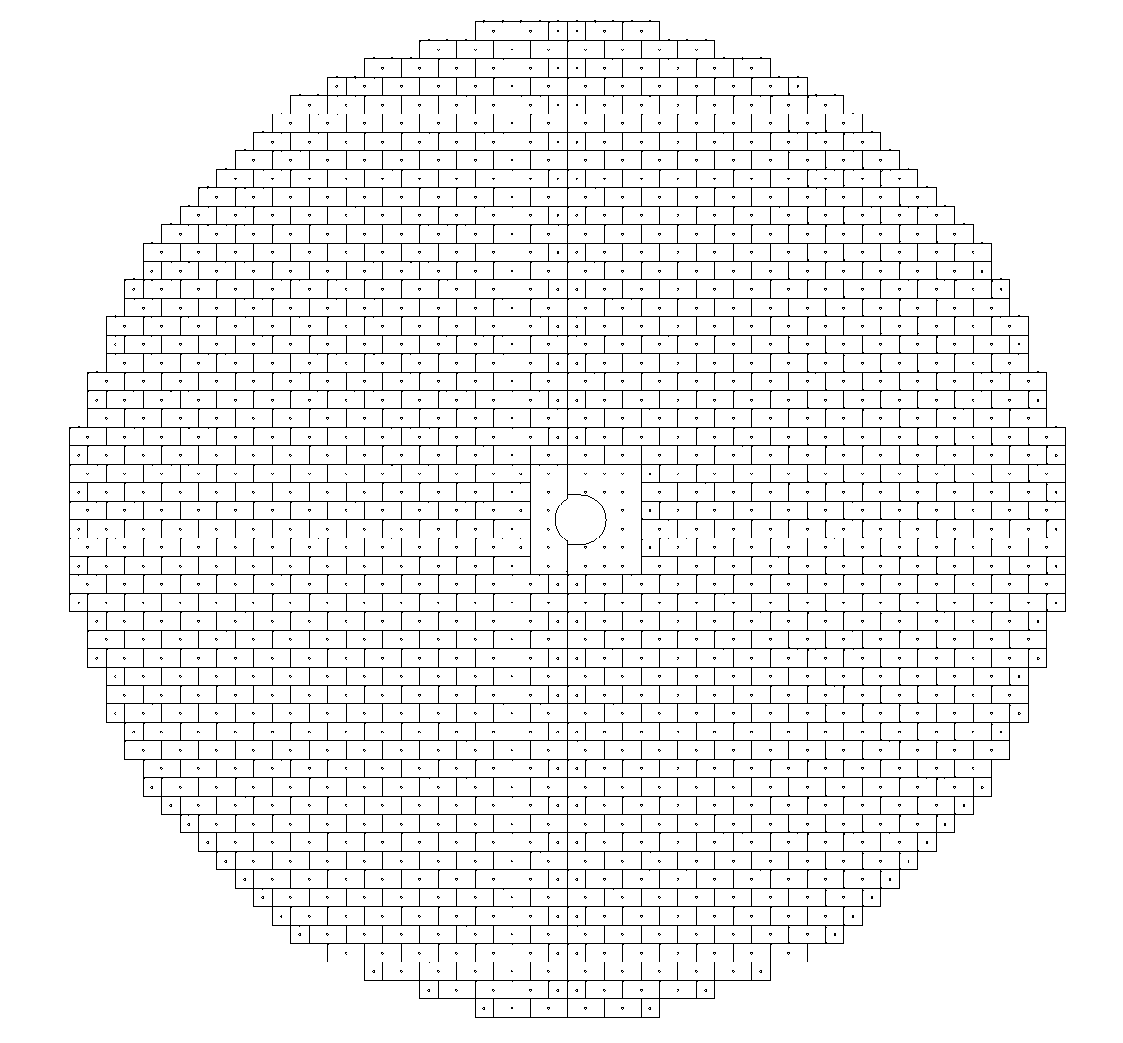
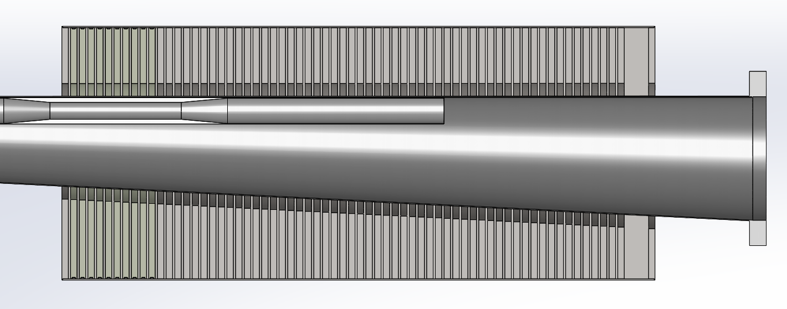
Top Level FHCAL Structure
Beampipe
Detector Features / Highlights:
Ø 5.4 meters, 1.4 meters thick, Vertical Split Design.
Staggered ‘brick’ stacking for stability & detector efficiency.
Contains 180,000 kg of Steel.
1,062x 8M Towers, 108x 4M Towers.
2x asymmetric “Insert” Towers for beampipe passage.
65x Scintillator assembly layers.
≈ 580,000x Scintillator Tiles, 47 x 47 mm with individual readouts.
LFHCal Detector Assembly
3 cm annular clearance around beampipe
Conceptual LFHCal Yolk
Conceptual support structure
Asymmetric Insert Assemblies

Slide 4
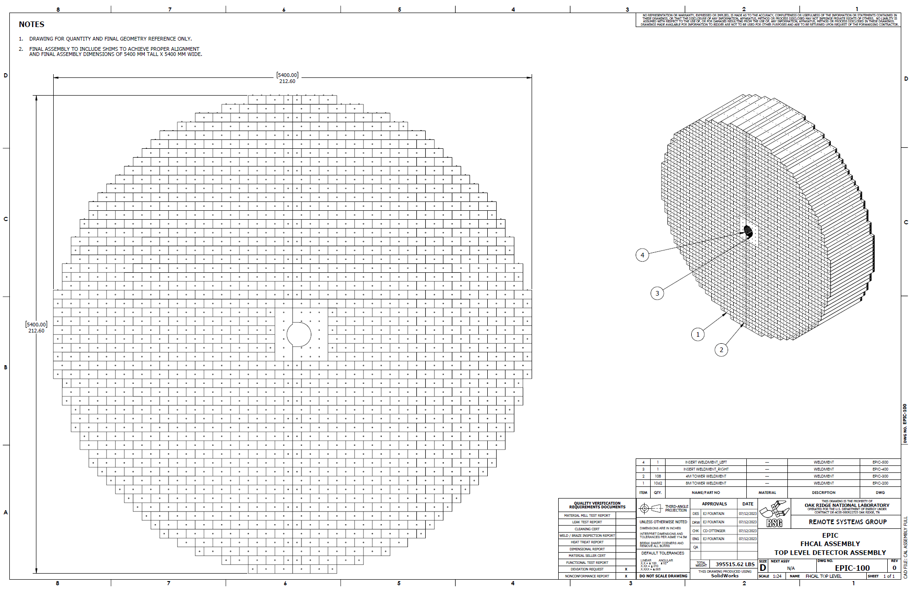
Top Level FHCAL Structure
Drawing of the LFHCal Stack

Slide 5
Tower / Insert Design

Slide 6
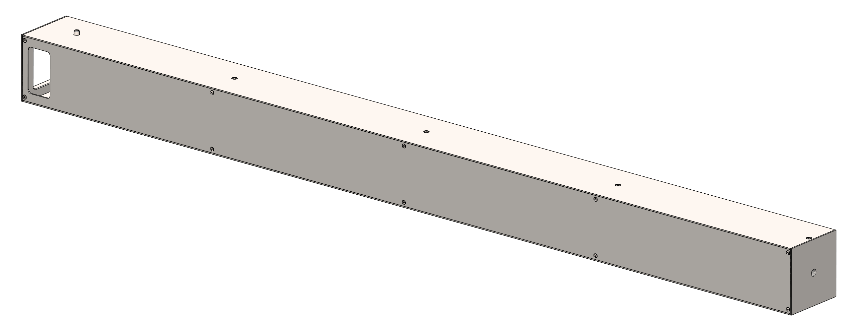
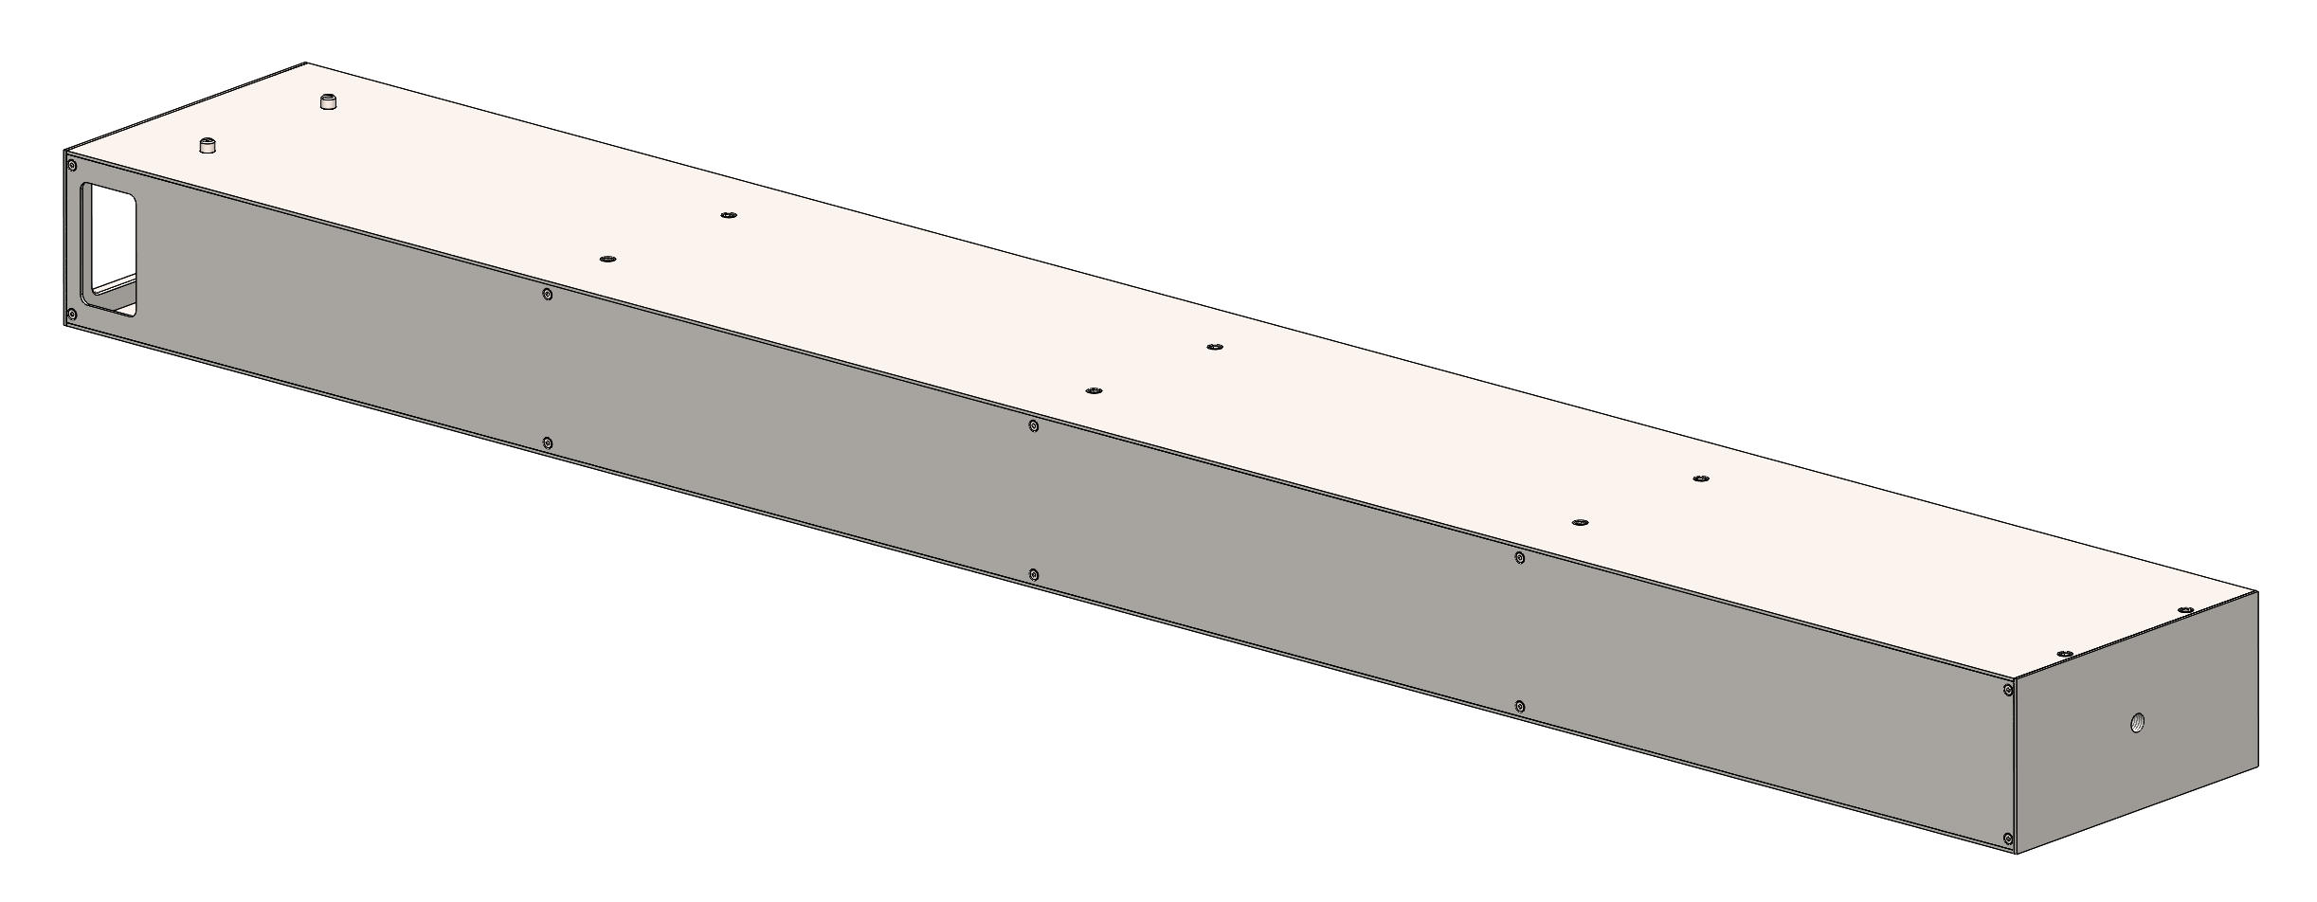
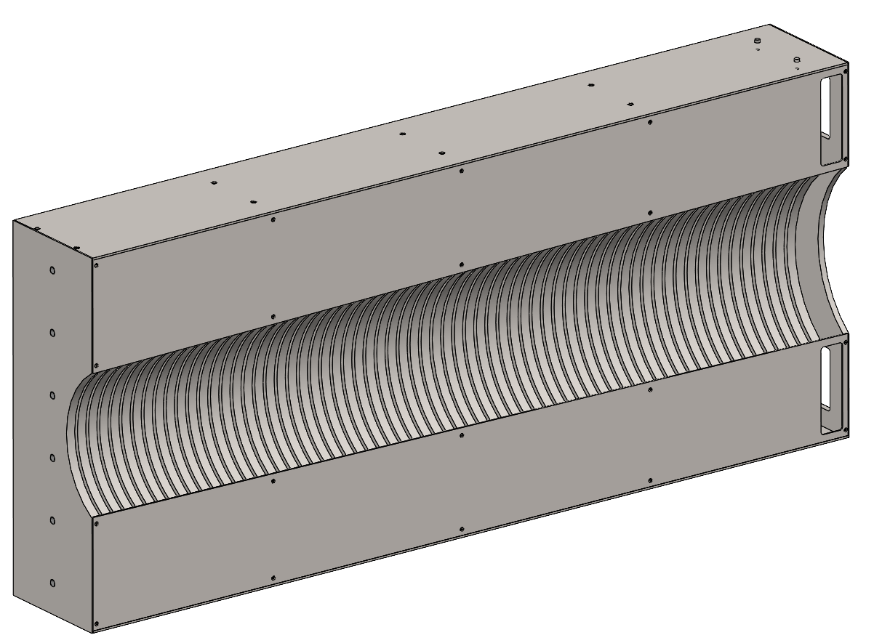
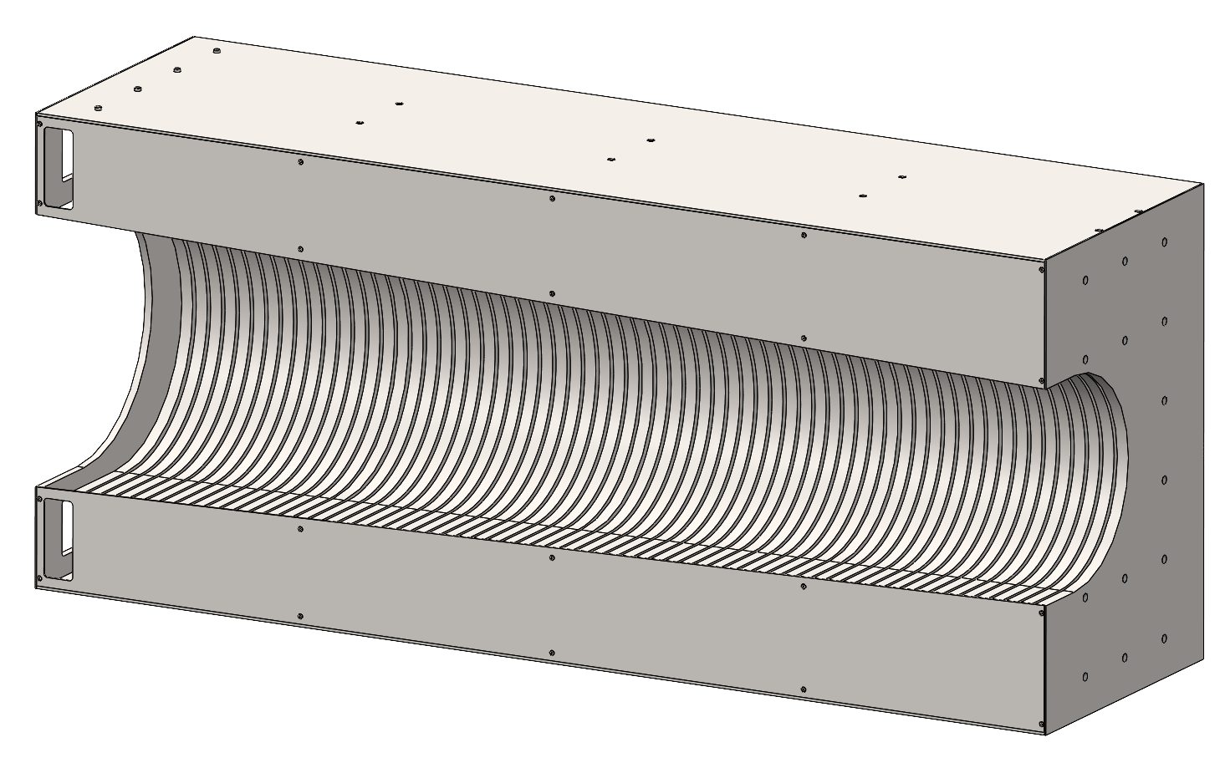
Unique Detector Geometries
4M Tower Assembly
- Dimensions: 10 x 10 x 140 cm
- Quantity: 108
- Mass: ≈ 78 kg
Common design and manufacturing processes for all geometries.
Constructed of 15.2 mm thick solid absorber plates, 1020 Carbon Steel
1020 Carbon steel sheet metal top, bottom, and back.
Electron-Beam welding of all steel components for a monolithic structure.
Removable side panel for scintillator assembly, maintenance.
M8 dowel pins threaded into last plate mate with 8.5 mm holes on bottom side for assembly / alignment.
M12 tapped hole in front plate.
M6 tapped holes for hoisting.
Generous windows at rear for PCB access / electrical connections.
8M Tower Assembly
- Dimensions: 10 x 20 x 140 cm
- Quantity: 1062
- Mass: ≈ 160 kg
Left Insert Assembly
- Dimensions: 60 x 20 x 140 cm
- Quantity: 1
- Mass: ≈ 860 kg
Right Insert Assembly
- Dimensions: 60 x 40 x 140 cm
- Quantity: 1
- Mass: ≈ 1,390 kg

Slide 7
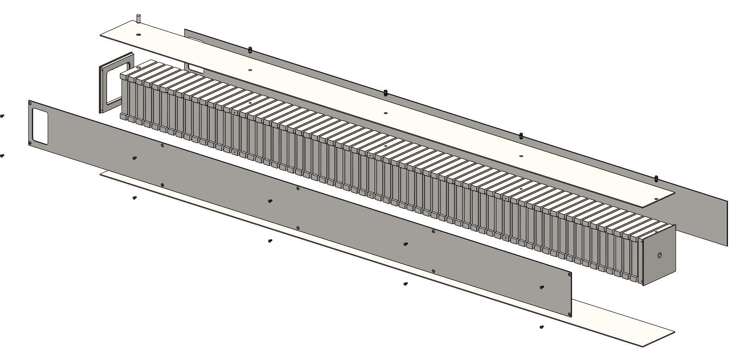
4M Tower Design
8M Tower Assembly
Fills voids left by 8M Tower stacking arrangement.
65x absorber plate layers, 1020 Carbon Steel.
Top, bottom, and side panels made from 14 GA sheet metal.
Steel Plates
Removable Side Plate
Expanded View
Front Plate
Front View with side panel removed

Slide 8
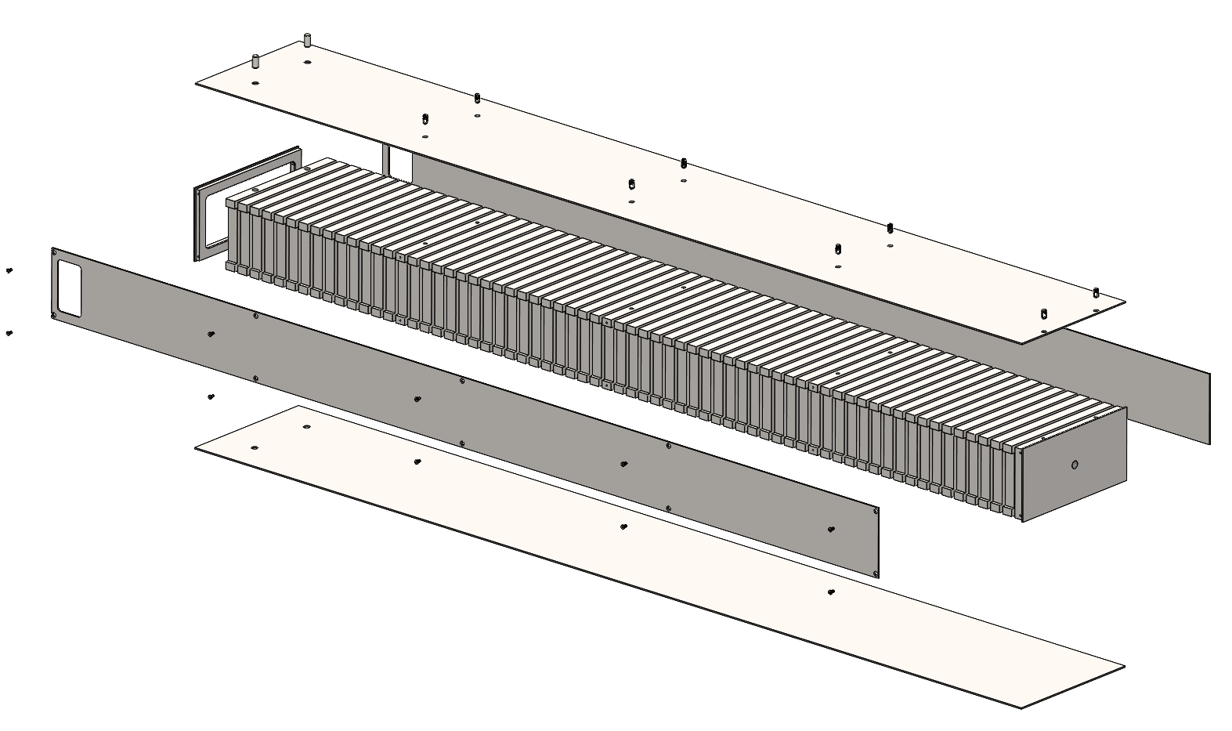
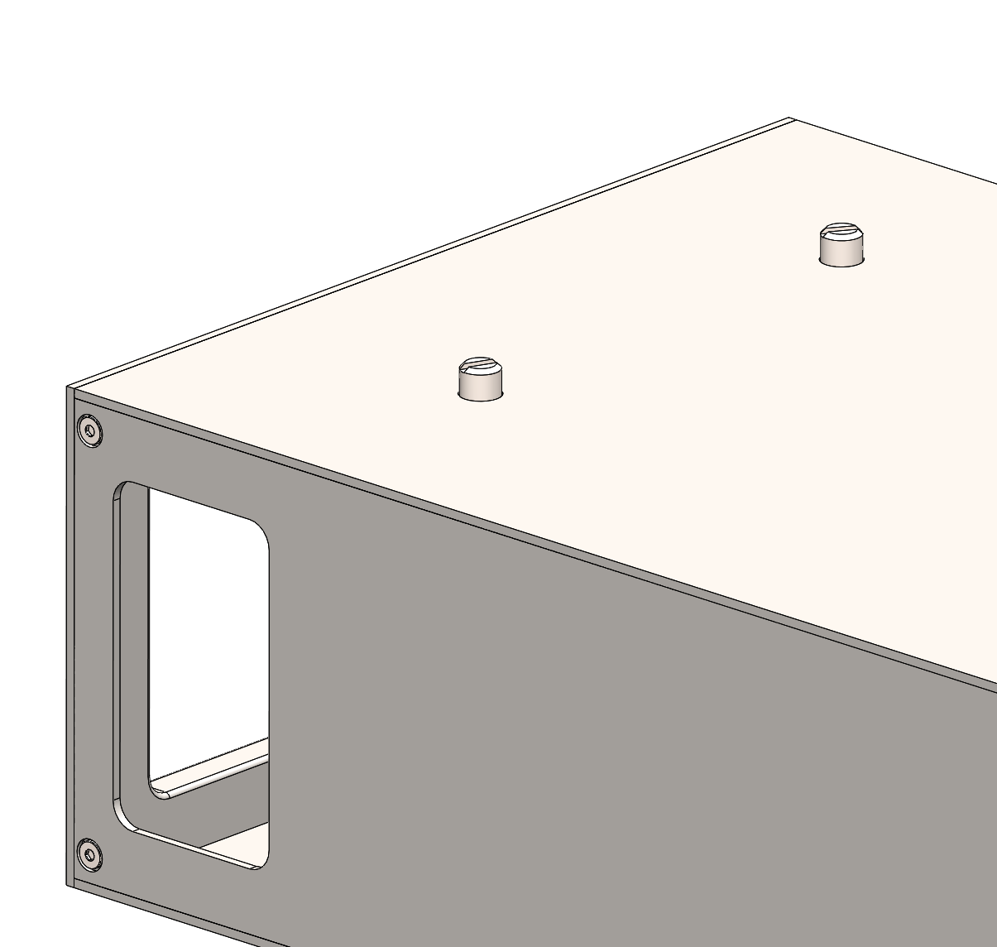
8M Tower Design
8M Tower Assembly
Main detector module shape.
65x absorber plate layers, 1020 Carbon Steel.
Top, bottom, and side panels made from 14 GA sheet metal.
Steel Plates
Alignment Pins
Removable Side Plate
Front Plate
Expanded View
Front View with side panel removed

Slide 9
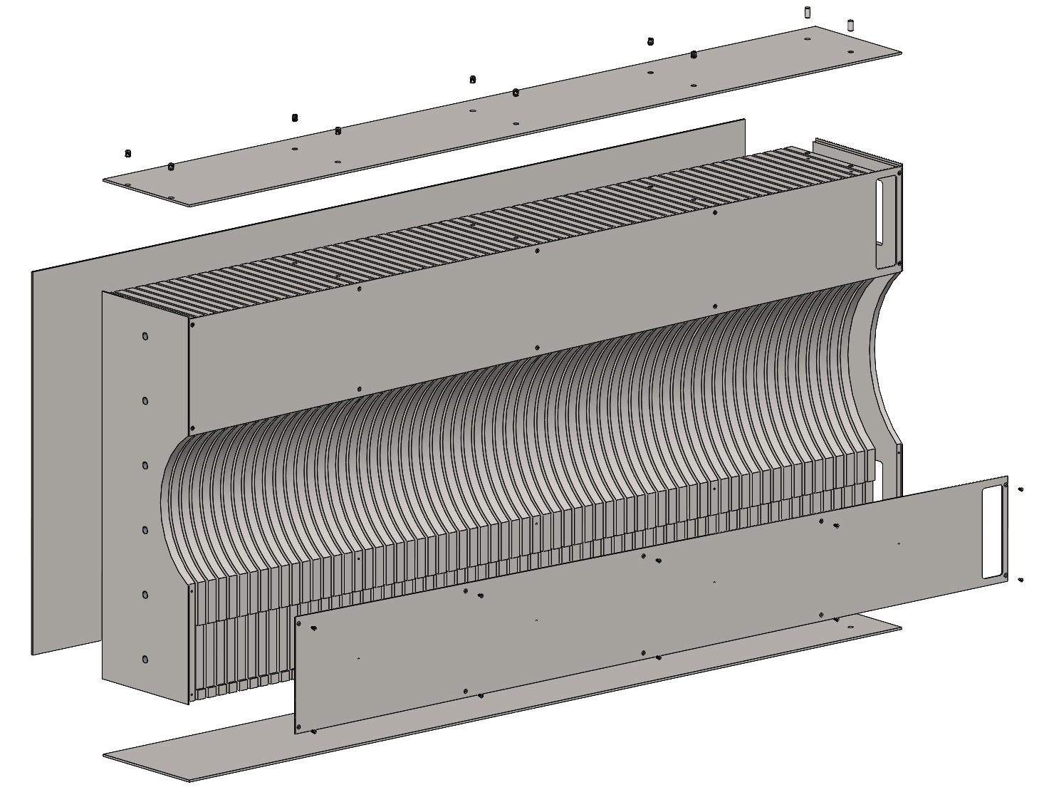
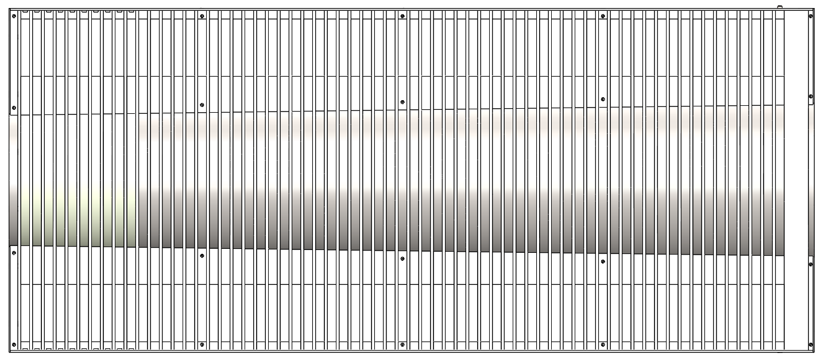
Insert Assembly Design (Left Side)
65x absorber plate layers, 1020 Carbon Steel.
Continuously expanding circular cut for constant beampipe clearance.
Top, bottom, and side panels made from 10 GA sheet metal.
Left Insert Assembly
Expanded View
Removable Side Plate
Unique Geometry Steel Plates
Front View with side panels removed
Removable Side Plate
Front Plate

Slide 10
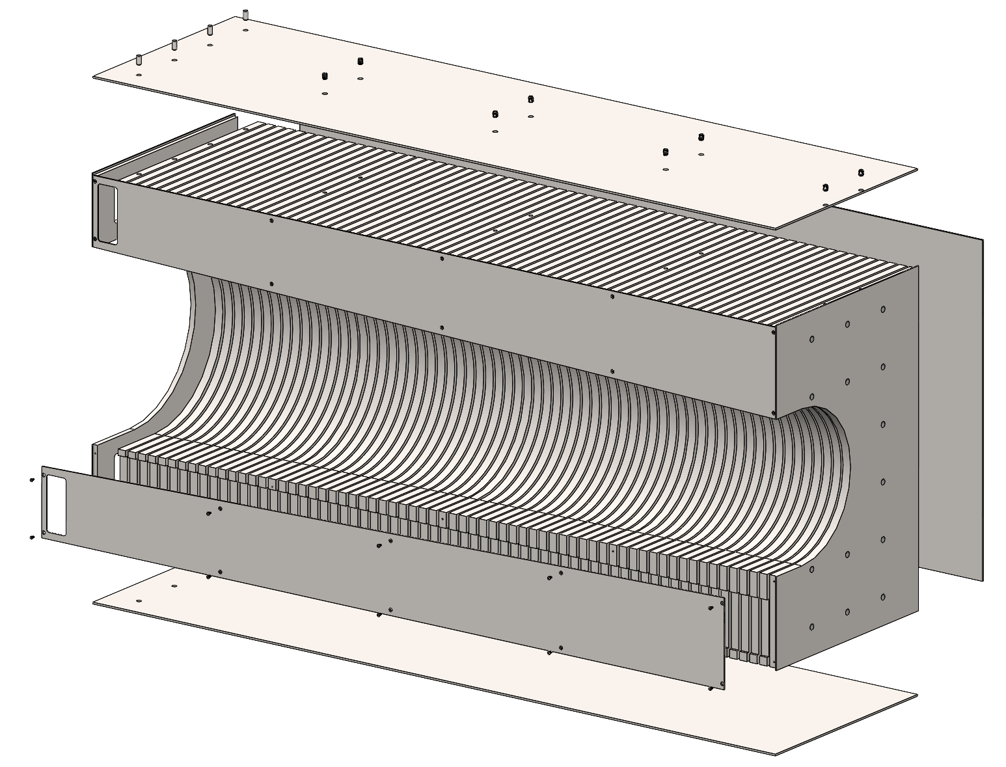
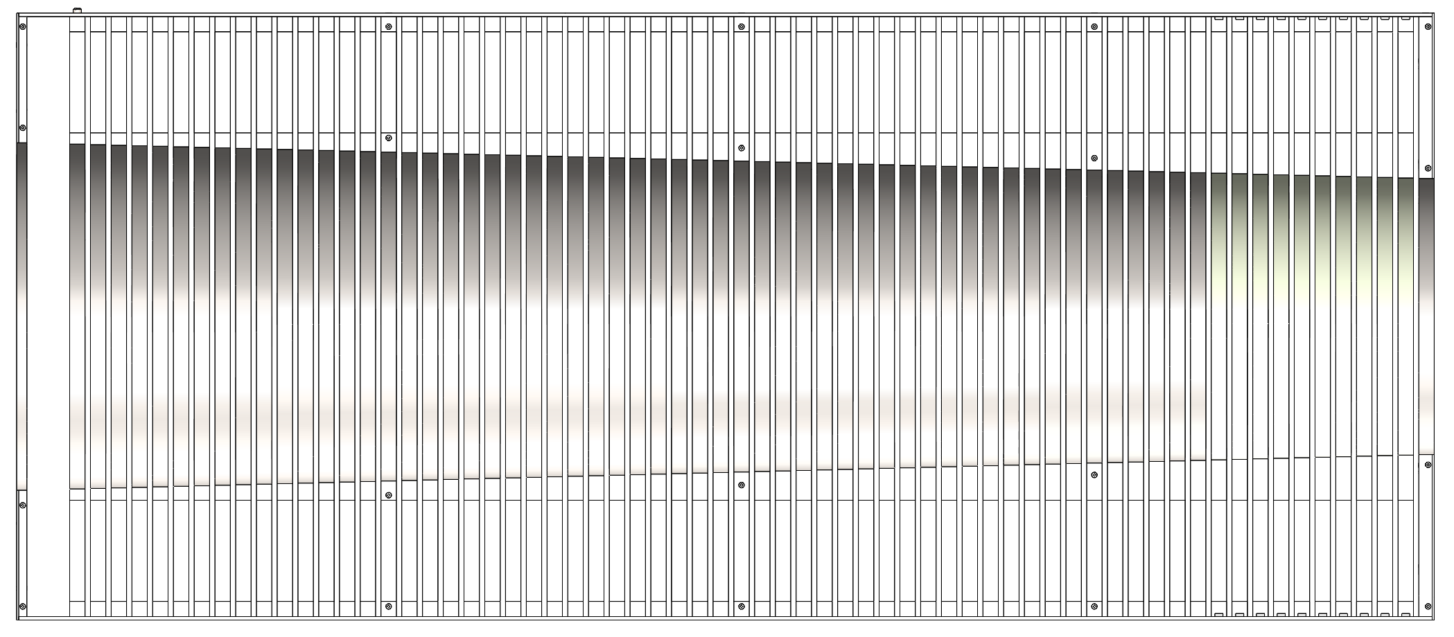
Insert Assembly Design (Right Side)
Right Insert Assembly
65x absorber plate layers, 1020 Carbon Steel.
Continuously expanding circular cut for constant beampipe clearance.
Top, bottom, and side panels made from 10 GA sheet metal.
Expanded View
Unique Geometry Steel Plates
Removable Side Plate
Front Plate
Front View with side panels removed
Removable Side Plate

Slide 11
Fabrication Progress

Slide 12
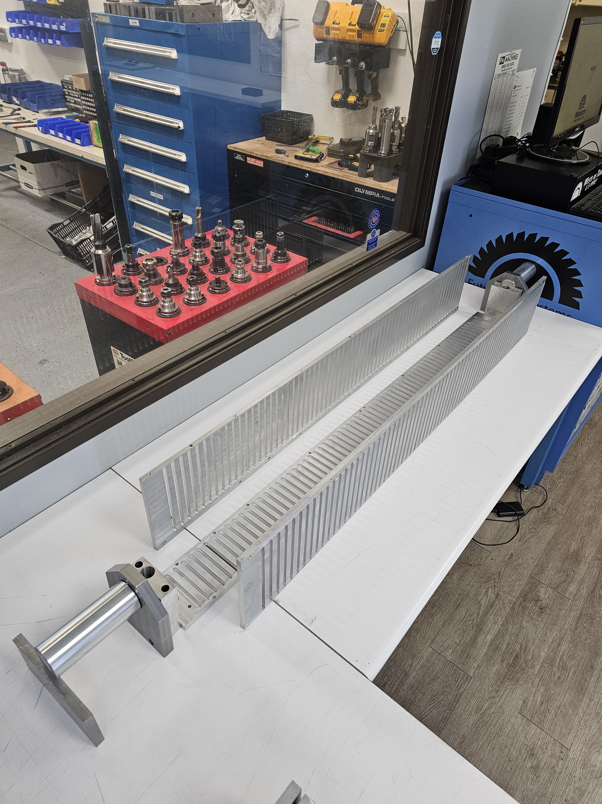
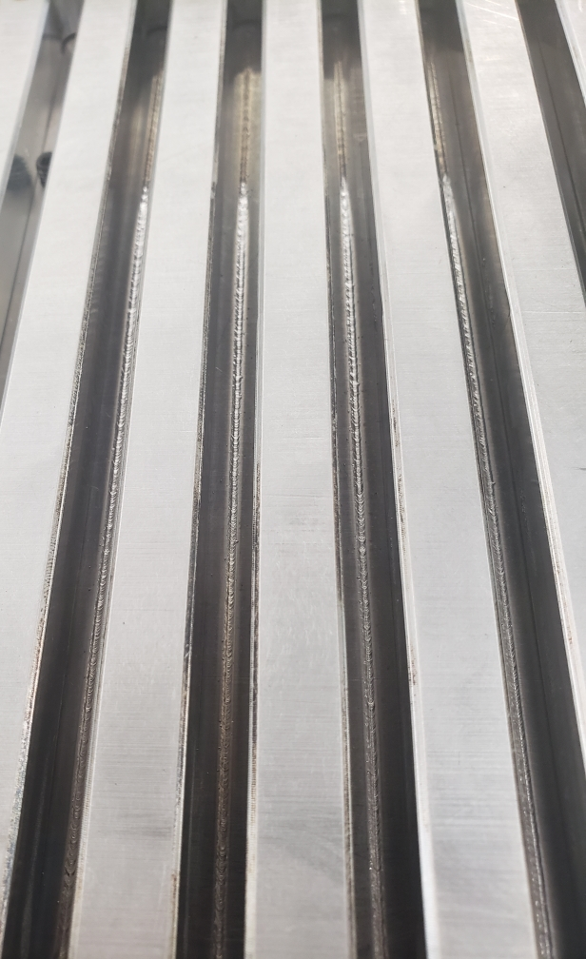
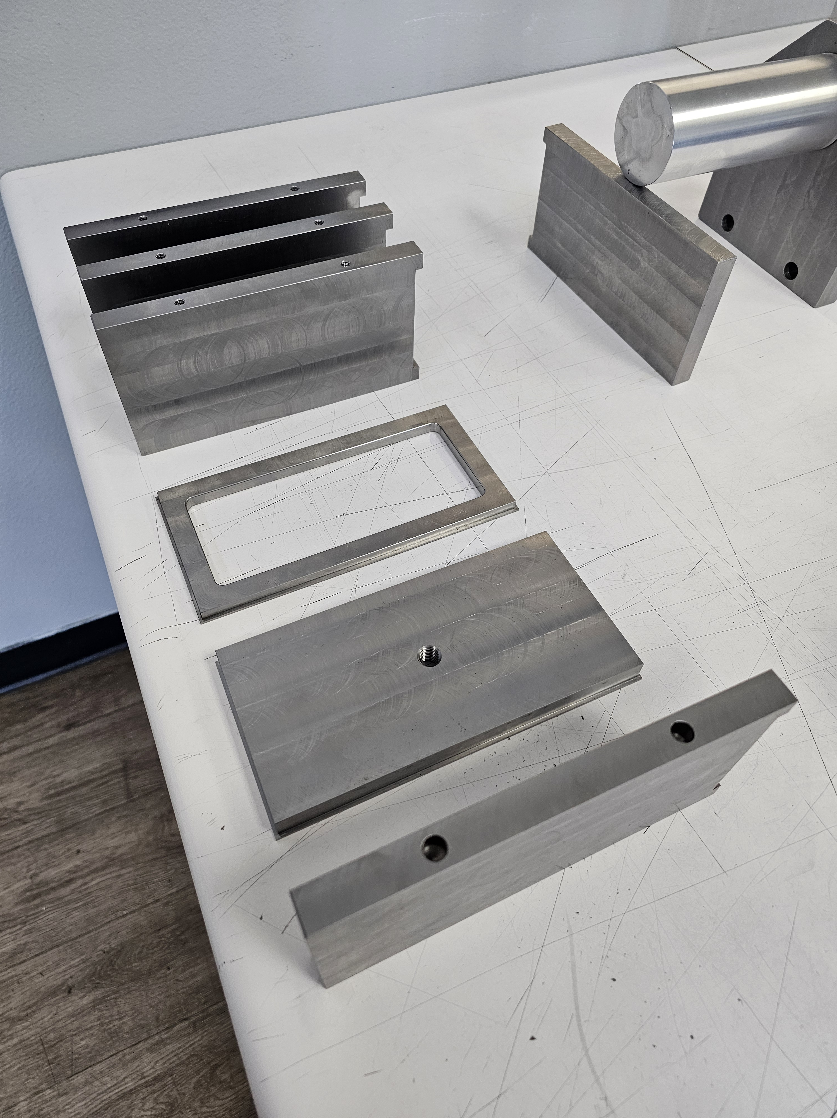
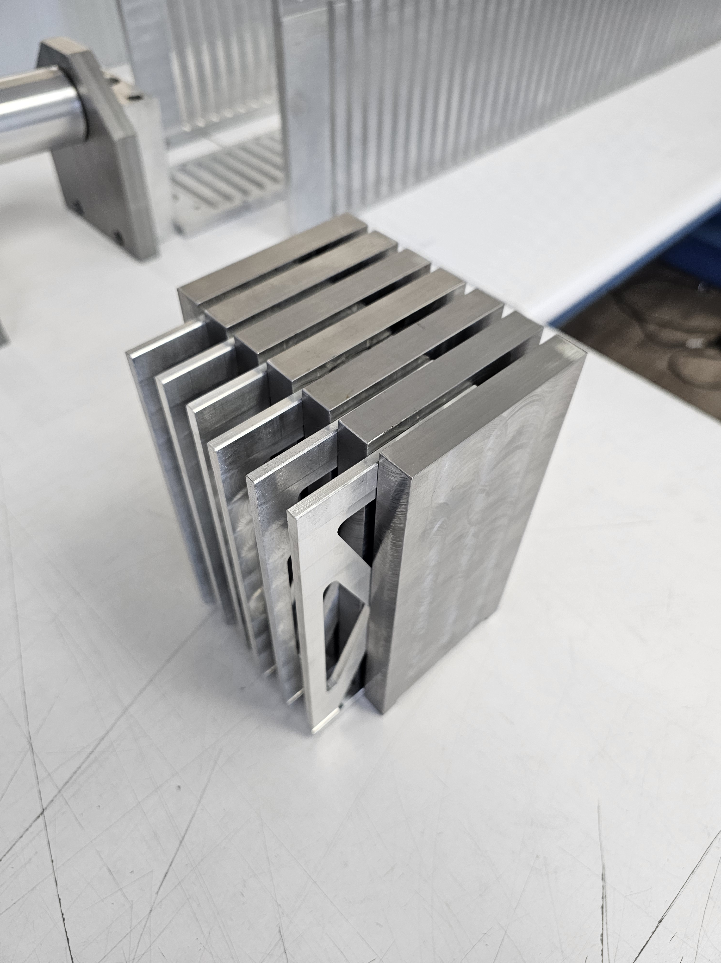
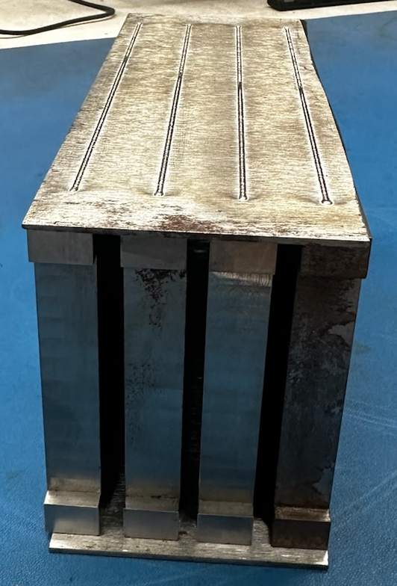
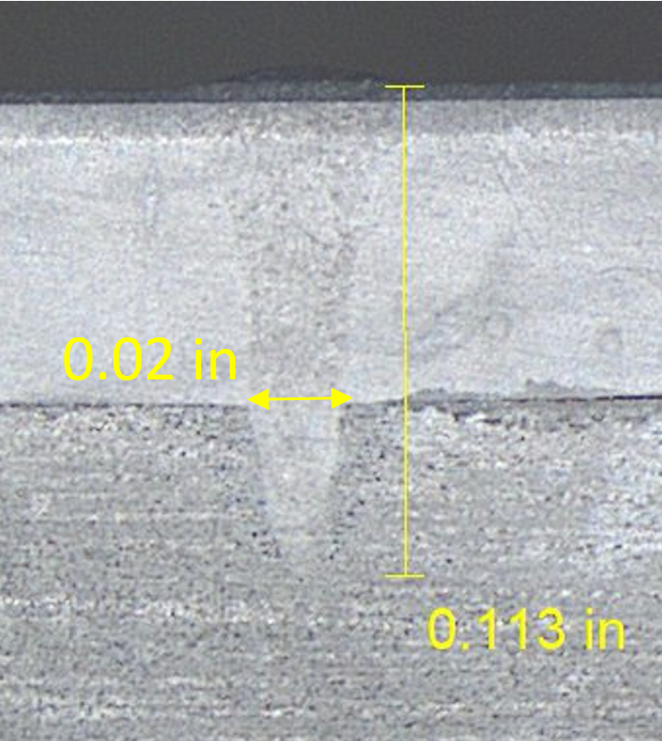
E-Beam Welding
8M Tower Welding Jig
E-Beam Welding of first 8M Tower Assembly
Manufactured Parts
Absorber plate Spacers
E-Beam Weld Testing

Slide 13
Scintillator Integration

Slide 14
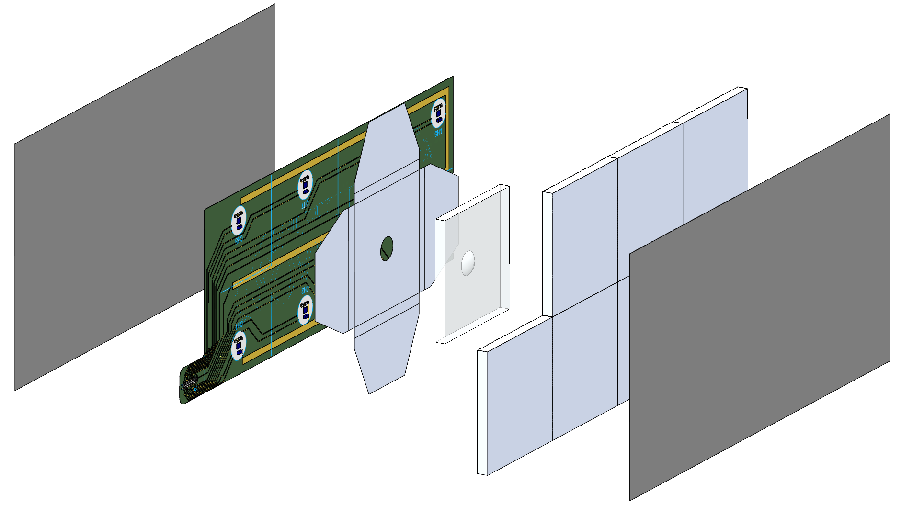
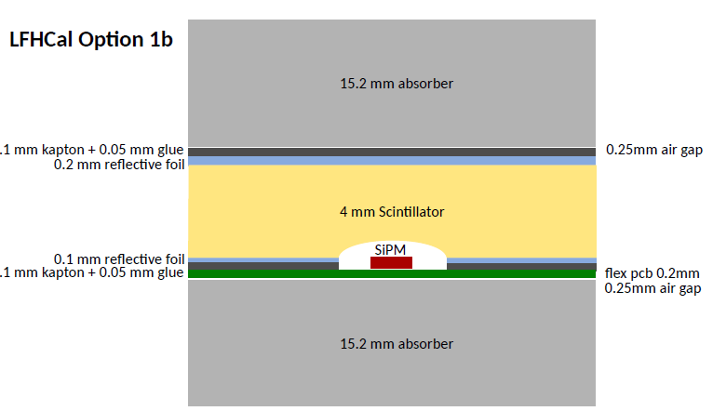
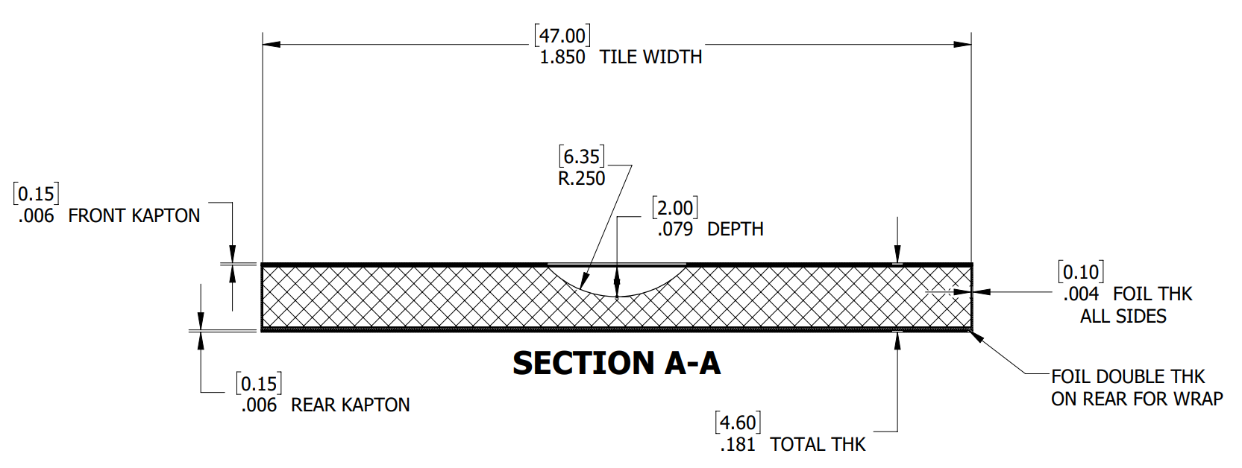
Common Scintillator Assembly Features (8M shown)
Material / Manufacturing:
  FNAL injection molded tile (bulk fabrication)
Dimensions:
  Raw Tile: 47 x 47 x 4 mm
  Wrapped tile: 47.2 x 47.2 x 4.6 mm (not including SiPM board thickness)
Envelope Assembly:
  Approximate weight: 100 grams / envelope
  Total weight per Tower Assembly:
  4M Tower – 4 kg / 8M Tower – 7 kg
  Left Insert – 40 kg / Right Insert – 57 kg
SiPM Flexible PCB connects to the common PCB running along the tower to the rear of the assembly.
The flex PCB then connects to the readout board at the rear of the Tower.
Wrapped Tiles
Unwrapped Tile
Kapton Sheet
Kapton Sheet
SiPM Flex PCB
3M Reflective Foil

Slide 15
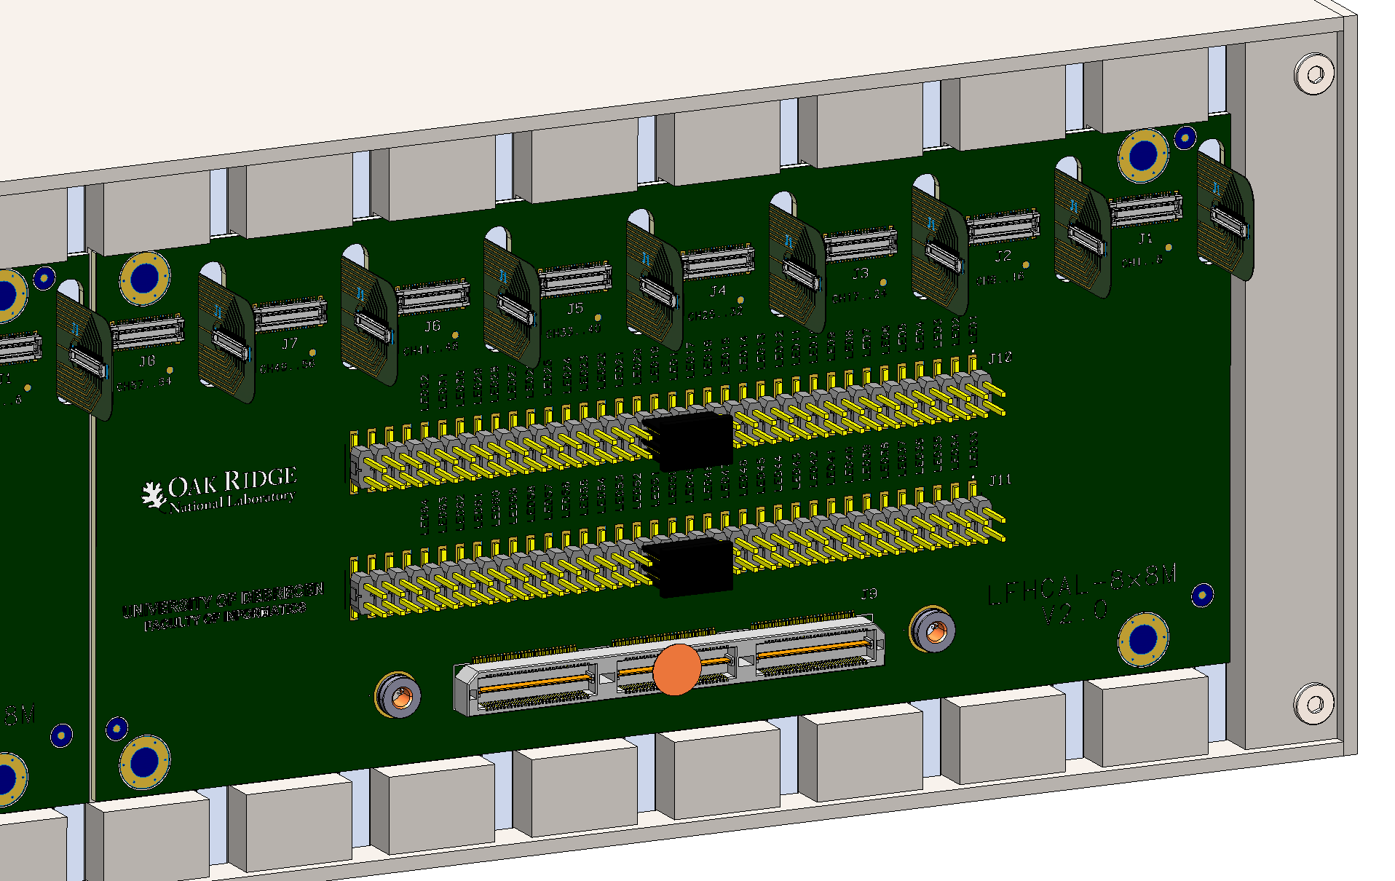
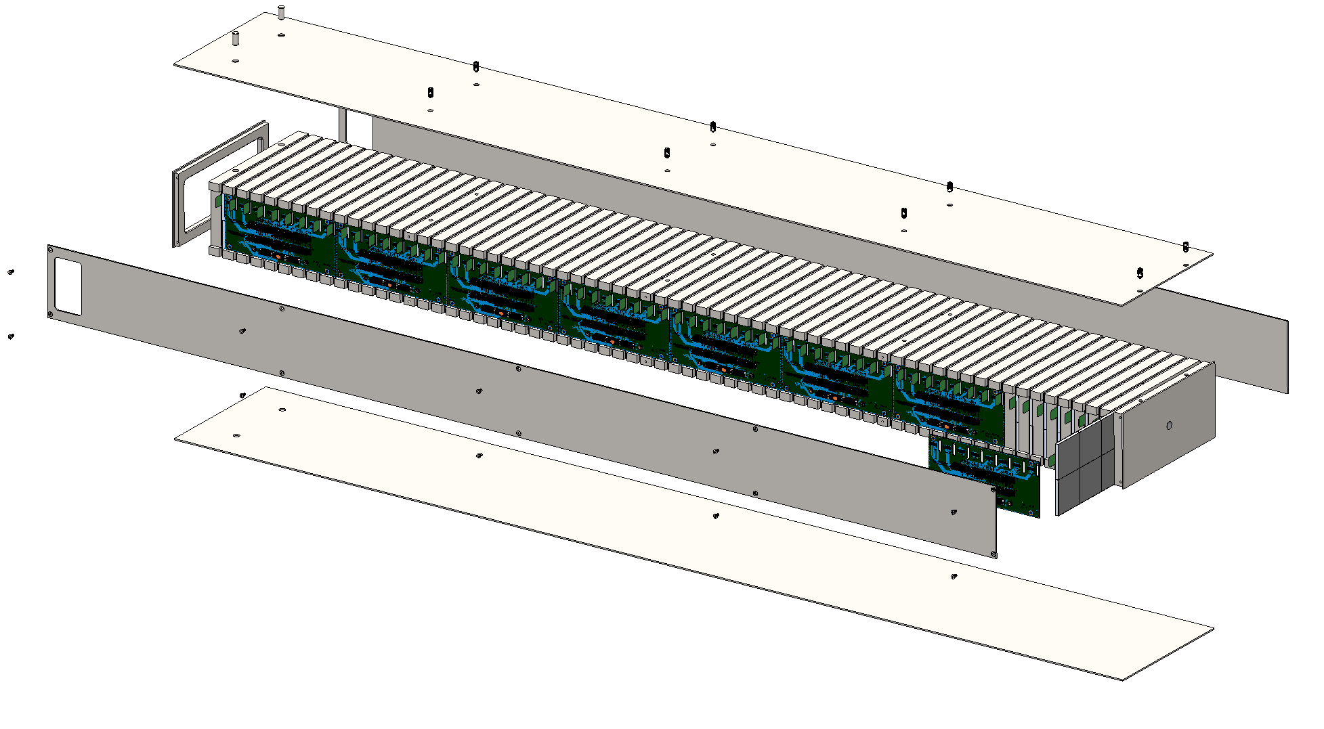
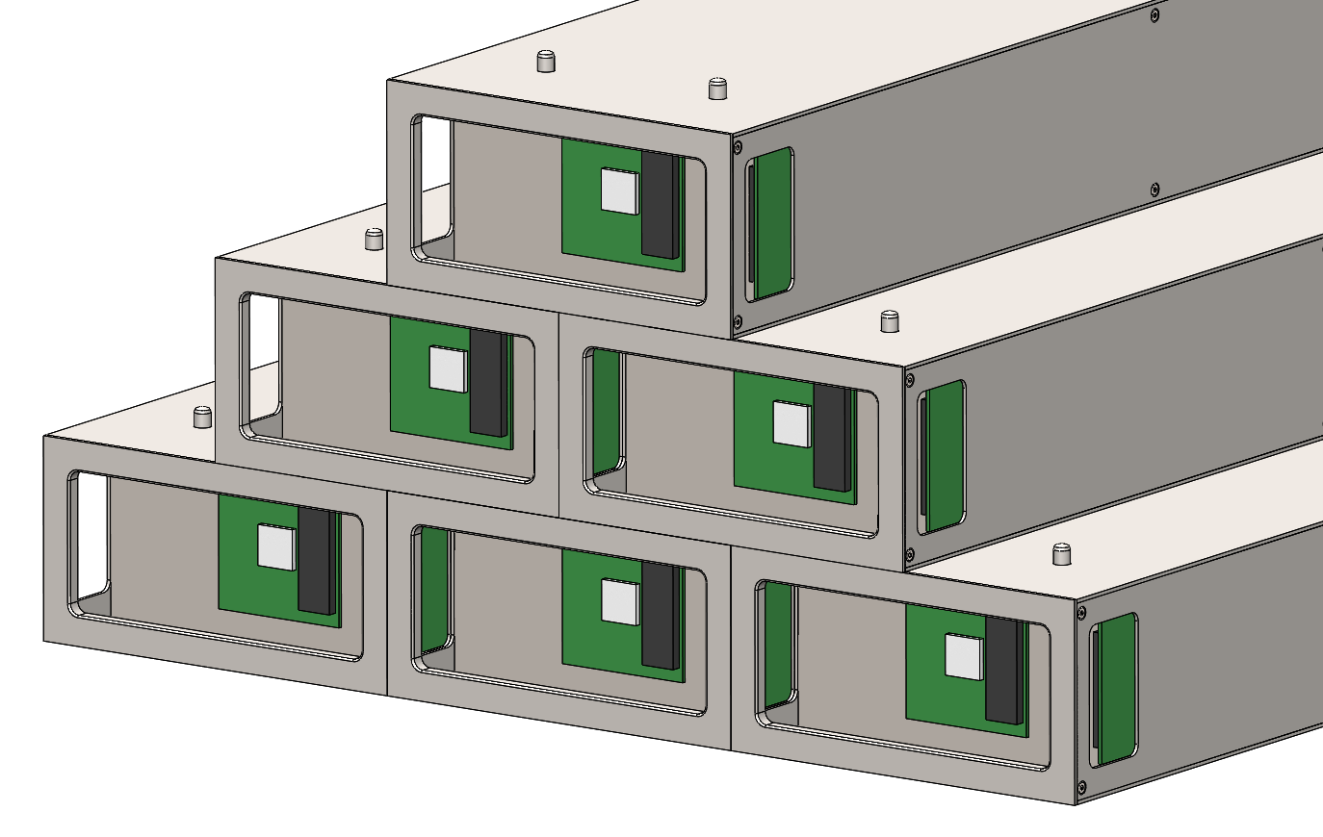
Assembly Methods (8M Tower / Scintillator Envelopes)
Scintillator Envelope:
  Tiles are wrapped in 3M Foil.
  SiPM Boards attached to wrapped tiles.
  Kapton sheet attached to front and back of envelope assembly.
Assembling Tower:
  Side panel is removed from tower (10x screws).
  Each Scintillator Envelope is slid into the slot between absorber plates (65x).
  The side flex PCB is connected to each of the SiPM board connectors.
  The flex PCB is connected to the readout board at the rear of the tower.
  The side panel is re-attached.
Flex PCB Connections
(90 degree bend)
8 x 8 Side PCBs
Readout Board
(not used for test beam)
Scintillator Envelope

Slide 16
Structural Analysis

Slide 17
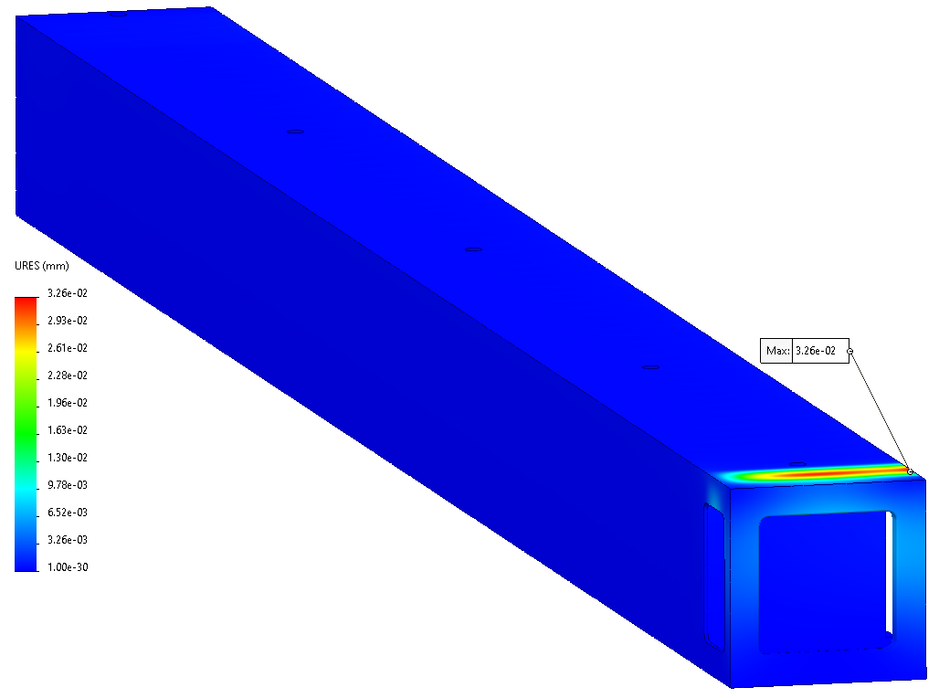
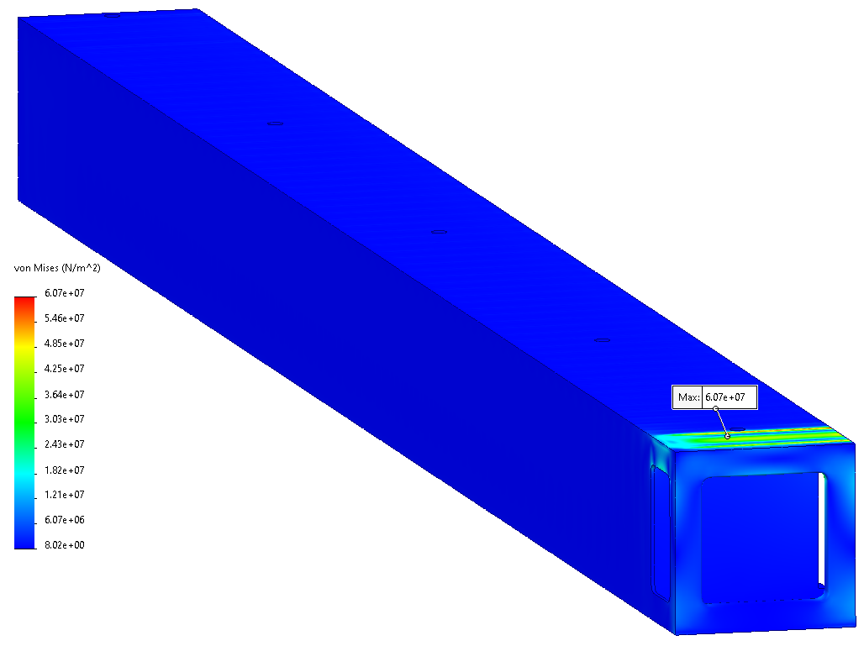
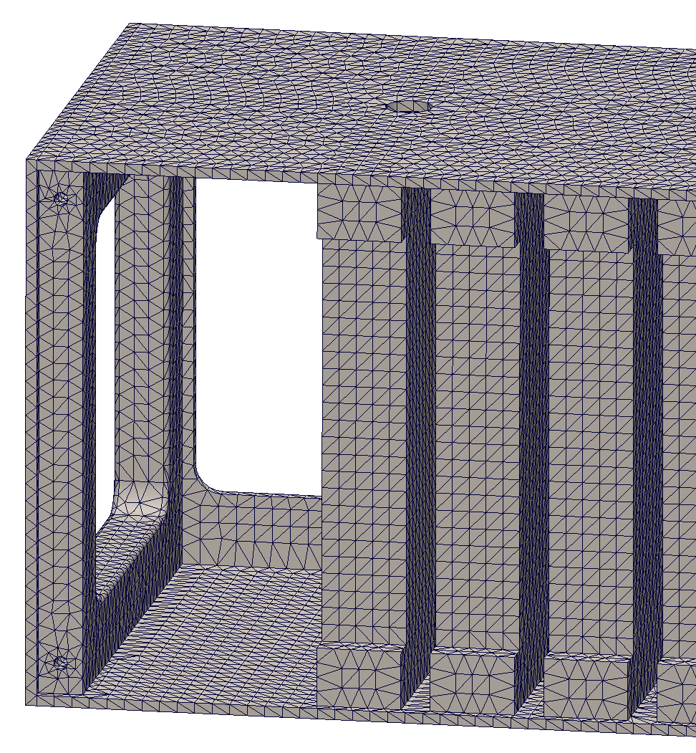
Bearing Load Analysis (4M Tower)
Identified Tower for analysis: 4M Tower with highest vertical loading identified in image below, on bottom row.
Analysis Setup: Removable side cover and all hardware removed from model.
Materials: 1045 Carbon Steel / Tungsten
Applied Load: 4,539 kg (51x 88 kg)
Fixtures: Bottom Face is held Fixed, Load is applied evenly distributed on top face.
Analysis Results:
Max Deflection: 0.03 mm. At rear of Tower, window area.
Max Stress: 60.7 MPa / 450 MPa (U_{YS}).

Slide 18
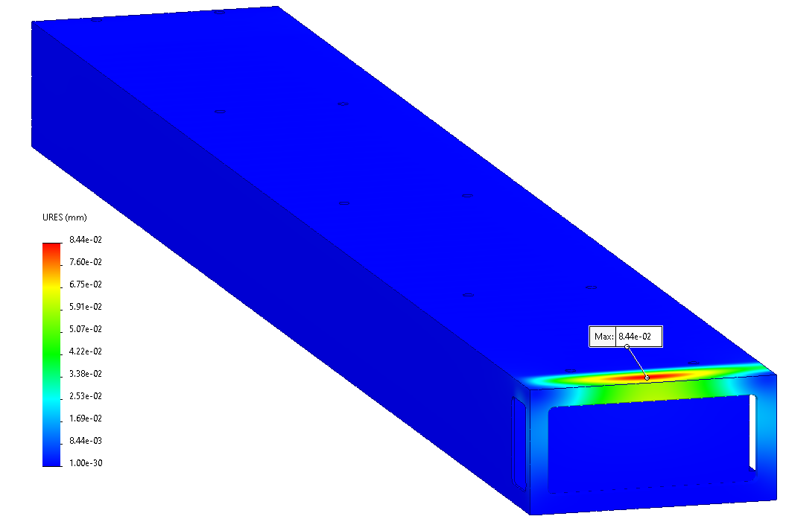
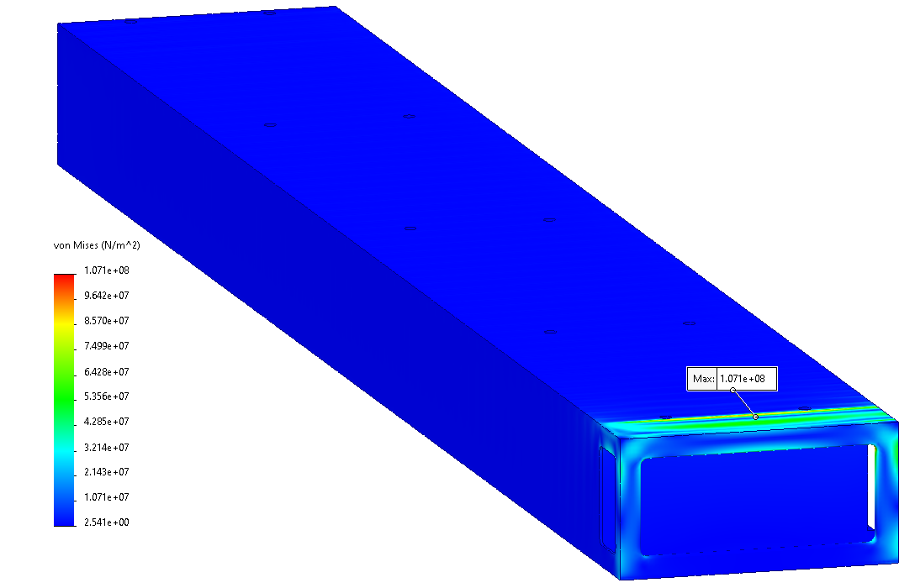
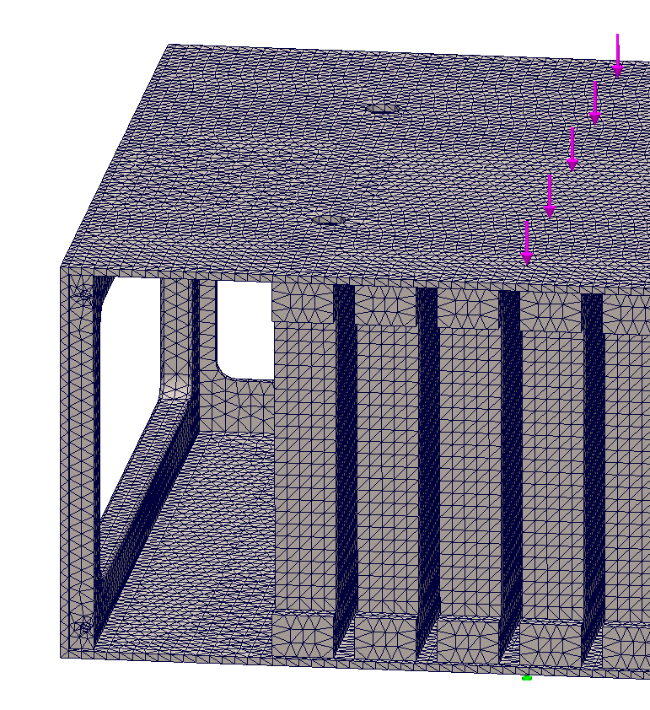
Bearing Load Analysis (8M Tower)
Identified Tower for analysis: 8M Tower with highest vertical loading identified in image below, on bottom row.
Analysis Setup: Removable side cover and all hardware removed from model.
Materials: 1045 Carbon Steel / Tungsten
Applied Load: 9,027 kg (51x 177 kg)
Fixtures: Bottom Face is held Fixed, Load is applied evenly distributed on top face.
Analysis Results:
Max Deflection: 0.08 mm. At rear of Tower, window area.
Max Stress: 107.1 MPa / 450 MPa (U_{YS}).

Slide 19
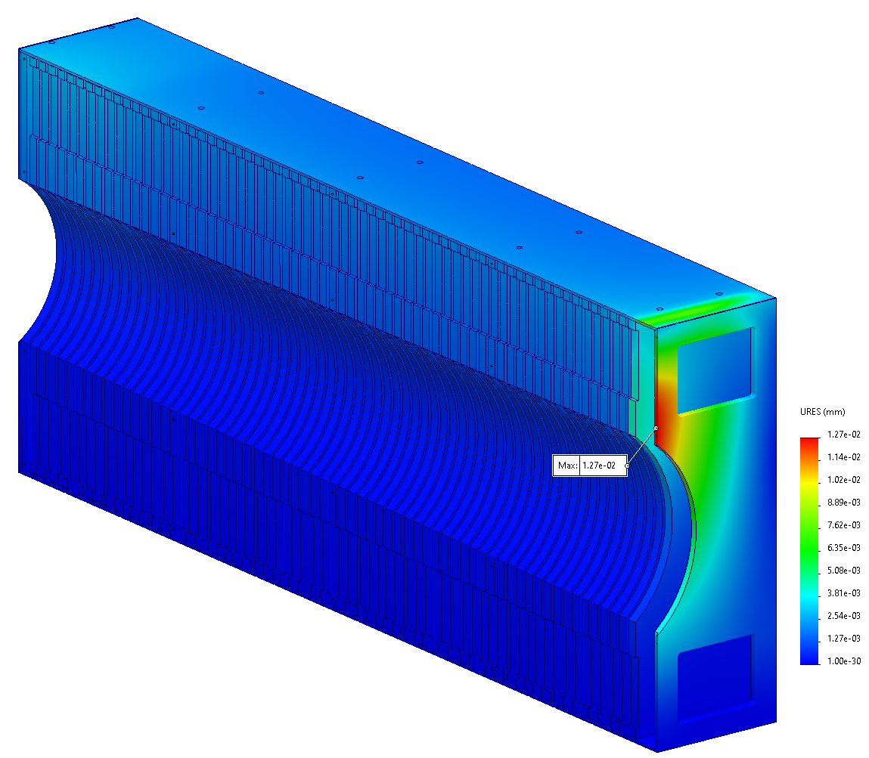
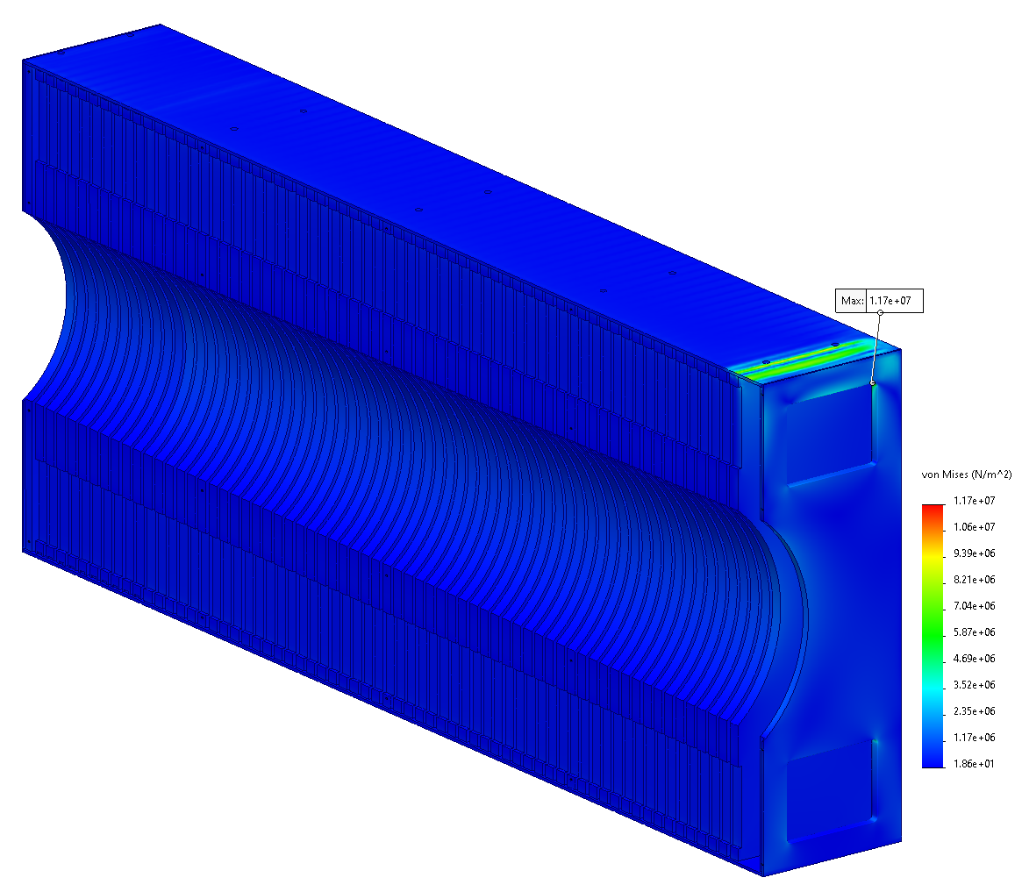
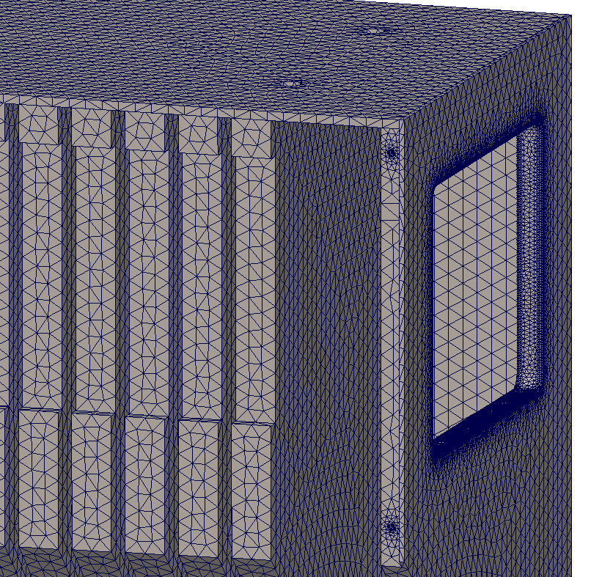
Bearing Load Analysis (Left Insert)
Analysis Setup: Removable side covers and all hardware removed from model.
Materials: 1045 Carbon Steel / Tungsten
Applied Load: 4,071 kg (23x 177 kg)
Fixtures: Bottom Face is held Fixed, Load is applied evenly distributed on top face.
Analysis Results:
Max Deflection: 0.01 mm. At rear of Insert, window area.
Max Stress: 11.7 MPa / 450 MPa (U_{YS}).

Slide 20
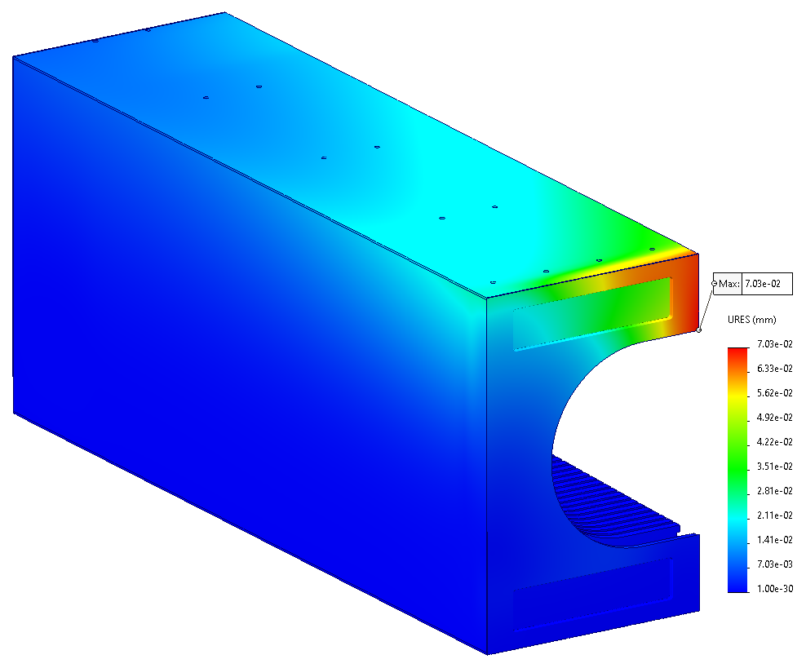
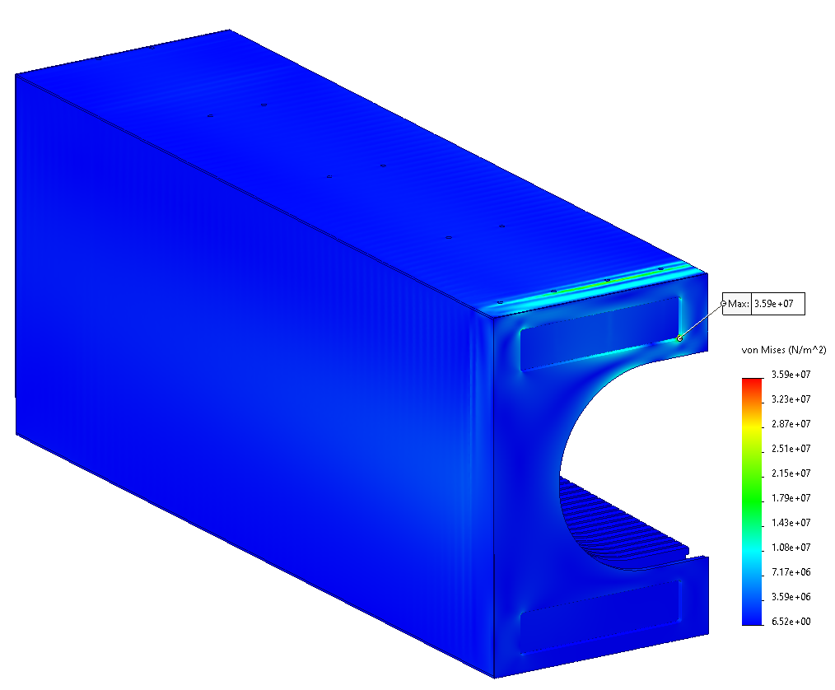
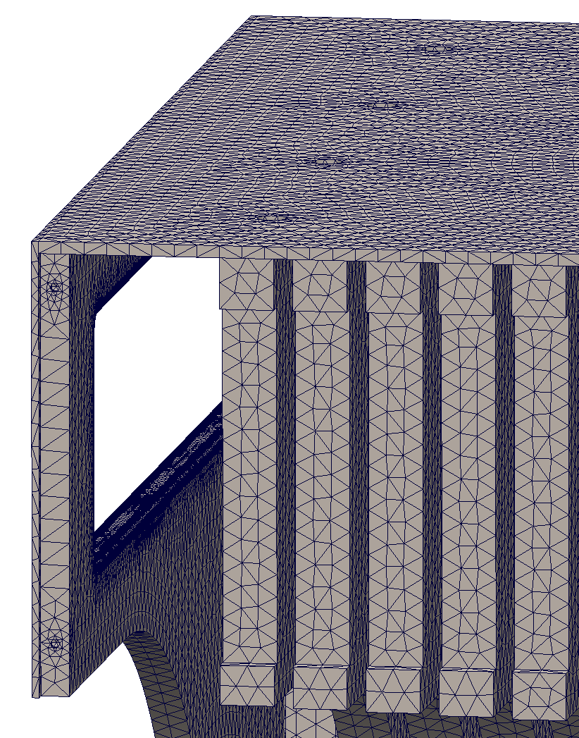
Bearing Load Analysis (Right Insert)
Analysis Setup: Removable side covers and all hardware removed from model.
Materials: 1045 Carbon Steel / Tungsten
Applied Load: 8,142 kg (2x rows 23x 177 kg)
Fixtures: Bottom Face is held Fixed, Load is applied evenly distributed on top face.
Analysis Results:
Max Deflection: 0.07 mm. At rear of Insert, window corner.
Max Stress: 35.9 MPa / 450 MPa (U_{YS}).

Slide 21
Hoisting / Detector Assembly

Slide 22
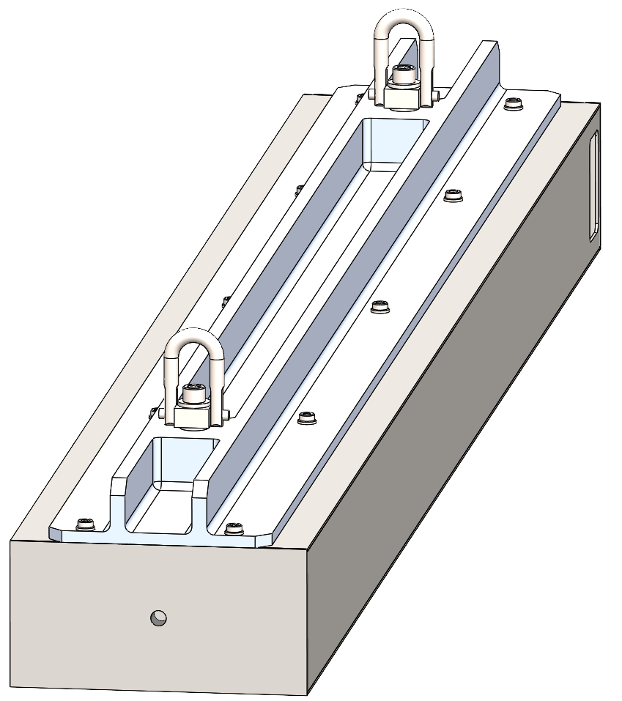
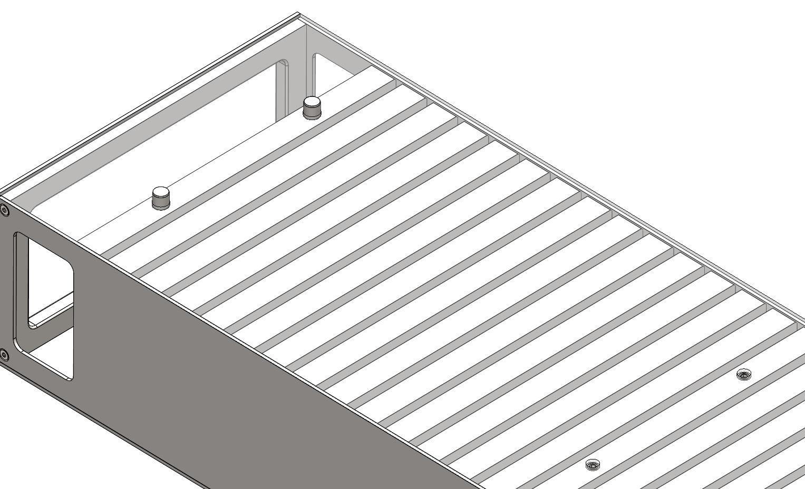
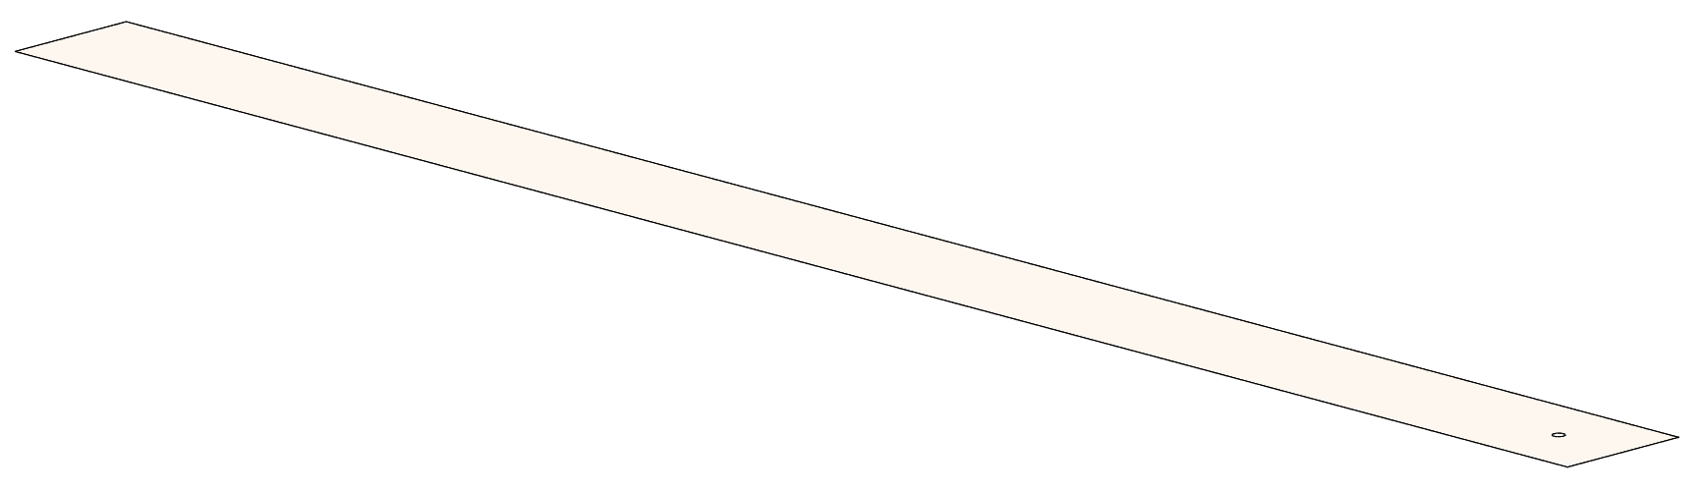
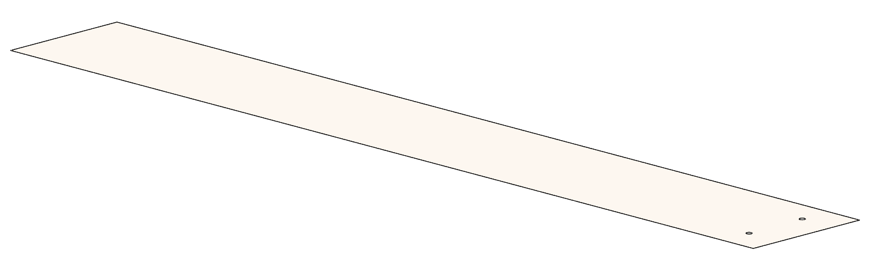
Assembly Methods (Detector Stacking)
Strongback attached to 8M Tower
Strongback Lifting Fixture:
  Ensures structural integrity of the tower assemblies during assembly process.
  Attaches via M6 threaded holes atop each Tower.
  Threaded holes tapped into same absorber plates which are tapped for side cover screws to reduce unique parts.
  2-Point lift with Assembly CG centered between Hoist Rings for redundancy and stability.
  Hoist Rings are each rated above full assembly weight for all lifting scenarios.
  Monolithic, milled 6061-T6 Al construction for multiple units to be fabricated and utilized if desired.
Strongback Variations (3x):
  4M Tower
  8M Tower
  Insert Assembly (Common Strongback for both)
Assembly of Detector Stack:
  After Tower is positioned on stack, the strongback is removed and alignment pins are installed in the rear 2x holes and set screws are installed in the remaining 8x holes.
  Sheet metal shims of various thicknesses / widths allow for fine adjustments of the stack during the final assembly process.
Alignment Pins / Set Screws
Top plate transparent for visualization
Full and half width .005” thick shims

Slide 23
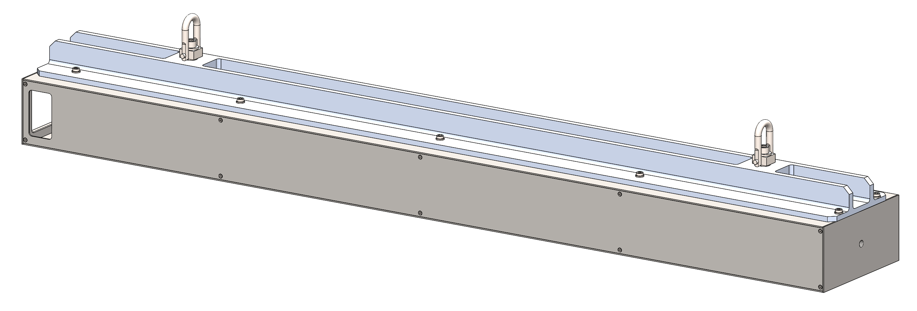
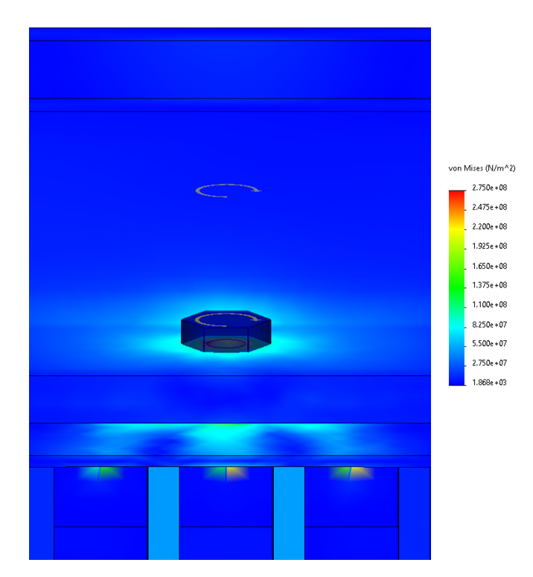


8M Tower Strongback Lifting Analysis
Items for Analysis: 8M Tower under normal lift. (Tower + Strongback)
Analysis Setup:
Applied Load: 125% Proof Load
Gravity (weight from assigned material density) + Estimated weight of internal components (scintillator envelopes). 170 kg x 1.25
Fixtures:
Hoist Ring modeled as “puck” with M10 Bolt 96 N-m torque (2x).
Strongback attached with M6 Bolts 17 N-m torque (10x).
Analysis Results:
Max Deflection: 0.145 mm.
Max Stress: <150.0 MPa / 450 MPa.
* Also analyzed accident load with 1x hoist ring, with no failure predicted.
Deformation Plot (mm)
Loads and fixtures

Slide 24
Seismic Load Calculations

Slide 25
Seismic Loading Calculations
Seismic Loading: 0.25 g
Considerations:
The LFHCal stack may be subjected to low acceleration seismic activity based on its location and facility foundation. A preliminary evaluation should be performed to predict any lateral and/or axial movement of the stacked towers in relation to each other during a seismic event, and ensure the alignment pins are adequately sixed to prevent excess movement / damage of the stack.
Assumptions:
The LFHCal is well contained in a rigid and properly secured support structure, which prevents tipping or movement of the assembly (no dynamic effects considered).
Equivalent force method used to evaluate the assemblies. (Acceleration x Mass of object = Applied force on object)
Tower material is Nickel Plated 1020 Carbon Steel, Shim material is 304 Stainless Steel.
Evaluation:
Based on the 0.25 g acceleration, an equivalent force applied to the towers in the lateral and axial directions would be 0.25 X Tower weight, which is compared to the coefficient of static friction between the towers. This is based on the tower and shim materials, which are 1020 Steel, Nickel, and Stainless steel. The lowest coefficient of static friction between any combination of these materials is ≈ 0.7, which is significantly lower than the 0.25 applied by the seismic loading. Therefore, no shifting or sliding is predicted to occur between the LFHCal towers during a 0.25 g seismic event, and no shear loading will be applied to the alignment pins from seismic loading.

Slide 26
Next Steps
Finish assembly of 6x 8M Towers.
Ensure proper fitment in Tower stacking, and installation of scintillator assemblies.
Create Design Specification document for fabrication standards / testing procedures, acceptance criteria, and shipment instructions.
Heat load calculations for SiPM to ensure no external cooling systems are required.
Design Scintillator Tile wrapping device / Scintillator package assembly device to allow for fast, repeatable operation.

Slide 27
Thank you for your attention!
Questions / Comments / Discussion

