Slide 1
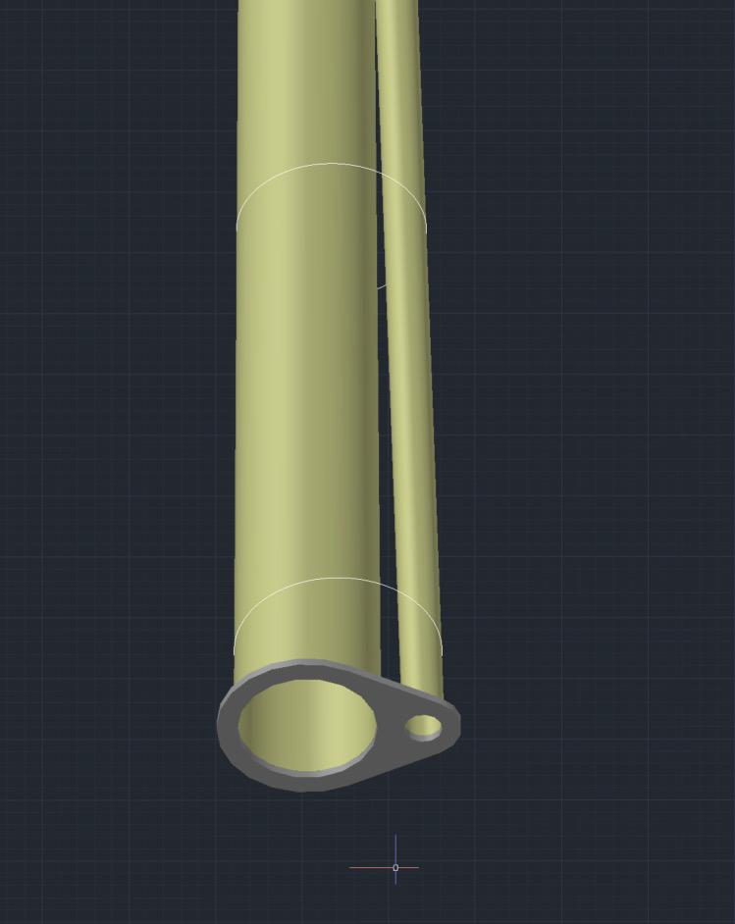
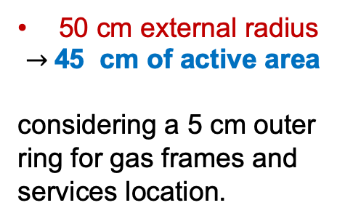
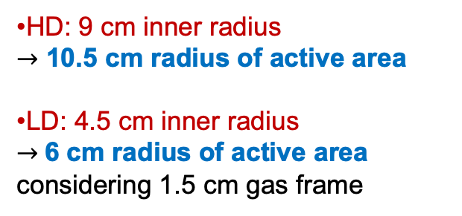
Detector Geometry: Envelope and Active Regions
The geometrical envelopes are available at: https://eic.jlab.org/Geometry/Detector/Detector-20240117135224.html
Endcaps Envelope Dimensions -
Beam Pipes Envelope Radii and Offsets
MPGD Disk | Max Z Pos (cm) | Disk Outer Radius (cm) | Outer Active Reg. radius (cm) | Calculated Beam pipes radii (mm) | Offset (mm) | Disk Inner Radius (cm) | Inner Active Reg. radius (cm)
HD MPGD 2 | 163.5 | 50 | 45 | 55.8 | 22.5 | 9 | 10.5
HD MPGD 1 | 150.5 | 50 | 45 | 53.1 | 19.9 | 9 | 10.5
LD MPGD 1 | -112.5 | 50 | 45 | 37.7 | -3.1 | 4.5 | 6.0
LD MPGD 2 | -122.5 | 50 | 45 | 39.2 | -3.4 | 4.5 | 6.0
Disks Outer Radius
Disks Inner Radius
different for the two HD and LD regions
50 cm external radius
$→$45 cm of active area
considering a 5 cm outer ring for gas frames and services location.
Calculated
Radii
HD: 9 cm inner radius
$→$ 10.5 cm radius of active area
LD: 4.5 cm inner radius
$→$6 cm radius of active area
considering 1.5 cm gas frame

Slide 2
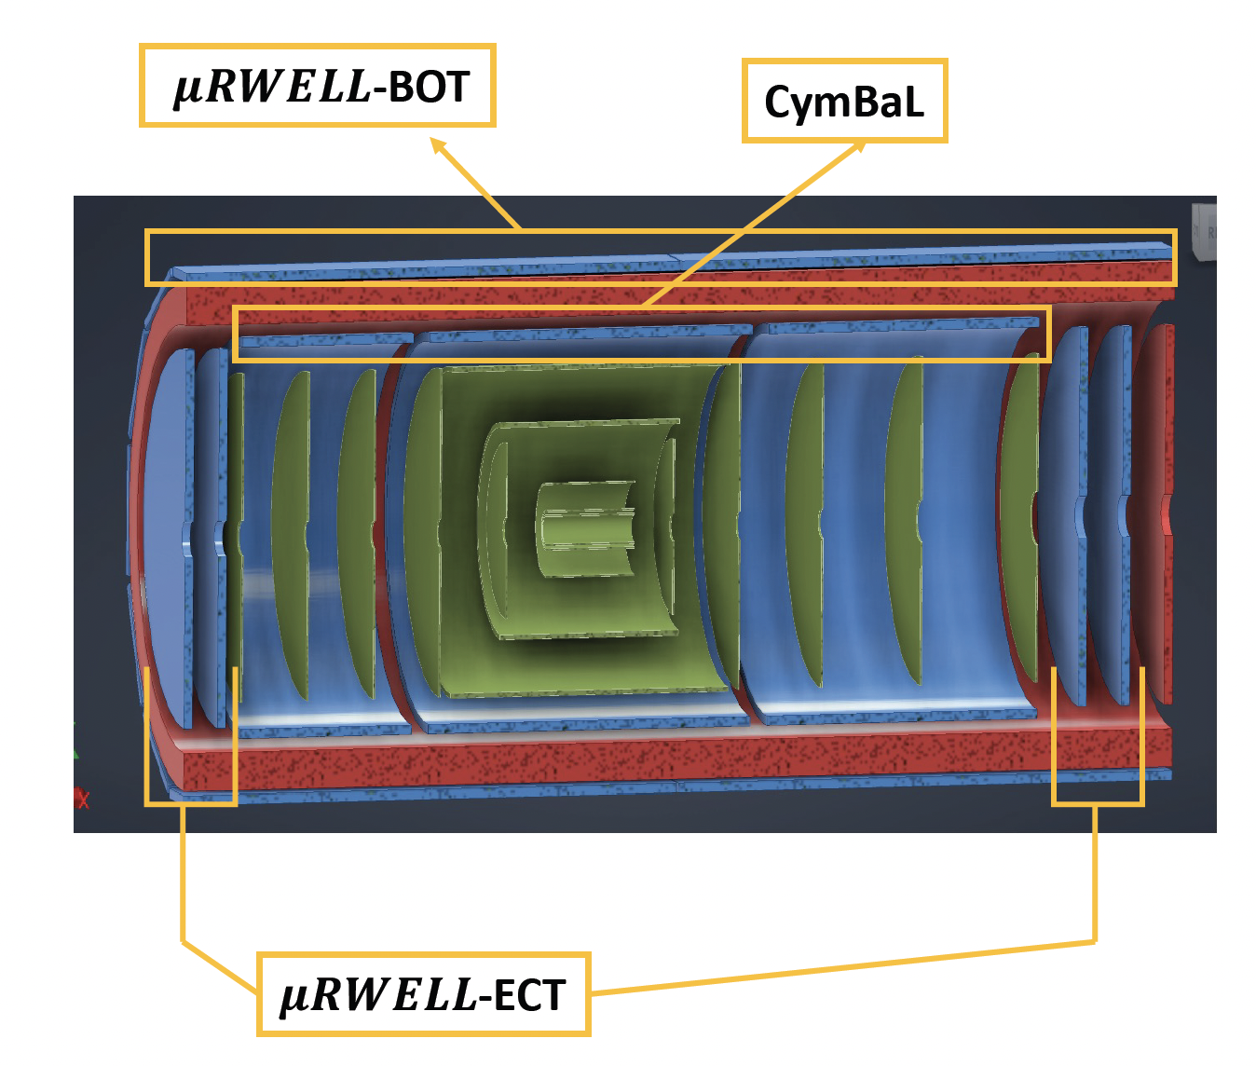

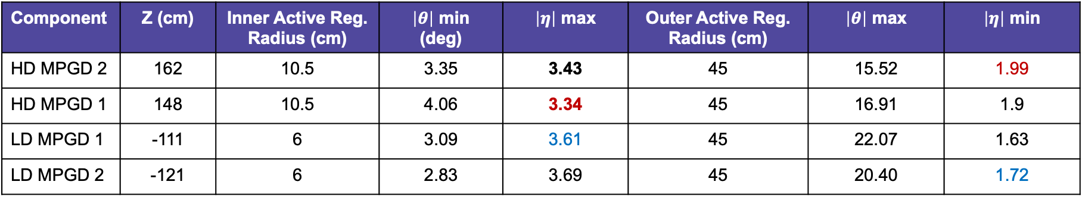

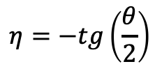

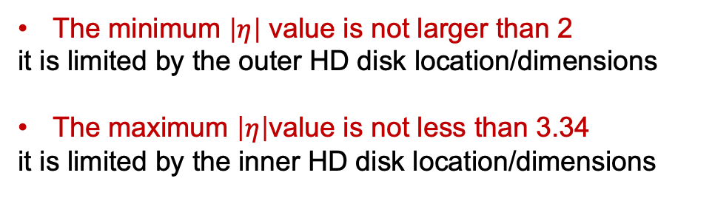
Pseudo-rapidity coverage: effective $η$ranges
Component | Z (cm) | Inner Active Reg. Radius (cm) | $\left|θ\right|$ min (deg) | $\left|η\right|$ max | Outer Active Reg. Radius (cm) | $\left|θ\right|$ max | $\left|η\right|$ min
HD MPGD 2 | 162 | 10.5 | 3.35 | 3.43 | 45 | 15.52 | 1.99
HD MPGD 1 | 148 | 10.5 | 4.06 | 3.34 | 45 | 16.91 | 1.9
LD MPGD 1 | -111 | 6 | 3.09 | 3.61 | 45 | 22.07 | 1.63
LD MPGD 2 | -121 | 6 | 2.83 | 3.69 | 45 | 20.40 | 1.72
The minimum $\left|η\right|$ value is not larger than 2
it is limited by the outer HD disk location/dimensions
The maximum $\left|η\right|$value is not less than 3.34
it is limited by the inner HD disk location/dimensions
-3.61$<η<−1.72$
1.99$<η<$3.34
The$η$ range covered by the MPGD Endcap tracking disks is compliant with requirements.
$$η=−tg\left(\frac{θ}{2}\right)$$

Slide 3
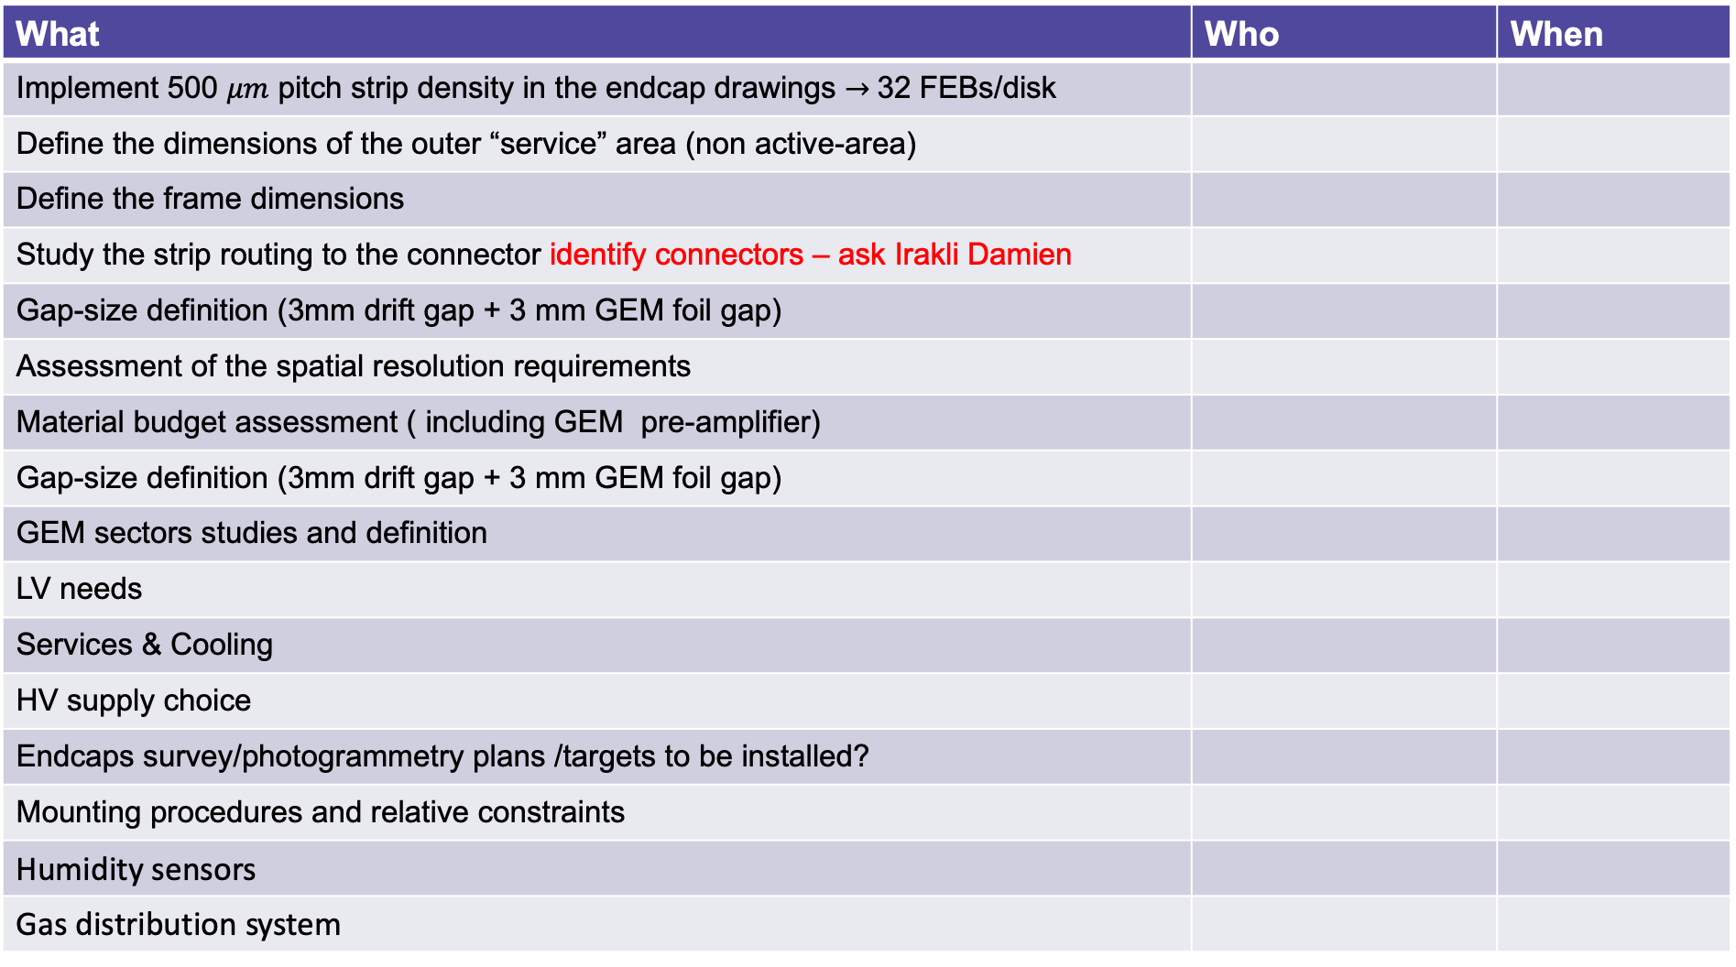
Actions – To Do List – Hardware et al.
What | Who | When
Implement 500 $μm$ pitch strip density in the endcap drawings $→$32 FEBs/disk
Define the dimensions of the outer “service” area (non active-area)
Define the frame dimensions
Study the strip routing to the connector identify connectors – ask Irakli Damien
Gap-size definition (3mm drift gap + 3 mm GEM foil gap)
Assessment of the spatial resolution requirements
Material budget assessment ( including GEM pre-amplifier)
Gap-size definition (3mm drift gap + 3 mm GEM foil gap)
GEM sectors studies and definition
LV needs
Services & Cooling
HV supply choice
Endcaps survey/photogrammetry plans /targets to be installed?
Mounting procedures and relative constraints
Humidity sensors
Gas distribution system

Slide 4
Actions – To Do List - Software
What | Who | When
Detector geometry simulation (Matt supervision&support)
Detector response simulation (Matt supervision&support)
Implementation of MPGD endcaps in the Tracking
Ghost hits and disks orientation | Mariangela, Lucilla
On-Line Calibration
Alignment procedure
Slow controls
On-line monitoring

Slide 5
Actions – To Do List - Plans
What | Who | When
Financial plan: - ask Rui for disks uRwell and GEM foils costs
Financial plan: - FEB costs (including cables)
Financial plan: - HV costs (including cables)
Financial plan: - LV distribution costs (including cables)
Financial plan: - Cathods
Financial plan: - Peek Frames
Financial plan: - Connectors
Financial plan: - Mechanical support
Overall time plan and costs
Understanding the assembly needs (clean room, instrumentation, materials)

