Slide 1


GEM Gluing Tests
Stefano Gramigna (sgramigna@roma2.infn.it) on behalf of the ECT group:
C. Ammendola, R. Ammendola, M. Bondì, A. D’Angelo, R. Di Salvo, A. Fantini, L. Lanza, S. J. Lee, G. Nobili, E. Sidoretti, L. Torlai
Sept 19th 2025 – ECT meeting

Slide 2
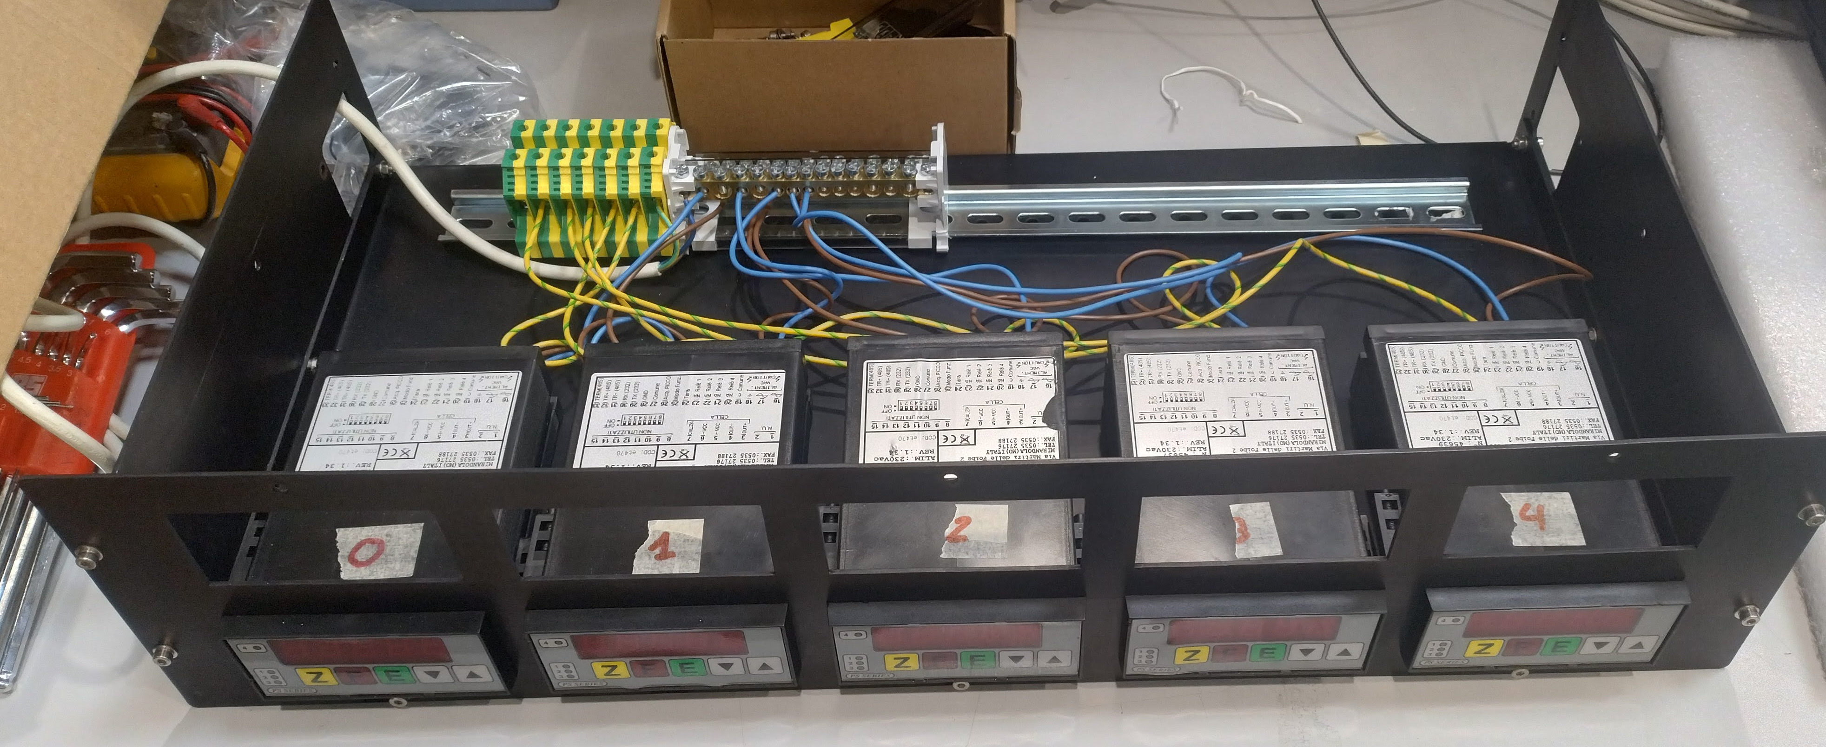
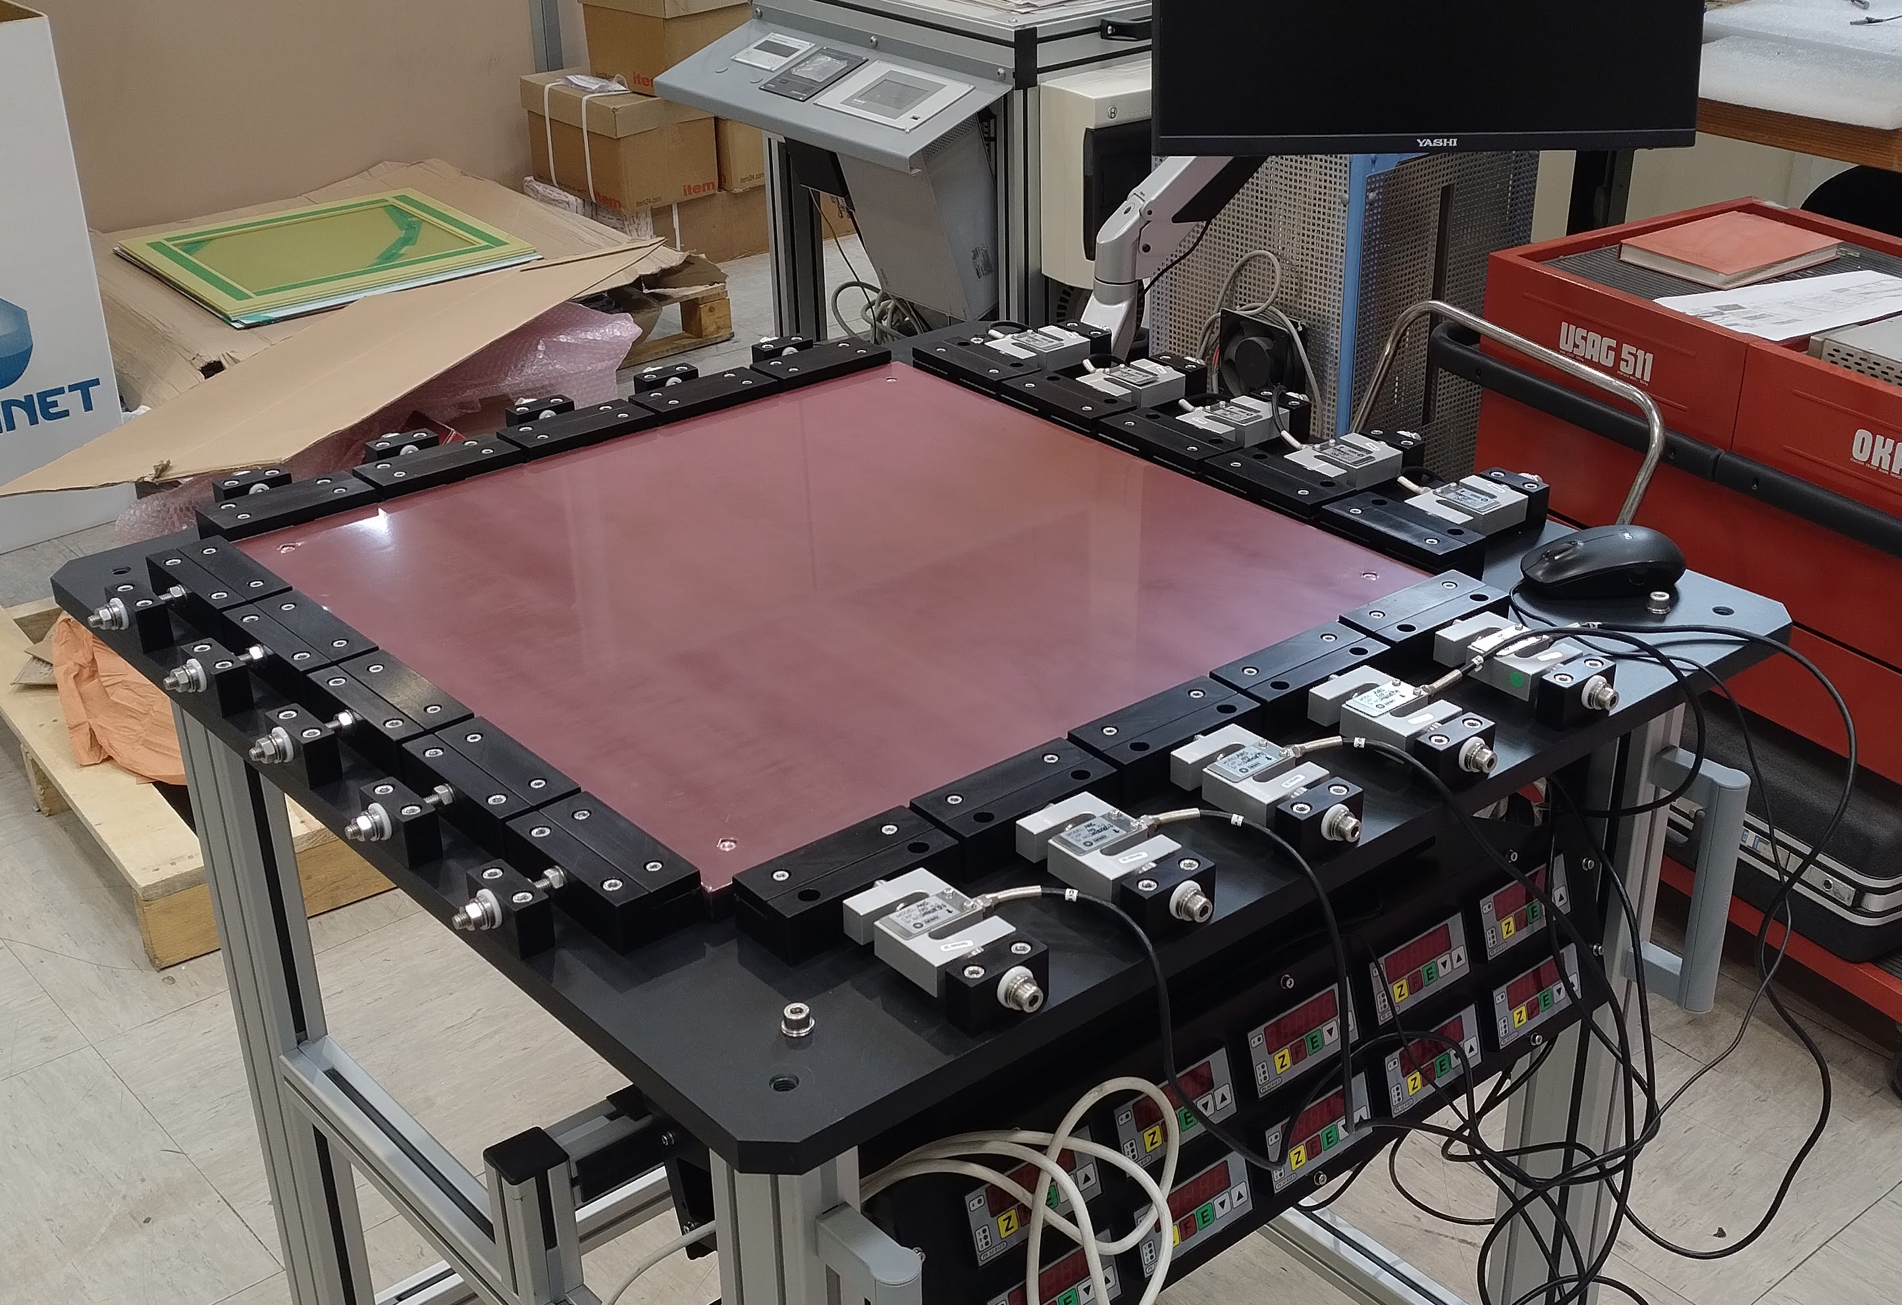
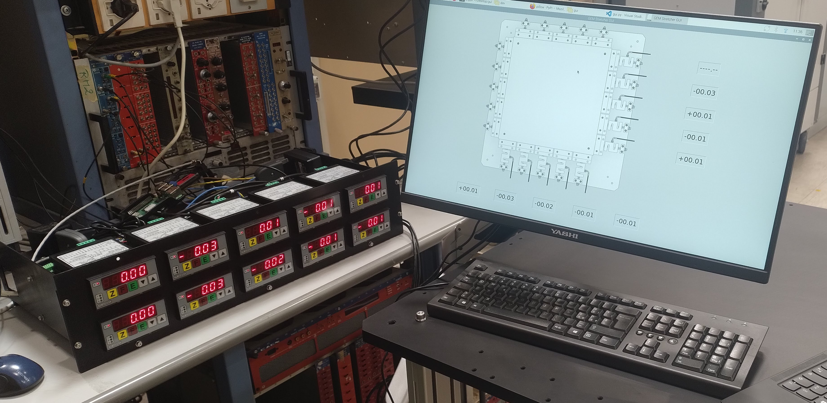
GEM Stretcher Assembly

Slide 3
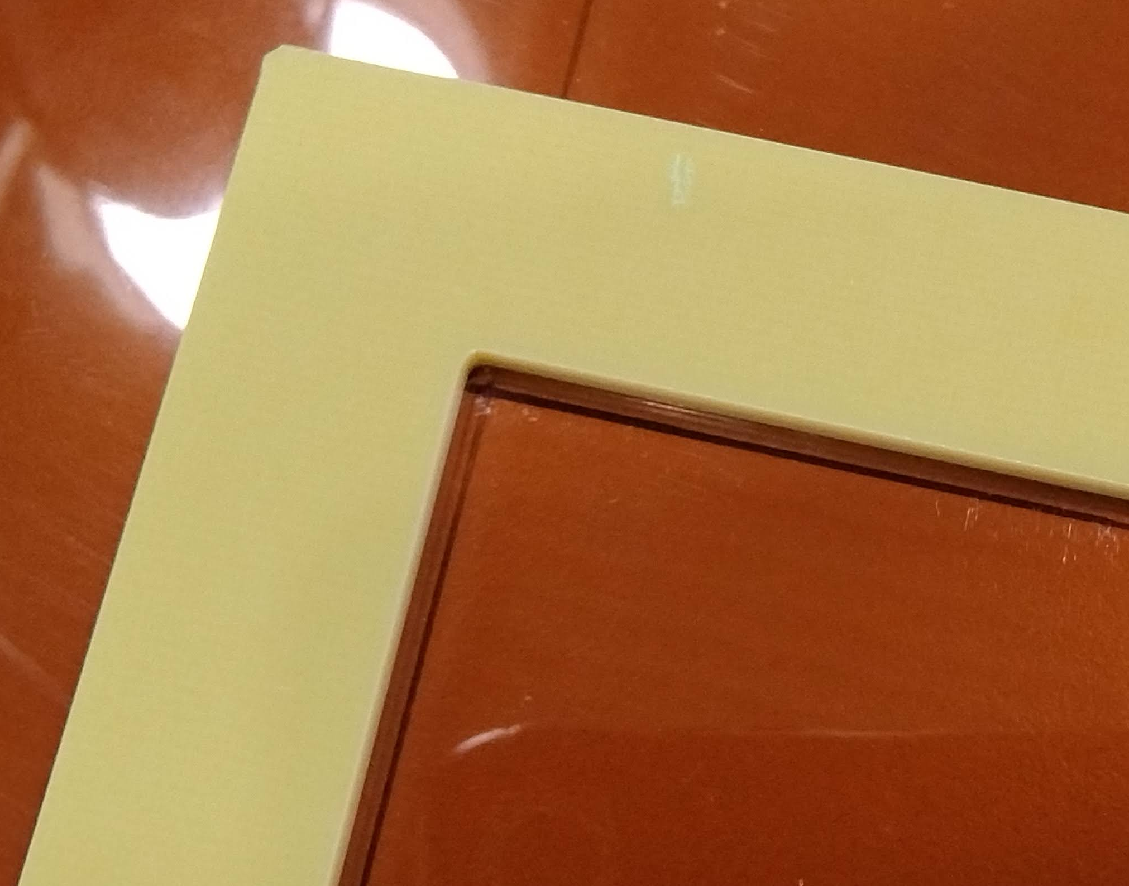
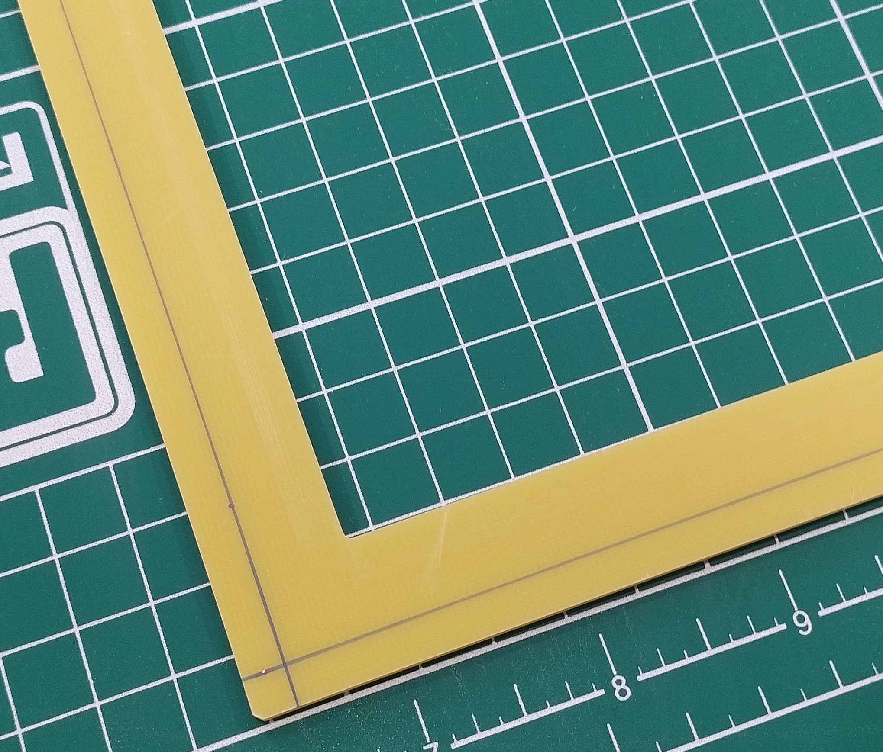
Sample preparation
Holes region drawn on the frame
Active area drawn on the foil
The glue must remain
within this region

Slide 4
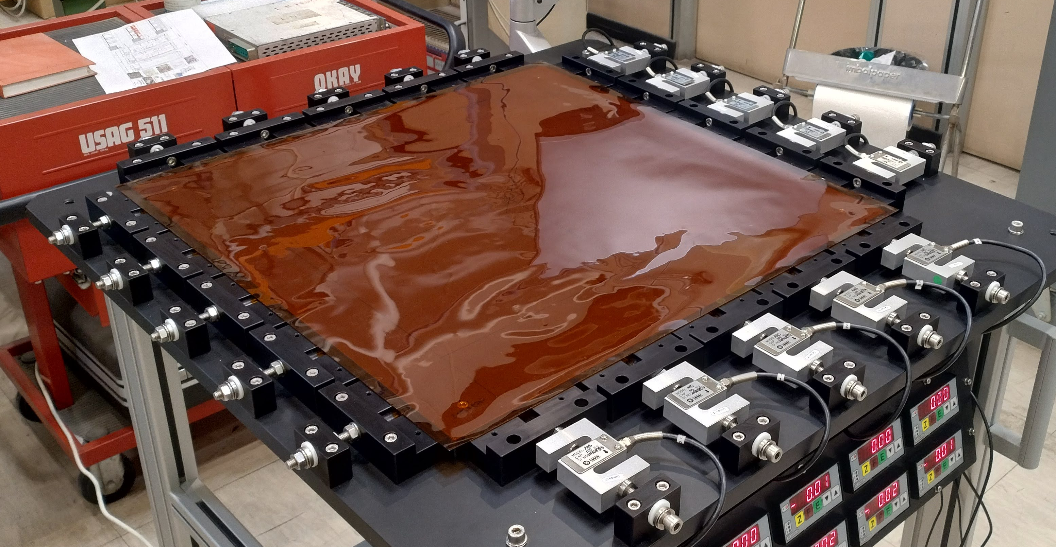
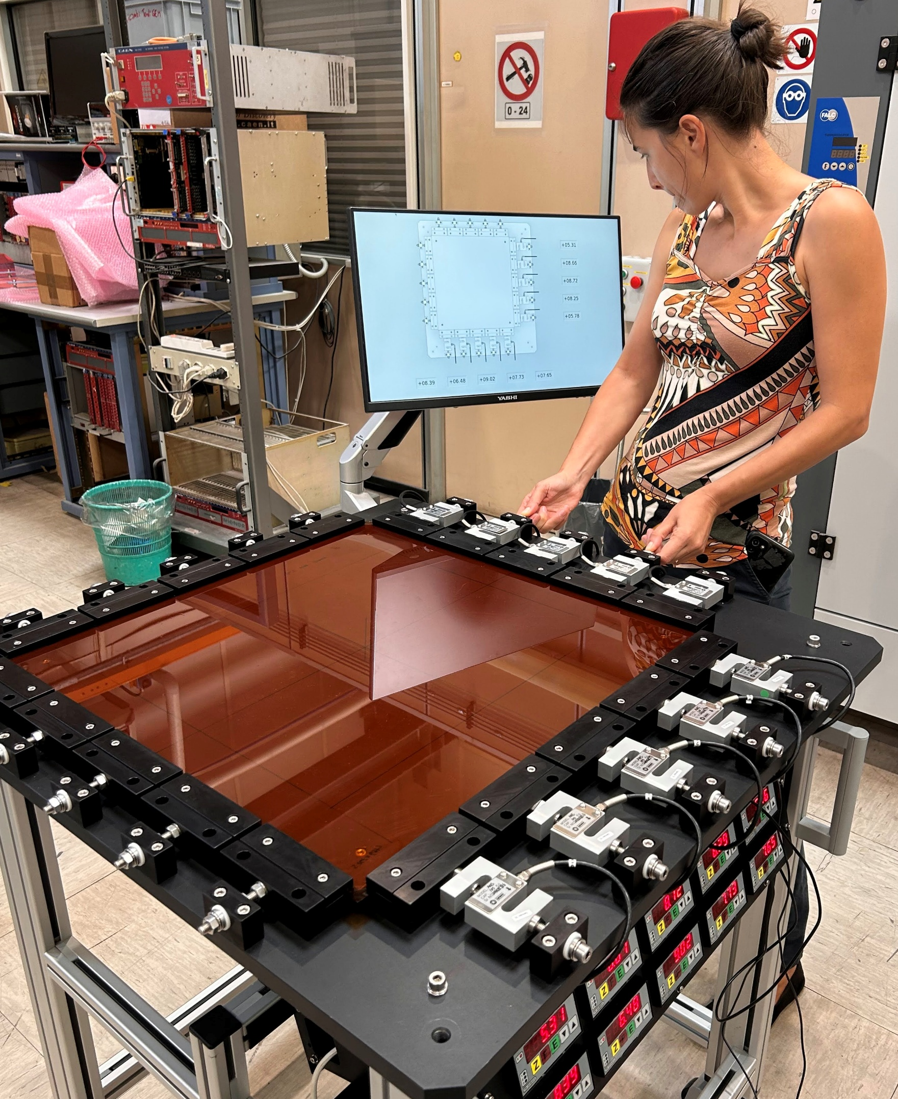
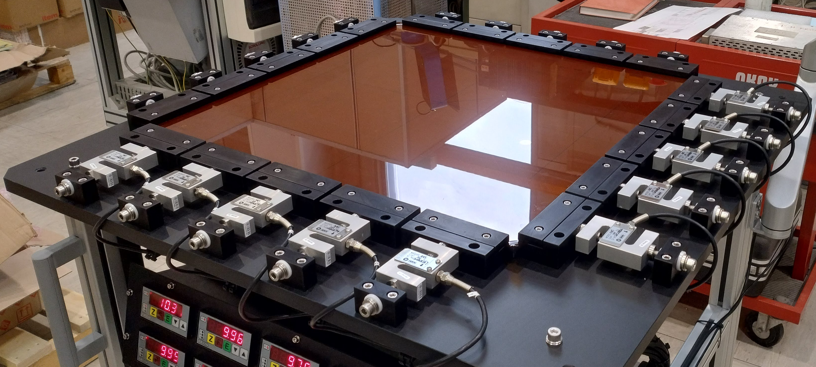
Stretching
12 kg initial tension to have
10 kg after curing
BEFORE
AFTER

Slide 5
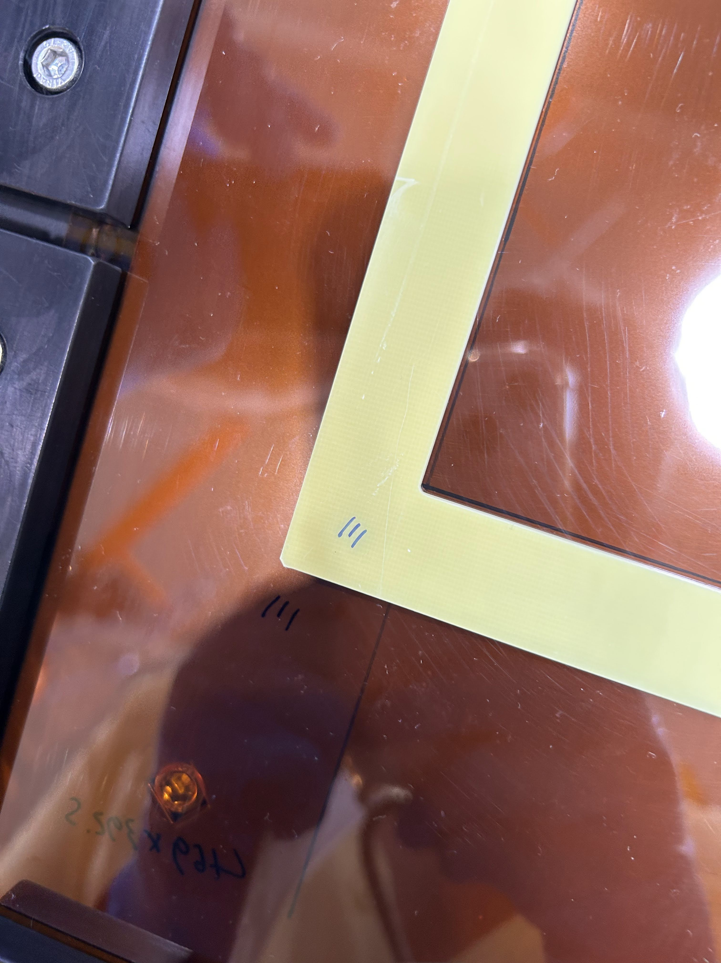
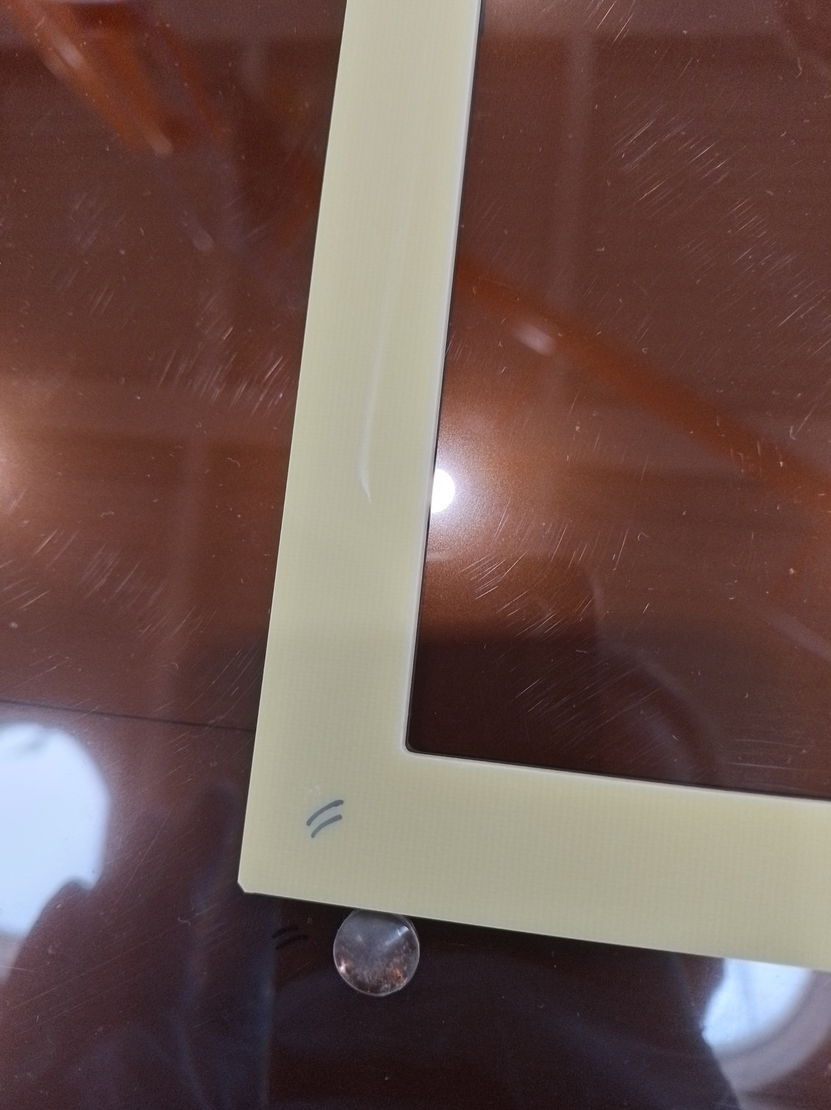
Dry Test
Place frame onto foil
Center the active area
Tape in place
Mark corners and edges
Place reference silicone pads

Slide 6
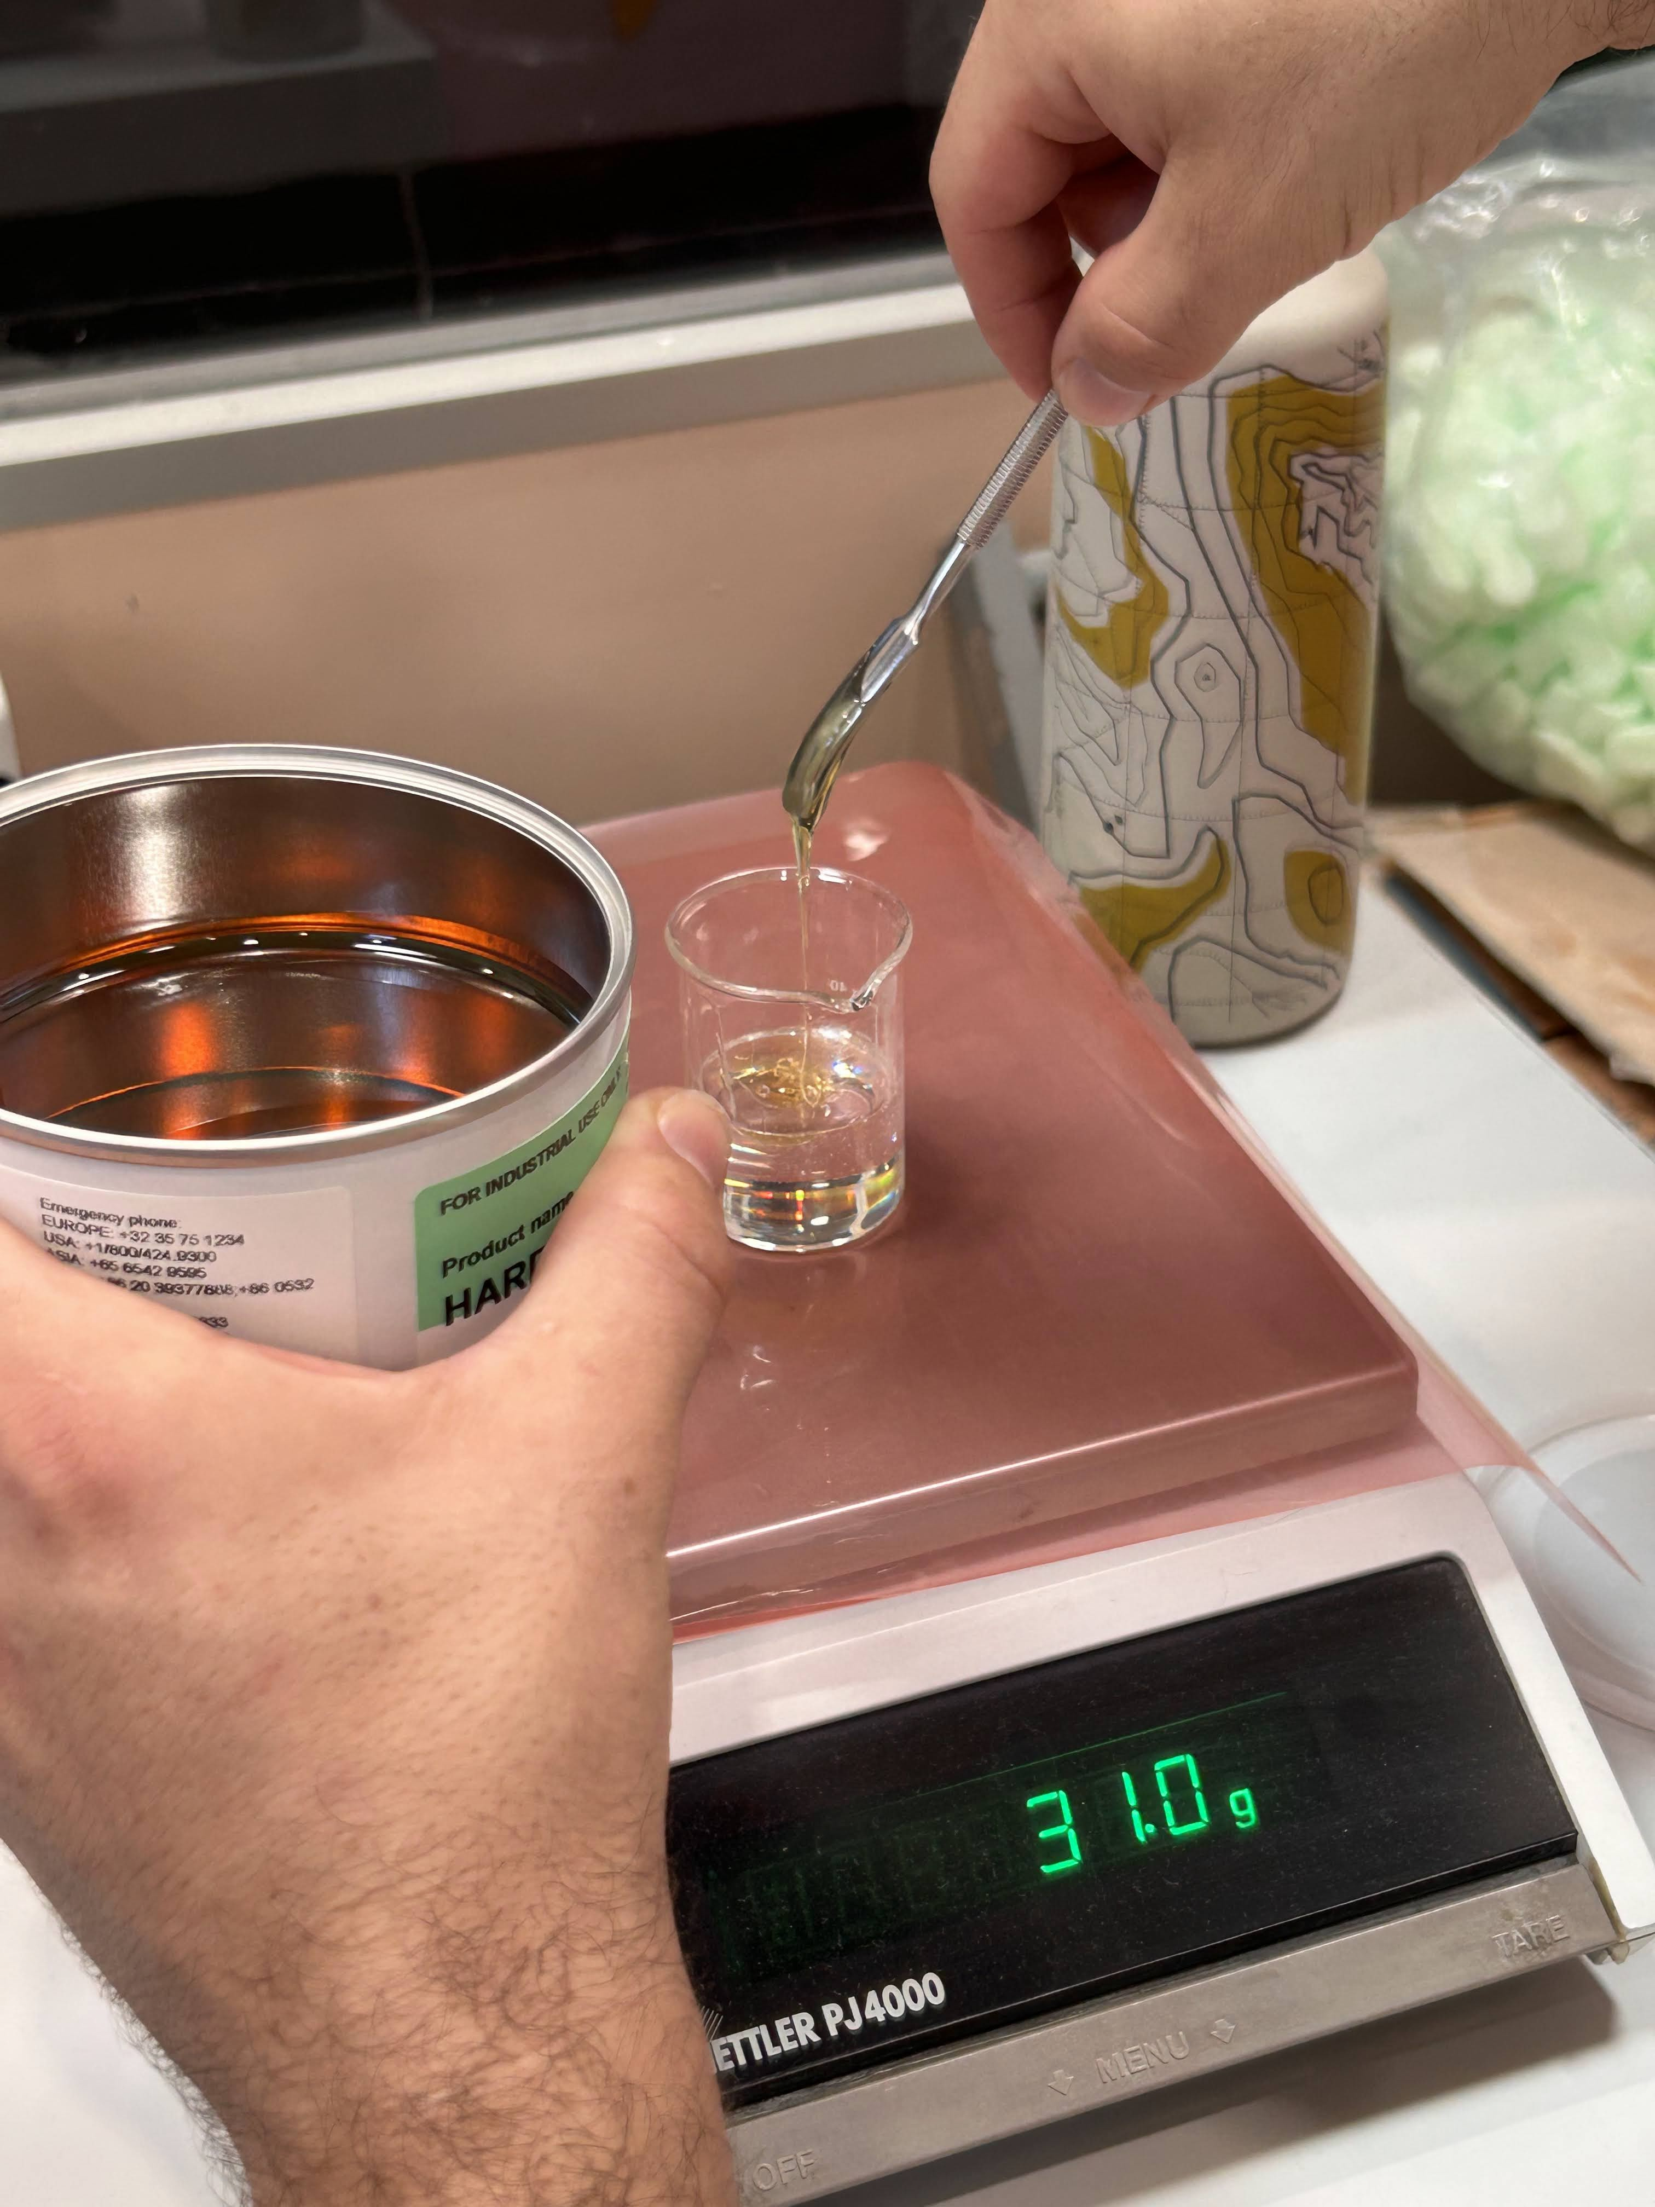
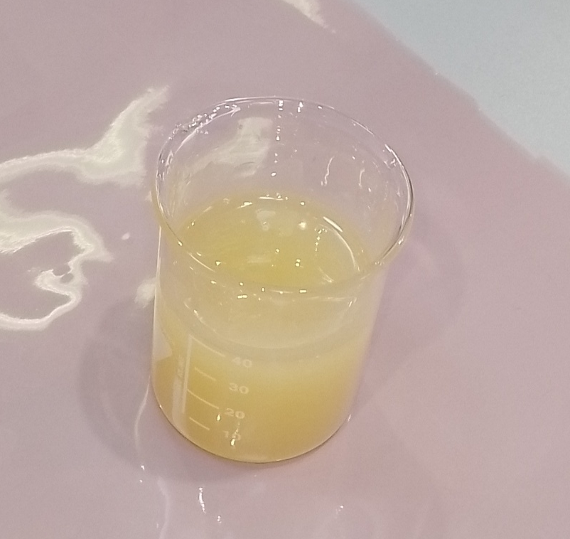
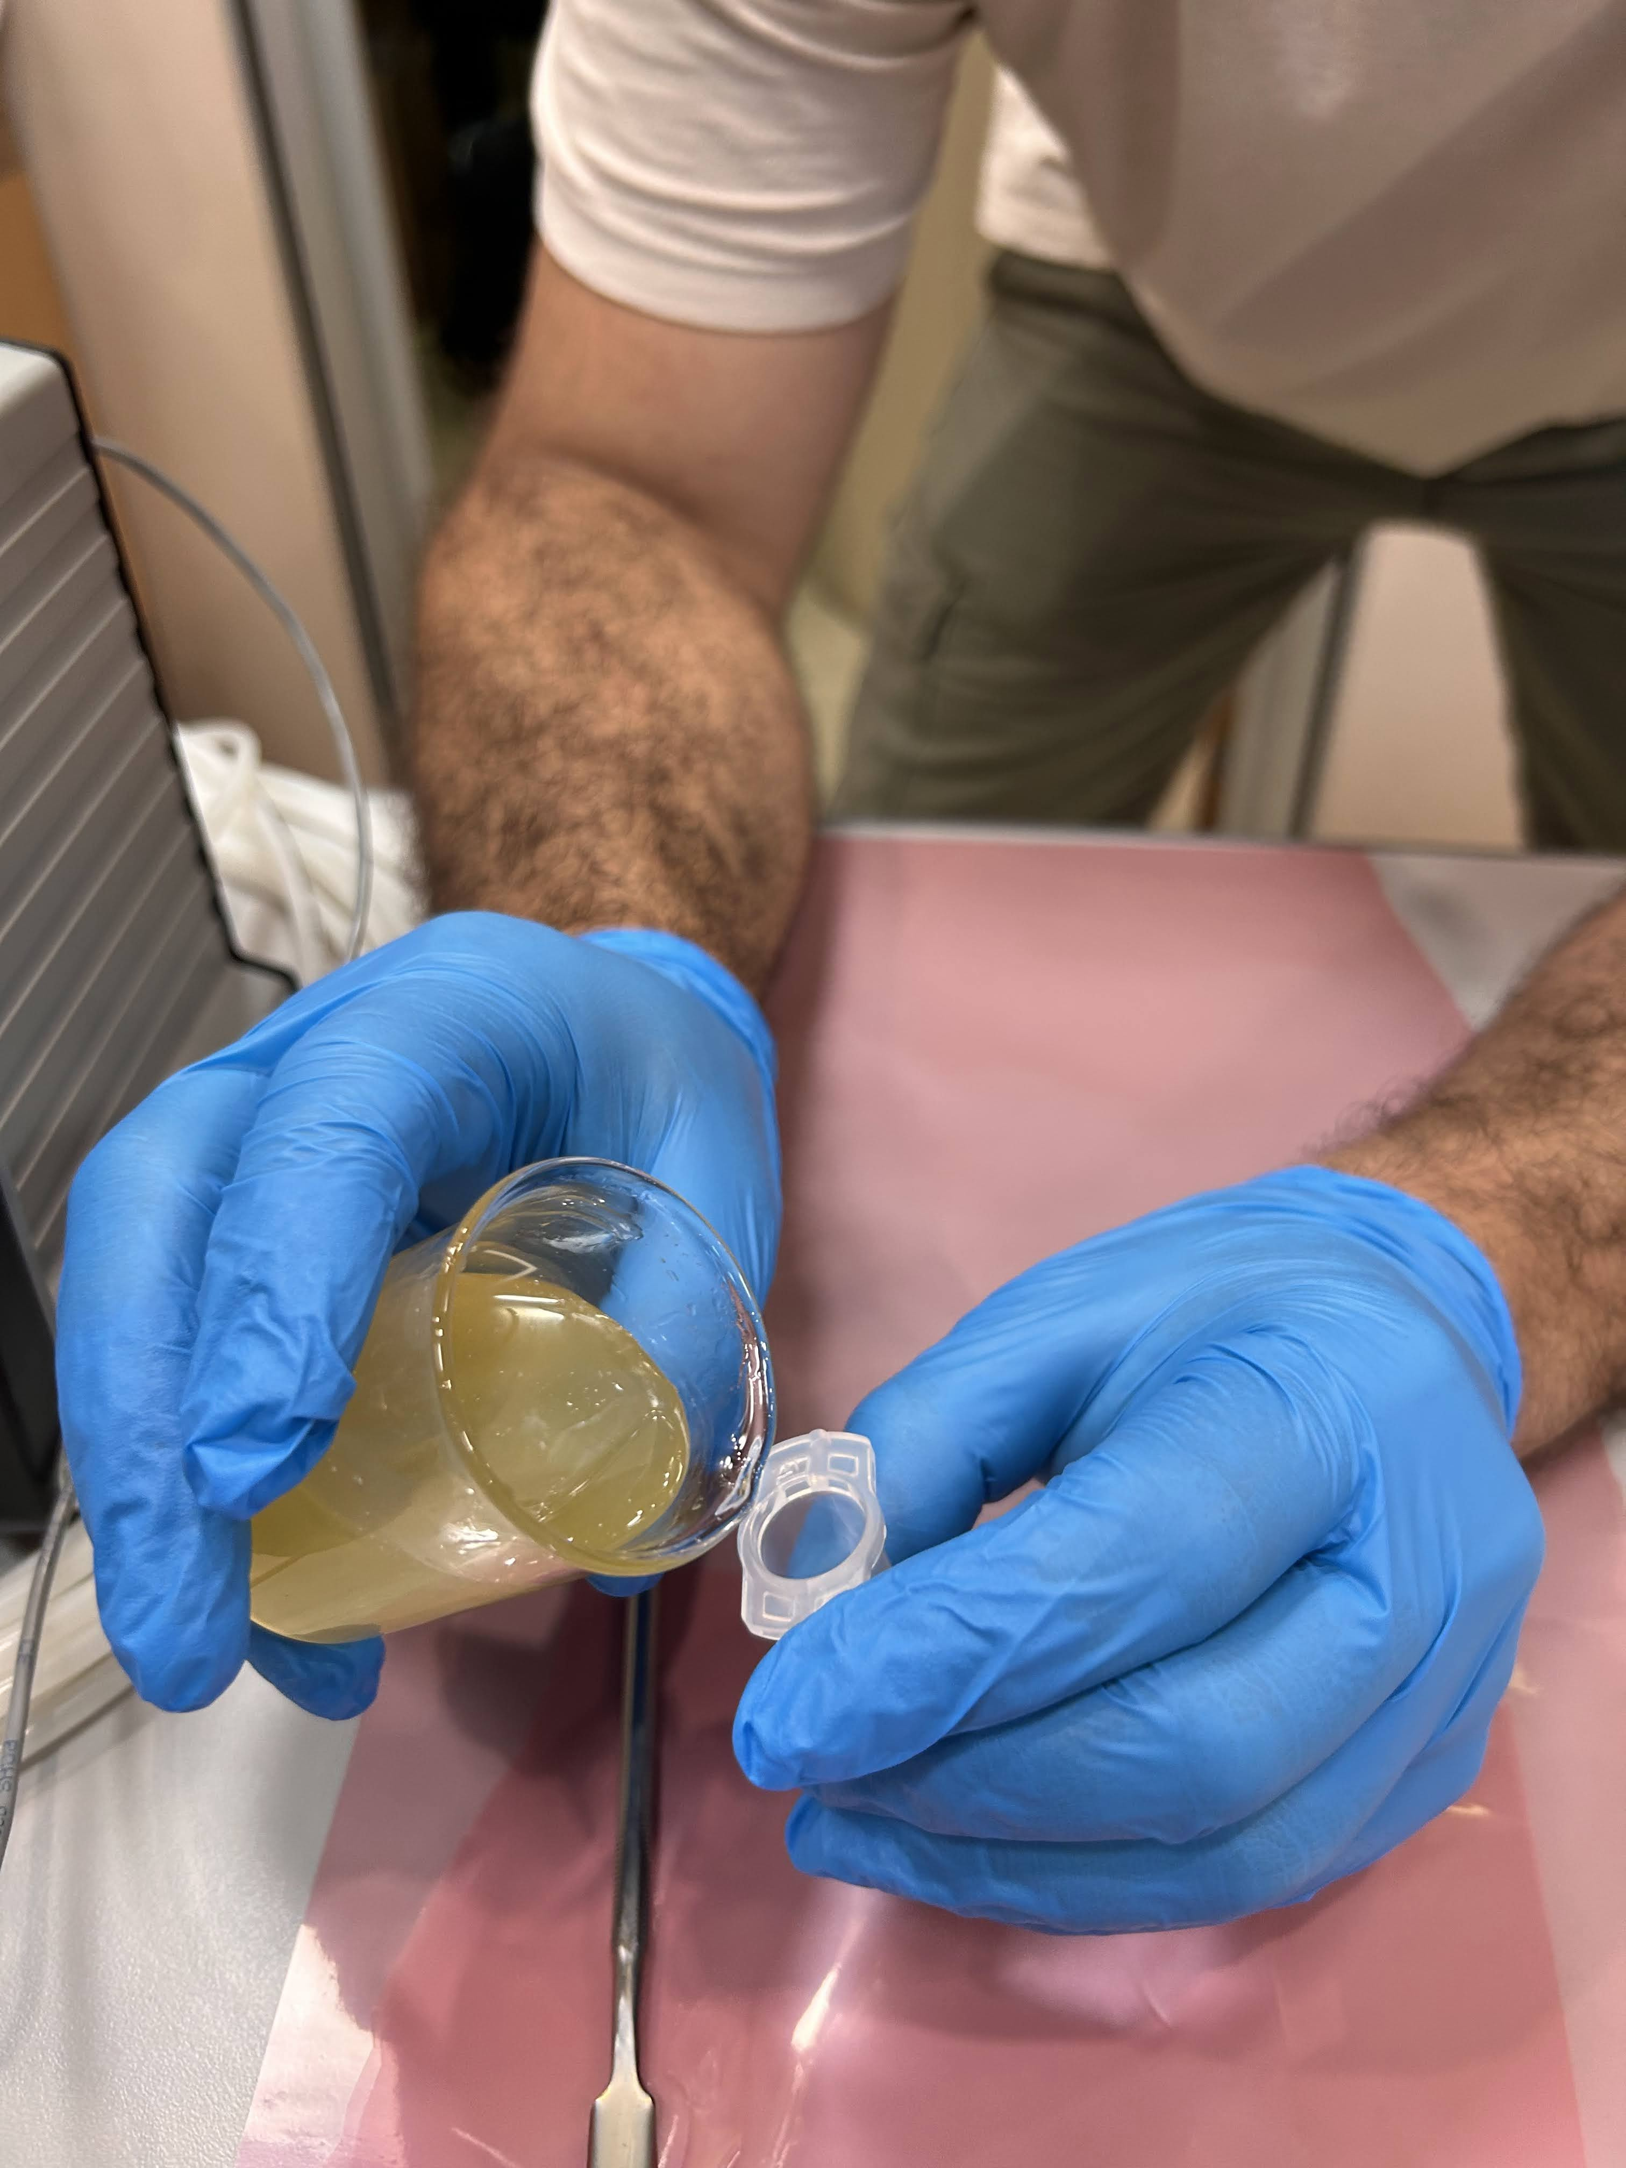
Glue preparation
After mixing
+
20’ rest
Araldite AY 103-1 + Hardener HY 991 - 100:40 (mass ratio)
Slowly mix with a spatula
Rest for 20’
Break bubbles with spatula
Pour into the syringe

Slide 7
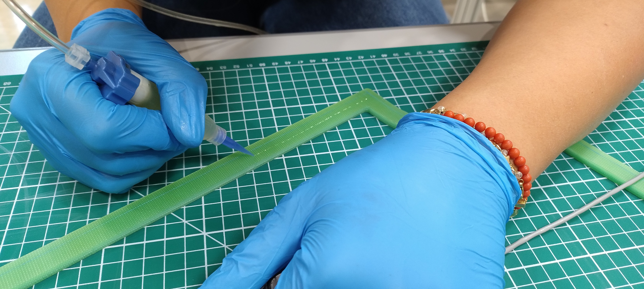
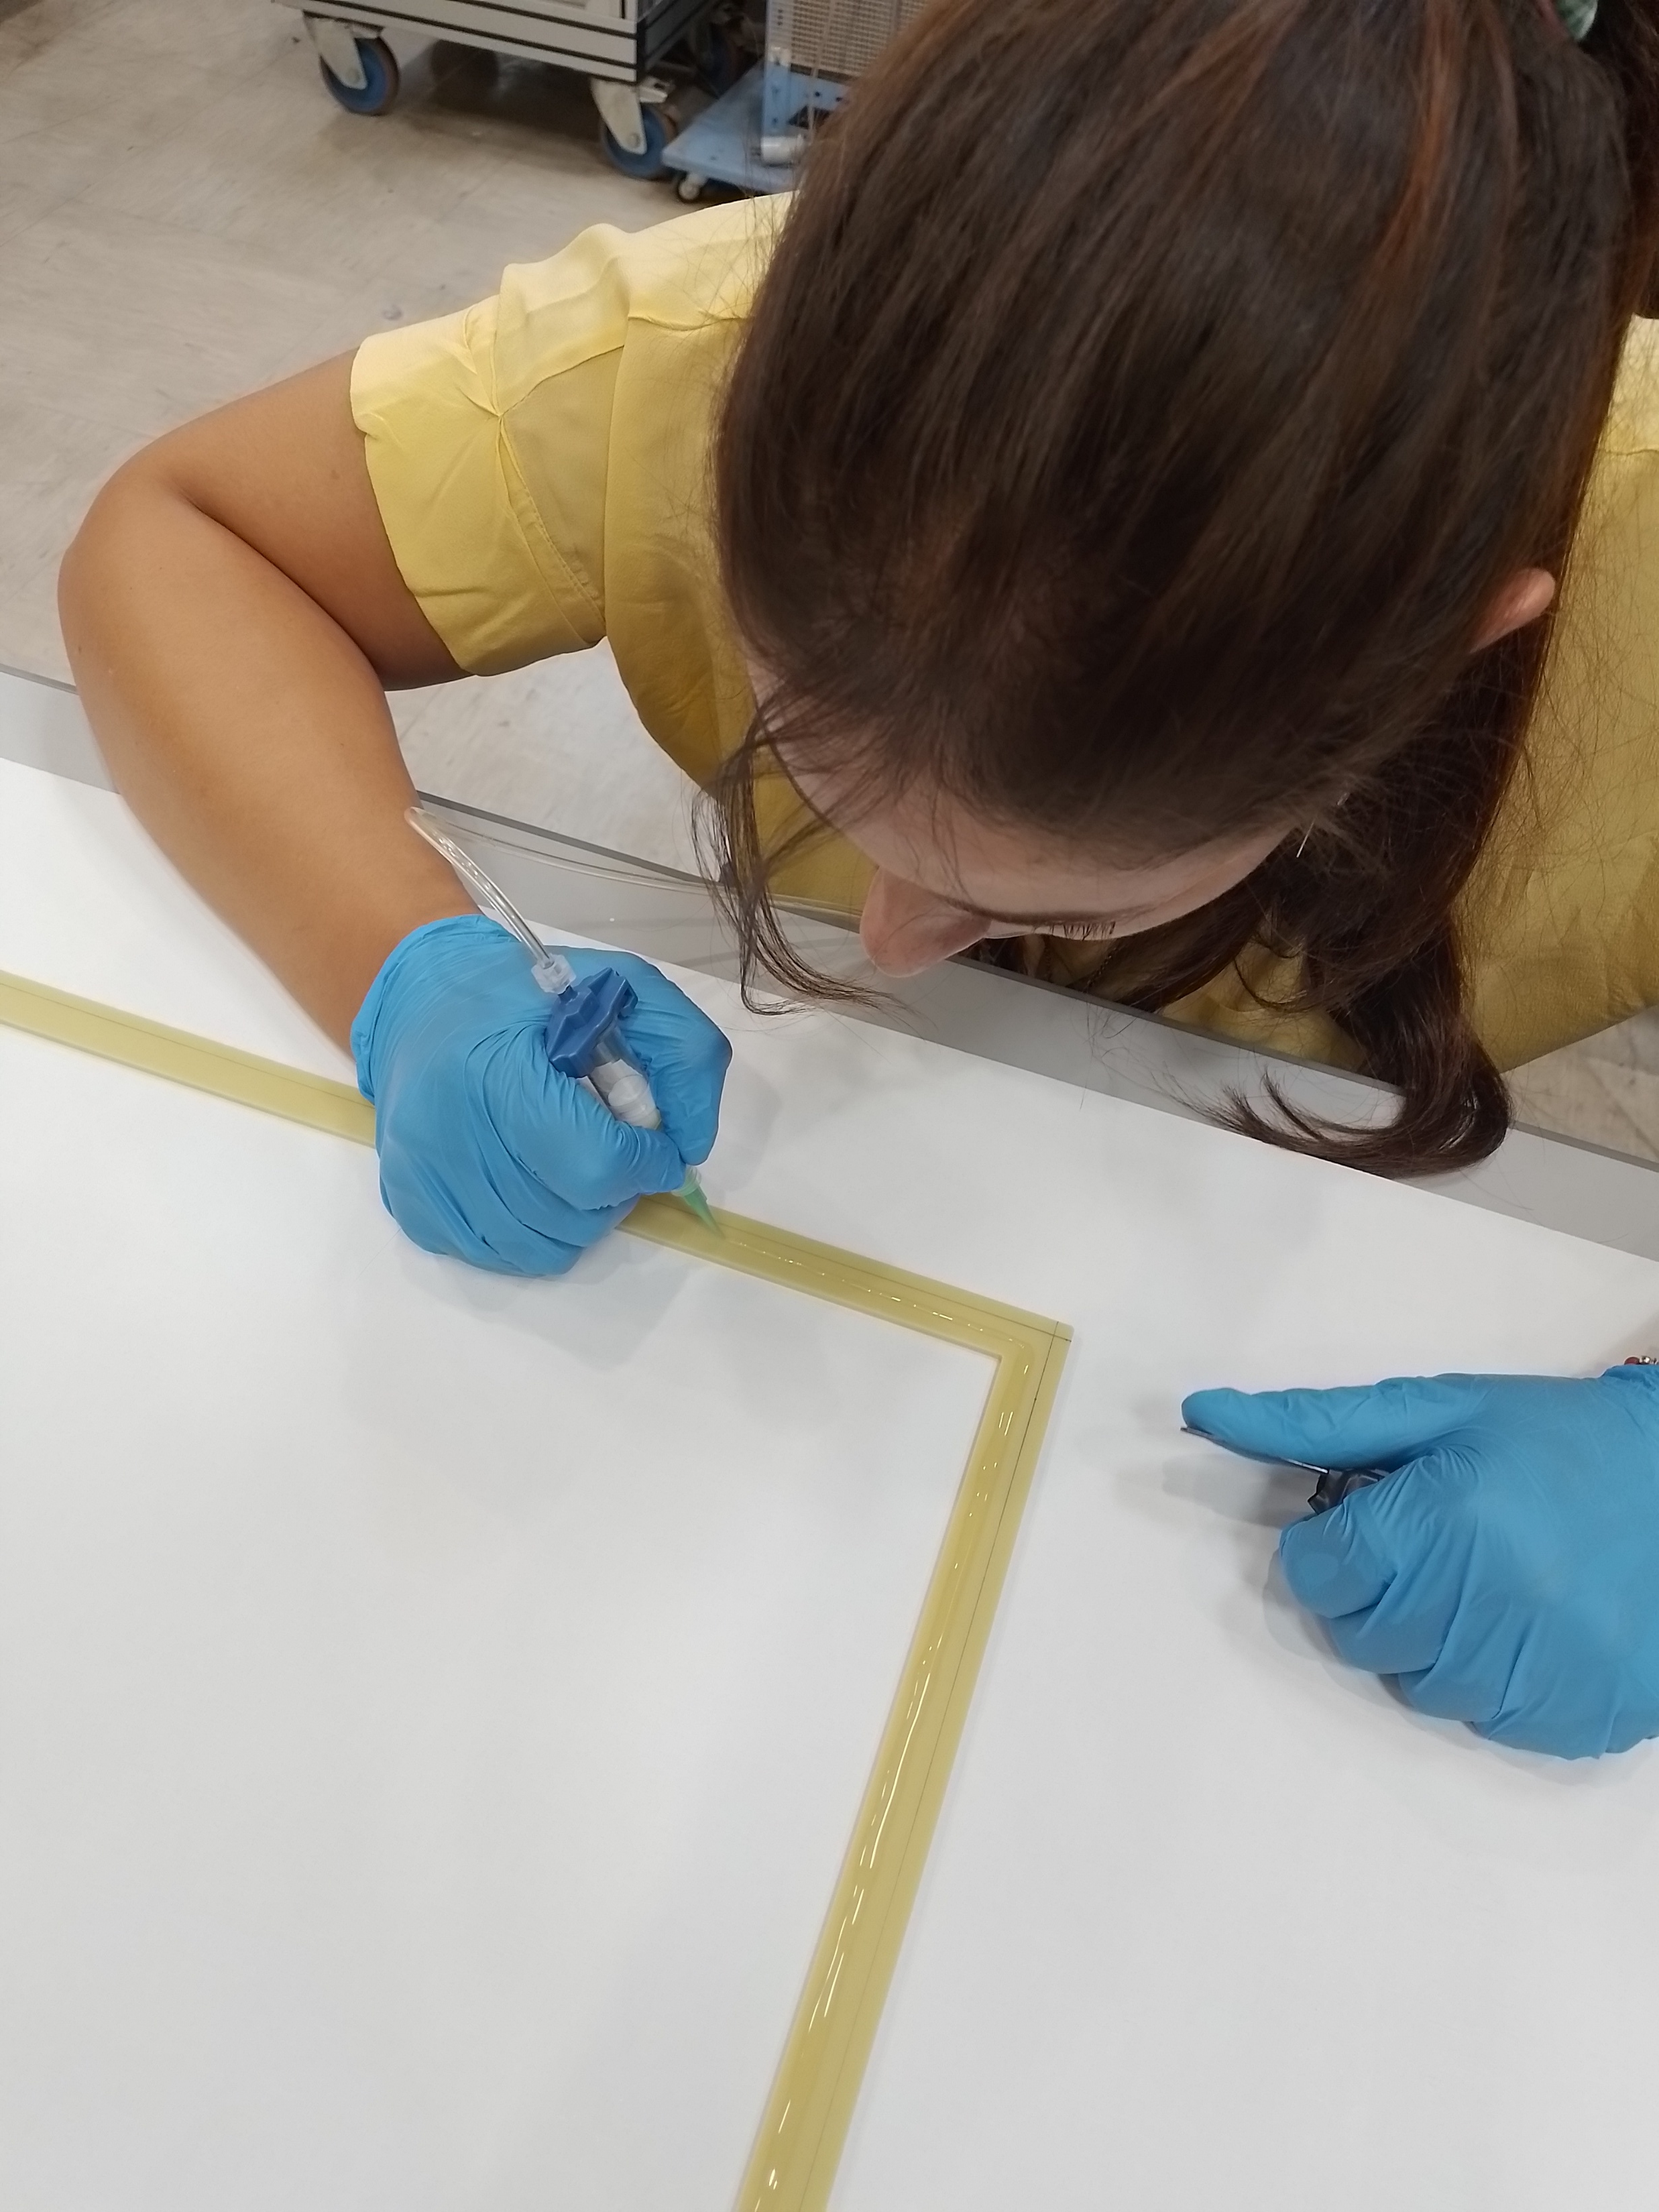
Glue deposition
The glue is deposited in a thin line in the middle of the allowed region
Needle gauges from 14 (1.6 mm) to 25 (0.254 mm) tested
Various pressures and dispensing times tested

Slide 8
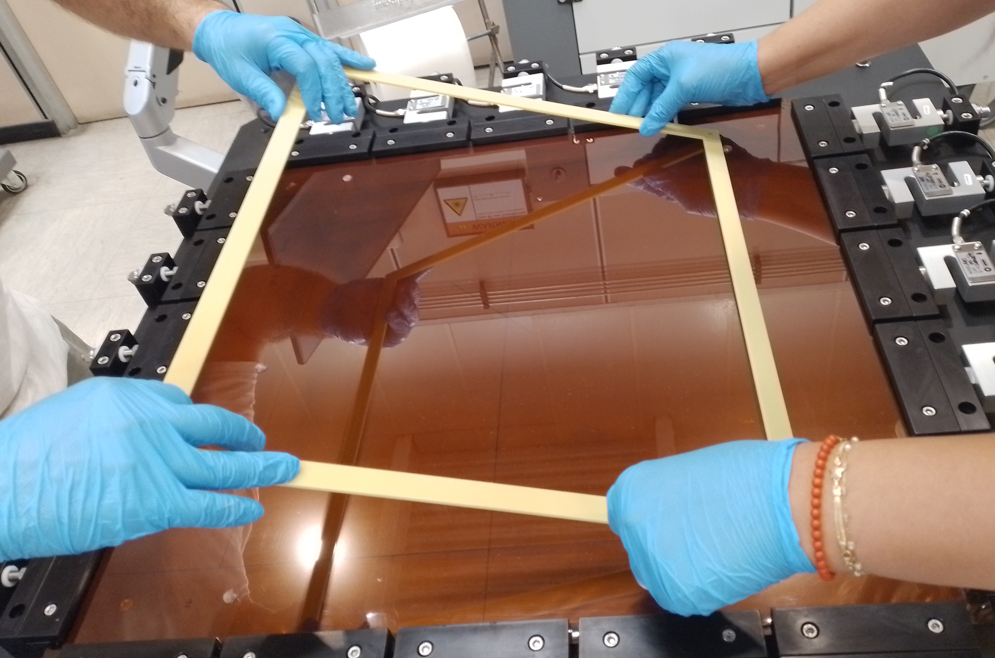
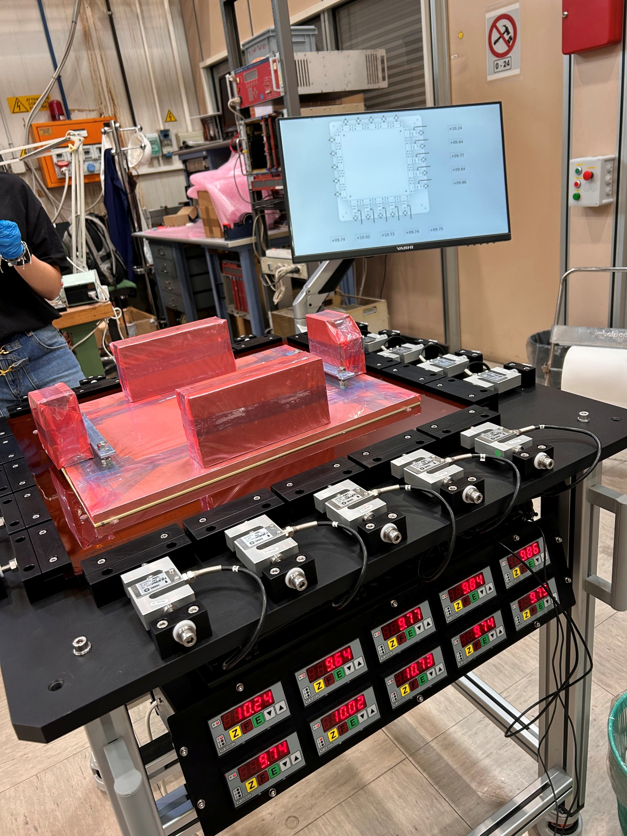
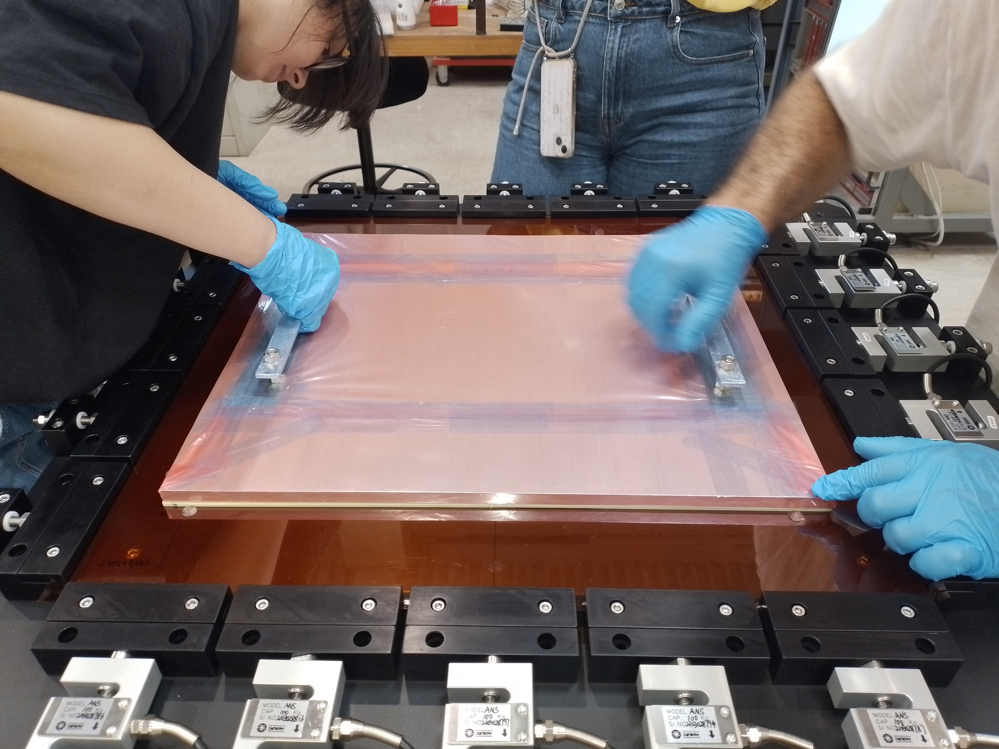
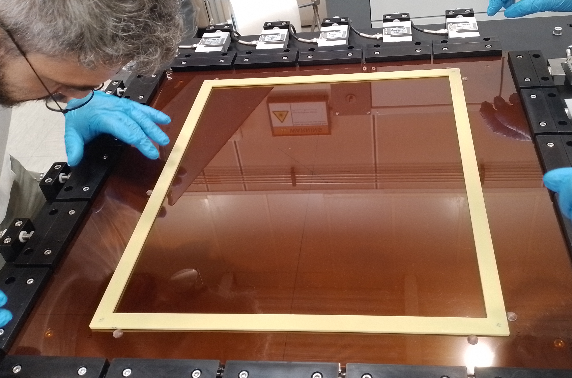
Frame placement

Slide 9
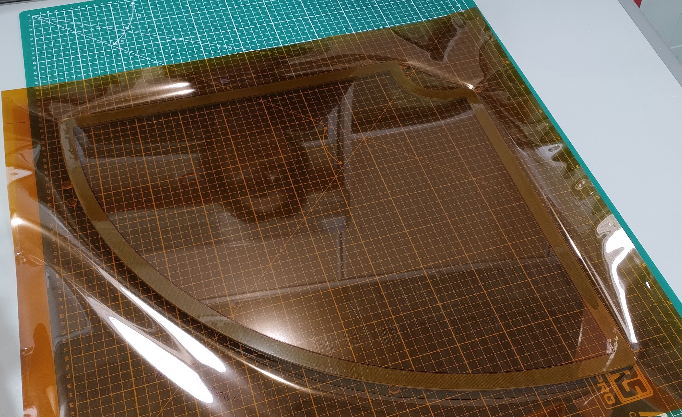
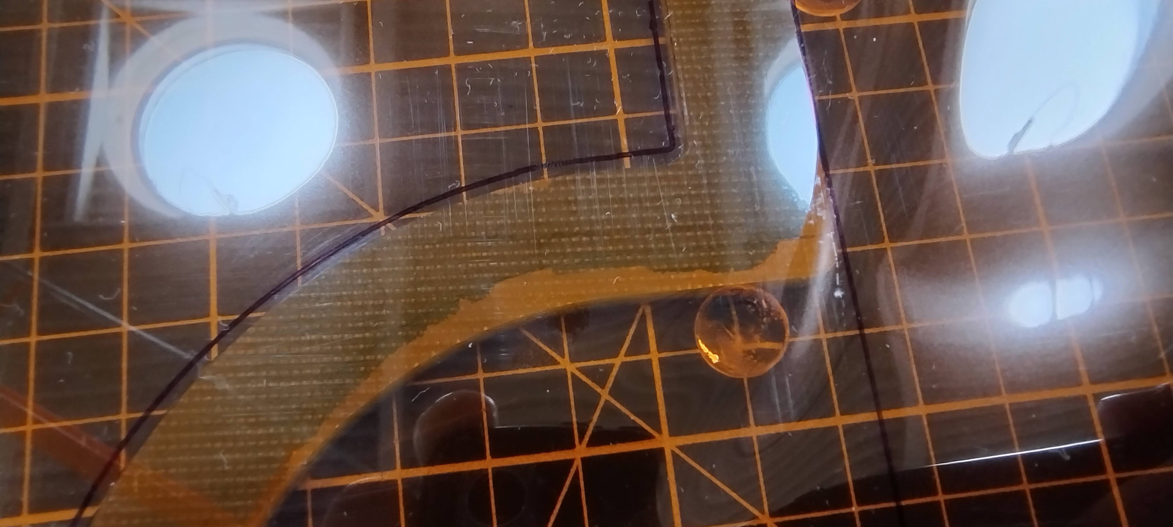
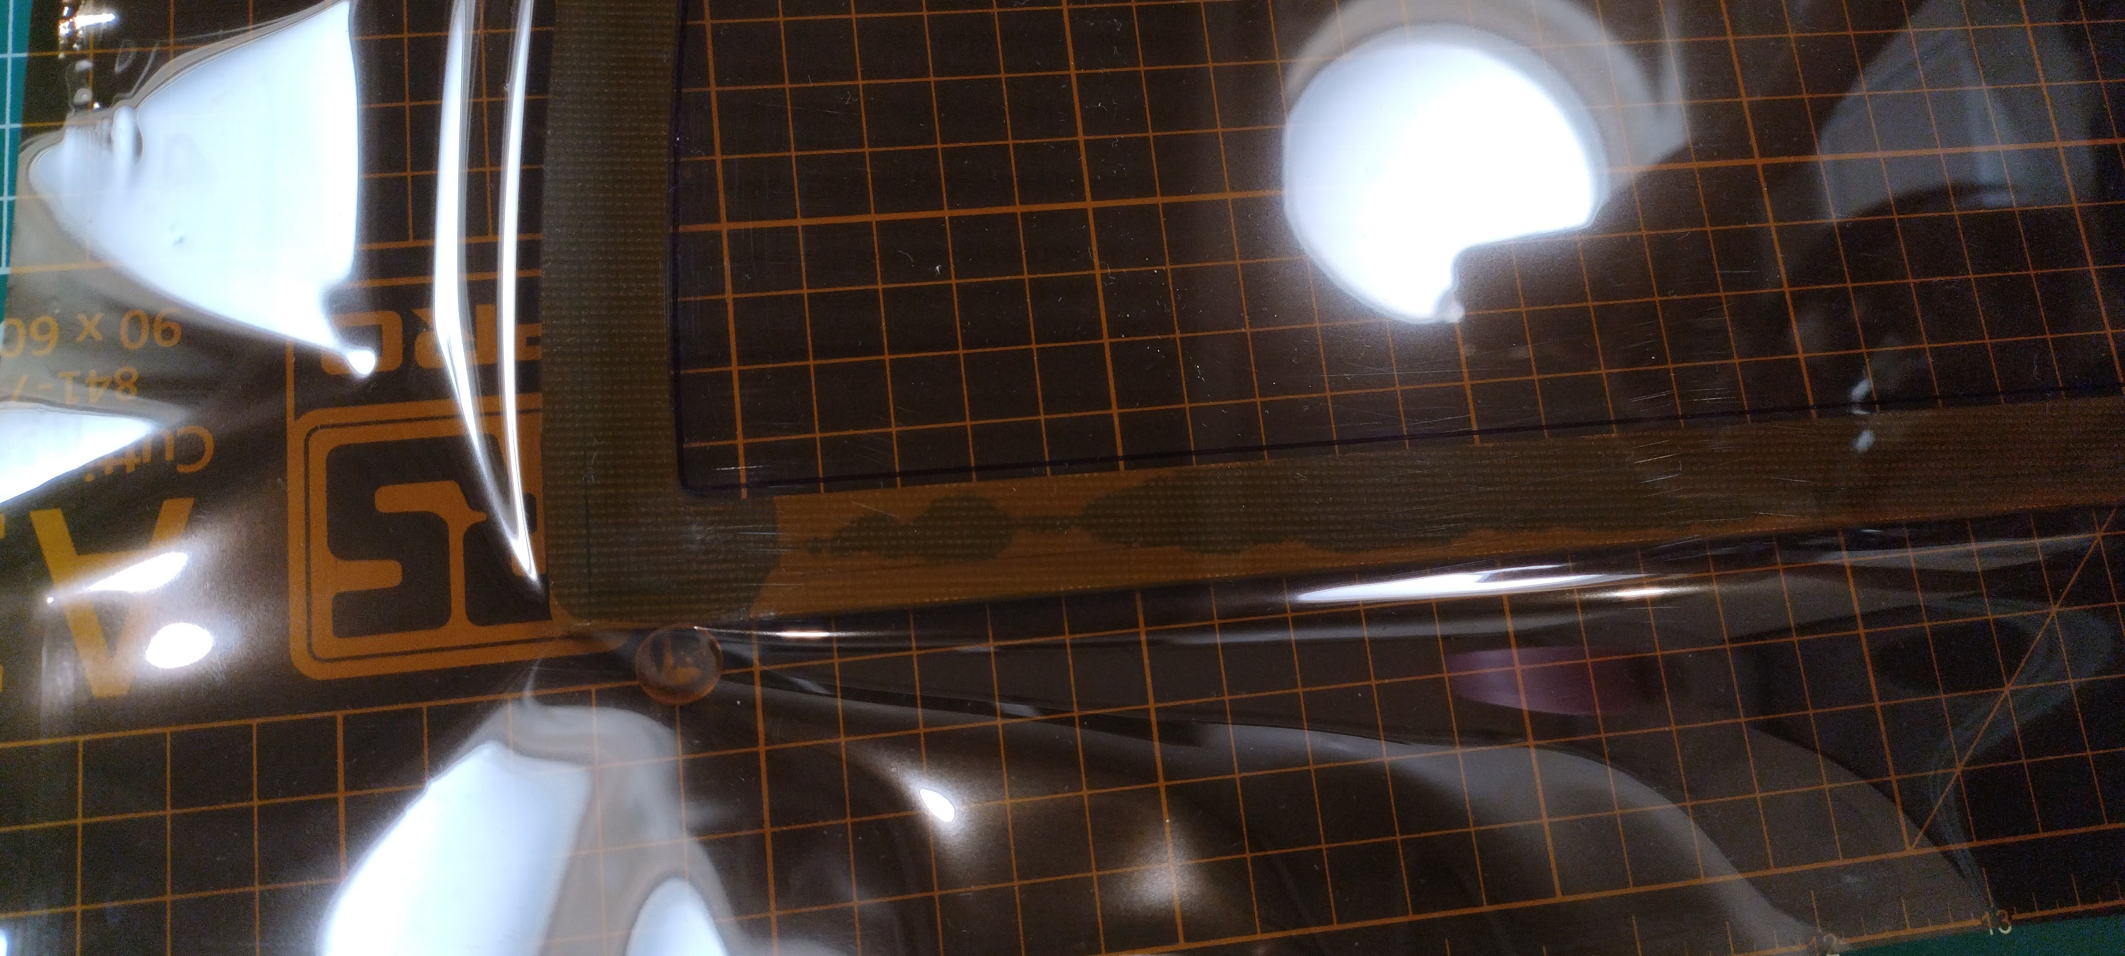
Test results
Stretching results are satisfactory
Tension is retained within the frame for both geometries, frame deformation within acceptable range
Glue deposition unsatisfactory on all samples, excessive overflow may require a change of technique

Slide 10
Conlusions
The GEM stretcher was assembled and tested
Performance is very good, minor quality of life improvements may be implemented before moving to the CR
Gluing tests on both rectangular and quadrant frames were performed
Stretching technique is consolidated, glue distribution requires more work
The more viscous Araldite 2011 can be adopted as backup for the prototypes if the next gluing tests are also unsatisfactory

