Slide 1
Interaction with PST and I3 Group

Slide 2
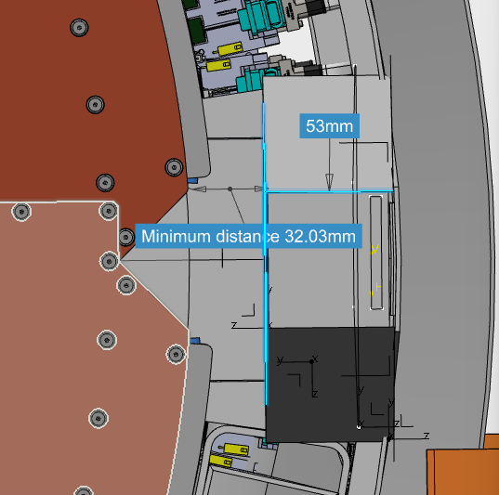
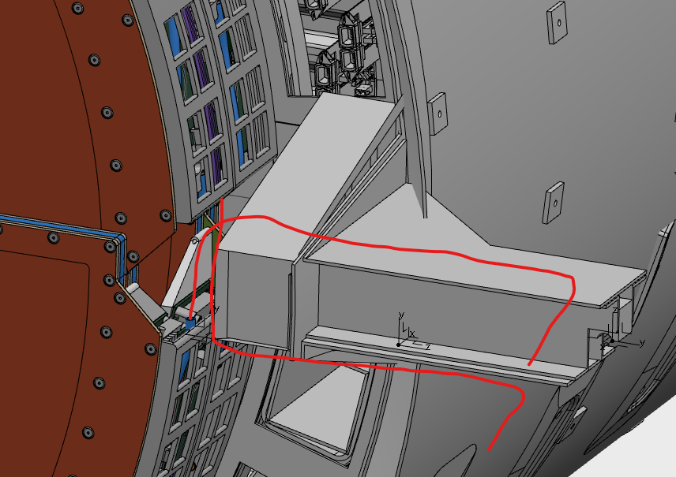
Routing solutions at 0° and 180°

Slide 3
