Slide 1
ePIC Timing Implementation for the Readout Chain
William Gu
Introduction: EIC beam (crossing) structure
Requirements
Overall hardware design
Detailed signal implementations
Clock distribution test results
Status and Summary

Slide 2
EIC beam (crossing) structure
 | Electron Storage Ring (ESR) | Hadron Storage Ring (HSR) (N_{b}=290) | HSR (N_{b}=1160)
Circumference C [m] | 3833.940 | match T_{rev} | match T_{rev}
Revolution period T_{rev}=C/c [µs] | 12.7886
RF harmonic number h [-] | match HSR | 2520 | 7560
RF bucket spacing T_{b}=T_{rev}/h [ns] NOT bunch spacing!!! | match HSR | 5.075 | 1.692
Number of bunches N_{b} | match HSR | 290 | 1160
Bunch spacing T_{bun} [ns] | match HSR | 40.599 | 10.150
Gap length [ns] | match HSR | 1015 | 1015
Beam crossing: 98.5MHz
Orbit period: 12.7886 µs
 | ESR | HSR
RMS bunch length σ_{z} [mm/ps] | 7-9/23-30 | 75-60/250-200
RMS momentum spread [10⁻⁴] | 5.8-10.9 | 10.3-6.8
RMS horiz beam size σ_{x} [um] | 100-250
σ_{z}/σ_{x} ratio [-] | 28-90 | 240-750
Electron Beam Energy: 5 – 18 GeV
Proton Beam Energy: 41, 100, 275 GeV
Luminosity: 10³⁴ cm⁻²s⁻¹

Slide 3
EIC beam (crossing) structure
Beam crossing ( * electron ion collision )
* * * * * * * *
* * * * * * * *
* * * * * * * *
1 1 1 1
1 1 1 1 1 1 1 1 1 1 1 1
1 1 1 1
2 2 2 2
1 1 1 1 1 1 1 1 1 1 1 1
2 2 2 2
5 5 5 6
5 5 5 5 5 5 5 6 6 6 6 6
5 5 5 6
7 8 9 0
1 2 3 4 5 6 7 8
3 4 5 6 7 8 9 0 1 2 3 4
7 8 9 0
1 2 3 4
1160 (all or 1/4 with beam)
100 (no-beam /gap)
Orbit period: 1260*10.150 ns = 12.7886 µs

Slide 4
2. Requirements
Streaming Data
Time Slice 1 …
Time Slice M
Time Slice M+1
Time Slice M+2
Time Slice M+3
Time Slice M+4
Time Slice M+5
START
RE-START
RE-START
STOP
START
RE-START
RE-START
RE-START
RE-START: STOP and START at the same Beam Crossing
Whole detector dead time
2.1 The whole detector has a single clock source to align the streaming data slices;
2.2 jitter of the FEE/ASIC received clock: less than 5ps;
2.3 For TOF detectors, the phase of the clock relative to the beam crossing center point is stable (< 5ps)
2.4 For ? detectors, the phase of the clock relative to the beam crossing center point is stable (zero suppression)

Slide 5
ePIC
3. Overall Hardware Design
System Clock: 98.5 MHz (100MHz nominal)
GTU: Global Timing Unit
control encoding, status decoding.
The interface for machine clock source,
Data acquisition control and monitor etc.
DAM: Data Aggregation Module:
The clock/control fanout, and status/busy accumulation.
local control over the RDO boards connected, though the main function of the DAM is for Data Acquisition.
RDO: optical interface of detector ReaDOut
control decoding, status encoding.
The clock/control interface to the front end electronics.
Data collection from Frontend boards, and data transmission to the DAM
FEB:
Detector dependent Front End / ASIC carrier boards.
Online computer
Status
GTU
GTU (O)1
Control
EIC
Common
Platform
Clock
Data Acquisition
DAM
(O)100
DAM
DAM
RDO
(O)1000
RDO
RDO
RDO
RDO
FEB
FEB
FEB
4

Slide 6
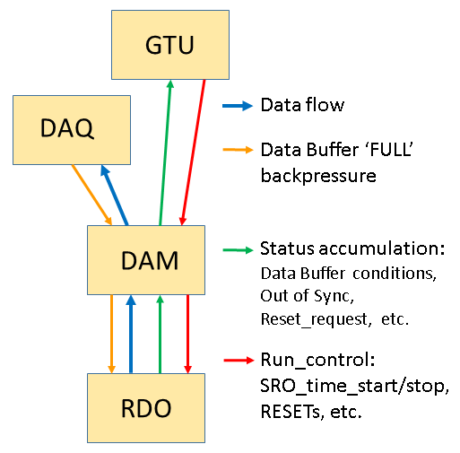
3. Overall hardware design
Clock Distribution
Control
EIC
common platform
RunControl computer
GTU fanouts (1:~200):
Additive Jitter <1ps; Phase: fixed
Ethernet
System clock
(98.5MHz)
Two-level fanouts
Beam orbit
Beam Orbit synchronized RunControl
Dedicated (clock only, 197 Mbps) fiber
Additive Jitter <1ps; Phase: fixed
GTU
Host PC
DAM fanouts (1:12):
Additive Jitter <1ps; Phase: fixed
Clock fanout
(optional jitter cleaner)
DAM
Control config, status
DAQ
8-bit, 24-bit, 32-bit, 48-bit, 64-bit every clock cycle (10.15ns)
MGT Clock/Control encoding (1:4):
Additive Jitter <~ps; Phase: stable, can be fixed
RefClk
TX/RX
GTY
1:1 (Clock/Control, 7.88 (/3.94)Gbps) fiber:
Additive Jitter <1ps; Phase: fixed
Clock recovery
(optional iitter cleaner)
Clock fanouts
RefClk
TX/RX
Control
Config
DAQ
RecClk
GTY
RDO RECovered Clock:
Additive Jitter <3ps; Phase: stable,
fixed with PseudoClock
RDO
FEB/ASIC
Beam Crossing phase aligned
Beam orbit phase aligned

Slide 7
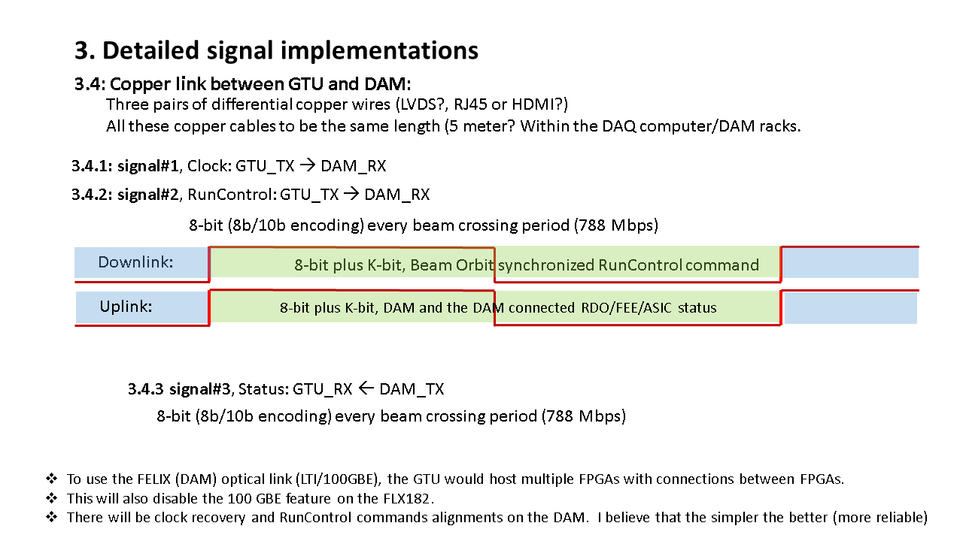
4. Detailed signal implementations
4.1: Fiber link between GTU and DAM:
The GTU will have ~150 ports (four fiber per port). Each port can connect to one DAM.
Clock @ 98.5 MHz
Transmitters
Receivers
Downlink
GTU_CONTROL, 8-bits (+ 1 k_bit) @ 98.5 MHz
GTU
DAM
Uplink
DAM/RDO Status, 8-bits (+ 1 k_bit) @ 98.5 MHz
Receivers
Clock feedback @ 98.5 MHz, 197 MHz, or maybe 394 MHz (optional)
Transmitters
Using FireFly TX/RX modules will save power than regular QSFP optic transceivers, but the fiber connection/mapping can be challenging (easy to make mistake).
It is ok to send more (than 8-bit) data between GTU and DAM per clock cycle, but not needed.

Slide 8
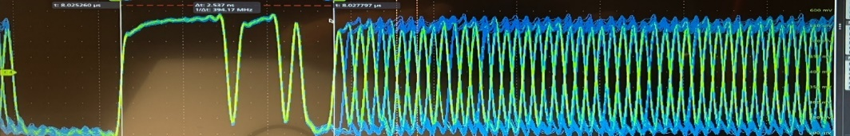
4. Detailed signal implementations
4.2: Fiber link between DAM and RDO:
Each DAM will have 48 ports (one pair of fibers per port). Each port can connect to one RDO.
Fiber length/signal delay to be measured, and delay compensated on RDO
MGT_TX
DOWNLINK @ 7.88 Gb/s (80 bits @ 98.5 MHz)
MGT_RX
1:2
Pseudo_Clock: 0x0000_0003_FFFF_FFFF_FC00 (LSB first)
CONTROL: DAM3_DAM2_DAM1_DAM0_GTU1_GTU0_FFC00
* DAMn, GTUn are 8b10b encoded
Rx_REC_Clk
System Clock Generation
(and Phase
Detection)
DAM
CDR_reset
RDO
UPLINK @7.88 Gb/s (80bits @98.5 MHz)
MGT_RX
MGT_TX
IDLE: 0x0000_0003_FFFF_FFFF_FC00 (LSB first)
STATUS: STAT3_STAT2_STAT1_STAT0_STAT_ENABLE_FFC00
DATA: 64-bit Frontend data with 8b10b encoding
FEB/ASICs
RunControl (from GTU) is guaranteed every beamcrossing cycle (98.5MHz). It can be hijacked by the DAM for sub-system test
The RDO/FEB configuration depends on the specific DAM (which comes from the host computer).
The DOWNLINK can be 3.94 Gb/s (40 bits @ 98.5 MHz) to accommodate the VTRX+ optic transceivers
The UPLINK can be 10 Gb/s (up to 12 Gb/s) if needed.
The ¼ clock period of 0...01…1 I should be reserved for alignment, which is also compatible with the pseud_oclock patterns

Slide 9
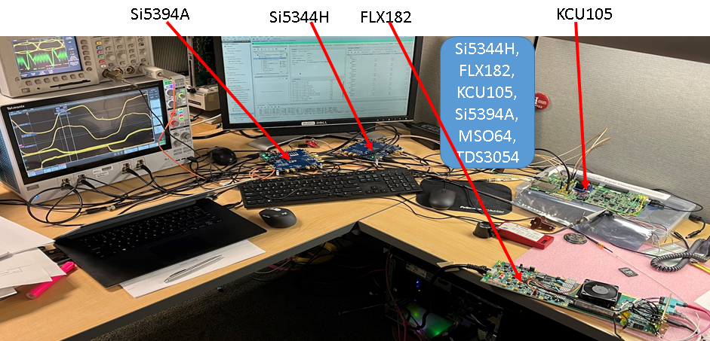
5. Clock distribution test results
5.1: RDO RECovered clock: jitter σ < 3ps, no jitter cleaner is required.

Slide 10
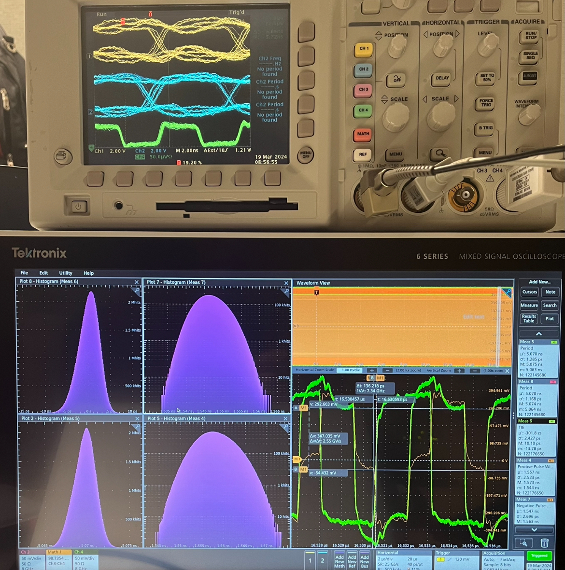
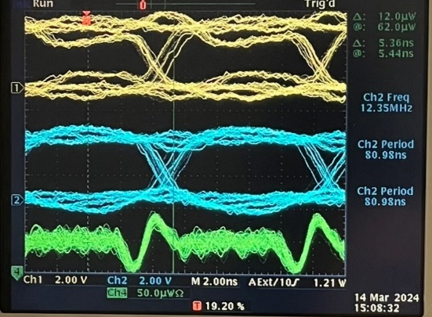
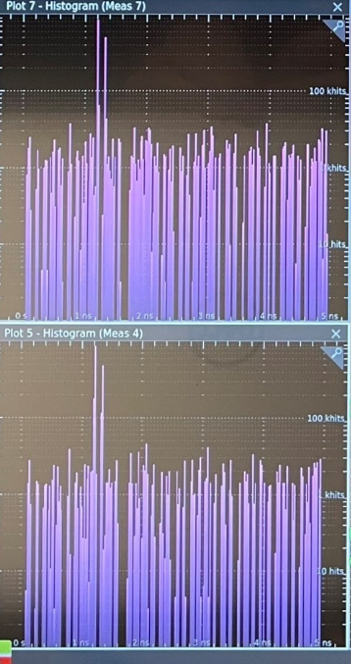
5. Clock distribution test results
5.1: RDO RECovered clock: jitter and phase.
Si5344H → FLX182 → KCU105/XEM8320
RxRECclk jitter < 3 ps
RxRECclk phase can be fixed at ~(0)ps precision
(by measuring the phase difference between the RxRECclk and the pseudoClock, and resetting the RxRECclk CDR.)

Slide 11
5. Clock distribution test results
5.2: DAM MGT Tx phase stability
Si5344H→ KCU105_MGT_TX

Slide 12
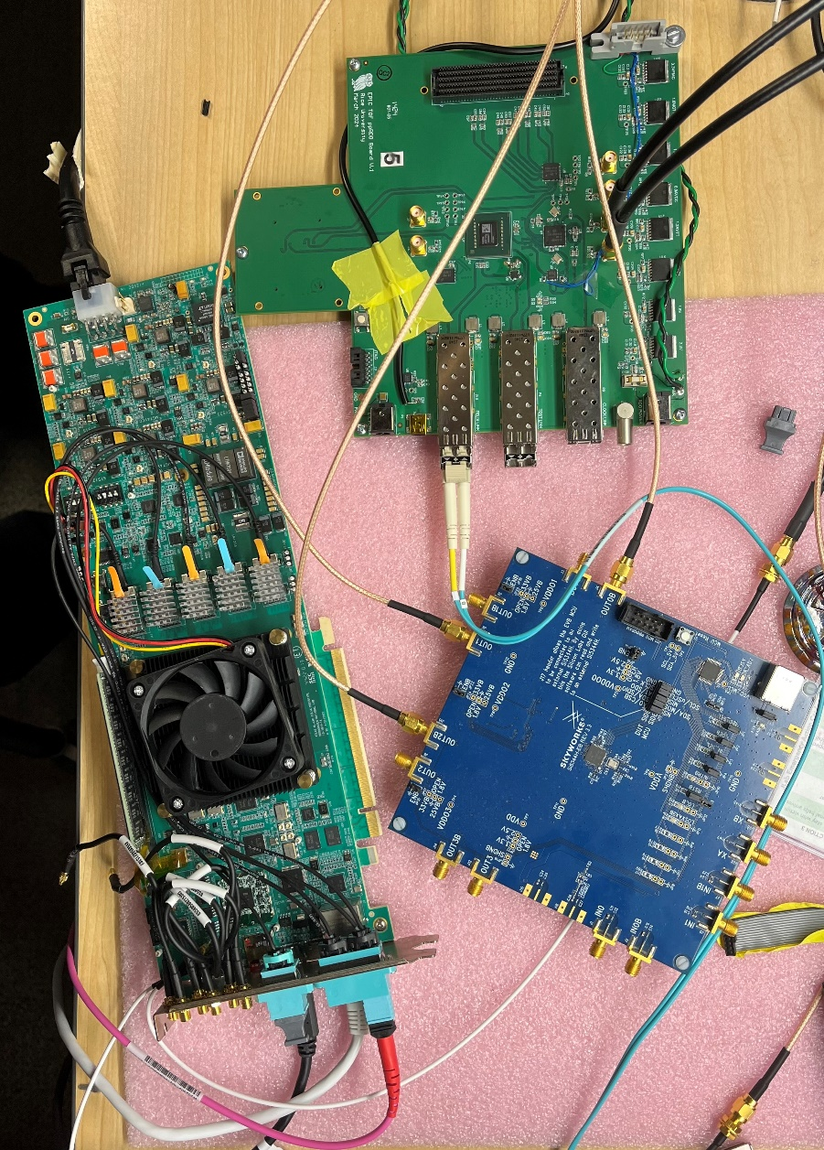
5. Clock distribution test results
5.3: PseudoClock from DAM (FLX182) to RDO (pre-prototype RDO): the ADCLK944 1:4 fanout
ppRDO
(ADCLK944)
Si5344H
(ref Clock)
FLX182
More tests (similar to 5.1 and 5.2) are expected

Slide 13
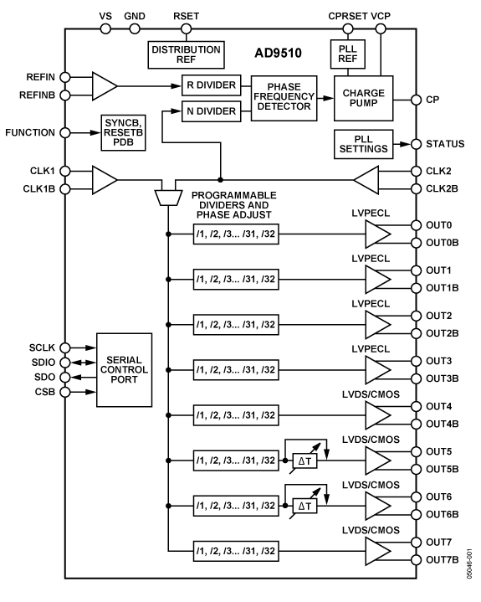
5. Clock distribution test results
5.4: Dedicated Clock from GTU to DAM
5.5: Other clocks from RDO to FEB/ASIC:
Jlab’s 12GeV upgrade
Trigger SuperVisor
PCB and backplane
Copper traces
Signal Distributor
Analog Devices
AD9510
PCB and backplane
Copper traces
Additive output jitter (rms)
LVPECL: 225 fs
LVDS/CMOS: 275 fs
Trigger Distributor
Optic Transceivers
Multi-Mode fibers
Trigger Interface
Clock Jitter (from Trigger Interface) σ < 3ps
Used on the Trigger Interface modules to generate SYNCHRONIZED /2, /4, /6 and /8 lower frequency clocks

Slide 14

6. Status and Summary
6.1: Status
RDO: preprotype RDO, six in hands, being tested
DAM: Prototype FLX155 (ePIC DAM) is expected this year
FLX155: Designed for ATLAS FELIX upgrade
GTU: prototype is being considered

Slide 15
6. Status and Summary
6.1: Summary

Slide 16
Backup slides

Slide 17
What if:
6.1: The DAM can NOT send phase determined serialized clock/control (MGT TX phase undetermined)
Answer: Dedicated fiber connection from GTU to RDO to distribute the clock to Time Of Flight detector
6.2: The EIC common platform delivered clock is not as good as expected
Answer: There will be jitter cleaner chip on the GTU to receive the clock from EIC common platform;
We can (should) build the beam monitoring circuits to monitor and correct the phase (clock edge relative to the center of beam crossings) shift

Slide 18
GTU: Global Timing Unit
Online computer
Run control
EIC
COMMON PLATFORM
EIC/ePIC clock & beam orbit info
GT
Clock buffers
1 : ~200
FPGA
RDO (TOF)
SFP
GTU
RunControl
CLOCK
STATUS
RDO (TOF)
DAM
DAM
DAM
Could be a separate clock fanout PCB, if needed
RDO
RDO
RDO
RDO
May be needed, RDO(TOF) , DAM(dRICH)

Slide 19
DAM: Data Aggregation Module
CLOCK
98.5MHz
Clock
buffer
LTI
FireFly
Tx/Rx
GTU
RunControl
Fabric
Clock
RefClks
STATUS
FireFly
TX
RDO
TXs
RunControl
RDO/FEE config
GTYs
(24/48)
FireFly
RX
Status merging
DataProcessing
RXs
RDO
RJ45
GigaBitEth
FPGA
Xilinx Versal
PCIexpress GEN4x16
2* GEN5x8
100 GBE
Host Computer/DAQ
Network Switch/DAQ

Slide 20
RDO: ReadOut card
Zero Delay FB
optional emergency circuit I²C
IN3
OUT
(N/M)* 98.5 MHz
O1
pseudoClock
98.5 MHz
O1
O2
optional clock buffer
1:2 fanout
Si53x5
Fiber
RX
197 or
394 MHz
IN
FEB
DAM
Optic transceiver
O0
O2
TX
Phase difference detection
RX
RxRECclk
FEB
GTY
control
TX
ClkRef
GENIO
FPGA
RDO

Slide 21
Beam orbit cycle and ASIC clock requirement:
One orbit cycle = 1260 Beam Crossing (or ePIC system clock cycles)
1260 = 2x2 x 3x3 x 5 x 7
98.5 x 2 / 5 = 39.4 (MHz)
98.5 / 2 = 49.25 (MHz)
……

Slide 22
Proposal:
Beam pickup, and digital feedback to GTU
EIC
common platform
RunControl computer
GTU: Phase Correction
Ethernet
System clock
(98.5MHz)
Two-level fanouts
Beam orbit
Beam Orbit synchronized RunControl
GTU
RF-SoC (?)
PhaseOrbit (average)
Host PC
Clock fanout
(optional jitter cleaner)
DAM
Control config, status
DAQ
Phase#1
Phase#2
Phase#1160
Phase#1
RefClk
TX/RX
GTY
RDO(area) Clock
Clock recovery
(optional iitter cleaner)
Clock fanouts
RefClk
TX/RX
Control
Config
DAQ
RecClk
GTY
Beam pickup
RDO
FEB/ASIC

Slide 23
Phase/Jitter of the clock measuring method:
EIC/Common Platform/GTU clock: Si5344H as reference;
Clk_98.6
Beam Crossing/Reference Clock
Si5344H
FLX182
CH#3
CH#1
CH#2
1:2
DAM MGT_TX output: FLX182/KCU105 pseudoClock
Encoded Clock
Fiber_7.89
ClkPD_98.6
Phase
Detect
MGT
RDO/FEB Recovered Clock: XEM8320/KCU105 plus Si5394A
ClkSys_98.6
Si5394A
KCU105
Recovered Clock
RxRecClk_197.3
Phase/Jitter measuring method using a scope (Tektronix MSO64):
Phase difference == WIDTH of the difference of the two signals
Jitter == uncertainty of the WIDTH of the difference of the two signals assuming the reference clock is perfect.
CH#3
Oscilloscope Probes

