Slide 1
Incremental Preliminary Design and Safety Review of the EIC Detector DAQ and Electronics
Electronics Implementation
Fernando Barbosa
L3 CAM WBS 6.10.08
Chief Electrical Engineer
DAQ & Electronics PDR
June 10-11, 2024

Slide 2
Charge Questions Addressed
Are the technical performance requirements appropriately defined and complete for this stage of the project?
Are the plans for the various detector electronics and data acquisition systems appropriately documented and complete for this stage of the project?
Are the current plans from front-end electronics to data acquisition for the detector likely to achieve the technical performance requirements, with a low risk for cost increases, schedule delays, and technical problems?
Are the schedule assumptions for the fabrication of the various electronics and data acquisition systems and assembly plans reasonable and consistent with the overall detector schedule?
Have ESH&Q and QA considerations been adequately incorporated into the plans at their present stage?

Slide 3
Outline
Design Philosophy
Streaming Readout
Chain, Development, Channels
eRD109 Initiatives
Initiatives, Synopsis, Scope of Effort
Infrastructure, Standards, Grounding
ESH&Q and QA/QC
Resources
Timeline
Recommendations from first PDR
Summary

Slide 4
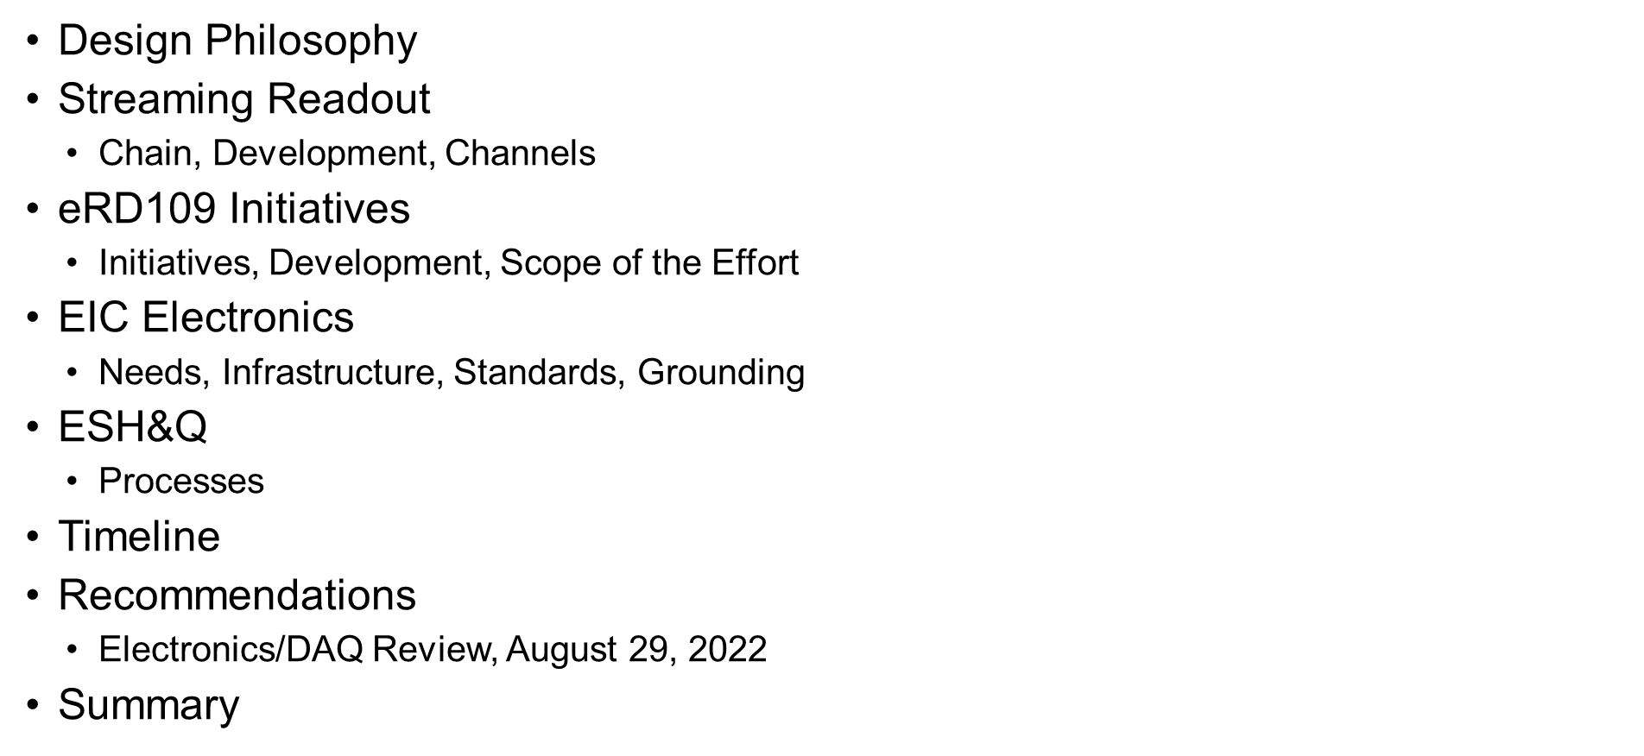
Outline

Slide 5
Design Philosophy
Charge 1
Maximize synergies in electronics:
Use same designs and architectures across sub-detectors, with possible variants.
Minimize number of distinct devices: fewer part #s, less maintenance.
Design re-use from proven implementations, including ASIC IP blocks.
Minimize cabling, services:
Fibers and copper interfaces for signal/data transport.
Electronics, including digitizers, close to the detector.
Limit FPGA use inside detector volume.
Serviceability as a design criteria.
Triggerless operation as default; triggered operation for calibration, etc.
Meet current US standards per NEC, UL, FCC, NEMA.
Equipment assessment reviews for conformance to EHS&Q.

Slide 6
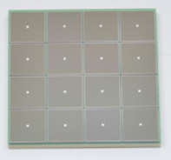
Streaming Readout Chain – P6 Partitions
Global Timing Unit (GTU)
-Interfaces to Collider, Run Control & DAM
-Config & Control
-Clock & Timing
Charge 1
Sub-Detector P6s
Electronics P6
WBS 6.10.08
DAQ P6
WBS 6.10.09
On Detector
SMT BGA
Name
Design
Function
Attributes
Sensor
Detector Specific
-Multi-Channel Sensor
-MAPS
-AC-LGAD
-MPGD
-MCP-PMT
-SiPM
-LAPPD
Adapter
Detector Specific
-HV/Bias Distribution
-HV divider
-Interconnect Routing
-Sensor Specific
-Passive
Front End Board
(FEB)
Detector Specific
-Amplification
-Shaping
-Digitization
-Zero Suppression
-Bias Control & Monitoring
-ASIC/ADC
-Discrete
-Serial Link
Readout Board
(RDO)
Few Variants
-Communication
-Aggregation
-Formatting
-Data Readout
-Config & Control
-Clock & Timing
-FPGA
-Fiber Link
Data Aggregation Module (DAM)
Common
-Computing Interface
-Aggregation
-Software Trigger
-Config & Control
-Clock & Timing
-Large FPGA
-PCIe
-Ethernet
Computing
Common
-Data Buffering and Sinking
-Calibration Support
-QA/Scalers
-Collider Feedback
-Event ID/Building
-Software Trigger
-Monitoring
-COTS
-Ethernet
Nomenclature standardized after August 2022 Electronics & DAQ Review (PDR 1) .

Slide 7
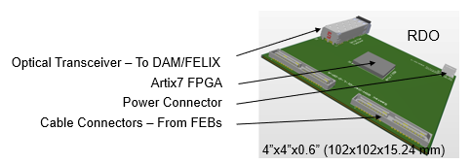
Streaming Readout - Development
Charge 1, 2
“Coalesce” specifications to minimize the number of ASIC/FPGA/PCB part numbers.
Power is nominally 1 W ± 0.25 W per ASIC (64 ch, 32 ch). Cooling systems will be an integral part of the detector design.
Serviceability as a design criteria. Reliability assessment of componentry.
ASIC Development timeline is critical ~ 3.5 – 4 Years
Revise and adapt present designs is our strategy.
Design re-use of IP blocks from existing ASICs.
Standardization of data format (header, timestamp, etc.) at the system design level.
Firmware development requires specialized expertise in close connection with both the detector development and the DAQ systems.
Testing and integration (w/ detectors/prototypes) takes considerable
Time and resources.
RDO footprint defined and passed on to ME.
Refer to talks by Tonko and Pietro.

Slide 8
Streaming Readout - Channels – Scale & Technology
Charge 1, 2
Detector System |  | Channels | SensorTechnology | Redout Technology
Si Tracking
 | 3 vertex layers | 7 m^2 | MAPS | lpGBT, VTRX+
 | 2 sagitta layers | 368 pixels | MAPS | lpGBT, VTRX+
 | 5 backward disks | 5,200 MAPS sensors | MAPS | lpGBT, VTRX+
 | 5 forward disks |  | MAPS | lpGBT, VTRX+
MPGD Tracking
 | Barrel, e & H Endcaps | 202 k | uRWELL, MicroMegas | SALSA
Forward Calorimeters
 | LFHCAL | 63,280 | SiPM | CALOROC
 | HCAL Insert | 8 k | SiPM | CALOROC
 | pECAL W/SciFi | 16,000 | SiPM | Discrete
Barrel Calorimeters
 | HCAL | 7,680 | SiPM | CALOROC
 | ECAL SciFi/Pb | 5,760 | SiPM | CALOROC
 | ECAL Imaging Si ASTROPIX | 500 M pixels | Astropix
Backward Calorimeters
 | nHCAL | 3,256 | SiPM | CALOROC
 | ECAL (PWO) | 2,852 | SiPM | Discrete
Far Forward
 | B0: 3 Crystal Calorimeter | 135 | SiPM/APD | Discrete
 | B0: 4 AC-LGAD layers | 688,128 | AC-LGAD Pixel | EICROC
 | 2 Roman Pots (RP) | 524,288 | AC-LGAD Pixel | EICROC
 | 2 Off Momentum (OMD) | 294,912 | AC-LGAD Pixel | EICROC
 | ZDC: Crystal Calorimeter | 900 | SiPM/APD | Discrete
 | ZDC: HCAL | 9,216 | SiPM | CALOROC
Far Backward
 | Low Q Tagger 1 | 33,030,144 | Timepix4
 | Low Q Tagger 2 | 33,030,144 | Timepix4
 | Low Q Tagger 1+2 Cal | 420 (2x210) | SiPM | CALOROC
 | 2 Lumi PS Calorimeter | 3,360 (2x1680) | SiPM | Discrete
 | 2 Lumi PS Tracker | 128,000 (2x64,000) | AC-LGAD Strip | FCFD/EICROCx
 | Lumi Direct Photon Calorimeter | 100 | SiPM | Flash250
PID-TOF
 | Barrel bTOF | 2,359,296 | AC-LGAD Strip | FCFD/EICROCx
 | Hadron Endcap fTOF | 3,719,168 | AC-LGAD Pixel | EICROC
PID-Cherenkov
 | dRICH | 317,952 | SiPM | ALCOR, VTRX+
 | pfRICH | 69,632 | HRPPD | FCFD/EICROCx
 | hpDIRC | 73,728 | MCP-PMT or HRPPD | FCFD/EICROCx
CERN
eRD109
JLab
eRD109

Slide 9
eRD109 Initiatives
Charge 1, 2, 3
Addresses ASIC and Electronics R&D needs.
FY23 Proposals submitted in October 2022 (DAC R&D Review August 2022)
Contract awards took longer than expected.
FY24 Proposals submitted in July 2023 (DAC R&D Review August 2023)
Contract awards should now be in synch with FY funding
Continuation of previous work.
FY25 Proposals due 1 July 2024 (DAC R&D Review August 2024)
R&D completion dates have been included in P6
Si-related R&D tends to have longest times to complete
ASIC completion is ~4 years, compatible with EIC detector schedule.
ASIC & Electronics:
Discrete/COTS – Calorimeters, SiPMs, 12-14 bit
CALOROC – Calorimeters, SiPMs, 10 bit *
EICROC - AC-LGAD, pixel *
FCFD – AC-LGAD, strip
ALCOR – dRICH, SiPM, 1 p.e.
SALSA – MPGD.
*Considerable commitment of resources by OMEGA/IN2P3.

Slide 10
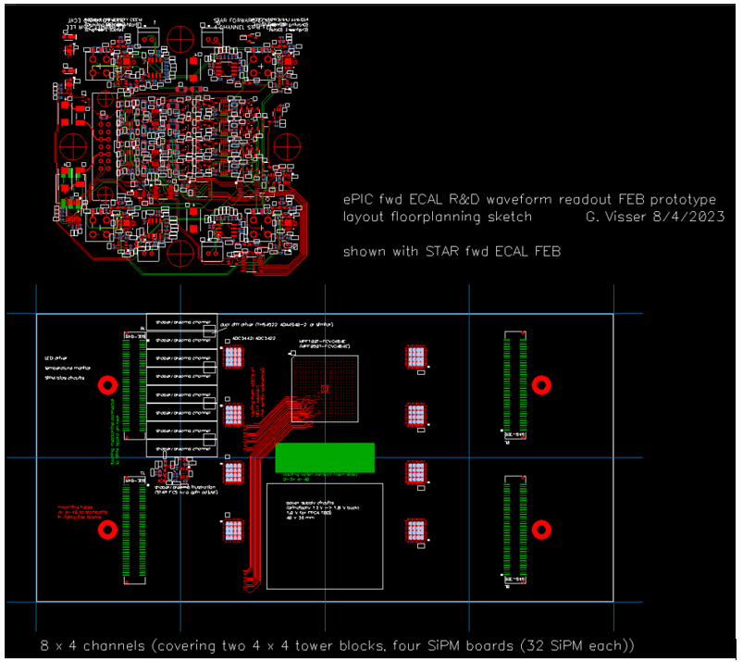
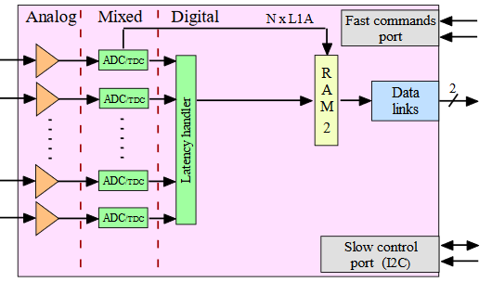
eRD109 Initiatives – Synopsis
Charge 1, 2, 3, 4
Calorimeters – SiPMs – Discrete/COTS (IU)
32 ch Waveform Digitizer
12/14-bit TI ADC3422
Microsemi MPF100T-FCVG484E Polarfire (radiation hard FPGA)
CERN DC/DC converter bPOL12V, bPOL48V or COTS
Cabling, Power, Cooling, Packaging.
Refer to talk by G. Visser
Design, Fab: FY23 –FY24
Tests + Beam: FY24 – FY25
Engineering Article: FY25
Production: FY25 – FY26
Calorimeters – SiPMs – CALOROC (OMEGA/IN2P3/ORNL)
Based on H2GCROC
1D, 72 ch.
65 nm CMOS
Charge (ADC+TOT) + Time (TOA)
Cdin: 50-1000 pF
Dynamic Range: 1-320 pC
Timing: 100-120 ps
ADC: 10b; TOT: 15b
39.4 MHz operation from BX 98.5 MHz
Links: 1260.8 Mbps @ 39.4 MHz, multiple
Power: 10-15 mW/ch
Radiation tolerant
Refer to talk by F. Dulucq
No Change
Modify trig, mem, CLK dist.
Design Backend: FY23 - FY24
CALOROCv0: FY24 – FY25
CALOROC: FY26

Slide 11
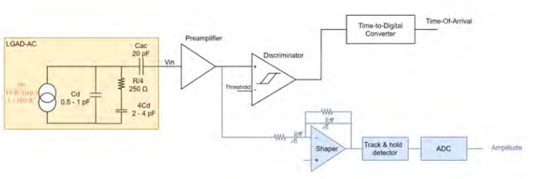
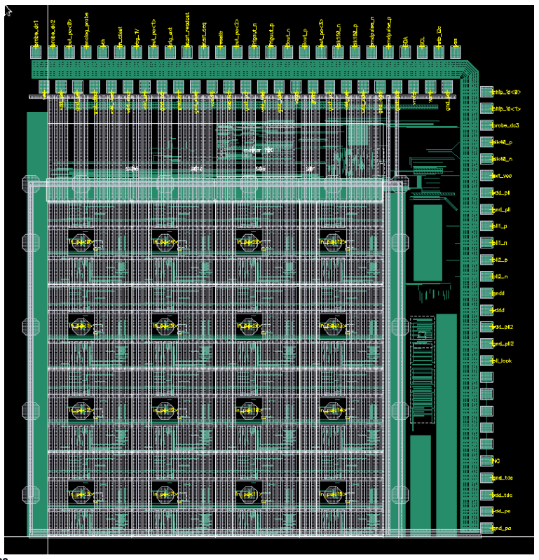
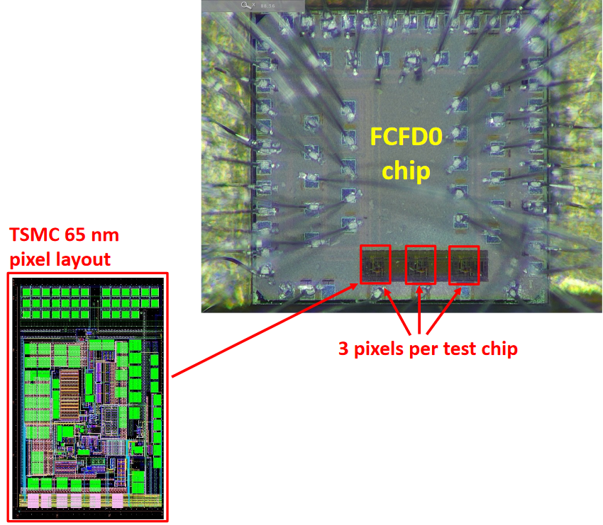
eRD109 Initiatives – Synopsis cont.
AC-LGAD pixel – EICROC (OMEGA/IN2P3/IJCLab/CEA-IRFU/AGH)
Charge 1, 2, 3, 4
One pixel – EICROC0
2D, 32x32 pixel readout
65 nm CMOS
Preamp, Discriminator, TOA, ADC
Cdin: 1-5 pF; Dynamic Range: 1-50 fC
Timing: 15-20 ps; ADC: 8b
39.4 MHz operation from BX 98.5 MHz
Links: 1260.8 Mbps @ 39.4 MHz, multiple
Power: <1 mW/ch
Packaging: Bump+Wire bonds
Radiation tolerant
Sensor
Refer to talk by C. de la Taille
EICROC0: FY23
EICROC0_v1: FY23 – FY24
EICROC1: FY24 – FY25
EICROC2: FY26
4x4 500 um pixels
AC-LGAD strip – FCFD (FNAL)
128 ch strip readout
65 nm CMOS
Constant Fraction Discriminator
Plus TDC, ADC, interfaces
Cdin: <15 pF
Dynamic Range: 5-40 fC
Timing: 10-30 ps
Links: ~Gbps, multiple
Considerable synergy with FNAL need for FCFD.
Refer to talk by A. Apresyan
FCFDv1 (6 ch): FY23 (Aug 2023)
FCFDv2: FY24 – FY25
FCFDv3: FY25

Slide 12
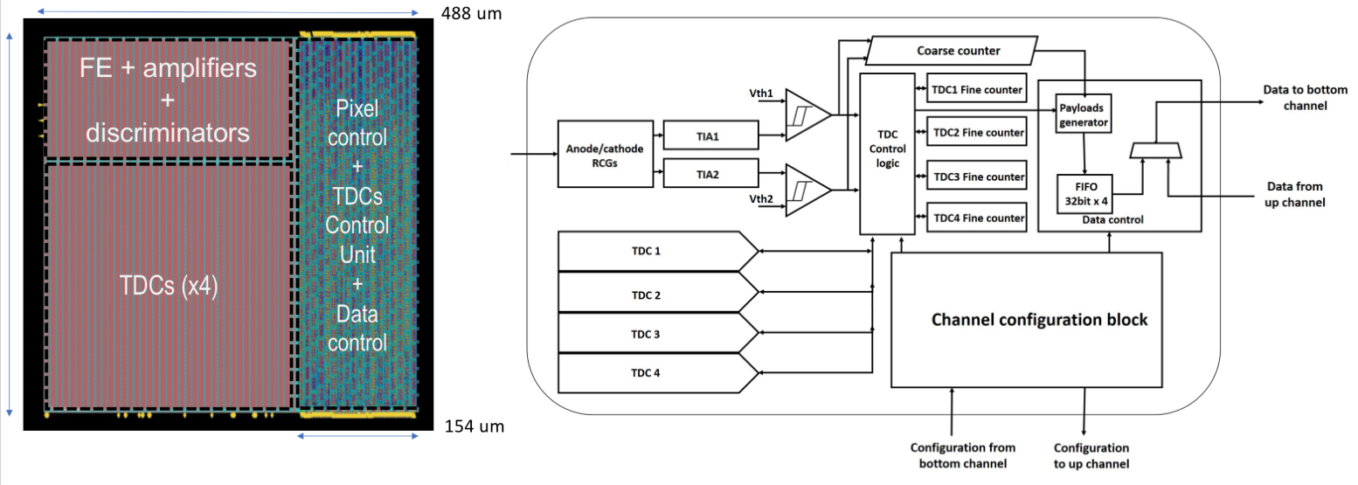
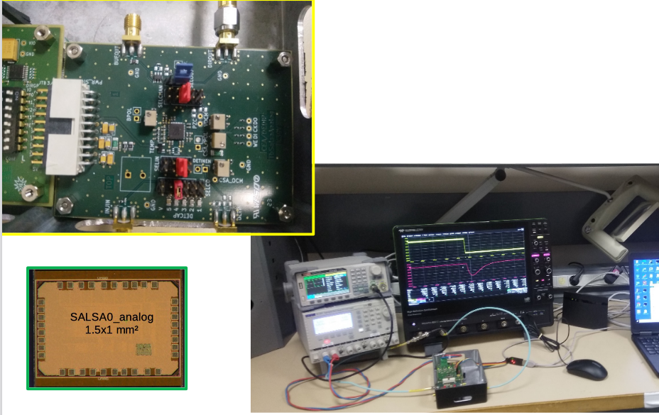
eRD109 Initiatives – Synopsis cont.
dRICH – SiPM – ALCOR (INFN – BO, TO)
Charge 1, 2, 3, 4
2D 8x8 pixel readout
110 nm CMOS
Dual polarity, RCG Amplification, conditioning, inhibit , digitization.
Modes of operation: single-photon tagging or time and charge.
Triggerless and triggered operation.
25 ps TDCs, TOA+TOT
5 MHz input
4 or 8x 640 Mbps LVDS links.
SPI configuration.
Refer to talk by F. Cossio
ALCOR v2 (32 pixel): FY23 (June 2023)
ALCOR v3: FY24 – FY26
ALCOR v4: FY26
MPGD – SALSA (CEA-Saclay, U. Sao Paulo)
64 Ch
65 nm CMOS
Peaking time: 50 – 500 ns;
Inputs: Cdin<200 pF; Dual polarity
ADC: 12 bits, 5 – 50 MSPS.
Extensive data processing capabilities
I2C configuration.
Triggerless and triggered operation;
Several 1 Gbps links.
Power: 15 mW/Ch
Refer to talk by D. Neyret
SALSA0 (IP blocks): FY23 (June 2023)
SALSA1: FY23 – FY24
SALSA2: FY24
SALSAf: FY25 – FY26
SALSA: FY26

Slide 13
Scope of the Effort
Charge 2, 3
Approximate quantities and costs.
Costs include mask sets, fabrication and packaging, wrt quantities needed.
 | #Ch | #Ch/Unit | #ASICs/Wafer | #Wafers | Node (nm) | Packaging | Cost/ch ($)
Discrete/COTS | 24 k | 32 | NA | 740 Digitizers | COTS | NA | 91*
CALOROC | 97 k | 64 | 480 | 5 | 130 | BGA | 3.2
EICROC | 5.2 M | 1,024 | 160 | 42 | 130 | Wafer Bump | 0.1
FCFD | 2.6 M | 128 | 180 | 149 | 65 | Wafer Bump | 0.5
ALCOR | 318 k | 64 | 800 | 8 | 110 | BGA | 0.9
SALSA | 202 k | 64 | 500 | 9 | 65 | BGA | 4.1
* Includes FE
Production
65 nm: $750 k masks + $3.5 k per wafer
110 nm: $190 k masks + $4 k per wafer
130 nm: $250 k masks + $4 k per wafer
Packaging BGA: $3-$7.5 per chip.
ASIC Costs Total: ~$3.3 M
Masks: ~$2.2 M; Chips: ~$1.1 M

Slide 14
Infrastructure, Standards, Grounding
Charge 1, 2, 3, 5
ASICs – Application Specific Integrated Circuits
Electronic components & PCBs – consignment/turnkey fabrication - Qty. < 1,000.
Cabling – Turnkey fabrication of cables and optical fibers (COTS) - Qty. > 1,000.
Power Supplies – Multi-channel, Low Noise, Floating, Modules:
Low Voltage (LV) - < 15 VDC, 5 A – 10A range per channel. Qty. < 1,000.
Bias - < 100 VDC, mA range per channel. Qty. < 10,000.
High Voltage (HV) - < 8 kV, mA range per channel. Qty. < 1,000.
Racks and Cooling – COTS. Qty. < 100.
Environment 21°C ± 2°C, RH <50%.
Grounding In detector interaction region area by bonding of segregated loads via multiple, low inductance conductors to existing infrastructure.
Cabling NEC 2011 NFPA 70, UL CL2 or better.
Cable Routing NECA/NEMA 105-2007. Open cable tray systems.
EMI & RFI FCC part 15, Class B, CISPR 11/EN55011 Class B, CISPR 22/EN 55022 Class B and EN 61000-6-3, or equivalent.
Power Supplies Floating and referenced at the detector ground.
Racks Open frame, COTS with cable managers.
NOTE: Exceptions or non-conformance to these standards must be approved prior to installation.

Slide 15
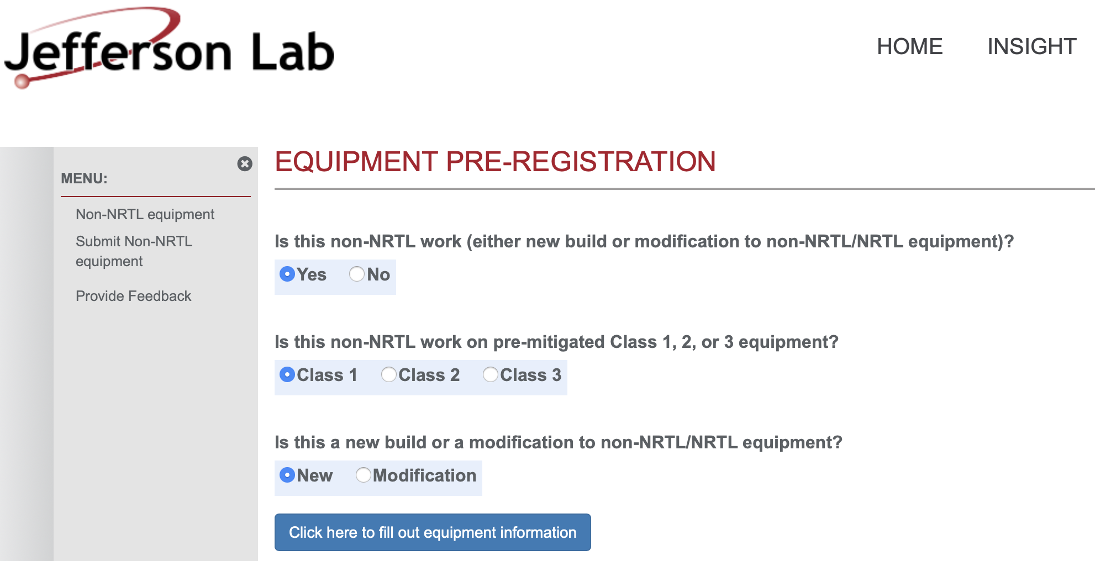

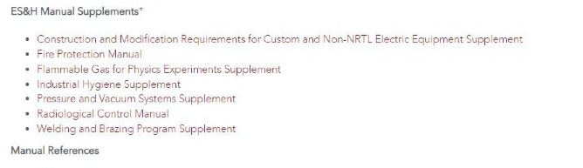
ESH&Q
Charge 5
BNL and JLAB have ESH&Q processes for Non-NRTL Electronics
Custom electronics built by collaborators for use in experiments at JLAb must go through a registration process first.
This is any equipment that is NOT certified by a Nationally Recognized Test Lab (NRTL) like UL and recognized by OSHA.
The JLAB EHS&Q Manual has a supplement guide for construction and/or modification of any custom or non-NRTL equipment.

Slide 16
QA/QC
Charge 2, 3, 5
Addressed at several levels
ASICs:
Wafer – by standard fab
Die – by fab & developer, sample
Packaged devices (wafer bump, BGA) – by developer and institutions, full production
Procurement specified:
PCBs - fab & assembly
Bare board tests – by sub-contractors
Flying probe, bed-of-nails (electrical nets) – by sub-contractors
Assembled units:
Production – functional, by institutions
Limited Integration – full functional, by institutions
System:
Pre-installation integrated – full functional, by institutions

Slide 17
Resources – Design, Development, Construction
Charge 2, 3, 4
Detector System |  | Channels | SensorTechnology | Redout Technology | Institution
Si Tracking
 | 3 vertex layers | 7 m^2 | MAPS | lpGBT, VTRX+ | STFC, UK, ORNL
 | 2 sagitta layers | 368 pixels | MAPS | lpGBT, VTRX+ | STFC, UK, ORNL
 | 5 backward disks | 5,200 MAPS sensors | MAPS | lpGBT, VTRX+ | STFC, UK, ORNL
 | 5 forward disks |  | MAPS | lpGBT, VTRX+ | STFC, UK, ORNL
MPGD Tracking
 | Barrel, e & H Endcaps | 202 k | uRWELL, MicroMegas | SALSA | CEA, OMEGA, JLab
Forward Calorimeters
 | LFHCAL | 63,280 | SiPM | CALOROC | ORNL, Debrecen
 | HCAL Insert | 8 k | SiPM | CALOROC | ORNL, Debrecen
 | pECAL W/SciFi | 16,000 | SiPM | Discrete | IU
Barrel Calorimeters
 | HCAL | 7,680 | SiPM | CALOROC | ORNL, Debrecen
 | ECAL SciFi/Pb | 5,760 | SiPM | CALOROC | U Regina, ORNL
 | ECAL Imaging Si ASTROPIX | 500 M pixels | Astropix |  | KIT,NASA (GSFC), ANL
Backward Calorimeters
 | nHCAL | 3,256 | SiPM | CALOROC | ORNL
 | ECAL (PWO) | 2,852 | SiPM | Discrete | IU, EEEMCAL Consortium
Far Forward
 | B0: 3 Crystal Calorimeter | 135 | SiPM/APD | Discrete | IU, JLab
 | B0: 4 AC-LGAD layers | 688,128 | AC-LGAD Pixel | EICROC | IJCLab, OMEGA, BNL, ORNL, Rice
 | 2 Roman Pots (RP) | 524,288 | AC-LGAD Pixel | EICROC | IJCLab, OMEGA, BNL, ORNL, Rice
 | 2 Off Momentum (OMD) | 294,912 | AC-LGAD Pixel | EICROC | IJCLab, OMEGA, BNL, ORNL, Rice
 | ZDC: Crystal Calorimeter | 900 | SiPM/APD | Discrete | IU, JLab
 | ZDC: HCAL | 9,216 | SiPM | CALOROC | ORNL, Debrecen, JLab
Far Backward
 | Low Q Tagger 1 | 33,030,144 | Timepix4 |  | U. Glasgow
 | Low Q Tagger 2 | 33,030,144 | Timepix4 |  | U. Glasgow
 | Low Q Tagger 1+2 Cal | 420 (2x210) | SiPM | CALOROC | U. York
 | 2 Lumi PS Calorimeter | 3,360 (2x1680) | SiPM | Discrete | U. York
 | 2 Lumi PS Tracker | 128,000 (2x64,000) | AC-LGAD Strip | FCFD/EICROCx | FNAL, OMEGA, Hiroshima, NTU, ORNL, UIC, UH, Rice, KSU, Tokyo
 | Lumi Direct Photon Calorimeter | 100 | SiPM | Flash250 | AGH Krakow, JLab
PID-TOF
 | Barrel bTOF | 2,359,296 | AC-LGAD Strip | FCFD/EICROCx | FNAL, OMEGA, Hiroshima, NTU, ORNL, UIC, Rice, BNL, KSU, Tokyo
 | Hadron Endcap fTOF | 3,719,168 | AC-LGAD Pixel | EICROC | IJCLab, OMEGA, BNL, ORNL, Rice
PID-Cherenkov
 | dRICH | 317,952 | SiPM | ALCOR, VTRX+ | INFN (BO, FE, TO)
 | pfRICH | 69,632 | HRPPD | FCFD/EICROCx | BNL, FNAL, JLab
 | hpDIRC | 73,728 | MCP-PMT or HRPPD | FCFD/EICROCx | BNL, FNAL, JLab
Institutions – expressions of Interest.
BNL, JLab – Support as needed.
Covering Adapters, FEBs, RDOs, GTUs, DAMs.

Slide 18
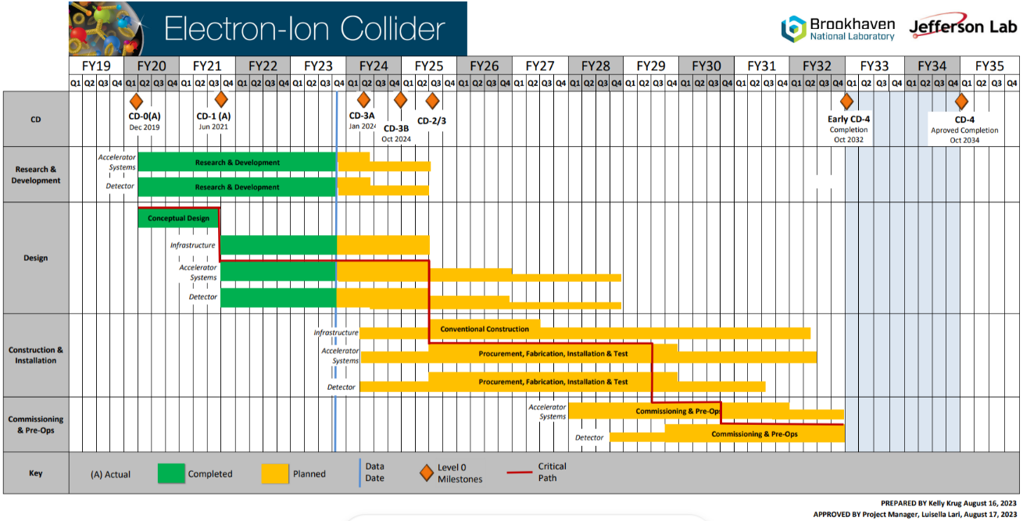
Timeline - Project
Charge 3, 4
Construction and Installation includes procurements and deliveries and are initiated at different times of this phase.
eRD109 until mid FY27
ASIC Production mostly in FY26
R&D
Engineering Articles
Design until 9/2028
Construction
4/2025 to 4/2031
Bulk of Construction & Installation phase for Electronics: April 2025 – October 2029.
Installation of some items may be extended to April 2031.

Slide 19
Timeline cont. - Development
Charge 3, 4
Example of development (not to scale)
Construction
FY23 through mid-FY27
ASIC Development (eRD109)
FY26 – 1 Year
ASIC Fab Production & Testing
6 Months
ASIC Testing
Eng. Article Development
Eng. Article Tests
Installation
<1 Year
PCB Production
<1 Year
First Production ASICs
Production Tests
<3 Months
Integration Tests
<3 Months
R&D
System Tests
Design

Slide 20
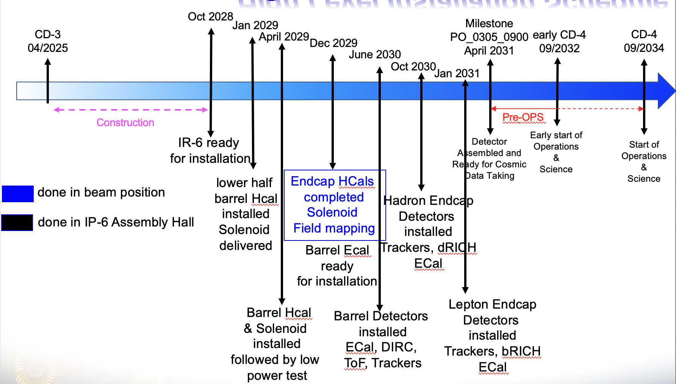
Timeline cont. - Installation
Charge 3
eRD102 | eRD109 | R&D Milestones | Production QA/QC Complete
Calorimeters | Discrete, CALOROC | 30 September 2025 | Mar 2028 – Jan 2030
AC-LGAD | EICROC, FCFD | 30 September 2025 | Nov 2027 – Jan 2029
dRICH | ALCOR | 2 January 2026 | Nov 2028
MPGD | SALSA | 31 March 2026 | Sep 2028 – Jun 2029
LAPPD/MCPMT | FCFD/EICROCx | 23 December 2026 | Sep 2028 – Jan 2029
Installation
Jan 2029 – Jan 2031
eRD102 – Electronics for detectors R&D.
eRD109 – Readout R&D.
R&D Milestones – ASICs ready for production.
ASIC Production FY26.
Production QA/QC Complete – Ready for integration.
FY23 – FY26
FY26
R&D (eRD109)
ASIC Production
11/2027 – 1/2029
FY26 – FY29
Readout Production & QC
QC Complete

Slide 21
Recommendations from PDR 1 - #1
Charge 1, 2, 3
The collaboration should investigate the potential for high data rates from the RICH detectors, which could significantly impact the concept and feasibility of a streaming detector readout.
We understand that the data rate is dominated by SiPM DCR.
The DCR is in turn dependent on the operating temperature and radiation damage of the sensors. These effects can be mitigated by:
1) Implementing a time shutter in the ALCOR ASIC (refer to talk by Fabio Cossio)
2) Annealing in-situ (refer to talk by Pietro Antonioli).
The DCR is 3 kHz/SiPM at the beginning of operation and 300 kHz/SiPM after irradiation.

Slide 22
Recommendations from PDR 1 cont. - #2
Charge 1, 2, 3
Given the requirement for a backup triggered readout for RICH, it is necessary to carefully define the physics trigger rate, trigger conditions, and trigger latency in order to facilitate design of the RICH front-end.
ePIC depends upon a flexible scheme in which sufficient bandwidth is available for data to the dRICH DAM in the worst case. (> 4x safety). The selecting detectors (ex FWD HCAL) generate information characterizing beam in O(10us). The decision is made by the GTU and returned to DAM boards with fixed latency. The maximum latency is orders of magnitudes less than available buffering in DAM board memory. A hardware trigger is supported by the GTU but uses the same dRICH buffering scheme and delays as the firmware trigger option.
FWD HCAL RDO
FWD HCAL RDO
FWD HCAL RDO
FWD HCAL RDO
FWD HCAL RDO
FWD HCAL RDO
FWD HCAL RDO
dRICH
RDO
RDO_DATA
48
48
48
48
48
48
FWD HCAL DAM
dRICH DAM
FWD HCAL DAM
dRICH DAM
FWD HCAL DAM
dRICH DAM
Activitiy | Notes
Data Arrives at DAM | <=10us from Bunch Crossing
Data Evaluation (DAM) | 100ns
TRG_STATUS to GTU | Data transmitted to GTU after fixed delay from source crossing O(10us)
Trigger Evaluation on GTU | Fixed Latency O(100ns)
Keep/Drop Bit to DAM | Fixed Latency O(40ns)
Drop data / forward data | Drop Forward after fixed time O(11us)
DAM Buffer | 16GB
Buffer Time available | 2.6 seconds
TRG_STATUS
64 bits
Bunch Data
Fixed delay O(10us)
DAM_CTRL
3
(Keep/Drop
Bunch bit)
30
GTU
Fixed delay O(10us)
Hardware Trigger Option
Ex: Hcal generates trigger
dRICH is triggered

Slide 23
Summary
ePIC is actively developing a streaming readout architecture, benefiting from resources within its large collaboration and to meet the physics goals of the EIC.
Developing the readout electronics by building upon previous developments, with design re-use as a guiding principle:
Readout and technology solutions have been defined and are being implemented
Continuously refining detector requirements and services to inform electronics specifications towards final implementations.
Defined requirements in agreement with US codes and safety norms.
Design maturity targeting CD-2 and CD-3 readiness.
Readout development timelines are within the R&D projected schedules. We must remain vigilant, however, especially with ASIC and Si solutions due to their risk potential to the project.
Developments are within the R&D, design, construction and installation schedules. Costs are also well understood.

Slide 24
Backup Material

Slide 25
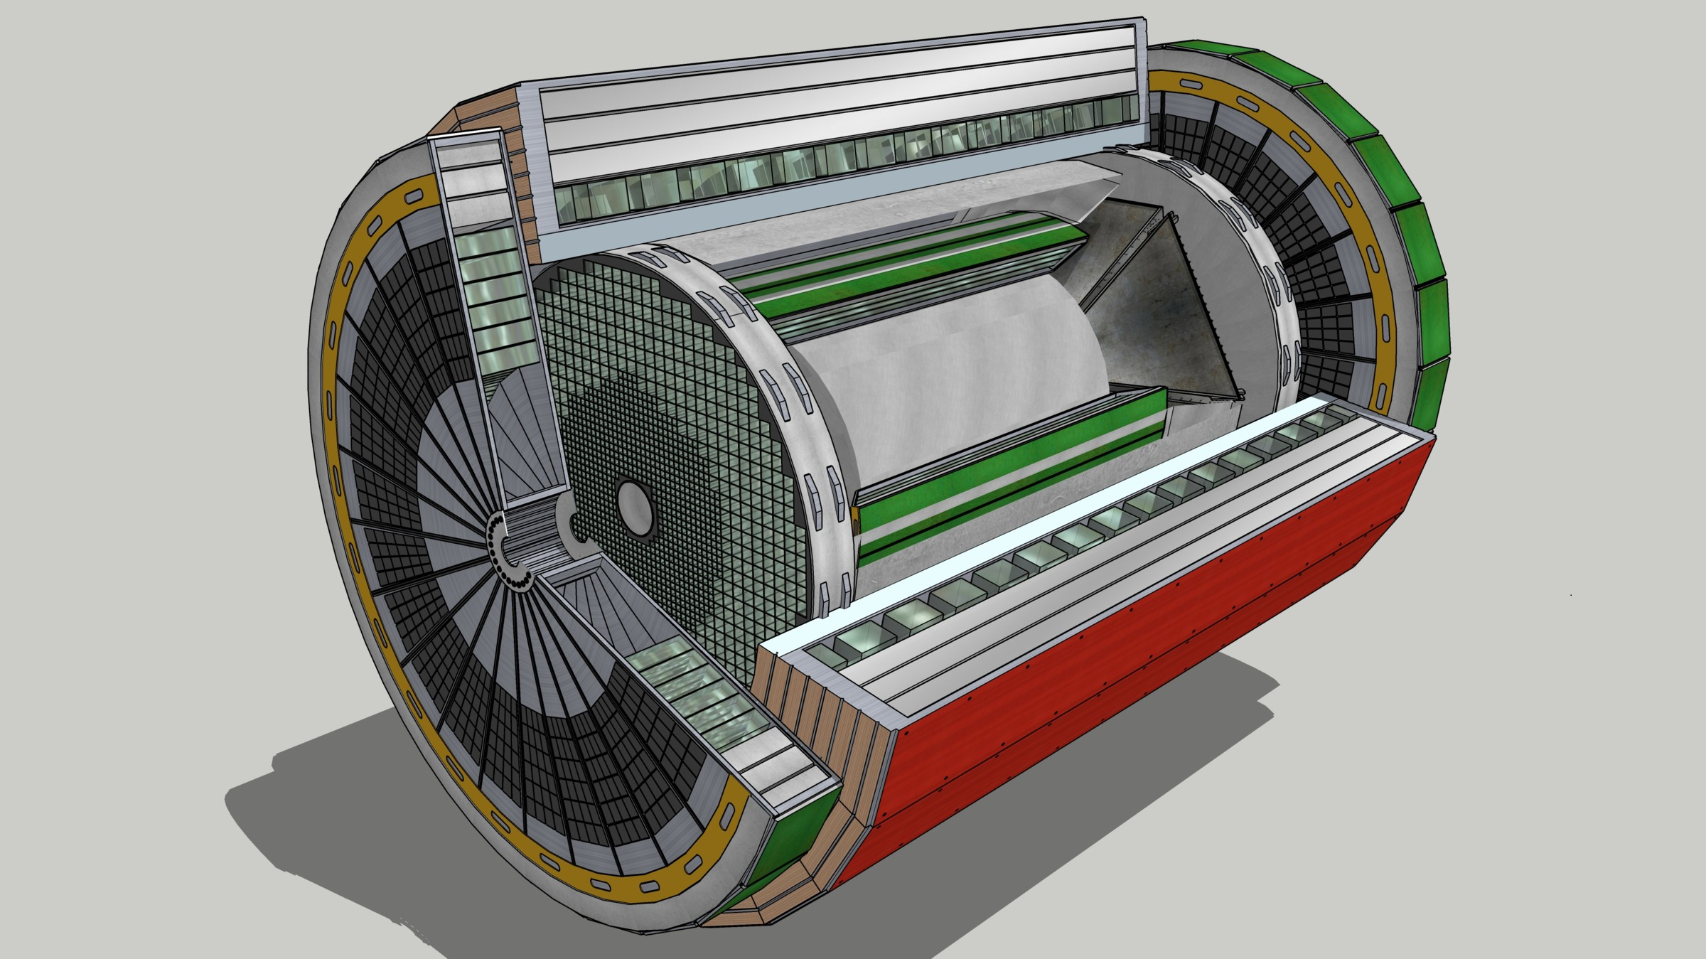
Streaming Readout - Architecture
Standardized Nomenclature
Front-End Electronics
DAQ
Charge 1
Detector
FEB
(Front End Board)
RDO
(Readout Board)
DAM + Computing (Data Aggregation Module)
Total
BW: O(100 Tbps)
BW: O(10 Tbps)
Bunch Crossing ~ 10.2 ns/98.5 MHz
Event Rate ~ 2 us/500 kHz
Low occupancy.
L ~ 100 m
fiber
Jitter ~ 5 ps
ASIC
Goal: O(100 Gbps)
Fiber
Switch / Server / Link-Exchange: Readout
Switch / Server: Processing
Switch / Server: Buffer
FEB
Storage
FPGA
Fiber
Monitoring
RDO
FEB
LVDS ~ 20-30 m*
Analog ~ 20m
Power Supply System
(HV, LV, Bias)
Cooling Systems
Data
Configuration & Control
Power
*LVDS – ANSI/TIA/EIA-644A standard. Maximum cable length dependent on data rate.

Slide 26
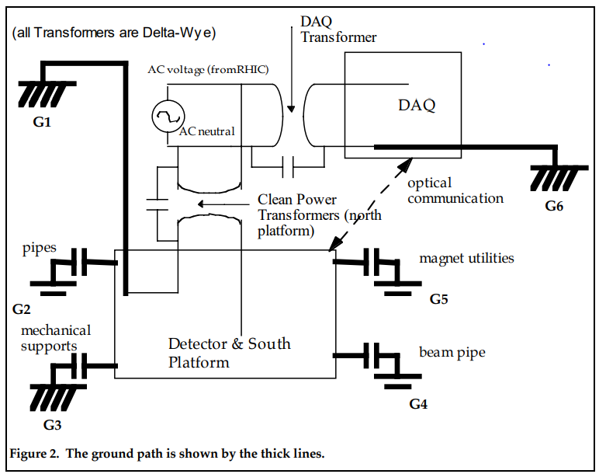
EIC – Electronics Needs, Infrastructure, Standards, Grounding
Charge 1
Power Supply & Cooling Systems
Use COTS units – Wiener, CAEN, …
Grounding & Shielding
Builds upon the STAR installation, uses floating supplies referenced to ground at the detector for low noise and good signal integrity plus ground fault monitor.
Grounding
Column in IR
Grounding in
DAQ House
Low Impedance connection via 6, 4/0 cables.
*Minimize capacitive coupling (G2 – G5).
STAR Note 202A, H. Matis, D. Jared

