Slide 1
ePIC DAQ/Computing - Overview
David Abbott (JLAB) & Jeff Landgraf (BNL)
L3 CAMs
WBS 6.10.09 Data Acquisition (DAQ)
ePIC DAQ/Electronics
Preliminary Design Review
June 10-11, 2024

Slide 2
Charge Questions
Are the technical performance requirements appropriately defined and complete for this stage of the project?
Are the plans for the various detector electronics and data acquisition systems appropriately documented and complete for this stage of the project?
Are the current plans from front-end electronics to data acquisition for the detector likely to achieve the technical performance requirements, with a low risk for cost increases, schedule delays, and technical problems?
Are the schedule assumptions for the fabrication of the various electronics and data acquisition systems and assembly plans reasonable and consistent with the overall detector schedule?
Have ESH&Q and QA considerations been adequately incorporated into the plans at their present stage?

Slide 3
Outline
Documentation status
The readout technology and scale of the EPIC DAQ
  Collider environment
  Readout Technologies
  Streaming architecture
  System components and operational concepts
  Component counts & expected data flow
  Fiber protocol and operation
(Fernando Barbosa)
Electronics
(David Abbott)
DAQ Architecture and component Status
DAQ and Computing related tasks for 2024
  Evaluating and defining timing and data protocol
  Development of RDOs
  FELIX boards
Scientific computing Interface
Echelon 0 (DAQ Computing)
Schedule
QA and ES&H
Summary

Slide 4
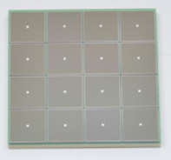
ePIC Readout Chain
Global Timing Unit (GTU)
-Interfaces to Collider, Run Control & DAM
-Config & Control
-Clock & Timing
DAQ/Computing
Project
Work Breakdown Structure (WBS) Focus
On Detector
SMT BGA
Echelon 1
Computing
Name
Design
Function
Attributes
Sensor
Detector Specific
Multi-Channel Sensor
MAPS, AC-LGAD
MPGD, MCP-PMT
SiPM, LAPPD
Adapter
Detector Specific
-HV/Bias Distribution
-HV divider
-Interconnect Routing
-Sensor Specific
-Passive
Front End Board
(FEB)
Detector Specific
-Amplification
-Shaping
-Digitization
-Zero Suppression
-Bias Control & Monitoring
-ASIC/ADC
-Discrete
-Serial Link
Readout Board
(RDO)
Few Variants
-Communication
-Aggregation
-Formatting
-Data Readout
-Config & Control
-Clock & Timing
-FPGA
-Fiber Link
Data Aggregation Module (DAM)
Common
-Computing Interface
-Aggregation
-Software Trigger
-Config & Control
-Clock & Timing
-Large FPGA
-PCIe
-Ethernet
Computing
Common
-Data Buffering and Sinking
-Calibration Support
-QA/Scalers
-Collider Feedback
-Event ID/Building
-Software Trigger
-Monitoring
-COTS
-Ethernet

Slide 5
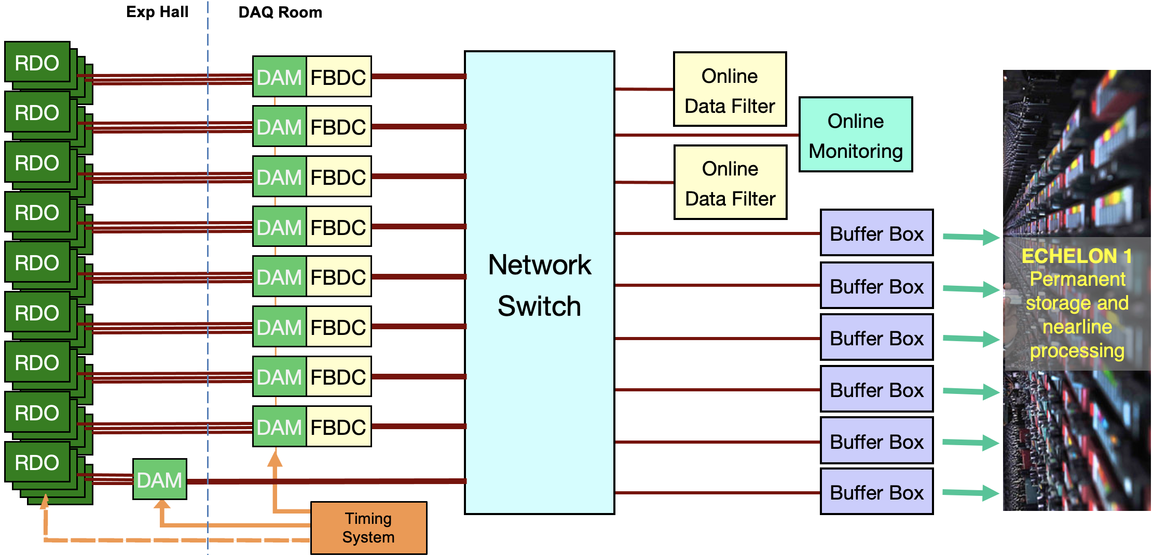
EIC Streaming DAQ/Computing Architecture
Bunch Crossing ~ 10.2 ns/98.5 MHz
Interaction Rate ~ 2 us/500 kHz
Low occupancy
BW O(100Tbps)
ePIC DETECTOR
BW O(10Tbps)
BW O(100Gbps)
GTU/Distributed clock
(jitter ~5ps)

Slide 6
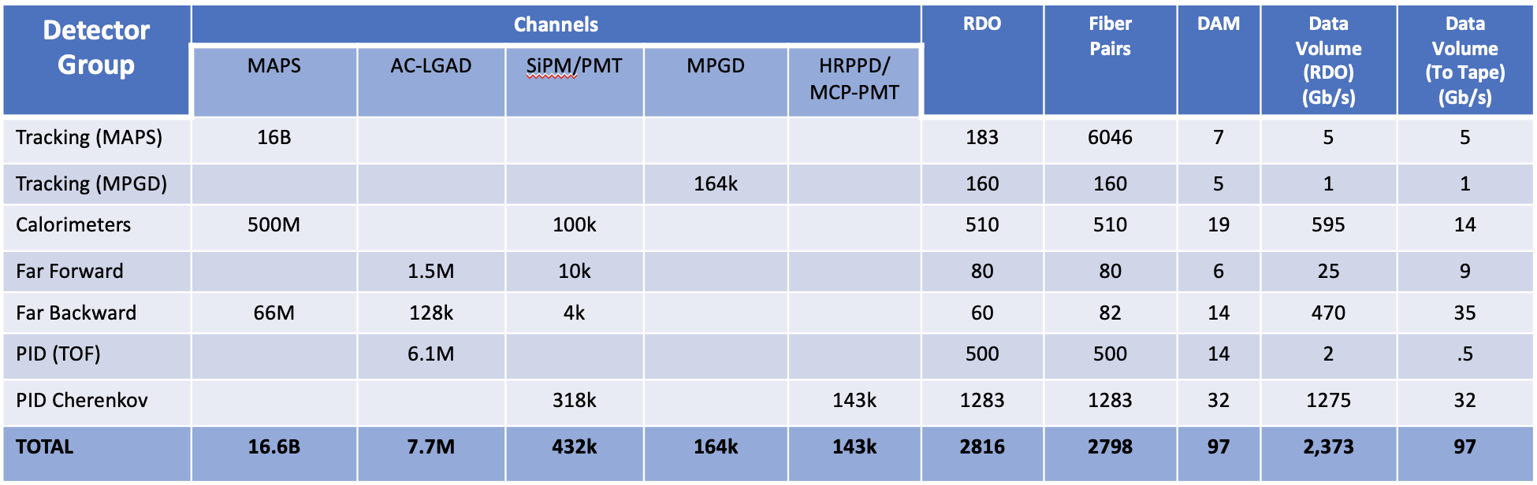
Summary of ePIC Channel Counts and Data Flow
Charge 1
ePIC Detector
24 sub-systems
General Strategy
  Supply enough bandwidth to account for maximum data volume to the DAM boards
  Apply cross-detector correlation filters with other sub-systems in the Online Farm and Readout computers including AI/ML techniques to reduce recorded data volume
  Optional “Interaction Tagger” implemented in DAM firmware to support background suppression.
Summary of Data Flow
Detector
FEB
Copper
RDO
Fiber
DAM
PCI/Eth
Readout Computer
Eth
100% Occupancy | 27.5-1760 Pb/sec
Aggregate | ~100 Gb/sec
Collision Signal | 42 Gb/sec
Synchrotron Rad | Under design
Electron Beam | 4.5 Gb/sec
Hadron Beam | 1 Gb/sec
Noise | 40 Gb/sec
Aggregate | 2.3 Tb/sec
Noise | 1.6 Tb /sec
Signal from Physics + Background | 700 Gb / sec
Aggregate | 2.3 Tb/sec
Per RDO (Avg) | 0.8 Gb/sec

Slide 7
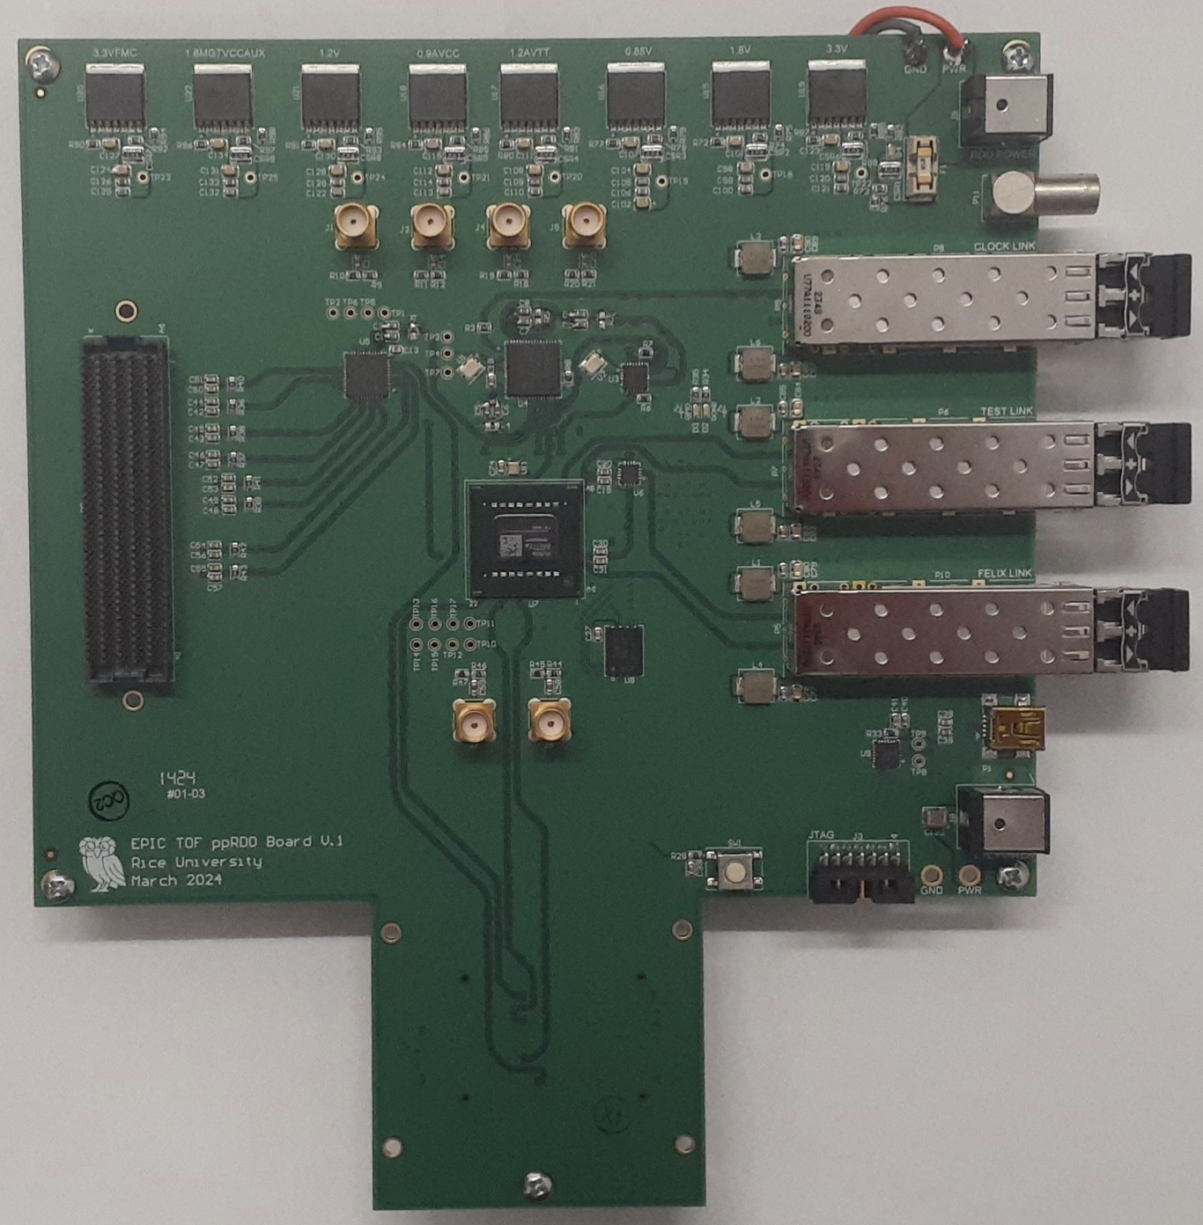
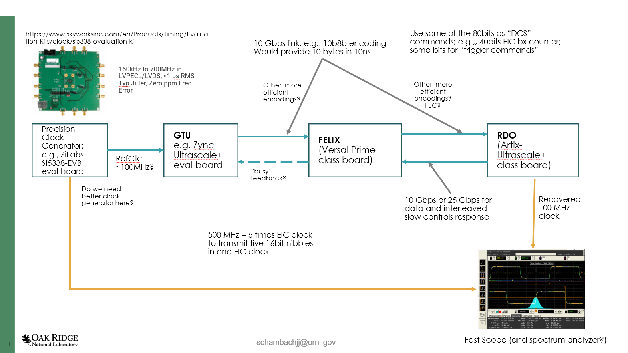
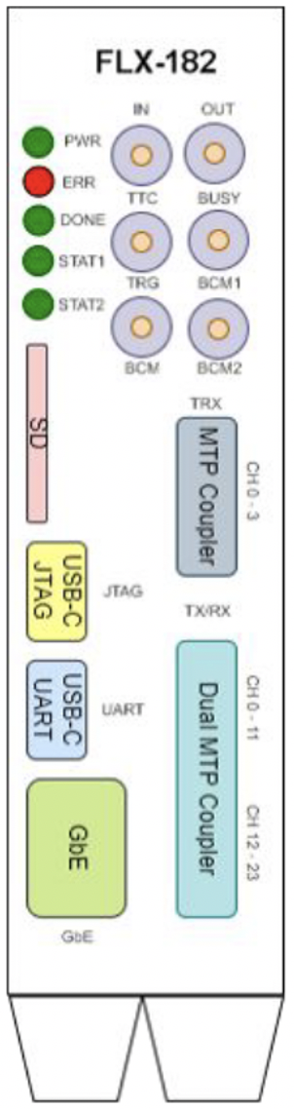
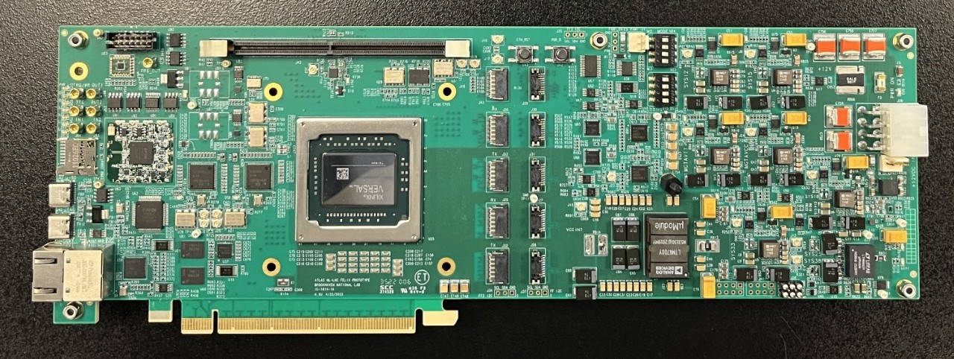
DAQ System Components
Charge 1
RDO Status:
Pre-prototype now available for timing studies and firmware development
Nominal 2.5” x 2.5” for common elements + connector space
FPGA defined by price (Artix Ultrascale+ Class)
Power 3-5 Watts. 2 LV +5V for optical interfaces, lower for FPGA/digital components
Accept 2 or 3 fibers for potential very low jitter timing
Full component production starts with CD3.
The current status is that we are evaluating system design and interfaces between components.
Optical Protocol
Defines the communications and data flow between the GTU, RDOs, and DAM boards
Optical protocol requirements
  Timing (<=5ps Hi-Res Detectors)
  Timing (<=100ps Lo-Res Detectors)
  Timing phase stability on power cycle/reset
  Configuration and slow control monitoring passthrough for ASICS/FEBs
  Real-Time Command / Control
  Data Transfer (2.5 - 16Gb/s per RDO)
Optical protocol under evaluation for ePIC
  GTU<->DAM<->RDO
  Simple custom protocol
  Dedicated or Reconstructed Clock
  4 fibers GTU<->DAM link and 2 or 3 fibers per RDO
GTU status:
Mocking up with dev-kits for initial studies
Interface to collider (Bunch crossing clock, Spin Patterns per bunch crossing)
Distribution of timing to ~150 DAMs + ~220 RDOs for Hi-Res Timing Detectors
User command interface & distribution
Interface to Run Control
DAM Status:
2 FELIX engineering articles obtained (Model FLX-182)
Xilinx Versal FPGA
PCIe Gen4 x16 or 100Gb Ethernet output
24 Firefly links up to 25Gb/s options
Additional front panel I/O

Slide 8
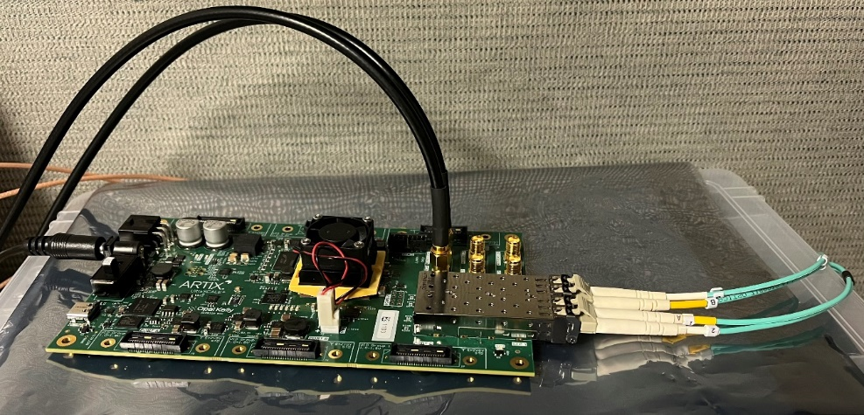
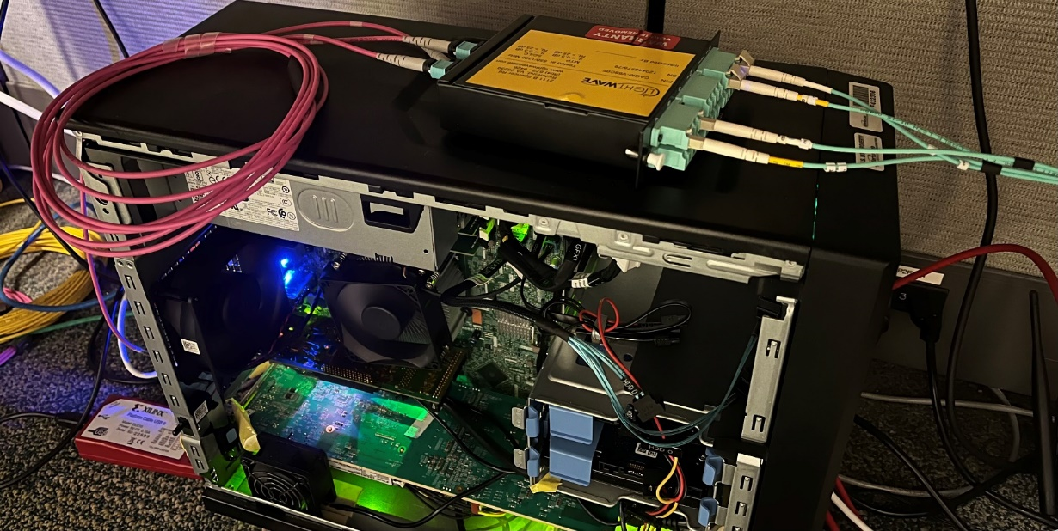
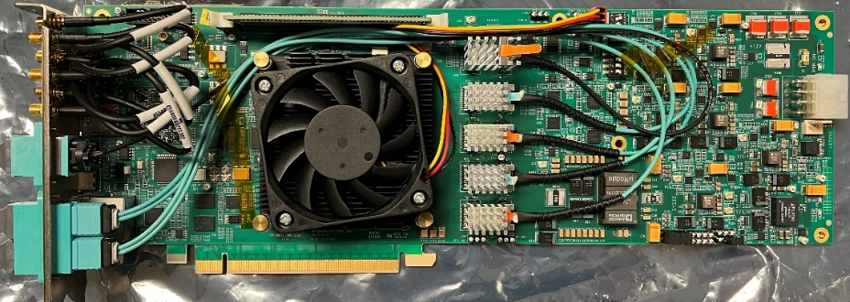
DAQ/Computing Activity in 2024
Charge 3
Finishing timing studies (see William Gu’s talk)
  Define clock/command distribution protocol
  (manage jitter and phase drift)
  Refine requirements for the GTU
  (scale of the distribution, interface to DAM)
Finalize requirements for FELIX development to define EIC DAM Board.
  Collaborating with ATLAS OMEGA group at BNL
Refine expected RDO counts and flavors for all detector sub-systems and
  Required interfaces with FEB electronics (ASICS, VTRX+, FADC).
  Better estimates of backgrounds and data volumes.
All for development of the TDR and the CD2 baseline.
XEM8320,
Artix Ultrascale+
(RDO)
FLX 182 board
Used for timing studies and
DAM firm/software development

Slide 9
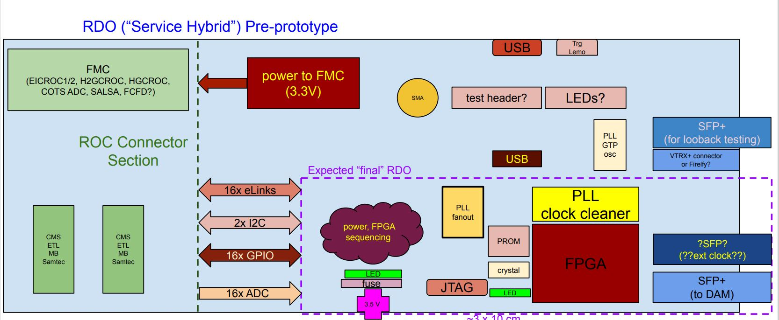
RDO development – General plans
Charge 3
The Readout Board (RDO) is the first processing interface of the DAQ with the front-end electronics/digitizers.
There are currently 6 identified “flavors” of RDO - dependent on the detector subsystems (see Pietro’s for dRICH example)
It must support both a common DAQ communication protocol as well as manage configuration and control with the different front-ends
A pre-prototype board has been produced to support early DAQ and detector development (See Tonko’s talk for more details)
ppRDO
Readout Board Flavors
Detector | Characteristics
TOF | Highest Timing Requirement (Generic)
dRICH | Small Footprint (VTRX+ optics)
ITS-3 | Detector side uses fiber (VTRX+)
Imaging Calorimeter | Integrated with ASTROPIX Sensor
Low Q Tracker | High Rates, 20 TX fibers expected / RDO
Direct Photon Calorimeter | Pure 200MHz Streaming (bypass DAQ protocol)

Slide 10
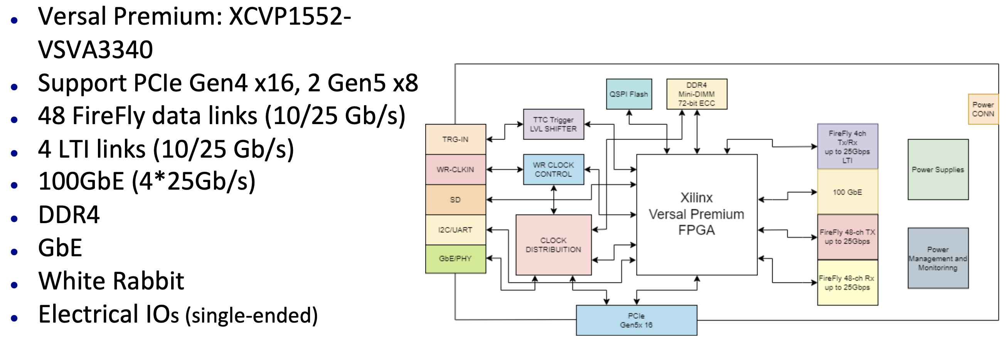
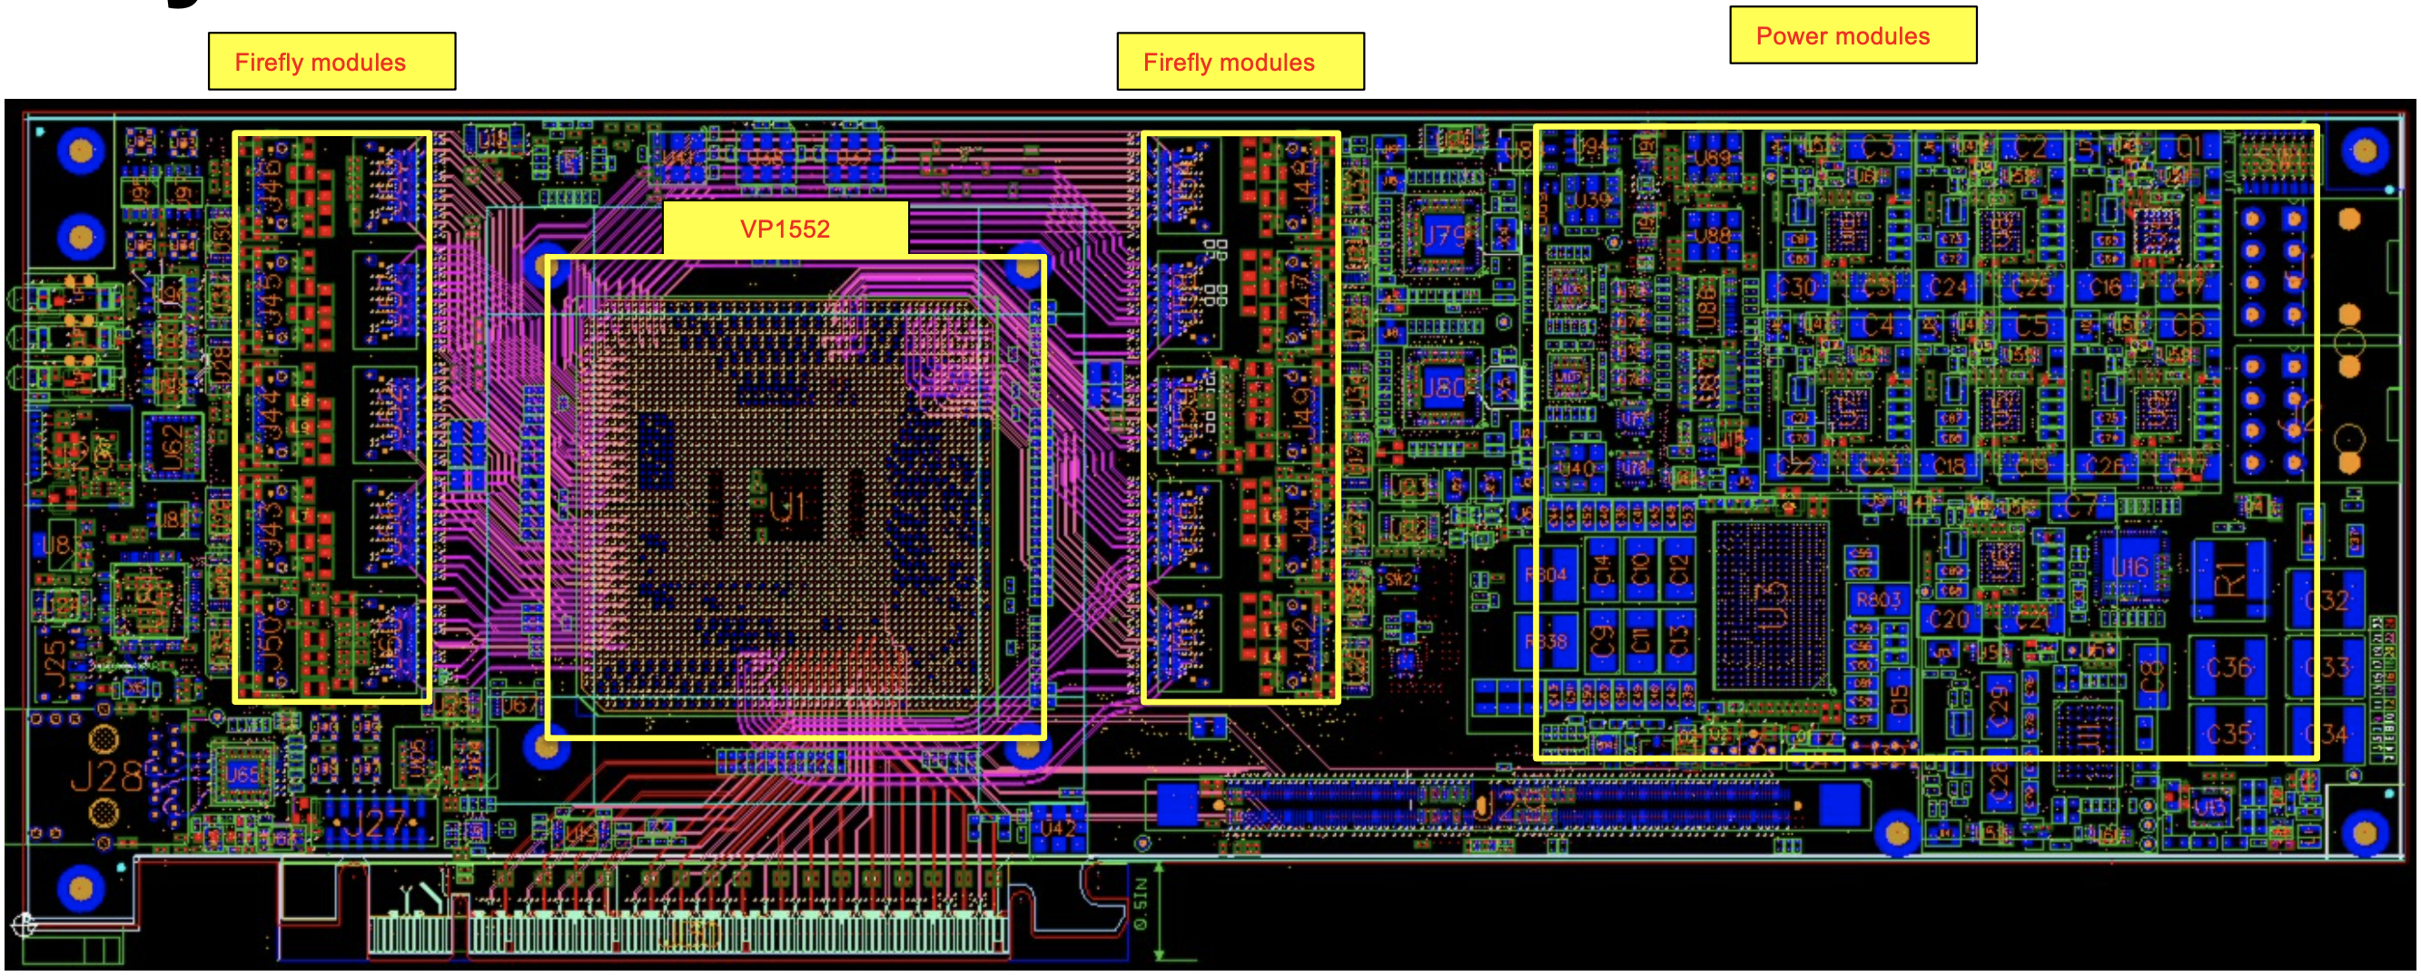
FELIX Updates – FLX-155
Charge 3,4
FELIX (Front-End Link Exchange) hardware for future ATLAS experiments at HL-LHC is being developed at BNL (Omega Group)
  Long term support is insured. Development timelines are compatible with EIC.
  ePIC is collaborating with Omega to use this design as our DAM board.
Latest (FLX-155) design review completed by ATLAS and AMD
  It has been sent out for fabrication. PCBs available by July.
First 4 populated boards expected by late August/early September
  We expect to receive at least one board by the end of this year
Note: 4 fiber LTI Link supports receiving either reconstructed or a direct clock
Versal FPGA is a SoC (Dual Core ARM) and can operate either standalone or in a Server

Slide 11
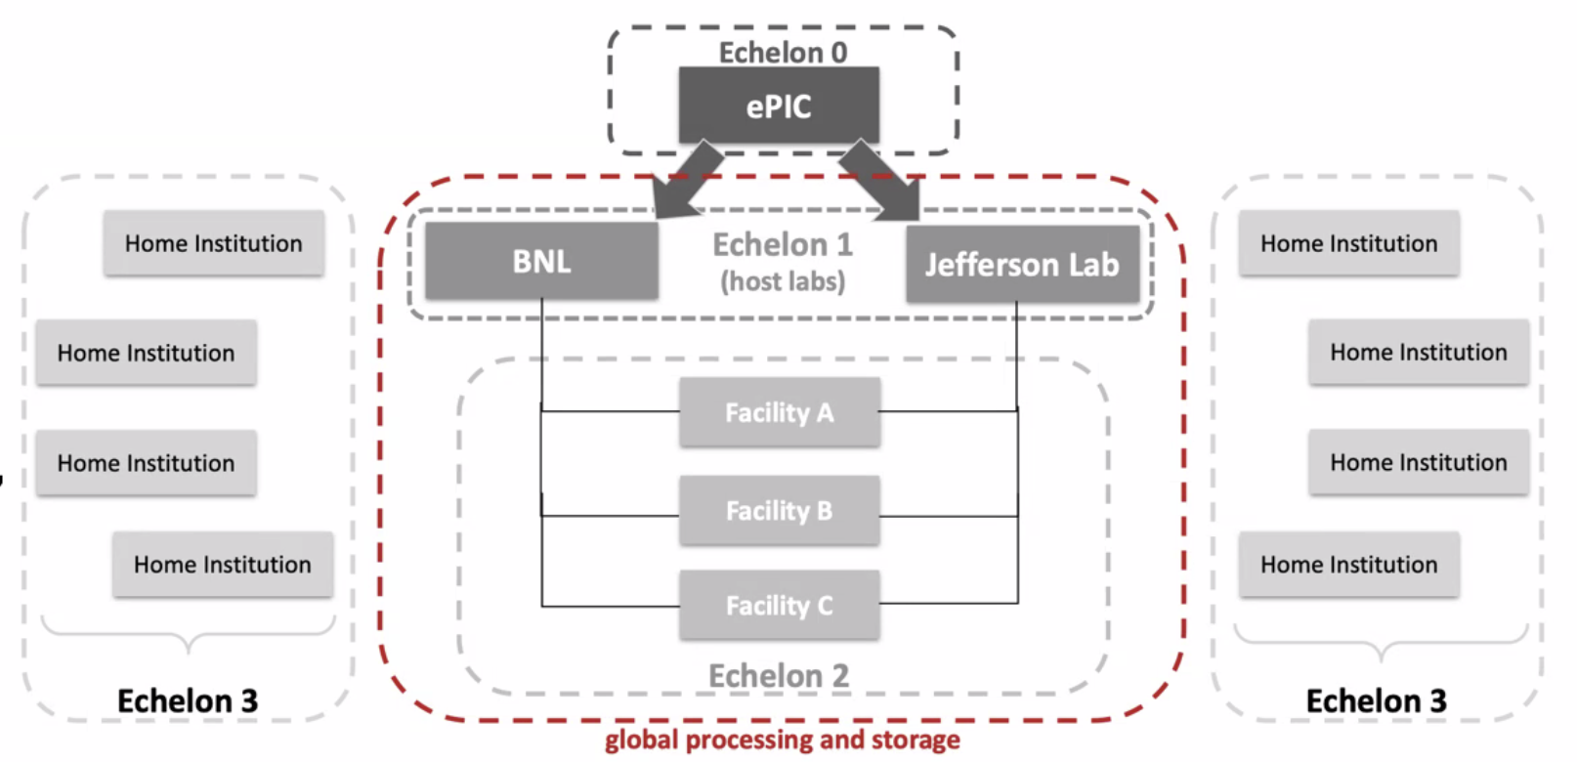
Boundary between Online and Offline
The streaming architecture allows for some blurring of the offline and online processing with respect to calibrations, QA monitoring, and potential seed analysis to improve reconstruction turn around. These aspects are not yet fully specified.
Require an interface to allow sharing of code between offline / online processing
Local buffering (Echelon 0) provides elasticity in the transfer of data to computing facilities
Offline buffering (Echelon 1) will allow several weeks for calibration and reconstruction.
ePIC Scientific Computing
Is a dependency for the project handled in conjunction with host labs.
The Resource Review Board (RRB) looks at the international detector and computing resources.
The ePIC computing groups are actively implementing scientific software as well as working with the DAQ to define the interface with the streaming DAQ system.

Slide 12
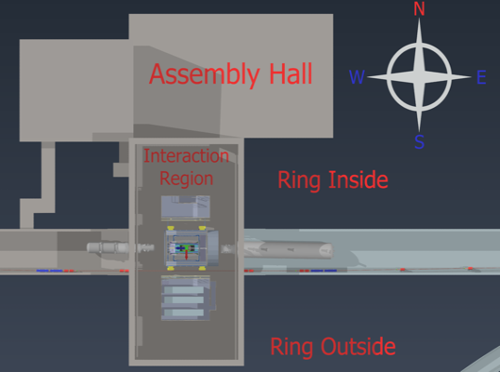
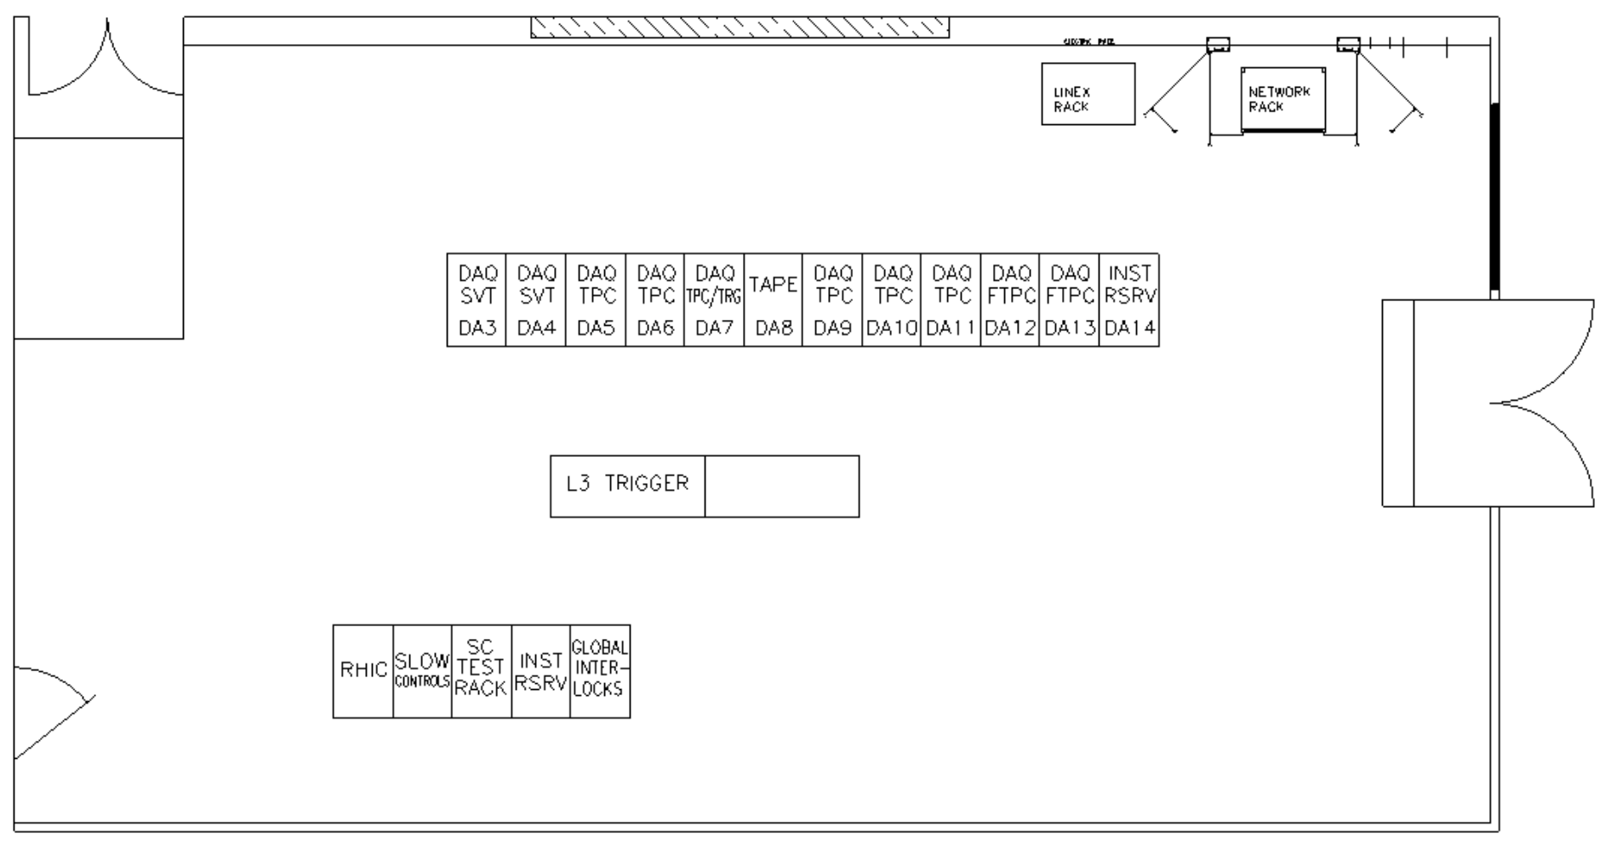
Scale of Echelon 0 DAQ/Computing
Current estimates in P6 provide for roughly 20 racks/cabinets
  200+ nodes
  ~6000+ fibers from the hall (~150m)
  ~120 DAM Servers
Expected total power requirements are between 300-350kW
Current power infrastructure for the DAQ Room is sufficient, however cooling efficiency should be improved
Some discussions over splitting Echelon 0 resources between IP6 and the BNL Data Center.
Charge 1
From Control Room
26 ft
DAQ Room
48 ft
To Assembly Hall

Slide 13
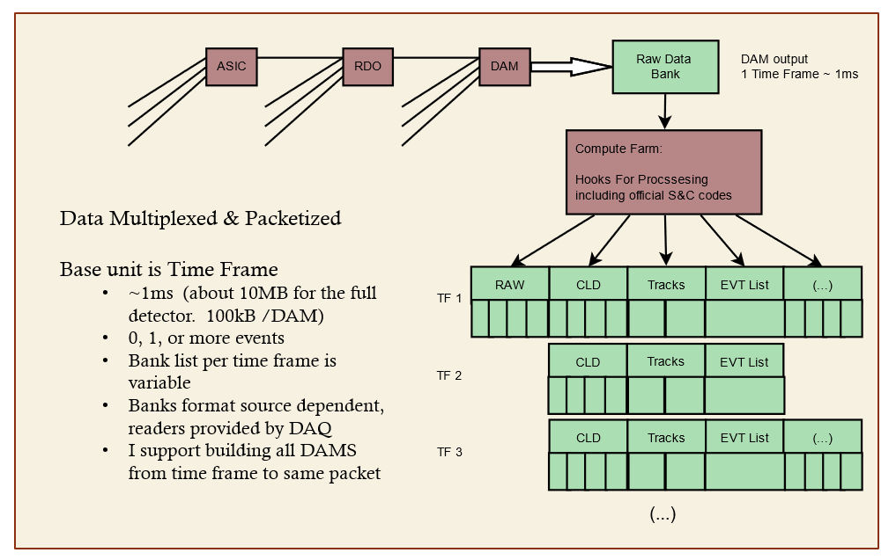
DAQ Computing – Stream Processing
DAQ
Time Frames (~668µs)
  16 bits at 10.2ns
  ~350 collisions per Frame
  ~10MB data per Frame
  ~2.0MB input per DAM
  ~100kB output per DAM
Online Computing
Routing data
Formatting data
Processing data
  DAM FPGA & CPUs
  Cluster finding
  Software filters
  Sanity Checkers
  QA Monitoring
  Metadata
  Slow controls integration
Scalers / continuously running DAQ components
3 levels of aggregation
DAM output
1 Time Frame
Additional “Banks” can be created to facilitate online processing
  Bank structure can be variable for different time frames.
  Bank format can differ depending on the data source.

Slide 14
Slow Control Integration
There will be many slow control and monitoring systems associated with the EIC collider and ePIC detector subsystems.
  BPMs, magnets, detector biases, HV, gas flows, temps, pressures, etc…
  Communication and configuration with all front-end boards must be supported – via DAM/RDO interfaces
Design and implementation of these control systems driven primarily by the relevant subsystems.
  We want to coordinate ePIC slow control as much as possible with the collider approach (expected to be primarily based on EPICS)
DAQ/Computing has defined responsibility for SC Integration (L4 WBS 6.10.09.2)
  Databases for maintaining SC data for calibrations and online/offline processing
  Manage SC data readout to synchronize with the physics stream data
  Maintain Software tools and libraries
Also included in the WBS is the development and implementation of a general network infrastructure in the experimental hall and counting house to support slow controls and other ancillary systems.

Slide 15
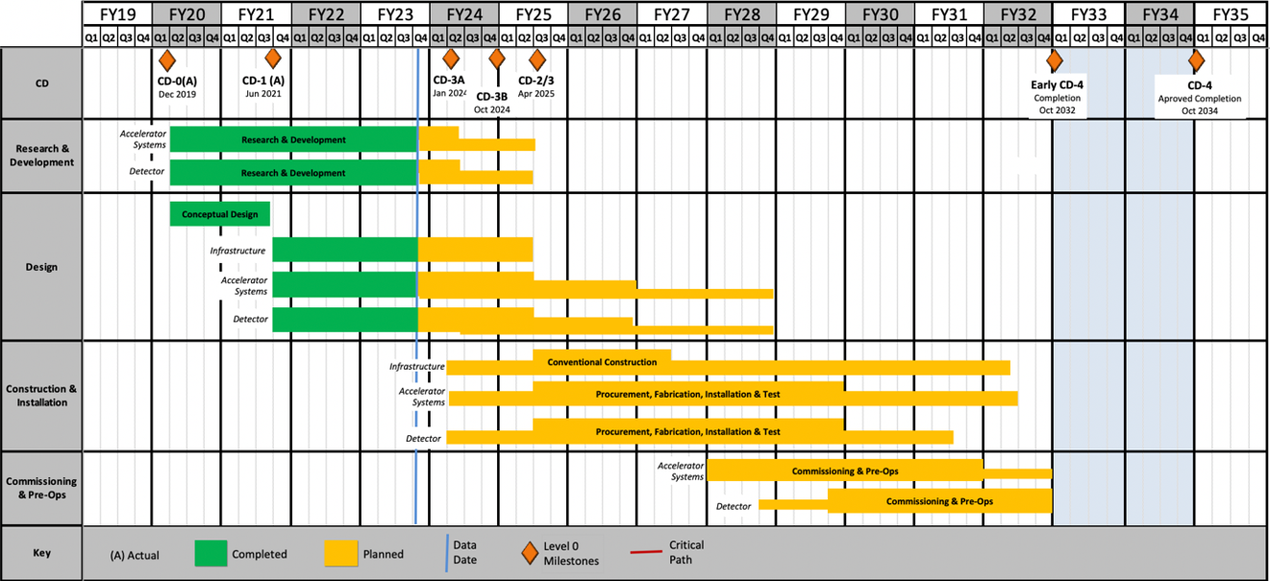
DAQ/Online Schedule
Charge 4
The DAQ and computing schedule is planned to be accelerated in relation to the full detector construction.
A functional DAQ will be necessary for small scale detector testing as well as commissioning and pre-ops.
Computing resources are staged to make purchases when the hardware is needed, taking advantage of price savings and performance improvements in time.
Hardware and software development early in the construction phase will produce a series of releases with increasing functionality.
Detector Install: FY29Q2 - FY31Q2
Cosmics: FY31Q3
Early CD-4: FY32Q1
DAQ Releases:
PicoDAQ FY26Q1
  Readout test setups
MicroDAQ: FY26Q4
  Readout detector data in test stand using engineering articles
MiniDAQ: FY28Q1
  Readout detector data using full hardware and timing chain
Full DAQ-v1: FY29Q2
  Full functionality DAQ ready for full system integration & testing
Production DAQ: FY31Q3
Ready for cosmics
Mini
DAQ
Production
DAQ

Slide 16
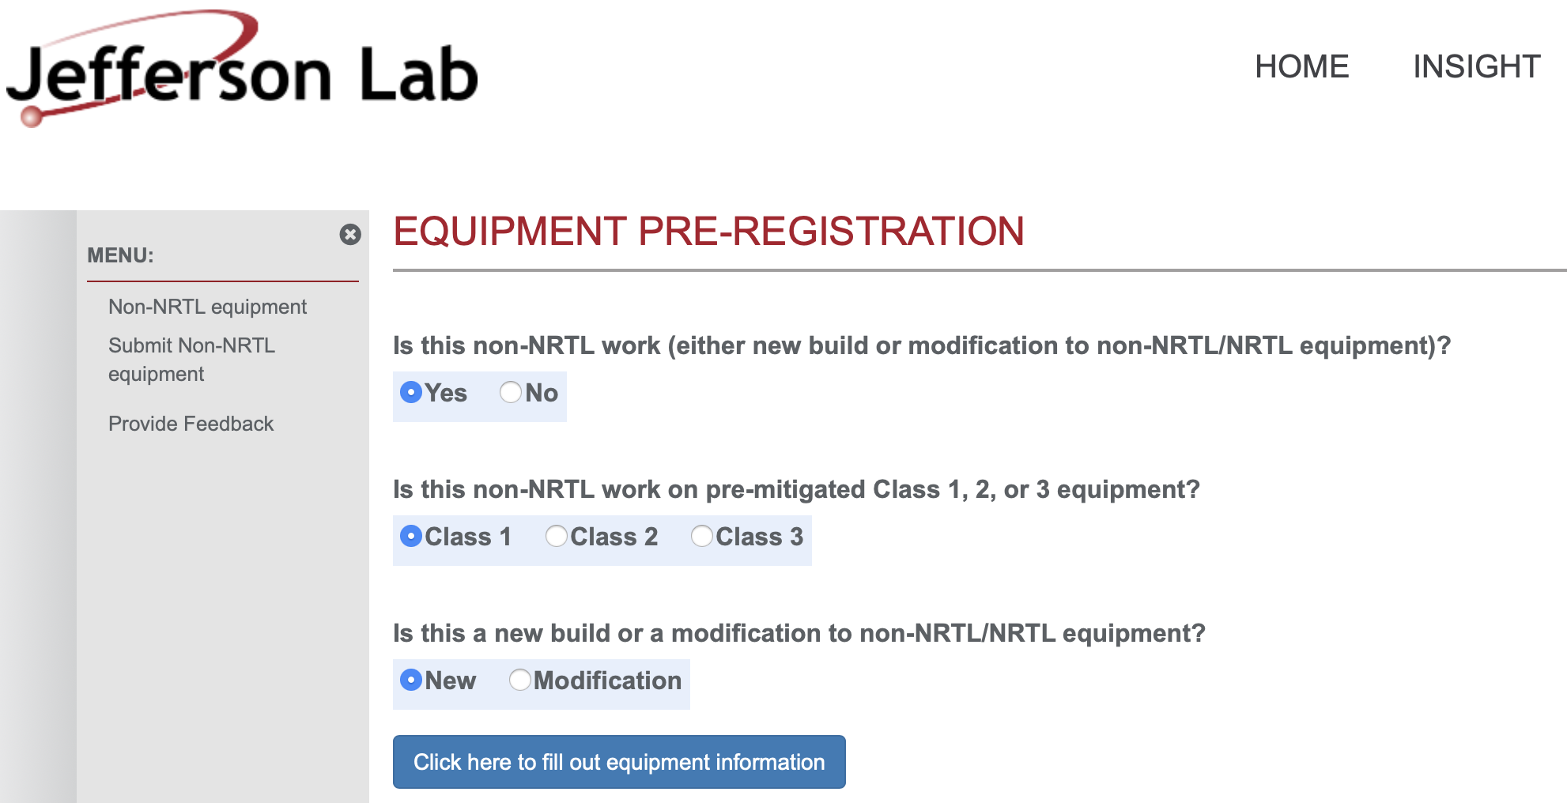
ES&H and QA Considerations
Charge 5
Both JLab and BNL have EHS&QA processes for electrical safety and “in-kind” electronics
At JLab, custom electronics built by collaborators for use in experiments must go through a registration process first. This includes any equipment that is NOT certified by a Nationally Recognized Test Lab (NRTL) like UL and recognized by OSHA.
The JLAB EHS&Q Manual has a supplement guide for construction and/or modification of any custom or non-NRTL equipment.
BNL Electrical Safety Advisor (ESA) for Physics Division
  Available to support a wide range of safety topics relevant to designing, planning, and acquiring electrical equipment and components for operations.
BNL Experimental Safety Review Process
  The experimental details and hazards are submitted to the ESH Coordinator
  An ESR form must be submitted to the C-A department
  The local representative must give a formal presentation to an ESH committee
  Before operations, the equipment must be inspected by the review committee and approved for operation

Slide 17
Summary
We have given a quantitative picture of the scope, scale and technologies we expect to require for the ePIC Data Acquisition System.
Technical, Cost, and Schedule risks are mitigated by:
  Significant COTS-based solutions
  Existence of viable solution for a front-end interface and data management hardware (DAM - FELIX)
  Accelerated schedule for detector sub-system readout support is planned.
    A Streaming Readout (SRO) work-fest is being organized for this Summer’s (July) ePIC collaboration meeting to understand what support is needed during detector development.
Integration plans for all the detector subsystems are actively under development.
  Protocol for communication/dataflow/time synchronization between DAQ components is defined
  Channel counts, data volumes, and FEB<->RDO interface requirements are still being refined.

Slide 18
Back-up slides

Slide 19
EIC SRO Community
The EIC Streaming Readout (SRO) Consortium
  Formed in 2018 with the goals of engaging the nuclear physics community to explore a streaming readout architecture for the EIC detectors.
  Series of ten workshops so far since 2018 (next in Dec 2023)
  Led to adoption of SRO for Yellow Report the physics program for EIC.
ePIC Electronics/DAQ Working Group
  Conveners: F. Barbosa (JLab), J. Huang (BNL), J. Landgraf (BNL)
  Regular meetings to focus on design and requirements specifically for the new ePIC detector
  Interface to detectors, readout, DAQ, online processing, monitoring and control.
ePIC Software/Computing Working Group
  Conveners: M. Diefenthaler (Jlab), S. Joosten (ANL), T. Wenaus (BNL), W. Deconinck (UM)
  Coordinate software development for EIC physics
ePIC Software/Computing Streaming DAQ Working Group
  Conveners: M. Battaglieri (JLab), J. Huang (BNL)
  Streaming Reconstruction

Slide 20
ePIC Software & Computing Review Summary
On October 19–20, 2023 the EIC Computing and Software Advisory Committee (ECSAC) assessed the ePIC computing model in preparation for the EIC RRB meeting in December, 2023.
The scope of this review also included the organization of the EIC Computing and Software Joint Institute (ECSJI), which has been formed by BNL and JLab.
The documents from the review, including the closeout report, can be accessed publicly on the ePIC Indico.
All five charge questions answered in the affirmative with three recommendations shared:
  Q1 (… comprehensive and cost-effective long-term plan …):
    We recommend that ECSJI verify the readiness of simulation and reconstruction for the TDR by May 2024.
    We recommend that ePIC document a first computing needs assessment by the next ECSAC review, in roughly one year.
  Q3 (… integrated with the HEP/NP community developments …):
    We recommend that the ePIC collaboration starts, by the time of next year’s ECSAC review, an evolving list of software dependencies that includes: the packages, who the primary supporters are, and what the ePIC collaboration contributes to them.

Slide 21
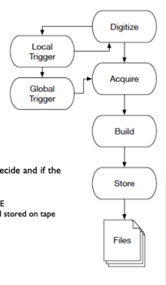
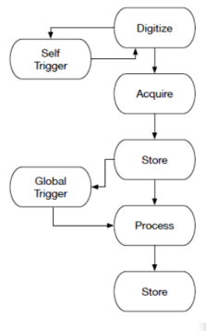
Streaming DAQ concept
Features of ePIC SRO
No global trigger
  No custom trigger electronics
  Zero-suppress early (ASICs)
Hits identified by time stamp rather than by event
Flexibility in event selection
  Can be performed with all channels available
  Can be performed in CPU, FPGA, or GPU
Cons
  SRO has greater sensitivity to noise and background
Triggered DAQ
Streaming Readout (SRO)

Slide 22
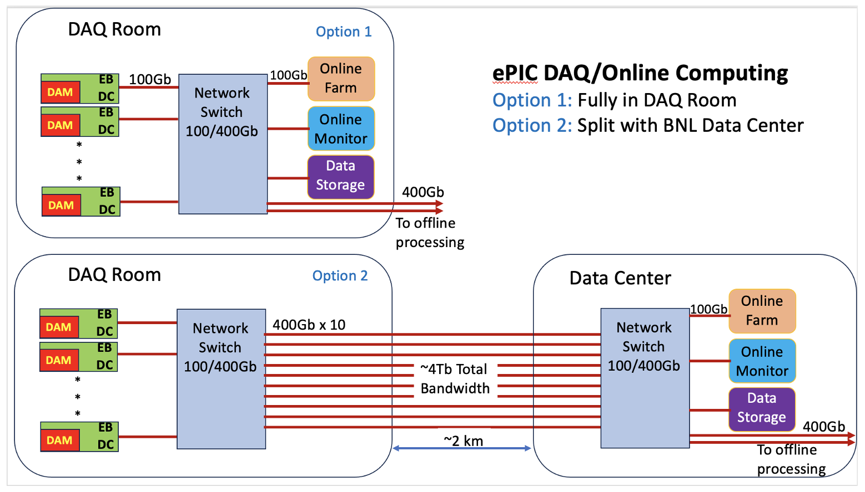
To Echelon 1
processing
To Echelon 1
processing

Slide 23
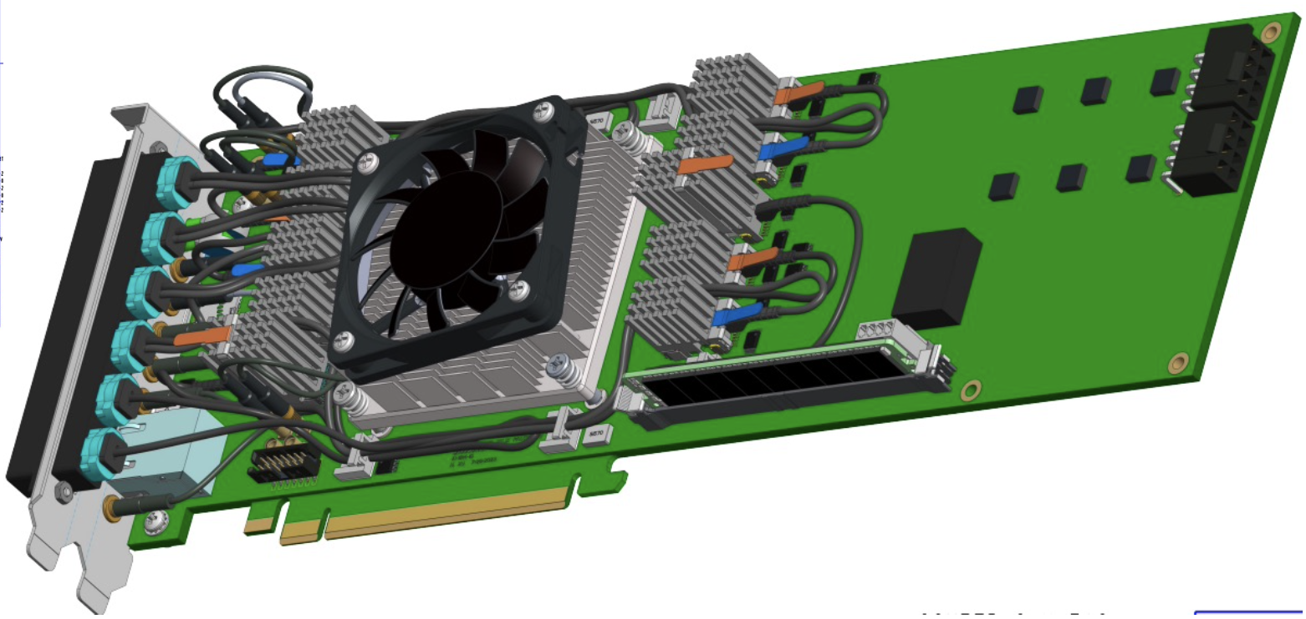
FELIX 155

Slide 24
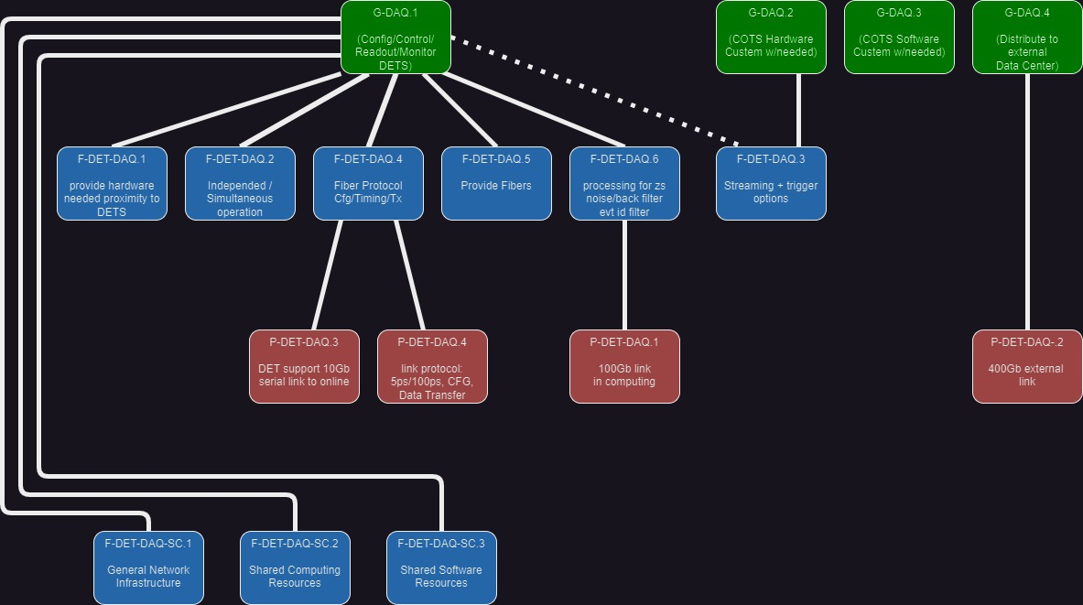
Requirements Flow Down

Slide 25
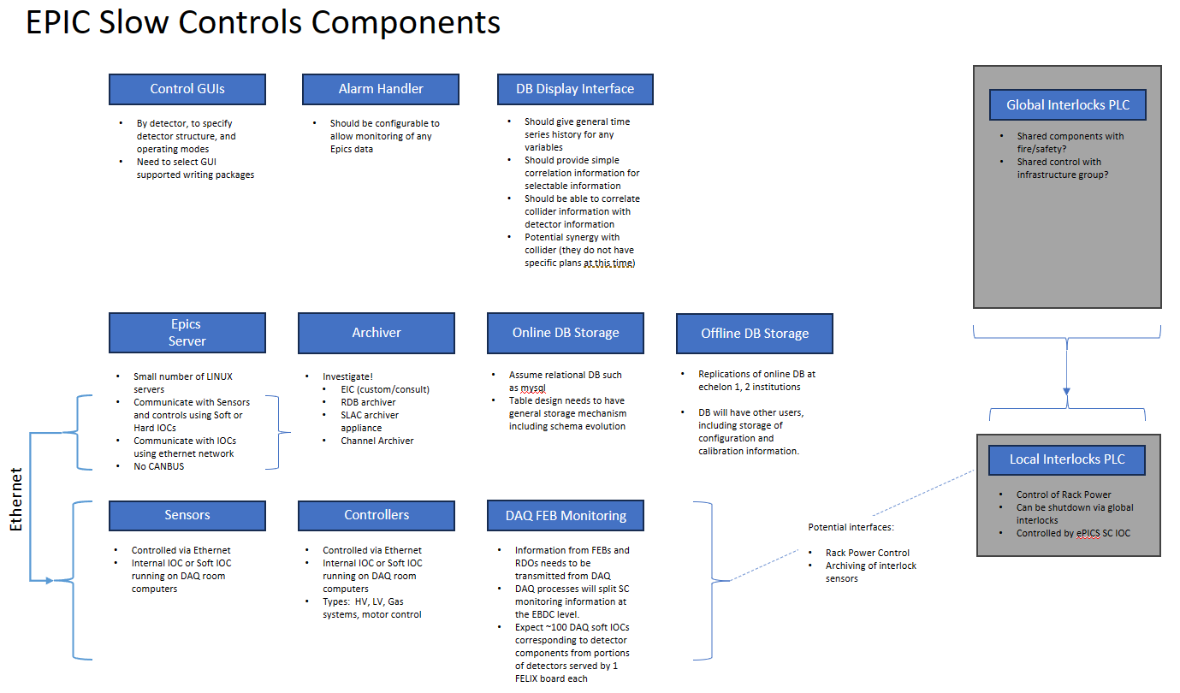

Slide 26
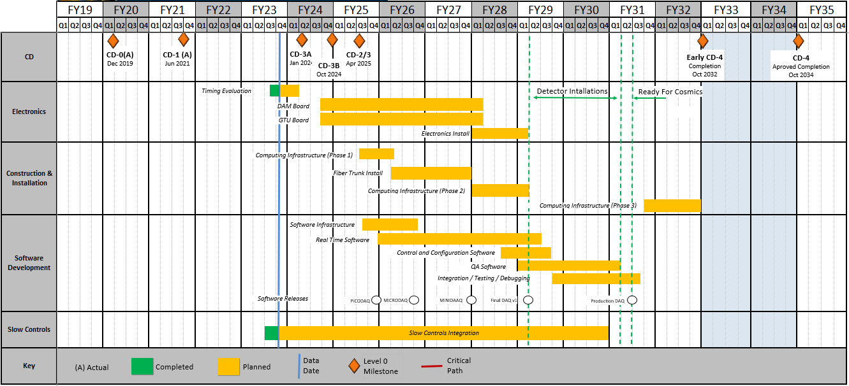
Detailed DAQ Schedule
Releases:
PICODAQ:
  Communicate with electronics test setup
MICRODAQ:
  readout detector data in test stand
MINIDAQ:
  readout detector data using full timing chain
Final:
  Full functionality DAQ

