Slide 1
Electronics and DAQ Overview WBS 6.10.08 & 6.10.09
Jeff Landgraf (BNL) & Dave Abbott (JLAB)
WBS 6.10.09 Data Acquisition (DAQ)
Fernando Barbosa(JLAB)
WBS 6.10.09 Data Acquisition (DAQ)
Electronics & DAQ PDR2 Review
June 10-11, 2024

Slide 2
Charge Questions Addressed
Are the technical performance requirements appropriately defined and complete for this stage of the project?
Are the plans for the various detector electronics and data acquisition systems appropriately documented and complete for this stage of the project?
Are the current plans from front-end electronics to data acquisition for the detector likely to achieve the technical performance requirements, with a low risk for cost increases, schedule delays, and technical problems?
Are the schedule assumptions for the fabrication of the various electronics and data acquisition systems and assembly plans reasonable and consistent with the overall detector schedule?
Have ESH&Q and QA considerations been adequately incorporated into the plans at their present stage?

Slide 3
Outline
Documentation status
The readout technology and scale of the EPIC DAQ
Collider environment
Readout Technologies
Streaming architecture
System components and operational concepts
Component counts & expected data flow
Fiber protocol and operation
(Fernando Barbosa)
Electronics
(Dave Abbott)
DAQ and Computing related tasks for 2024
Evaluating and defining timing and data protocol
Development of RDOs
FELIX boards
Echelon 0 (DAQ Computing)
Scientific computing Interface
Schedule
QA and ES&H
Summary

Slide 4
Available Documentation
Charge 2
Prior review closeout documentation
2 documents with a more detailed overview of the electronics and DAQ
Project Requirements Doc
Project Interfaces Doc
Detector technology, channel counts, electronics board counts
Detailed data volume document broken down to component level
P6 electronics / DAQ
Schedule

Slide 5
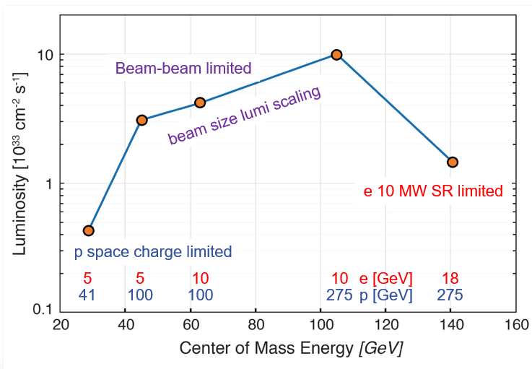
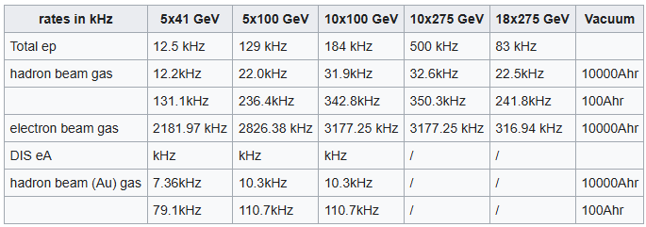
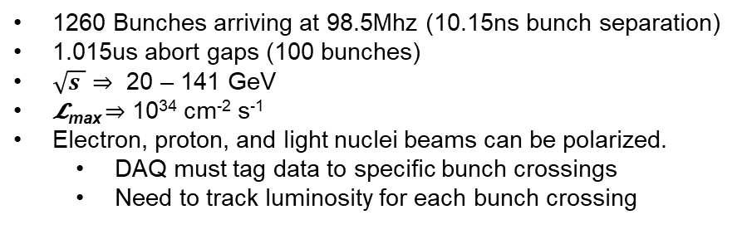
EIC Collider DAQ Environment
Charge 1&3
1260 Bunches arriving at 98.5Mhz (10.15ns bunch separation)
1.015us abort gaps (100 bunches)
$\sqrt{s }$ ⇒ 20 – 141 GeV
𝓛_{max} ⇒ 10³⁴ cm⁻² s⁻¹
Electron, proton, and light nuclei beams can be polarized.
DAQ must tag data to specific bunch crossings
Need to track luminosity for each bunch crossing

Slide 6
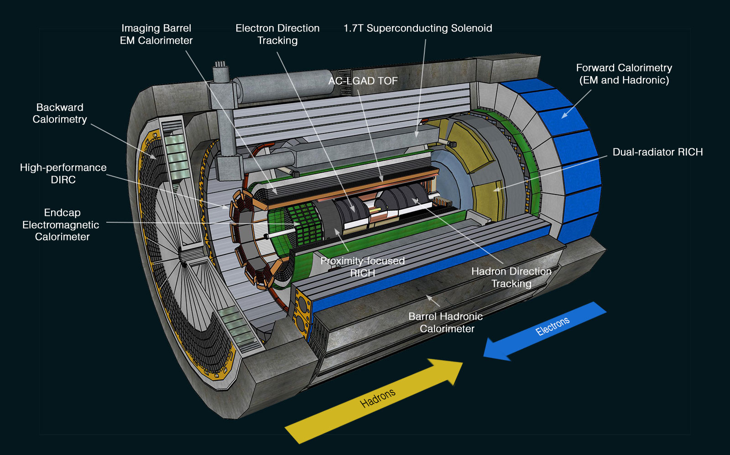
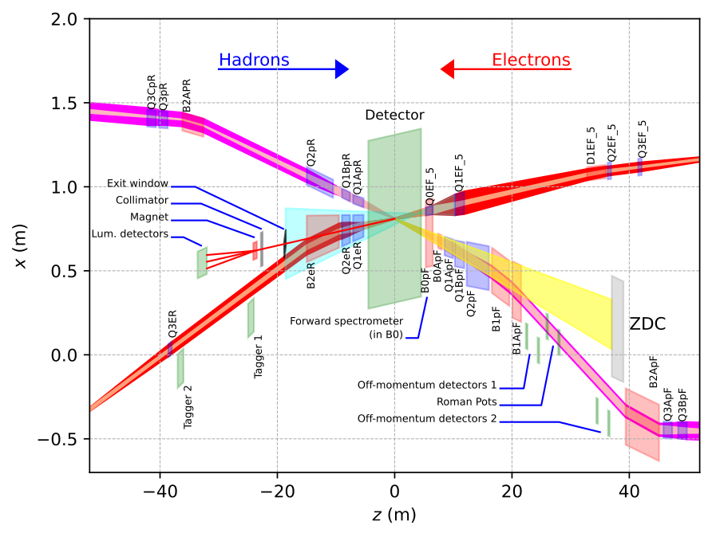
Readout Technologies
Charge 1&3
~30 Detectors
Spread over +/- 40 meters
(13 bunch crossings @ C)
Many technologies, but effort has been made to make use of possible synergy…

Slide 7
Readout Technologies
Charge 1&3
13 Calorimeters:
7 x SiPM – CALOROC
5 x SiPM – Discrete
1 x SiPM – Commercial fADC250

Slide 8
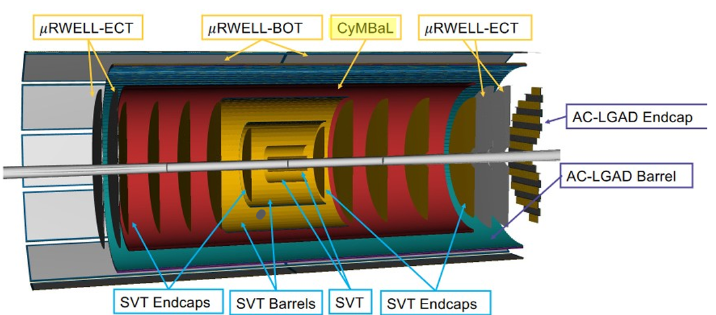
Readout Technologies
Charge 1&3
Tracking:
4 x ITS3 – VTRX+ / lpGBT
3 x uRWELL – SALSA
1 x Micromegas – SALSA
AC-LGAD time of flight

Slide 9
Readout Technologies
Charge 1&3
AC-LGADs:
6 x Pixels: EICROC
2 x Strips: FCFD / EICROCx

Slide 10
Readout Technologies
Charge 1&3
3 RICH Detectors:
dRICH: SiPM – ALCOR
(needs single photon sensitivity)
pfRICH: HRPPD – FCFD / EICROCx
hpDIRC: MCPPMT – FCFD / EICROCx
(same FCFD / EICROCx as for
AC-LGAD strip detectors)

Slide 11
Readout Technologies
Charge 1&3
MAPS (non-ITS3):
Imaging Barrel Calorimeter – Astropix
Low Q2 Tracker – Timepix4

Slide 12
Streaming in ePIC
Charge 3
ePIC DAQ uses streaming architecture
DAQ
Definition of streaming is “No L0 trigger”
All data is zero suppressed by the front end electronics
No system wide deadtime in normal operation
Collaboration should have the full ability to make data selection cuts on the widest possible criteria
Flexible event selection, data selection and background characterization
But subject to an overall throughput budget of ~100Gb/sec
ePIC Streaming will include
Capabilities for hardware and firmware based triggering
Capability for flow control
Zero suppression & aggregation within data packets
Greater sensitivity to noise than triggered system
Greater sensitivity to backgrounds than triggered system
Computing
Definition of streaming is “Process data as it arrives”
Fast Analysis (~3 weeks not months or years) using automation of calibration and reconstruction.
Requires some overlap between DAQ/computing
Automation of calibrations
Mapping calibration dependencies
Mapping application of calibrations
Mapping evolution of calibrations
QA and monitoring can make use of full offline structure
Consistent schemes and language for data/metadata
Event selection / tagging / and accounting

Slide 13
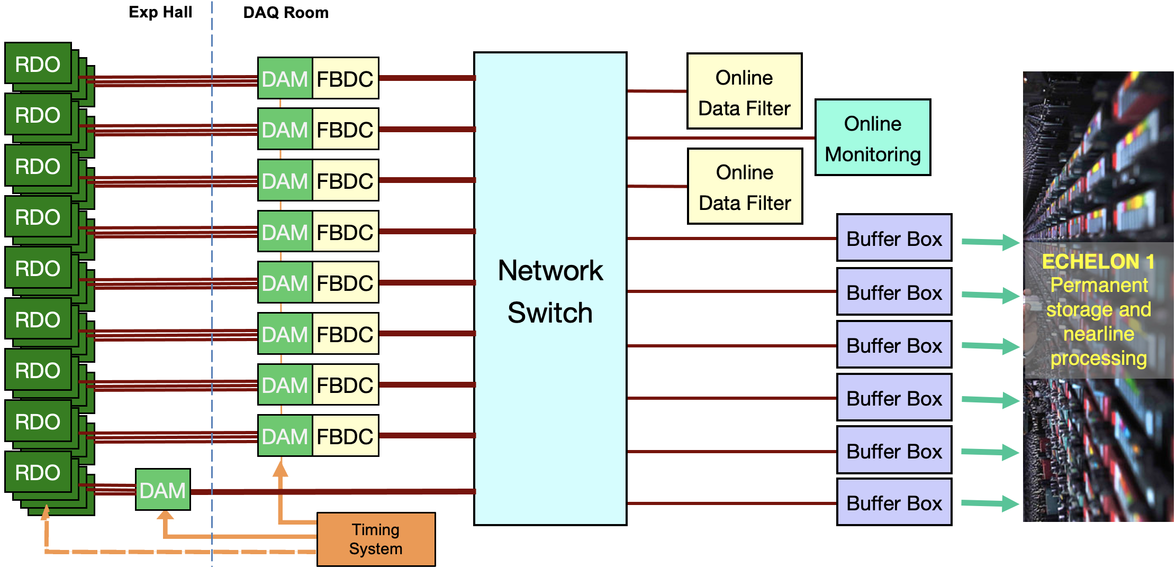
EIC Streaming DAQ/Computing Architecture
Charge 1&3
Bunch Crossing ~ 10.2 ns/98.5 MHz
Interaction Rate ~ 2 us/500 kHz
Low occupancy
BW O(100Tbps)
ePIC DETECTOR
BW O(10Tbps)
BW O(100Gbps)
GTU/Distributed clock
(jitter ~5ps)

Slide 14
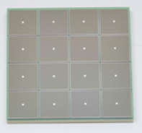
ePIC Readout Chain
Charge 3
Global Timing Unit (GTU)
-Interfaces to Collider, Run Control & DAM
-Config & Control
-Clock & Timing
On Detector
SMT BGA
Name
Design
Function
Attributes
Sensor
Detector Specific
Multi-Channel Sensor
MAPS, AC-LGAD
MPGD, MCP-PMT
SiPM, LAPPD
Adapter
Detector Specific
-HV/Bias Distribution
-HV divider
-Interconnect Routing
-Sensor Specific
-Passive
Front End Board
(FEB)
Detector Specific
-Amplification
-Shaping
-Digitization
-Zero Suppression
-Bias Control & Monitoring
-ASIC/ADC
-Discrete
-Serial Link
Readout Board
(RDO)
Few Variants
-Communication
-Aggregation
-Formatting
-Data Readout
-Config & Control
-Clock & Timing
-FPGA
-Fiber Link
Data Aggregation Module (DAM)
Common
-Computing Interface
-Aggregation
-Software Trigger
-Config & Control
-Clock & Timing
-Large FPGA
-PCIe
-Ethernet
Computing
Common
-Data Buffering and Sinking
-Calibration Support
-QA/Scalers
-Collider Feedback
-Event ID/Building
-Software Trigger
-Monitoring
-COTS
-Ethernet

Slide 15
ePIC Readout Chain
Charge 3
Global Timing Unit (GTU)
-Interfaces to Collider, Run Control & DAM
-Config & Control
-Clock & Timing
On Detector
SMT BGA
Name
Design
Function
Attributes
Sensor
Detector Specific
Multi-Channel Sensor
MAPS, AC-LGAD
MPGD, MCP-PMT
SiPM, LAPPD
Adapter
Detector Specific
-HV/Bias Distribution
-HV divider
-Interconnect Routing
-Sensor Specific
-Passive
Front End Board
(FEB)
Detector Specific
-Amplification
-Shaping
-Digitization
-Zero Suppression
-Bias Control & Monitoring
-ASIC/ADC
-Discrete
-Serial Link
Readout Board
(RDO)
Few Variants
-Communication
-Aggregation
-Formatting
-Data Readout
-Config & Control
-Clock & Timing
-FPGA
-Fiber Link
Data Aggregation Module (DAM)
Common
-Computing Interface
-Aggregation
-Software Trigger
-Config & Control
-Clock & Timing
-Large FPGA
-PCIe
-Ethernet
Computing
Common
-Data Buffering and Sinking
-Calibration Support
-QA/Scalers
-Collider Feedback
-Event ID/Building
-Software Trigger
-Monitoring
-COTS
-Ethernet
Readout Board Flavors
Detector | Characteristics
TOF | Highest Timing Requirement (Generic)
dRICH | Small Footprint (VTRX+ optics)
ITS-3 | Detector side uses fiber (VTRX+)
Imaging Calorimeter | Integrated with ASTROPIX Sensor
Low Q Tracker | High Rates, 20 TX fibers expected / RDO
Direct Photon Calorimeter | Pure 200MHz Streaming (bypass DAQ protocol)

Slide 16
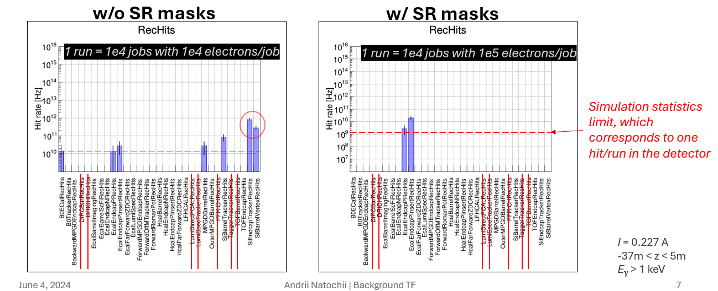
Simulations of Data Volumes
The ePIC background group has evaluated background sources.
For data volume evaluation we have used:
18x275 DIS events, scaled to the maximum event rates to be seen in 10x275GeV DIS
10 GeV Electron beam gas events scattered from realistic vacuum under 10000Ahr of pumping
275 GeV Proton Beam gas events scattered from realistic vacuum under 10000Ahr of pumping
Synchrotron radiation is still under evaluation. Recent results have shown both that Synchrotron radiation
is a potentially serious issue with the currently implemented beam line, but also that relatively simple remediation schemes can lower the rate significantly.

Slide 17
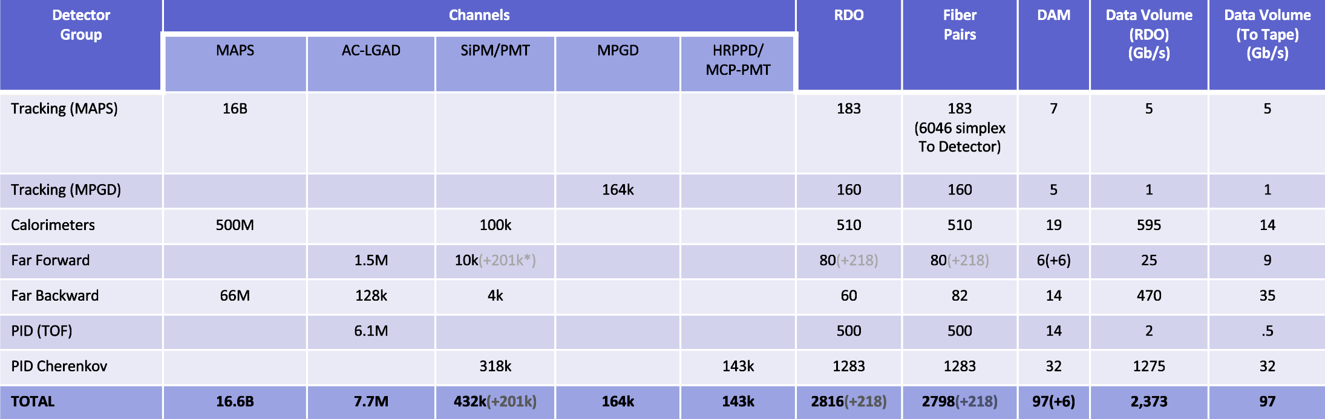
Summary of Channel Counts and Data Flow
Charge 3
Summary of Data Flow
Detector
FEB
Copper
RDO
Fiber
DAM
PCI/Eth
Readout Computer
Eth
100% Occupancy | 27.5-1760 Pb/sec
Aggregate | Gb/sec
Collision Signal | 41.6 Gb/sec
Synchrotron Rad | Under design
Electron Beam | 4.5 Gb/sec
Hadron Beam | 1.0 Gb/sec
Noise | 40 Gb/sec
Aggregate | 2.3 Tb/sec
Noise | 1.6 Tb /sec
Signal from Physics + Background | 700 Gb / sec
Aggregate | 2.3 Tb/sec
Per RDO (Avg) | 0.8 Gb/sec

Slide 18
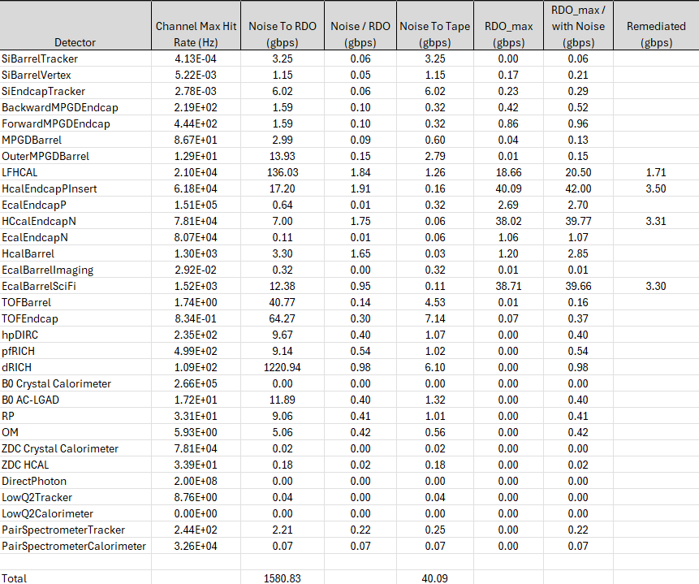

Data Bottlenecks
Charge 3
Evaluated Data Bottlenecks by tiling detector regions with RDO/ASIC combos
RDO data volume spec 10 gbps
CALOROC expected to have inefficient readout (single hit reads out N samples x 18 channels)
Remediate by readout 1 sample,
By suppressing empty channels in RDO
By using fewer populated FEB per RDO in strategic locations
dRICH dark currents handled by firmware trigger
Direct Photon Detector ~100 channels direct streaming, readout only summary
Preliminary Noise Assumptions
Detector | Noise (hz/channel)
ITS3 | 0.01
Astropix | 0.01
Timepix | 0.01
AC-LGAD | 30
HRPPD | 230
dRICH(initial) | 3000
dRICH(Max) | 300,000
All others | 4σ = 311

Slide 19
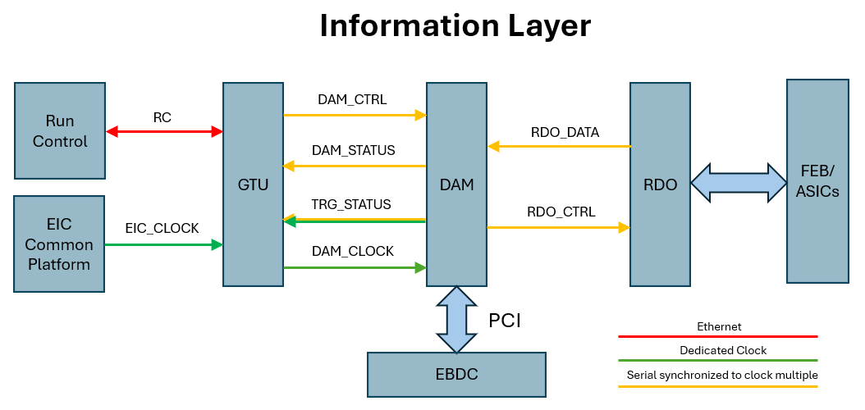
Fiber Protocol / DAQ operation
Charge 3
Synchronous Commands:
64 bits (80 bits 8b/10b encoded) per bunch
Reconstructed clock
Redundant BCO
Distinct synchronous commands (eg)
RC
Time Frame Control & Definition
Flow Control
Trigger
Request special events
Data filter (firmware trigger)
Configuration (ASIC / RDO firmware)
Data Formatting
Data Transfer
Hits
Slow Controls
Time Frame Definition:
16 bits BCO (0.66ms -> 8MB @ 100Gbps)
Flexible formatting
Filtered & Unfiltered data can coexist
Time Frames are built, they contain the full set of detectors for the time period
Tiered Data Format.
High level flexible, named navigation via banks (e.g. star SFS, sPHENIX DAQRC)
Low level supports direct, detector specific (eg ASIC) formats.
Trigger Operation:
Support Max Data Volume to DAM / Readout computer Buffers
Generate Trigger Signals in DAM
Communicate triggered crossings via synchronous cmds through GTU

Slide 20
Summary
Described an overview of the readout system for ePIC
Described the expected data volumes expected from noise, background and collisions.
Listed the technologies, and the scale of the ePIC Electronics and DAQ systems, to put the following talks into context

Slide 21
Back-up

Slide 22
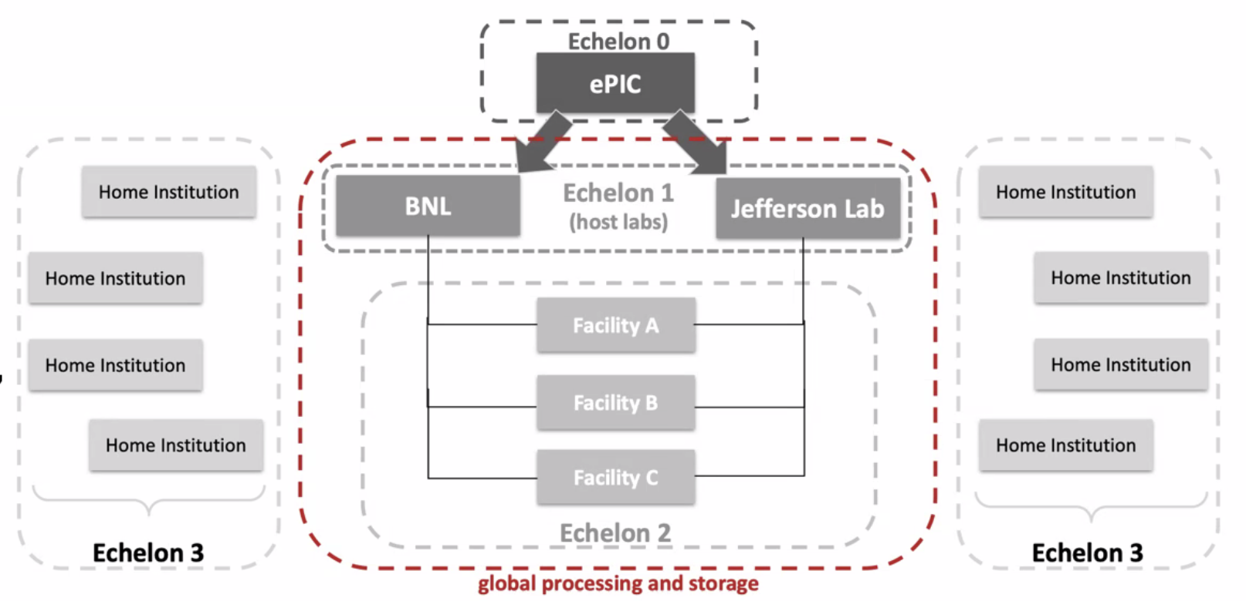
Echelon 0 Computing
COTS DAQ computing
~200 computers
130 for reading out DAM boards
70 for:
Building time frames
Low level QA / logging
Interface to Slow Controls
Configuration and Conditions Databases
Buffering of data files
Transfer of data files to Echelon 1

Slide 23
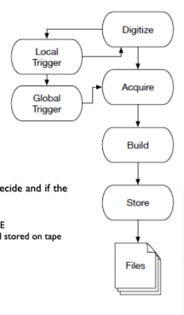
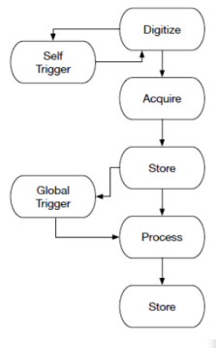
Streaming DAQ Concept
Triggered DAQ
Streaming Readout (SRO)
Features of ePIC SRO
No global trigger
No custom trigger electronics
Zero-suppress early (ASICs)
Hits identified by time stamp rather than by event
Flexibility in event selection
Can be performed with all channels available
Can be performed in CPU, FPGA, or GPU
Cons
SRO has greater sensitivity to noise and background

Slide 24
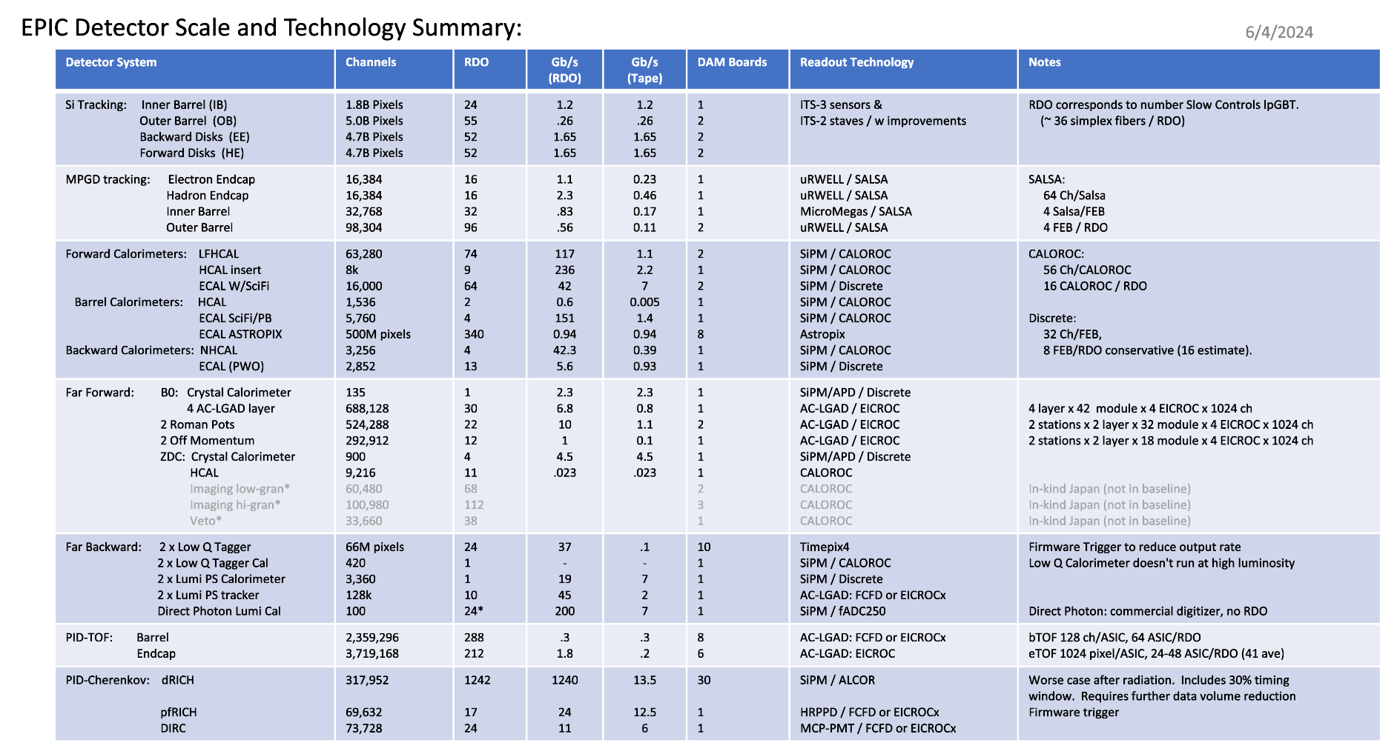

Slide 25
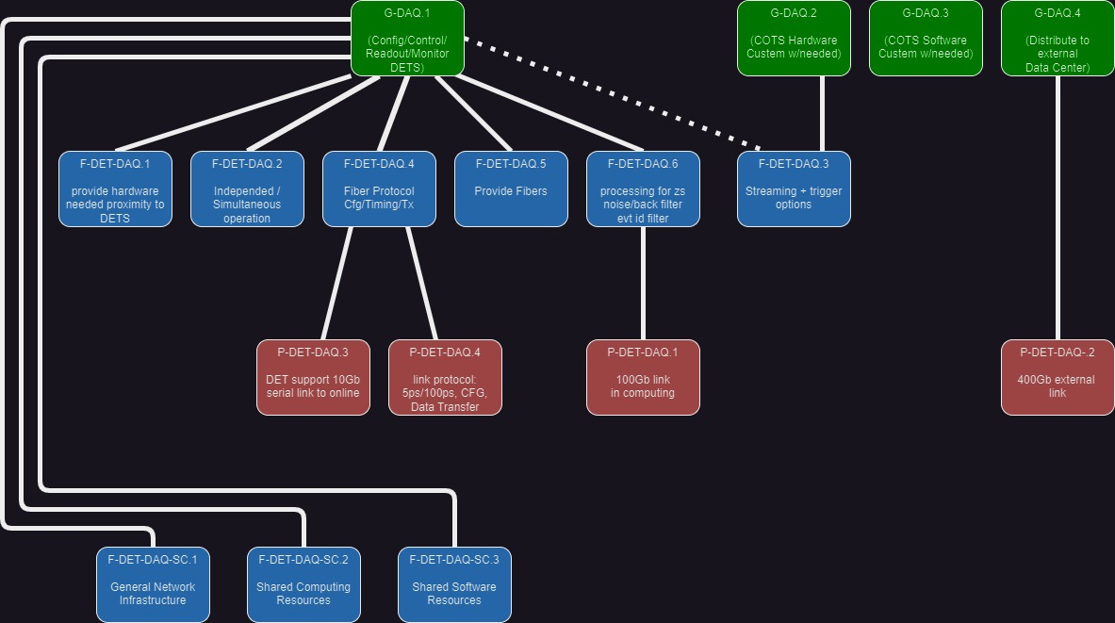
Requirements Flow Down

Slide 26
ePIC Software & Computing Review Summary
On October 19–20, the EIC Computing and Software Advisory Committee (ECSAC) assessed the ePIC computing model in preparation for the EIC RRB meeting in December 2023.
The scope of this review also included the organization of the EIC Computing and Software Joint Institute (ECSJI), which has been formed by BNL and JLab.
The documents from the review, including the closeout report, can be accessed publicly on the ePIC Indico.
All five charge questions answered in the affirmative with three recommendations shared:
Q1 (… comprehensive and cost-effective long-term plan …):
We recommend that ECSJI verify the readiness of simulation and reconstruction for the TDR by May 2024.
We recommend that ePIC document a first computing needs assessment by the next ECSAC review, in roughly one year.
Q3 (… integrated with the HEP/NP community developments …):
We recommend that the ePIC collaboration starts, by the time of next year’s ECSAC review, an evolving list of software dependencies that includes: the packages, who the primary supporters are, and what the ePIC collaboration contributes to them.

Slide 27
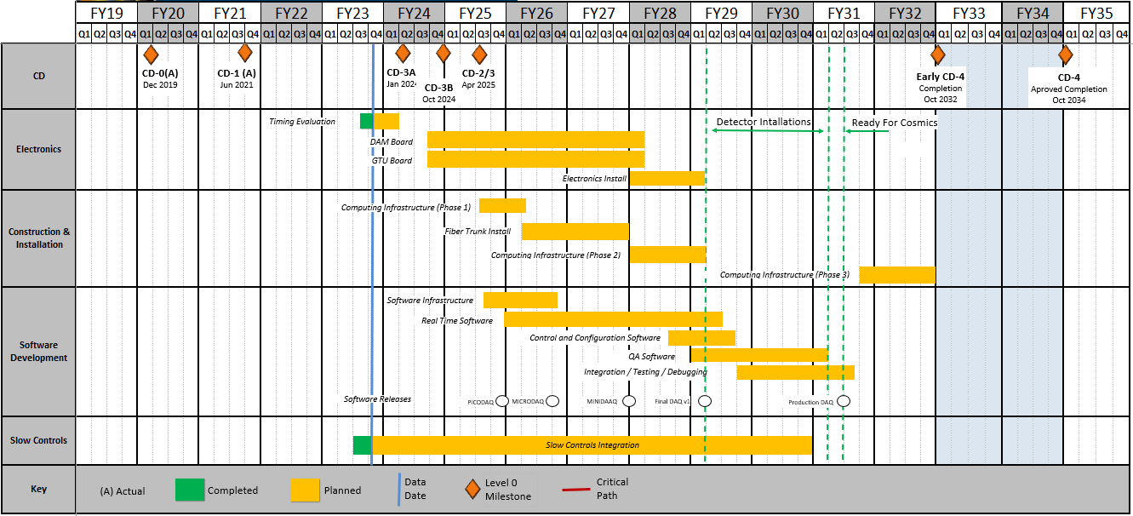
Detailed DAQ Schedule
Releases:
PICODAQ:
Communicate with electronics test setup
MICRODAQ:
readout detector data in test stand
MINIDAQ:
readout detector data using full timing chain
Final:
Full functionality DAQ

Slide 28
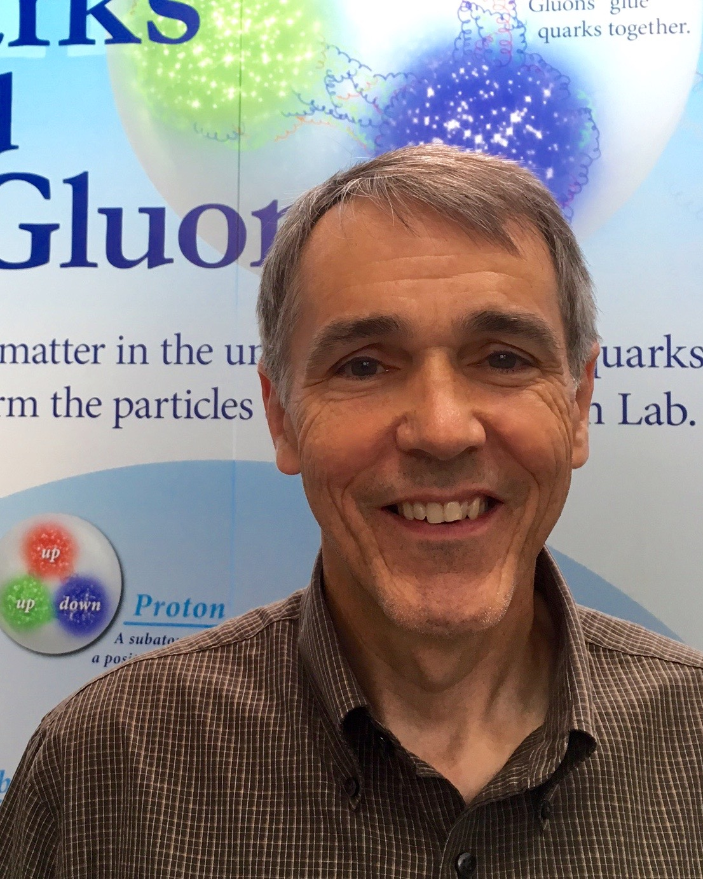
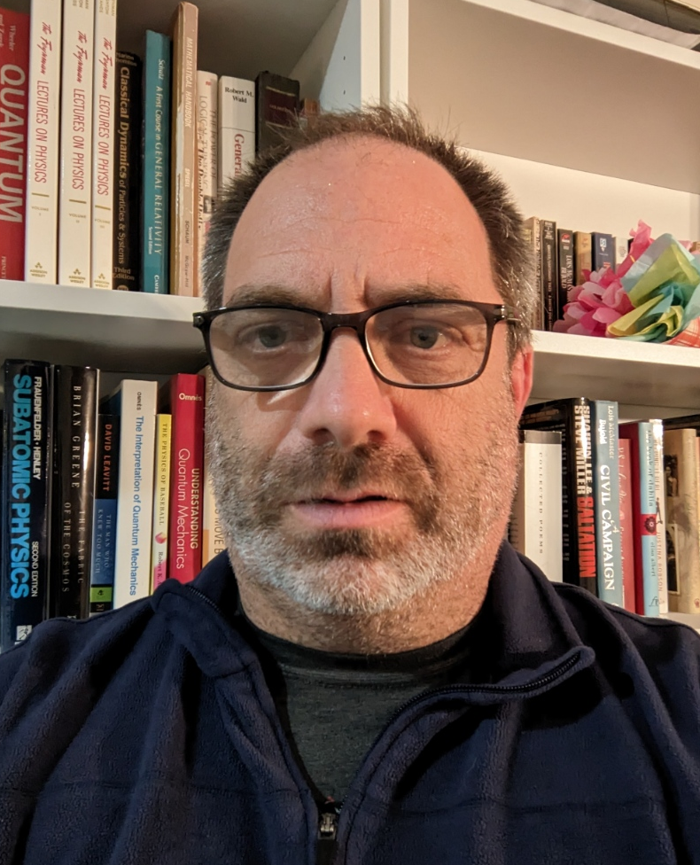
Introductions
David J. Abbott
L3 co-CAM for 6.10.09
Staff Scientist at Jefferson Lab
Nuclear Physics Ph.D. from UNC Chapel Hill, 1990
Developed and supported the data acquisition systems for all JLab experiments as part of the Physics DAQ and Fast Electronics support groups (33 years).
Jeffery M. Landgraf
L3 co-CAM for 6.10.09
Senior Technology Architect at Brookhaven National Laboratory
Physics Ph.D. from University of Michigan, 1995
Developed and supported the DAQ, Trigger and online computing systems for the STAR detector since 1999
co-Convener for ePIC Electronics and DAQ WG

Slide 29
EIC SRO Community
Charge 1
The EIC Streaming Readout (SRO) Consortium
Formed in 2018 with the goals of engaging the nuclear physics community to explore a streaming readout architecture for the EIC detectors.
Series of ten workshops so far since 2018 (next in Dec 2023)
Led to adoption of SRO for Yellow Report the physics program for EIC.
ePIC Electronics/DAQ Working Group
Conveners: F. Barbosa (JLab), J. Huang (BNL), J. Landgraf (BNL)
Regular meetings to focus on design and requirements specifically for the new ePIC detector
Interface to detectors, readout, DAQ, online processing, monitoring and control.
ePIC Software/Computing Working Group
Conveners: M. Diefenthaler (Jlab), S. Joosten (ANL), T. Wenaus (BNL), W. Deconinck (UM)
Coordinate software development for EIC physics
ePIC Software/Computing Streaming DAQ Working Group
Conveners: M. Battaglieri (JLab), J. Huang (BNL)
Streaming Reconstruction

Slide 30
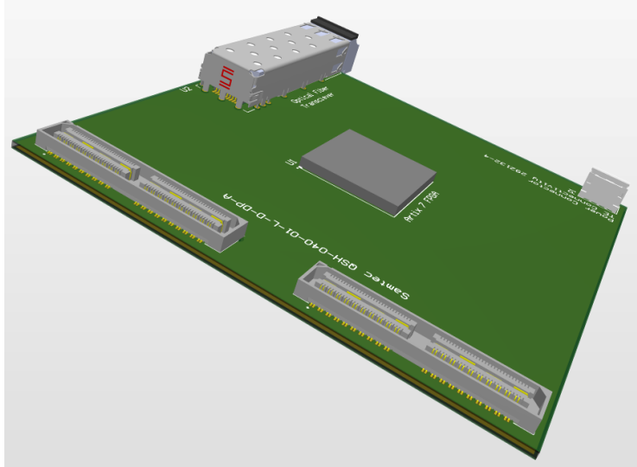
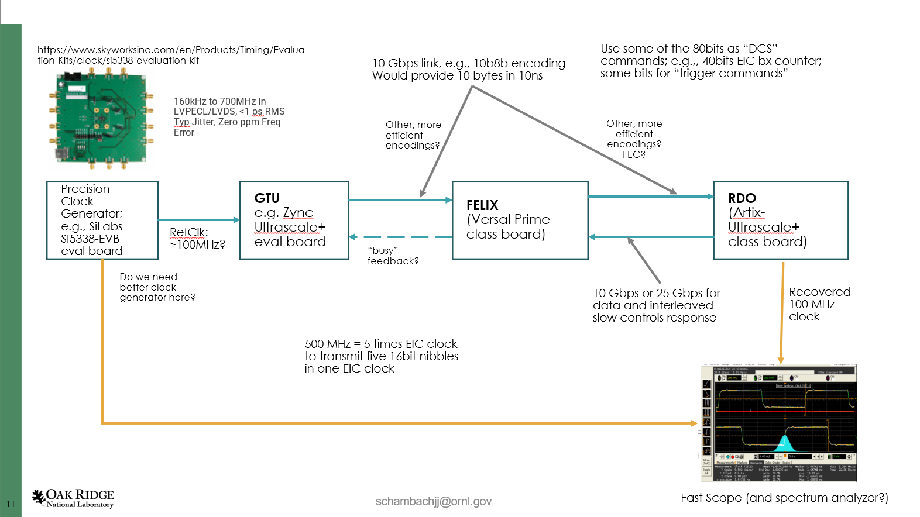
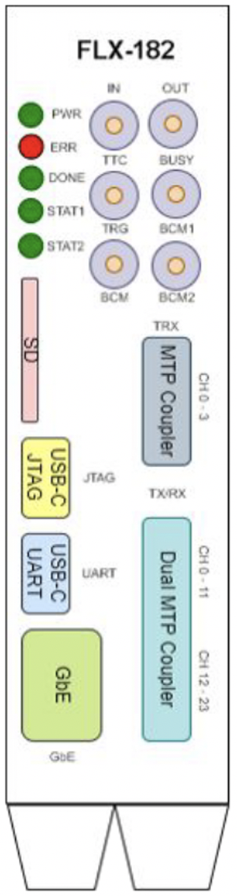
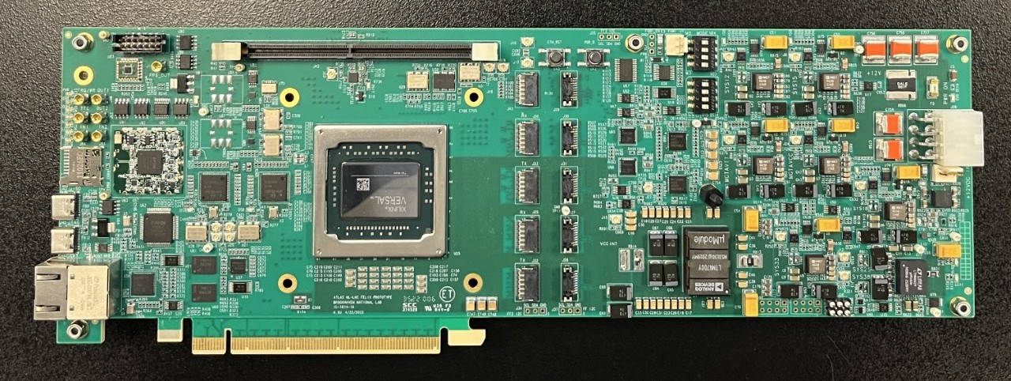
System Component Status
Charge 1
Detailed Electronics Design starts with CD3.
The current status is that we are evaluating system design and interactions between components.
RDO Status:
Mocking up with devkits for initial studies
Nominal 2.5” x 2.5” for common elements + connector space
FPGA defined by price (Artix Ultrascale+ Class)
Power 3-5 Watts. 2 LV +5V for optical interfaces, lower for FPGA/digital components
Accept 2 or 3 fibers for potential Hi-Res Timing
Optical Protocol
Defines the data flow between the GTU, RDO, and DAM boards
Optical Protocol Requirements
Timing (<=5ps Hi-Res Detectors)
Timing (<=100ps Lo-Res Detectors)
Timing phase stability on power cycle
Configuration and slow control monitoring passthrough for ASICS/FEBs
Real-Time Command / Control
Data Transfer (>=10Gb/s per RDO)
Optical protocol choices under evaluation
ePIC – simple custom protocol
GPT in FPGA
Dedicated Clock/Reconstructed Clock (2 or 3 fibers per RDO)
GTU status:
Mocking up with devkits for initial studies
Interface to collider (Bunch crossing clock, Spin Patterns per bunch crossing)
Distribution of timing to ~100 DAMs + ~220 RDOs of Hi-Res Timing Detectors
User command interface & distribution
Interface to Run Control
DAM Status:
FELIX engineering article obtained
Xilinx Versal FPGA
PCIe Gen4 x16 or 100Gb Ethernet output
24 Firefly links up to 25Gb/s options
48 link upgrade planned
Additional front panel I/O

Slide 31
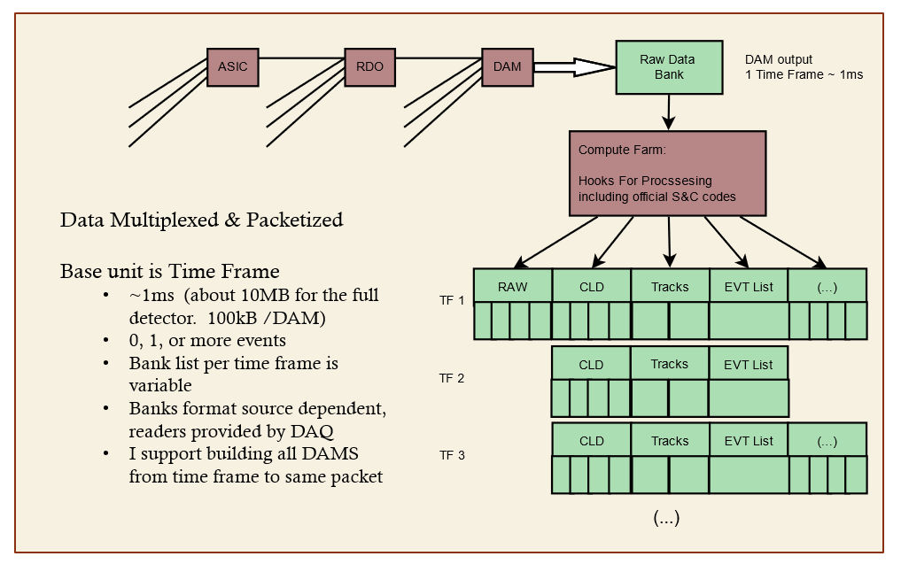
DAQ Computing - Streams
Charge 1
Time Frames (~1ms)
Up to ~500 events per Frame
~10MB data per Frame
~2.0MB input per DAM
~100kB output per DAM
Routing data
Formatting data
Processing data
DAM FPGA & CPUs
Cluster finding
Software triggering
Sanity Checkers
QA Monitoring
Metadata
Slow controls integration
Scalers / continuously running DAQ components

Slide 32
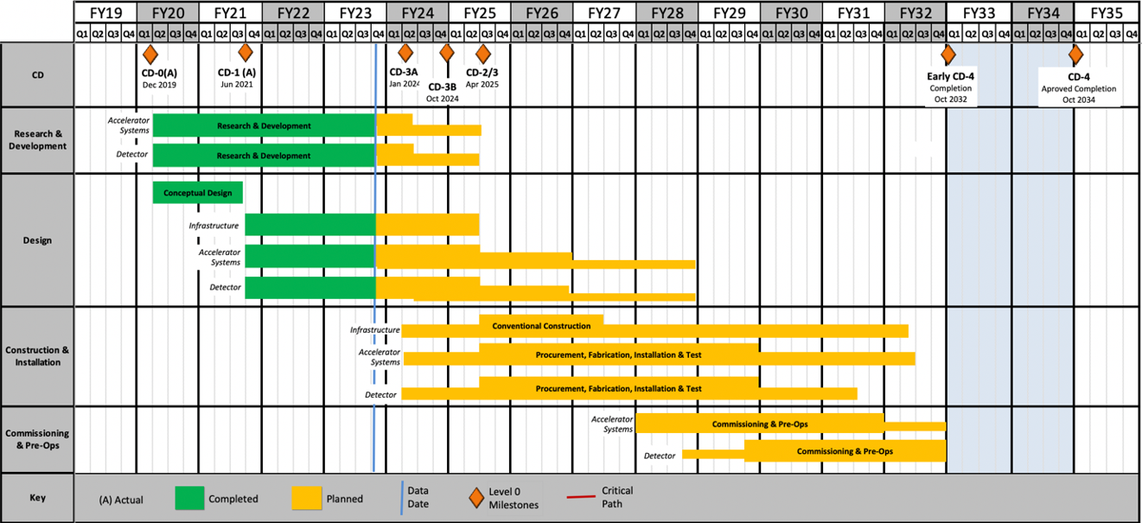
DAQ/Online Schedule
Charge 3
The DAQ and computing schedule is planned to be accelerated in relation to the full detector construction.
A functional DAQ will be necessary for small scale detector testing as well as commissioning and pre-ops.
Computing resources are staged to make purchases when the hardware is needed, taking advantage of price savings and performance improvements in time.
Hardware and software development early in the construction phase will produce a series of releases with increasing functionality.
Detector Install: FY29Q2 - FY31Q2
Cosmics: FY31Q3
Early CD-4: FY32Q1
DAQ Releases:
PicoDAQ FY26Q1
Readout test setups
MicroDAQ: FY26Q4
Readout detector data in test stand using engineering articles
MiniDAQ: FY28Q1
Readout detector data using full timing chain
Full DAQ-v1: FY29Q2
Full functionality DAQ ready for full system integration & testing
Production DAQ: FY31Q3
Ready for cosmics
Mini
DAQ
Production
DAQ

Slide 33
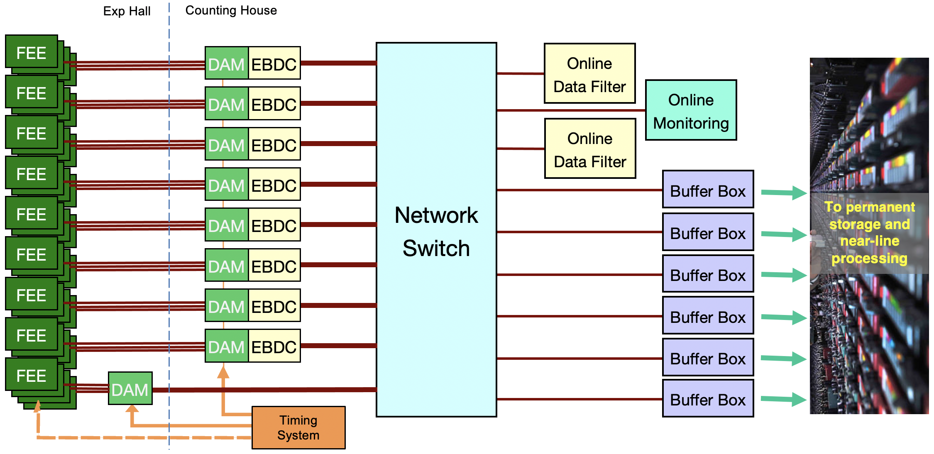
EIC Streaming DAQ/Computing Architecture
Charge 3
Bunch Crossing ~ 10.2 ns/98.5 MHz
Interaction Rate ~ 2 us/500 kHz
Low occupancy
BW O(100Tbps)
RDO
RDO
RDO
RDO
ePIC DETECTOR
BW O(10Tbps)
RDO
RDO
RDO
BW O(100Gbps)
RDO
RDO
GTU/Distributed clock
(jitter ~5ps)

Slide 34
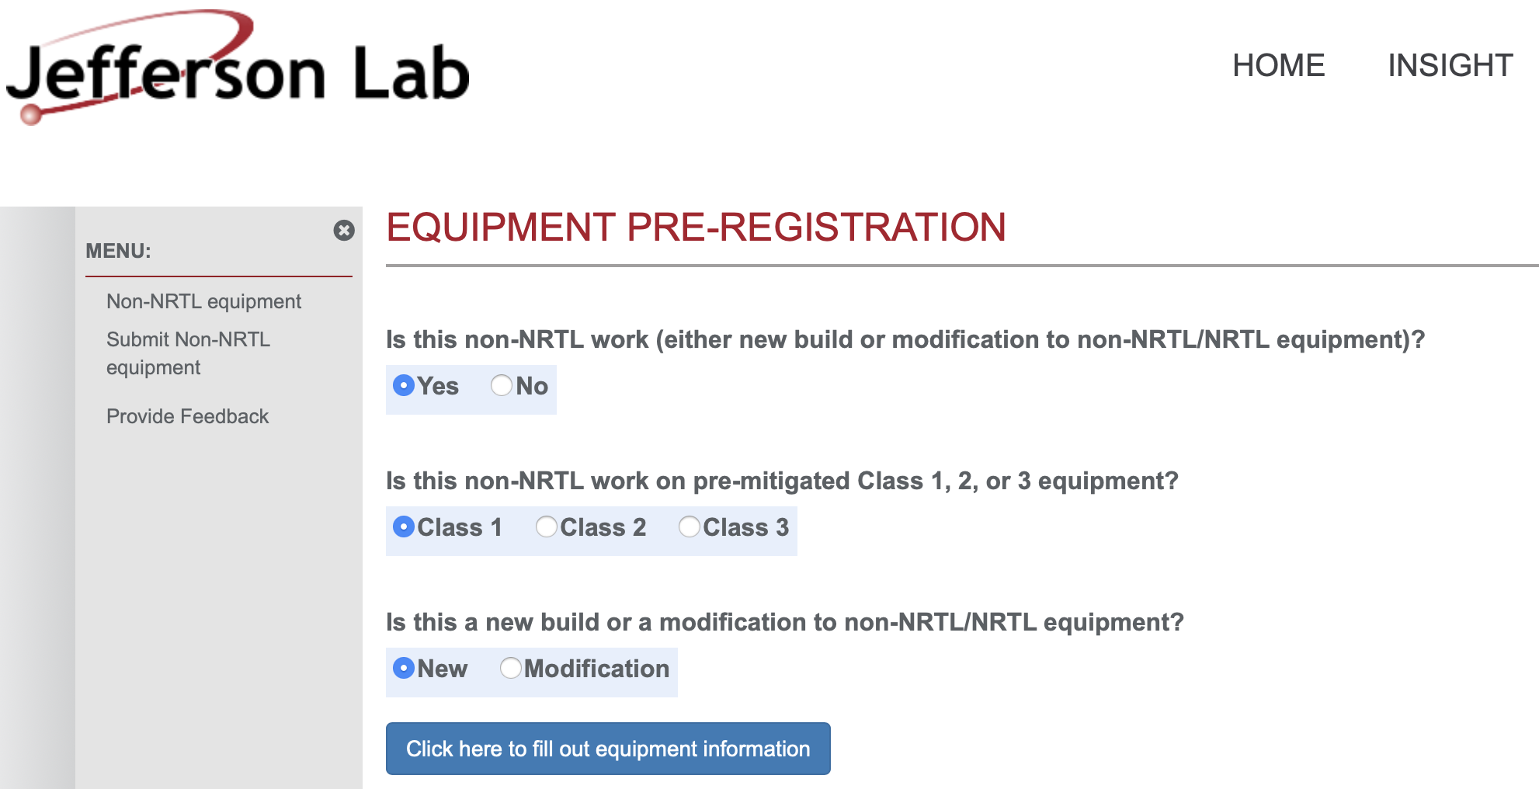
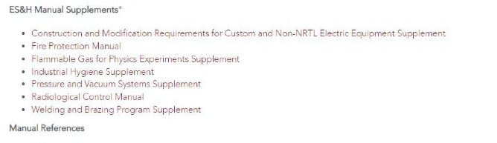
ES&H Considerations
Charge 4
Both JLab and BNL have EHS&Q processes for “in-kind” Electronics
At JLab, custom electronics built by collaborators for use in experiments must go through a registration process first. This includes any equipment that is NOT certified by a Nationally Recognized Test Lab (NRTL) like UL and recognized by OSHA.
The JLab EHS&Q Manual has a supplement guide for construction and/or modification of any custom or non-NRTL equipment.
BNL Experimental Safety Review Process
The experimental details and hazards are submitted to the ESH Coordinator
An ESR form must be submitted to the C-A department
The local representative must give a formal presentation to an ESH committee
Before operations, the equipment must be inspected by the review committee and approved for operation

