Slide 1
Final Design and Safety Review of the VTRX+ and lpGBT Electronics Components for the EIC Detector
Electronics Requirements for lpGBT and VTRX+
Fernando Barbosa
L3 CAM WBS 6.10.08
Chief Electrical Engineer
VTRX+ and lpGBT FDR
June 10-11, 2024

Slide 2
Charge Questions Addressed
Are the technical performance requirements and subsystem interfaces complete and documented?
Do the design and specifications meet the performance requirements with a low risk of cost increases, schedule delays, and technical problems?
Are the fabrication and assembly plans consistent with the overall project and detector schedule?
Are the plans for integration of the VTRX+ and lpGBT in specific ePIC detector subsystems appropriately developed?
Have ES&H and QA considerations been adequately incorporated in the design and procurement planning?
Is the procurement approach sound and the procurement schedule credible?

Slide 3
Outline
The lpGBT ASIC
The VTRX+ Module
Application at EIC
ESH&Q
QA/QC
Timeline
Summary

Slide 4
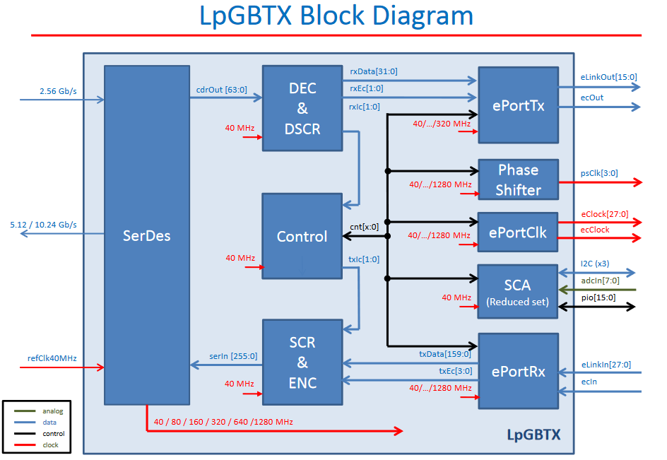
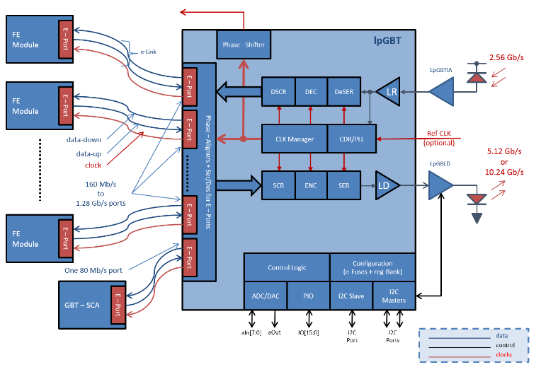
lpGBT – Low Power Giga-bit Transceiver
Charge 1, 2
Application
Replaced with VTRX+
Operation up to 12.24 Gbps Input [Up-link, elink up to 1.28 Gbps], and up to 2.56 Gbps Output [Down-link, elink up to 320 Mbps].
Power consumption up to 750 mW.
Radiation hardness to 200 Mrad TID, SEU robust.
BGA, 9 mm x 9 mm x1.24 mm.
Refer to talk by J. Schambach

Slide 5
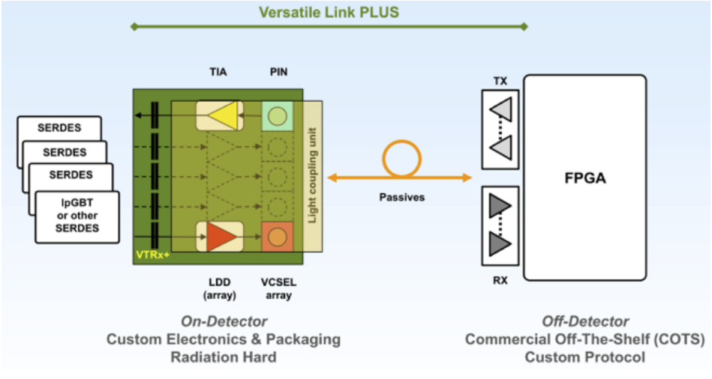
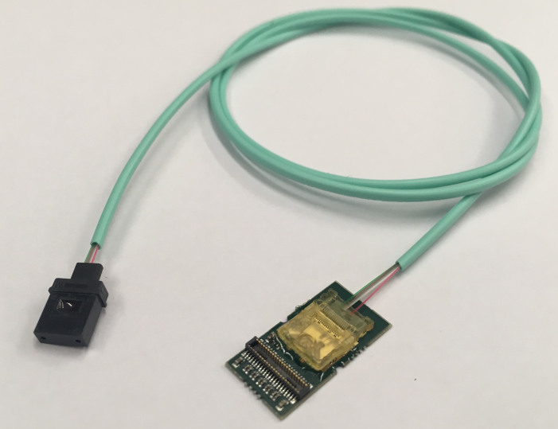
VTRX+ – Versatile Link+ Transceiver
Charge 1, 2
Tx Data rate up to 10.24 Gbps.
Rx Data rate up to 5.12 Gbps.
Power consumption up to 320 mW.
Fiber pigtail length [200 mm to 1000 mm], to be specified by customer. Low Smoke Halogen-Free Polymer.
Radiation Hard.
Magnetic field up to 4 T.
Refer to talk by P. Antonioli

Slide 6
Application at EIC
Charge 1, 2, 4
EIC MAPS detectors
Follow development of ITS2, ITS3 at CERN.
These use both the lpGBT ASIC and the VTRX+ Module.
High radiation environment, high magnetic field, low power, small size.
dRICH detector
Uses the VTRX+ Module
High radiation environment, high magnetic field, low power, small size.
The data rate requirements at EIC are within the specifications of both the lpGBT ASIC and the VTRX+ Module.

Slide 7
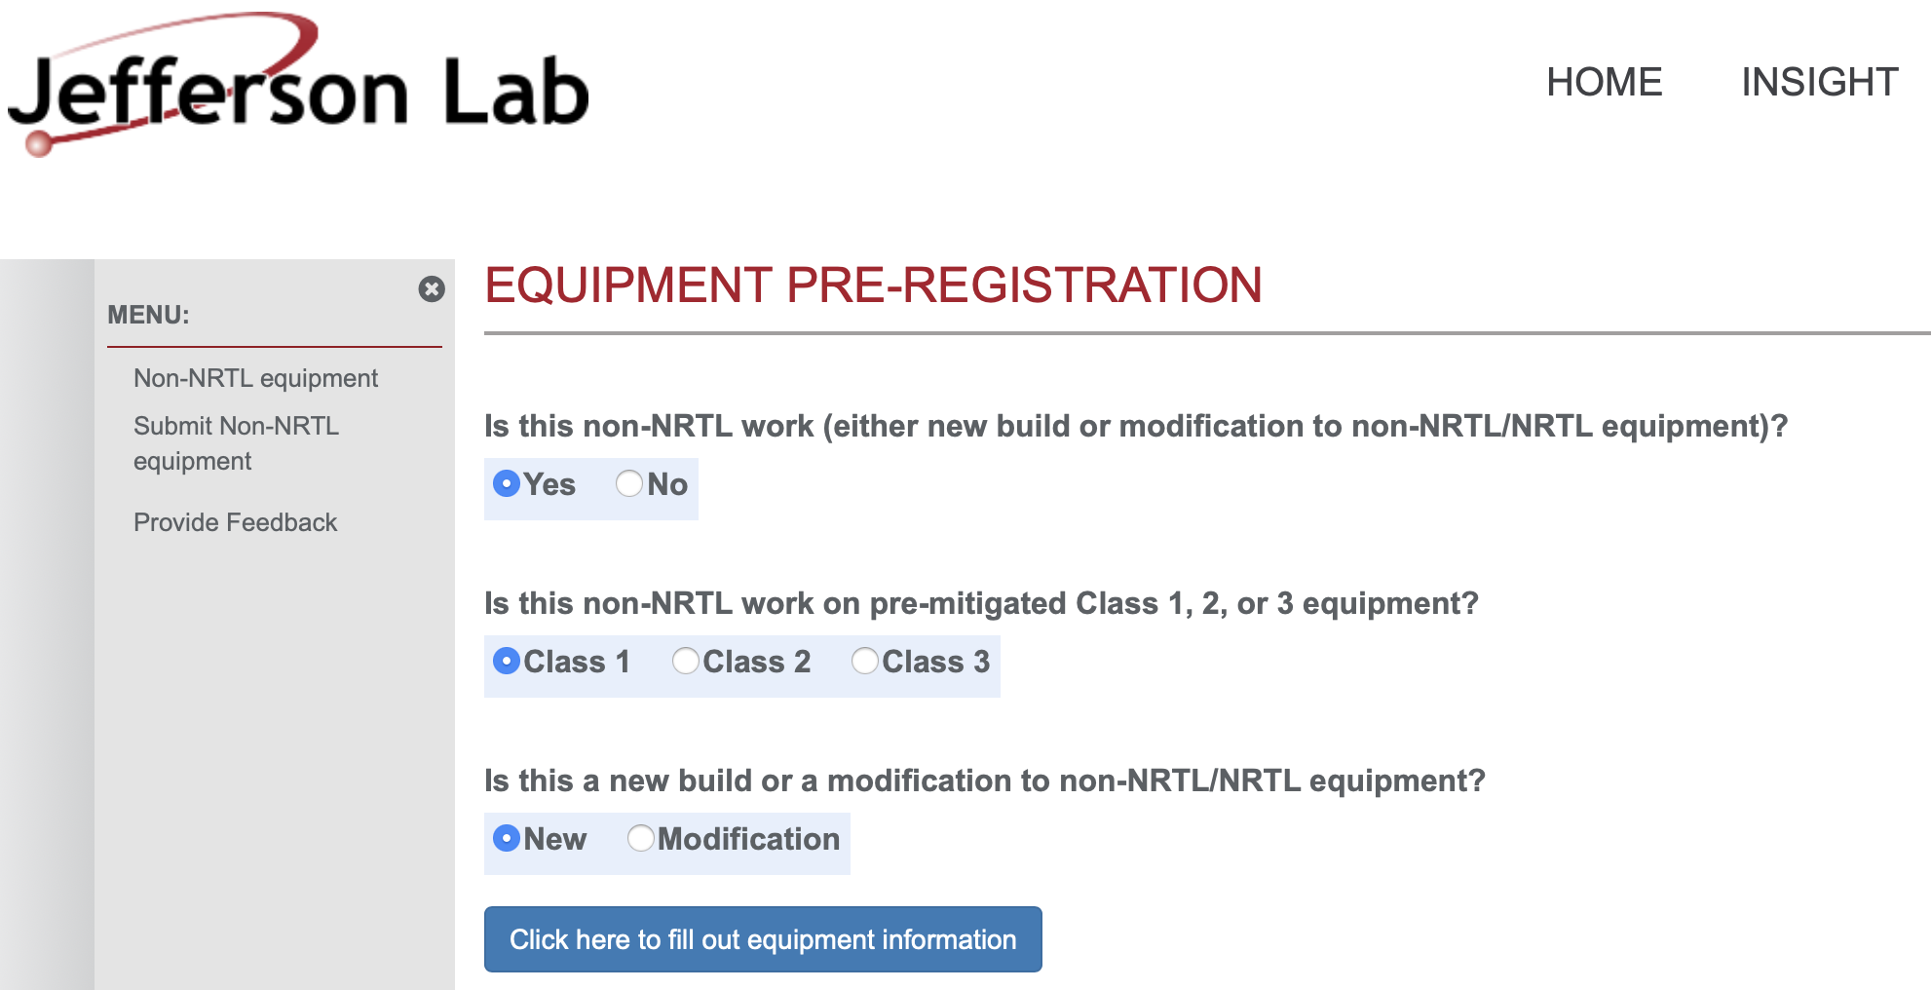
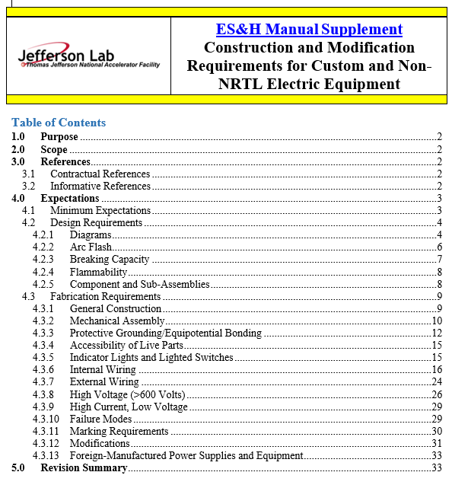
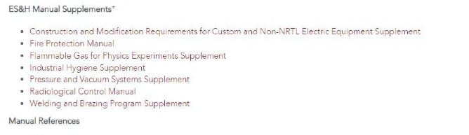
ESH&Q
Charge 5
BNL and JLAB have ESH&Q processes for Non-NRTL Electronics
Custom electronics built by collaborators for use in experiments at JLAb must go through a registration process first.
This is any equipment that is NOT certified by a Nationally Recognized Test Lab (NRTL) like UL and recognized by OSHA.
The JLAB EHS&Q Manual has a supplement guide for construction and/or modification of any custom or non-NRTL equipment.
Processes are in place to address any safety concerns from these devices

Slide 8
QA/QC
Charge 4, 5
Addressed at several levels
lpGBT:
Packaged devices (BGA) – by CERN and EIC institutions (full).
VTRX+
Module tests – by CERN sub-contractors and EIC institutions (full).
Final tests by the CERN sub-contractor require the installation of the fiber pig-tail.
The length(s) of the fiber pig-tails will be specified by the EIC prior to initiation of procurement.
All devices will be functionally tested prior to assembly and integration into the EIC detectors.

Slide 9
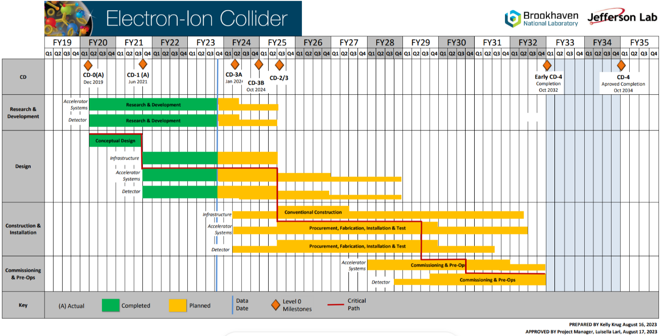
Timeline - Project
Charge 3
Construction and Installation includes procurements and deliveries and are initiated at different times of this phase.
eRD109 until mid FY27
ASIC Production mostly in FY26
R&D
Engineering Articles
Design until 9/2028
Construction
4/2025 to 4/2031
Bulk of Construction & Installation phase for Electronics: April 2025 – October 2029.
Installation of some items may be extended to April 2031.

Slide 10
Timeline cont. - Procurement
Charge 3, 4, 6
Procurement timeline (not to scale):
Until 5 January 2025
Specify Fiber pig-tail length
5 May 2025 - 4 January 2027
lpGBT and VTRX+ Production
Tests
From 1st Quarter of 2027
Procurement
dRICH Assembly
Procurement approach follows standard procedures for COTS devices but subject to delivery to collaborating institutions (e.g. drop ship) and to import/export regulations.
Quantities
lpGBT: 250 (MAPS only)
VTRX+: 3,500 (1,500 for dRICH, 2,000 for MAPS)

Slide 11
Summary
The lpGBT and the VTRX+ have demonstrated performance meeting or exceeding the requirements for EIC.
Application at EIC is consistent with current developments at CERN.
Production schedules at CERN fit well within the EIC schedule, with the dRICH detector as the first user of the VTRX+ during the 1st quarter of 2027.
Cost variances are subject to the exchange rates (CHF – USD), with low risk for significant cost increases.
Standard procurement approach with details on the deliveries to collaborating institutions to be finalized.

