Slide 1
ePIC Silicon Vertex Tracker lpGBT/VTRx+ Needs
J. Schambach

Slide 2
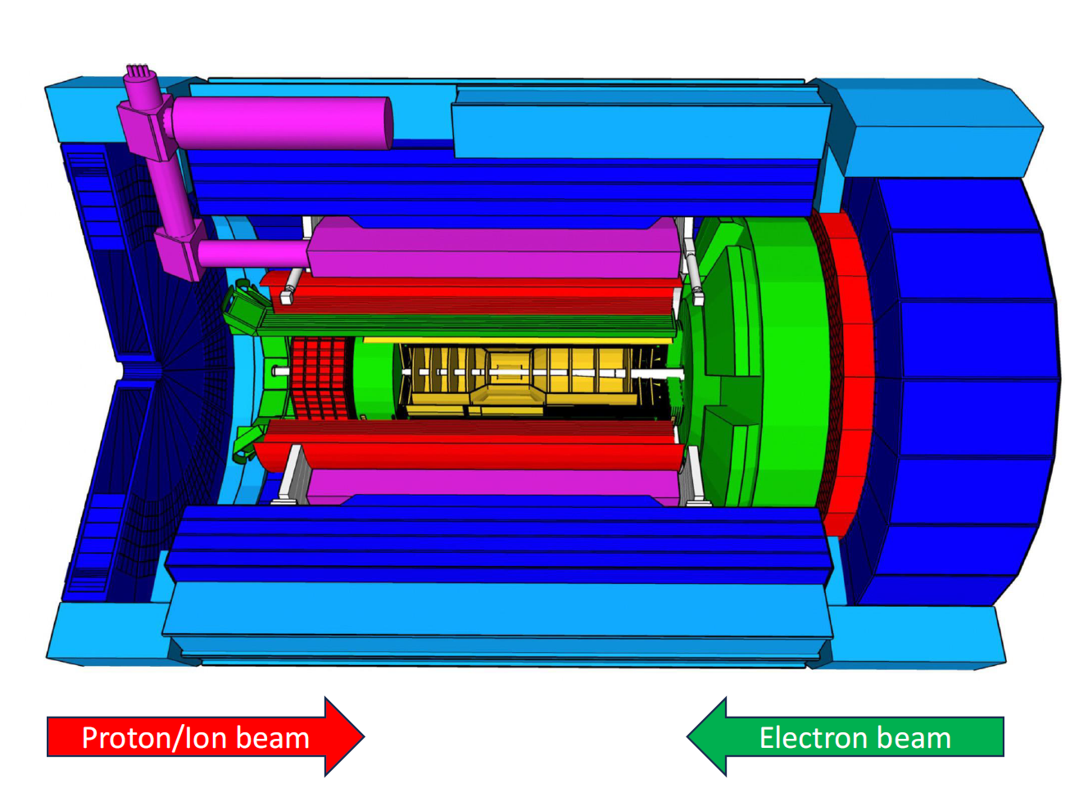
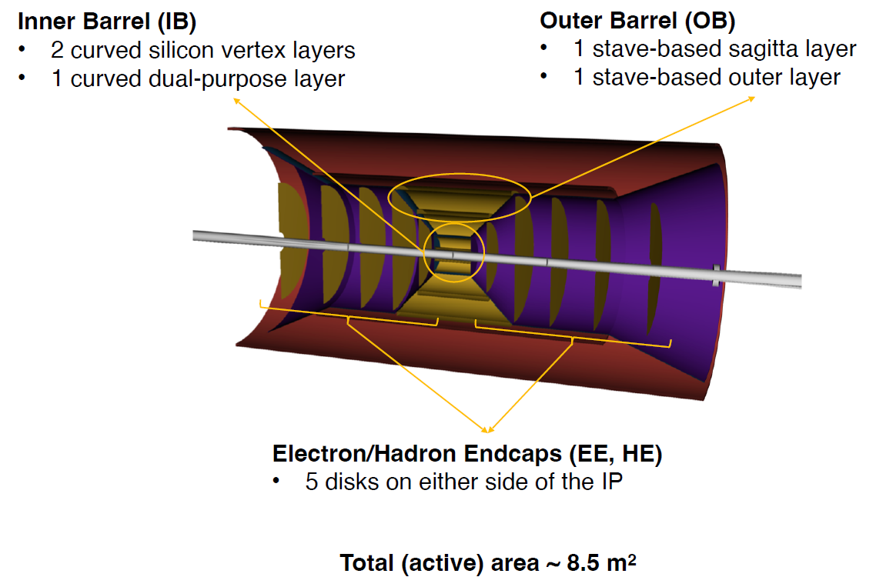
Silicon Vertex Tracker (SVT)

Slide 3
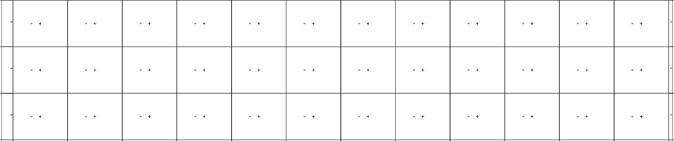
MOSAIX Architecture
Supplies
I/Os
Supplies
SEGMENT
Supplies
I/Os
RSU
Supplies
Supplies
I/Os
Supplies
LEC
RSU
REC

Slide 4
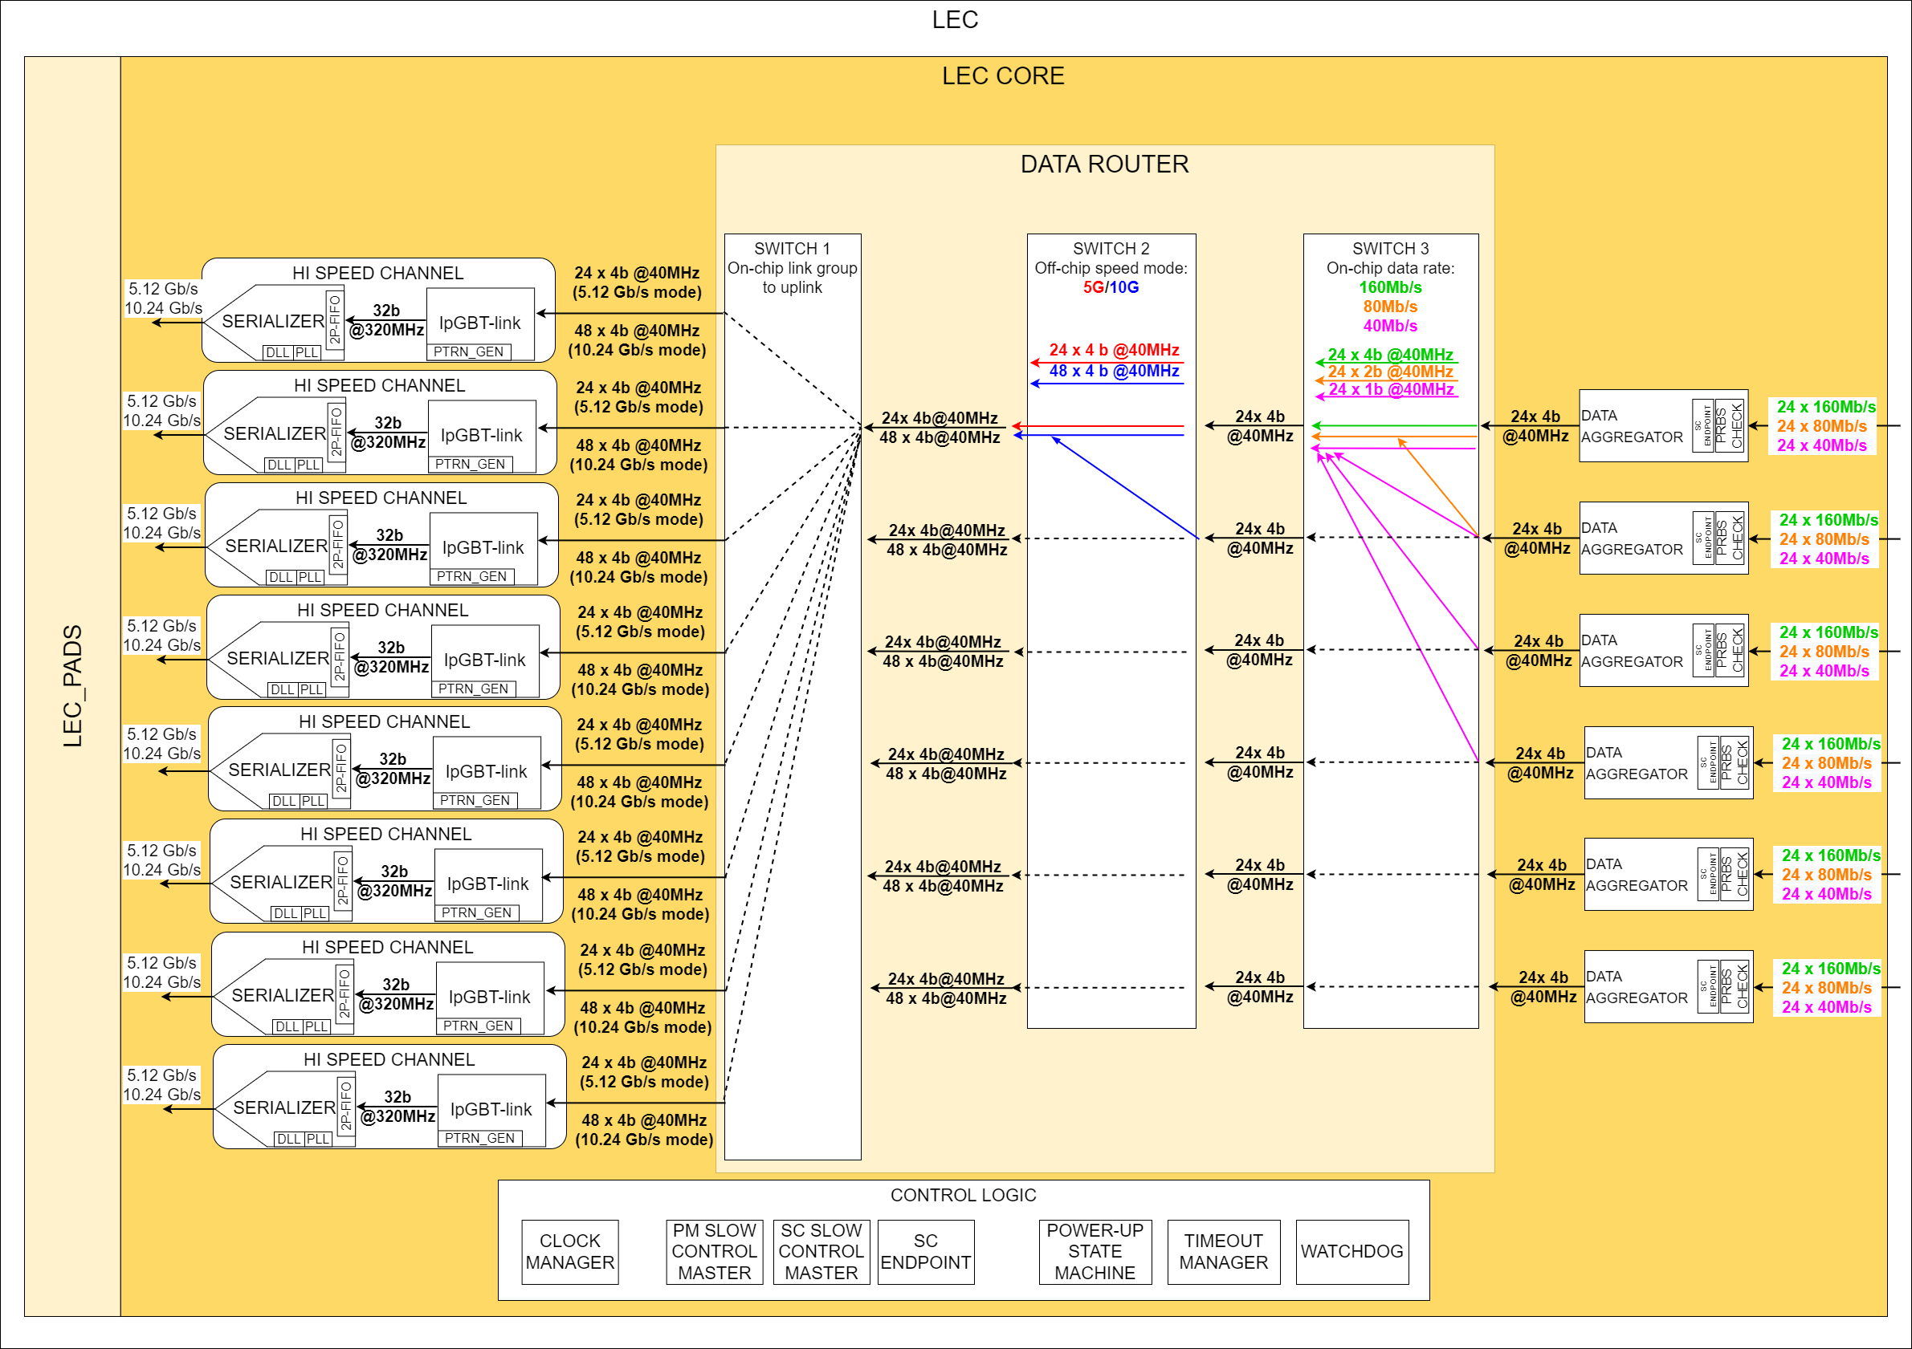
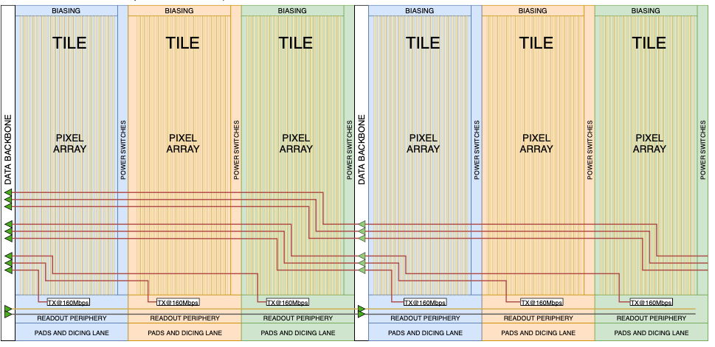
Data Flow – From Tiles to Left Endcap
x 12 RSU
10.24 Gbps
10.24 Gbps
72 Links
10.24 Gbps
10.24 Gbps
10.24 Gbps
10.24 Gbps
72 Links
10.24 Gbps
10.24 Gbps
12-RSU MOSAIX (SVT IB)
The data encoding block is the lpGBT’s TX core
160 Mbps x 144 = 22.5 Gbps
Full capacity: 8 HS serializers = 80 Gbps (10 Gbps each, only 3 used)
Fallback: 40 Gbps, 5 Gbps each (6 used)
4 serializer data outputs drive one VTRx+
SVT Outer Barrel & Disks
6-RSU LAS
72 Tiles
1 HS serializer = 10 Gbps
5-RSU LAS
60 Tiles
1 HS serializer = 10 Gbps

Slide 5
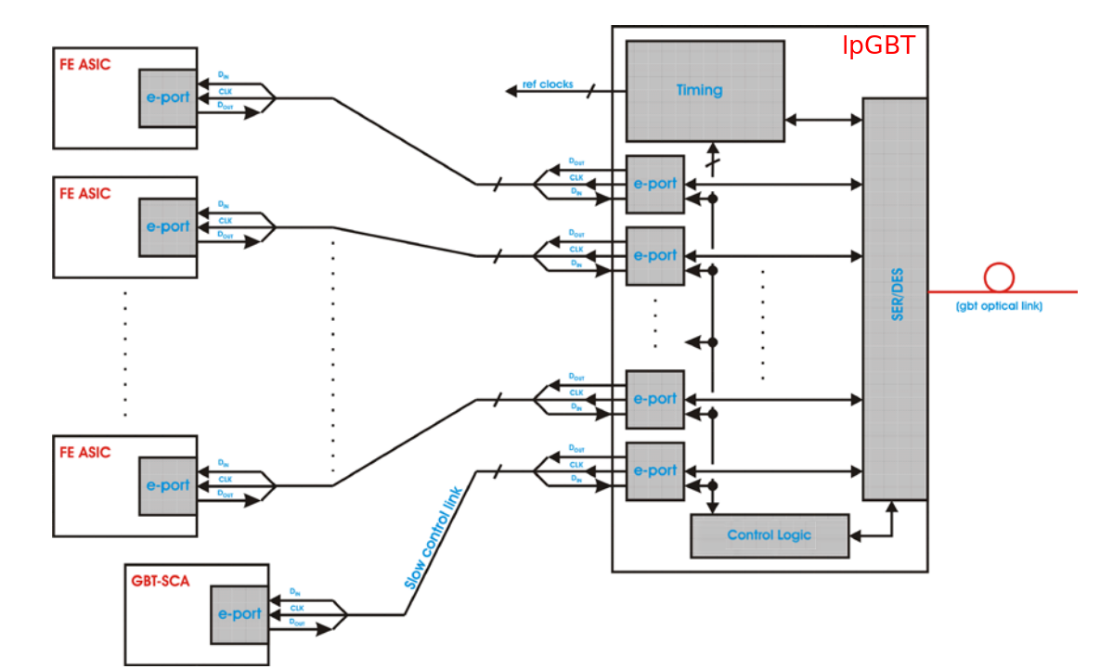
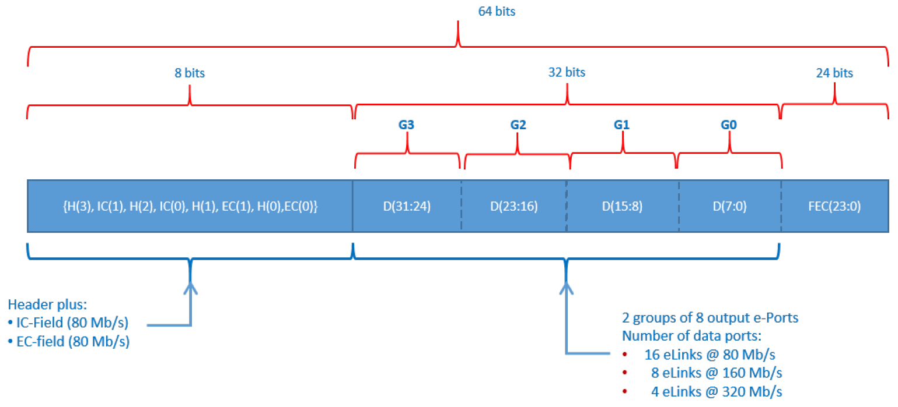

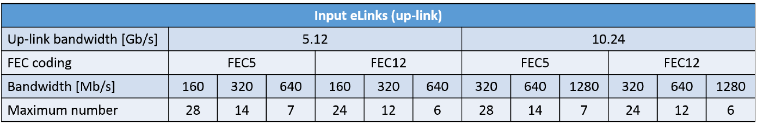
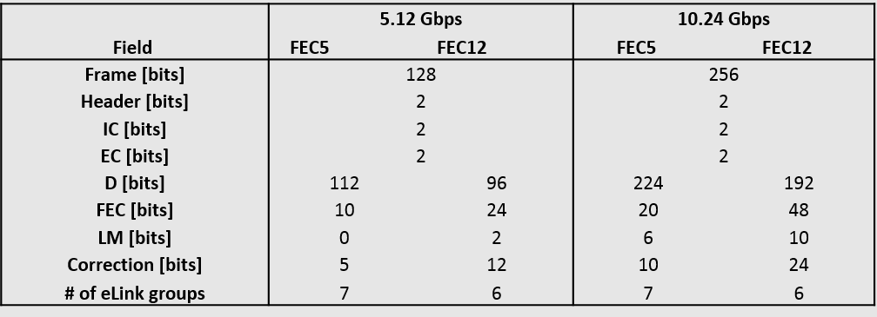
lpGBT Protocol
Downlink
Line Rate: 2.56 Gbps
32 out of 64 bits are data:
Payload = 1.280 Gbps
Data Uplink
192 out of 256 bits are data:
Payload = 7.680 Gbps
Front Ends connect to “e-links”
The fiber protocol includes “Forward Error Correction”
Downlink runs at 2.56 Gbps
  Downlink frame is 64bit wide, of which 32 bits are payload
  1.28 Gbps payload
  Up to 16 e-links @ 80 Mbps
Uplink runs at either 10.24 Gbps or 5.12 Gbps
  Uplink frame is either 128bit or 256bit
  256bit frame contains 192bits of payload (7.68 Gbps)
  Up to 24 e-links at either 160 Mbps or 320 Gbps

Slide 6
Supplies and I/Os
All I/Os are differential
8x 10.24 Gb/s data outputs
1x clock at 160 MHz
2x slow control buses at 5 Mbps
2x synchronization signals
(slow controls via lpGBT: 1 clk, 4 elink down, 2 elink up, 1 spare down)
Global analog and digital supplies per segment
On-chip supply segmentation and control
Reverse biasing of substrate (PSUB)
SVT LAS has power only from the LEC, no REC on LAS

Slide 7
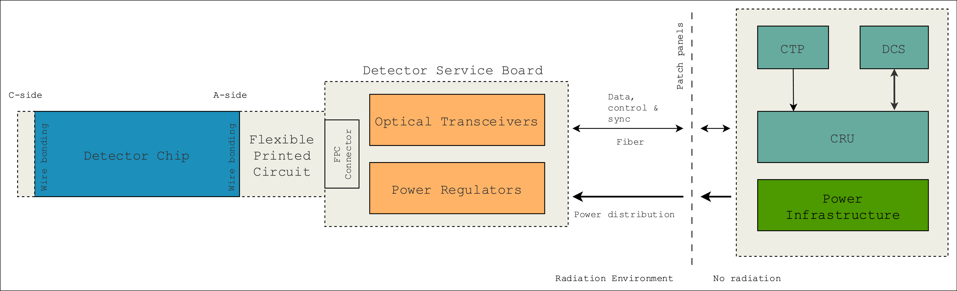
SVT Electronics – Simplified Overview
ePIC DAQ
Readout Electronics
Data, Control & Sync
GTU
DCS
Fiber
Fiber Aggregation Board
Flexible Printed Circuit
LAS
LAS
LAS
LAS
Stave(let)s
~10
FELIX
Fiber
Readout Electronics
Fiber
Power Infrastructure
Inner Barrel
< 50 cm long

Slide 8
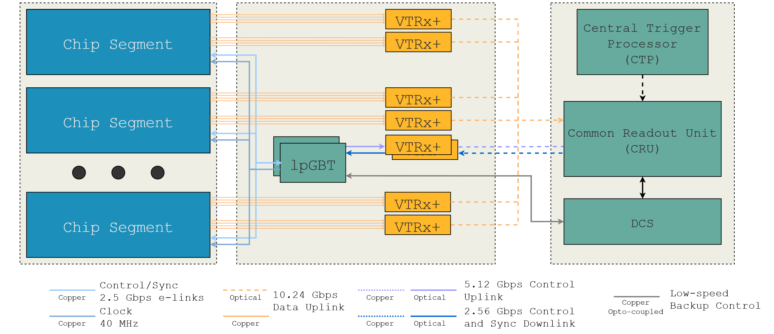
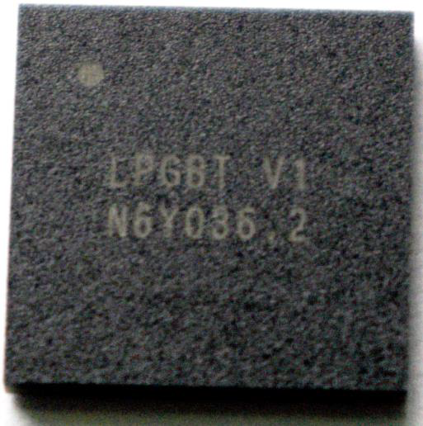
Inner Barrel Readout Electronics
Radiation Area
Counting House
Global Timing Unit
(GTU)
FELIX
(DAM Board)
Control
VTRx+
lpGBT
5 Mbps e-links
Clock
160 MHz
Data : 4 HS lines connected to 1 VTRx+ -> Fiber bundle
Slow Controls : uses lpGBT e-links for one-to-one connection with the LEC SC signals
lpGBTs are also used to control and monitor RDO electronics itself
lpGBTs are connected to individual VTRx+ for fiber up and downlink

Slide 9
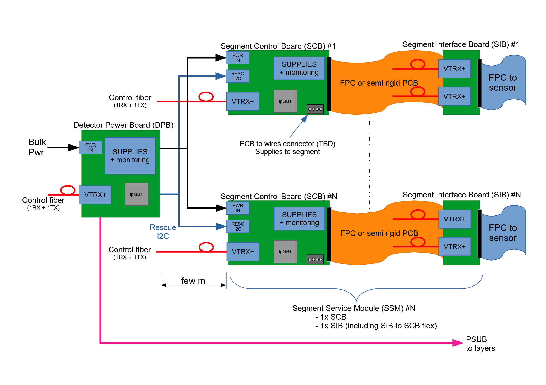
IB Readout Architecture

Slide 10
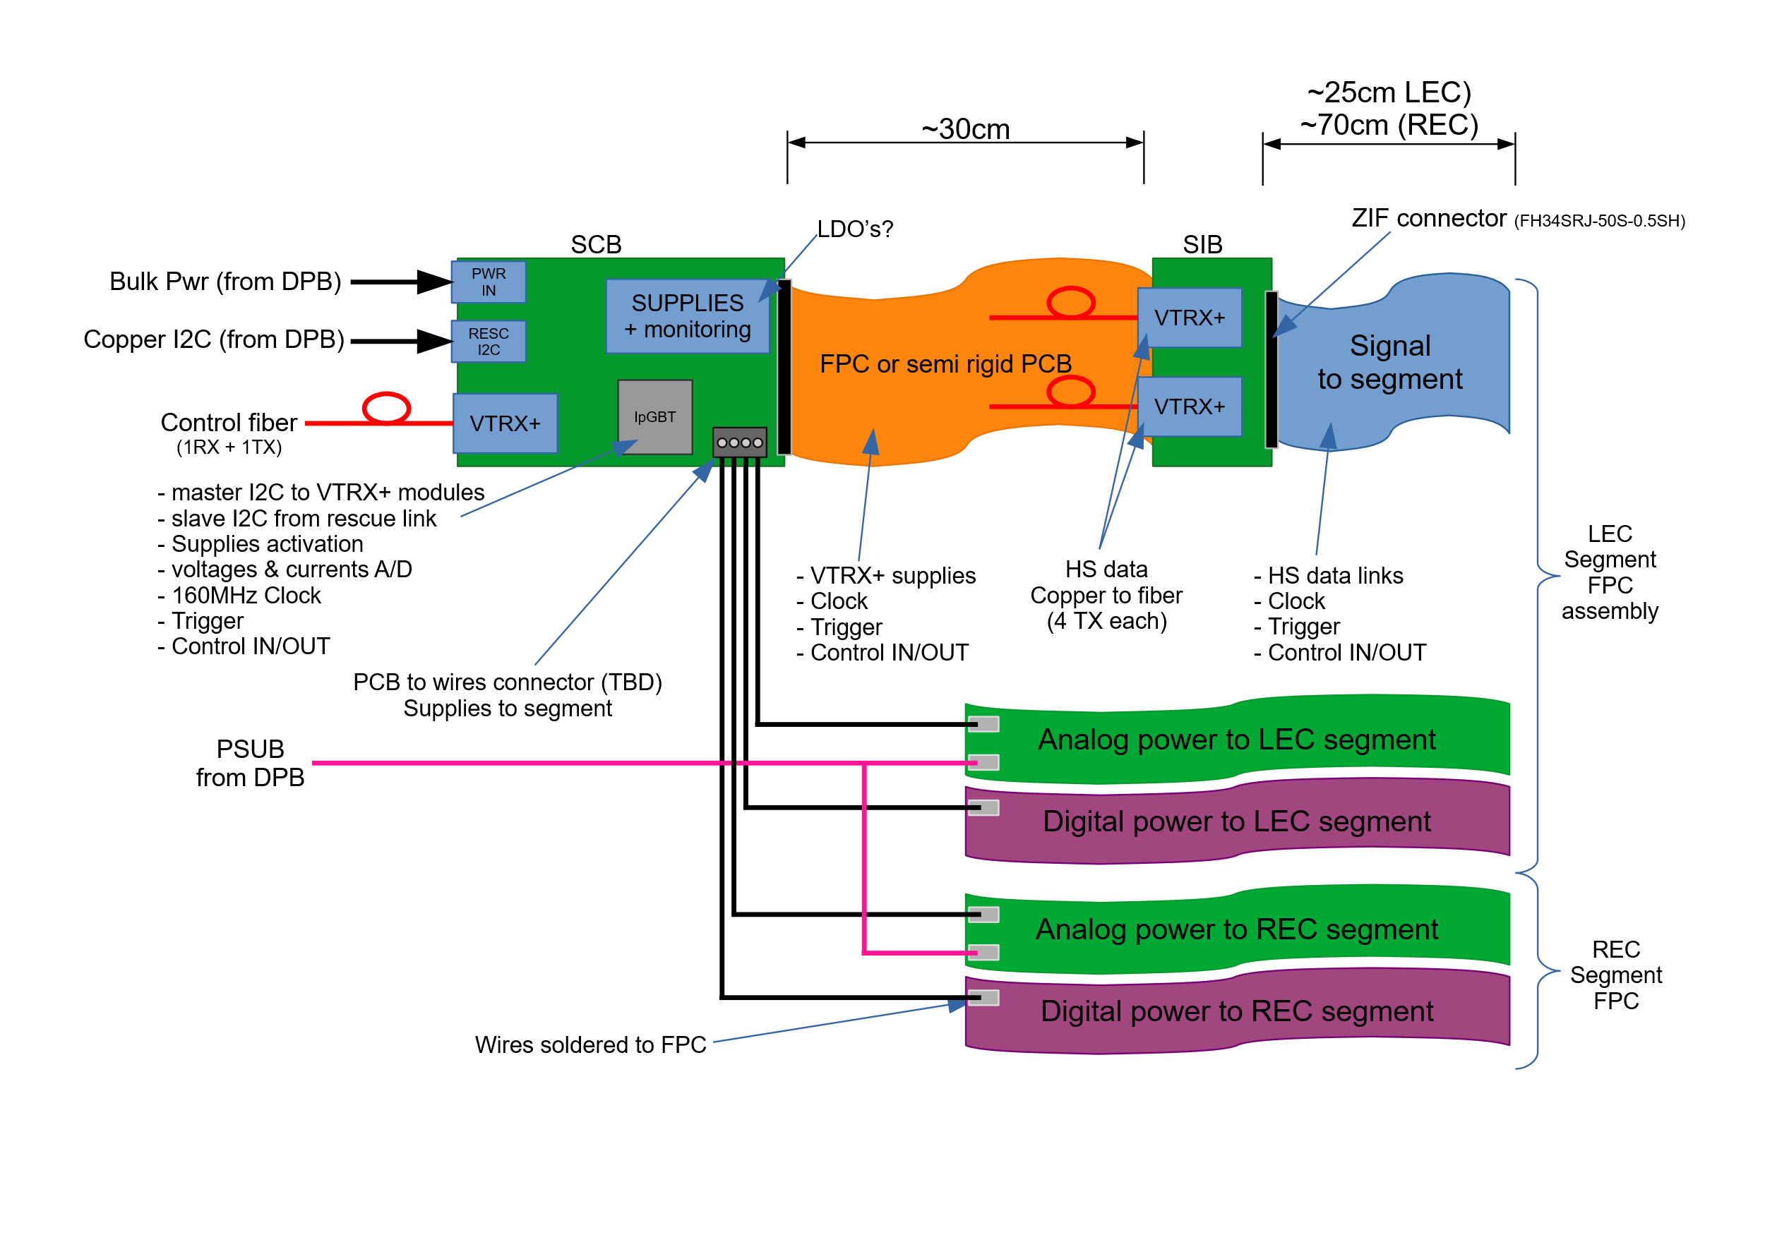
Readout Segment Architecture

Slide 11
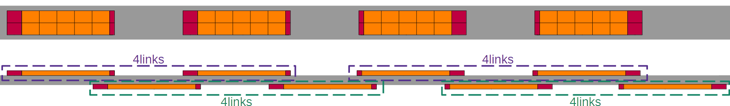
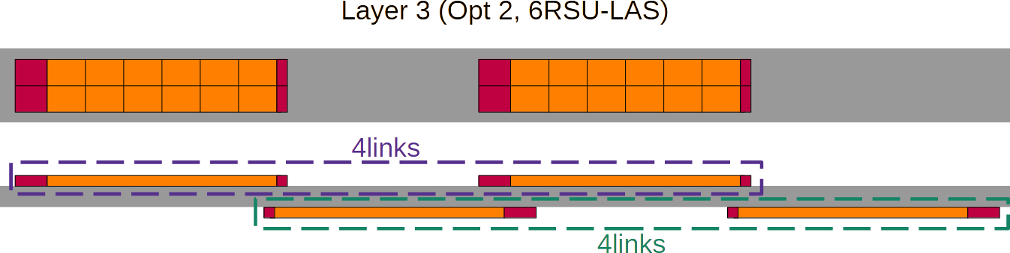
Disk/Outer Barrel Readout Configuration
Outer Barrel Layer 3
Outer Barrel Layer 4
Disks

Slide 12
Outer Barrel and Disk Readout Electronics
LAS
LAS
LAS
LAS
VTRx+
H/S Data
Fiber up
Slow ctrl
Slow Ctrl
Slow Ctrl
Slow Ctrl
SC up/down
VTRx+
&
lpGBT
elink 1
LAS
LAS
LAS
LAS
Fiber up/down
elink 2
Slow Ctrl
Slow Ctrl
Slow Ctrl
SC up/down
Slow Ctrl
….
elink 12
….
Disks & Staves:
SC up/down
LAS
LAS
LAS
LAS
Up to 4 LAS connect their H/S data to one VTRx+
Slow Controls is provided via lpGBT e-links to a SC bus
One e-link provides SC to a group of up to four EIC-LAS
Each SC e-link has 3 signals: Clock, SC_in, SC_out
Slow Ctrl
Slow Ctrl
Slow Ctrl
Slow Ctrl

Slide 13
Assumptions for SVT lpGBT & VTRx+ Needs
Each VTRx+ has 4 TX and 1 RX fiber
Each lpGBT provides 16 output elinks on downlink side
  Up to 4 of those are used for RDO internal use
  Up to 12 down elinks are available for slow controls
  Uplink count needs are equal or smaller than downlink count needs
For data up to 4 Readout links are connected to 1 VTRx+ where geometrically possible
For slow controls on the IB, each of the 5 downlink control lines are connected individually to lpGBT output elinks
  Each lpGBT is assumed to be used to serve (up to) 2 Segments
For slow controls on the OB and Disks, each “Module” (up to 4 LAS) is multiplexed to 1 elink (up and down)
  Each lpGBT is assumed to be used to serve (up to) 8 “Modules”
Each lpGBT requires 1 VTRx+ (1 TX & 1 RX used)

Slide 14
SVT lpGBT and VTRx+ Needs
 | width (mm) | length (mm) |  | # pixels per RSU
Reticle size | 19.564 | 21.666 |  | 831,168
Pixel size | 0.0208 | 0.0228
Barrel |  |  |  |  | Sensor
Layer Index | radius (mm) | z (mm) |  | Area (mm^2) | RSU in width | RSU in length | # of sensors in r-phi | # of sensors in z |  | # pixels | # sensors | Notes | # Readout Links | # Staves | # Data VTRx+ | # SC lpGBTs
L0 | 36 | 260 |  | 58,811 | 3 | 12 | 4 | 1 |  | 119,688,192 | 4 | bent ITS3 | 96 |  | 24 | 6
L1 | 48 | 260 |  | 78,414 | 4 | 12 | 4 | 1 |  | 159,584,256 | 4 | bent ITS3 | 128 |  | 32 | 8
L2 | 120 | 260 |  | 196,035 | 5 | 12 | 8 | 1 |  | 398,960,640 | 8 | bent ITS3 | 320 |  | 80 | 20
L3 | 270 | 520 |  | 882,158 | 1 | 6 | 96 | 4 |  | 1,915,011,072 | 384 | 6-RSU LAS | 384 | 48 | 96 | 12
L4 | 420 | 840 |  | 2,216,706 | 1 | 5 | 148 | 8 |  | 4,920,514,560 | 1184 | 5-RSU LAS | 1184 | 74 | 296 | 37
e-endcap
Disk index | z (mm) | inner r (mm) | outer r (mm) |  |  | 5-RSU LAS |  |  |  |  |  |  |  | Readout Modules
ED0 | -250 | 36.76 | 240 | 176,710 |  | 96 |  |  |  | 339,116,544 | 96 | 5-RSU LAS | 96 | 26 | 26 | 4
ED1 | -450 | 36.76 | 415 | 536,815 |  | 334 |  |  |  | 1,388,050,560 | 334 | 5-RSU LAS | 334 | 96 | 96 | 12
ED2 | -650 | 36.76 | 421.4 | 553,632 |  | 334 |  |  |  | 1,388,050,560 | 334 | 5-RSU LAS | 334 | 96 | 96 | 12
ED3 | -850 | 40.0614 | 421.4 | 552,835 |  | 334 |  |  |  | 1,388,050,560 | 334 | 5-RSU LAS | 334 | 96 | 96 | 12
ED4 | -1050 | 46.3529 | 421.4 | 551,127 |  | 334 |  |  |  | 1,388,050,560 | 334 | 5-RSU LAS | 334 | 96 | 96 | 12
h-endcap
Disk index
HD0 | 250 | 36.76 | 240 | 176,710 |  | 96 |  |  |  | 339,116,544 | 96 | 5-RSU LAS | 96 | 26 | 26 | 4
HD1 | 450 | 36.76 | 415 | 536,815 |  | 334 |  |  |  | 1,388,050,560 | 334 | 5-RSU LAS | 334 | 96 | 96 | 12
HD2 | 700 | 38.52 | 421.4 | 553,216 |  | 334 |  |  |  | 1,388,050,560 | 334 | 5-RSU LAS | 334 | 96 | 96 | 12
HD3 | 1000 | 53.43 | 421.4 | 548,909 |  | 334 |  |  |  | 1,388,050,560 | 334 | 5-RSU LAS | 334 | 96 | 96 | 12
HD4 | 1350 | 70.14 | 421.4 | 542,422 |  | 334 |  |  |  | 1,388,050,560 | 334 | 5-RSU LAS | 334 | 96 | 96 | 12
TOTAL |  |  |  | 8,161,315 |  |  |  |  |  | 19,296,396,288 | 4448 |  | 4976 |  | 1348 | 187
 |  |  |  |  |  |  |  |  |  | # of segments | 4500
 |  |  |  |  |  |  |  |  |  | # of SC links down | 22500
 |  |  |  |  |  |  |  |  |  | # of SC links up | 9000

Slide 15
Summary
Data VTRx+
Slow Controls lpGBT & VTRx+
Layer/disk | VTRx+ count
L0 | 24
L1 | 32
L2 | 80
L3 | 96
L4 | 296
ED0 | 26
ED1-4 | 4x 96
HD0 | 26
HD1-4 | 4x 96
Layer/disk | lpGBT count | VTRX+ count
L0 | 6 | 6
L1 | 8 | 8
L2 | 20 | 20
L3 | 12 | 12
L4 | 37 | 37
ED0 | 4 | 4
ED1-4 | 4x 12 | 4x 12
HD0 | 4 | 4
HD1-4 | 4x 12 | 4x 12
Total VTRx+: 1,535
Total lpGBT: 187
With a 20 – 25% spares and a small number for R&D, this rounds to 2,000 VTRx+ and 230 lpGBT

