Slide 1
ENDF/B-IX Guided Discussion Activation Library
Will Wieselquist, PhD Oak Ridge National Laboratory
Mini CSEWG August 13, 2024

Slide 2
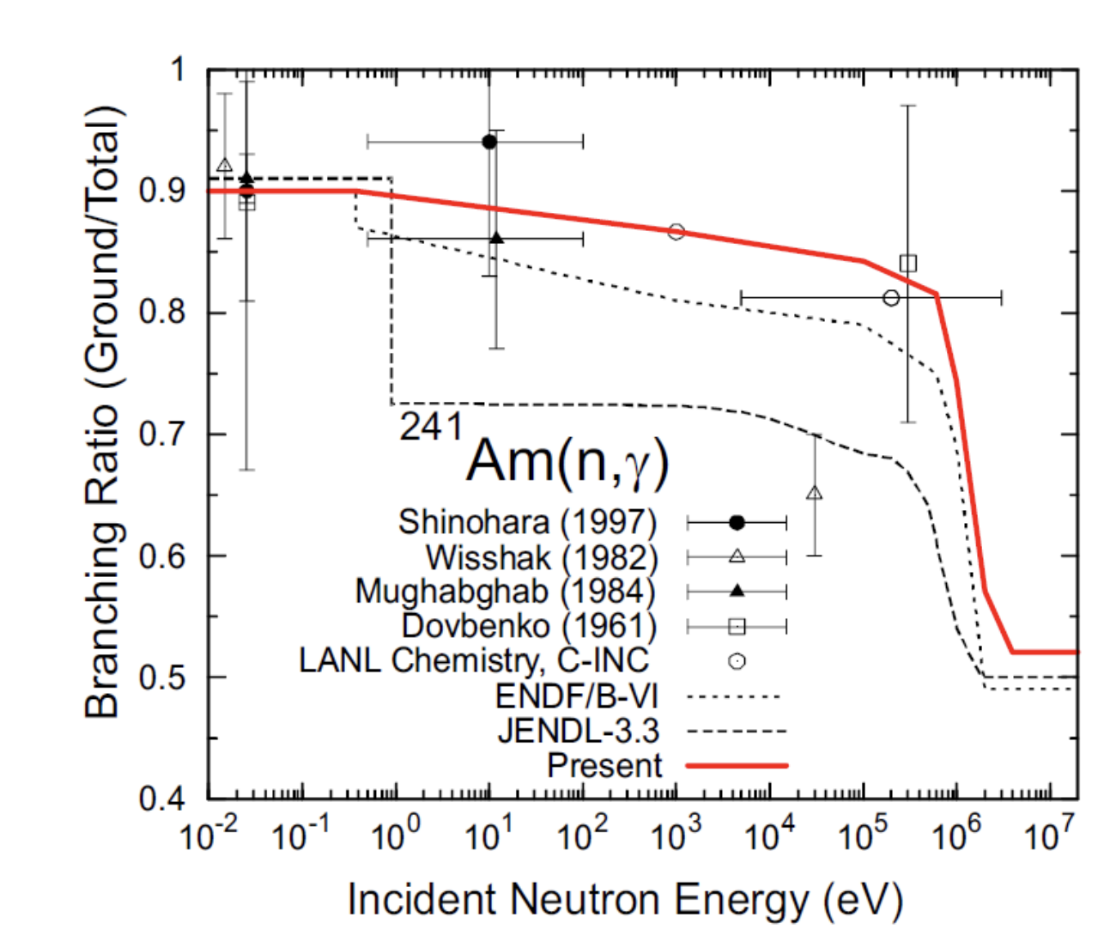
What is an “Activation Library”?
²⁴¹Am(n,$γ$): The most important isomeric branching for fission systems
Cross section data for nuclear transmutation, not particle transport
JEFF-3.3/A is a good, modern example
Includes isomeric branching “partial” xs
Does not include “2D data” like double differential scattering cross sections
SCALE/ORIGEN strategy
Start with baseline ENDF/B
Add supplementary resources such as JEFF/A, TENDL, IRDF
Baseline ENDF/B
Supplementary JEFF-3.1/A
$$\int_{0}^{∞}{dE σ_{m1}\left(E\right) φ(E)}$$
$$σ(n,γ)=σ_{m0}+σ_{m1}$$
$$\int_{0}^{∞}{dE σ_{m0}\left(E\right) φ(E)}$$

Slide 3
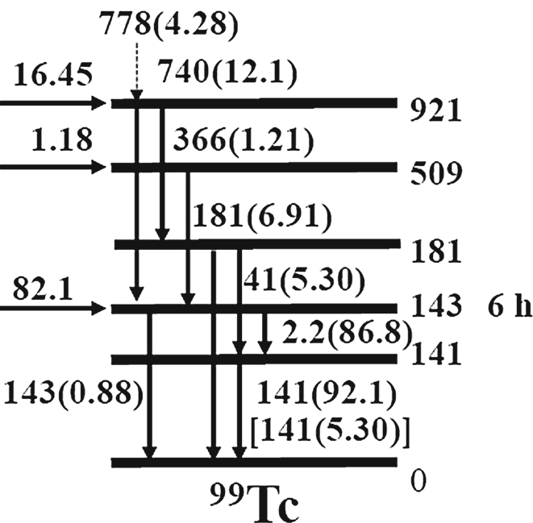
Remarks
Key applications
Activation
Spent fuel
Fusion
Isotope production
Neutrons are important, but for isotope production: photonuclear, proton also important
Future transmutation codes should be able to handle fields of all particles, e.g. both incident protons and exiting neutrons from (p,n)
Isomeric branching partials depend on decay levels
Define metastables/isomers
Probability of pausing at an isomeric state depends on probability of initial excited state + relaxation probabilities
Simplified level decay scheme for ⁹⁹Tc showing metastable and ground levels
^{99m}Tc
⁹⁹Tc

