Slide 2
Current and future Pu validation experiments
J. Hutchinson, T. Cutler, N. Kleedtke, G. McKenzie, I. Michaud, D. Neudecker, K. Stolte, N. Thompson, R. Little
8/13/24: Mini CSEWG

Slide 3
Overview
Historic Pu validation experiments
Recent NCERC benchmarks
  EUCLID
Future experiments
  Lilith
  PARADIGM
  Others

Slide 4
Historic Pu validation experiments
Experiment | Fission | Elastic | Inelastic | n,gamma | total nu
pu-met-fast-022-001 | 0.743 | 0.064 | 0.041 | -0.008 | 0.987
pu-met-fast-025-001 | 0.731 | 0.051 | 0.033 | -0.009 | 0.988
pu-met-fast-035-001 | 0.729 | 0.051 | 0.033 | -0.009 | 0.988
pu-met-fast-040-001 | 0.729 | 0.048 | 0.033 | -0.010 | 0.988
pu-met-fast-039-001 | 0.727 | 0.045 | 0.032 | -0.010 | 0.988
pu-met-fast-001-001 | 0.727 | 0.063 | 0.040 | -0.008 | 0.966
pu-met-fast-001-004 | 0.726 | 0.063 | 0.040 | -0.008 | 0.966
pu-met-fast-001-002 | 0.726 | 0.062 | 0.040 | -0.008 | 0.966
pu-met-fast-001-003 | 0.726 | 0.063 | 0.039 | -0.008 | 0.966
pu-met-fast-023-001 | 0.725 | 0.046 | 0.032 | -0.010 | 0.988
pu-met-fast-045-005 | 0.718 | 0.035 | 0.026 | -0.014 | 1.000
pu-met-fast-026-001 | 0.718 | 0.039 | 0.022 | -0.011 | 0.988
pu-met-fast-045-004 | 0.718 | 0.034 | 0.026 | -0.014 | 1.000
pu-met-fast-045-006 | 0.718 | 0.038 | 0.024 | -0.015 | 1.000
pu-met-fast-045-003 | 0.717 | 0.035 | 0.024 | -0.014 | 1.000
pu-met-fast-024-001 | 0.716 | 0.048 | 0.038 | -0.020 | 0.988
pu-met-fast-045-001 | 0.715 | 0.034 | 0.024 | -0.016 | 1.000
pu-met-fast-045-002 | 0.713 | 0.034 | 0.023 | -0.015 | 1.000
pu-met-fast-045-007 | 0.712 | 0.035 | 0.021 | -0.017 | 1.000
pu-met-fast-036-001 | 0.710 | 0.042 | 0.037 | -0.021 | 0.988
pu-met-fast-015-001 | 0.707 | 0.033 | 0.018 | -0.013 | 0.985
pu-met-fast-009-001 | 0.706 | 0.044 | 0.032 | -0.010 | 0.964
EUCLID_3x2x64 | 0.702 | 0.043 | 0.025 | -0.011 | 0.965
pu-met-fast-003-103 | 0.701 | 0.039 | 0.018 | -0.008 | 0.962
pu-met-fast-021-002 | 0.700 | 0.040 | 0.027 | -0.016 | 0.968
pu-met-fast-005-001 | 0.699 | 0.035 | 0.025 | -0.012 | 0.965
pu-met-fast-013-001 | 0.696 | 0.023 | 0.018 | -0.019 | 0.986
pu-met-fast-021-001 | 0.696 | 0.042 | 0.028 | -0.019 | 0.968
pu-met-fast-018-001 | 0.696 | 0.033 | 0.030 | -0.016 | 0.965
pu-met-fast-014-001 | 0.695 | 0.025 | 0.019 | -0.018 | 0.985
pu-met-fast-008-001 | 0.695 | 0.035 | 0.025 | -0.012 | 0.955
pu-met-fast-029-001 | 0.690 | 0.059 | 0.036 | -0.008 | 0.915
EUCLID_8x1x130 | 0.685 | 0.022 | 0.010 | -0.011 | 0.965
Table at right shows benchmarks sorted in order of descending Pu239 fission sensitivity.
Integrated over all energy, ENDF/B-VIII.0 nuclear data.
List mostly filled with historic LANL (blue) and Russian (red) experiments.
LANL has a history of Pu239 validation experiments.
  We are continuing to add new experiments.

Slide 5
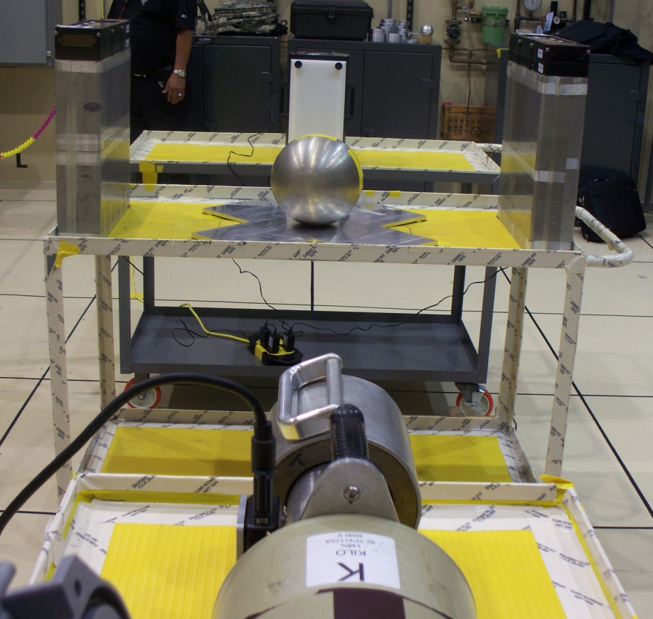
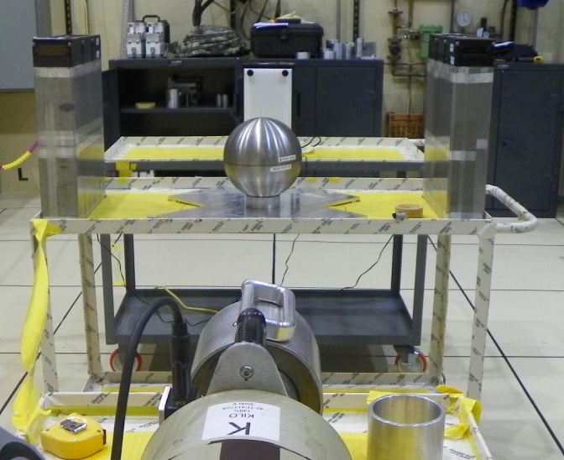
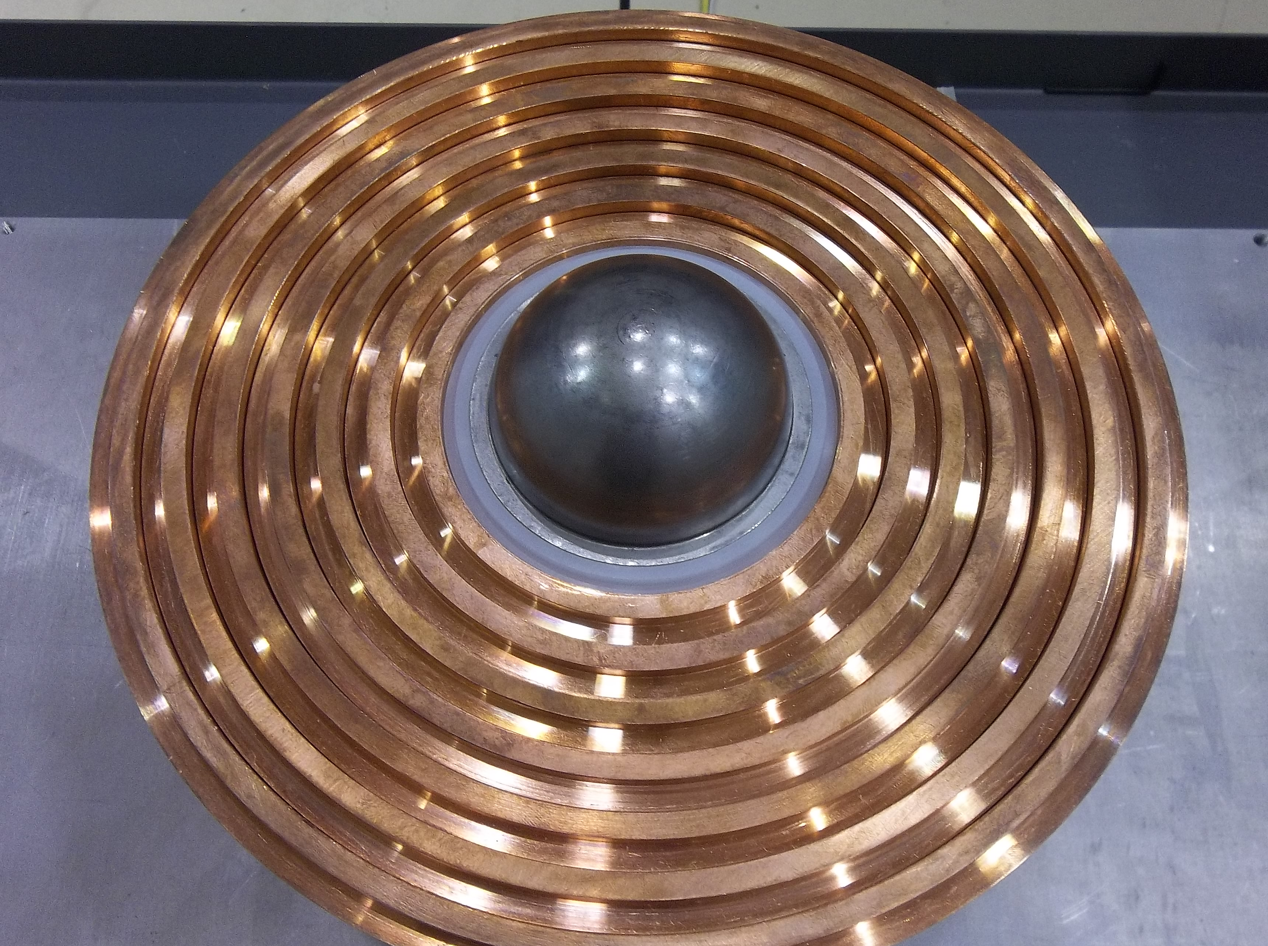
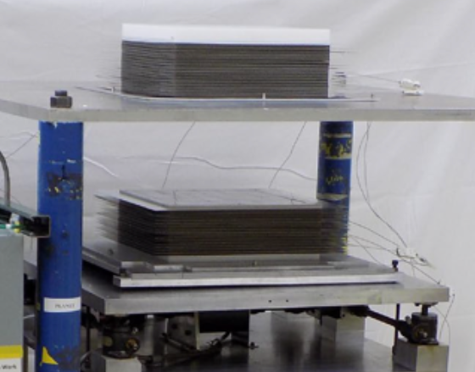
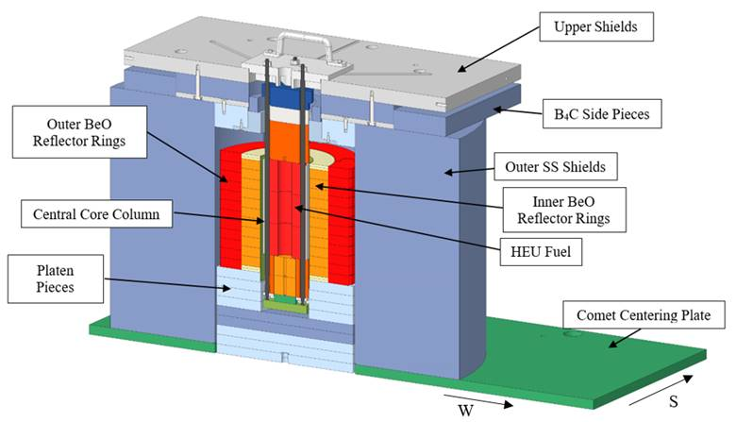
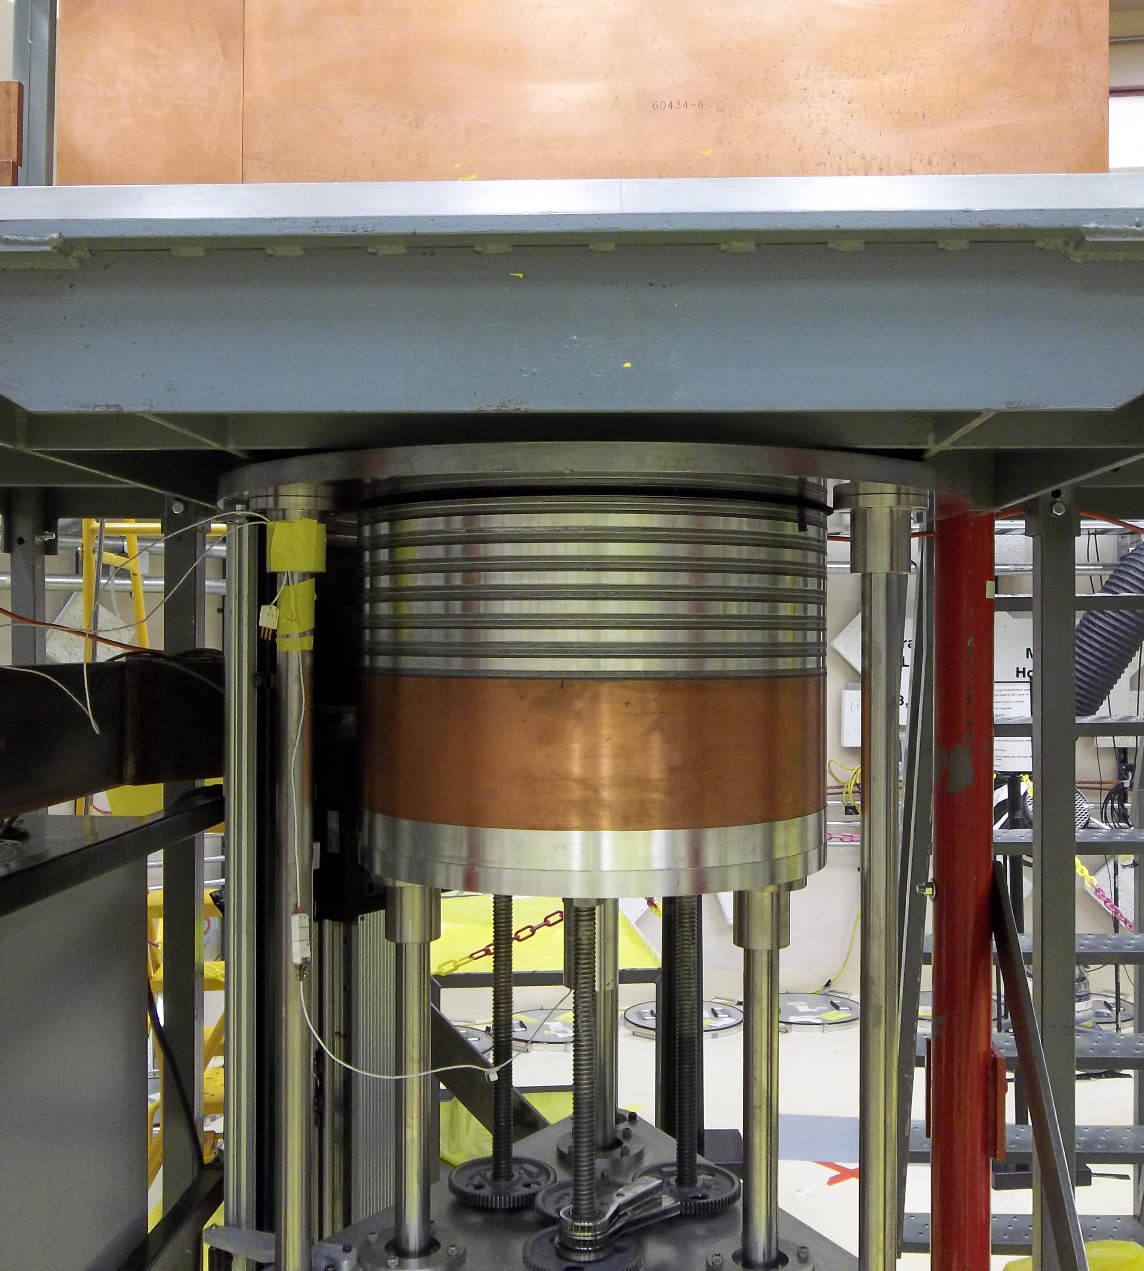
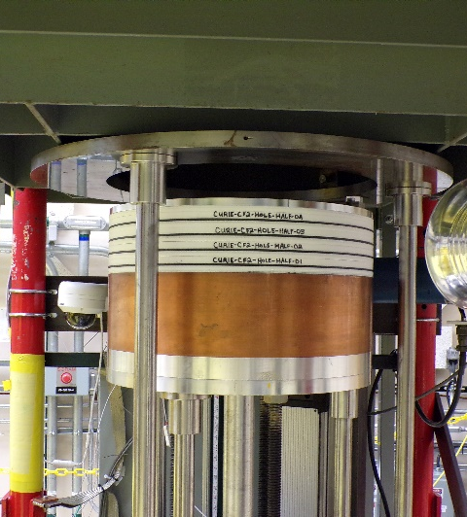
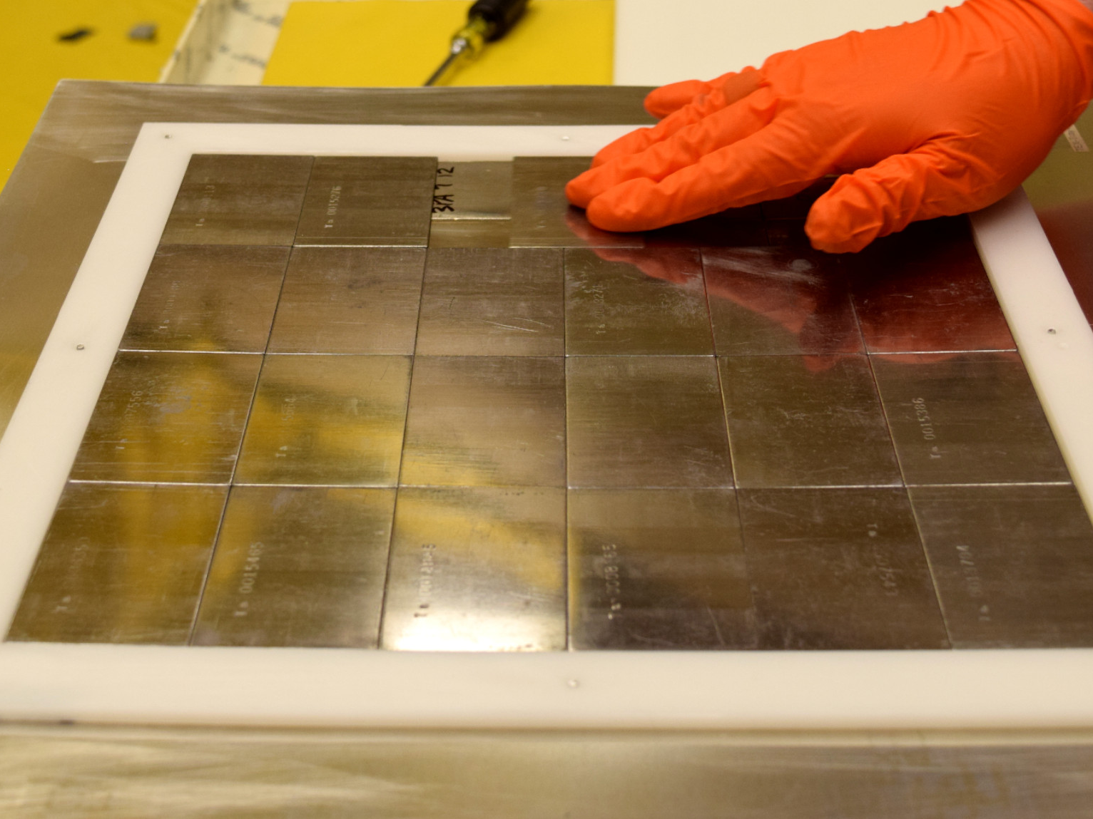
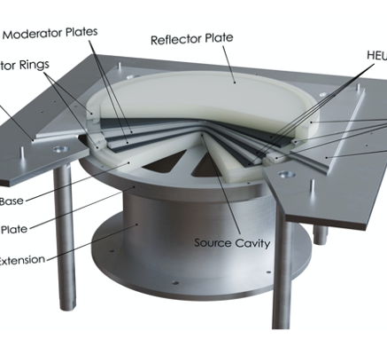
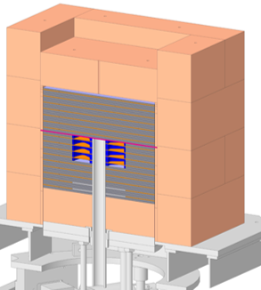
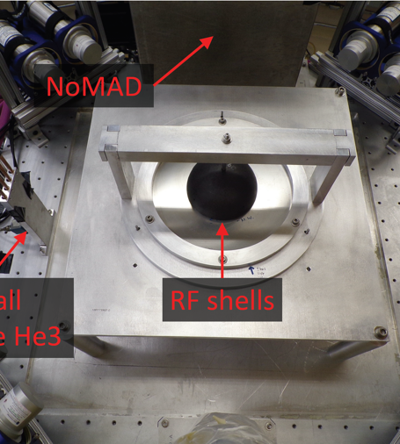
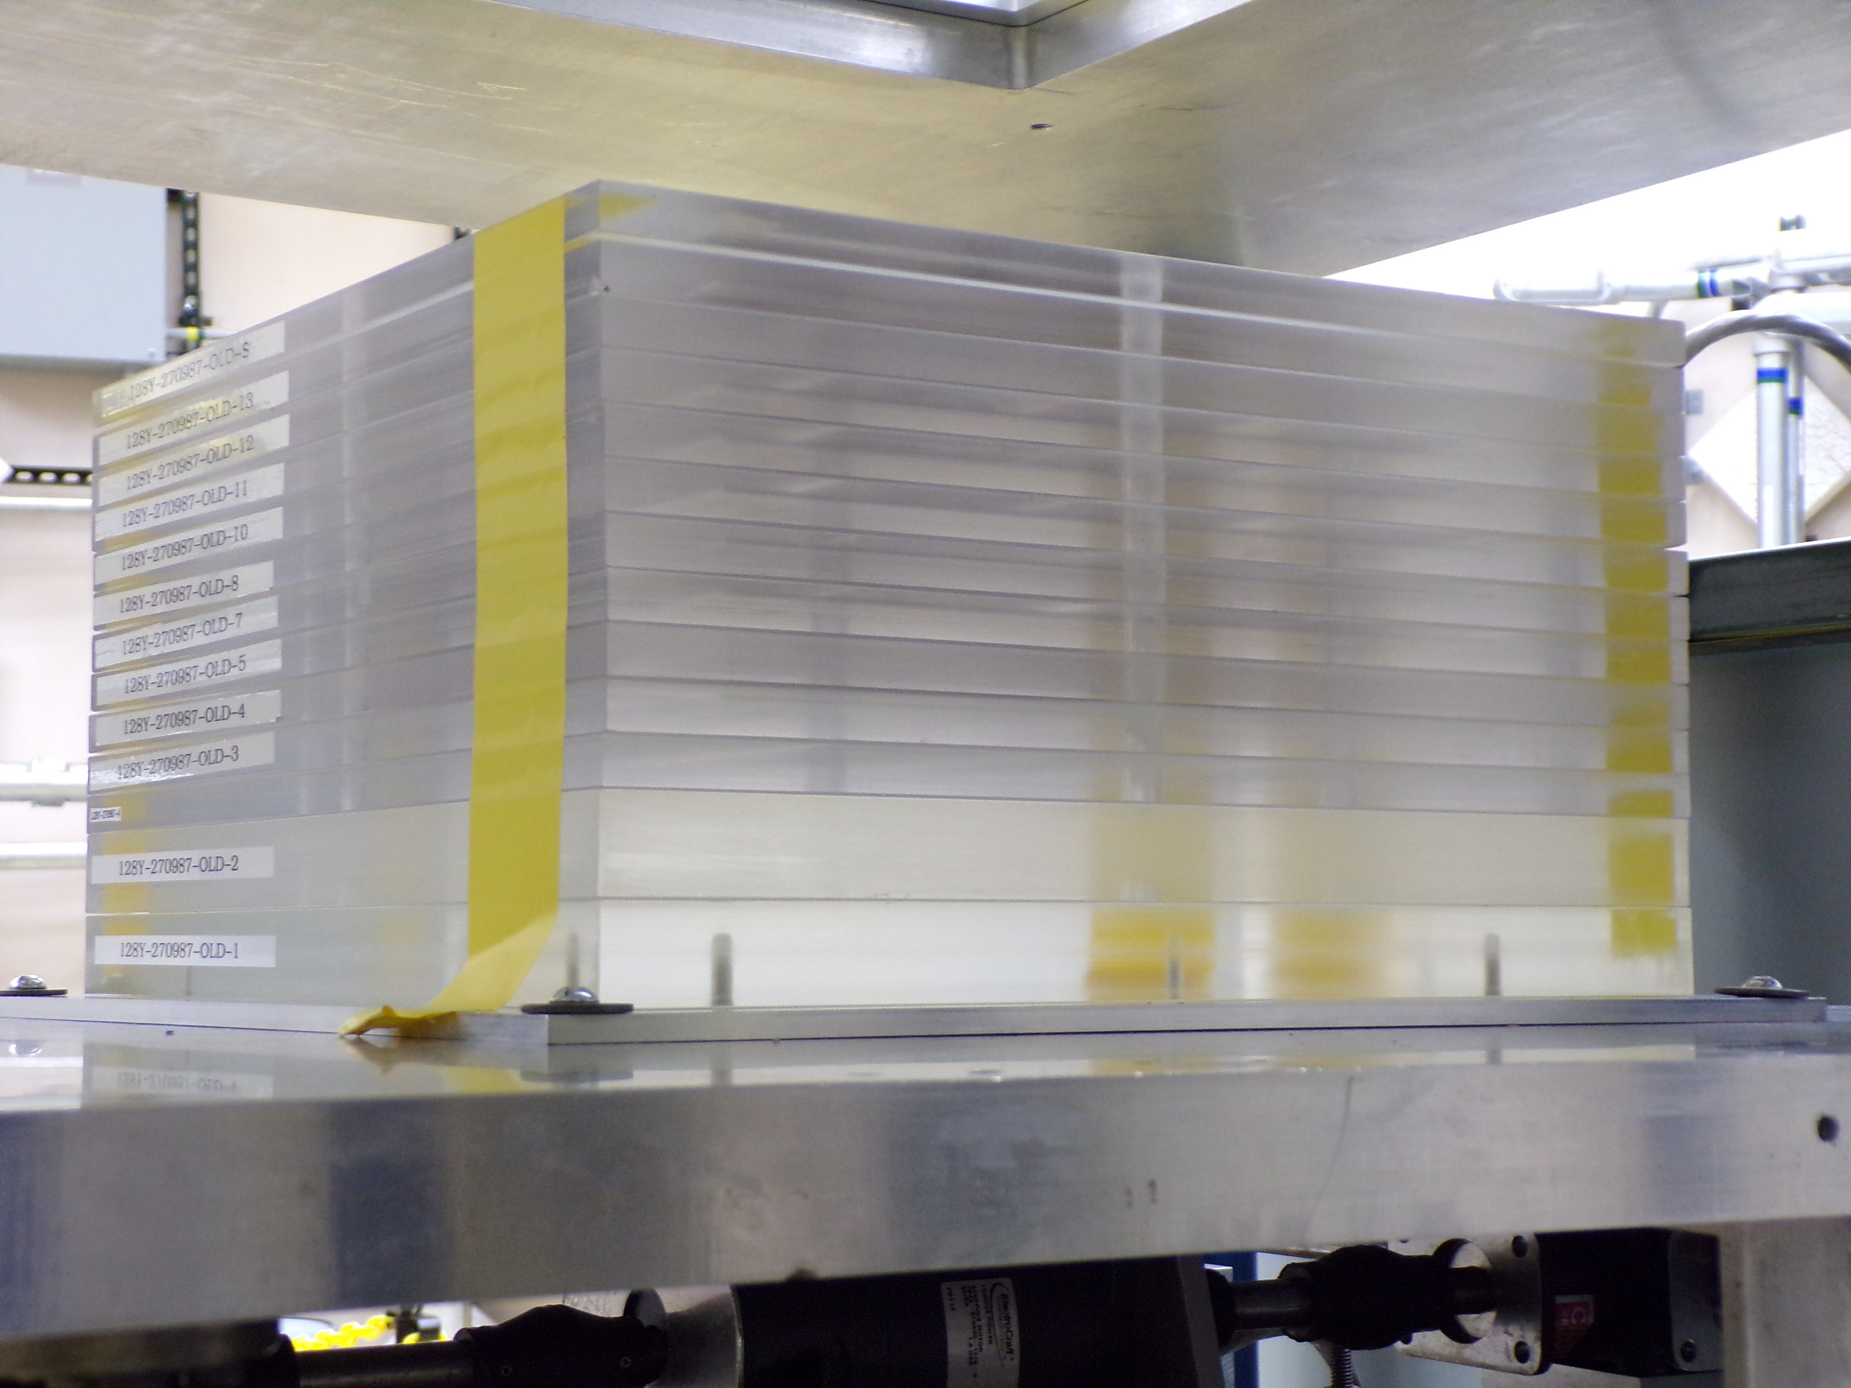
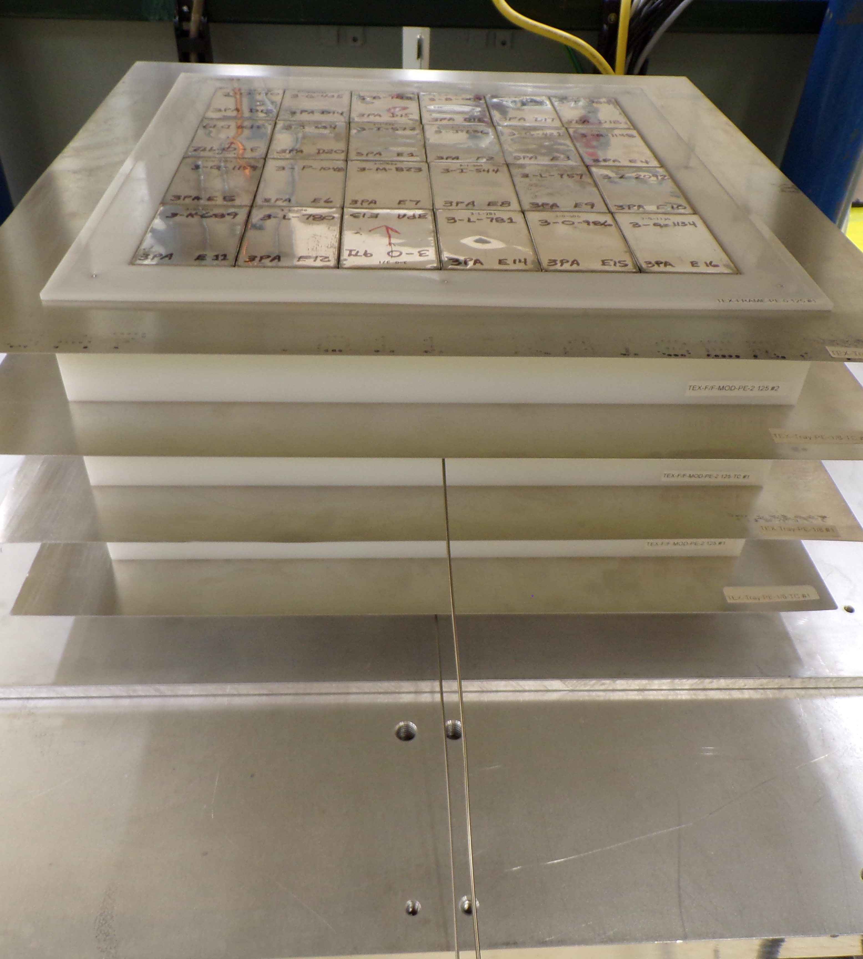
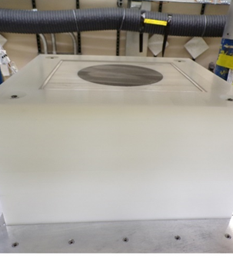
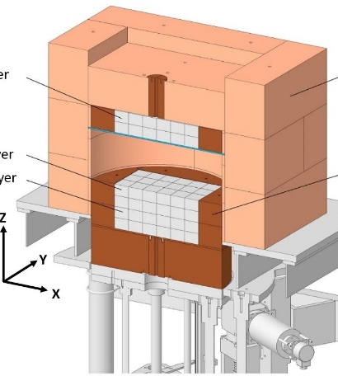
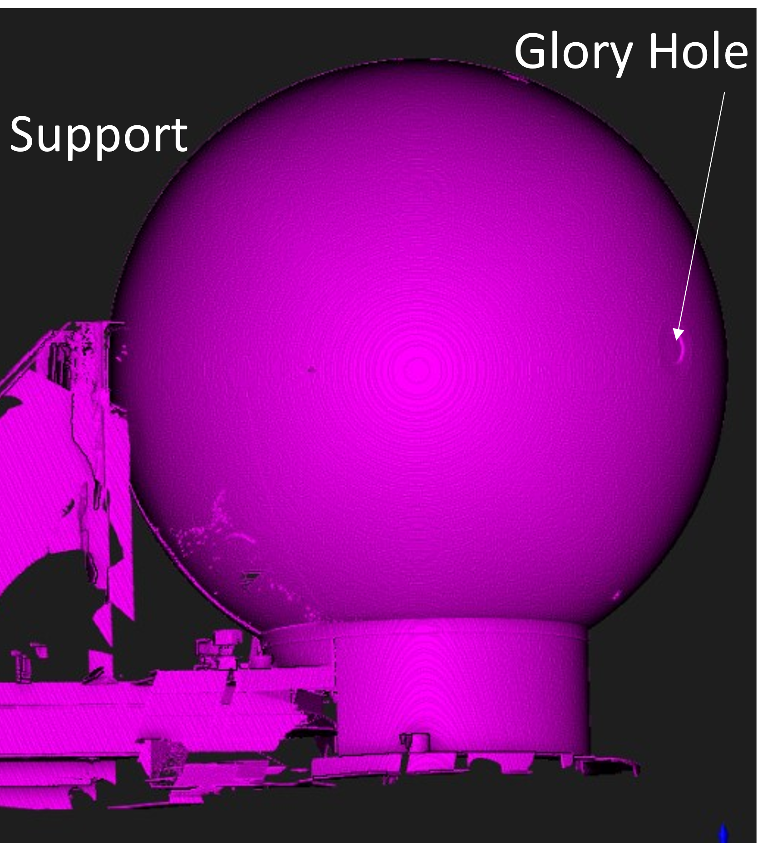
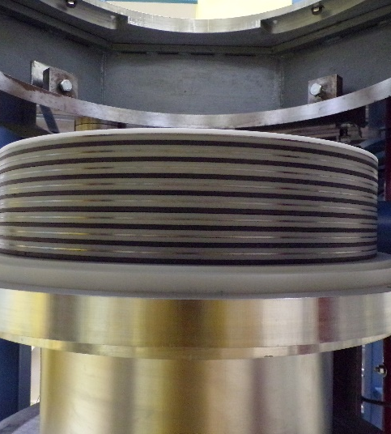
Recent NCERC benchmarks
Of the 17 ICSBEP evaluations of experiments performed at NCERC, 8 are Pu systems.
Many of these are included in our modern validation suite.
Fast, intermediate, and thermal systems.
Most of the Pu benchmarks are WG Pu.
  Some upcoming benchmarks with high Pu240.
Subcritical BeRP experiments:
  Still need to make validation easier for these experiments.

Slide 6
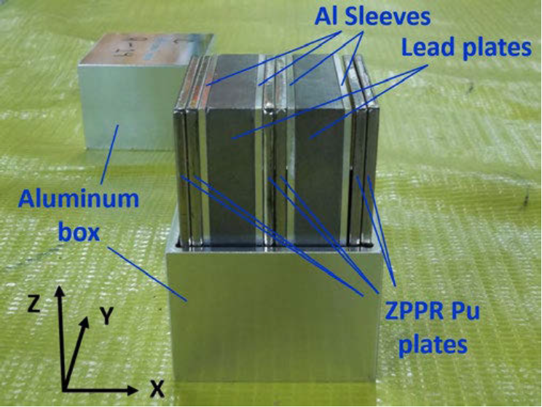
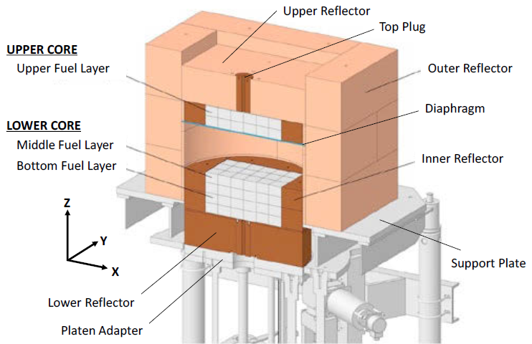
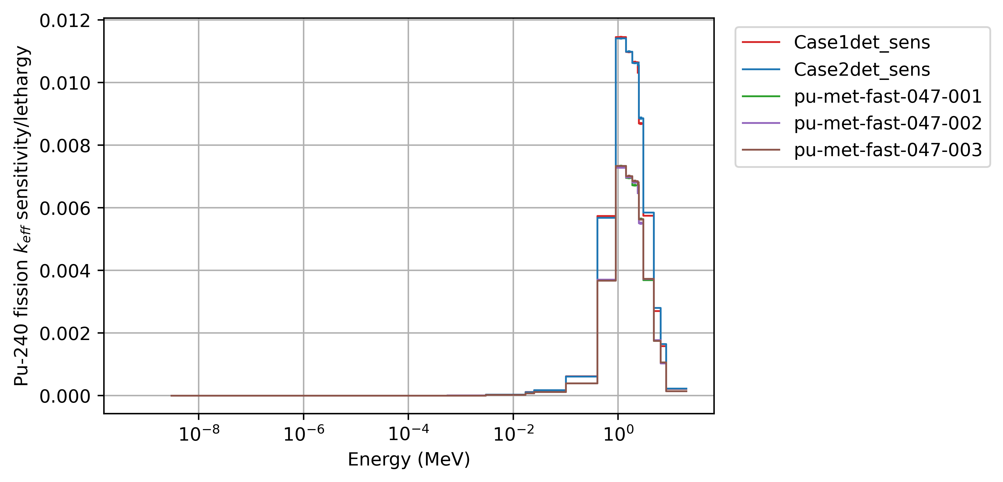
Jupiter High-240 experiment
Collaboration with JAEA to help validate Accelerator Driven Systems (ADS).
Similar to the WG Pu Jupiter experiments.
Performed at NCERC in 2019.
ICSBEP evaluation currently underway.
Jupiter High-240
Jupiter

Slide 7
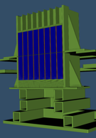
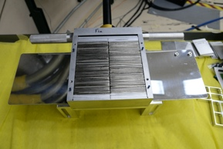
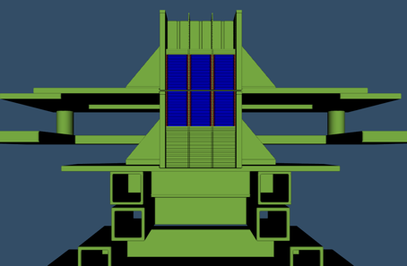
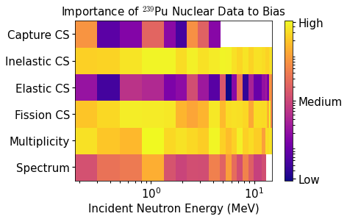
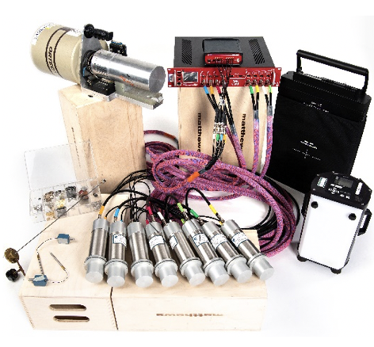
EUCLID
designed validation experiments optimized to reduce ²³⁹Pu compensating errors & adjusted nuclear data to experiments
Experiment Refines Nuclear Data to Improve Simulations
Neutron Transport
Simulation (MCNP)
ML-Optimally Designed Experiment to Resolve Compensating Errors
ML-Augmented
Search for Compensating Errors
Validation Experiments

Slide 8
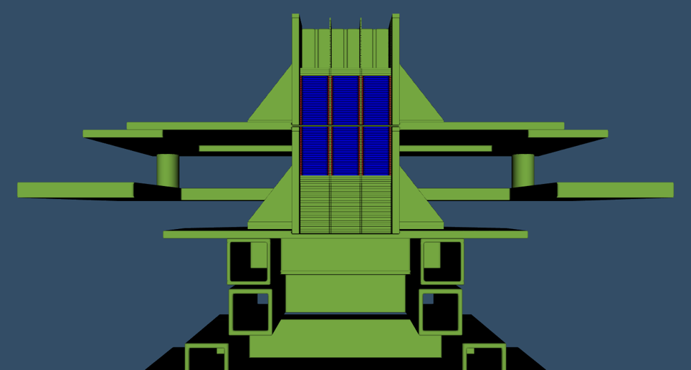
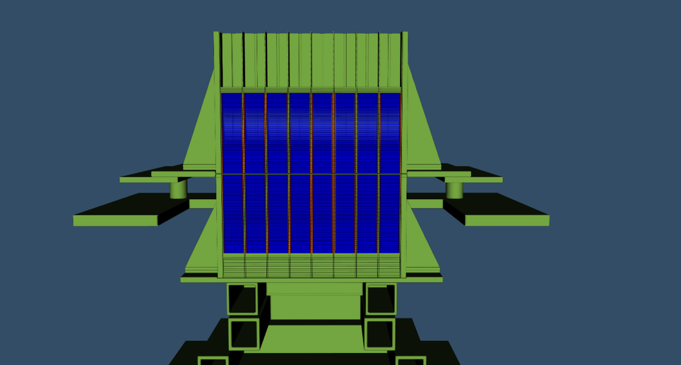
Experiment Optimization
Results of the D-Optimality analysis led us to two configurations:
  Both utilize WG Plutonium-Aluminum No-Nickel (PANN) ZPPR plates as fuel
  Non-nuclear components can be used for future experiments as well
3 X 2 (Low Mass/Cube)
Critical with 384 ZPPR plates (41 kg Pu)
8 X 1 (High Mass/Slab reactor)
Critical with 1033 ZPPR plates (109 kg Pu)
8x1 H/”D” ratio is 5.4

Slide 9

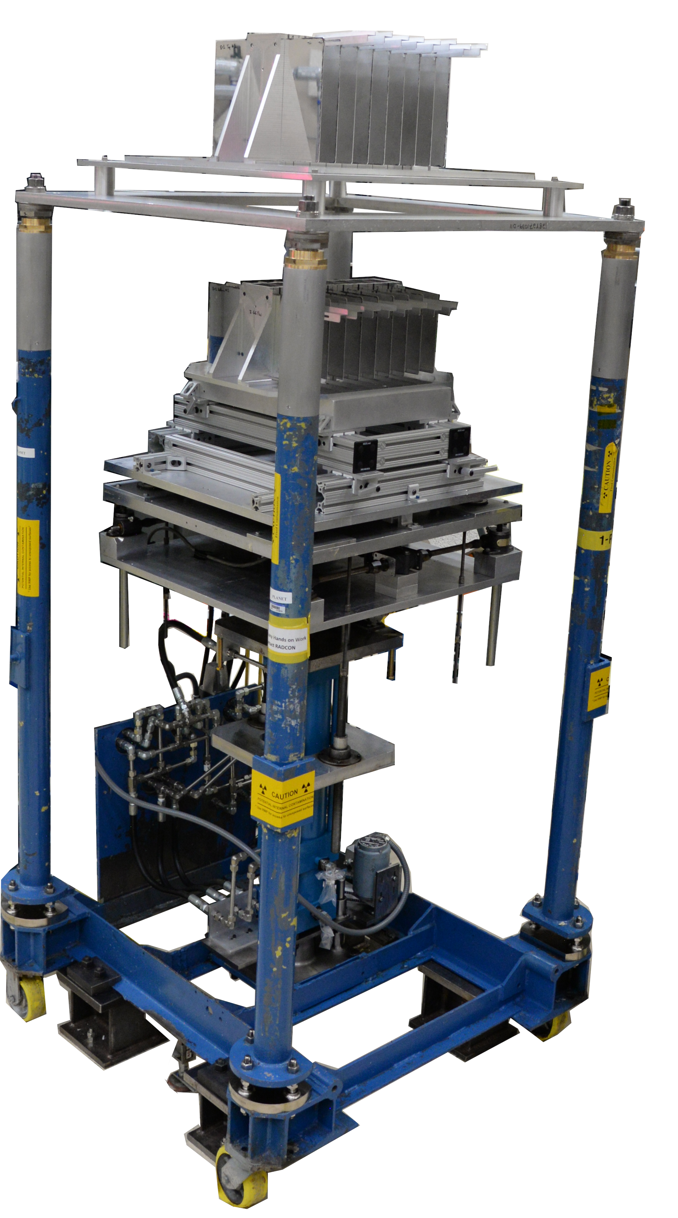
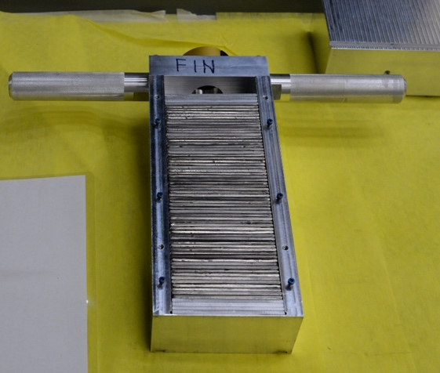
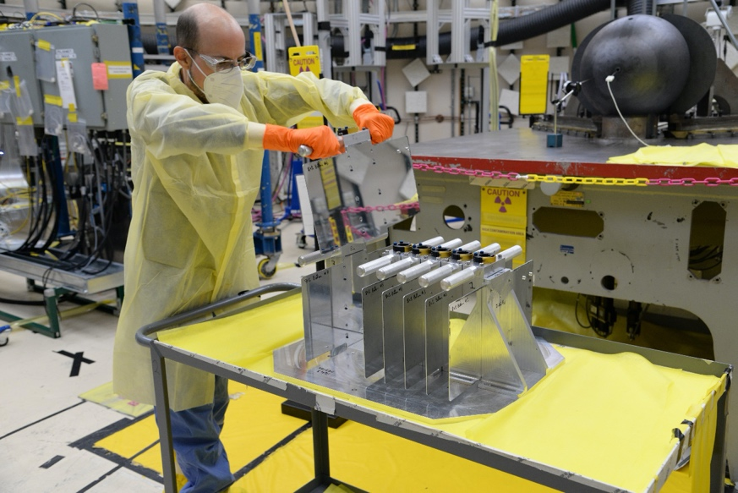
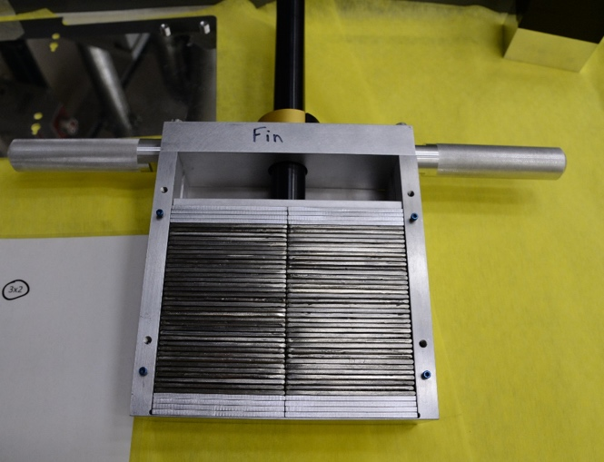
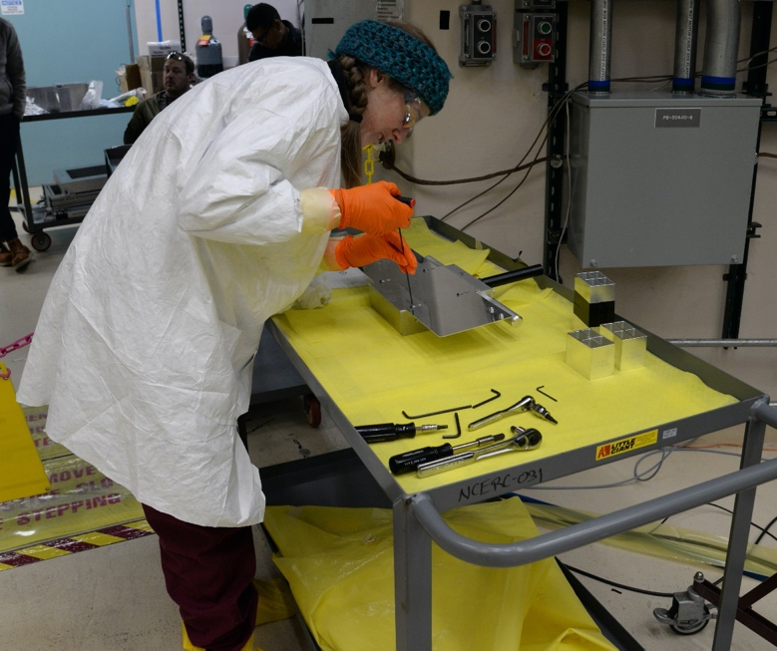
Experiment execution
7 weeks at NCERC: Nov 28 2022 - Jan 26 2023
The most Plutonium ever used in an NCERC Experiment

Slide 10
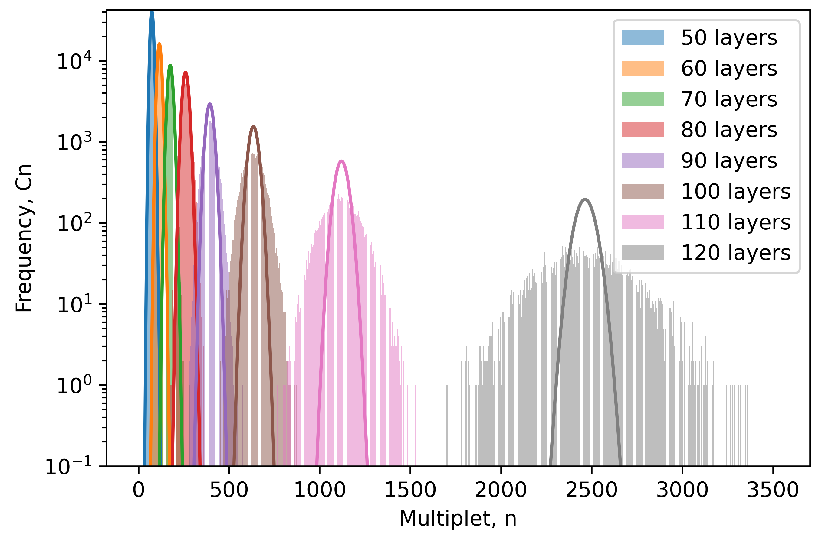
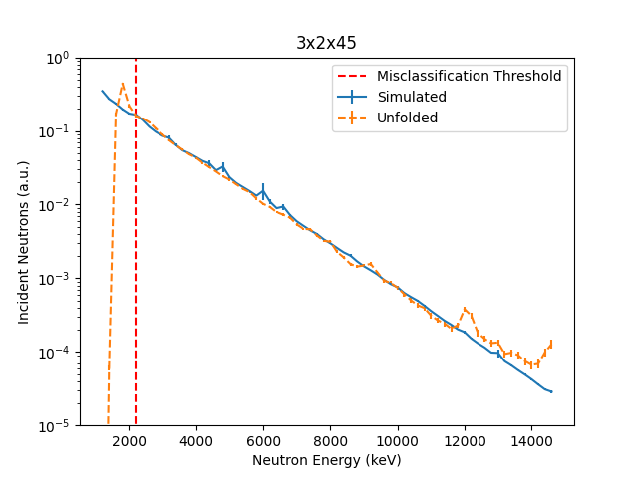
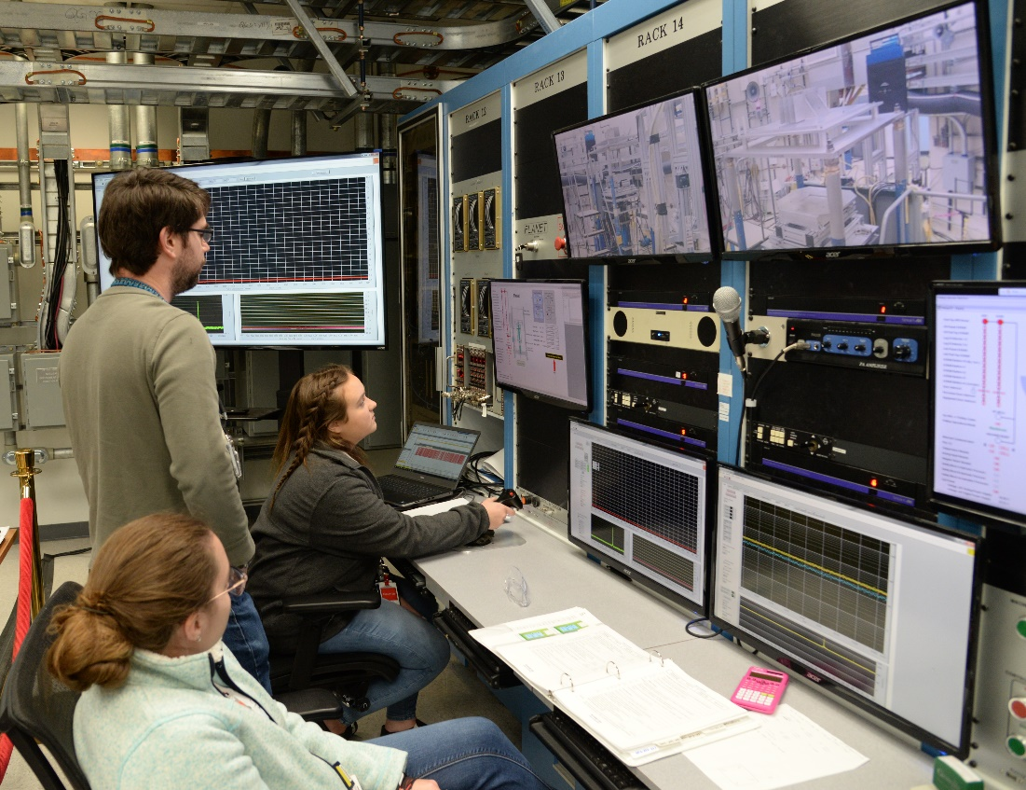
Measurement Responses
Six responses were measured for each configuration:
  Critical: ICNC 2023
  Subcritical (neutron noise): ANE
  Neutron leakage spectra: NIM A and APS 2023
  Rossi-α: future work
  Reactivity coefficients: ICNC 2023
  Reaction rate ratios: NSE

Slide 11
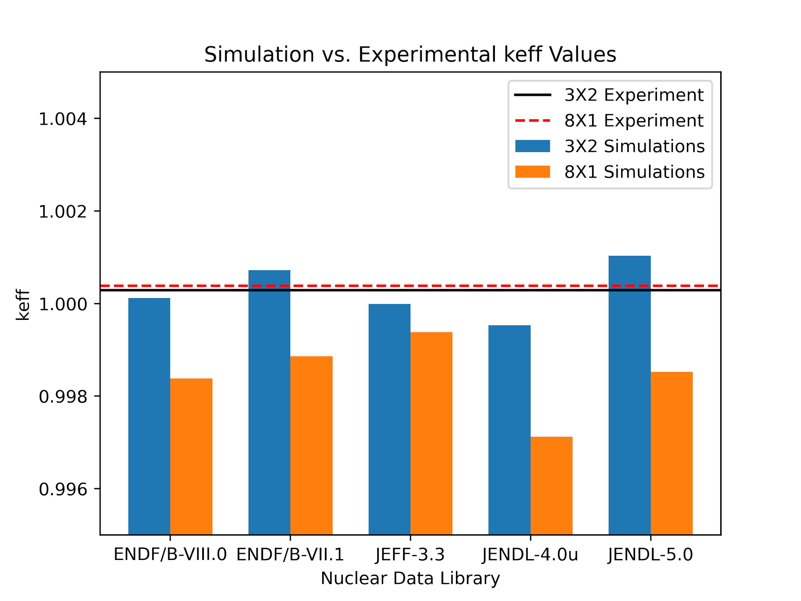
Calculated k_{eff} is mostly below experiment and varies with ²³⁹Pu library by 10s to 100s of pcm
3x2 exp: 1.00029 +/- 0.00200
Library | keff | keff unc | C-E (pcm)
ENDF/B-VIII.0 | 1.00012 | 0.00003 | -17
ENDF/B-VII.1 | 1.00072 | 0.00003 | 43
JEFF-3.3 | 0.99999 | 0.00003 | -30
JENDL-4.0u | 0.99953 | 0.00003 | -76
JENDL-5.0 | 1.00103 | 0.00003 | 74
Pu9VIII1beta1-11c | 0.9991 | 0.00003 | -119
Pu9LANL10172022-10c | 1.00011 | 0.00003 | -18
e81b2 | 0.99992 | 0.00003 | -37
8x1 exp: 1.00038 +/- 0.00300
Library | keff | keff unc | C-E (pcm)
ENDF/B-VIII.0 | 0.99838 | 0.00003 | -200
ENDF/B-VII.1 | 0.99886 | 0.00003 | -152
JEFF-3.3 | 0.99938 | 0.00003 | -100
JENDL-4.0u | 0.99712 | 0.00003 | -326
JENDL-5.0 | 0.99852 | 0.00003 | -186
Pu9VIII1beta1-11c | 0.99757 | 0.00003 | -281
Pu9LANL10172022-10c | 0.99802 | 0.00003 | -236
e81b2 | 0.99815 | 0.00003 | -223
Results when switching Pu239 nuclear data (all other nuclides are ENDF/B-VIII.0)

Slide 12
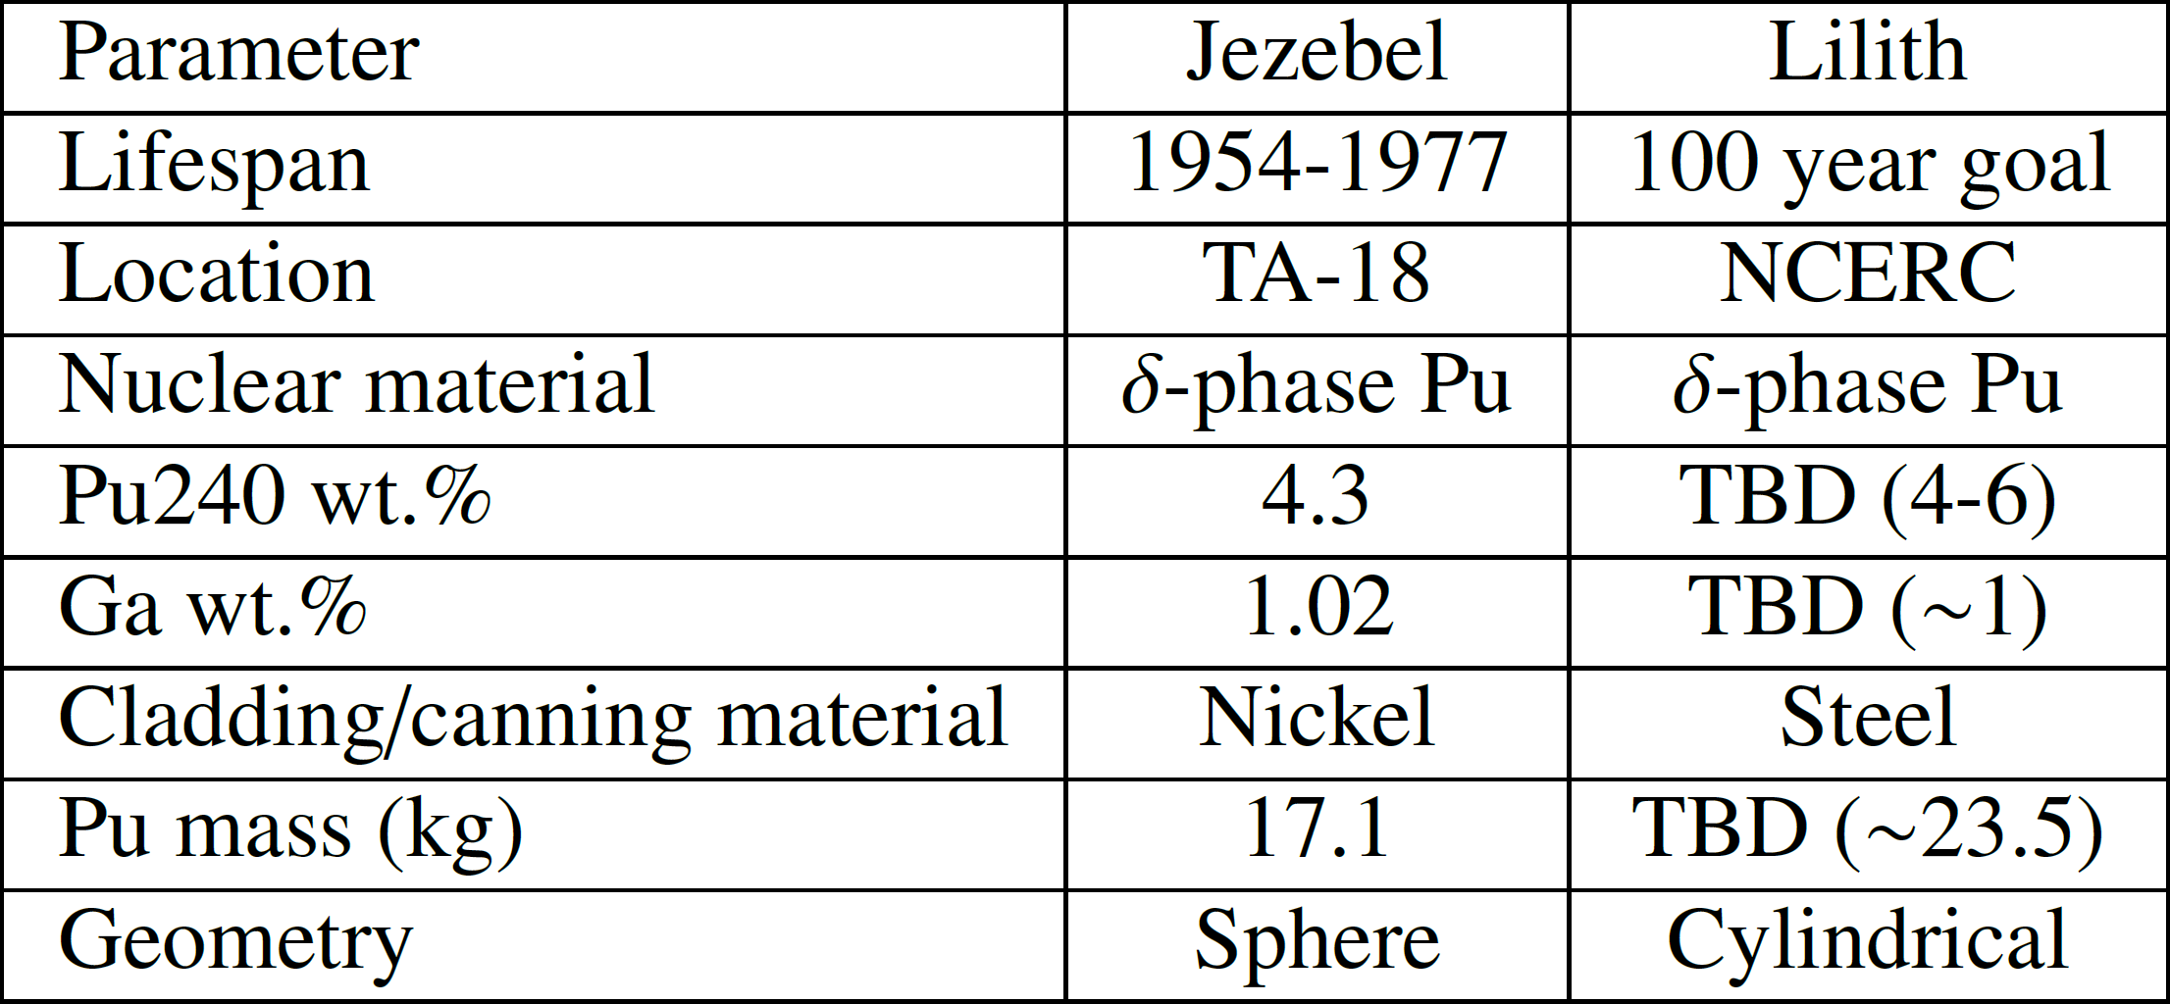
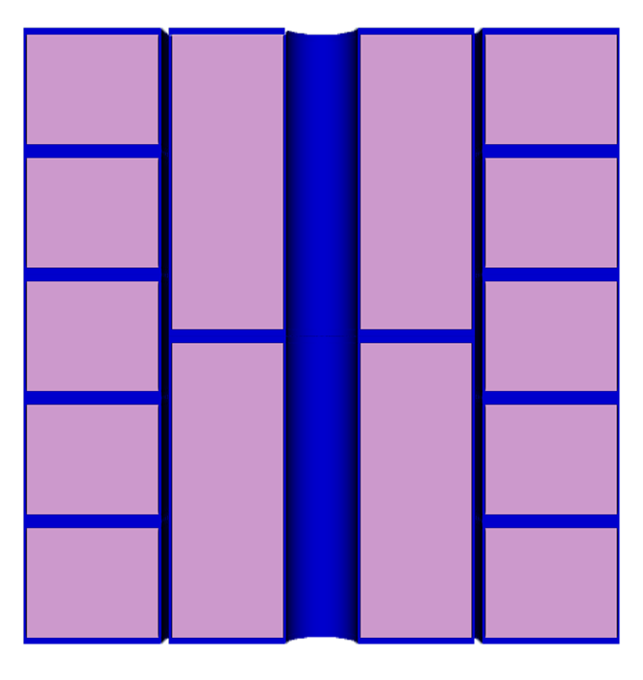
Future experiments: Lilith
ND validation
AM validation
Dosimetry
Reactor kinetics
Materials
Much more than just a “Jezebel replacement”
New enduring Pu assembly
  Design goal of 100 years of operation
Ability to change part of the Pu fuel
Will become the “default experiment” for Pu239 nuclear data validation
Benchmark can be updated over time as new technologies become available
Can be used to measure changes over long periods of time
Would provide new clean Pu assembly for spectral indices, reactor kinetics parameters, etc.
Lilith

Slide 13
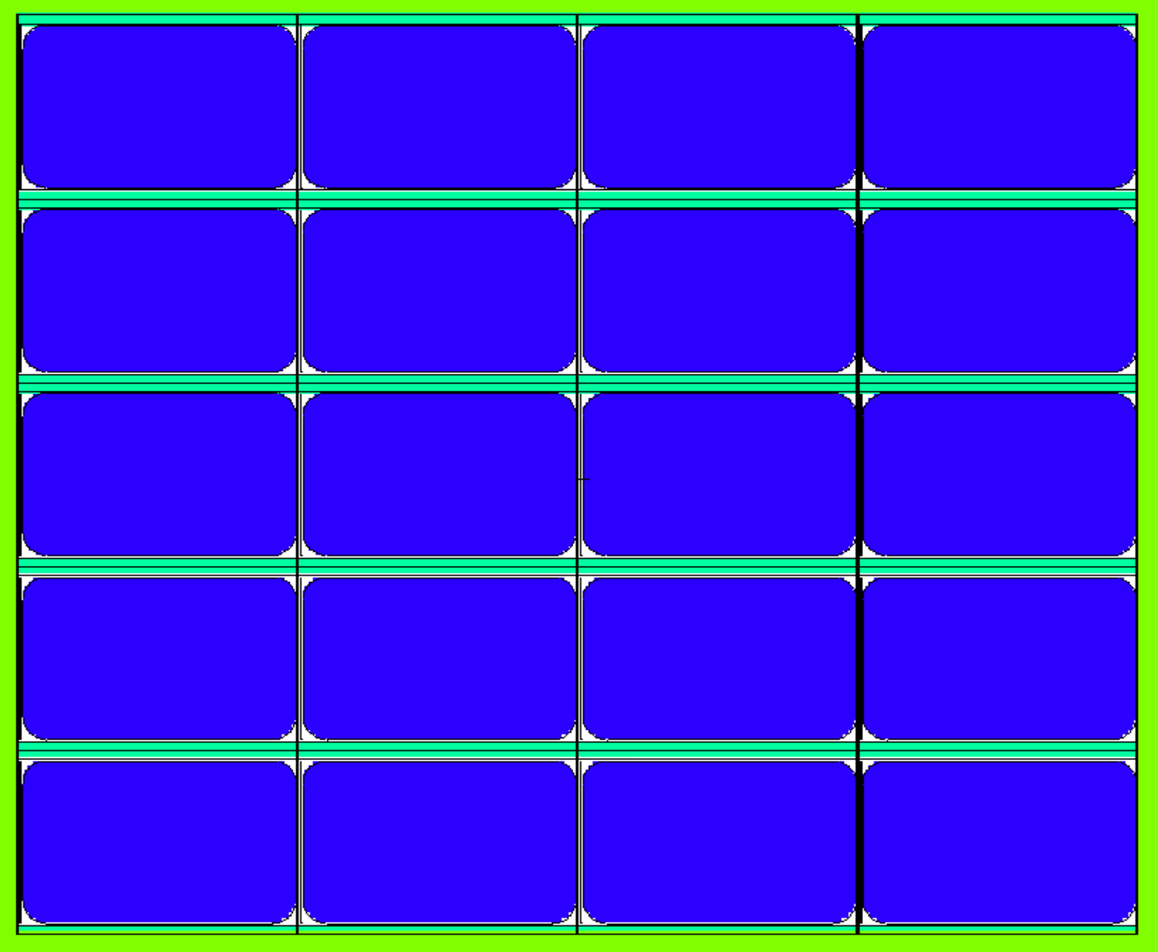
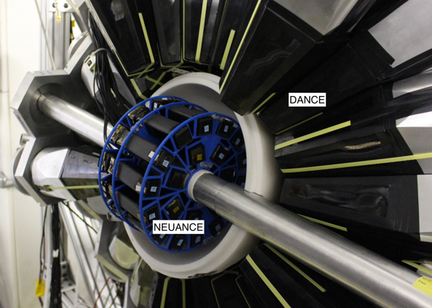
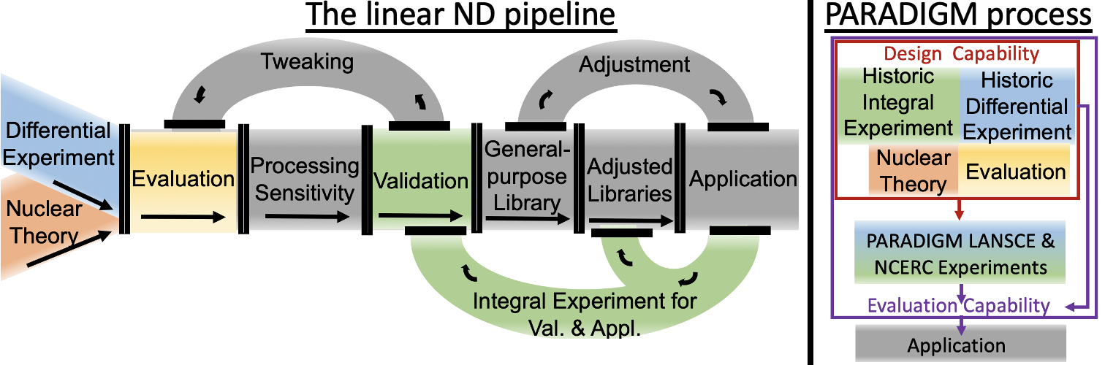
Future experiments: PARADIGM
Reduce Pu-239 nuclear data uncertainty in the intermediate region
  And reduce the timeline of the pipeline
Design differential (LANSCE) and integral experiments (NCERC) simultaneously using machine learning (see Christi Thompson talk)
  Differential, integral, and theory in single optimized process
Two validation experiments targeting Pu239 uncertainty reduction for:
  1-30 keV
  30-600 keV
More sensitive to Pu239 fission in these energies than any existing experiments
Additional responses (beyond k_{eff}) will be measured

Slide 14
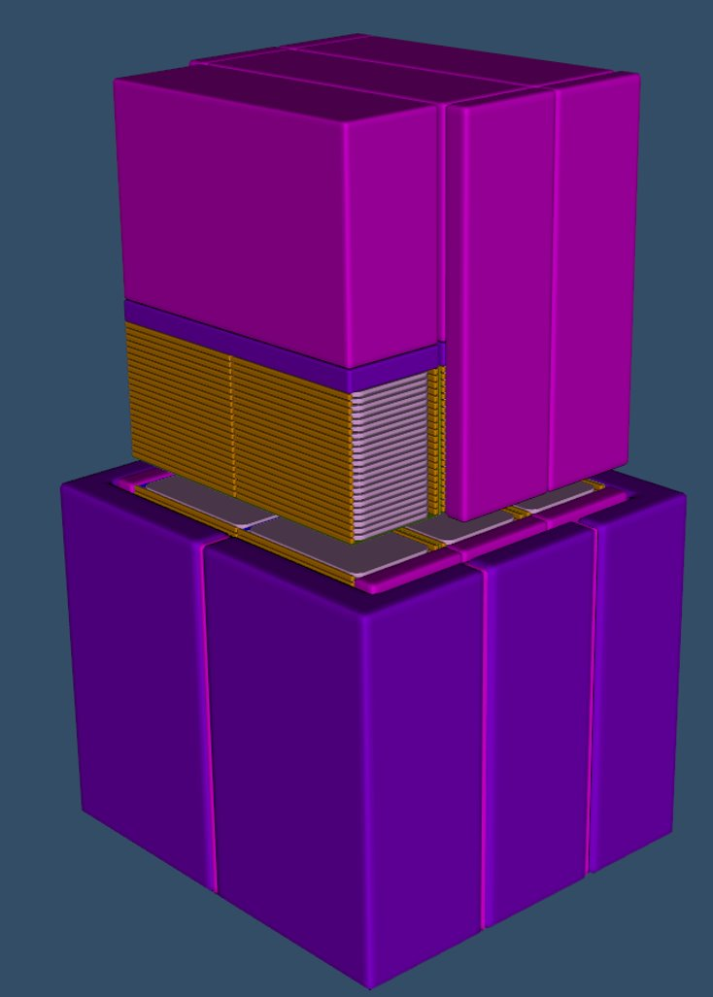
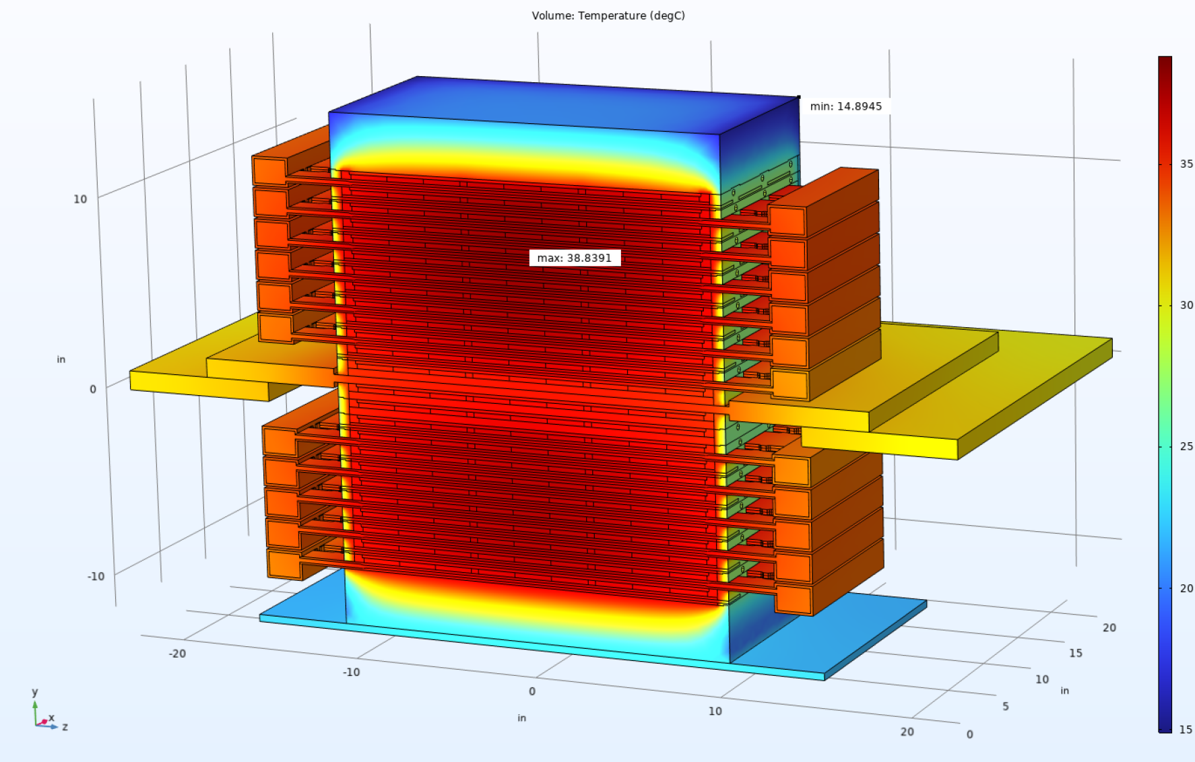
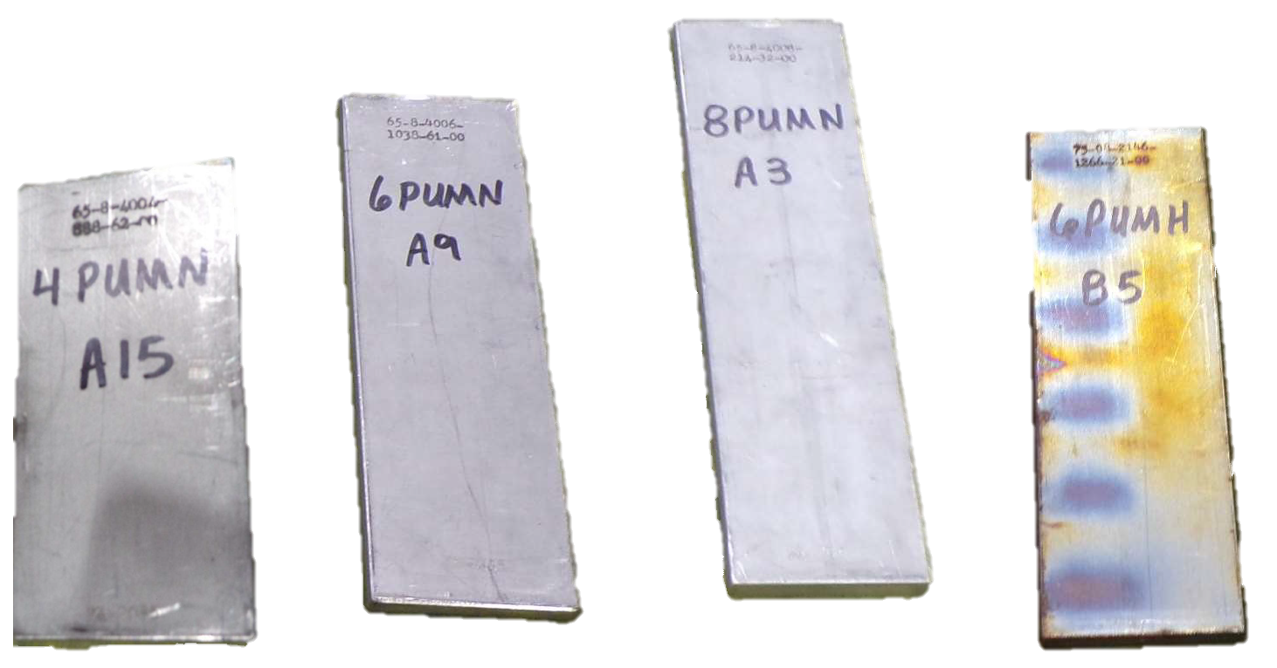
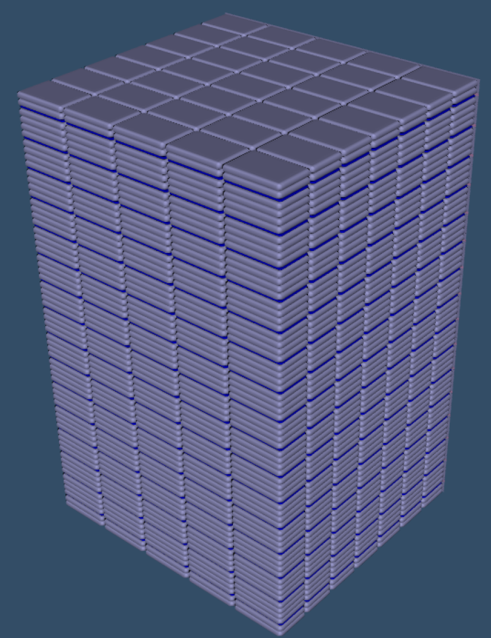
Future experiments: other
IER 607: Thales
  Tantalum reflection
  Validation for Ta for Pu processing
IER 296: TEX Mox
  Mox fuel with high Pu240
  Validation for Mox operations in France
Flattop Pu
  Updated evaluation
  General Pu validation and basis for other experiments
IER 551: EUROPA
  Intermediate energy Pu (WG and elevated Pu240)
  Complementary to PARADIGM and TEX experiments

Slide 15
Lessons learned and challenges
Some lessons learned along the way:
  AI/ML can be very useful in experiment design
  Measurement of additional responses can help further constrain nuclear data
  Integral experiments should be designed in parallel to differential experiments (PARADIGM approach)
  Performing benchmark evaluation directly after experiment completion is both cost effective and results in better benchmarks
Some challenges:
  Funding of benchmark evaluations is similar to the TRL “valley of death”. Outside of NCSP, we have had challenges securing funding
  Documentation for other responses of historical experiments is lacking
  “New” material is hard to acquire

Slide 16
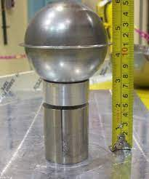
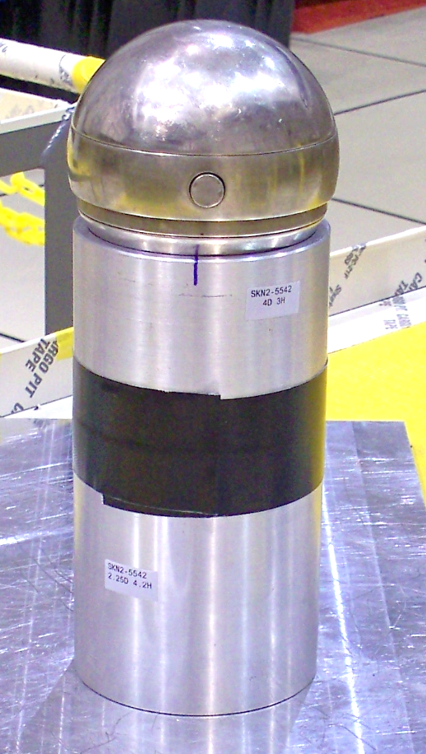
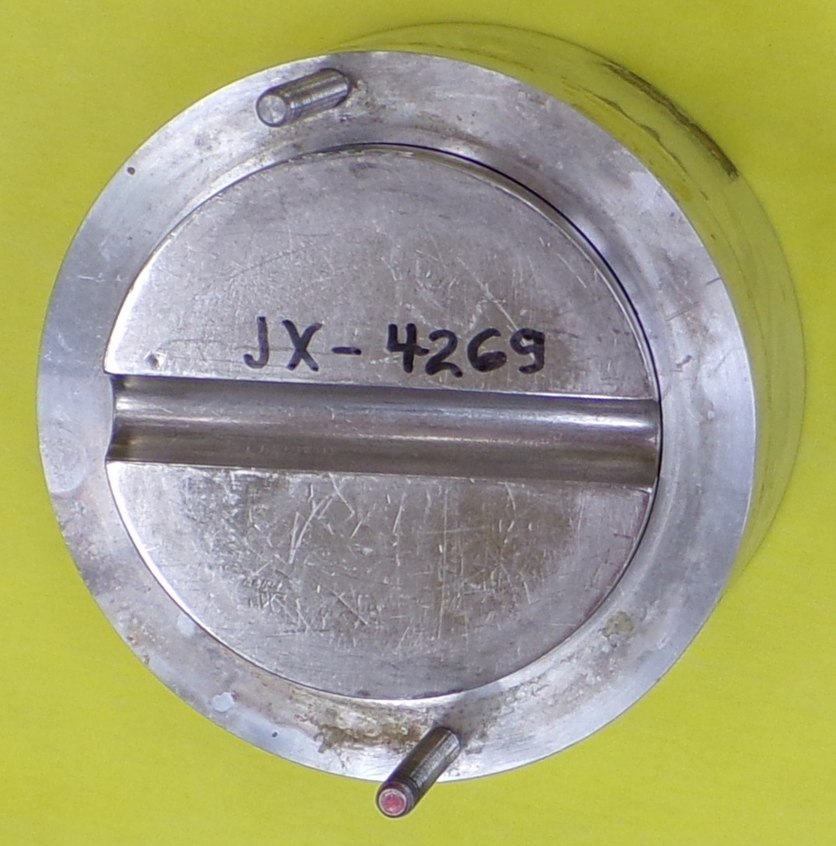
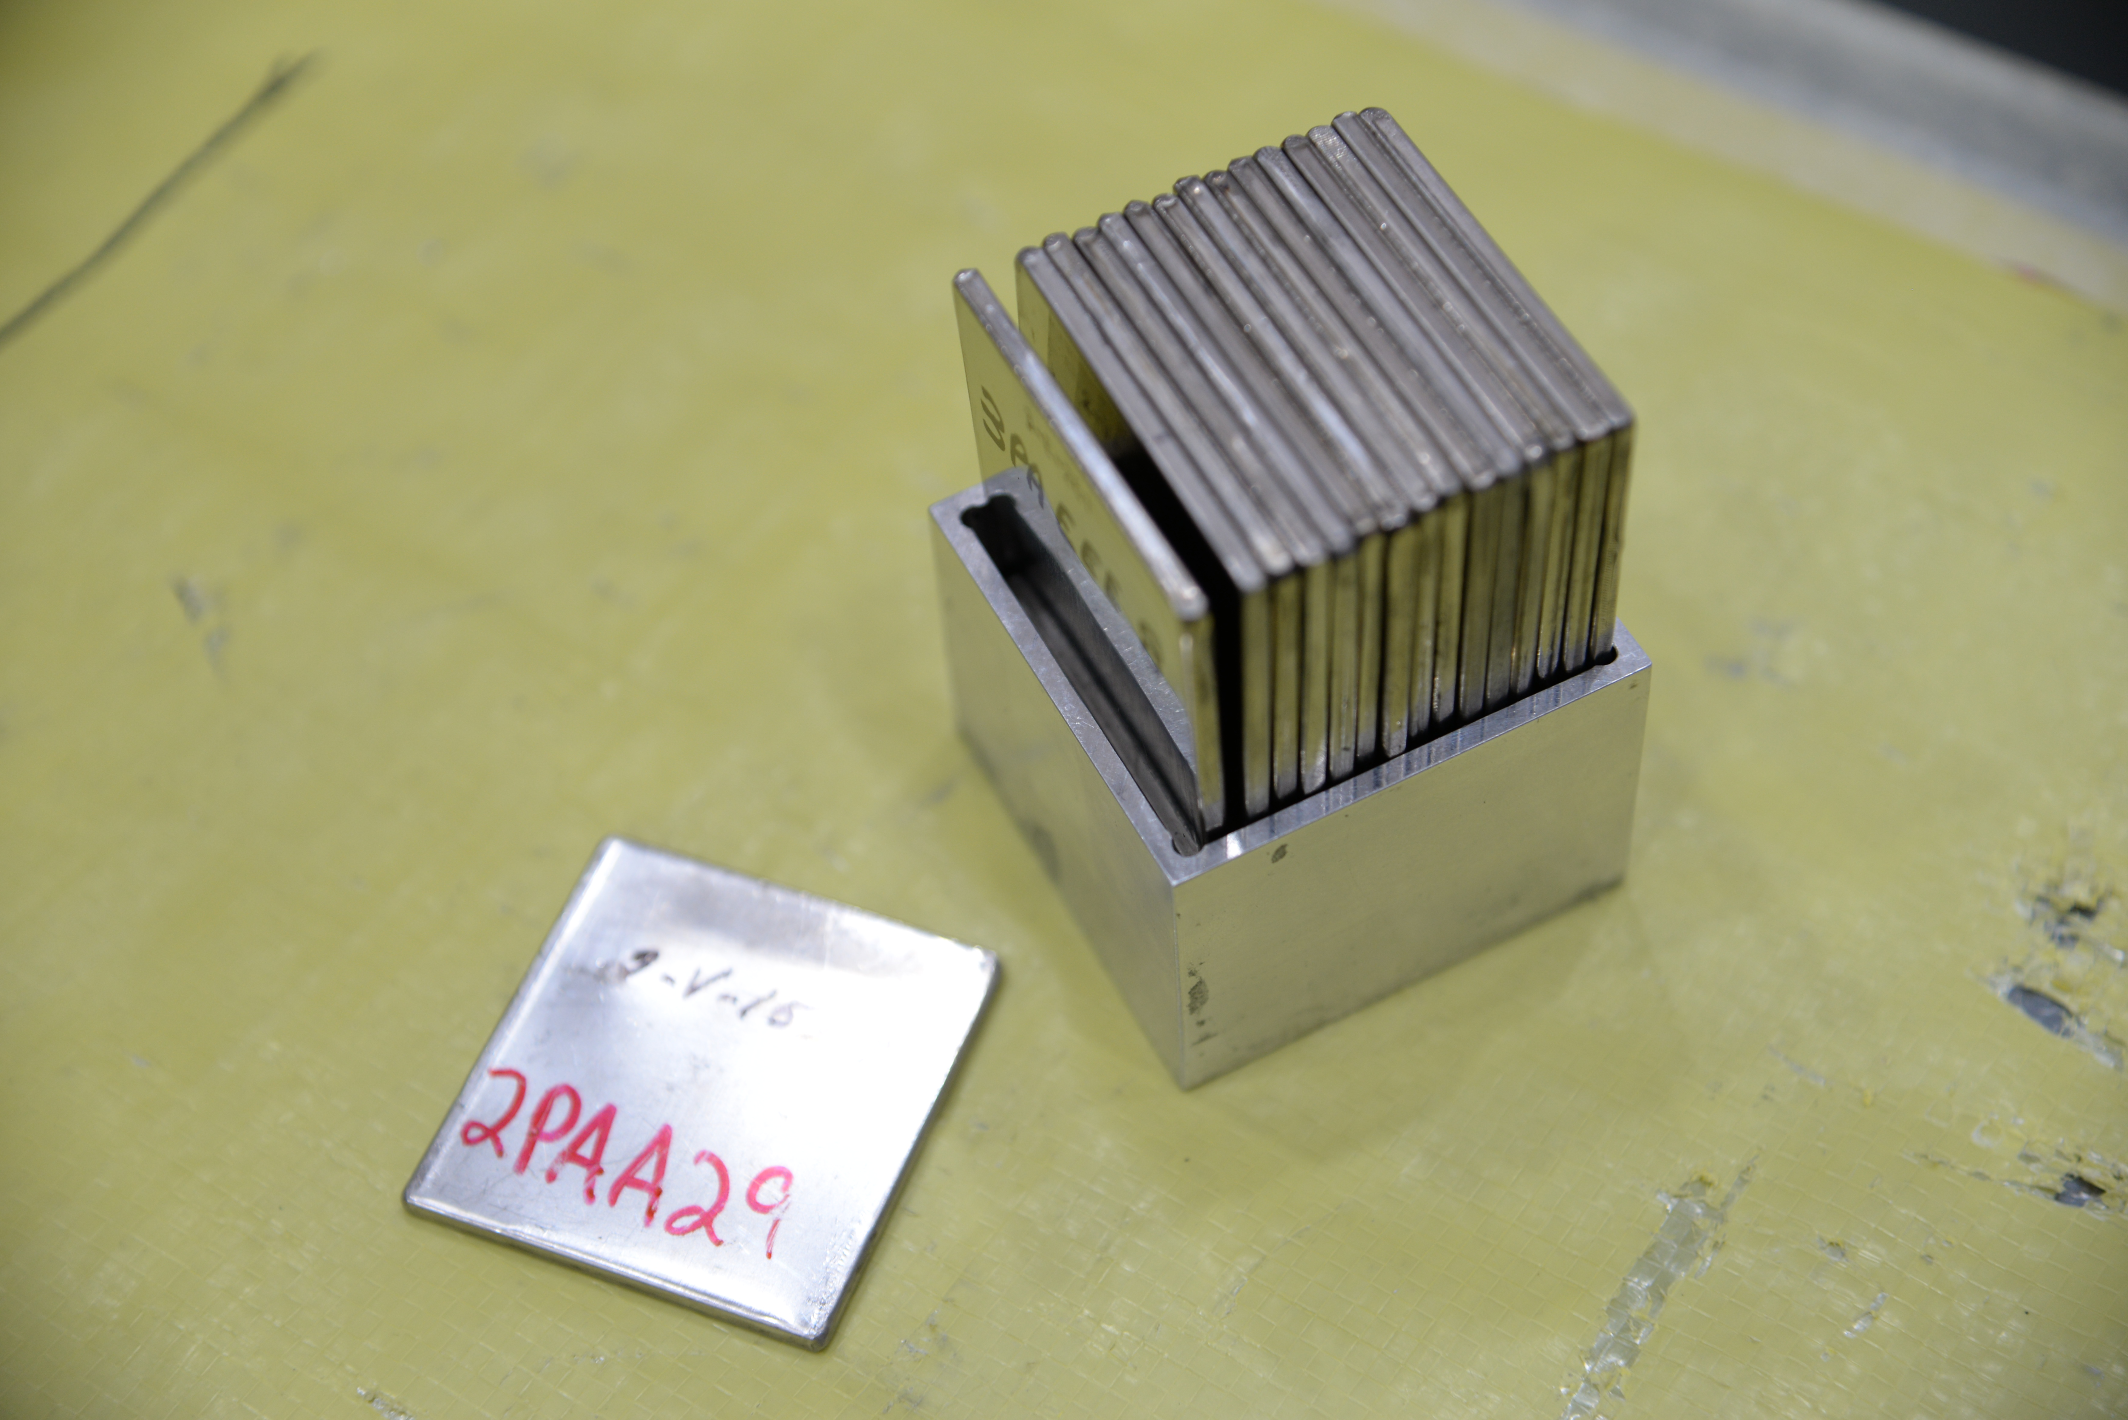
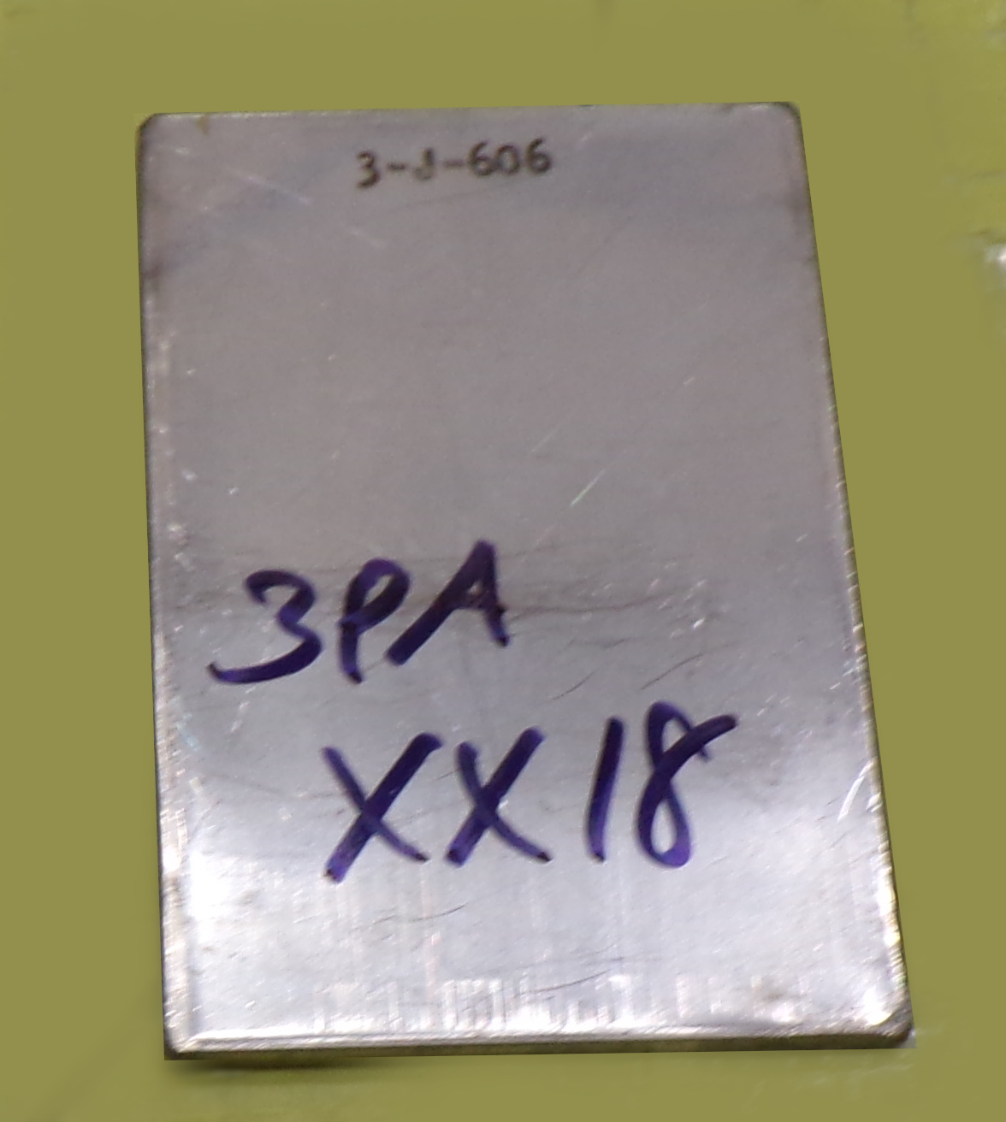
Conclusions
Recent and planned NCERC experiments provide rich opportunities for validation of Pu nuclear data
Including k_{eff} benchmarks as well as many other responses
Very interested in future Pu validation
  Pu239 and Pu240
  Fast
  Intermediate
  All reactions
Interested in collaboration with CSEWG regarding new validation experiments

Slide 17




Acknowledgments
Research reported in this publication was supported by the U.S. Department of Energy LDRD program at Los Alamos National Laboratory.
NCERC is supported by the DOE Nuclear Criticality Safety Program, funded and managed by the National Nuclear Security Administration for the Department of Energy.
Los Alamos National Laboratory is operated by Triad National Security, LLC, for the National Nuclear Security Administration of the US Department of Energy under Contract No. 89233218CNA000001.

