Slide 1
Update for 8.1 on the deuteron sublibrary for tritium
Mini-CSEWG
M. Paris & G. Hale (LANL/T-2)
2024-08-14
LA-UR-24-28654

Slide 2
Outline
Background
  ENDF/B-VIII.0: d-001_H_003.endf
Current file
  ENDF/B-VIII.1
Future work
  ENDF/B-IX.0

Slide 3
Background
d+³H in ENDF/B-VIII.0

Slide 4
R-matrix evaluation
⁵He compound system

Slide 5
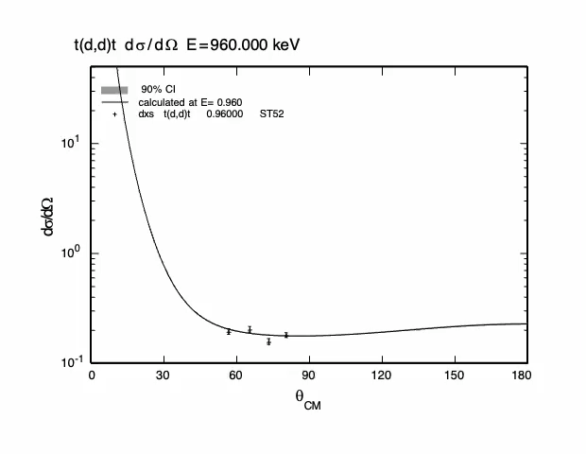
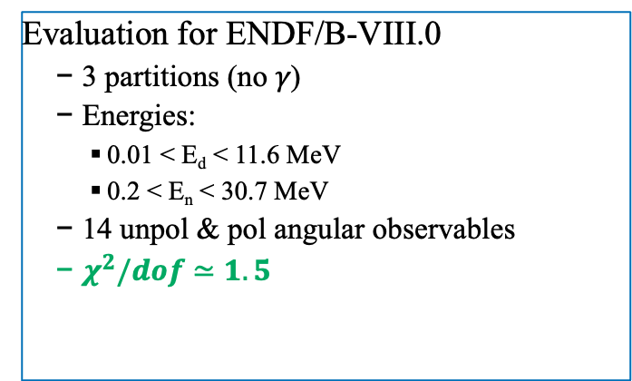
R-matrix evaluation
⁵He compound system
Evaluation for ENDF/B-VIII.0
  3 partitions (no 𝛾)
  Energies:
    0.01 < E_{d} < 11.6 MeV
    0.2 < E_{n} < 30.7 MeV
  14 unpol & pol angular observables
  $χ^{2}/dof$ $≃1.5$

Slide 6
Background
d+³H in ENDF/B-VIII.0
Integrated cross section MF3/6
³H(d,d)³H MT2
³H(d,n₀)⁴He MT50
³H(d,n₁)⁴He* MT51 (LR=1)
  MT=51, T(d,n)4He* reaction cross section. The data set for this reaction contained 11 data points, including the measurement of the zero-degree excitation function, and an angular distribution at one energy, by Poppe.
  MT=51, T(d,n)4He* reaction. Two-body (LAW=2) Legendre coefficients are given to L=2 at energies up to 10 MeV. The decay of the residual 4He* into p and t is approximated by a phase-space (LAW=6) representation.
  LR=1 (MF=6 for n,p,t subsecs)
  MF=6 NK=3 subsecs NK=1,2,3 -> n, p, t
  NK=1 ➔ LAW=2 ➔ discrete two-body
  NK=2 ➔ LAW=6 ➔ n-body phase space dist(!)
    NPSX ≧ 3 (required by ENDF-102); NPSX = 2
  NK=3 ➔ LAW=6 (same as NK=2)
LAW=6
SINGULAR
@ ENDPOINT!

Slide 7
Updates
d+³H in ENDF/B-VIII.1
phase 2
Integrated cross section MF3/6
³H(d,d)³H MT2
³H(d,n₀)⁴He MT50
³H(d,n₁)⁴He* MT51 (LR=1)
³H(d,n_{c})⁴He MT91
LANL updated
  MF3/6, MT50: extend upper energy to 40 MeV (from 30 MeV) → Drosg Legendre fit to data
  MF3/6, MT51: extend upper energy to 20 MeV (from 10 MeV) → extrapolation from < 10 MeV
After these LANL updates LLNL modified masses & Q values
  Incident & light product masses: “Mass quantities for incident particles (AWI) and “light” reaction products (AWP for Z ≤ 2) should be expressed in nuclear mass units.”
  Target masses: “Mass quantities for materials (AWR for all Z) and “heavy” reaction products (AWP for Z > 2) should be expressed in atomic units”
  These are inconsistent for CP with Z ≤ 2! To wit:
  Violates electron number conservation by one unit! Flaw in ENDF-102, 0.5.1.1; must be addressed; NB: nuclear masses solve this problem.

Slide 8
Updates
d+³H in ENDF/B-VIII.1
phase 2
Integrated cross section MF3/6
³H(d,d)³H MT2
³H(d,n₀)⁴He MT50
³H(d,n₁)⁴He* MT51 (LR=1)
³H(d,n_{c})⁴He MT91
LANL updated
  MF3/6, MT50: extend upper energy to 40 MeV (from 30 MeV) → Drosg Legendre fit to data
  MF3/6, MT51: extend upper energy to 20 MeV (from 10 MeV) → extrapolation from < 10 MeV
After these LANL updates LLNL modified MF=3,6; MT=51, 91
  Set LR=1 flag for MT=51 & 91, use LAW=6 for p, t distributions ➔ still incorrect
    “Incorrect” in the same way that ENDF/B-VIII.0 was though

Slide 9
Future work
Quick fix (kinematical only)
Three-body breakup sequential model
Treat breakup as
1st pass: non-relativistic
  Preliminary result indicates that energy conservation is violated
Suggests that relativistic treatment is required
  Ongoing work on this

Slide 10
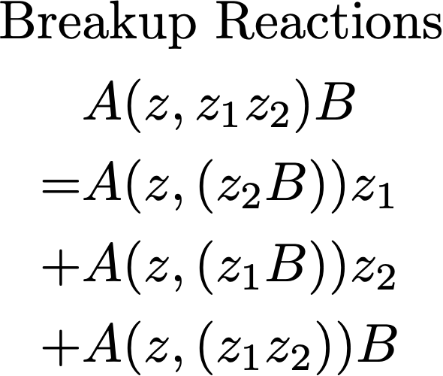
Future work
Comprehensive treatment
T2: Improved physics modeling and theoretical work
Objective: ・predictive model for breakup
・use existing R-matrix parameters

Slide 11

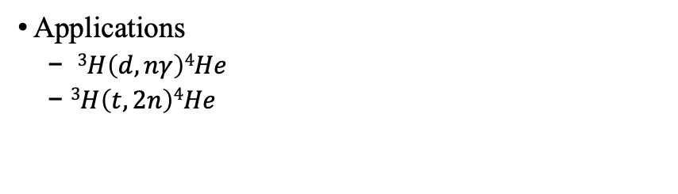

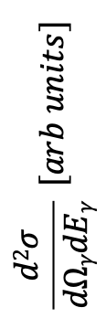
Recent work
Theoretical modeling & Applications
SPECT code calculation
  Employs state-of-the-art Faddeev-like resonance model
  Relativistic kinematics necessary for 𝛾 production
Applications
  $3H\left(d,nγ\right)4He$
  $3H\left(t,2n\right)4He$
$3H\left(d,nγ\right)4He$ spectrum @ 90º
$$\frac{d2σ}{dΩγdEγ} [arb units]$$
$Eγ$ [MeV]

Slide 12
Conclusion
Do no harm
Do not change masses, Q values from 8.0 – the manual is inconsistent and therefore impossible to implement
MT=51 & 91 are much smaller than MT=50
  Changes are not an improvement
  Maybe allowable on a temporary basis
    Clearly documented in comments MF=1, MT=151
    Fixed for ENDF/B-IX.0

