Slide 1
Enabling gamma cascades in GNDS
Emanuel Chimanski (echimansk@bnl.gov) + GRIN collaboration
@Mini-CSEWG

Slide 2
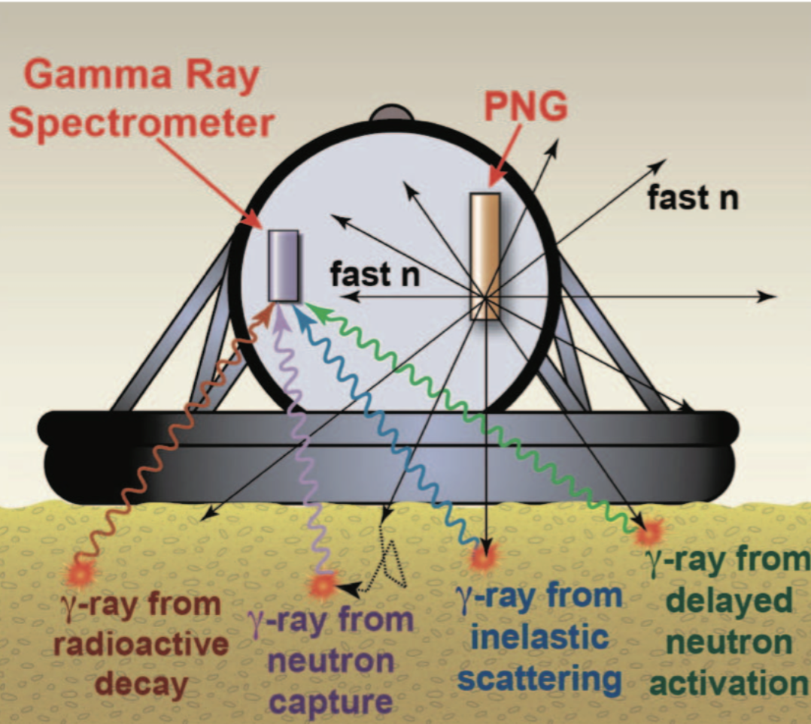
GRIN- Gamma Rays Induced by Neutrons
A project to help improving gamma-ray data libraries and enable inline gamma cascades in transport codes
Capture, Inelastic and Decay Gammas Nuclear fingerprints
Subject to - Thorough experimental knowledge; - Precise models and evaluations; - Incorporation of data into evaluated files;
Target users:
“Traditional” users call for a precise particle-γ spectrum to perform material identification.
“Event-by-event” users need the correlations between scattered neutrons, gammas emitted from nuclear de-excitations. Current evaluated data in ENDF libraries are not sufficient and must be extended.

Slide 3
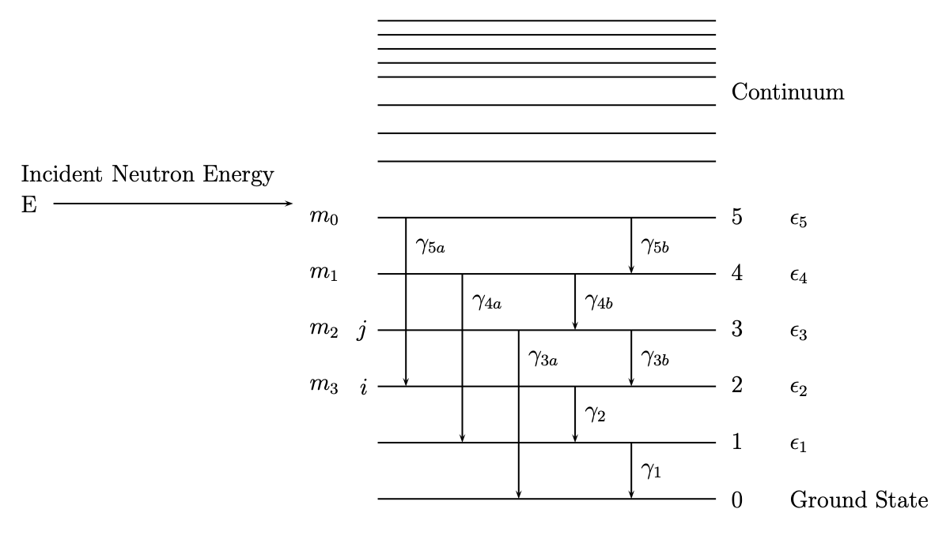
Neutron Induced Reactions and Gamma-Ray cascades
Thermal neutron capture gammas
Reactions are different but the decay process is similar
Inelastic reaction gammas
Inelastic reactions involve target (A) states while capture populates compound system (A+1) levels

Slide 4
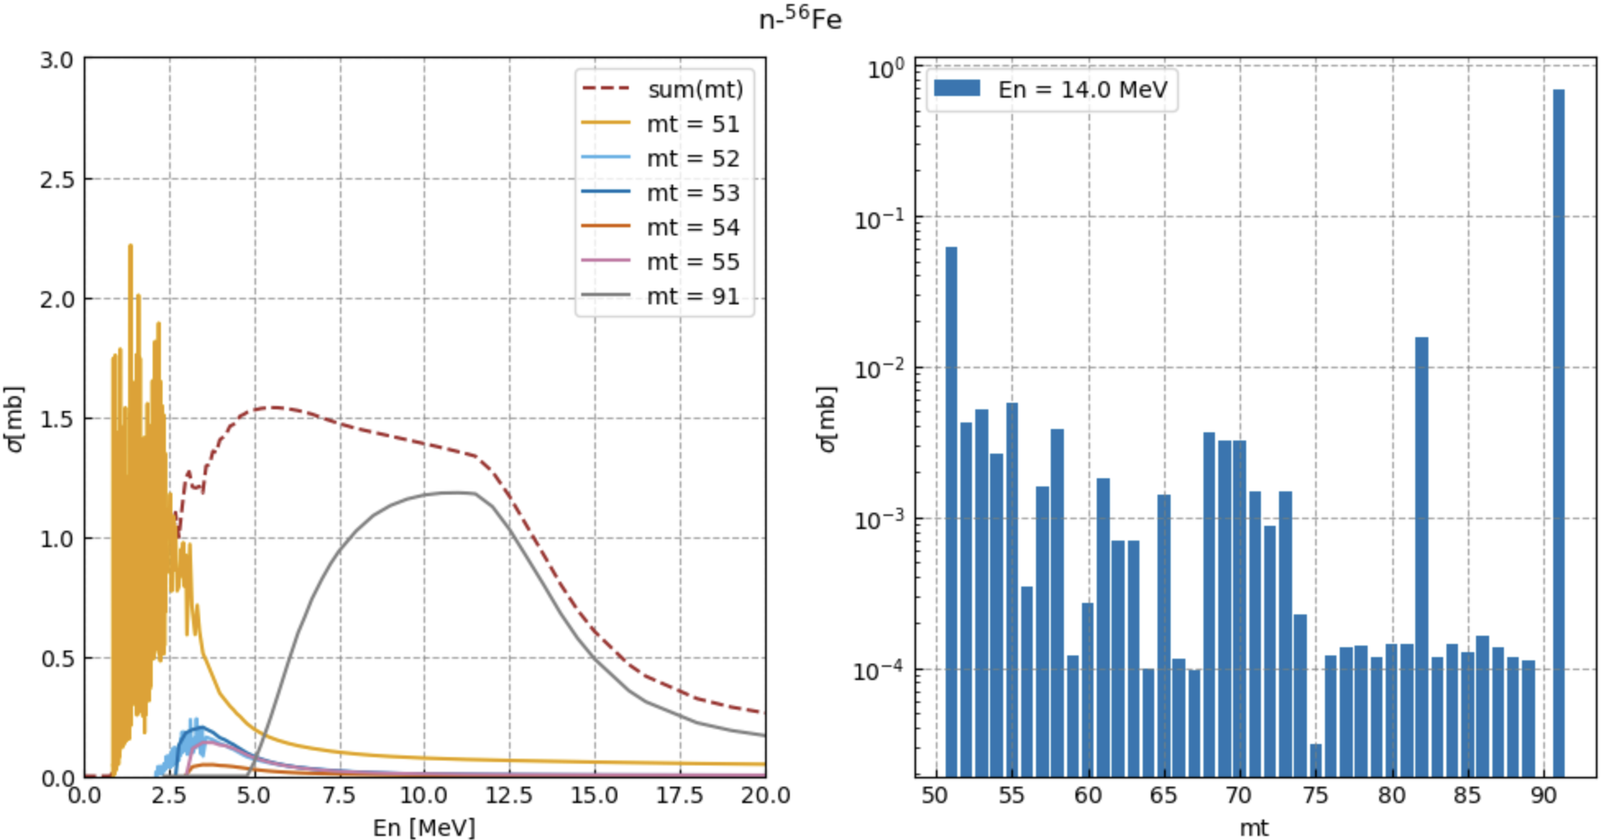
Inelastic Cross Sections in an ENDF file
continuum
MT 91
P^{c}₂
P^{c}₁
P^{c}₀
σ(n,n’g) = σ (n,n’_{lev=1})+ σ^{c}(n,n’_{from above})
⁵⁶Fe Excited states mt < 91 : discrete mt = 91: continuum
ENDF does not know how discrete levels are fed from the continuum

Slide 5
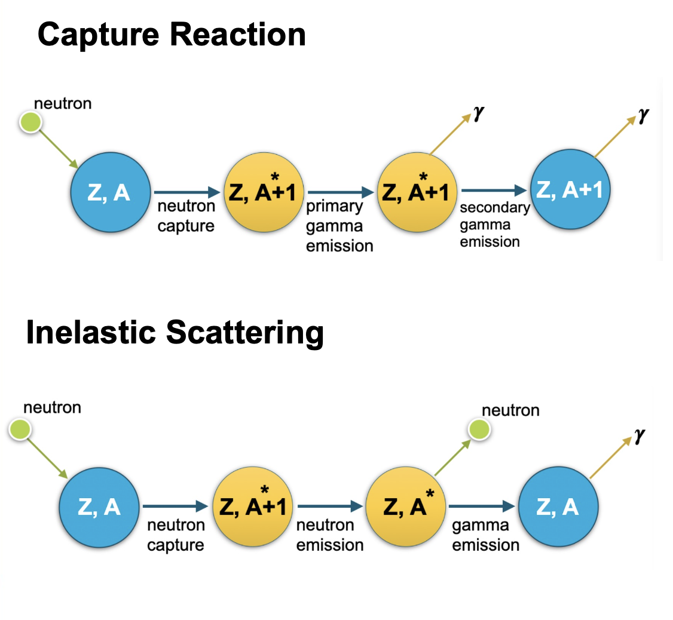
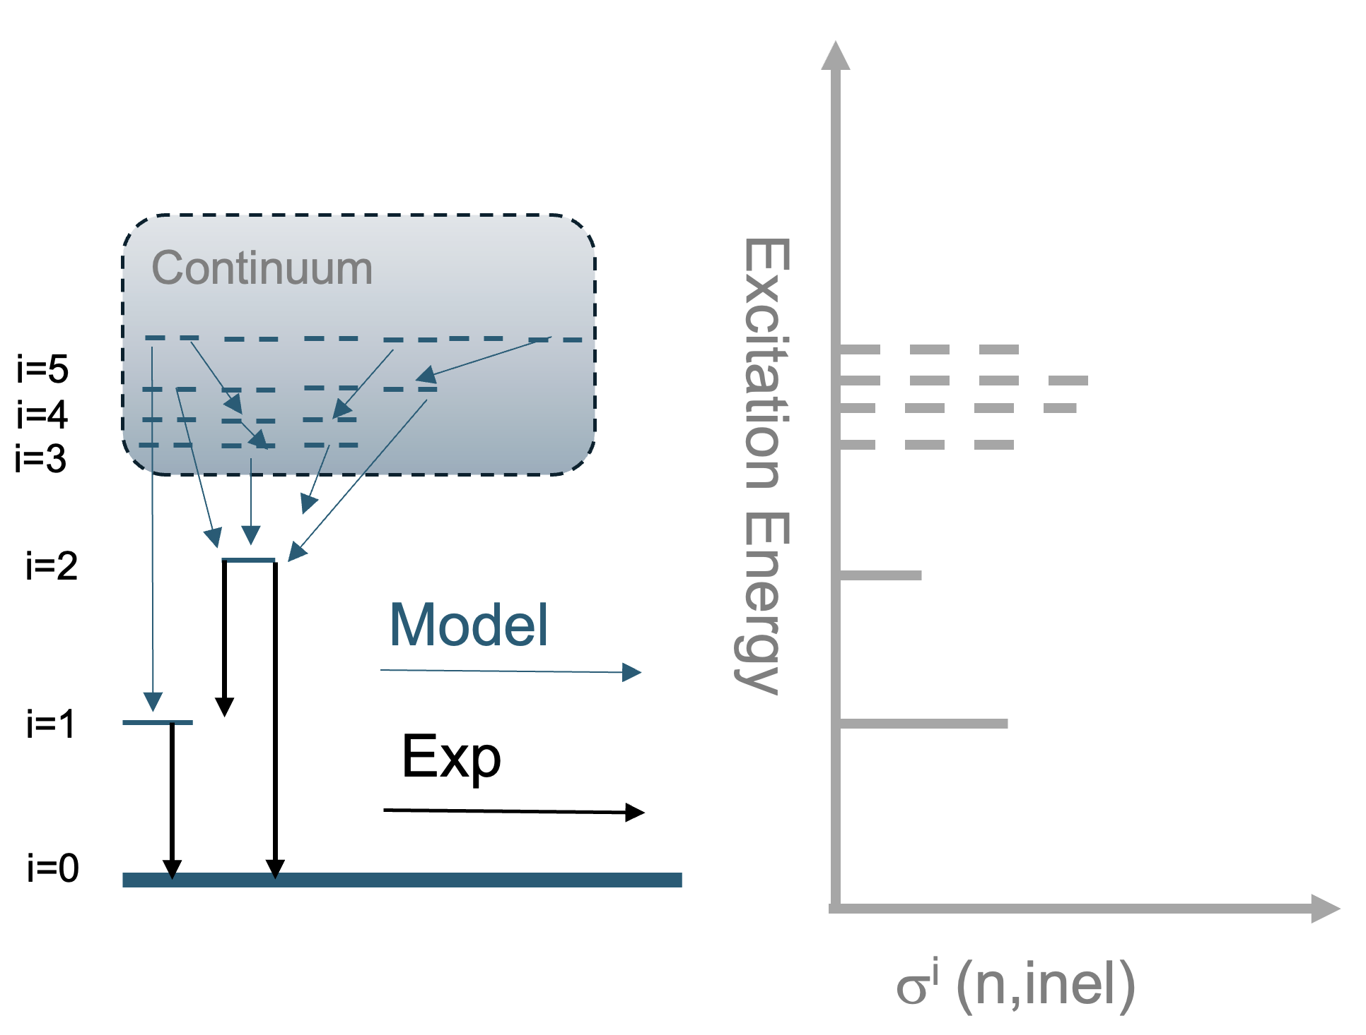
Neutron Induced Reactions and Gamma-Ray cascades
We need all levels (including "bins” for the continuum)
Population of each level as a function of incident energy
Capture is “easy” since one or two states are populated (s wave)
Inelastic is more complicated with a distribution of populated states

Slide 6
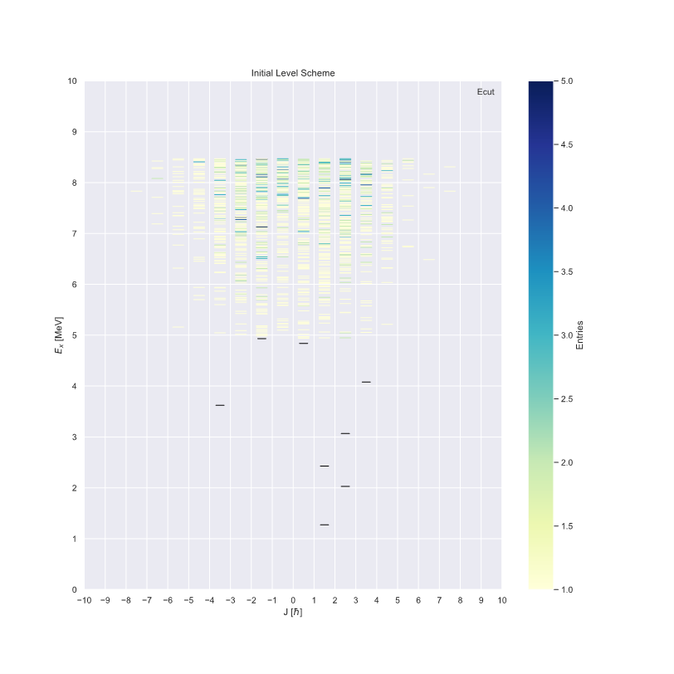
Levels and branching ratios
Continuum discretized: The bins in the continuum are generated with level densities
Each bin can be populated in a reaction. -- similar to (n,n’) to each discrete level
The branching ratios are computed with PSF
Theory (bins)
Experimental
All of these can be found in reaction codes
From IAEA/NDS RIPL Reference Input Parameter Library Derived from ENSDF
Experimental

Slide 7
In-line Gamma-Ray cascades
E_{n}: 2.2 MeV populations: [level 1: P = 1.]
Reactions inputs from detailed calculation (EMPIRE)
We are working on extending the GNDS format to accommodate necessary inputs
Cross sections to each experimental level is already stored in ENDF (mt51-90)
(n,n’)
…
reactions
E_{n}: 14 MeV populations: [level 1: P = 0.5] [level 4: P = 0.5.]
T H E O R Y
(n,γ)
…
energy: 5 MeV
J^{π}: 6⁺
kind: theory
gammas : [level 1: Br = .5] [level 4: Br = .5]
…
energy: 2 MeV
E N S D F / R I P L
J^{π}: 2⁺
kind: experimental
levels
gammas: [level 0: Br = 1.]
energy: 0 MeV
J^{π}: 0⁺
kind: experimental
gammas: []

Slide 8
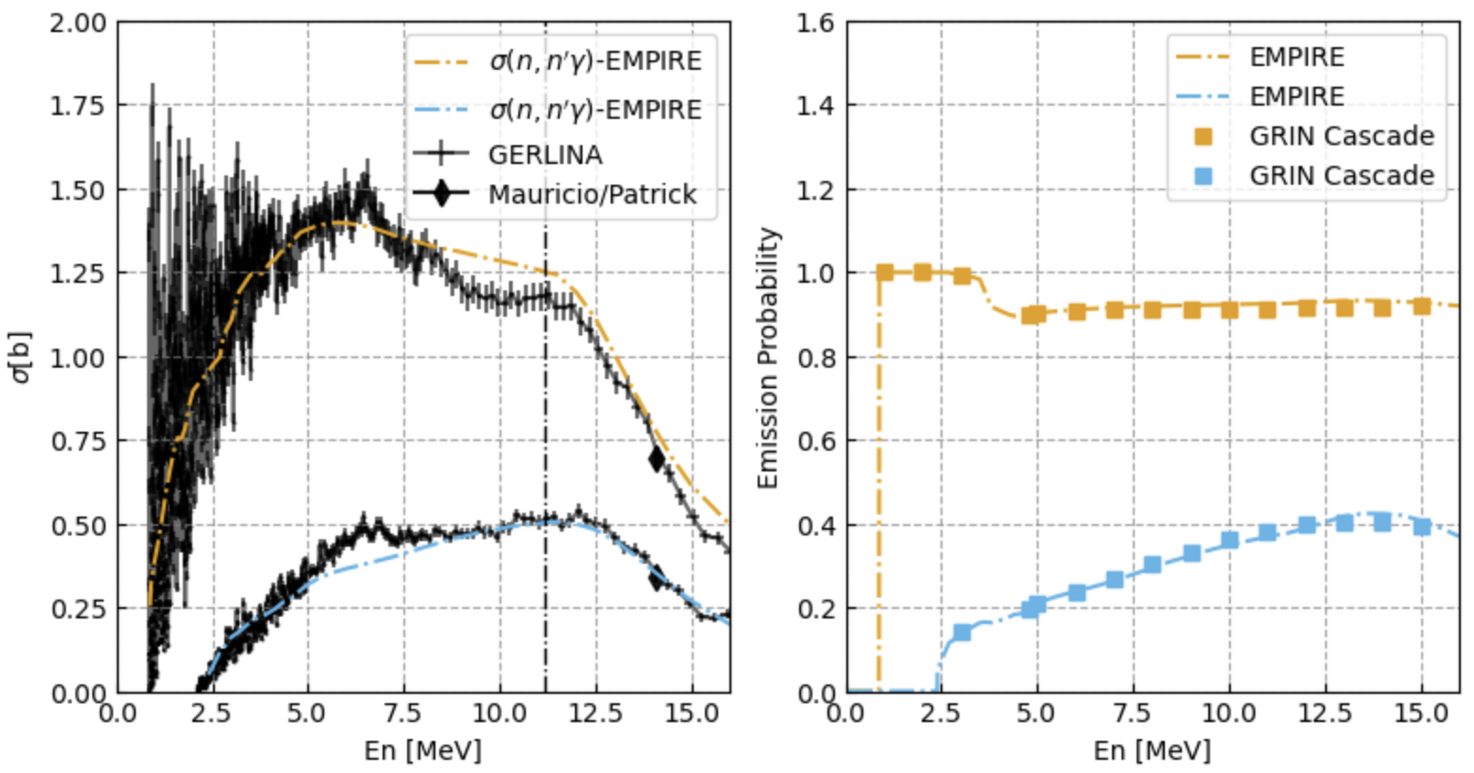
Inelastic cascades: (n,n’γ)⁵⁶Fe
847 KeV
1238 KeV
We used the CIELO/EMPIRE evaluation for ⁵⁶Fe All levels, populations and branching ratios (including bins in the continuum) were extracted and compiled in a test file
By using a simple Monte Carlo sampling we were able to reproduce empire inelastic gamma-ray data results

Slide 9
Capture cascades: (n,γ)¹³C
47 Neutron + C13 (C13+n->C14+photon[inclusive])
47 Gamma 8.175020e+00
48 Neutron + C13 (C13+n->C14+photon[inclusive])
48 Gamma 1.585420e+00
48 Gamma 4.957200e-01
48 Gamma 6.093880e+00
49 Neutron + C13 (C13+n->C14+photon[inclusive])
49 Gamma 8.175020e+00
50 Neutron + C13 (C13+n->C14+photon[inclusive])
50 Gamma 1.585420e+00
50 Gamma 4.957200e-01
50 Gamma 6.093880e+00
51 Neutron + C13 (C13+n->C14+photon[inclusive])
51 Gamma 8.175020e+00
Energy conservation on event by event basis -> the sum of the particle (gammas + residual nucleus) emission energies equals the total CN state energy of 8.17502 MeV (S_{n})
Capture
Gidi+/Mercury

Slide 10
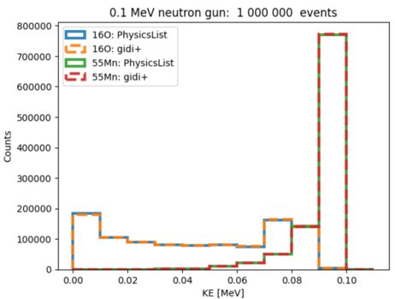
GIDI+ as an event generator
https://github.com/LLNL/gidiplus
GIDI+ uses GNDS rather than legacy ENDF files
Our new GNDS files contain all the inputs needed for in-line cascade simulation for both capture and inelastic
GIDI+ has its own broomstick like code but can work in other transport codes (Mercury, Geant4, OpenMC (Hunter + @ RPI))

Slide 11
In our new GNDS
All new entries are inside “applicationData” section of GNDS
do not affect current applications or transport codes
later can be officially incorporated
A pseudo “POPs” data structure for “theory levels”:
simple table to reduced the size of file
Capture and inelastic populated states have a new data structure
<captureLevelProbabilities>
<captureLevelProbability label="0" probability="1.0" spin="0.5" spinUnit="hbar" parity="1"
capturePrimaryToContinua="Fe57_e268">
<table rows="6" columns="2">
<columnHeaders>
<column index="0" name="finalLevel" unit="" types="label"/>
<column index="1" name="probability" unit=""/></columnHeaders>
<data>
Fe57 0.25
Fe57_e1 0.29
Fe57_e3 6e-2
Fe57_e8 0.0111
Fe57_e10 0.099
Fe57_e11 0.096 </data></table></captureLevelProbability></captureLevelProbabilities>

Slide 12
Some other GRIN products also include

Slide 13
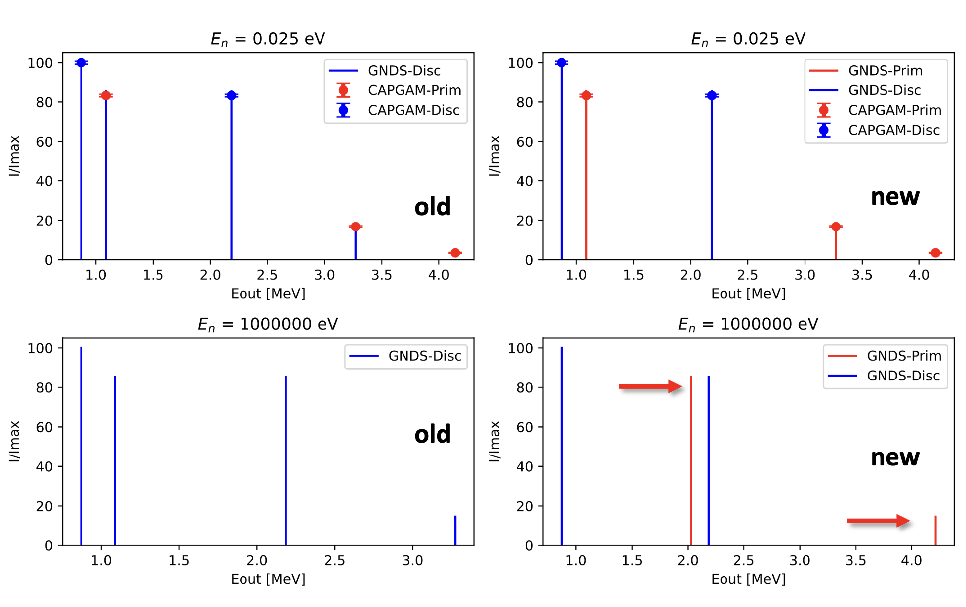
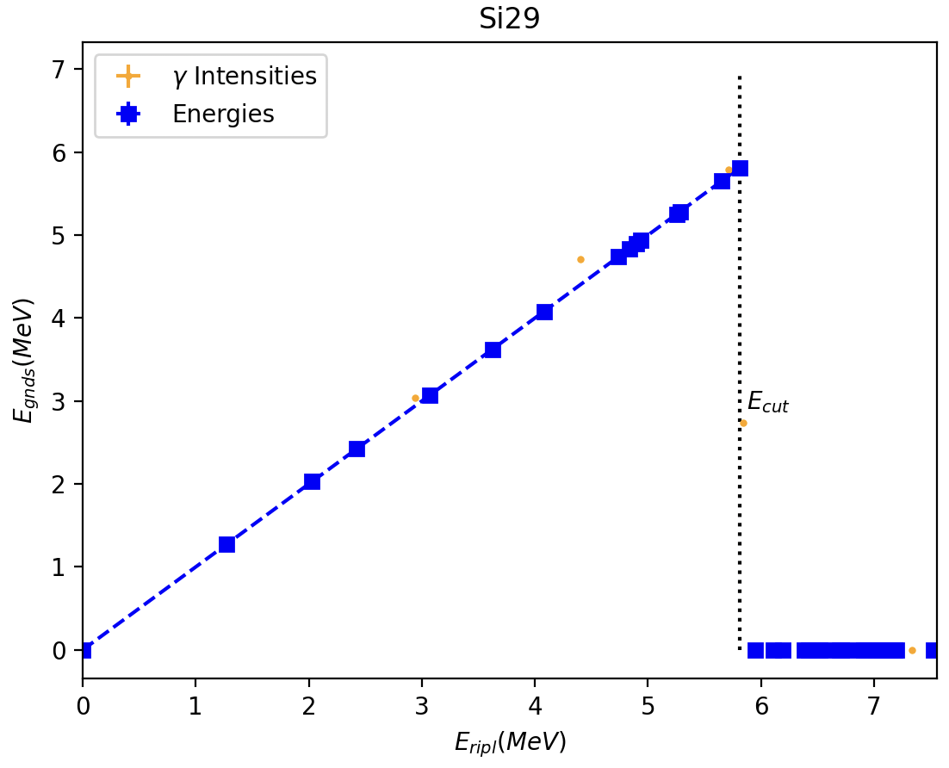
Properly flagging primary capture gammas
https://git.nndc.bnl.gov/grin/grin-formatter
grin-formatter.py
Python package to upgrade and update capture gamma-ray formatting and level and branching ratio fixes in evaluated ENDF and GNDS files
Formatting capture gamma spectrum and Ensuring energy conservation
Updating branching ratios and level info
13

Slide 14
We fixed the primary gamma flags of a handful of isotopes for the following up release (more to come for ENDF9)
Working on validation of our files with inelastic gammas from Baghdad Atlas:
Good for low energy but we need more effort on high energies (where continuum kicks in)

Slide 15
A Joint Effort: Experiment + Evaluations + Validation
Highlights:
GIDI+ uses GNDS rather than legacy ENDF files for correlated gamma emissions from capture reaction cascades. Our new GNDS files contain all the inputs needed for in-line cascade simulation.
Detailed reaction inputs are required: All can be given by reaction codes
We can embed discrete levels in the continuum: - a discrete level above E_{cut} and its branching ratios can be incorporated (replacing a “theory” level by the given discrete from RIPL/ENSDF-- under testing)
I would like to make sure ICCs are included in the evaluated files
We have tested C, S and Fe but the list of isotopes of interest is large
Benchmarking cases are needed: with coincidence or not; (at different incident energies)
Reach out if you are interested echimansk@bnl.gov
15

Slide 16
Thank you
chimanski@bnl.gov
not export controlled

