Slide 1
ORNL TSL Evaluations for ENDF/B-IX
Chris W. Chapman, Kemal Ramic, Iyad Al-Qasir
Oak Ridge National Laboratory
Mini-CSEWG meeting – 14 August 2024

Slide 2
Outline
What we’ve already done
What’s actively being worked on
What’s planned to be worked on

Slide 3
Disclaimer
This is not a finalized list of evaluations that will 100% for sure be submitted to NNDC
This is just a list of what we currently expect, this is not a final list

Slide 4
What we’ve already done
Atomistic TSLs
6 materials (W, V, Pb, Ni, Mo, Cu) are under consideration
Originally from NJOY+NCrystal collaboration
These materials show up in numerous ICSBEP benchmarks
Preliminary agreement to total cross section measurements was good, but felt improvements could be made
New transmission measurements planned for certain materials
Slight modifications are underway to ensure better agreement with cross section measurements
Next step is to do large scale, extensive testing across VALID suite

Slide 5
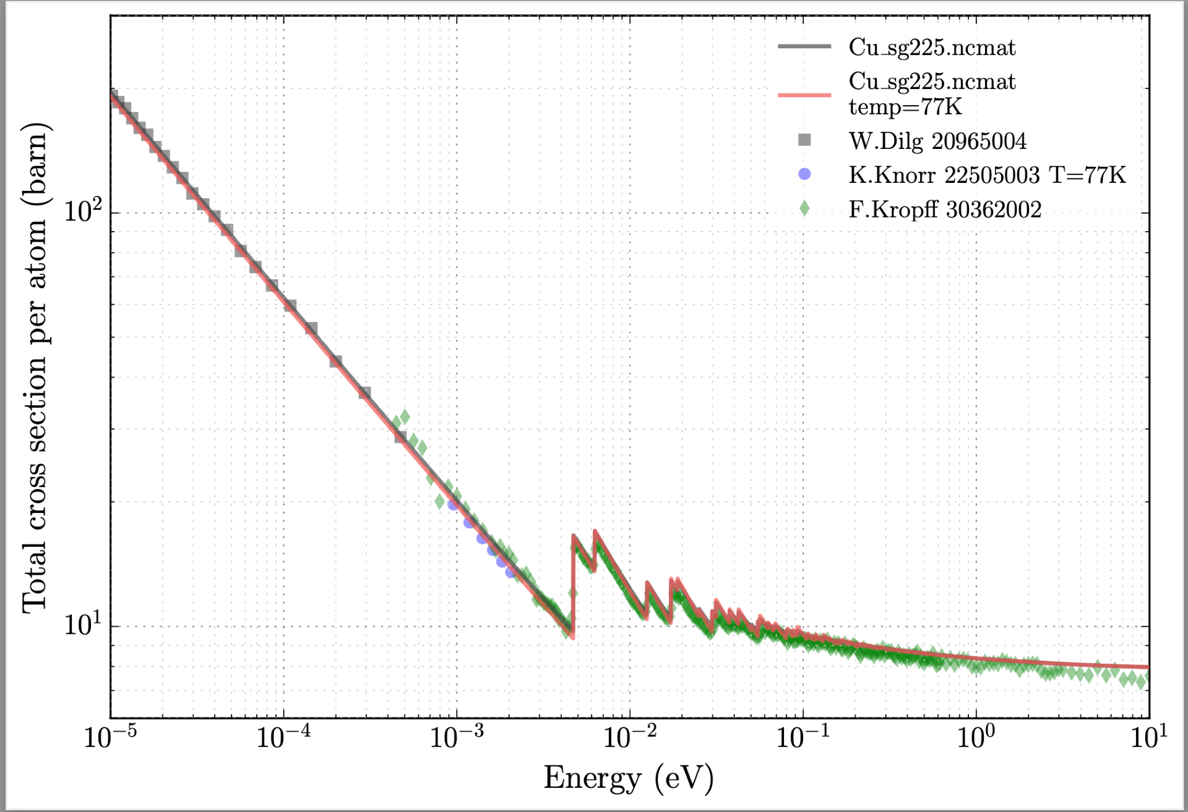
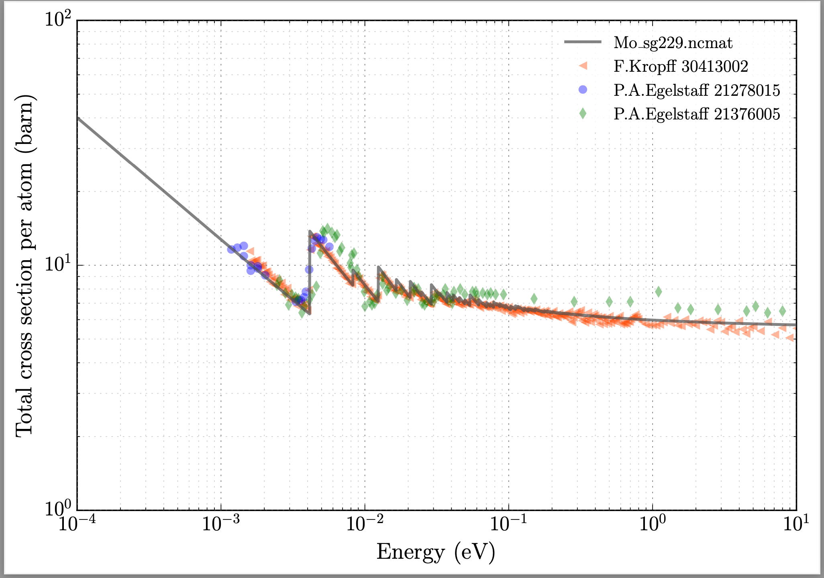
What we’ve already done – Cu & Mo

Slide 6
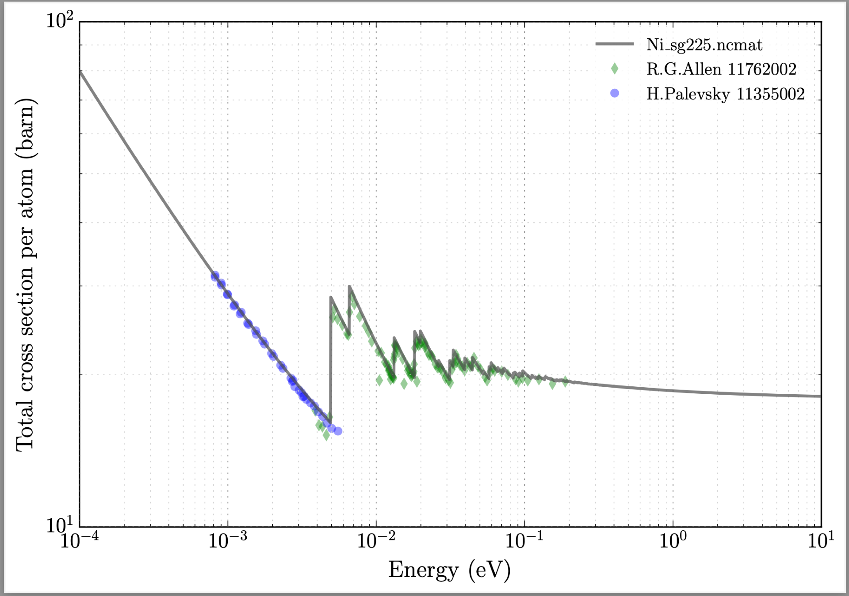
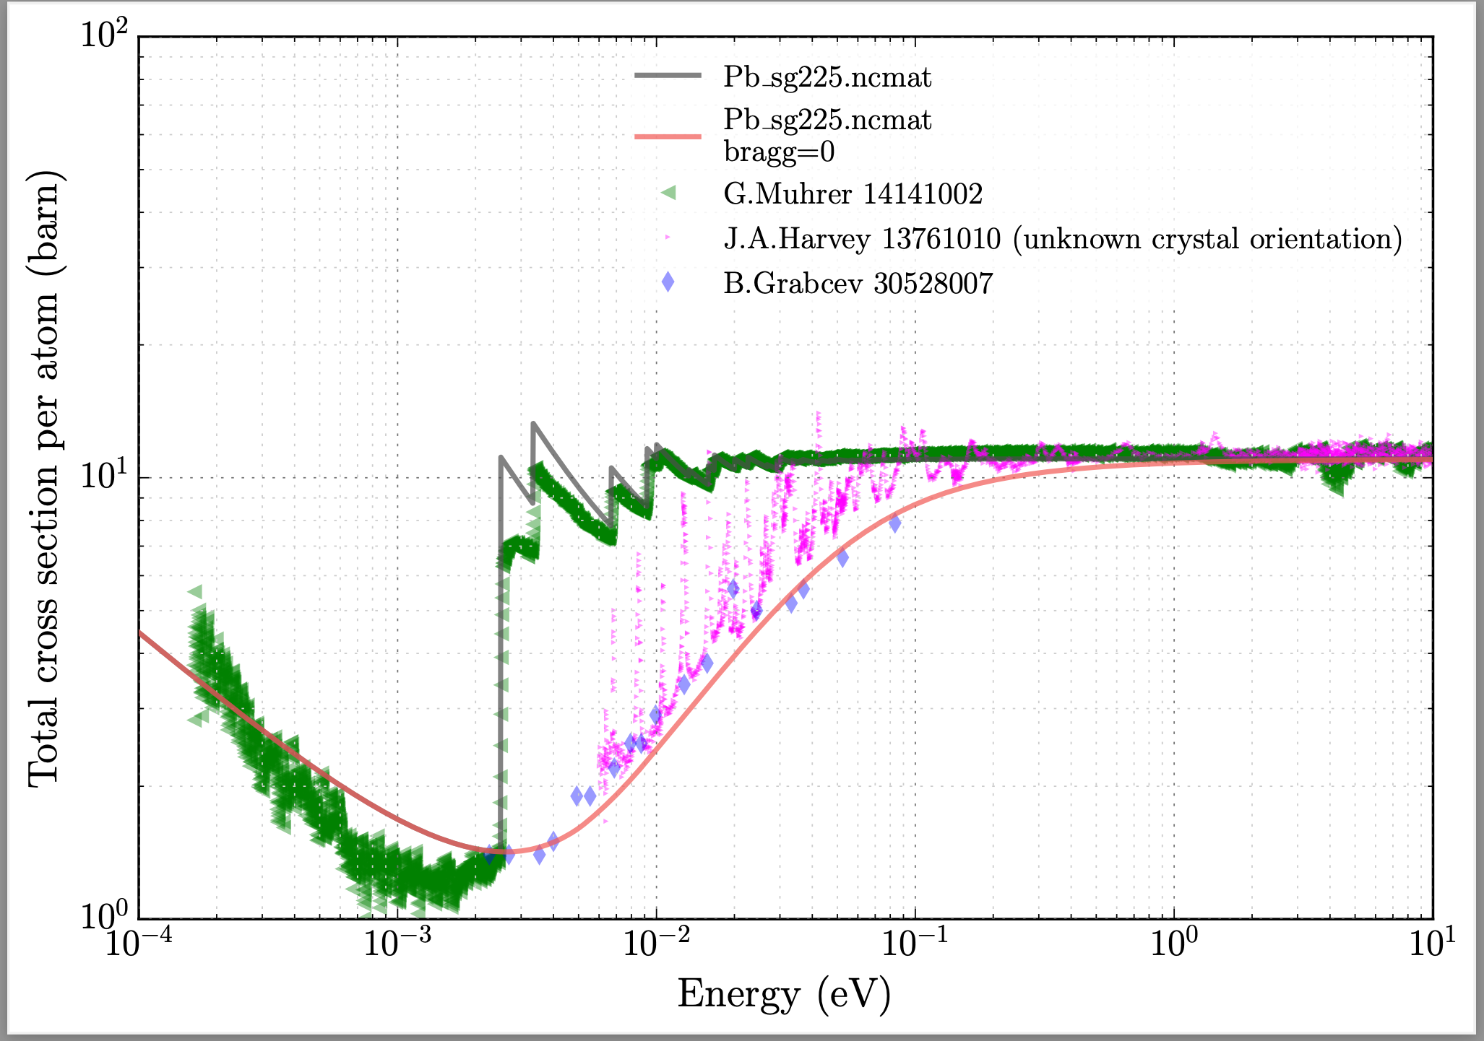
What we’ve already done – Ni & Pb

Slide 7
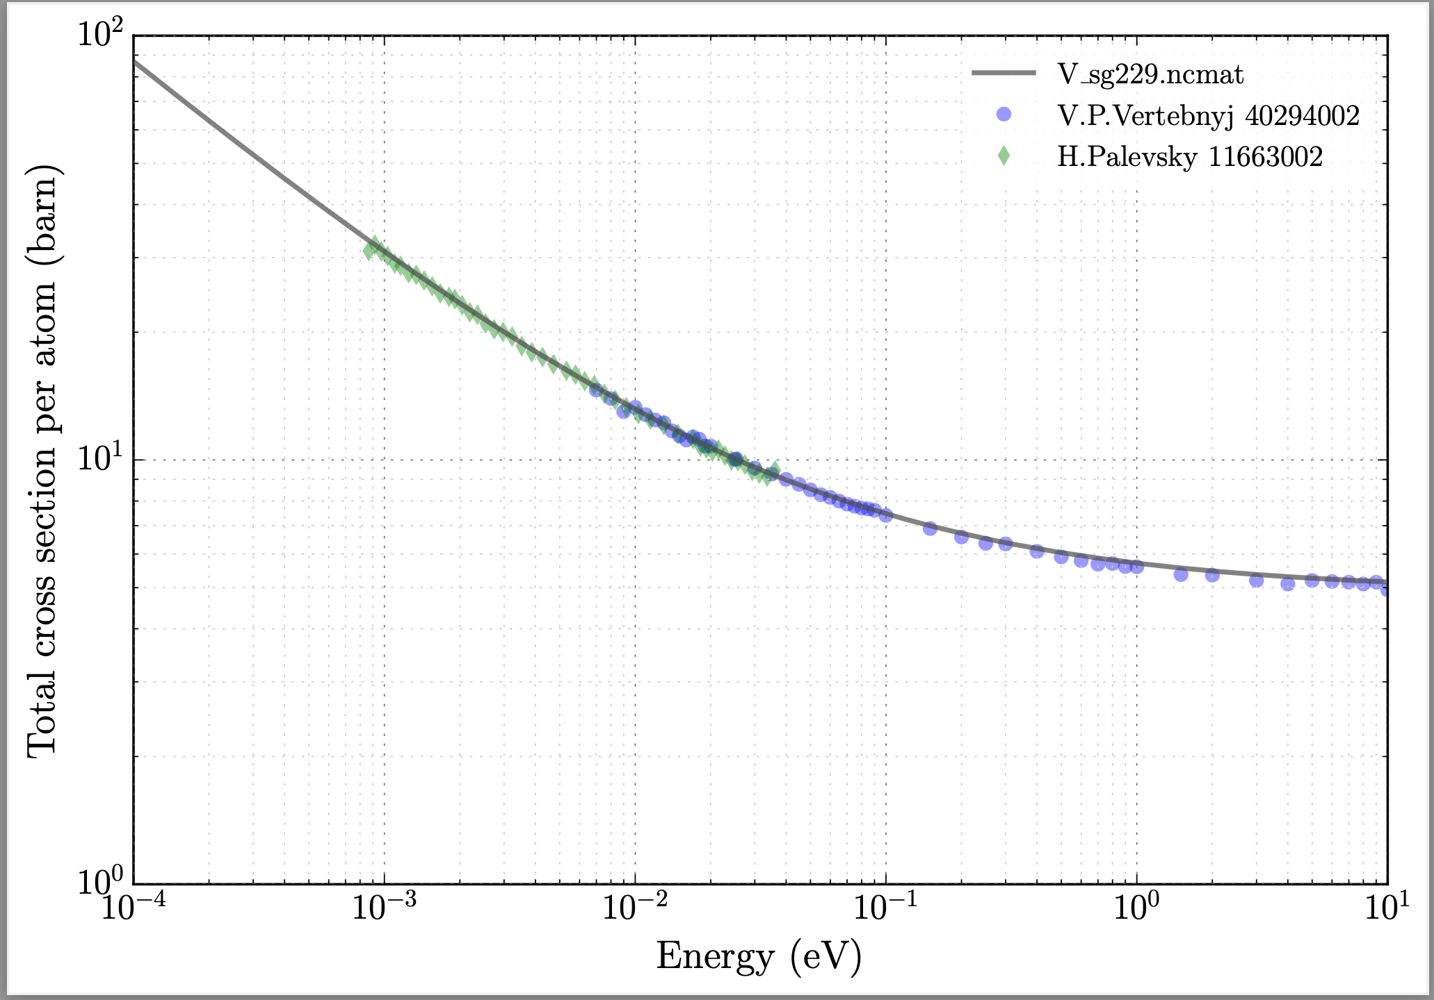
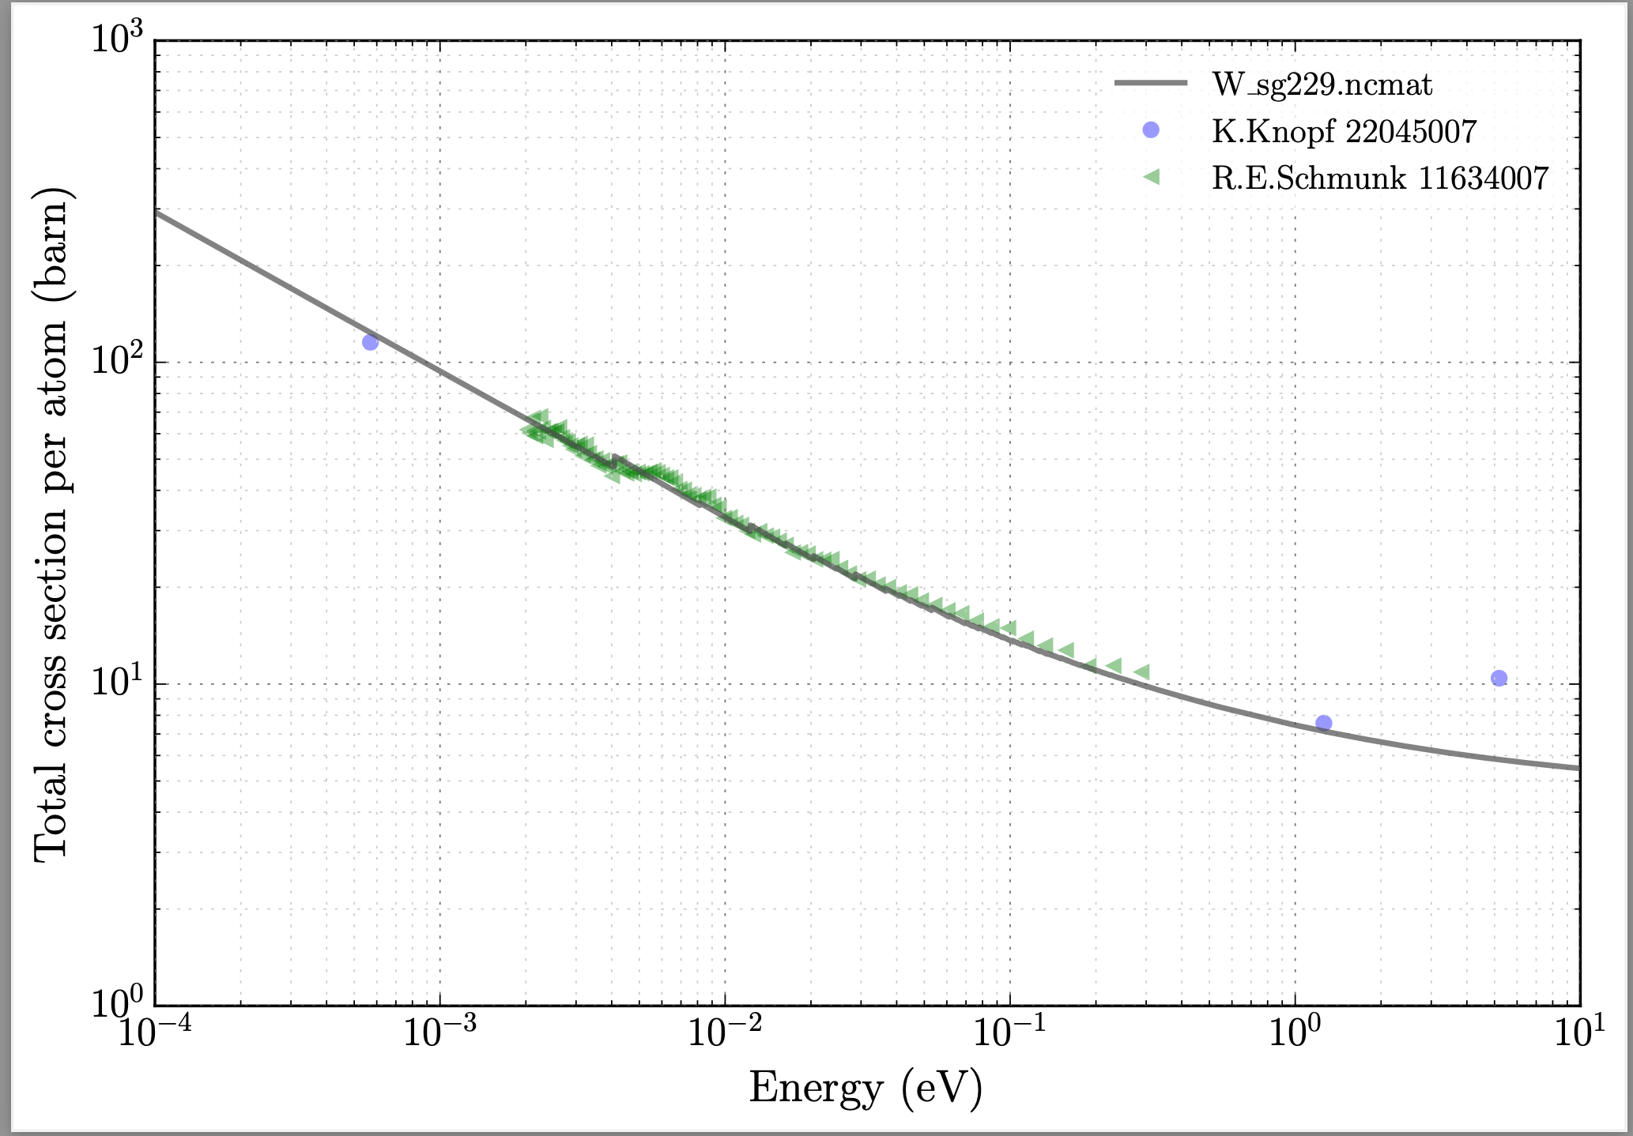
What we’ve already done – V & W

Slide 8
What’s actively being worked on
Polyethylene
Unanswered questions about discrepant agreement between differential & integral data
In-depth analysis into potential causes of this discrepancy is ongoing
UO₂, PuO₂
Simultaneous TSL & RRR evaluation which appropriately accounts for thermal resonances
Unclear if new ENDF format will be required
No differential measurements currently planned
Extensive testing on integral benchmarks planned
YH₂
Focus on high-temperature measurements and evaluation

Slide 9
What’s planned to be worked on
Graphite, MgO, SiC, ZrC, BeO, Be₂C
Focus is on high-temperature measurements and evaluations for advanced reactor applications
MgO, BeF₂, MgF₂
Focus on temperature-dependent files for neutron filter applications
Special care will be used to make sure neutron filter MgO is named differently from advanced reactor MgO files
H₂O
HOPEFULLY with a novel TSL covariance

Slide 10
Acknowledgements
This work was supported by the Nuclear Criticality Safety Program, funded and managed by the National Nuclear Security Administration for the Department of Energy.

