Slide 1
Electronics & DAQ WG
Fernando Barbosa (JLab)
23 May 2024

Slide 2
Review News
2nd Preliminary Design Report (PDR) Electronics & DAQ,
Final Design Report (FDR) VTRX+, lpGBT:
10 – 11 June 2024
Reviewers:
Prashansa Mukim (BNL)
Ken Wyllie (CERN)
Filippo Costa (CERN)
Mitch Newcomer (UPenn)
Page Turns – 31 May 2024
Rehearsals – 4 June 2024
Final Documentation, Slides Uploads – 6 June 2024

Slide 3
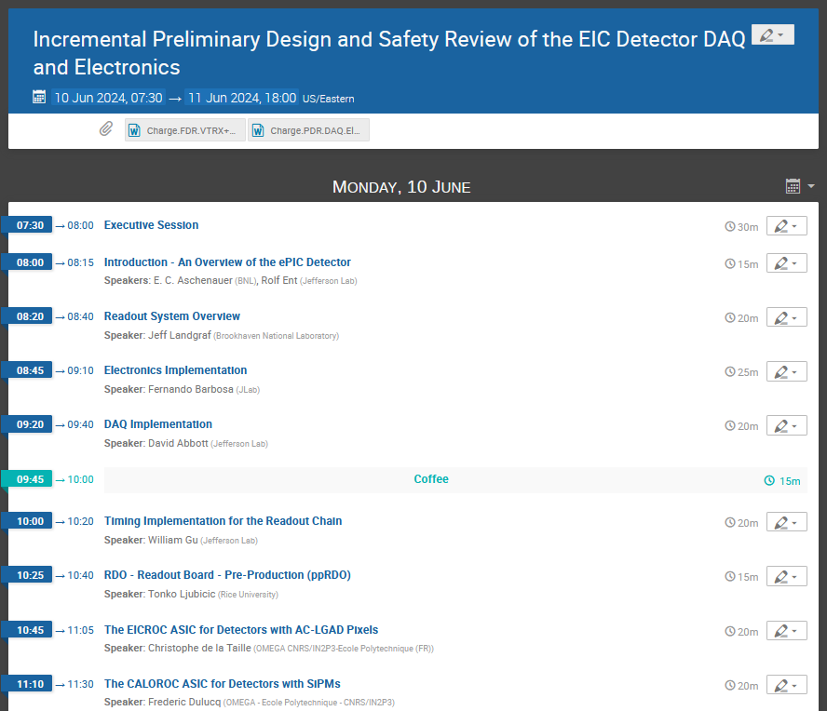
Review Schedule

Slide 4
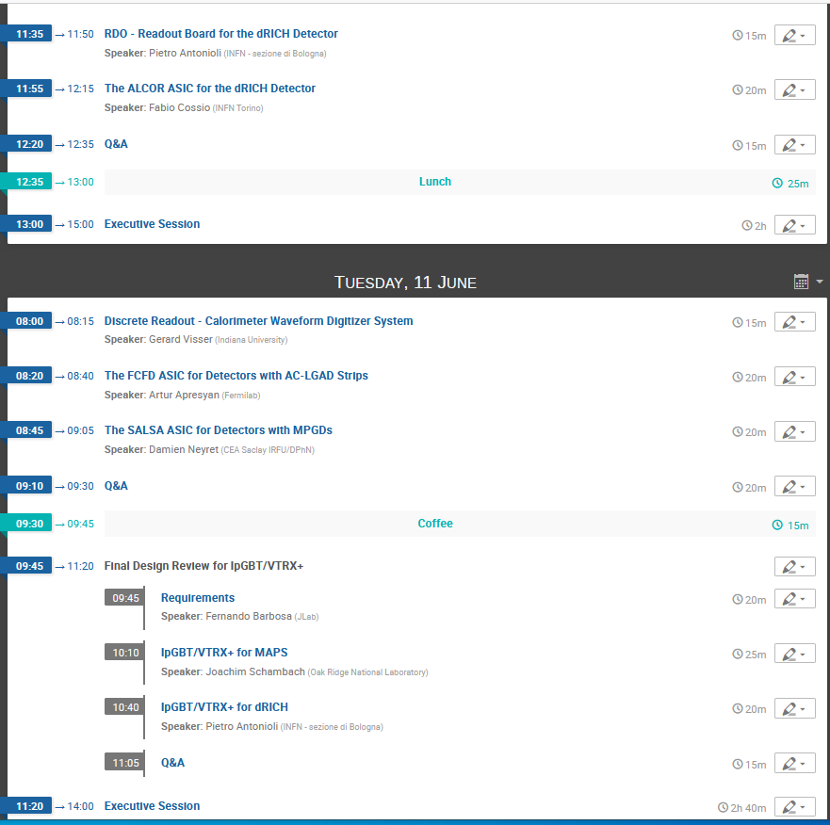
Review Schedule (cont.)

