Slide 1
TOF Key Plots toward TDR
AC-LGAD TOF Group
Satoshi Yano and Zhangbu Xu

Slide 2
Key plots
Detector configurations and Key requirements
Realistic Performance from R&D
Simulations of 1/beta vs p
PID performance

Slide 3
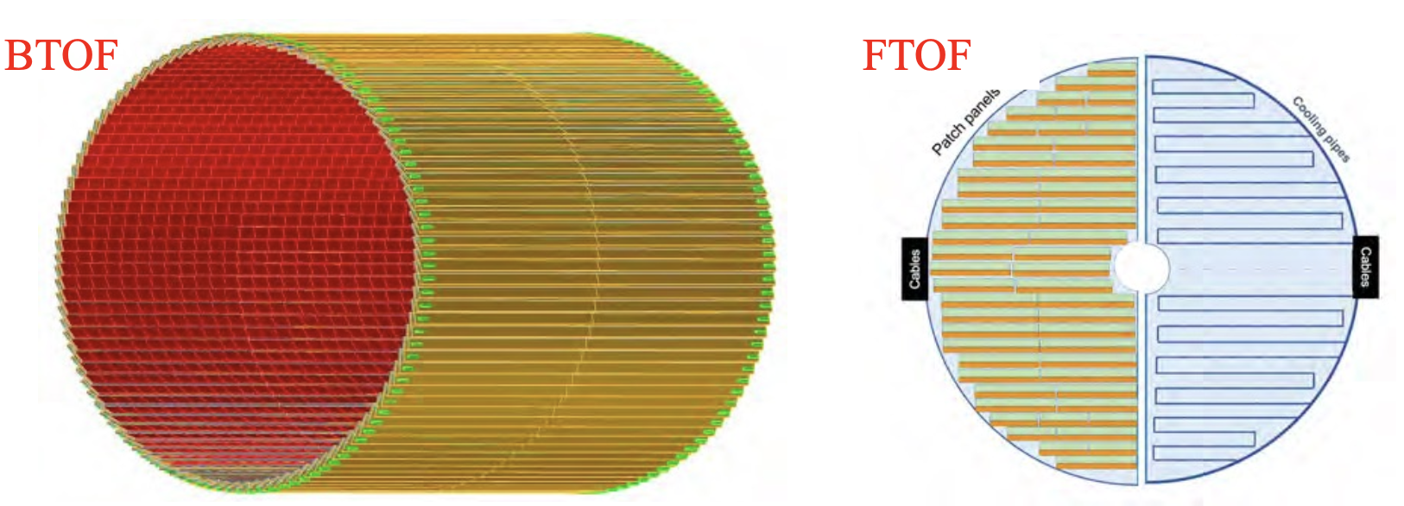
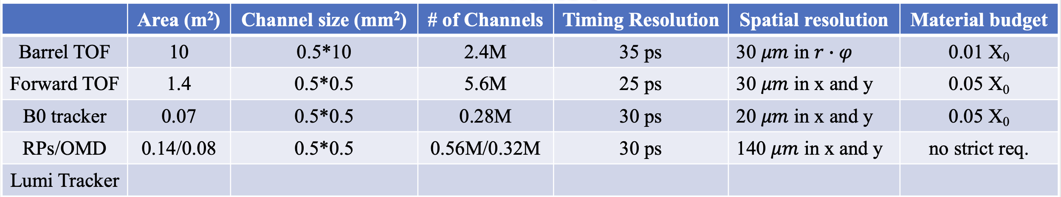
Detector

Slide 4
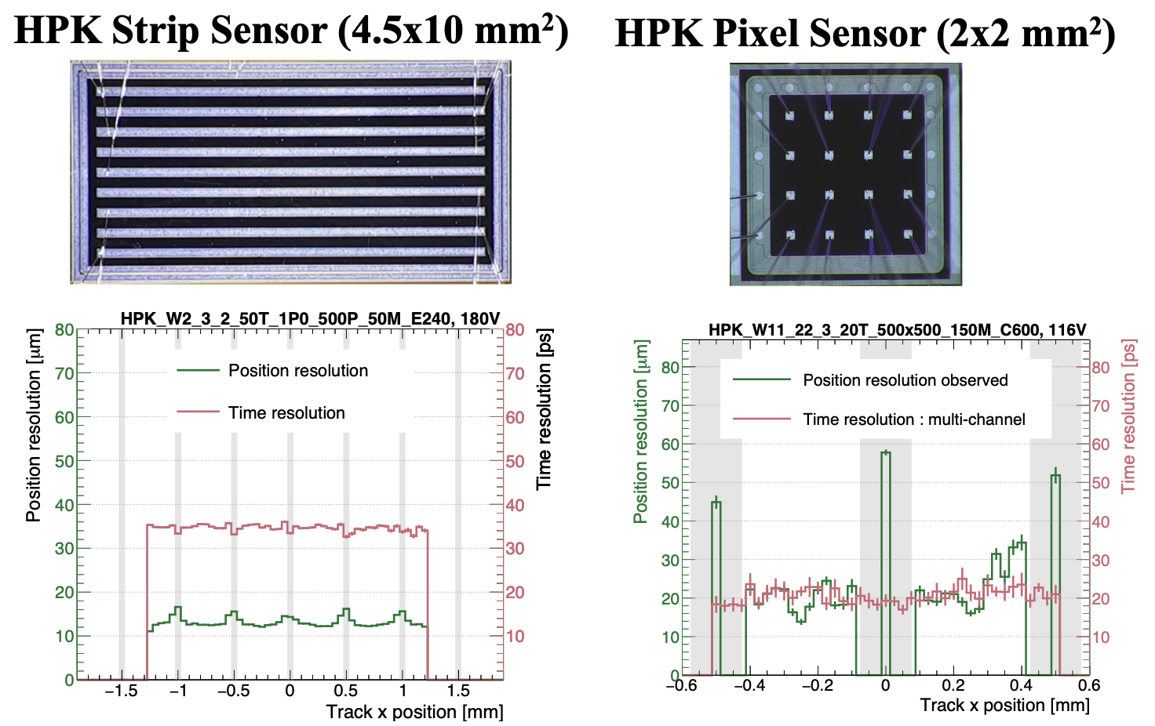
Position and timing resolutions from R&D

Slide 5
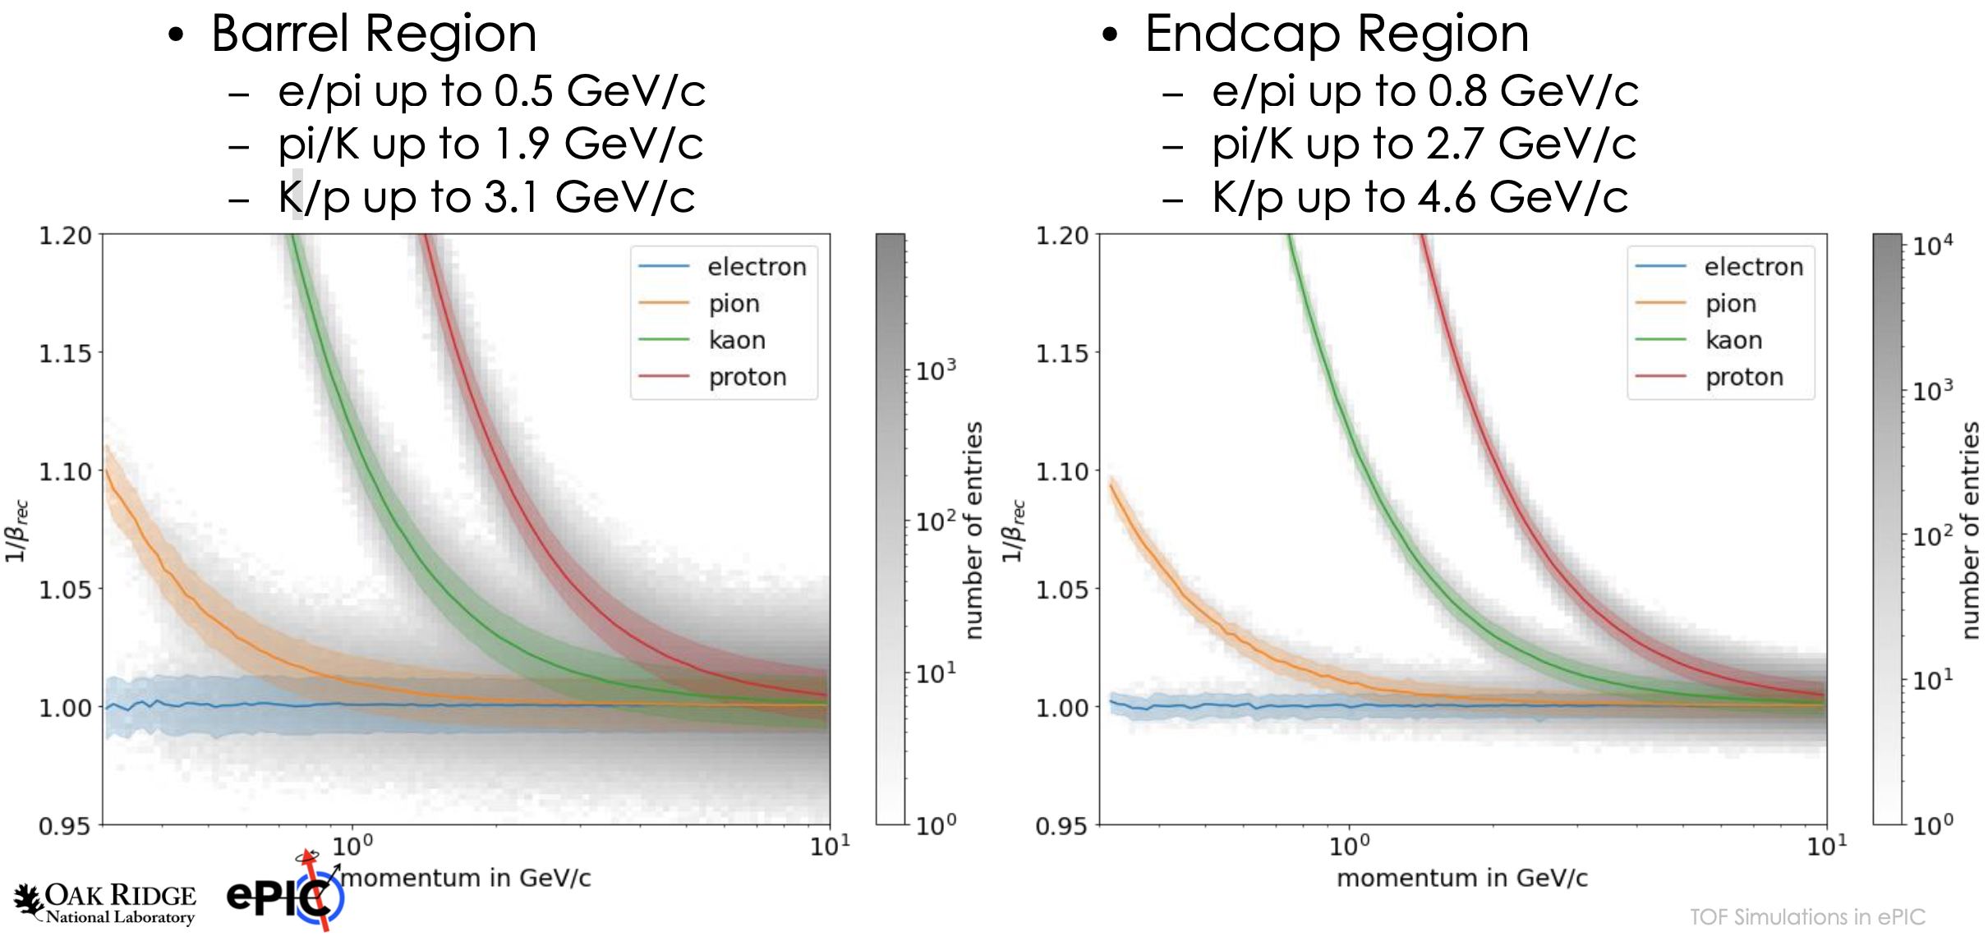
Time-of-Flight Performance

Slide 6
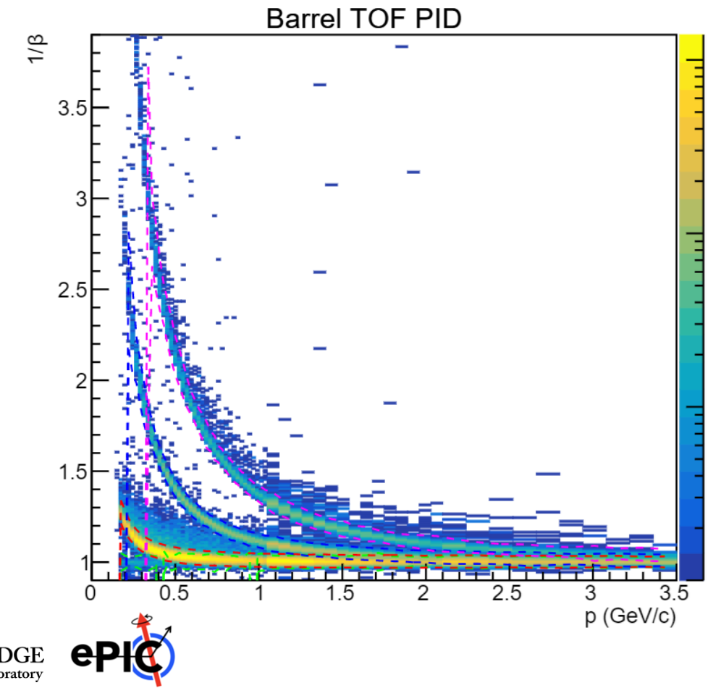
PYTHIA DIS full simulation
PYTHIA DIS event without beam background
PYTHIA DIS event with beam background and full reconstruction
To be done

Slide 7
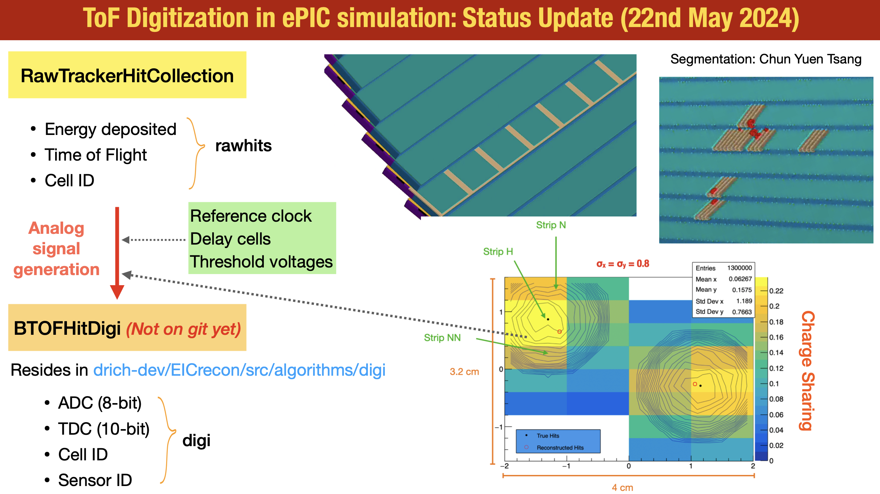
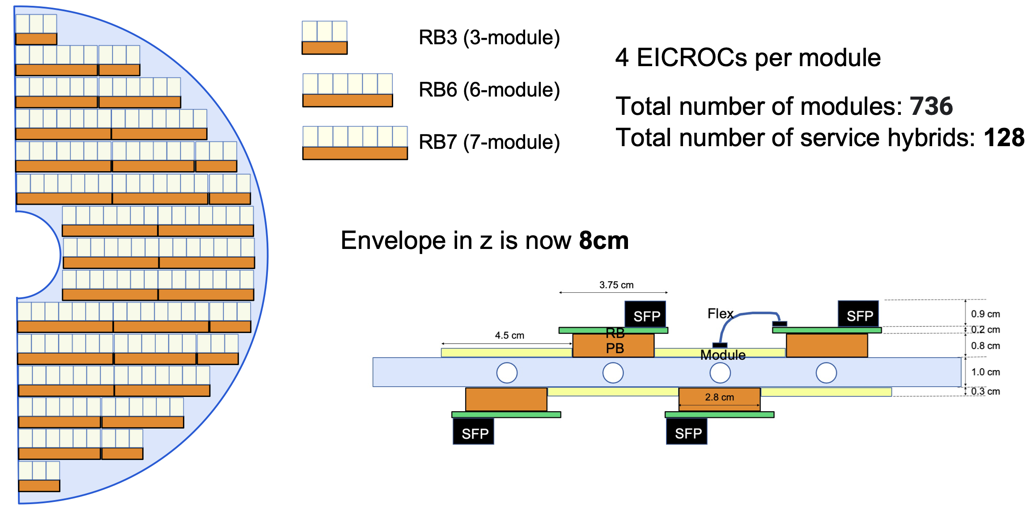
Updates since last time
Simulation progress: toward more realistic background simulation
Updates with detector geometry
material

