Slide 1
EIC Event Display
Phoenix based event display for EPIC Dmitry Romanov

Slide 2
Event display requirements
Requirements for event display
Two primary purposes:
Outreach through enhanced visualization of detector and physics data
(!) Detailed debugging of simulation and reconstruction

Slide 3
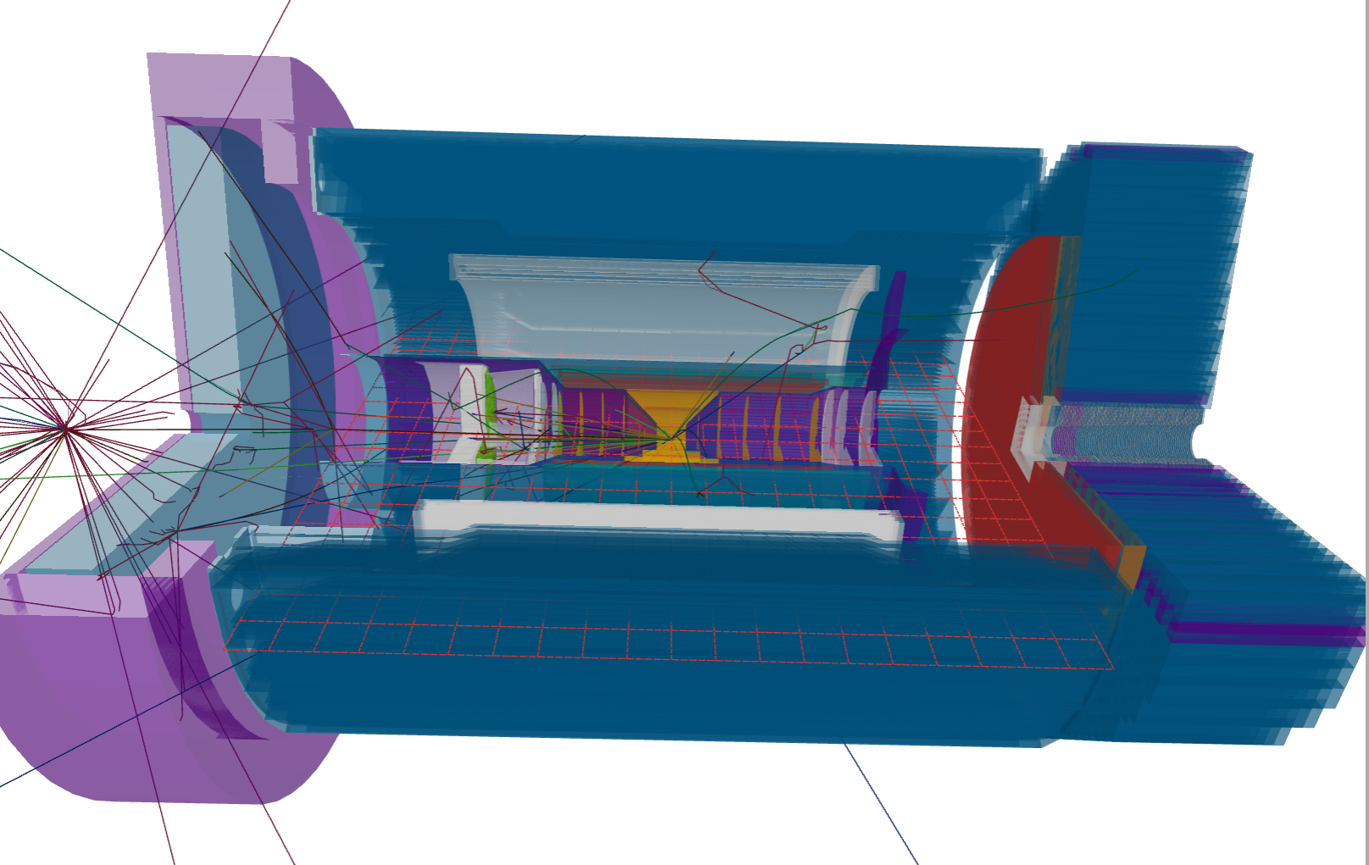
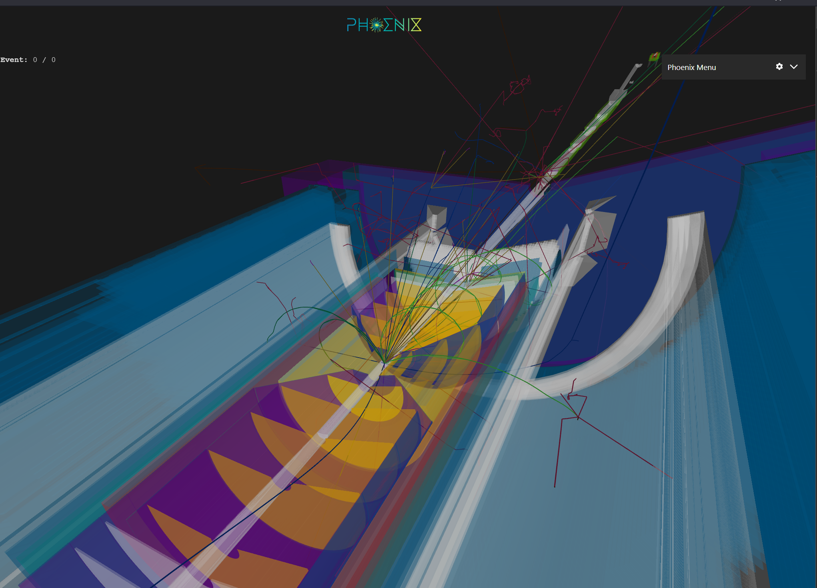
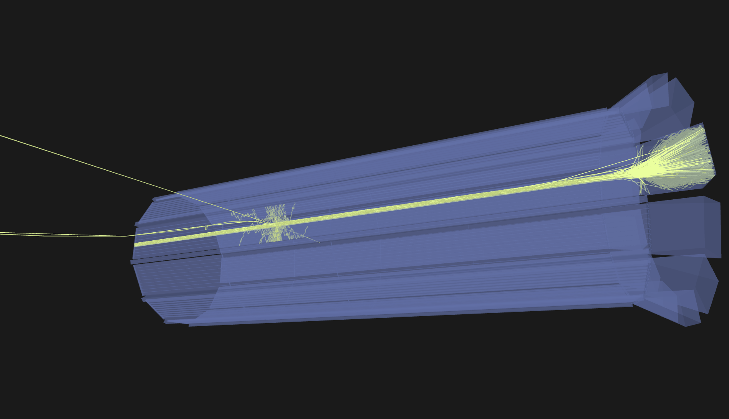
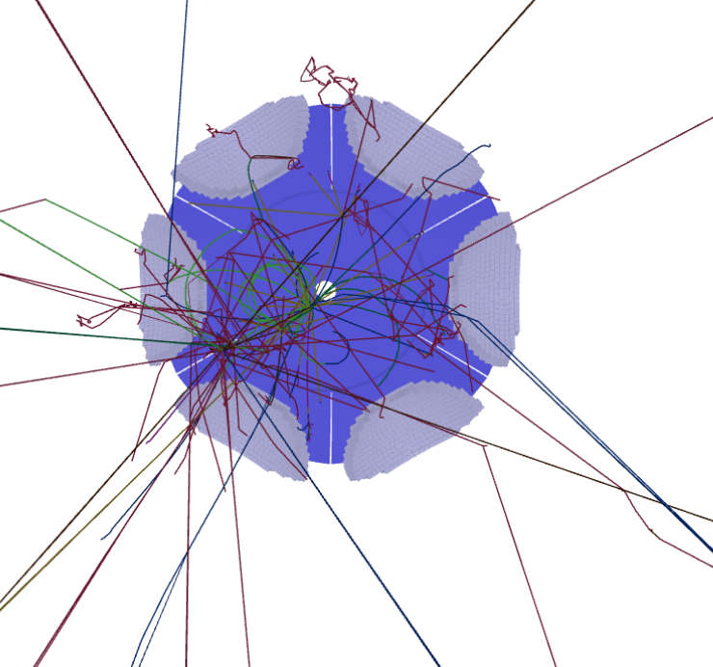
What is there so far
DD4Hep plugin saving tracks to phoenix format
Hits in EDM4Hep (json, + root in work)
Load current geometries
Can handle far-forward
Geometry optimization (being in progress)

Slide 4
EIC Phoenix based event display
Together with HSF Phoenix event display group
https://github.com/eic/firebird
Static website using GH pages
https://eic.github.io/firebird

Slide 5
Geometry time!

Slide 6
Geometry

Slide 7
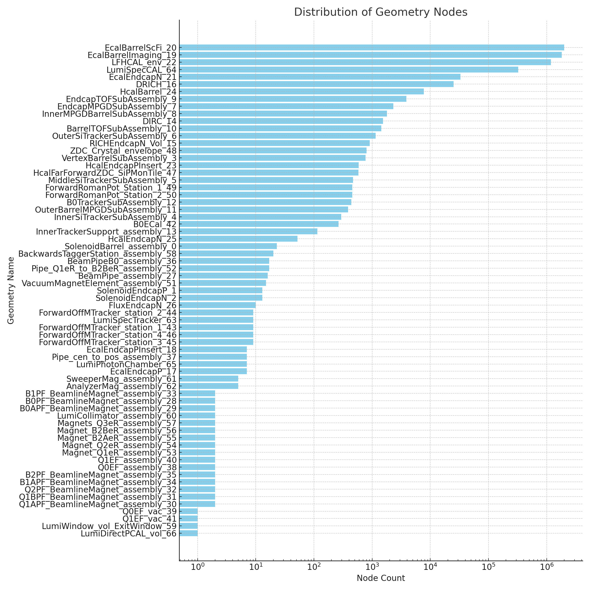
Geometry Nodes
Node Count | Geometry Name
2,007,793 | EcalBarrelScFi
1,816,561 | EcalBarrelImaging
1,185,962 | LFHCAL
324,163 | LumiSpecCAL
32,872 | EcalEndcapN
25,211 | DRICH
7,716 | HcalBarrel
3,860 | EndcapTOFSubAssembly
2,311 | EndcapMPGDSubAssembly
1,795 | InnerMPGDBarrelSubAssembly
1,537 | DIRC
1,443 | BarrelTOFSubAssembly
1,151 | OuterSiTrackerSubAssembly
910 | RICHEndcapN
802 | ZDC_Crystal
773 | VertexBarrelSubAssembly
588 | HcalEndcapPInsert
579 | HcalFarForwardZDC_SiPMonTile
471 | MiddleSiTrackerSubAssembly
455 | ForwardRomanPot_Station_1

Slide 8
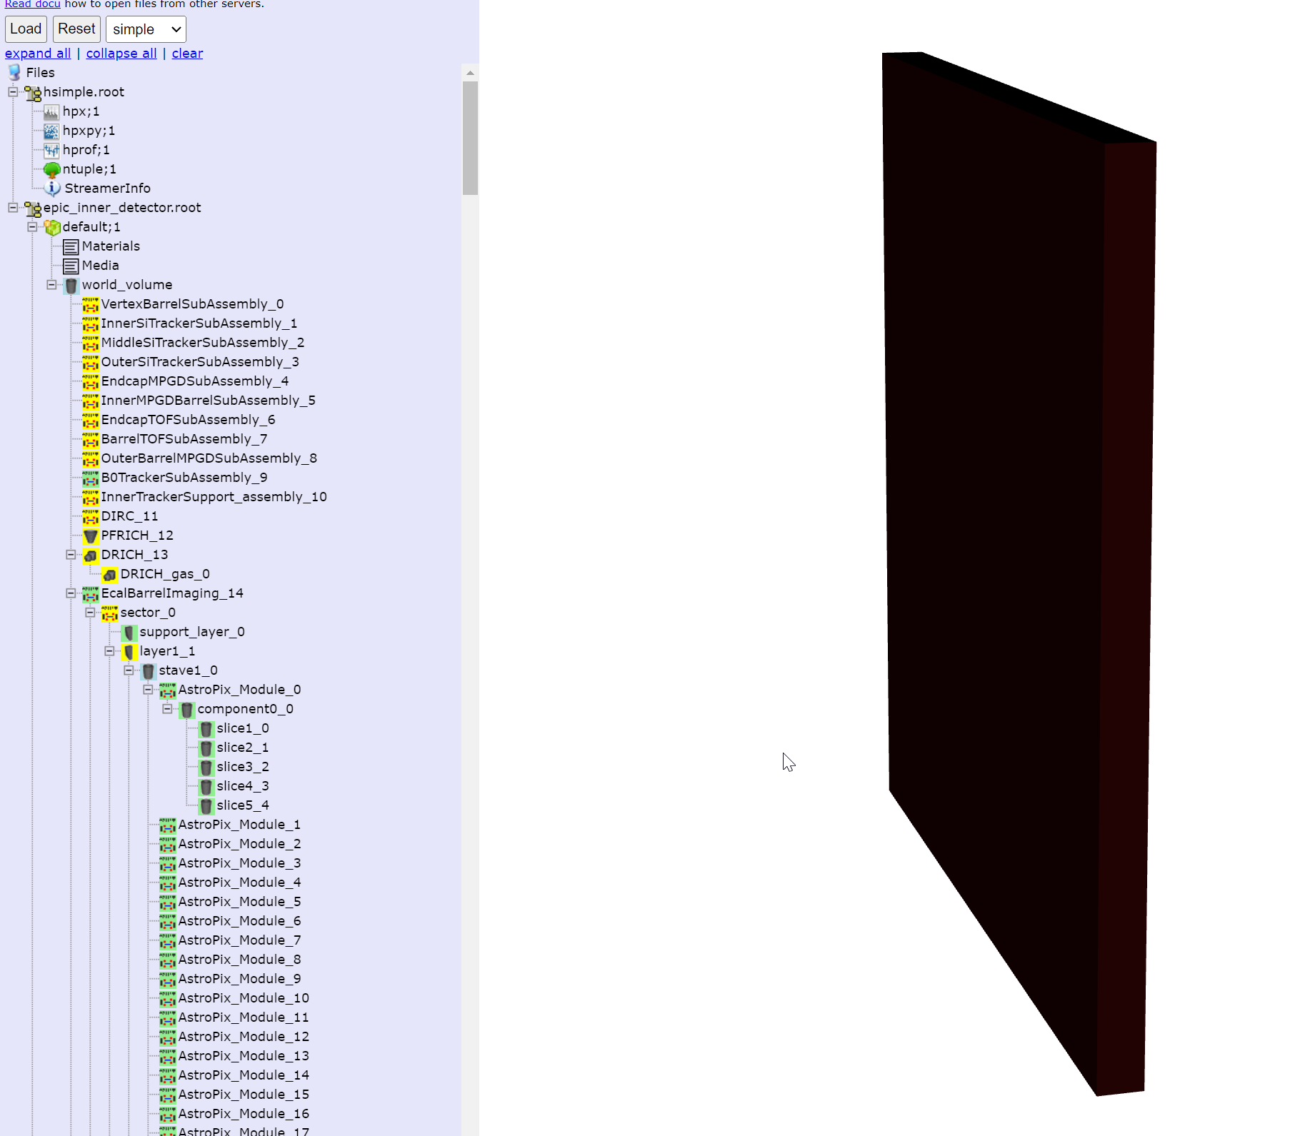
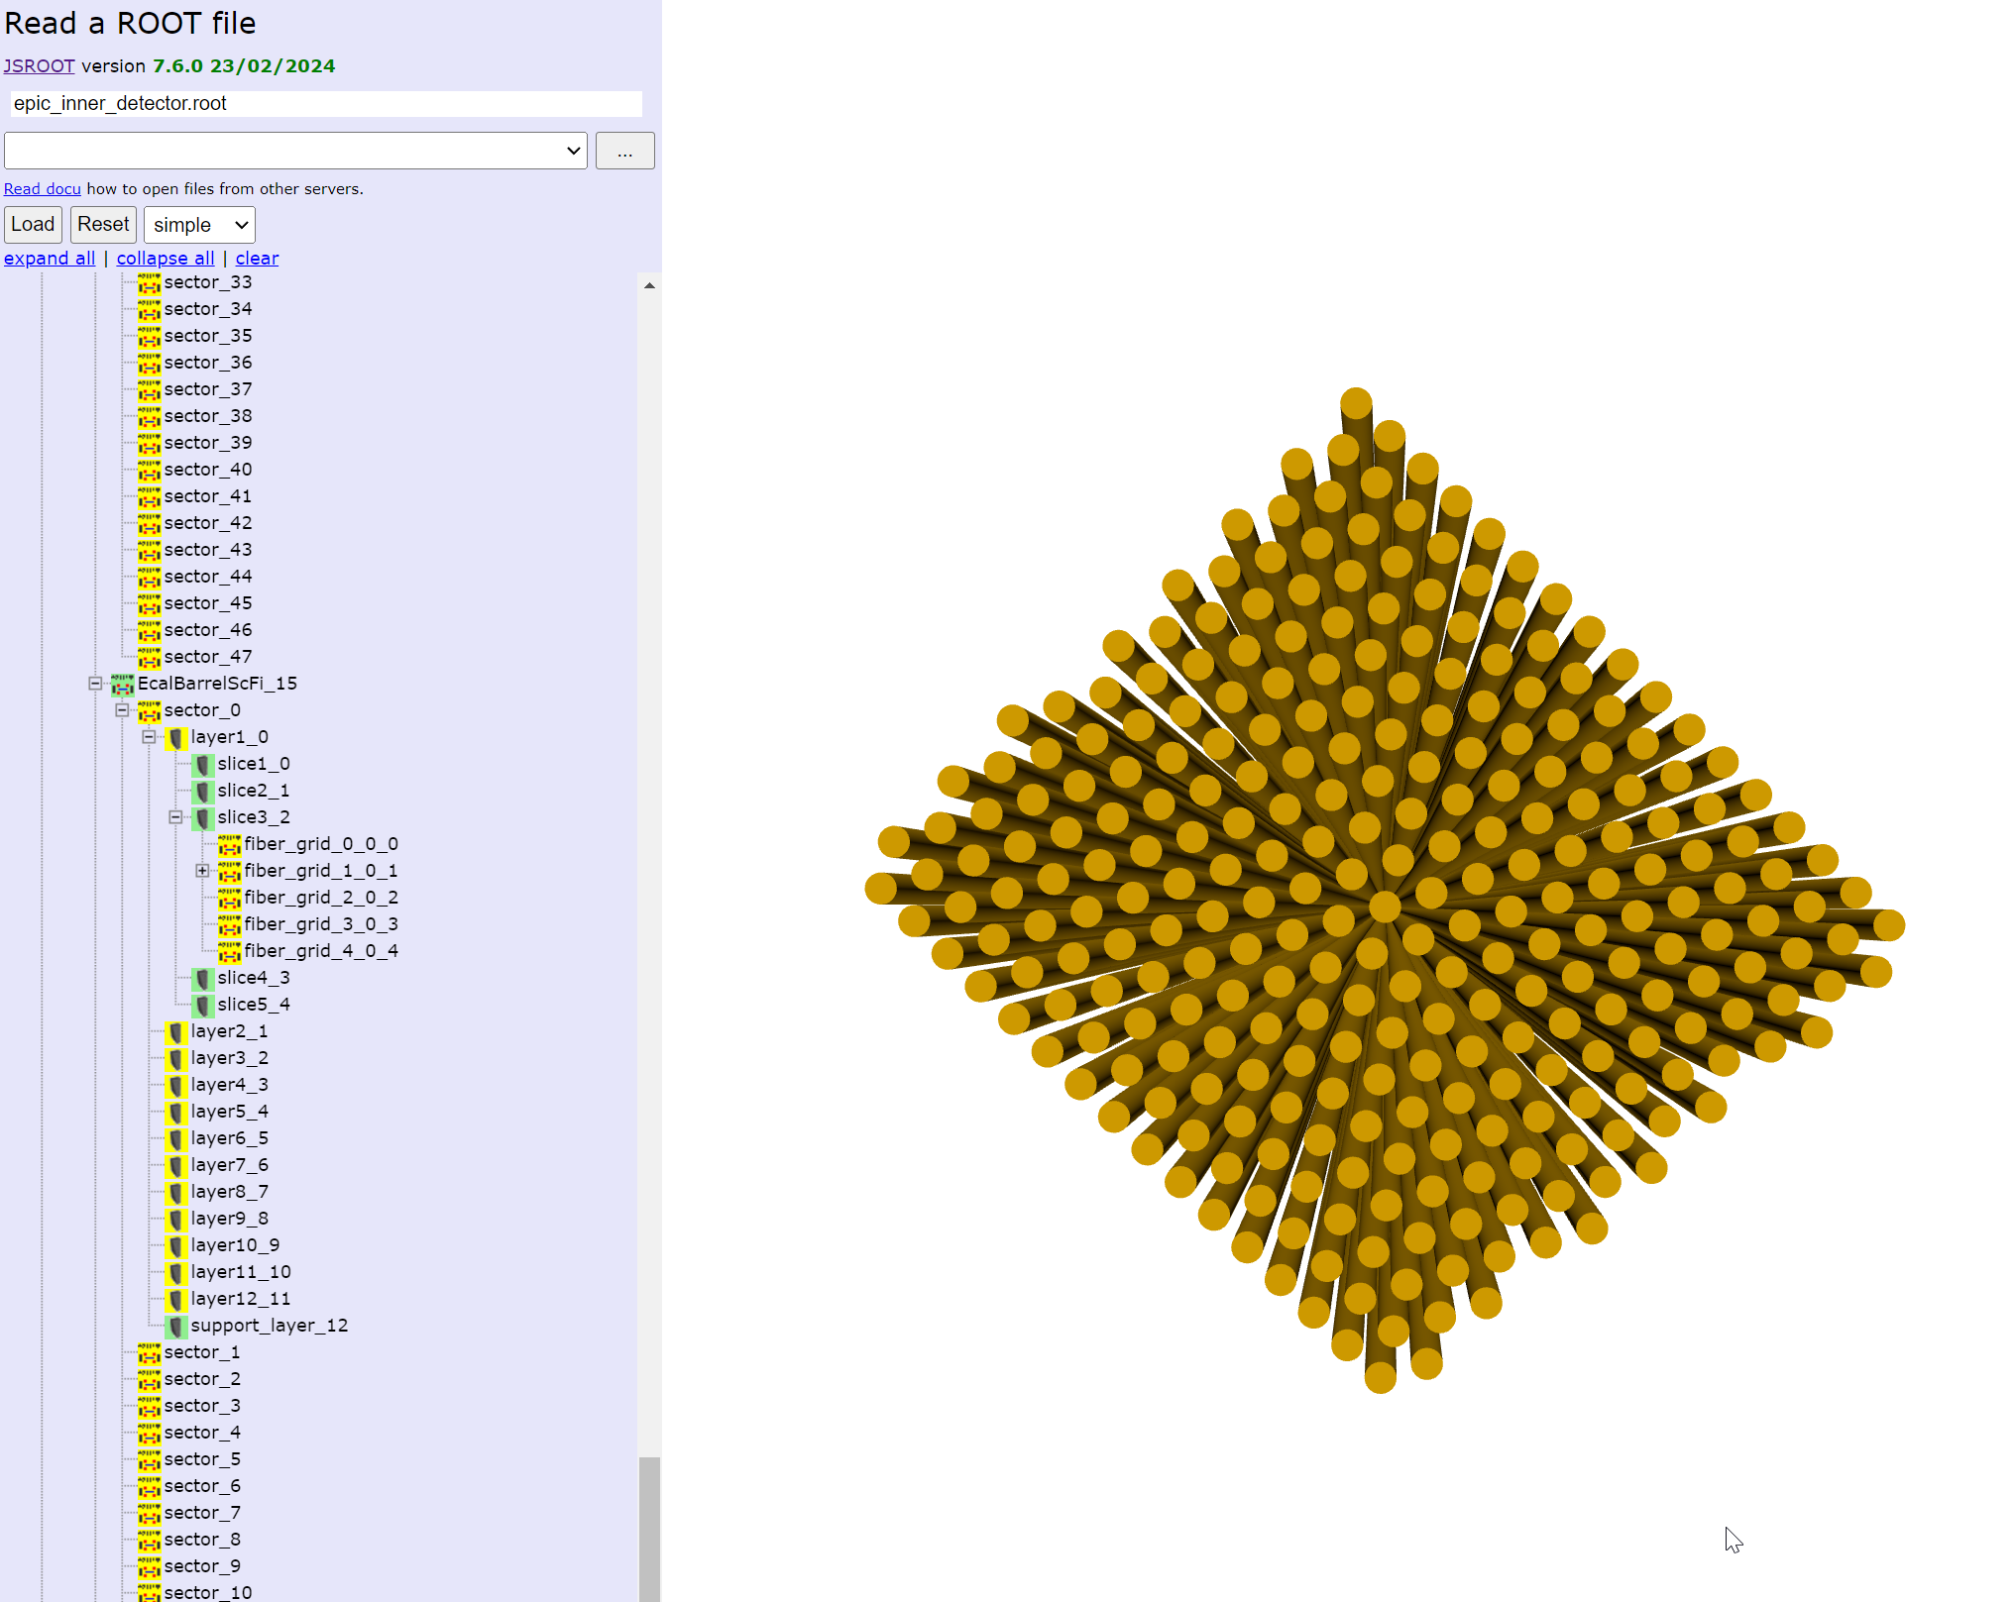
ECAL Barrel

Slide 9
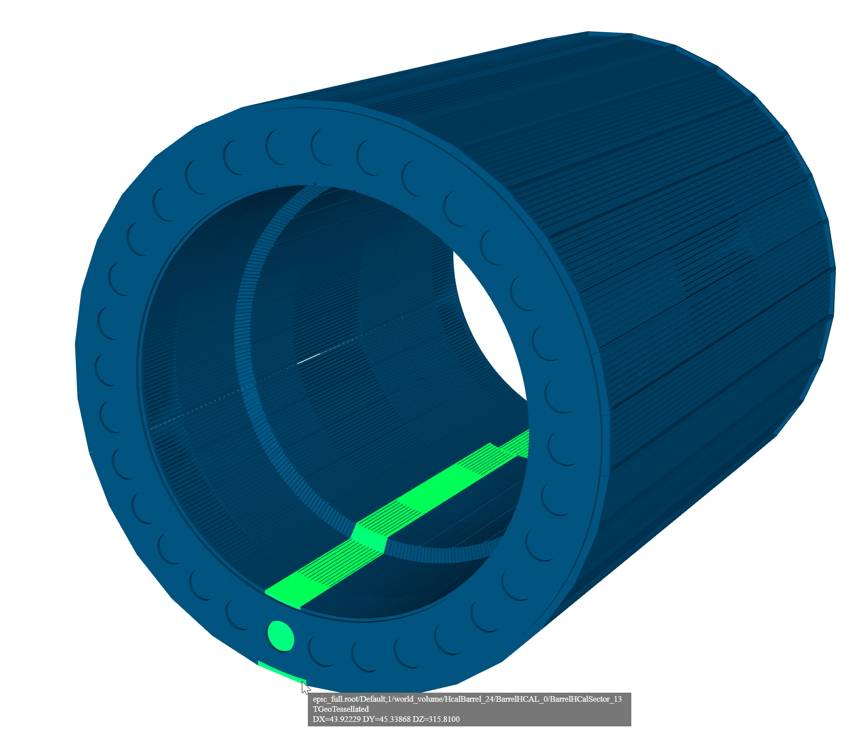
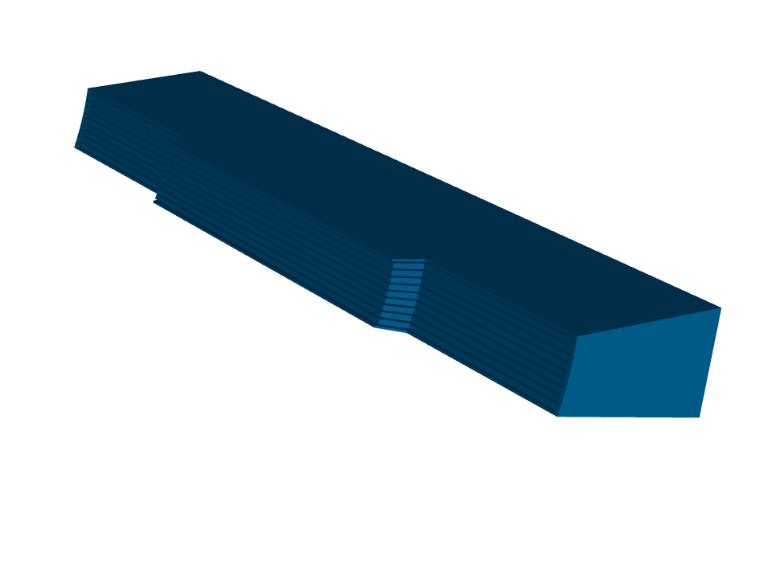
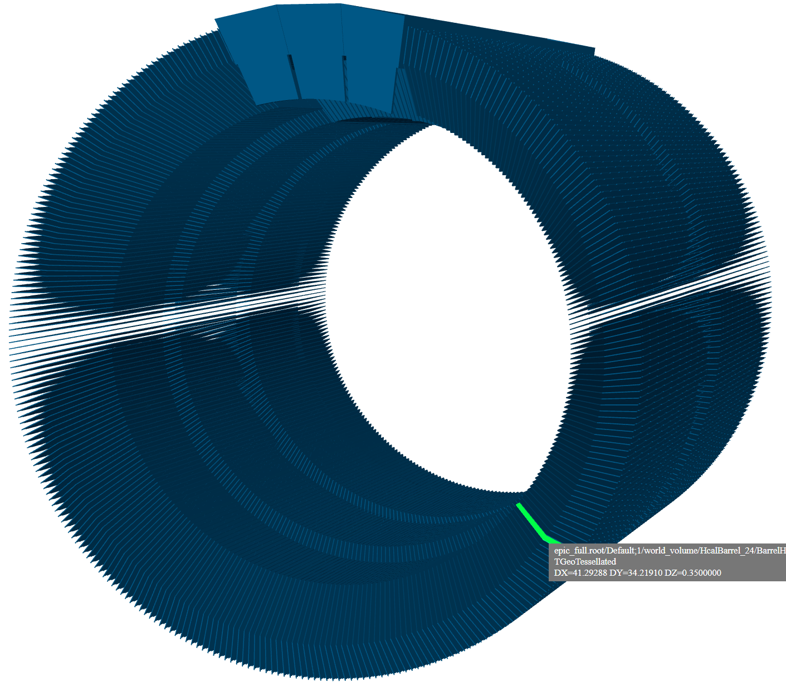
Hcal Barrel
Small number of parts, but active use of tessellated objects

Slide 10
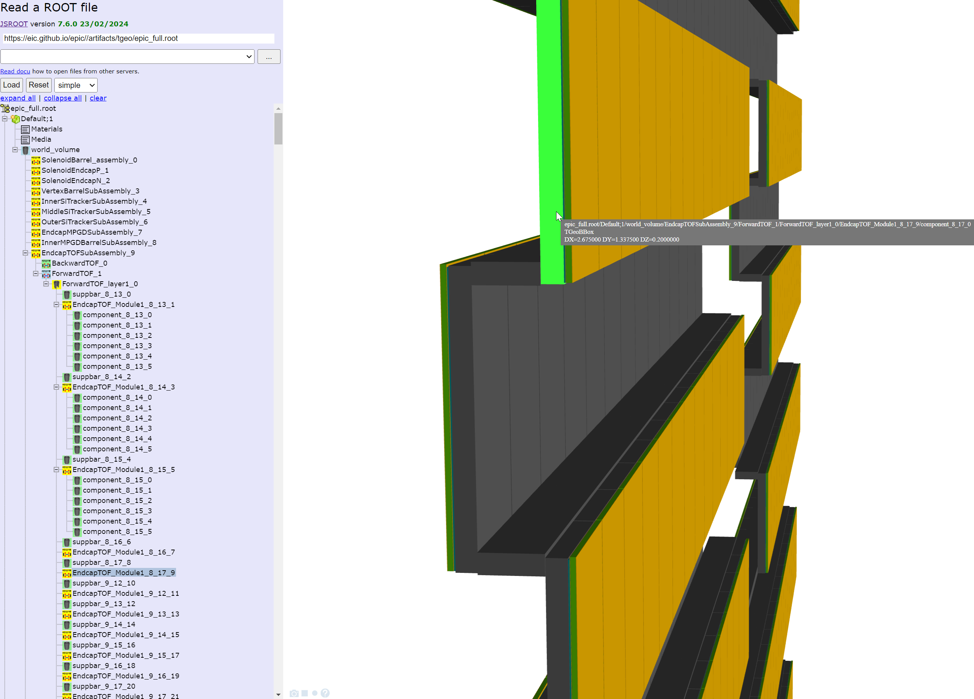
Inconsistent naming
Many geometry elements named assuming no one ever will use names

Slide 11
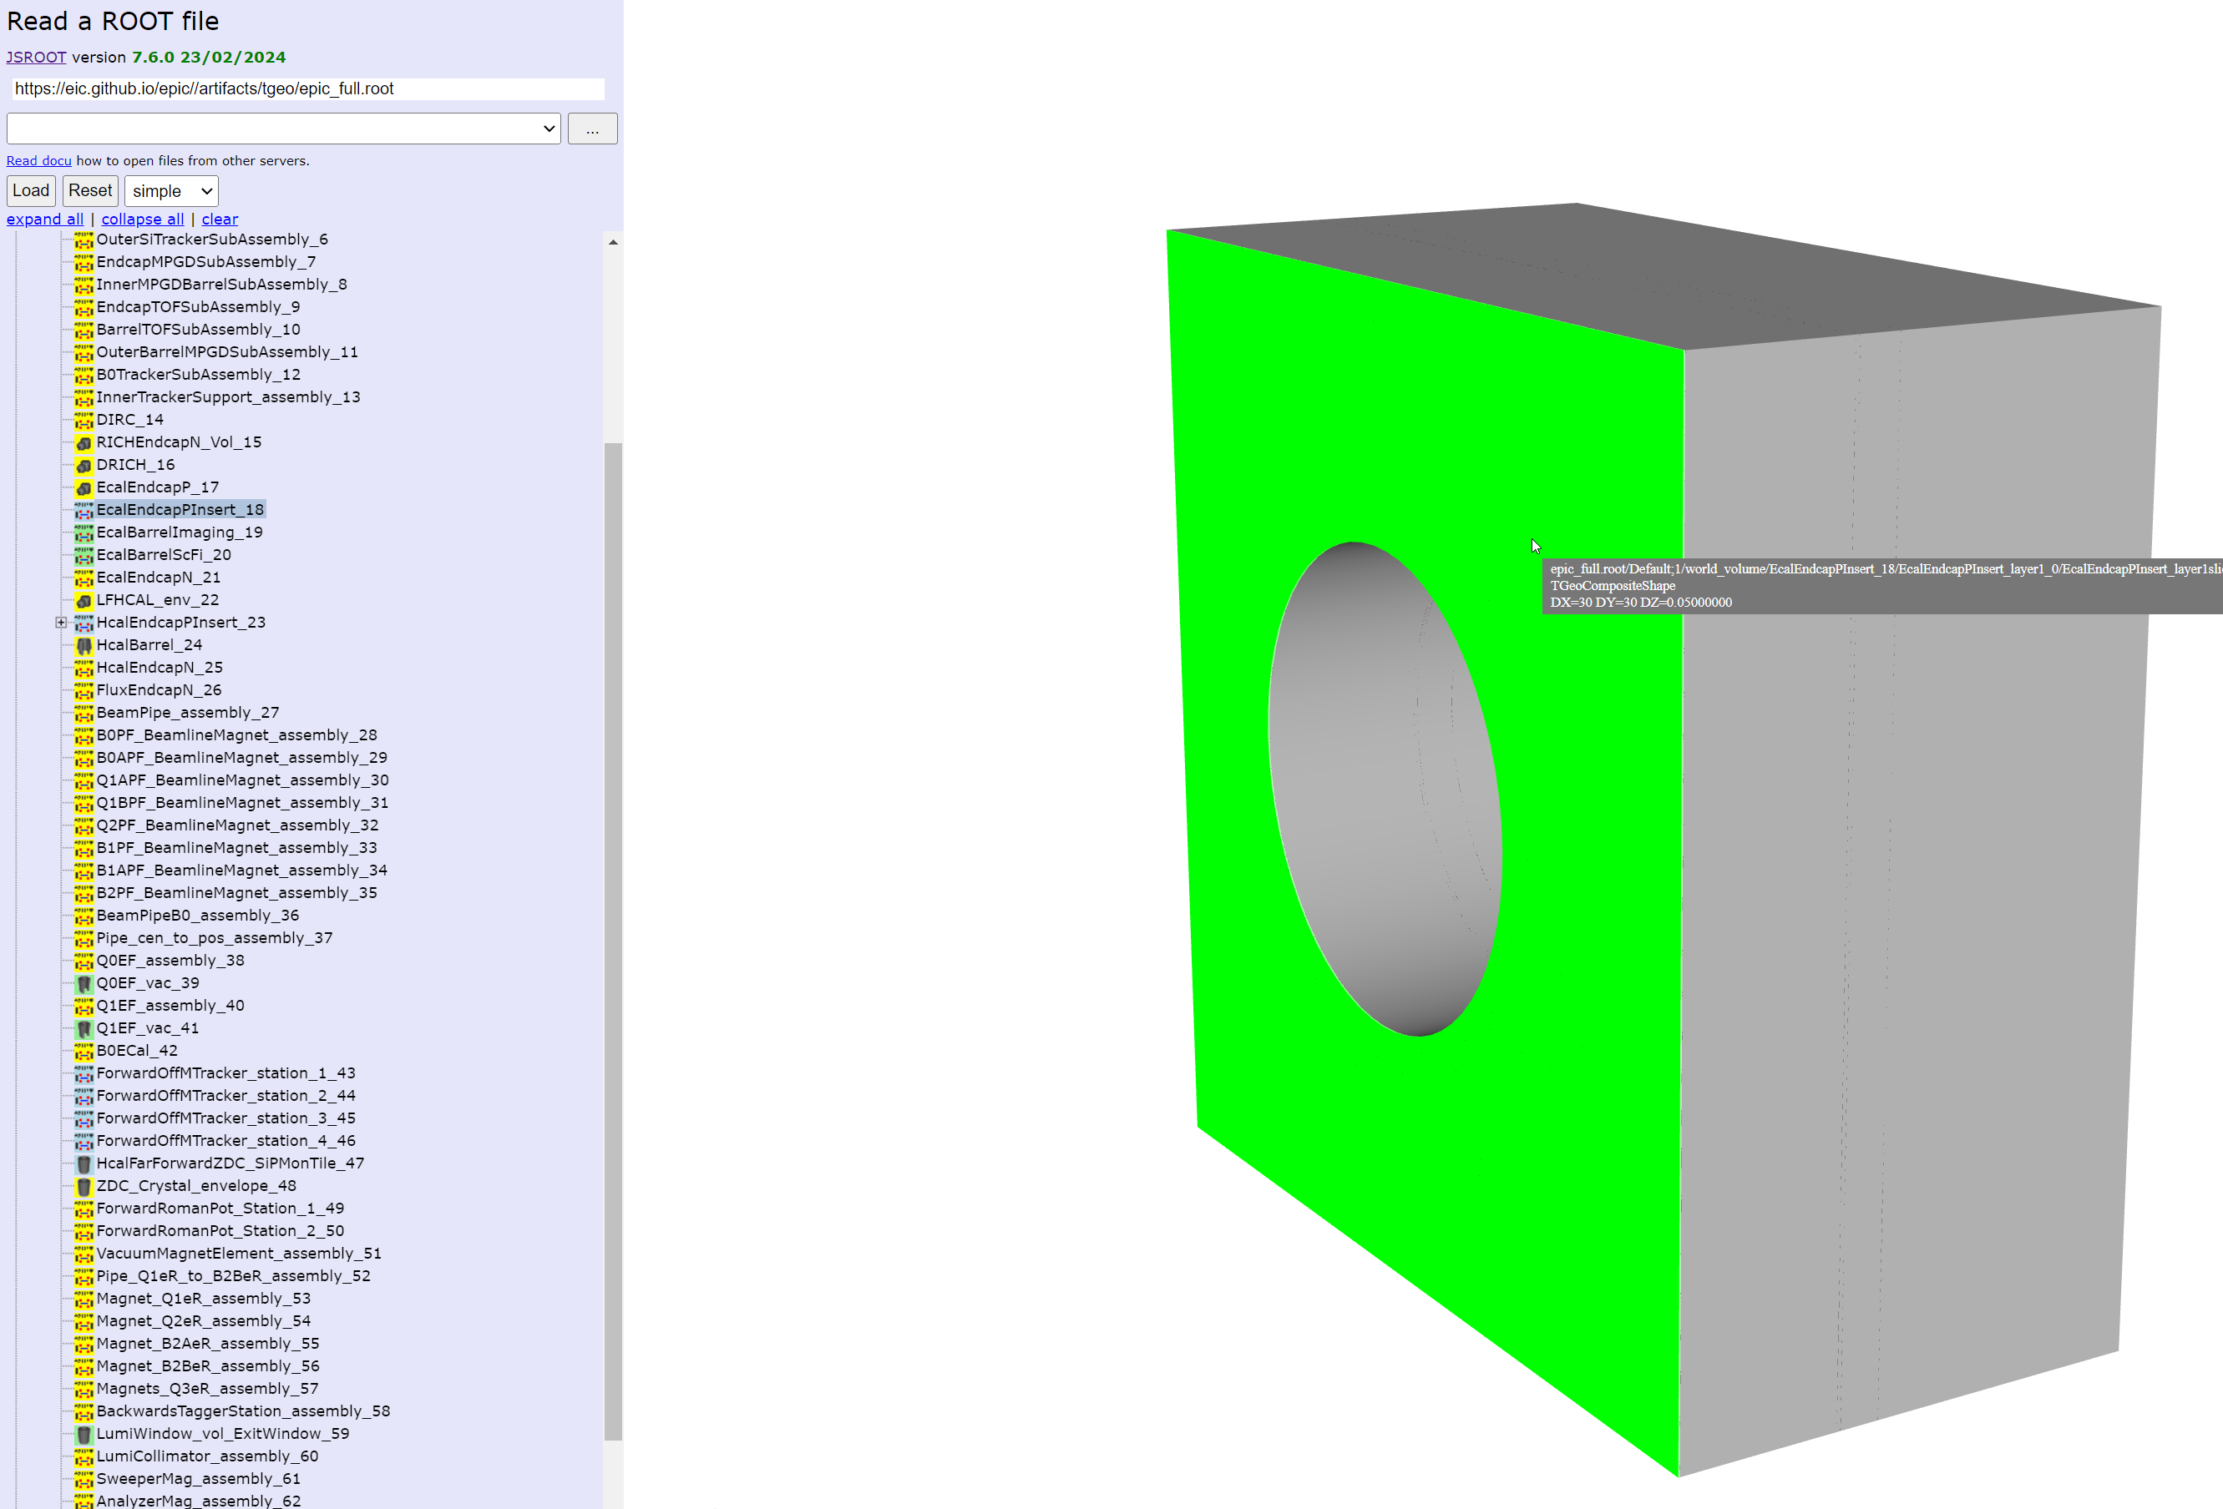
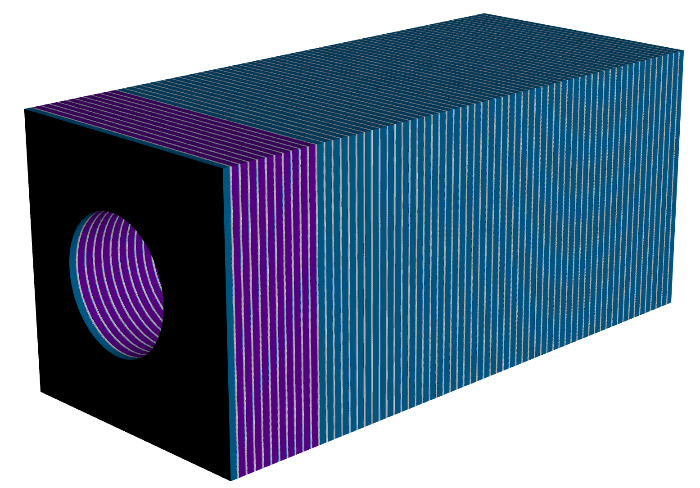
Same name? EcalEndcapPInsert

Slide 12
Performance Inner Detector
epic_inner_detector.root
(All numbers are [ms])
Open root file: 678
Reading geometry from file: 993
Go over all nodes: 132
Build geometry (for WebGL): 2002
Convert to JSon geometry (Phoenix): 20

Slide 13
So now it works fine?
Total visible nodes 15902 numfaces 412466

Slide 14
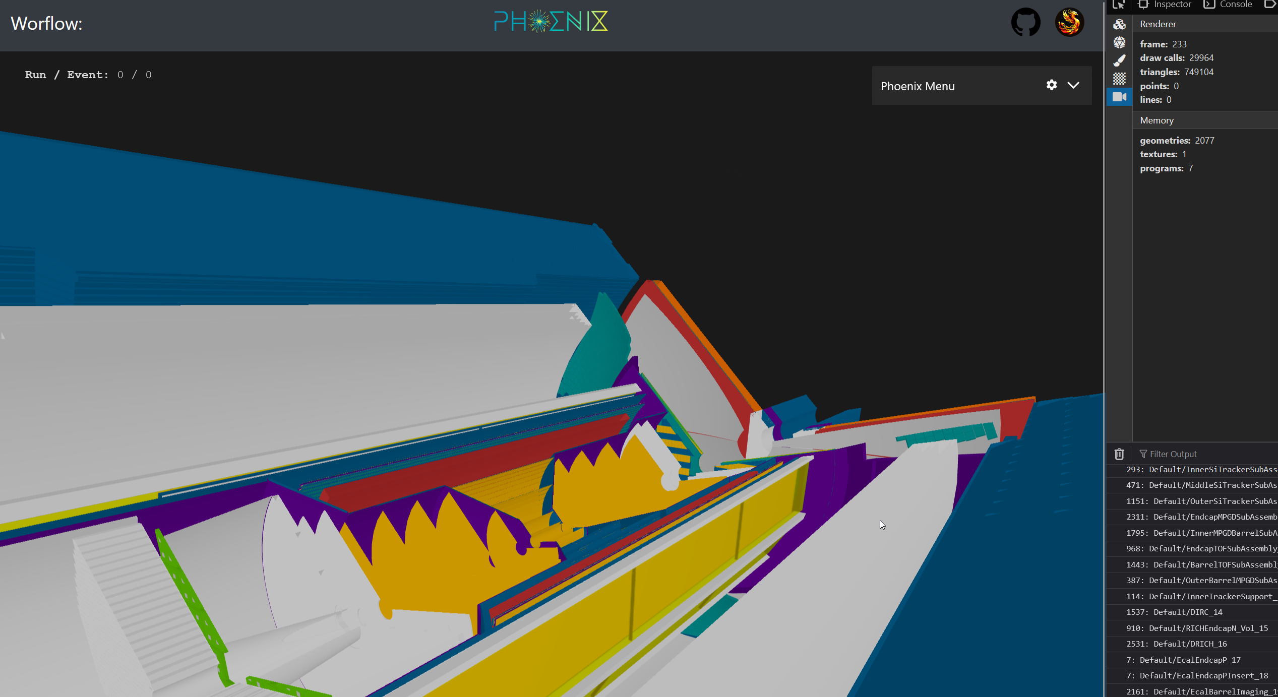
WebGL performance
29964 DRAW CALLS

Slide 15
WebGL performance
29964 DRAW CALLS

Slide 16
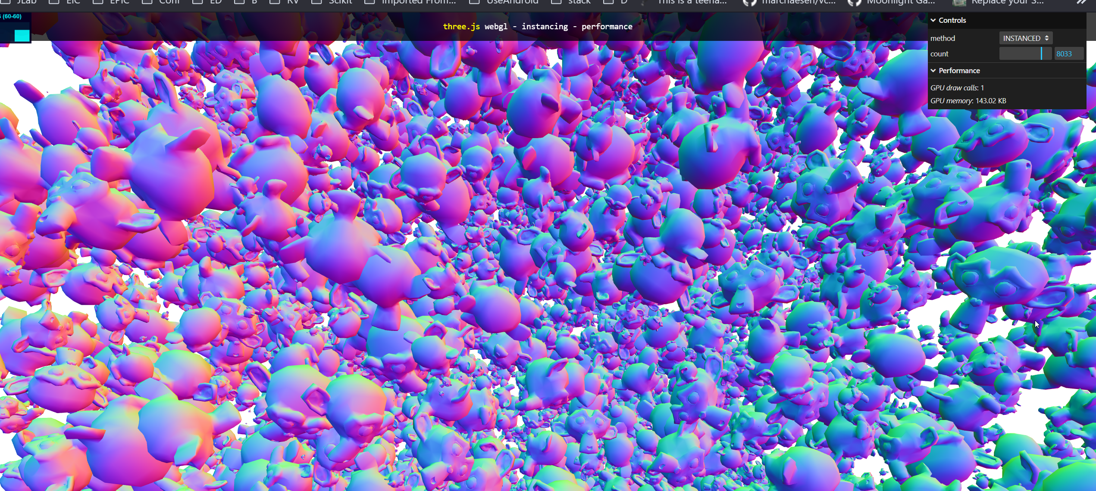
What is good drawcals number?

Slide 17
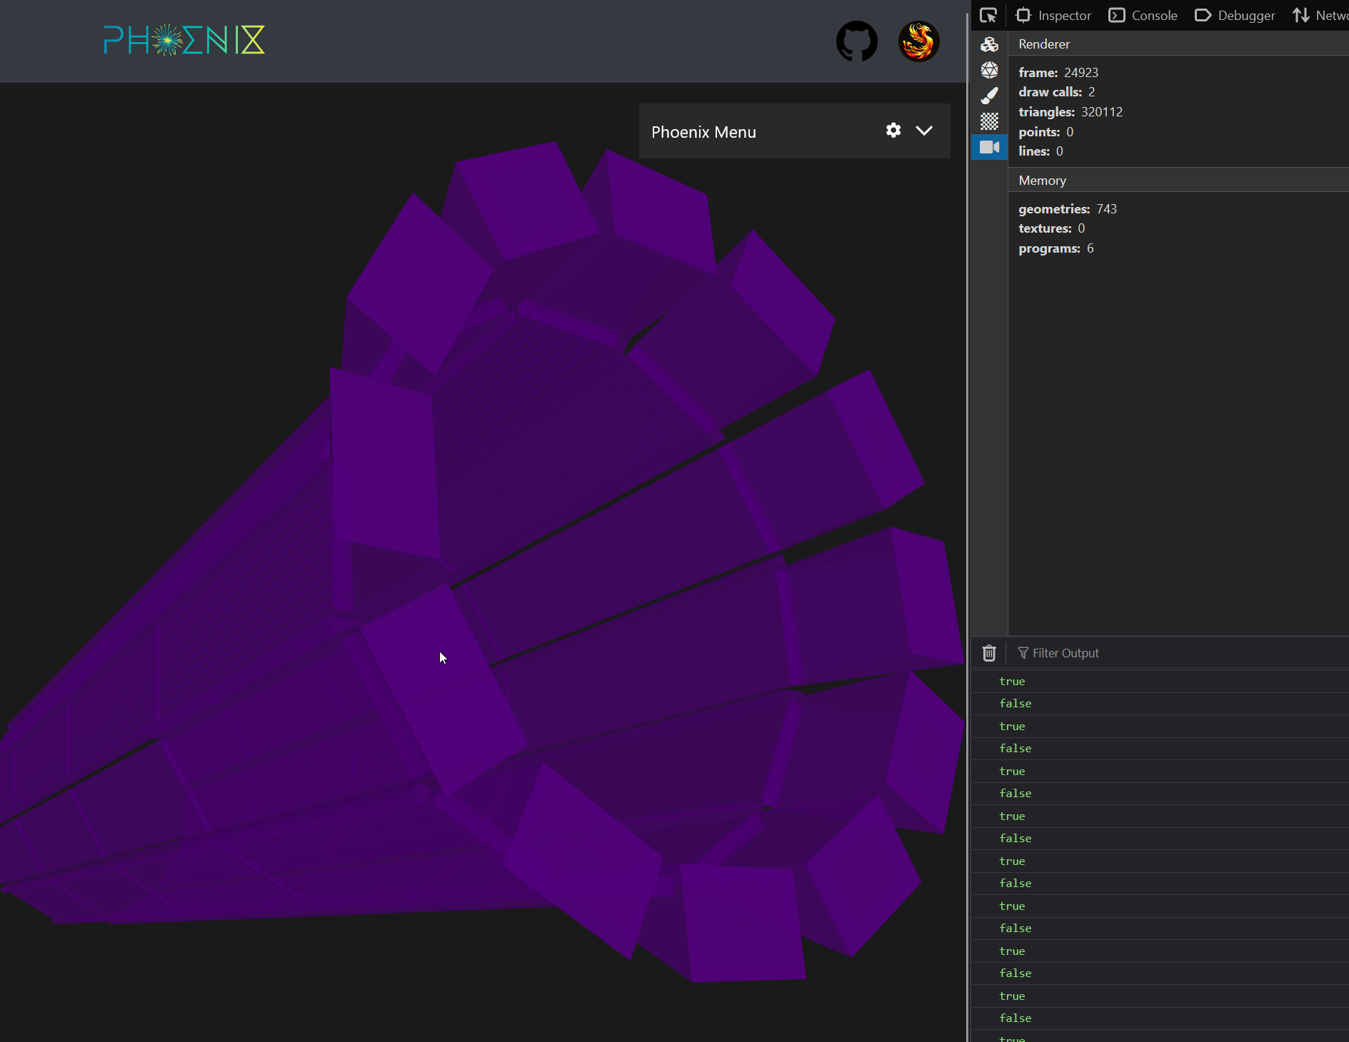
Can we do the same?
Kind of but…

Slide 18
Data processing chains
Geometry pipeline
Server-side Processed
Read ROOT file
Geometry PRE-process
BUILD root->three
Geometry POST-process
Display webGL

Slide 19
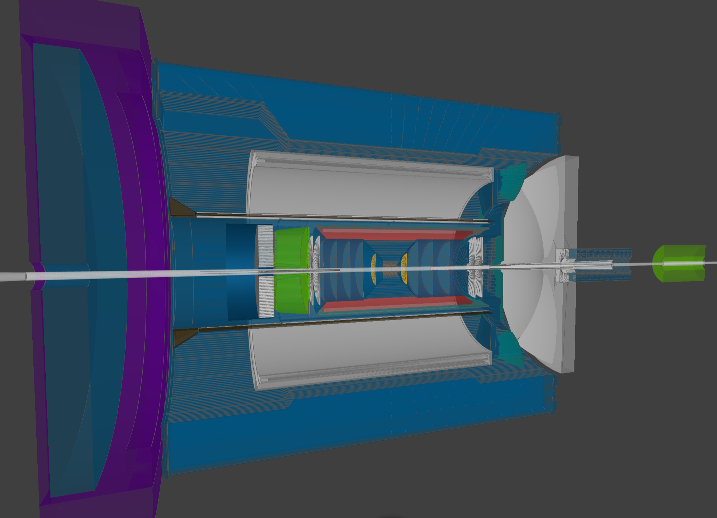
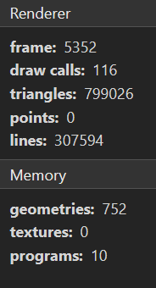
Current results
~100 Drawcals and 1000 geometries

Slide 20
What about hits?

Slide 21
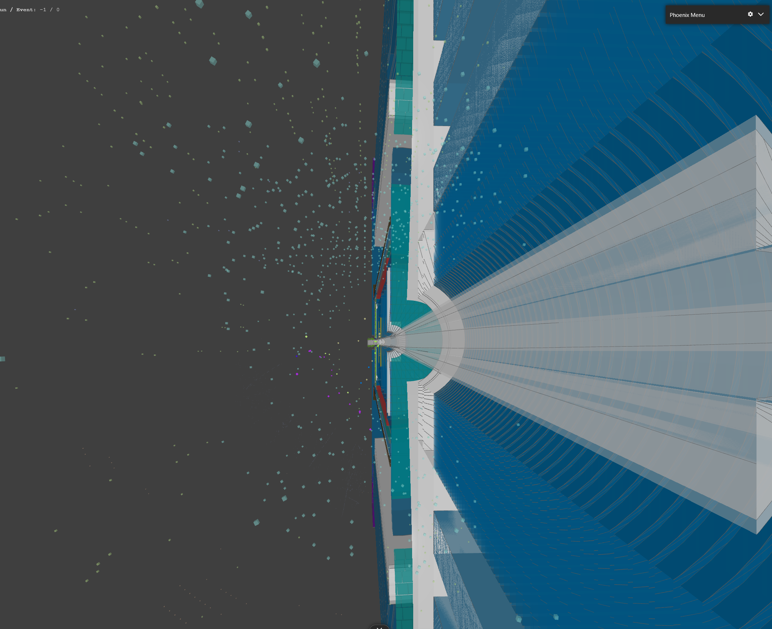
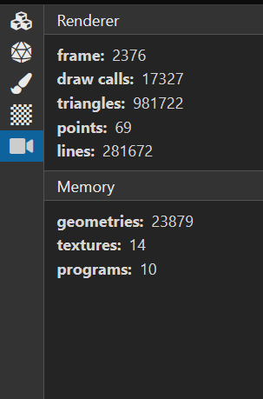
Hits rendering is not optimized and in TODO

Slide 22
Future plans

Slide 23
User local CLI (visioning)
Vision: pip install pyrobird > fbd display –g geometry –I input1 …

Slide 24
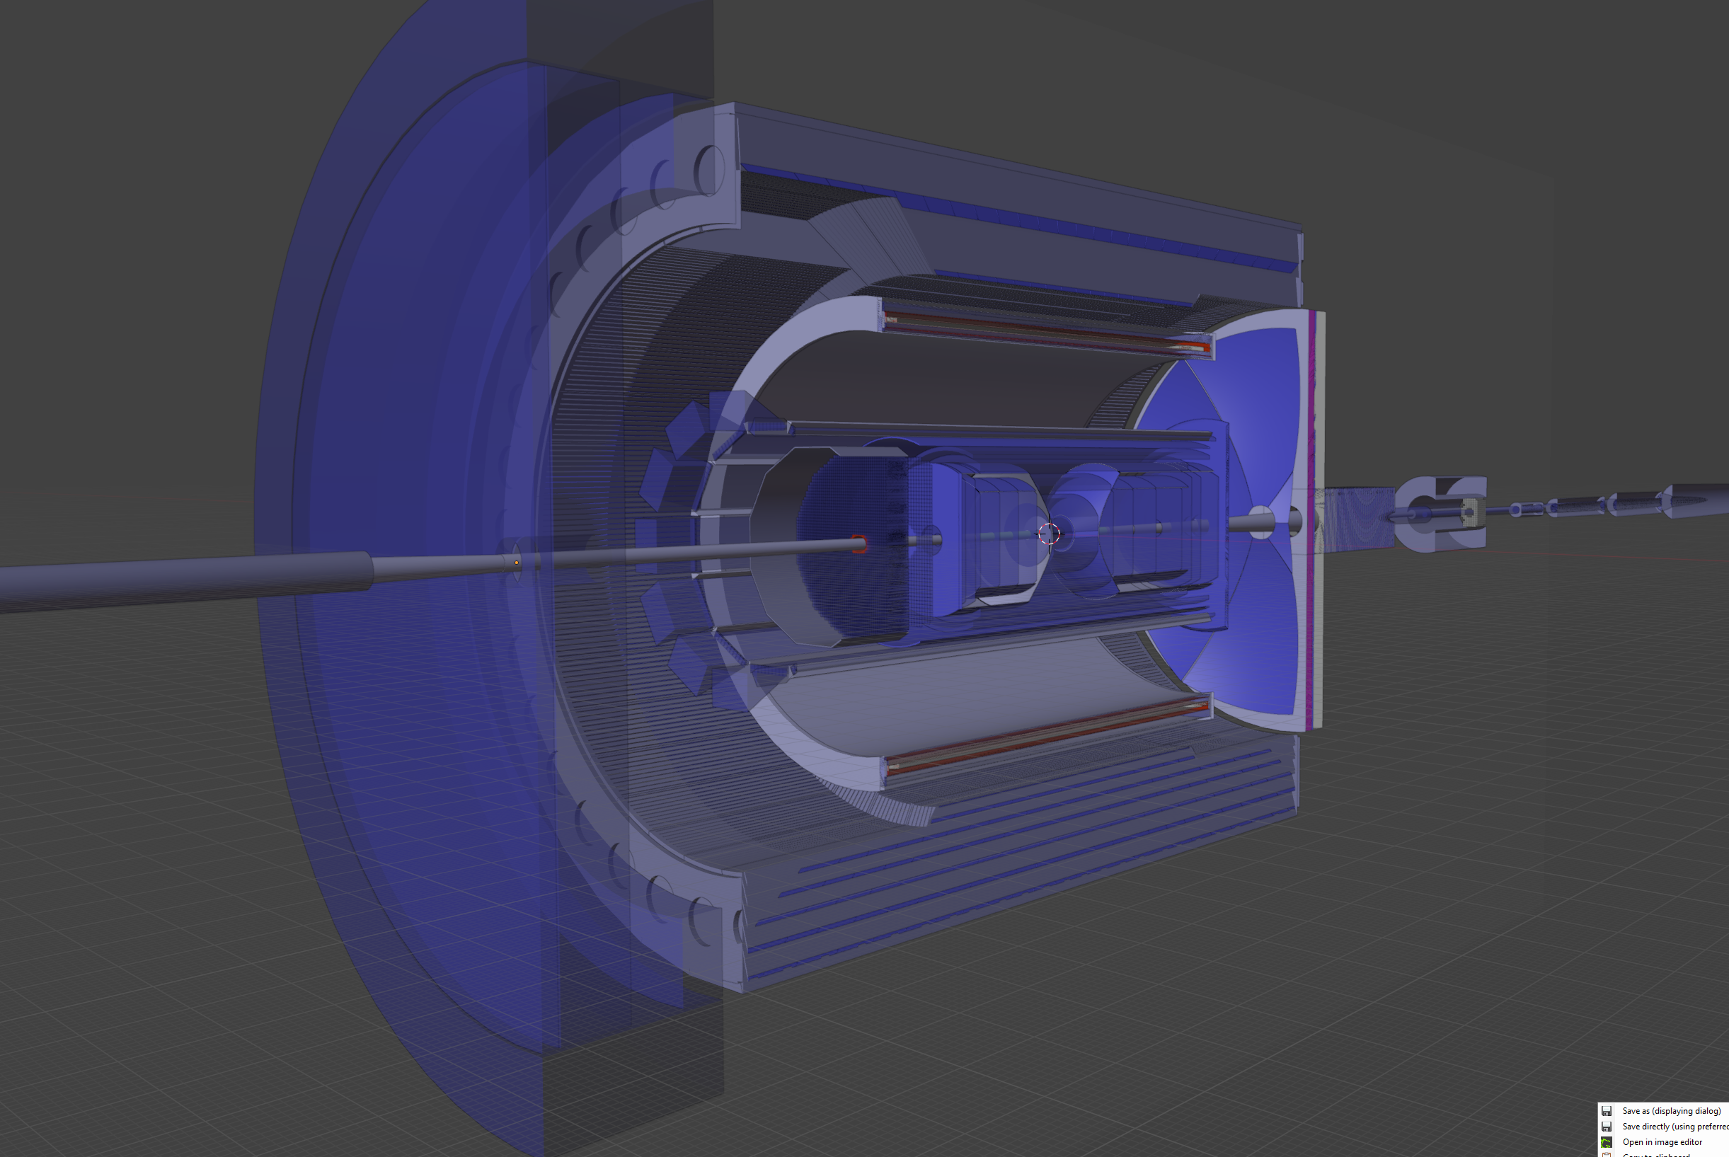
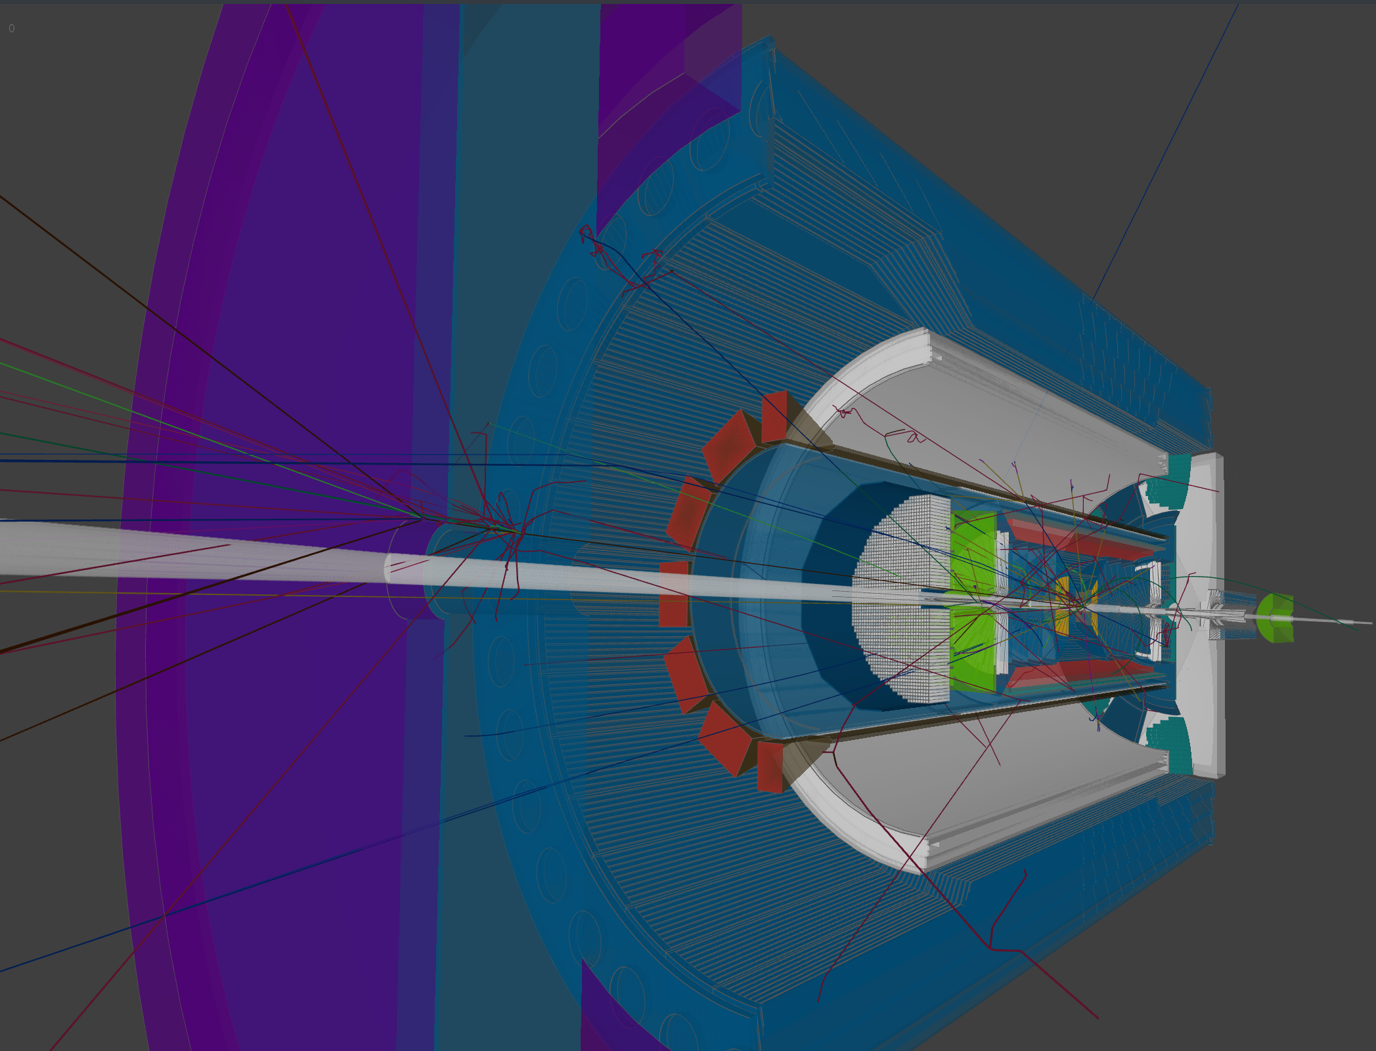
Better visual

Slide 25
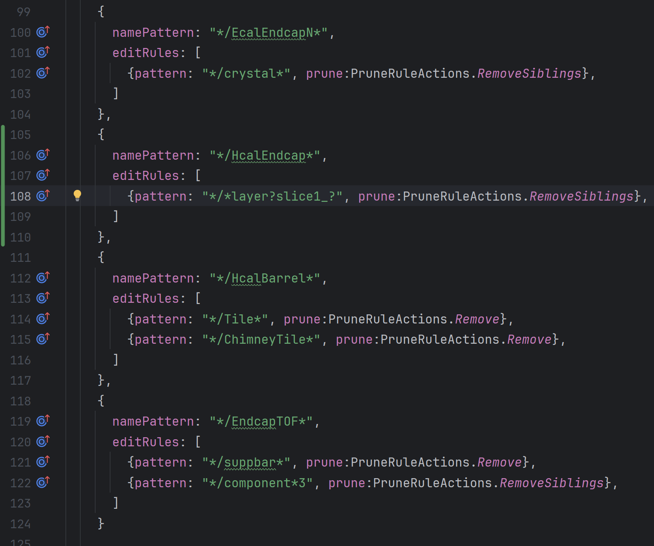
Geometry rules, community contributions
All geometry manipulations done by set of rules
Anticipated detector groups to contribute
No javascript coding for rules (as it seems now)

Slide 26
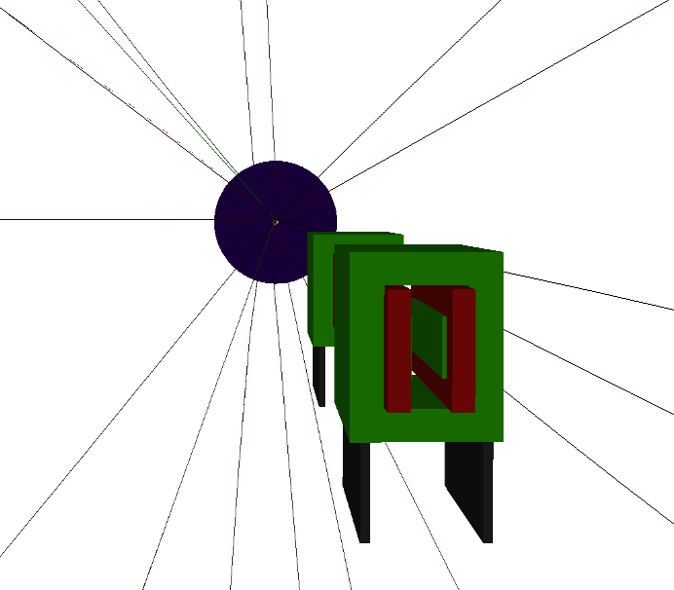
DD4HEP integration
Using non-intrusive DD4Hep plugin
Currently is a proof of concept
Vision / possibilities:
Full “what is happening” (easily GBs for event)
Cuts by region/energy/vertex/detector, …
Integration with npsim
Write to edm4hep
Far forward debug

Slide 27
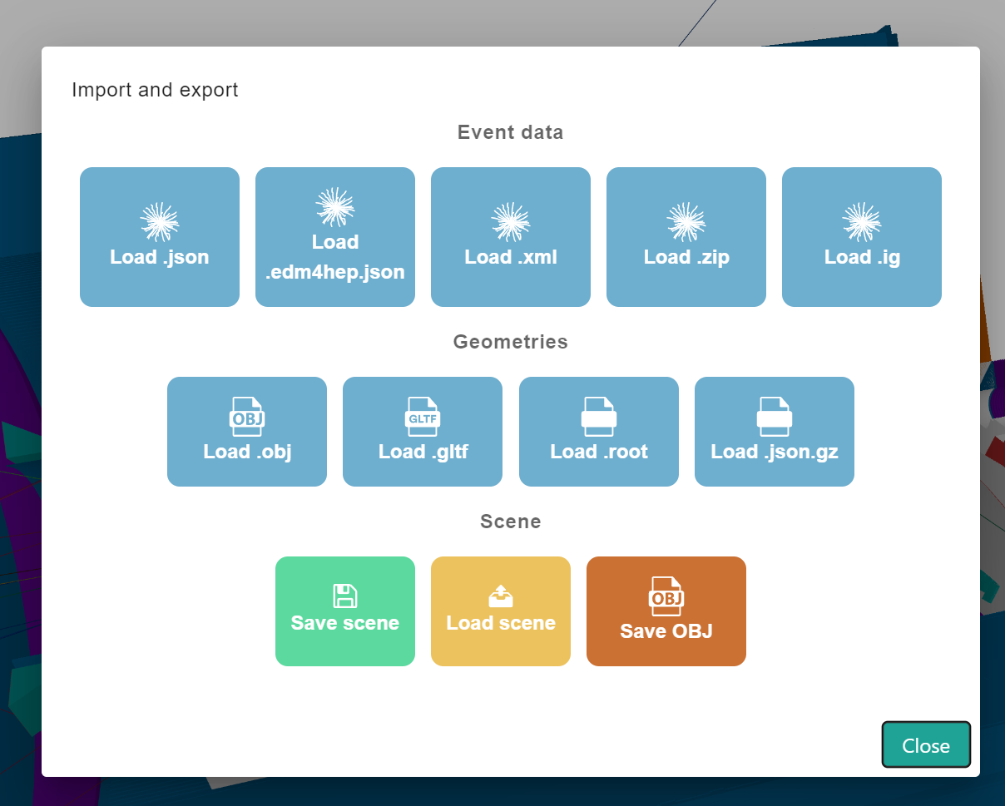
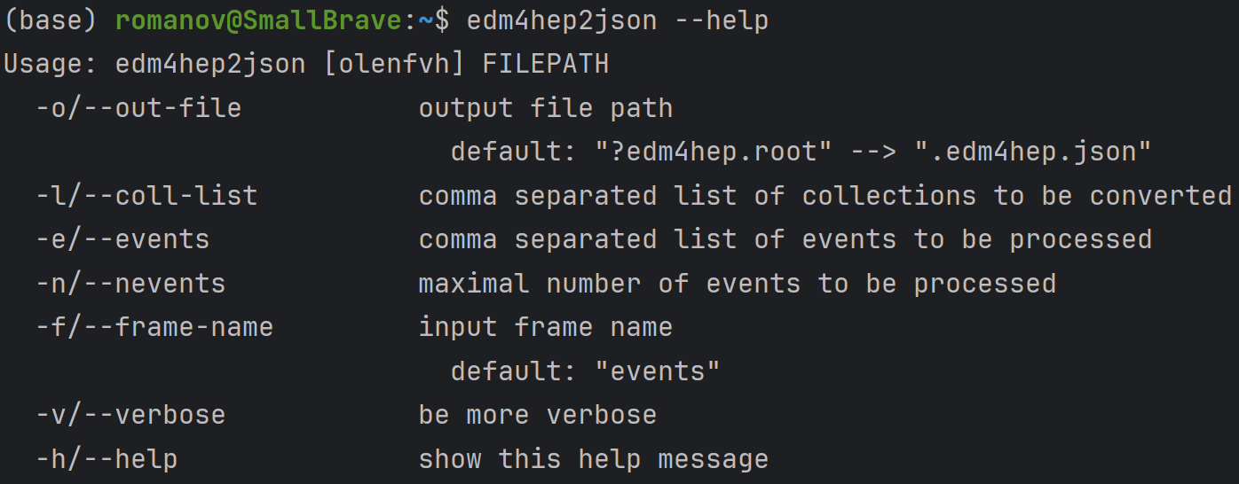
Import export
Load edm4hep from root (not json as of now)
Load edm4eic (planned by June 2024)
Load ACTS reconstructed tracks and info

Slide 28
Deliverables June
Deliverables will depend on community. Core plans:
Software perspective:
Initial integration with campaigns
Improve on modularity, making more convenient for groups to work on their parts of interest
Improve on cli part, make convenient for users and in batch operation
Implement particular event objects if available (recoil electron, jets, connected flows)
Acts data source
EDM4EIC data source
Users’ perspective:
Make tutorials on how to contribute to event display software
Collect and analyze feedback from the community to focus on further priorities
Can select runs and events from the latest simulation campaign reconstructed files
(more on planning on the next page)

Slide 29
More on planning and deliverables
Implementation plan for event display on google docs (written internally 2 months ago but is actual)
Requirements for event display

