Slide 1
Hadron-In-Jet Collins for TDR
Kevin Adkins, Morehead State University
ePIC Jet & HF Working Group Meeting
May 29, 2024

Slide 2
Target Plot:

Slide 3
Introduction
Collins effect connects initial proton spin to final state azimuthal distribution of hadrons in a jet (pions, kaons, protons)
Simulation is without polarization
  Randomly assigned a spin state for use in calculating the angles that appear in the sinusoidal modulation
    ϕ_{S} is related to the jet scatter direction
    ϕ_{H} is the azimuthal angle of a hadron in the jet
    ϕ_{C} = ϕ_{S} – ϕ_{H} is the “Collins angle”

Slide 4
Introduction Cont.
Isolate the asymmetry by exploiting the full 2π azimuthal coverage with the “cross ratio method”
  N is the number of hadrons that scatter into the upper (U) and lower (D) halves of the detector resulting from protons with spin up (+) and down (-)
  Each N is binned in two dimensions: ϕ_{C} and {z, j_{T}, jet p_{T}}

Slide 5
Analysis Basics
Sample: 18x275 GeV, campaign: 23.12.0, NCDIS
1M events for minimum Q² = 100 GeV² and Q² = 1000 GeV²
Basic cuts:
  Jet E > 5 GeV
  5 < Jet p_{T} < 51.9 GeV/c (binning may need to be adjusted for final plot, started with previous STAR binning)
  |η| < 2.5
  0.05 < j_{T} < 4.5 GeV/c
  0.1 < z < 0.8
  Jets containing the original electron are rejected

Slide 6
q_{T} Imbalance Cut
As suggested by Miguel, a q_{T} imbalance cut was added, where
The cut is:

Slide 7
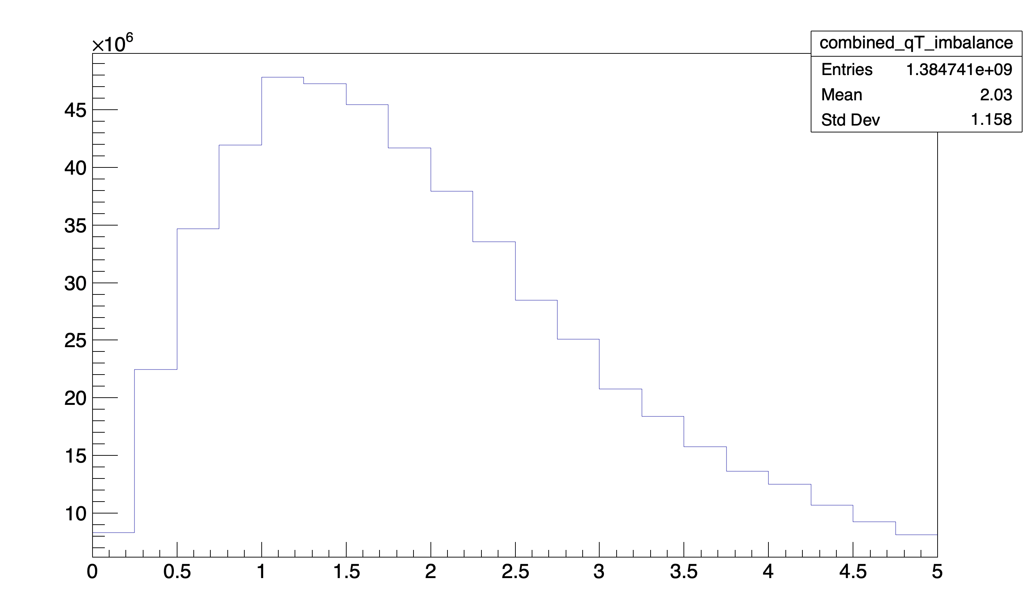
q_{T} Imbalance

Slide 8
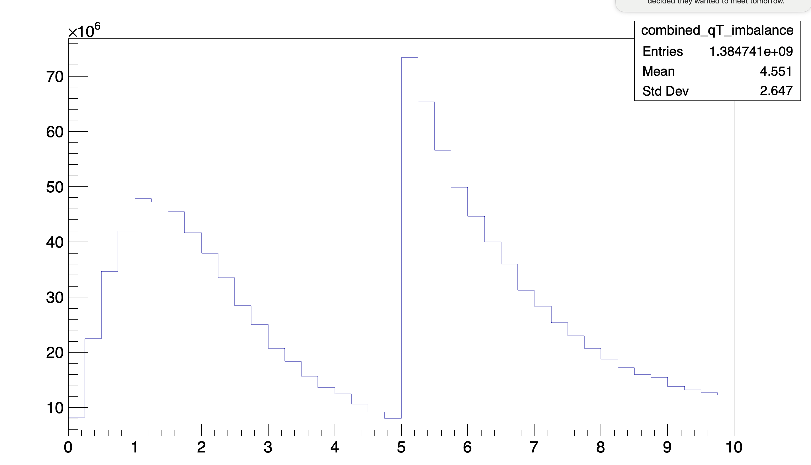
q_{T} Imbalance Cut

Slide 9
Weighting & Statistical Projection
Analyed 1e6 events from minimum Q² of 10, 100 and 1000 GeV²
Added the output results together according to the respective cross sections.
Projected the statistics to 100 fb⁻¹ as in the previous iteration of the plot.

Slide 10
Current Plots (May 29, 2024)
Black: Pions
Green: Kaons
Red: Protons
Positive charge only
100 fb⁻¹

Slide 11
Current Plots (May 29, 2024)
Black: Pions
Green: Kaons
Red: Protons
Positive charge only
100 fb⁻¹

Slide 12
Current Plots (May 29, 2024)
Black: Pions
Green: Kaons
Red: Protons
Positive charge only
100 fb⁻¹

Slide 13
To Do
Update binning on the z plot to match previous plot?
Add theory curves
Pretty up the plot
Anything else?

