Slide 1
AncASIC and EIC-LAS: Power and Size Update
Notes:
The abstract pattern can be removed or repositioned if required. Be careful to ‘Send to Back’ so that it does not obscure any important information.

Slide 2
Introduction
EIC-LAS Power Consumption
Updates based on better understanding of MOSAIX voltage levels
Updates from Engineering Review
AncASIC Power Consumption
Simulation set-up
Balancing currents with R3
Stave Simulations
Overall Power Numbers
Caveats
AncASIC Sizing
Sizing based on assuming SLDO is the largest part
Caveats

Slide 3
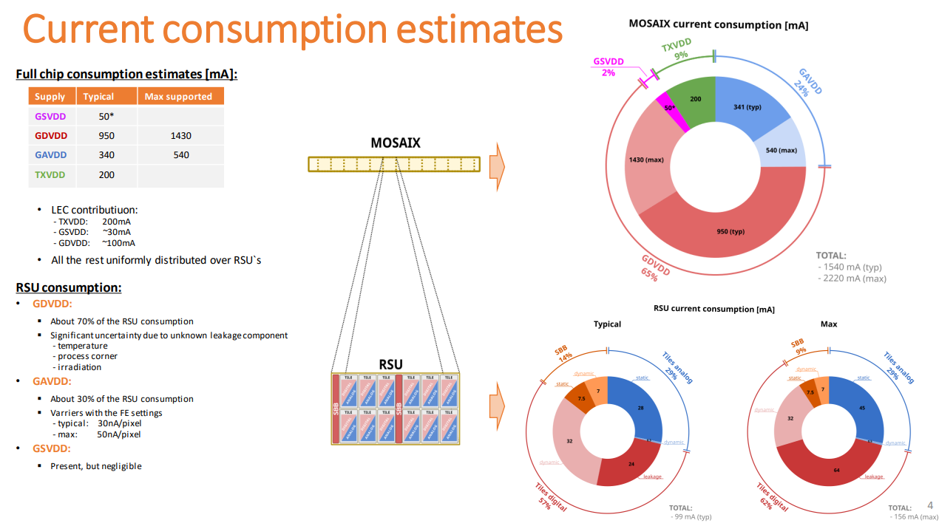
MOSAIX Power Consumption
MOSAIX Engineering Specification Review
Current consumption numbers for MOSAIX were updated in the engineering review.
What does this mean for EIC-LAS and the Ancillary ASIC

Slide 4
LAS Power Consumption
Converting to EIC-LAS
Assume 6 RSU LAS
Numbers in red do not have “Max” estimates in the previous slide, so assumed +50% on typ number (since this is true for supplies that do have it)
EIC-LAS is one LEC and 6 RSU
 | Typ Current Consumption (mA) |  |  | Max Current Consumption (mA)
 | RSU | LEC | EIC-LAS | RSU | LEC | EIC-LAS
GAVDD | 28 |  | 168 | 45 |  | 270
GDVDD | 71 | 100 | 526 | 111 | 150 | 816
GSVDD | 1.6 | 30 | 40 | 2.4 | 45 | 59.4
TXVDD |  | 200 | 200 |  | 300 | 300
Total |  |  | 934 |  |  | 1445

Slide 5
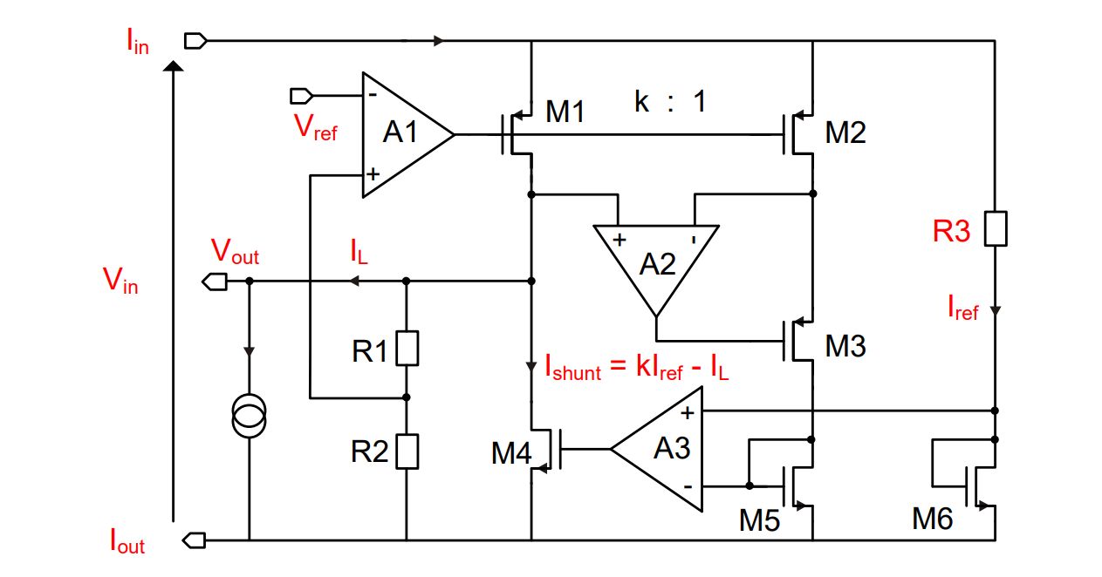
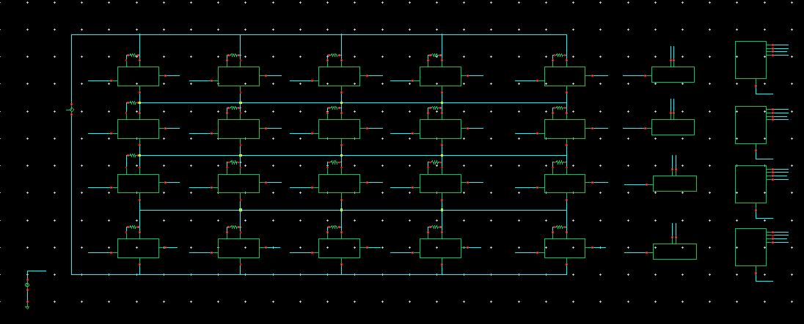
AncASIC Power Consumption
+10% shunt overhead based on https://cds.cern.ch/record/2292628/files/CR2017_385.pdf
LAS<3>
LAS<2>
LAS<1>
Programmable Output Voltage
Compared to earlier presentations (v7 and before), need to simulate case where GA=GD=Services=1.32V and Serialiser=1.2V. Requires adjustable SLDO output.
Implemented 4 bit variability. Should give swing between 1.1 – 1.5V
LAS<0>
Services
Serialiser
GlobalDigital
GlobalAnalog
AncASIC (0A)

Slide 6
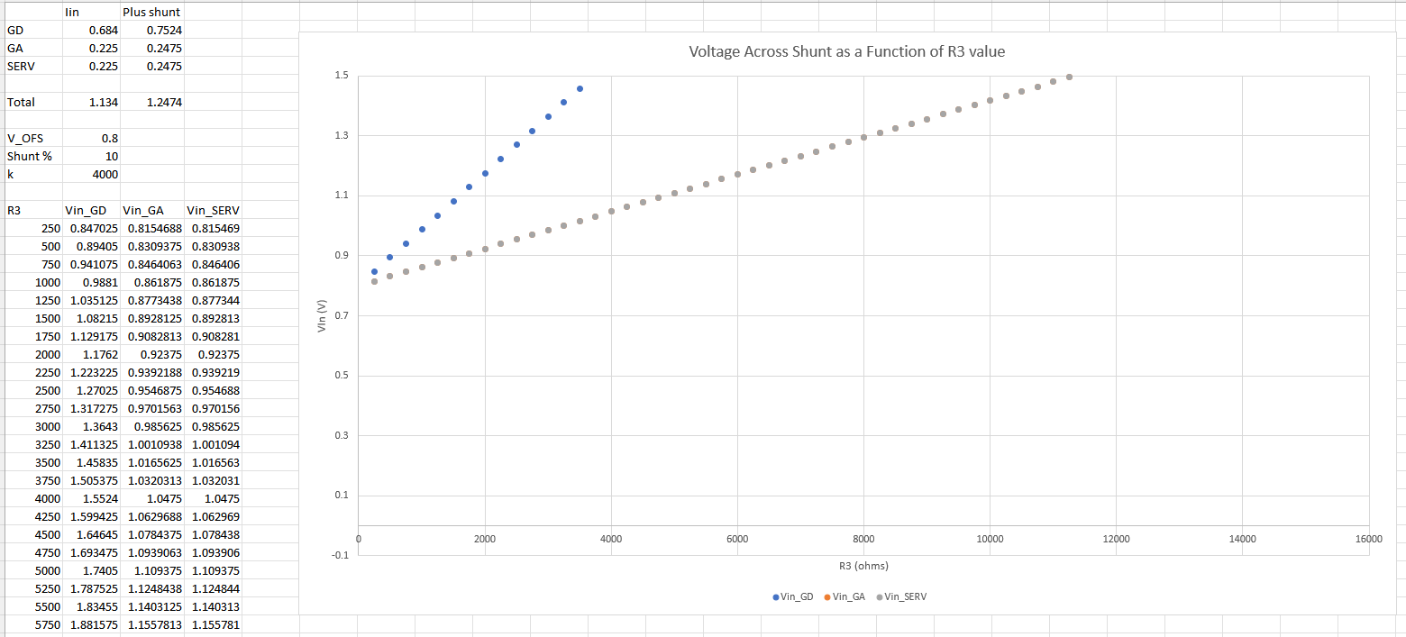
Balancing currents with R3
Power Optimisation
R3 must be different per supply
Otherwise current divides evenly and is very power in-efficient (extra is shunted)
Also different for different LAS power conditions
Will require real world tuning (perhaps per stave?)
Include MOSAIX to check if testing ER2 with SLDO will be possible (no plan for IB serial powering)
Supply | R3 Typ | R3 Max | R3 MOSAIX
Global Analog | 17k | 11k | 8.5k
Global Digital | 5.5k | 3.5k | 3k
Services | 72k | 48k | 58k
Serialiser | 14.4k | 9.6k | 14.4k

Slide 7
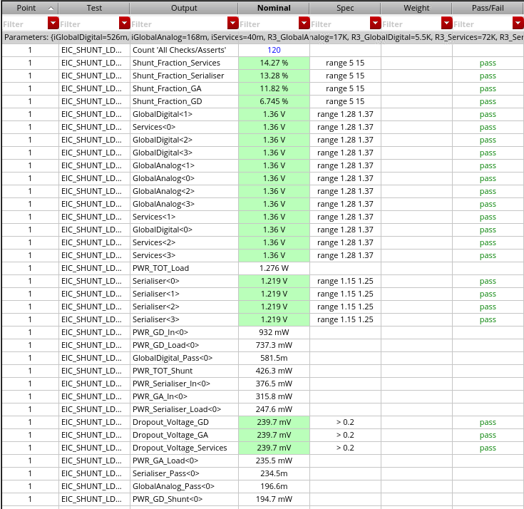
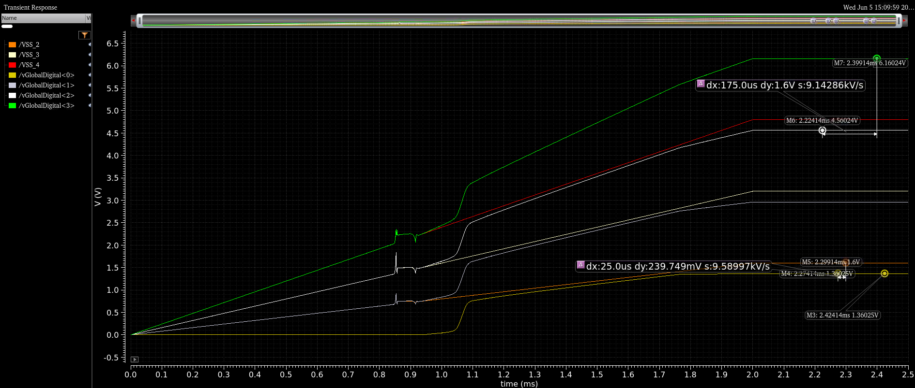
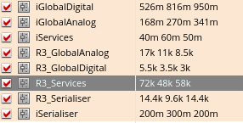
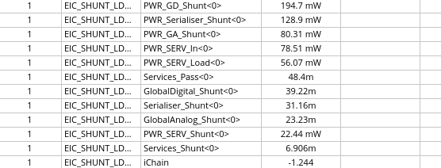
Ancillary Chip Power Consumption

Slide 8
Overall Power Consumption
 |  | AncASIC |  | EIC-LAS
 | Unit | Expected 25 | Max 45 | Expected 25 | Max 45
Global Analog | mW | 80 | 105 | 235 | 378
Global Digital | mW | 195 | 279 | 737 | 1144
Services | mW | 22 | 32 | 56 | 84
Serialiser | mW | 129 | 188 | 248 | 371
Total | mW | 426 (33%) | 604 (31%) | 1276 | 1977
Chain Current | A | 1.5 | 2.5 | N/A | N/A
- PSRR trade-off with drop out voltage/power
- All still simulated in 65nm process
- Low dropout at high current is not free…
- RD53B PT: 22,500um²
- AncASIC PT: 36,480um² (0.00036cm²)
Improvement of ~60% in AncASIC power and 30% in EIC-LAS power c.f previous (GA=GD=Serialiser=1.2V and TDR currents) case

Slide 9
Power Caveats…
Caveats to the numbers
Best estimate from MOSAIX. Not a warranty.
Possibility that LEC value will rise (additional functions)
For GAVDD, it is likely that EIC-LAS will be in the Max case, since we want the fastest frontend speed
We may be able to reduce TXVDD consumption if we don’t need all the transmitters (or can run slower)
Need to add consumption of non-SLDO AncASIC
Mis-match in GAVDD, GDVDD consumption may require different input voltages (waste of power in serial powering chain)
Irradiation
Future Updates
May be future releases from MOSAIX
AncASIC will need to be updated once porting to XT011 is completed
Test results from ER2

Slide 10
AncASIC Size
500um
500um
500um
PADS
???
???
Slow Control
>1.5mm
PADS
PADS
1mm
???
200um
SLDO
SLDO
SLDO
SLDO
SLDO
NVG
500um
PADS
>7mm
Preliminary – Treat as fully subject to change

Slide 11
Size Caveats
Very preliminary
Only producing at this stage to assist with requests for stave design
Not discussed with other designers yet
Chip has 3 components:
Negative Voltage Generator
Size unknown
Slow Control Multiplexing
Size unknown
SLDO
Size unknown, but will probably dominate
Size dominated by a few transistors, so some guess at chip size can be made
However:
Design at early stage
Sizes taken from 65nm design (not 110nm)
Of course, this also means we can be open to comments
Need someone to do thermal FEA – now that size and power are known
Preliminary – Treat as fully subject to change

Slide 12
Notes:
The abstract pattern can be removed or repositioned if required. Be careful to ‘Send to Back’ so that it does not obscure any important information.

Slide 13
Backup

Slide 14
MOSAIX Supply Complexities
GA, GD and Services
Remaining voltages are all driven at 1.32V
It is necessary that services should always be above the other two, but this is handled internally by assuming that only GA and GD droop.
Therefore we assume GA, GD and Services at 1.32V.
Testing MOSAIX with AncASIC
James suggested it would be useful to be able to test the AncASIC powering MOSAIX when ER2 returns
Ran some simulations to check if it is possible
Seems that it is (for the Expected 25 case) because designing for Max45 EIC-LAS leaves a lot of headroom

Slide 15
MOSAIX Supply Complexities…
The 1.8V Problem…
MOSAIX requires not just a 1.2V supply, but also 1.8V to run the serialisers
The AncASIC itself will need a 1.8V supply for logic and the NVG
However, all SLDOs need to be in parallel, and if we run them at 1.8V, the 1.2V supplies will waste considerable power
What can we do?
Run the SLDOs at 1.8V
Two serial powering chains
Use the NVG?
Tap power from the next stage?
Remove serialiser LDO from 65nm IP (serialiser itself is 1.2V)
Supply 1.8V externally to each LAS
Considerable waste of power - ~1.1W
Impossible – shared ground at various points
Could it step 1.2V up to 1.8V? Noise issues?
Routing complexity. Stability? Still a power waste - ~300mW. What about the last one?
1.2V
1.2V
0.4V
EIC-LAS
Would need 8 lines (supply and return for each of 4 LAS).
V= ~1.4V
1.2V
1.2V
EIC-LAS
V=0V

Slide 16
MOSAIX Supply Complexities…
The 1.8V Solution?
João’s idea to edit the 65nm database to skip the LDO seems like a good one.
We do not yet have a solution to powering the AncASIC circuits that run at 1.8V.
It does seem that the serialiser could be separated from it’s LDO
So for the rest of this presentation, I will assume that the serialiser can be powered at 1.2V in order to get an overall power number.
We should perhaps suggest to the higher SVT that they think about point-to-point powering of the 1.8V system just in case (would mean 8 extra wires)
https://indico.cern.ch/event/1376523/contributions/5785064/attachments/2789901/4865135/ALPIDE_65_30_01_2024.pdf

Slide 17
LAS Power Consumption – Earlier Estimates
 |  | Power Consumption
 | Unit | 5 RSU LAS | 6 RSU LAS | MOSAIX
LEC | mW | 696 | 696 | 696
RSUs | mW | 543 | 651 | 1303
Total | mW | 1240 | 1348 | 2000
Expected 25
2 published sources of data (power densities, and supply current breakdown)
LEC does not vary at all in the power density figures
Separation into supplies does not include Expected/Max variation
How to reconcile?
 |  | Power Consumption
 | Unit | 5 RSU LAS | 6 RSU LAS | MOSAIX
LEC | mW | 696 | 696 | 696
RSUs | mW | 889 | 1066 | 2133
Total | mW | 1585 | 1763 | 2829
Max 25
 |  | Power Consumption
 | Unit | 5 RSU LAS | 6 RSU LAS | MOSAIX
LEC | mW | 696 | 696 | 696
RSUs | mW | 1280 | 1536 | 3072
Total | mW | 1976 | 2235 | 3768
Max 45

Slide 18
LAS Power Consumption – Earlier Estimates
Towards individual supply estimates
Can only really make worst case assumptions:
6 RSU LAS
Expected 25 to Max 45 is 65% variation.
Apply this also to the LEC and assume published number is Expected 25.
Worst case numbers are then 1536mW for the RSUs and 1148mW for the LEC.
Total 2684mW
How does this compare to the published supply numbers (MOSAIX – 12RSU)?
N.B. We can make better case assumptions if we like, but we should do it consciously
Scale to EIC-LAS ->
+65% ->
272mW
648mW
1643mW
360 mW
XXXXXX
272mW
270mW
821mW
360 mW
XXXXXX
449mW
445mW
1354mW
594 mW
XXXXXXX
Total: 2923mW 1723mW 2842mW
Good match to our worst case Max45 estimate, so can probably assume the original numbers are for the Expected 25 case

Slide 19
LAS Power Consumption – Earlier Estimates
LAS, Best and Worst
Knowing the EIC-LAS current requirements is key for the SLDO design
Since the SLDO dominates the AncASIC (we need a better name…) power consumption, it is also key to get a power number for that chip
Current numbers needed for simulation
Power
Voltage
Current
Expected 25
Max 45
Expected 25
Max 45
Services
Global Analog
Global Digital
Serialisers
272mW
270mW
821mW
360 mW
449 mW
445 mW
1354 mW
594 mW
1.32V
1.32V
1.32V
1.2V
206 mA
205 mA
622 mA
300 mA
340 mA
337 mA
1026 mA
495 mA
Assume 1.2V for serialisers (if we can skip the on-chip LDO)

Slide 20
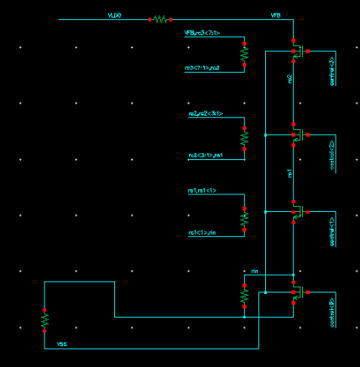
Ancillary Chip Adjustability
Programmable Output Voltage
Compared to earlier presentations (v7 and before), need to simulate case where GA=GD=Services=1.32V and Serialiser=1.2V. Requires adjustable SLDO output.
Since we also want some control over SLDO output to allow adjustment in real world, prefer to implement real circuit.
Implemented variable resistor (4bit) to allow this. Should give swing between 1.1 – 1.5V

