Slide 1
EIC-AncBRAIN: A Slow Control & Communication Management System of AncASIC
June 11, 2024
Contribution: A. Iqbal, D. Górni, G.W. Deptuch, S. Mandal, P. Purohit
V.2.0

Slide 2
Outline
Interfacing with lpGBT
Key Features of EIC-AncBrain
Documentation for Design and Implementation
Transaction Format and Register/Error Code Definition
EIC-AncBrain Block Diagram
AncASIC System-Level Design and Implementation Flow
Implementation Plan

Slide 3
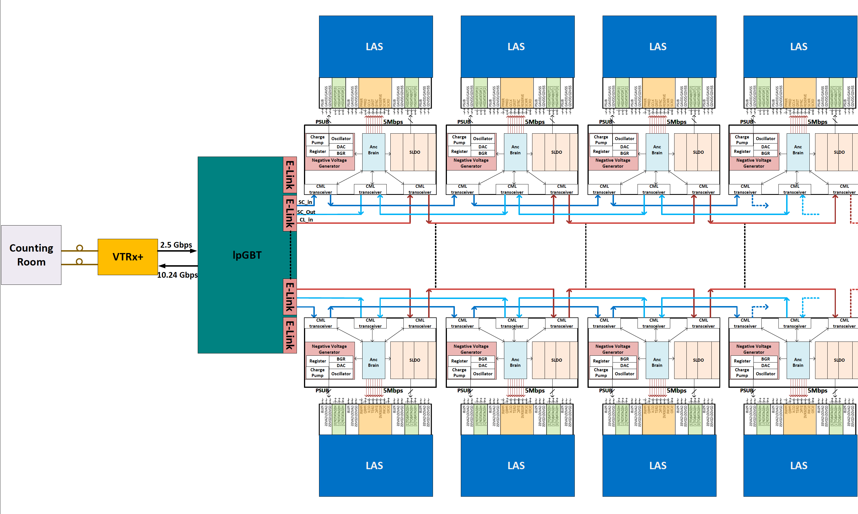
Interfacing with lpGBT
DC coupling with CML-like inter-chip TX-RX link
Each E-Link shares 3 signals: SC_In, SC_Out, Cl_In

Slide 4
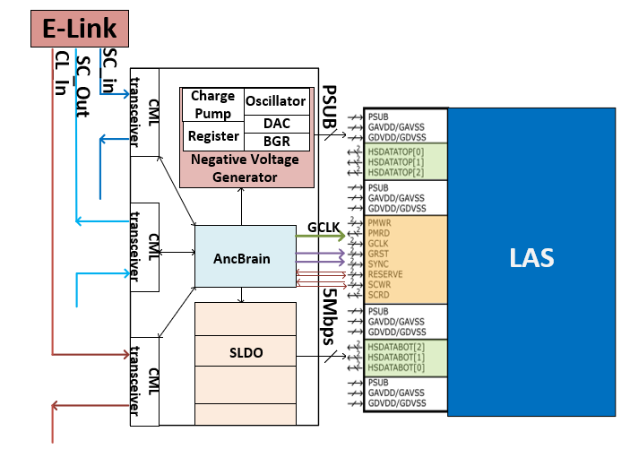
Key Features of EIC-AncBrain
The key functions are:
Internal Sub-Module Control
Communication Bridging
Broadcast Signal Generation
Robust Error Handling
System Stability
System flexibility and customization

Slide 5
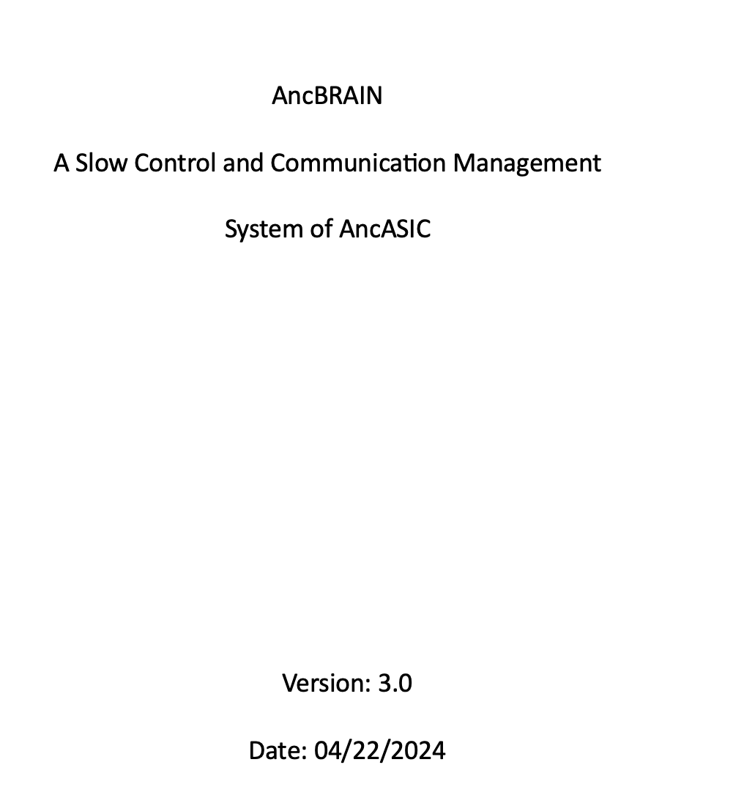
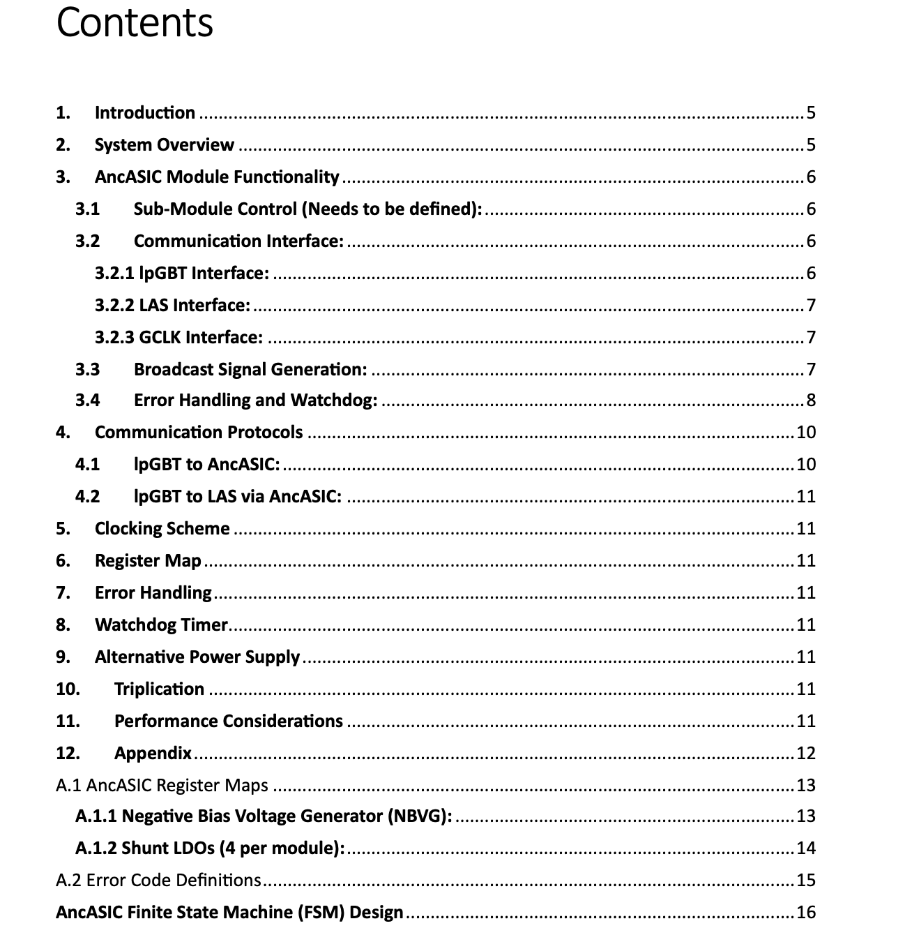
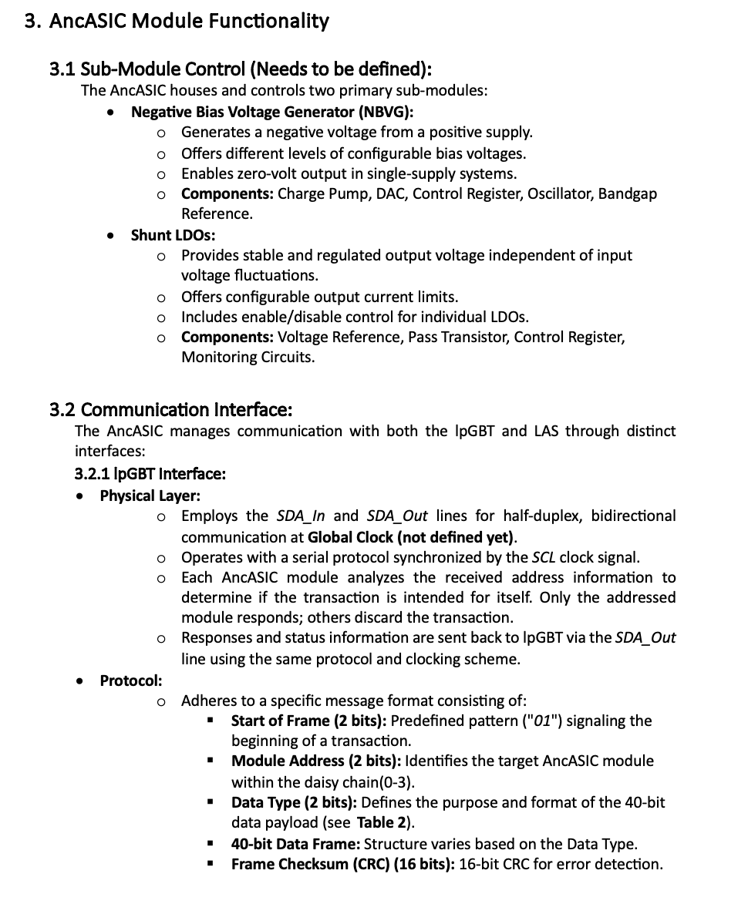
Documentation for Design and Implementation
The key functions are:
System Overview
Architecture
Communication Protocols
Internal Sub-module Control
Error Handling and Watchdog
Clocking Scheme
Physical Implementation
Verification and Validation

Slide 6
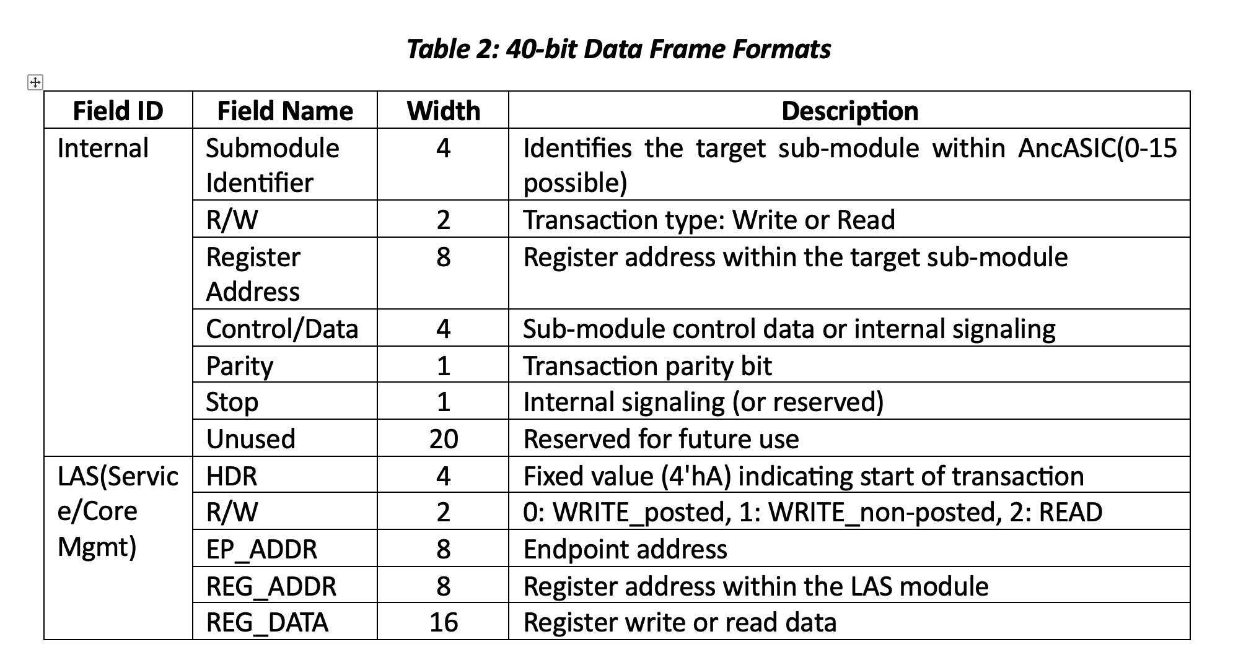
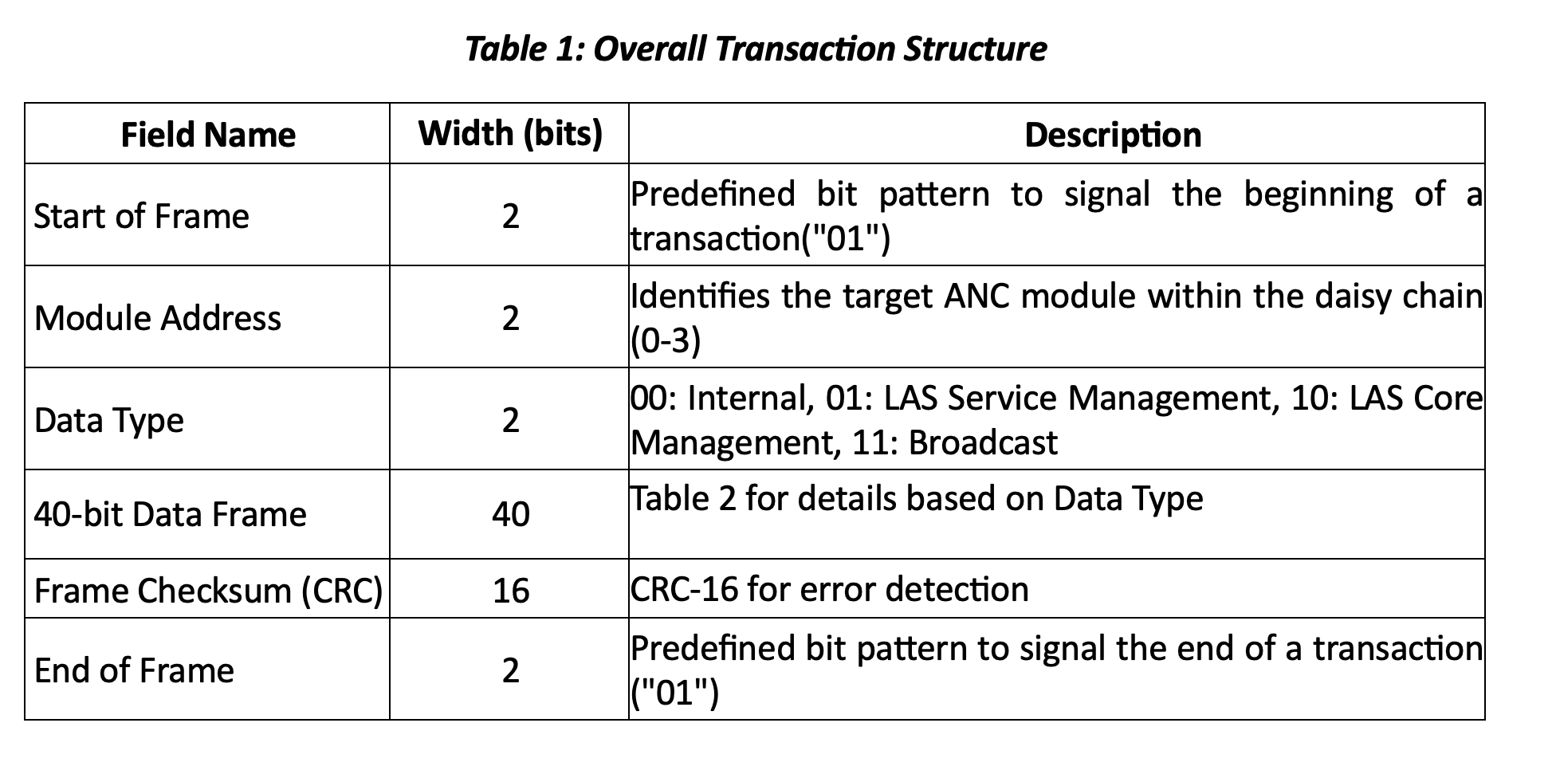
Transaction Format

Slide 7
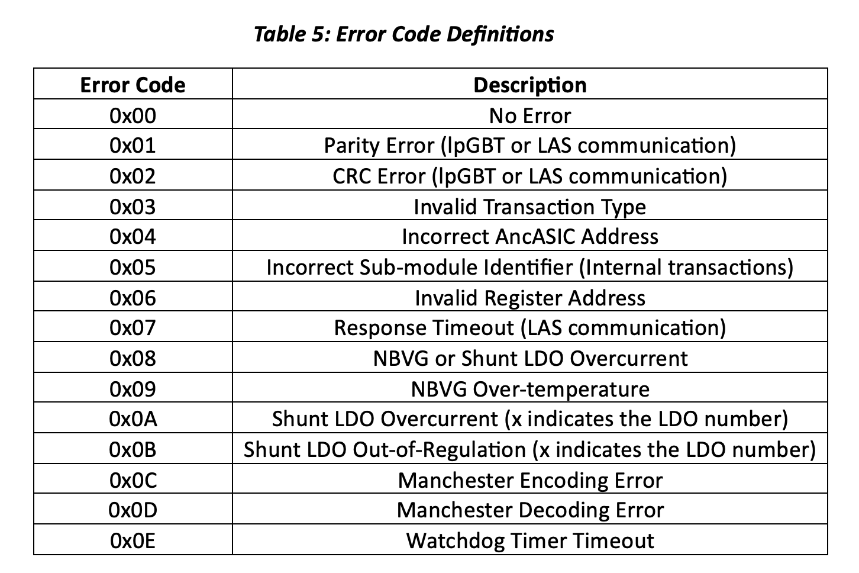
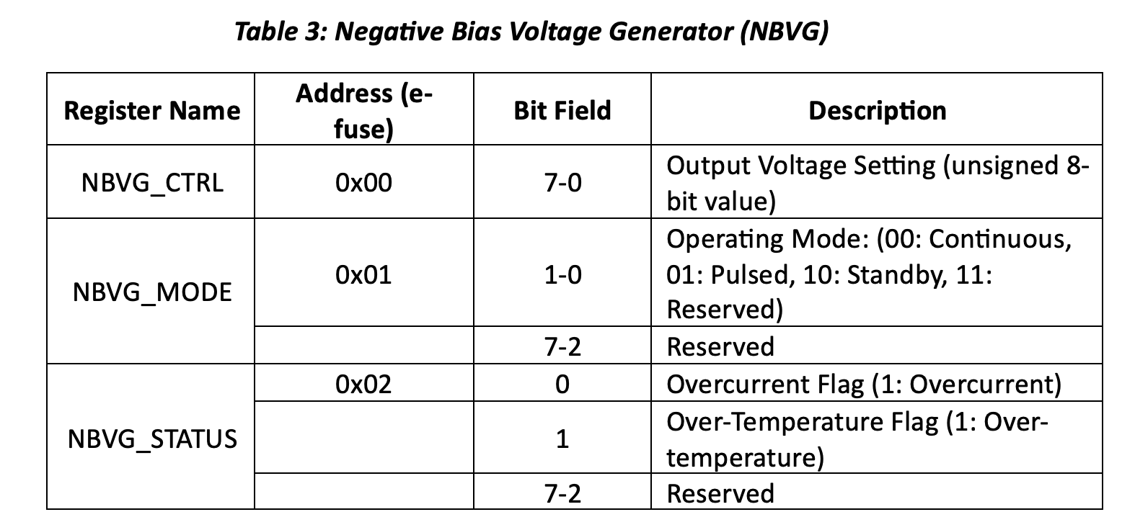
Register Map and Error Code Definitions

Slide 8
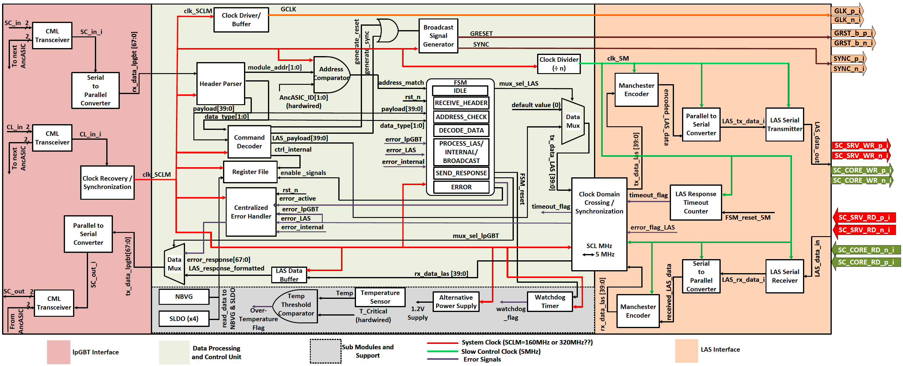
EIC-AncBrain Block Diagram

Slide 9
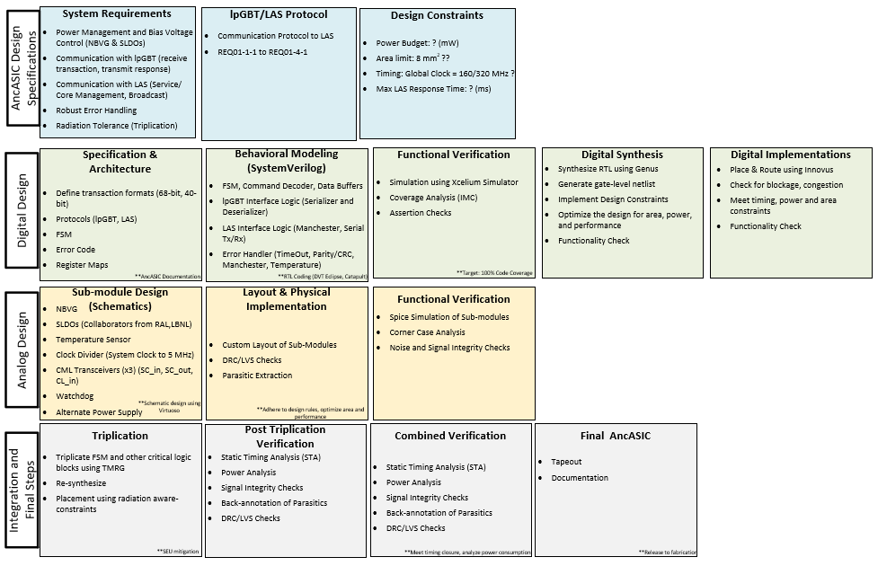
AncASIC System-Level Design and Implementation Flow

Slide 10
Implementation Plan
September Run
XT110 from XFAB
CML Transceiver
NBVG with simple interfacing mechanism (I2C)

Slide 11
Thank You

