Slide 1
Charge-light matching
https://indico.bnl.gov/event/23546/
Start with per-APA matching in WCT
  merge jsons with WC-python
  even single APA files (charge, light) are also useful
    [Haiwang] need to fix (t->x)
[Haiwang] PR for larwirecell
  incorporated BV’s suggestions
  formatting
[Haiwang] Fix interface mis-matches in “CLMatching” if any
  move the “CLMatching” to larwirecell for now
  rename “CLMatching” to “QLMatching”?
Plan:
Haiwang finish his items
Provide Chao with single-APA file
Discuss with Lynn and Ewerton to break down tasks

Slide 2
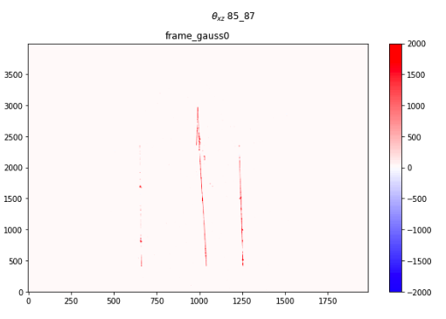
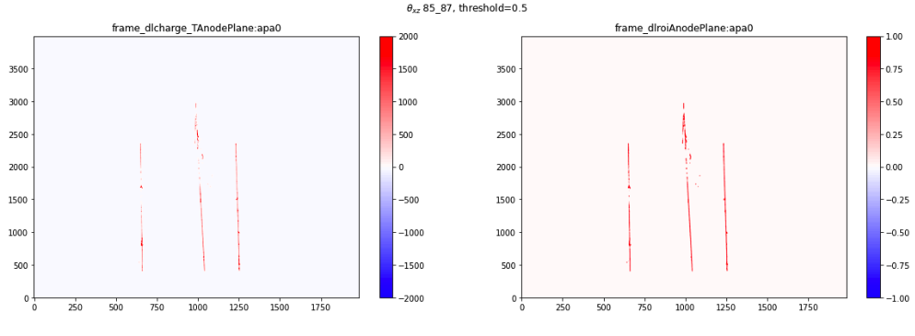
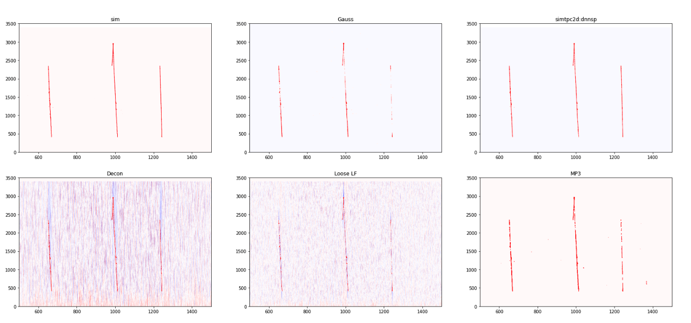
DNN-ROI
https://indico.bnl.gov/event/23605/
Cosmic+BNB
Avinay: new pytorch dataloader
Potential IO improvements
Moon:
extra prolonged muons in training to help prolonged tracks
  mixed training – NOT fine-tuning
Cosmic+BNB, prolonged muons

Slide 3
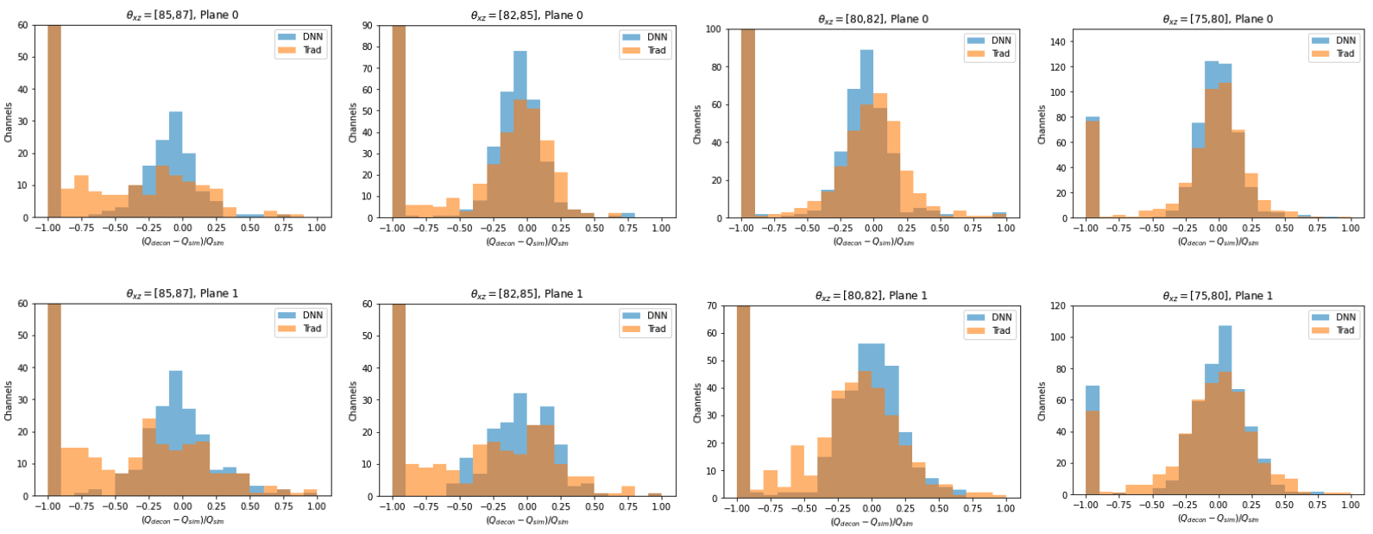
Moon - initial evaluation - charge

Slide 4
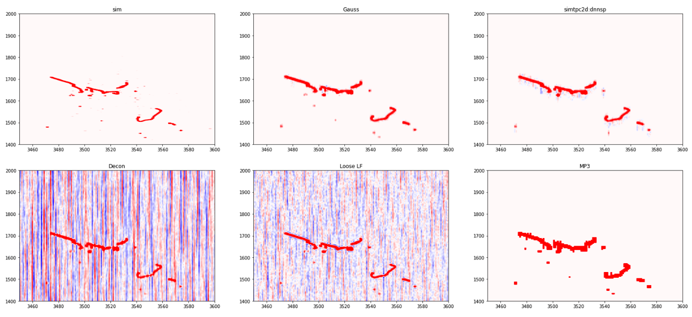
Moon - initial evaluation - shower
ROI too large?

Slide 5
DNN ROI To-do
reduce memory and speed the model up
profiling
review to remove un-needed copies based on profiling:
  frame -> eigen -> eigen (down sample) -> Tensor (torch::from_blob) -> Tensor (torch::stack) -> std::vector<torch::jit::IValue> -> ITensorSet -> forwar() -> ITensorSet -> torch::Tensor -> eigen -> eigen (up sample) -> eigen (mask on decon charge) -> frame
single -> half precision? (loose_lf, mp2, mp3)
  python side
  C++ side
    may need half precision eigen arrays or not
alternative NN architecture

