Slide 1
ProtoDUNE News and Data Management
Wenqiang Gu

Slide 2
Successful talks at the collaboration meeting
ProtoDUNE HD noise filter by Barnali
Configuration is done, may further adjust some parameters with physics run
DQM tools can be useful (see Gabriela’s talk)
CE response calibration by Karla
Further improvements: averaged waveform, overall gain vs pulse DAC?
Need a calibration table for ProtoDUNE HD
ProtoDUNE HD DNN ROI by Sergey
Short term: integrate into production
Long term: any further improvement?

Slide 3
Sim/Reco updates for APA#1 collection plane
Update simulation chain without signal in anode 0, plane 2
Reuse the field response file, plane 1 -> 2
Still provide RawDigits but with noise only in plane 2
Disable signal processing in anode 0, plane 2
Study PDHD imaging with 2 views
Practice 3-view imaging first to validate the workflow
For two-view imaging, study the improvement from de-ghosting
Use de-ghosted result to improve the deambiguation of recob::Hit

Slide 4
Data Access

Slide 5
How to use SL7 container on AlmaLinux?
$ ssh wenqiang@dunegpvm01.fnal.gov
# Use SL7 container in AlmaLinux
$ /cvmfs/oasis.opensciencegrid.org/mis/apptainer/current/bin/apptainer shell --shell=/bin/bash -B /cvmfs,/exp,/nashome,/pnfs/dune,/opt,/run/user,/etc/hostname,/etc/hosts,/etc/krb5.conf --ipc --pid /cvmfs/singularity.opensciencegrid.org/fermilab/fnal-dev-sl7:latest
> source /cvmfs/dune.opensciencegrid.org/products/dune/setup_dune.sh
> setup dunesw v09_89_01d01 -q e26:prof
> setup_fnal_security # setup proxy if you want to access files

Slide 6
How to get metadata (eg, file name) with run number?
> setup metacat
> export METACAT_SERVER_URL=https://metacat.fnal.gov:9443/dune_meta_prod/app
> export METACAT_AUTH_SERVER_URL=https://metacat.fnal.gov:8143/auth/dune
> metacat query "files from dune:all where core.run_type=vd-coldbox-bottom and core.file_type=detector and core.runs=21212"
vd-coldbox-bottom:np02_bde_coldbox_run021212_0000_dataflow0_datawriter_0_20230429T202252.hdf5
Find more run_type/namespace (equiv. to samweb definition) from the MetaCat portal page!

Slide 7
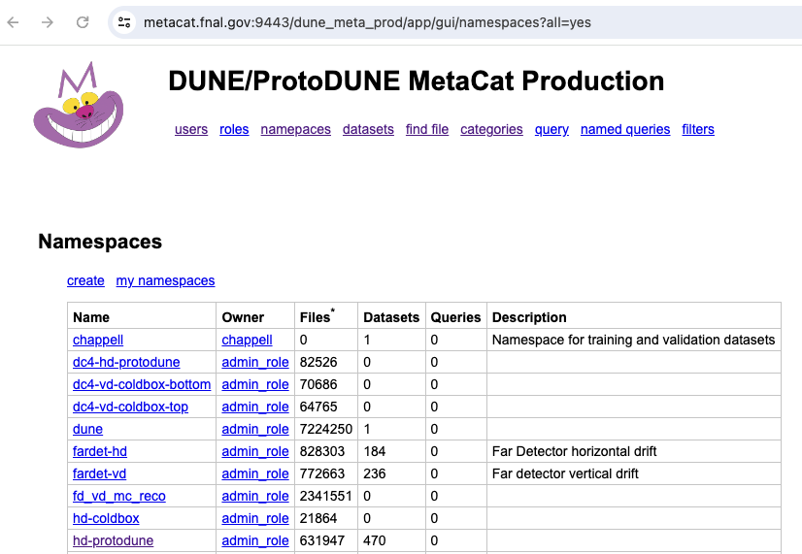
https://metacat.fnal.gov:9443/dune_meta_prod/app/gui/namespaces?all=yes
Use your SERVICE account to login

Slide 8
How to stream a file? (RUCIO)
> setup rucio
> export RUCIO_ACCOUNT=$USER
# locate the file with a namespace (i.e. defname) and filename
# returned paths in root:// format, choose the fnal one, not EOS (at CERN)
> rucio list-file-replicas hd-protodune:np04hd_raw_run025136_0723_dataflow0_datawriter_0_20240424T195956.hdf5 --pfns
# use LD_PRELOAD trick for streaming pdf5
> LD_PRELOAD=$XROOTD_LIB/libXrdPosixPreload.so lar -c <fcl> root://<name>.hdf5
# Alternatively, one can also copy the file to local
> xrdcp -f root://<name>.hdf5 ./

