Slide 1
OB prototype programme
For the UK SVT groups
With material from Adam Huddart and Stephanie Yang

Slide 2
Introduction
We are progressing in our designs for modules and stave, and the associated tooling
Before launch of production we wanted to get some independent look at what we are planning
Last Friday we had a review (https://indico.bnl.gov/event/23924/, reviewers: Tim Jones, James Glover, Adam Lowe)
The material Adam will show has been prepared for this
This has been extremely useful and the reviewers have produced a report with very quick turnaround (attached to the agenda)
We will now look at the suggested changes and see how to implement them
One concern raised was the very limited manpower for the suggested programme of work

Slide 3
Remit of the review
Assess the programme for OB stave prototyping, in particular
the requirements for the OB staves (for orientation),
the design for the prototype staves (incl. modules) and computational verification,
production tooling and procedures (stave and module),
proposed testing (incl. support conditions)
The basic stave design is not to be reviewed in detail at this point (although any suggestions will be gladly received and taken into consideration), as the basic stave design will be evaluated and reviewed once the results from this prototype programme are available. The purpose of the review is to give us input for optimization of the tooling and procedures for prototype module and stave assembly and tests to be employed, and to give us confidence that we can instigate production of the tooling.

Slide 4
Module and stave design and tooling
Talk by Adam

Slide 5
Highlights from computational studies
More details in talks at review

Slide 6
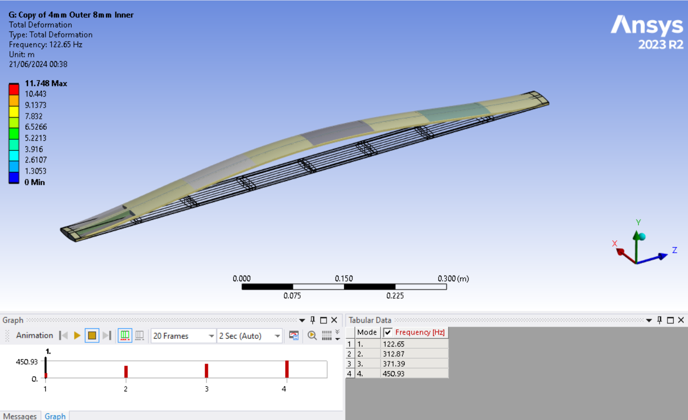
Mechanical FEA
First-mode frequency about 122 Hz
Expect real prototypes to be lower (joints, boundaries etc.)
No simple theory how this translates into deformations under air flow
But for external ASD of 10⁻⁷ g²/Hz (more than in typical detectors) f₀ = 50 Hz results in about 1 μm RMS deformation

Slide 7
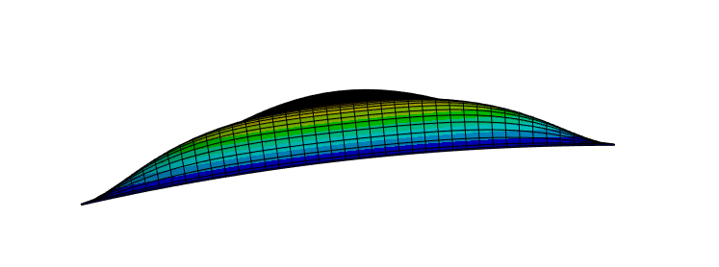
Why curved modules?
Curvature increases local stiffness
Sensors are only supported (glued) around perimeter
Most of the sensor area is not supported
Verified under static (pressure) load, but we expect better performance under air flow as well
We are also studying the overall stave performance for a square stave with similar moment of inertia
Possibly better overall performance due to the curvature, but will depend on the effects of buckling, not clear whether significant enough

Slide 8
Air flow CFD and thermal FEA
Complex problem and we are approaching it in steps
Currently: 2D CFD
Heat loads according to max 45 scenario + 33% power in AncASIC (latest numbers from Iain)
Air cooling: Naïve expectation (ΔT = 10°C):
L3: 1.6 l/s, L4: 2.9 l/s
For cross-section of 40×6 mm²: L3: 6.8 m/s, L4: 12.0 m/s
To reduce pressure gradients: foam blocks with Ø2 mm holes
To keep sensor cooler: split heat path (K9 blocks) between AncASIC and LEC
Sensor power depends on temperature, AncASIC performance less so
 | Nominal L [mm] | Tentative # per layer | LAS type | LAS per stave | Power [W]
 |  |  |  |  | per LAS | per AncASIC | per stave | per layer
L3 | 540 | 46 | 6-RSU | 2×4 | 1.98 | 0.66 | 21.0 | 1.0 kW
L4 | 840 | 70 | 5-RSU | 2×8 | 1.76 | 0.59 | 37.5 | 2.6 kW

Slide 9
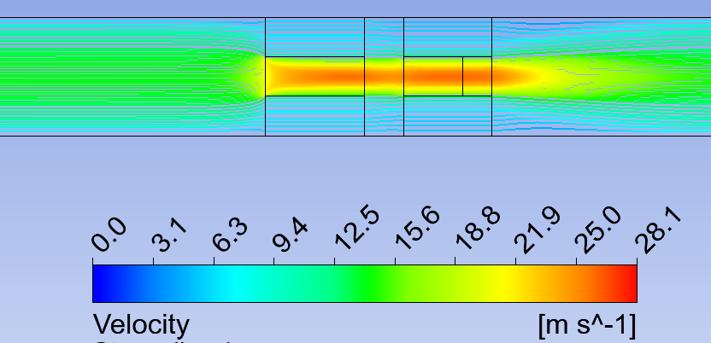
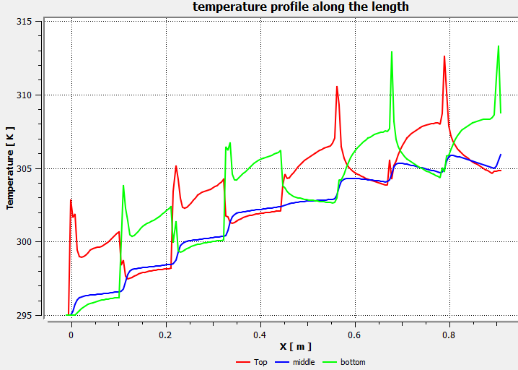
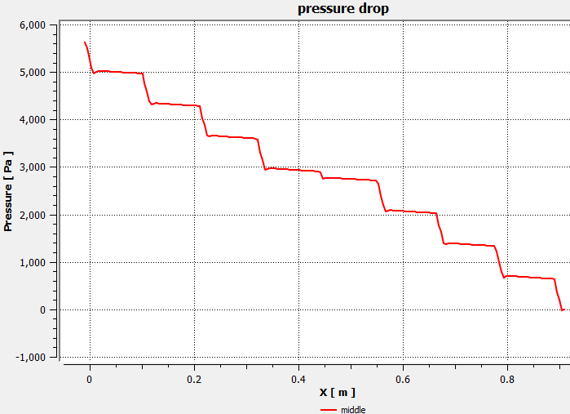
CFD results
For flow channel height of 6 mm
ΔT max = 18.8K;
ΔT (air) = 10.9K;
ΔT (sensors) =13.7 K
ΔT max: temperature difference between the hottest area of the boundary and inlet temperature;
ΔT air: temperature difference between inlet and outlet;
ΔT sensor: temperature difference between the hottest sensor area and inlet.

Slide 10
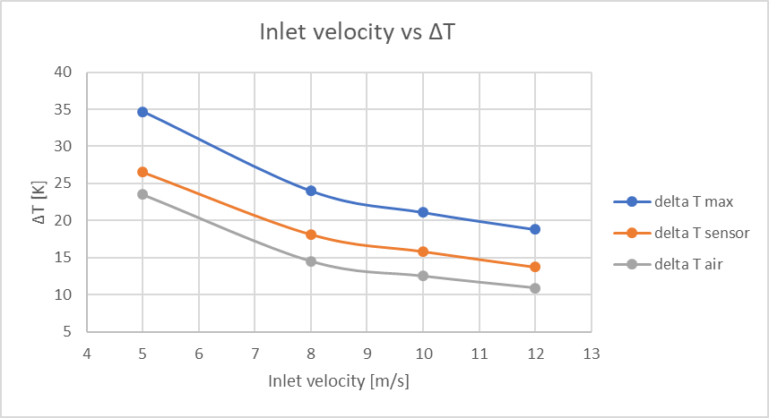
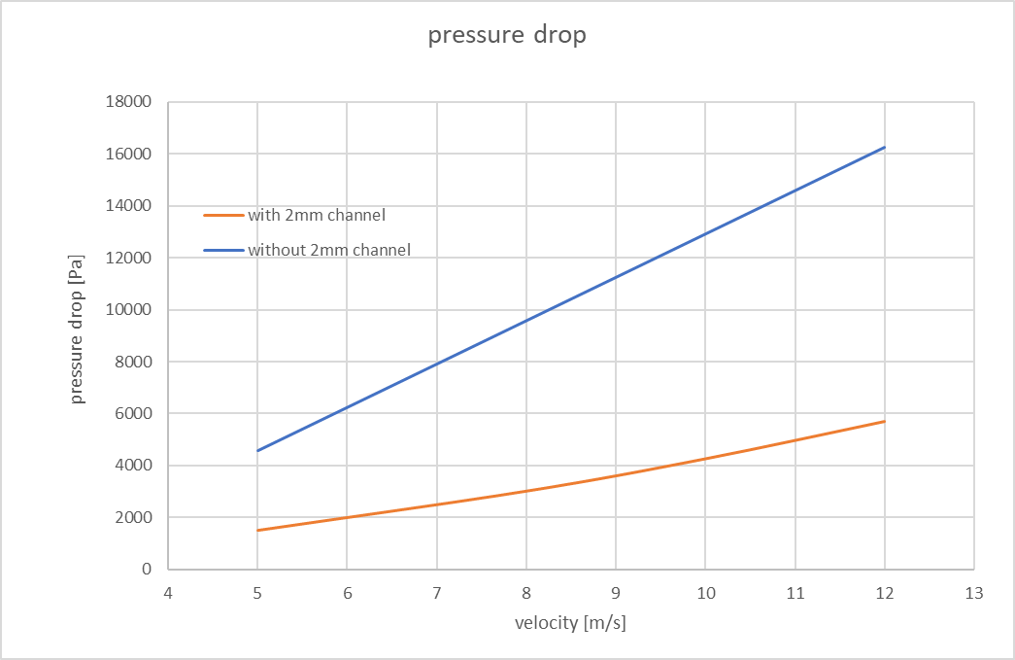
ΔT for different flows
2D CFD with 6 mm height, 2 mm holes in K9
2 mm holes in K9 reduce pressure gradient, with negligible degradation of thermal performance
But simulation accuracy is limited in modeling of interfaces
It appears that heat transfer at more than m/s is not as performant
Not clear why, will study further
Next step is 3D CFD (essential to assess performance of counter-flow)

Slide 11
Prototype test programme

Slide 12
What is different than in final system
Interfaces to support cones are not yet defined
Thermo-mechanical dummy sensors
40 μm thick silicon, encapsulated in Kapton with Cu heating traces (similar to ITS3 prototypes)
Simplified but representative power densities (2 power areas: LEC and matrix)
No discrete AncASIC chips
Current plan is to implement them directly as metal traces on the module carrier
No bridge FPC and no wire-bonding
Not clear how we will bring in power, either a special version of the main FPC, or wires
In the latter case the mass likely will be higher, but can be accommodated in FEA

Slide 13
Test programme – quarter stave
First challenge is to get a stave together (without modules)
Consolidation of CF prepreg and joints
Will possibly start with quarter stave
Quarter stave is quarter length L4 stave (2 modules = 4 dummy LAS)
Use the same tooling as for full size stave but only over a quarter of the length
Then assemble 2 modules and mount them on quarter stave
Again using parts of the full size tooling
With thermo-mechanical dummy modules this will be the first representative object for cooling studies
Thermo-mechanical modules are not expected before September/October
We have a wind channel, but need to work on couplings and mechanical interfaces
Will start on this when tooling manufacture is under way
Thermal performance will be verified by thermal imaging + some PT1000s for calibration (emissivity not well known)
Finally, quarter stave may be useful for bonding trials

Slide 14
Full size stave tests
After we are happy with building quarter stave and parallel to its tests we will build a full length L4 stave
First without modules
This can be tested in our vibration setup to find resonance frequencies & Q values
For the displacement measurements we can use capacitive sensors or FSI
Both are good to <1 μm when excitation frequency is known
Compare to FEA
With regards to thermal design we might want to try out holes of different geometry in the K9 blocks (decide after further CFD)
Then mount modules and repeat these mechanical measurements
Thermal test on full scale stave
Again use wind channel and thermal imaging
This also includes counter-current flow
In parallel measure deformations due to the airflow, again using capacitive sensors and FSI
If these are too large we will investigate methods of damping

Slide 15
Future prototypes and tests
Once all this has been completed we will do some, or all, of the following:
Work on optimization of L4 staves
Build modules with more realistic AncASICs, bridge FPC and wire-bonding
Build an L3 stave
Work on more realistic interfaces to support cone
Build an electrically functional stave (will depend on the availability of prototype LAS and AncASICs)
Guidance welcome

Slide 16
Further material

Slide 17
System overview
2 OB layers, segmented into staves
Exact dimensions still being optimized
Each LAS is accompanied with AncASIC (powering and control) on the stave
LAS is a version of ITS3 MOSAIX with reduced number of RSUs and rows
Power based on MOSAIX designs (still in work – likely to change)
Largest power density in LEC and AncASIC
LAS power is temperature-dependent (power from AncASIC less so)
We use worst case power estimates, what ITS3 call max 45 (maximum, at 45°C)
Current estimate is that power in AncASIC is about 1/3 of LAS power
Plan is to integrate 2 LAS and 2 AncASICs into a module
To allow for QC of complete unit
 | Nominal R [mm] | Nominal L [mm] | Tentative # per layer | LAS type | LAS per stave | Power [W]
 |  |  |  |  |  | per LAS | per AncASIC | per stave | per layer
L3 | 270 | 540 | 46 | 6-RSU | 2×4 | 1.98 | 0.66 | 21.0 | 1.0 kW
L4 | 420 | 840 | 70 | 5-RSU | 2×8 | 1.76 | 0.59 | 37.5 | 2.6 kW

Slide 18
Thermal requirements
Hope is to get away with air cooling
Plan B is to introduce thin-wall monophase cooling pipe in foam longerons along stave edge
Plan for a ΔT of 10°C, with c_{p,V} = 0.001297 J/Kcm³
L3: 1.6 l/s, L4: 2.9 l/s
For cross-section of 40×6 mm²: L3: 6.8 m/s, L4: 12.0 m/s
Things to study
Confirm temperature distributions of FEA
Intend to alleviate ΔT by counter-current air flow
Splitting the heat path from the LEC and the AncASIC to keep LEC cooler

Slide 19
Mechanical requirements
(As usual) sensor placement accuracy is not critical
Dimensional specifications for stave components and tooling will be driven by build requirements
In particular need for consolidation of CF prepreg
I do not have numbers for this – will need to find out from prototypes
Also, modules (sensors) will play structural role, and will close off air channel, so module/stave geometry and build accuracy needs to be compatible with that
Requirement is stability (= stiffness)
Don’t have a number (no software alignment studies done), but assume that we want similar to other trackers, ~1μm RMS
Loads:
Air flow most likely biggest source of vibrations
Thermo-mechanical loads – deformations
As a first benchmark we aim for a first mode >100 Hz (reality likely to be worse)
Things to study
Verify assembly tooling and procedures – in particular co-curing
Confirm FEA – even if stave geometry is not final, can use to benchmark FEA
Possibly damping

