Slide 1
Module and Stave Design and Tooling
Talk by Adam Huddart

Slide 2
Overview
L4 will use 5x1 RSU (Repeat Sensor Units) LAS
Prototype parts/tooling only designed for 5 RSU sensor
LEC:
REC:
(stitching plan termination)
EIC-LAS
~ 20 mm
Length L4 ~ 114 mm
Length L3 ~ 136 mm
Notes:
The Large Area Sensor used for the 2 outer barrel layers is a variation of the sensor used on the inner barrel layers and ITS3.
Within the sensor there are a number of Repeat sensor unites (RSU’s), this is the active region of the sensor, each RSU is around 22 x 20 mm.
REC which we won’t focus on too much,
LEC which houses the components for data and power connections, and is the highest power density region of the LAS.
For the EIC;LAS the number of repeat sensor units (or RSUs) from 12 to 6 RSU on the inner OB layer (L3) and 5 RSU on outermost layer (L4).
This number of RSU used for each layer has been selected to optimise the active area.

Slide 3
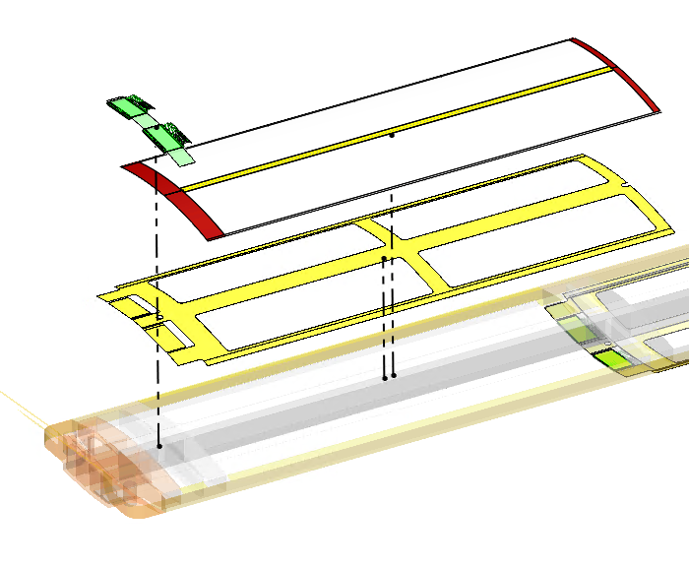
EIC-LAS Module Layout
REC
ASIC and Bridge
EIS-LAS are built into a module for testing and wire bonding.
Modules are built separately and adhesively mounted onto stave structure.
Modules are comprised of:
Kapton carrier – serves as an electrical insulation layer & bonding surface
2 EIC-LAS mounted side by side (2x6 or 2x5 RSU)
Ancillary ASIC (one ASIC per EIC LAS)
Bridge FPC (Flexible Printed Circuit)
LEC
Kapton Carrier

Slide 4
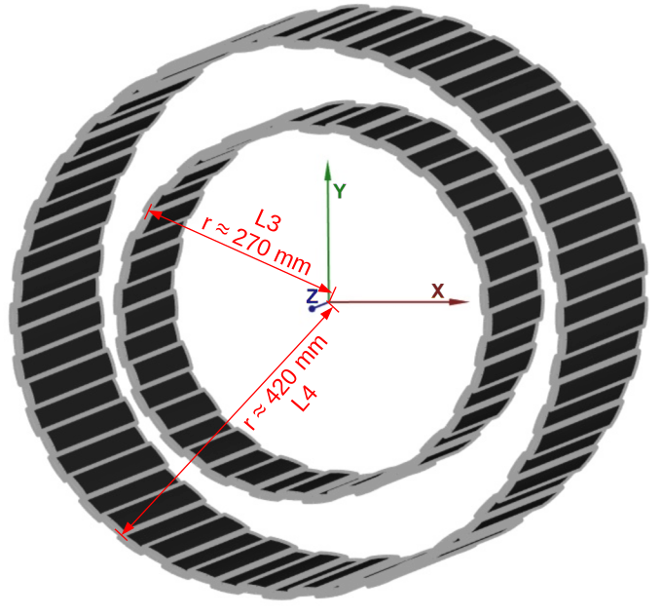
Outer Barrel Layout
OB L3 (6RSU segments)
Modules placed in an alternating top/bottom arrangement
Barrel layers comprised of castellated staves
L4 (8 x 5 RSU long EIC-LAS) at approx. 440 mm radius
L3 (4 x 6 RSU long EIC-LAS) @ approx. 270 mm radius
Modules are currently arranged for a minimum of overlap with a ± 10 cm interaction point and ideal radius locations
Notes:
To build up our staves we mount modules onto a support structure in an alternating top bottom arrangement, this allows sensor overlap in the Z direction.
The Longer L4 staves comprised of 8, 5 RSU sensors along their length are arranged at an approximately 440mm radius
L3 layer comprised of 4 x 6 RSU LAS sit at an approximately 270 mm radius
Neighbouring staves are castellated to allow sensor overlap around the Z axis.

Slide 5
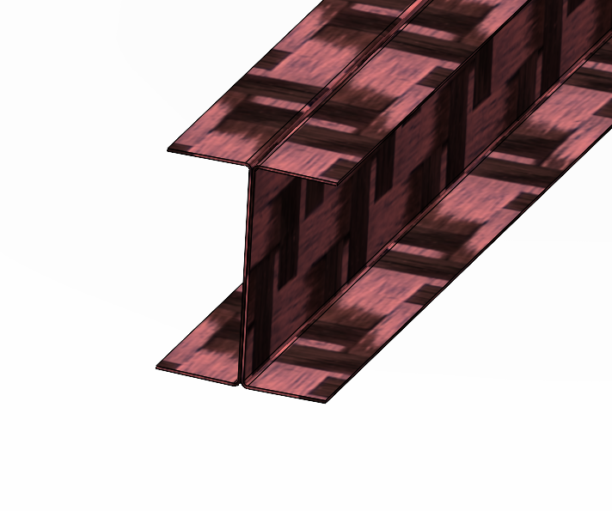
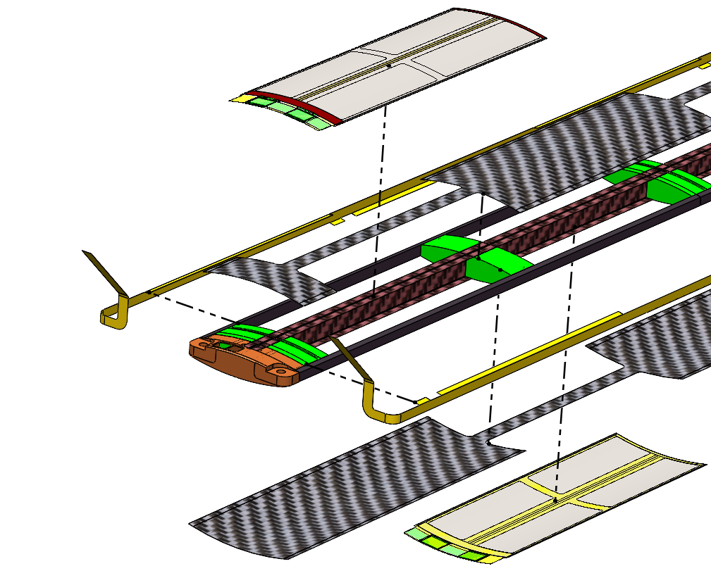
Stave Structure
Combination of carbon foams and carbon fibre prepreg laminates
Central carbon fibre I-beam divides left and right air channels (shown in red)
2 Densities of carbon foam (high porosity → allow airflow)
K9 used as a heatsink, in contact with the high power regions (ASIC & LEC) to aid heat dissipation
3% RVC foam longerons for structural support
0.1mm thick 2 ply carbon fibre skins on top and bottom of the structure
FPCs run along the longerons (shown in yellow)
Notes:
The stave structure is primarily build from carbon foam and carbon fibre laminates.
Main spine of the stave is a carbon fibre I beam build from 2 x 0.1mm thick U channel laminates, this runs uninterrupted down the lengths of the stave, giving rigidity and dividing the air volume of the stave into a left and right channel.
We use 2 types of carbon foam, K9 which you may be familiar with from ATLAS, is a higher density foam which gives better heat transfer properties and 3% RVC which offers lower flow resistance and is lighter weight. Importantly in both vases high porosity of the foams allow air to pass through them.
We use K9 foam for the cross braces which sit under the high power density regions of the stave (so the Left End Cap and the Ancillary ASIC)
3% RVC foam is used for the longerons which run along the edge of the stave structure, used to support the FPC, and outer edge of the sensor module.
A carbon fibre laminate skin runs accroos the top and bottom of the stave, combined with the EIC;LAS this forms the boundary for the internal flow channel.

Slide 6
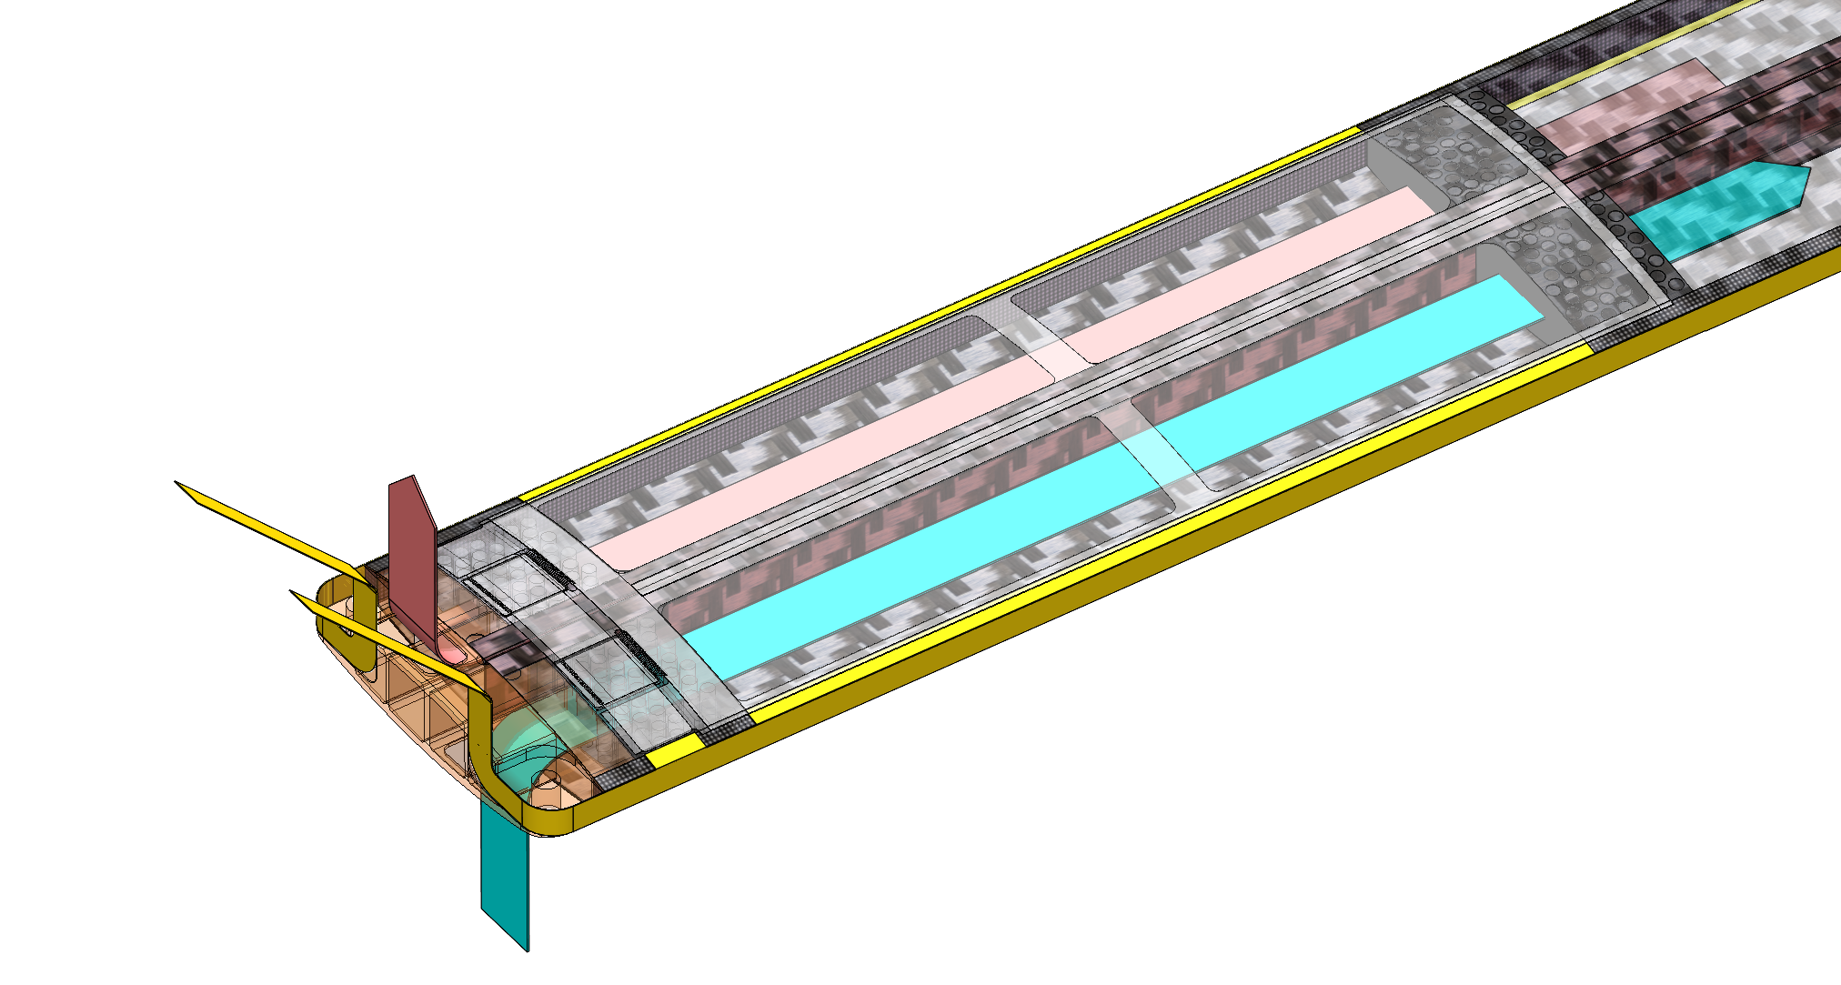
Internal Air Channel
Flow Channel 2 Outlet
Heat Flow
Flow Channel 1 Inlet
High Power Density ASIC & LEC
Notes:
Now if we look at the completed stave structure, with have 2 enclosed air volumes which are used as the coolant channels.
The two 3D arrows shows represent the flow direction within the channels. the cold inlet enters from the end of the stave and passes through the K9 foam cross braces, drawing heat away from the heat generating components which are primarily the ASIC and LEC,
Coolant temperature will become substantially higher by the end of the stave so will become less effective at cooling the power density components. Sensors closer to the exhaust will run hotter.
The idea of the counter current flow path which I have shown is that a lateral heat conduction through the k9 foam of 2 adjacent sensor will lead to come lateral heat flow, reducing the variation in temperature.
We’ve not done enough analysis to say this is effective yet.

Slide 7
Tooling
Stave Structure Assembly Tooling
Module Assembly Tooling
Module Installation Tooling

Slide 8
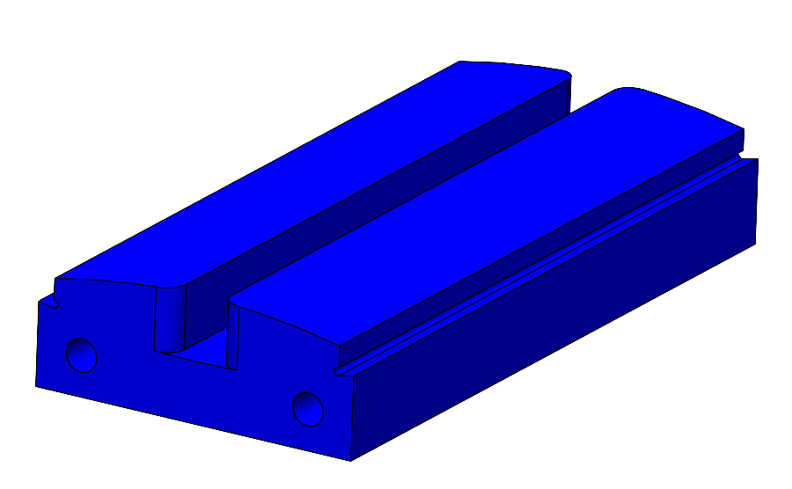
Prototype Stave Tooling
2 Part mould (+ some internal supports for I beam) cured in a heated press
Base of mould made from 6 mm thick carbon fibre sheet
Minimize/match CTE of mould to the stave to reduce internal stress/warping of stave
Components shown in blue are aluminium, each component (max ~140mm long) is pinned at the center to avoid expansion tolerance stack
Sections can be wire EDM cut and post machined

Slide 9
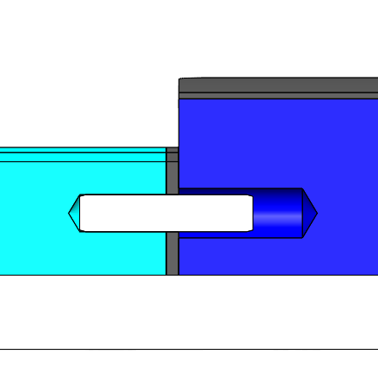
Mould Cross Section
Note: top side mould removed for clarity
Rubber layers (shown in black) between each aluminum section, layer will be compressed due to expansion of aluminum parts removing any gaps/leak paths
Rubber layer on the top of each dark blue section to help with consolidation (we can tune the stiffness/ thickness of this if we have issues).
Note: Horizontal dowels only constrain the rubber layer between aluminium parts, constraint of aluminum parts to base plate come from dowels in base plate aligning with hole & slot in aluminium parts
All carbon fibre surfaces are sandwiched between aluminium and K9 foam or rubber.

Slide 10
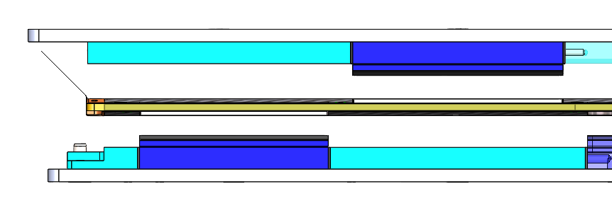
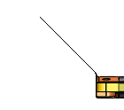
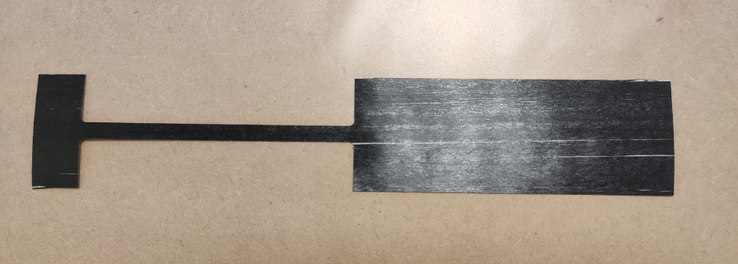
Shorter Prototypes
We will most likely start with a 2-module stave assembly
We can do this with the same tooling but leaving out the formers for modules 3-8 and lengthening the underside former for sensor 2
Required modified (longer) version of underside former
Test Section : 50-micron layer thickness

Slide 11
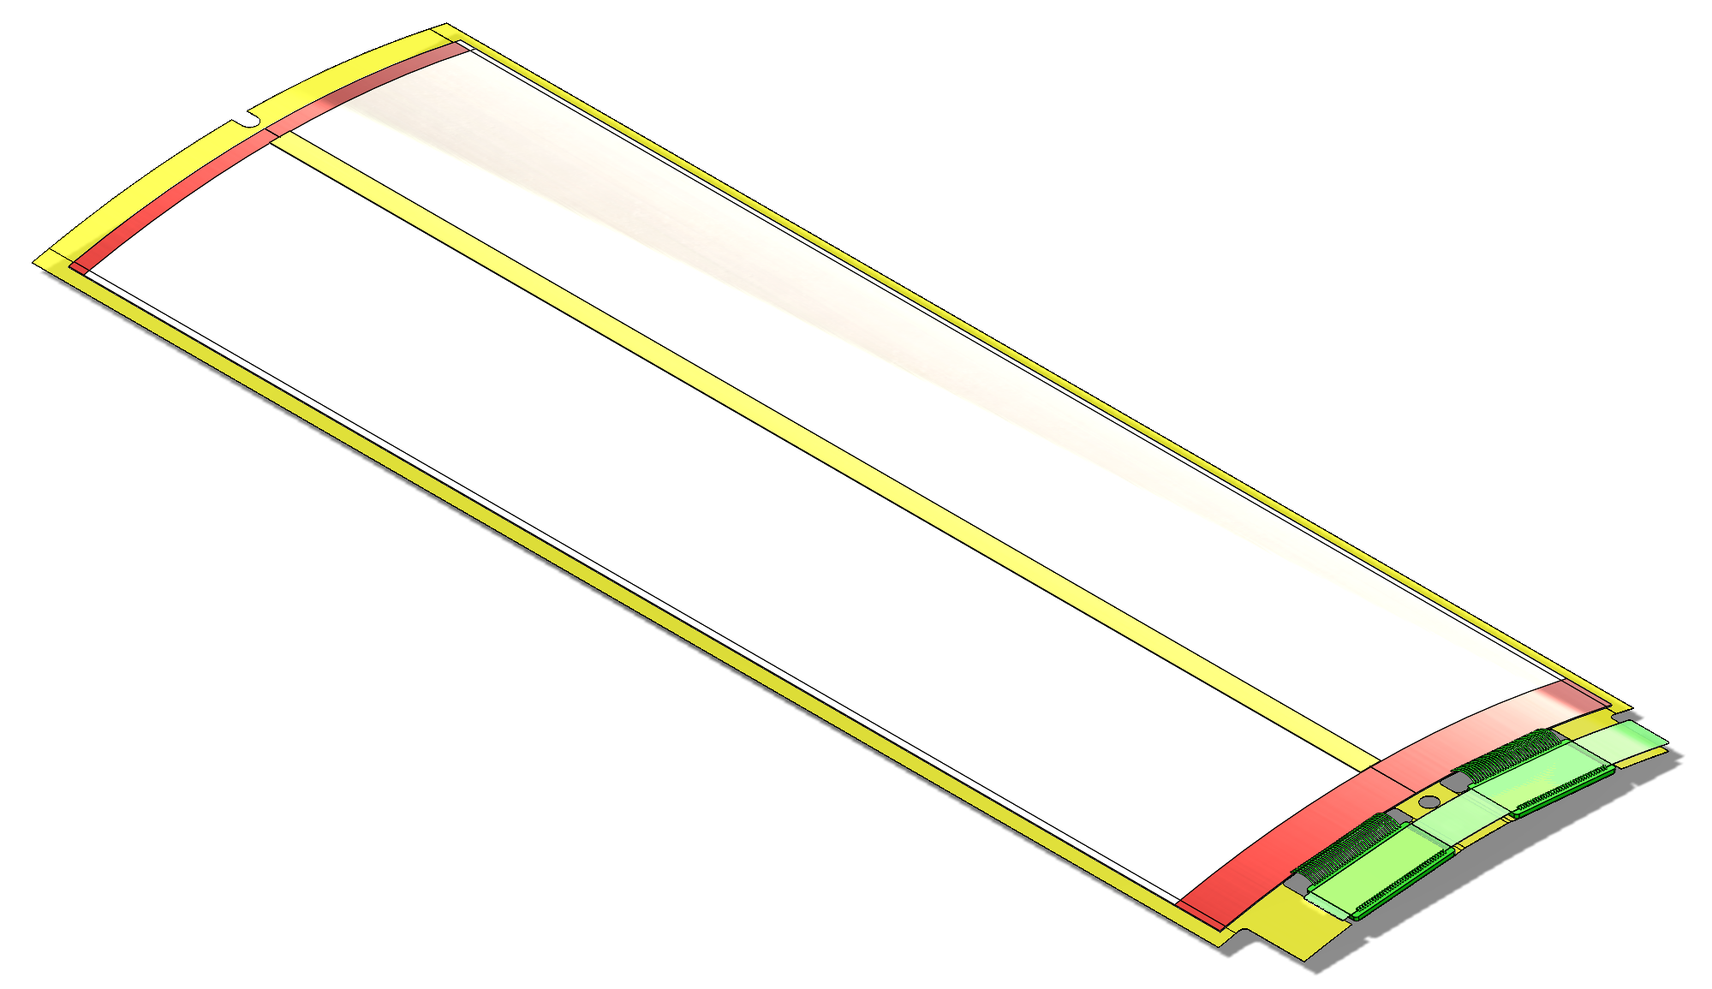
Module Assembly Tooling
Assemble the EIC-LAS (QTY 2) into a state where they can be easily tested (through connections on the bridge FPC) and transferred (repeatably and accurately) onto the stave structure.
Component List
2x EIC-LAS
1x Kapton Carrier
2x Ancillary ASIC
1x Bridge FPC
TBD 1x Kapton Cover Strip

Slide 12
Sensor Mounting
Silicon wafer will be cut into 5 & 6 RSU LAS (100x20 & 120x20mm)
Sensors need to be picked up and placed onto a jig where it will be aligned and bent (by applying load) onto a convex vacuum pad

Slide 13
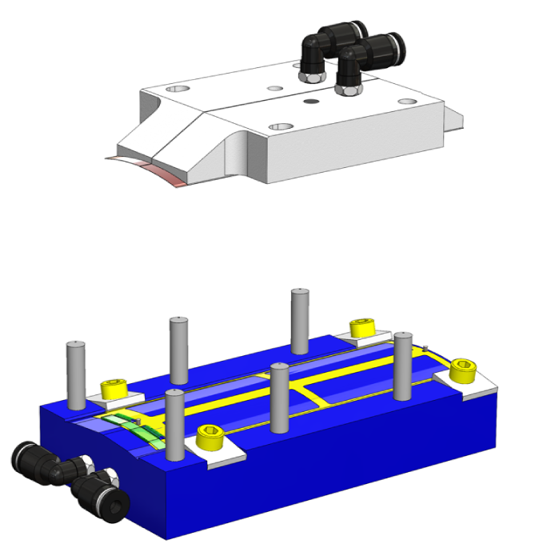
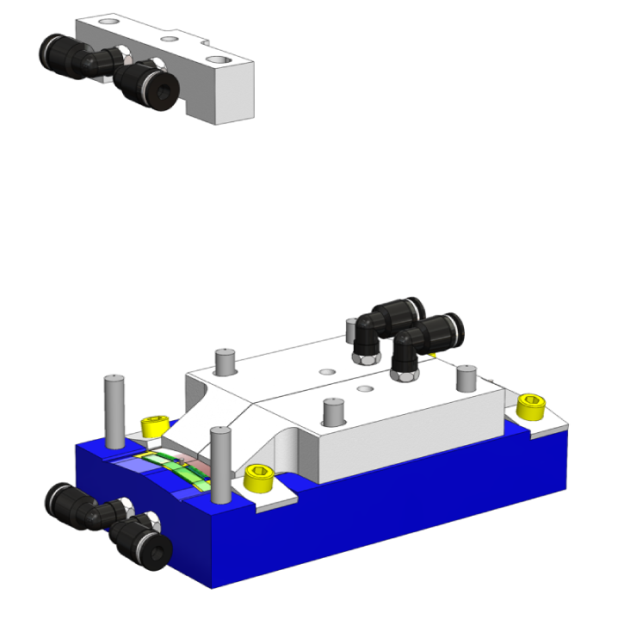
Assembly Procedure – Module Transfer Tooling
EIC-LAS are glues onto the kapton carrier in the assembly tooling
Wire/bump/tab bonds between EIC –LAS and FPC/ASIC can be made
Module Assembly Tooling becomes the transfer tooling
Material Legend
Aluminium
PEEK
316 Stainless (Bolts Yellow)
Kapton
Transfer Tooling

Slide 14
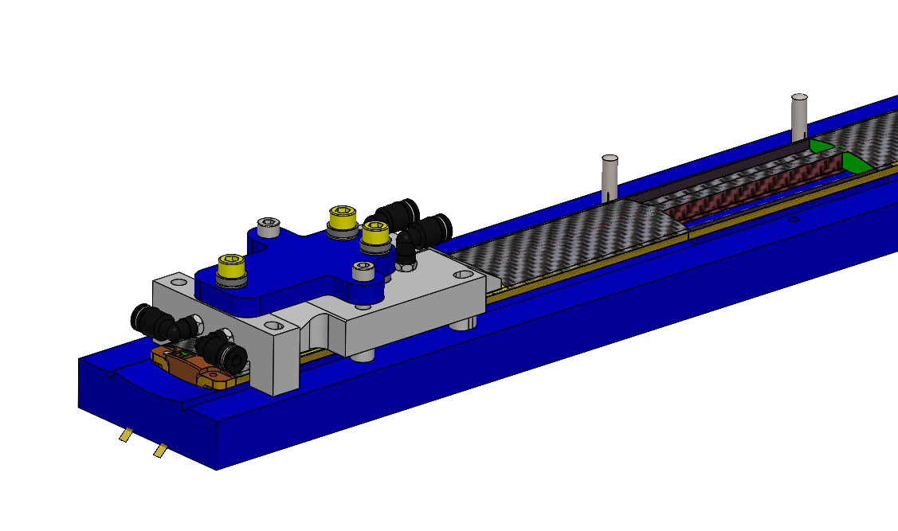
Module Installation Tool
Stave transferred onto module installation tooling
Module transfer tooling aligns with reference features on the installation tooling
Two installation tools, one for 4 topside modules, one for bottom side.

