Slide 1
Fraction of the left-side tail in the energy deposit sum distribution
July 09
Minho Kim

Slide 2
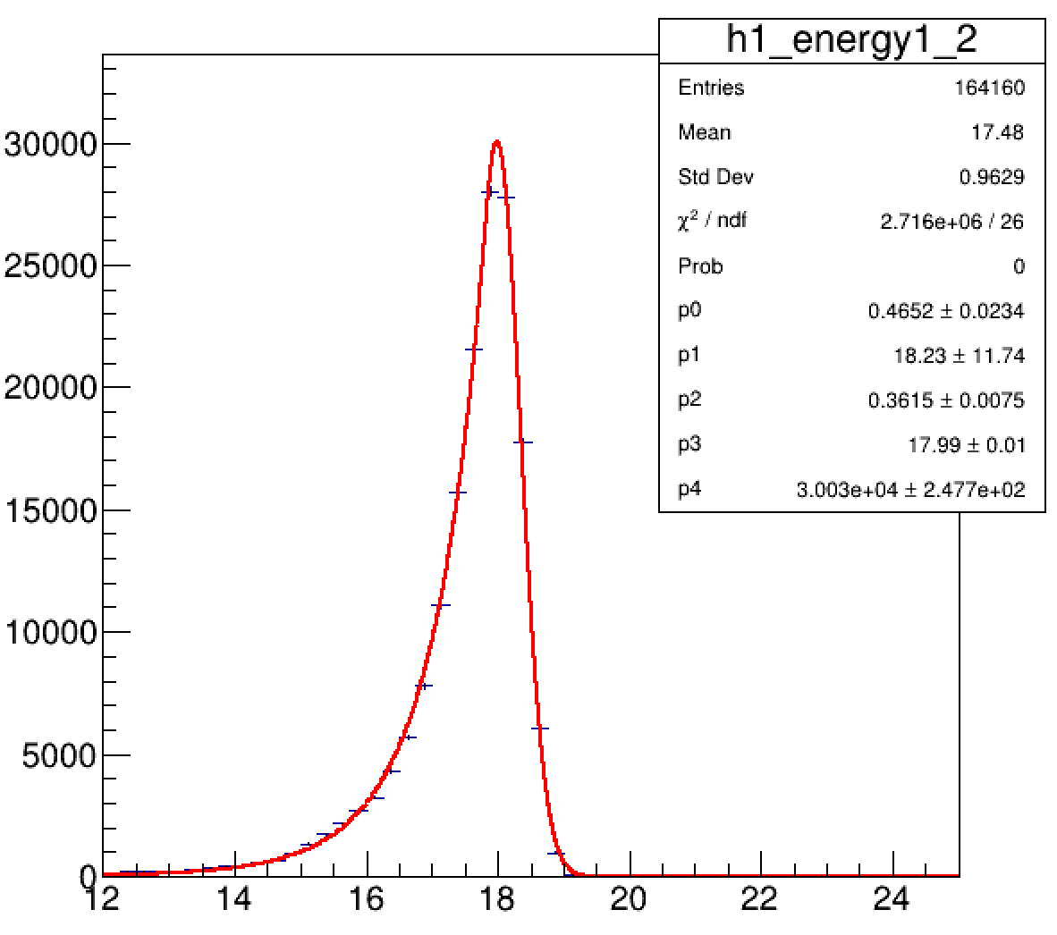
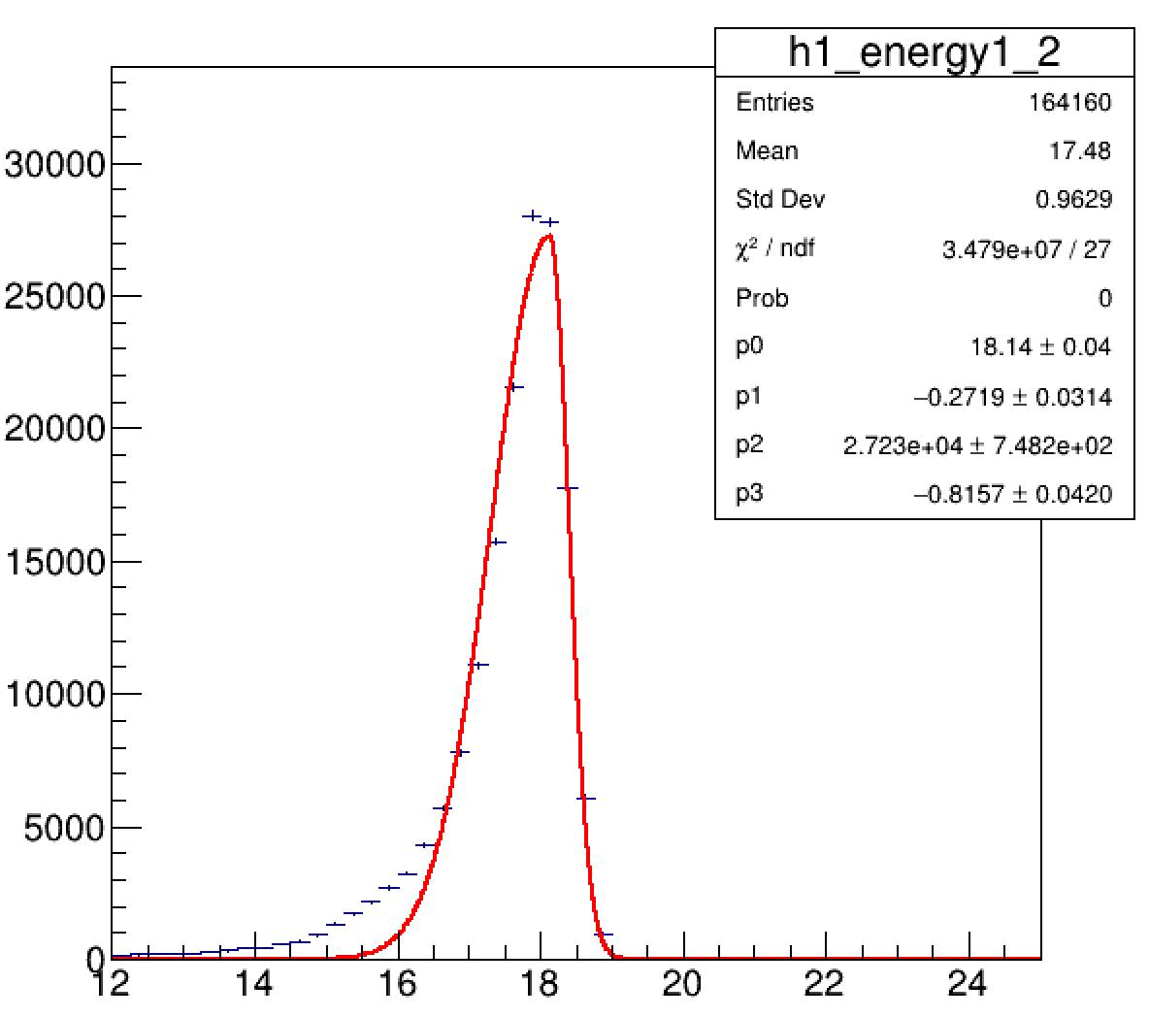
Selection of the fitting function
Crystal Ball
Asymmetric Gaussian
20 GeV photon
10 layers
20 GeV photon
10 layers
Counts
Counts
Edep sum (MeV)
Edep sum (MeV)
■
Because the Asymmetric Gaussian didn’t reproduce the left-side tail well, the Crystal Ball function was used to estimate the fraction of the left-side tail.
2/7
Notes:
24 33

Slide 3
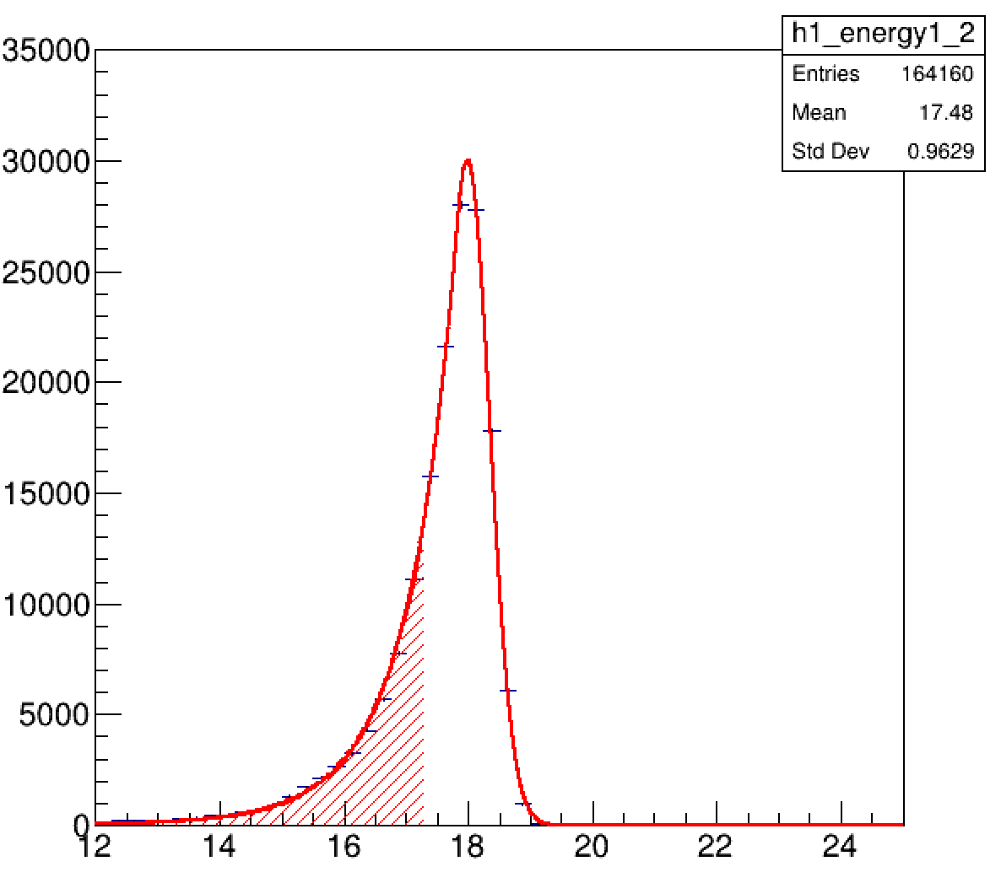
Evaluation of the left-side tail
Counts
Edep sum (MeV)
■
■
We want to study the fractions of the left-side tails depending on the energy and the number of ScFi layers used.
Area of the Edep sum distribution was integrated up to the first FWHM position and the ratio to the total area was calculated.
3/7
Notes:
24 33

Slide 4
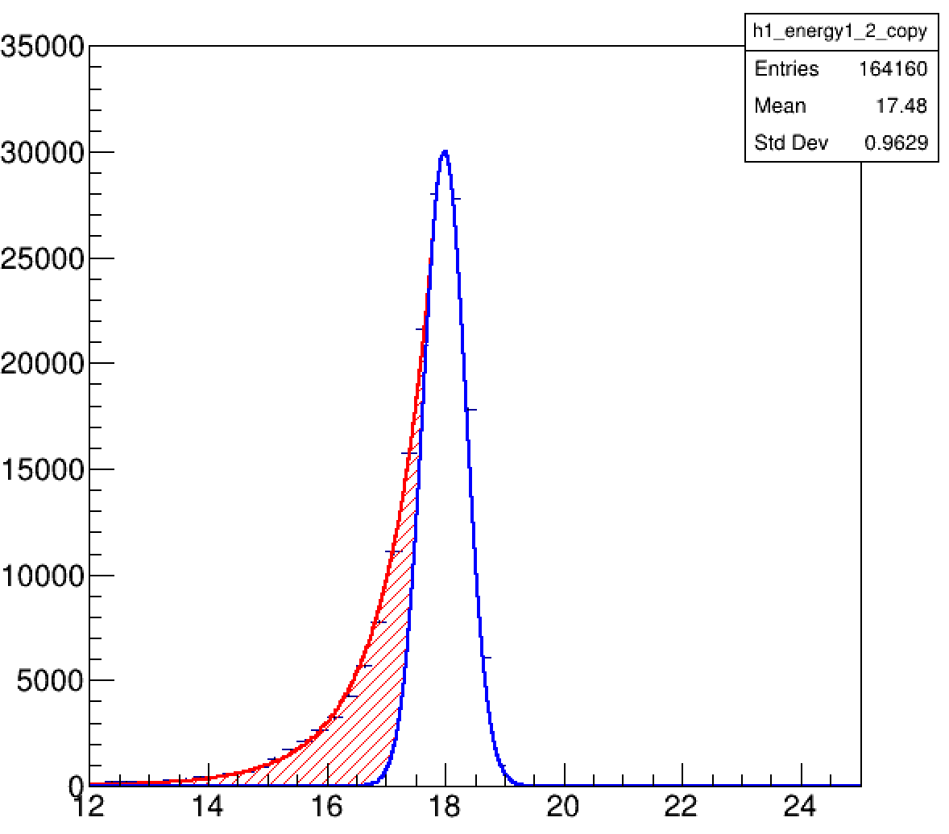
Evaluation of the left-side tail
Alternative
Counts
Counts
Edep sum (MeV)
Edep sum (MeV)
■
We can also integrate only the area which makes the distribution asymmetric.
4/7
Notes:
24 33

Slide 5
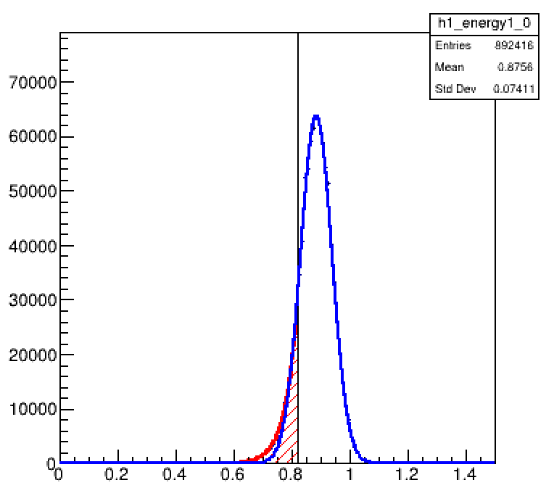
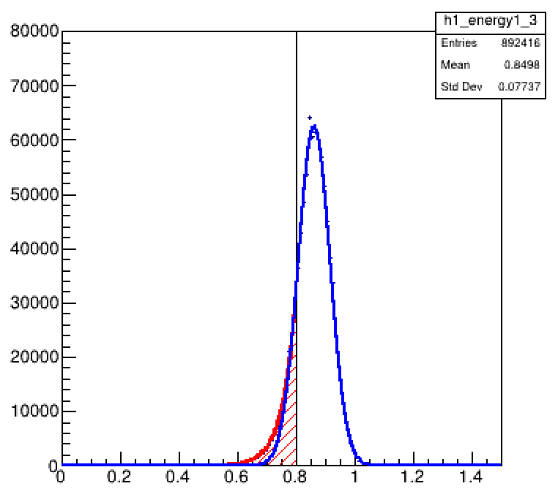
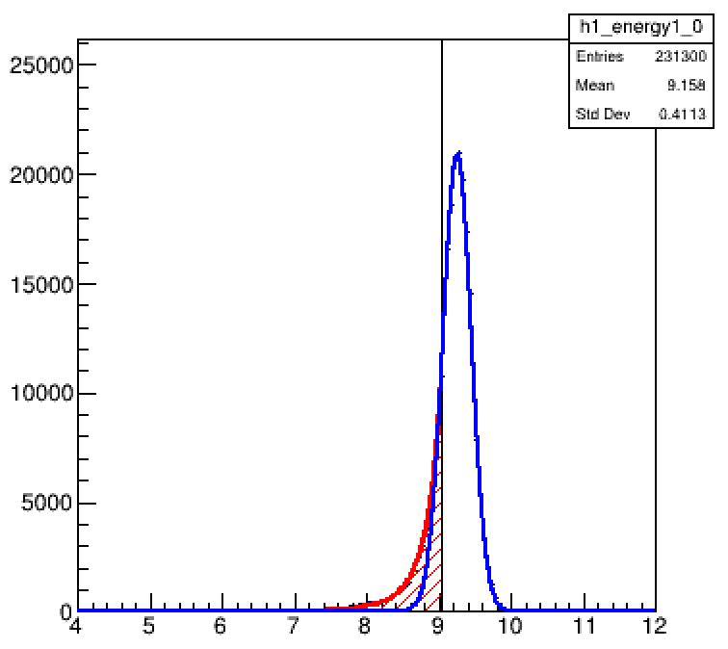
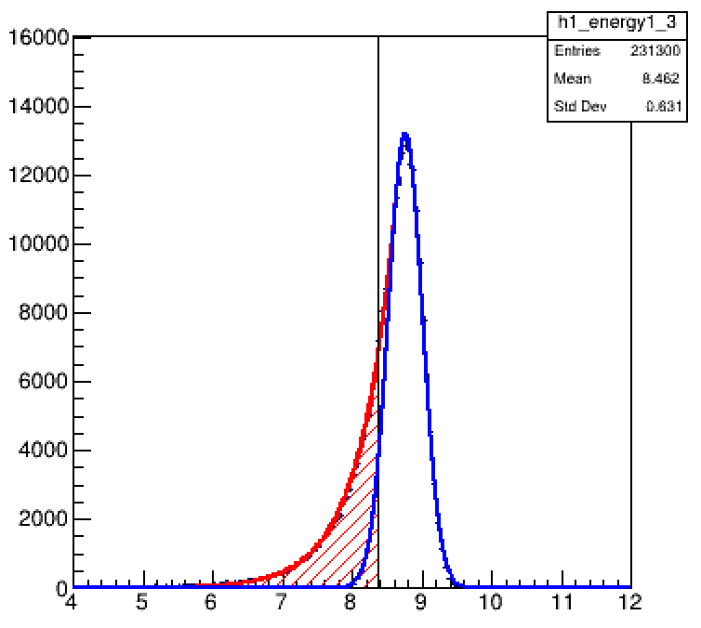
Edep sum distributions
1 GeV photon
12 layers
1 GeV photon
9 layers
Counts
10 GeV photon
12 layers
10 GeV photon
9 layers
Edep sum (MeV)
5/7
Notes:
24 33

Slide 6
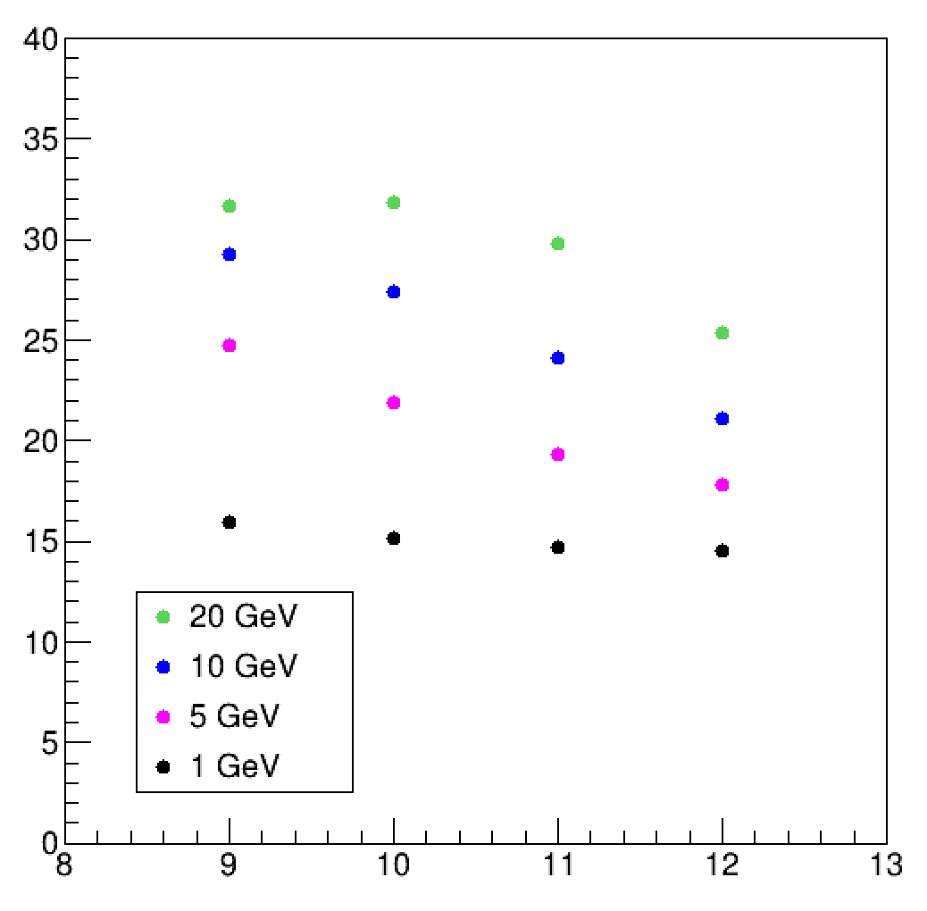
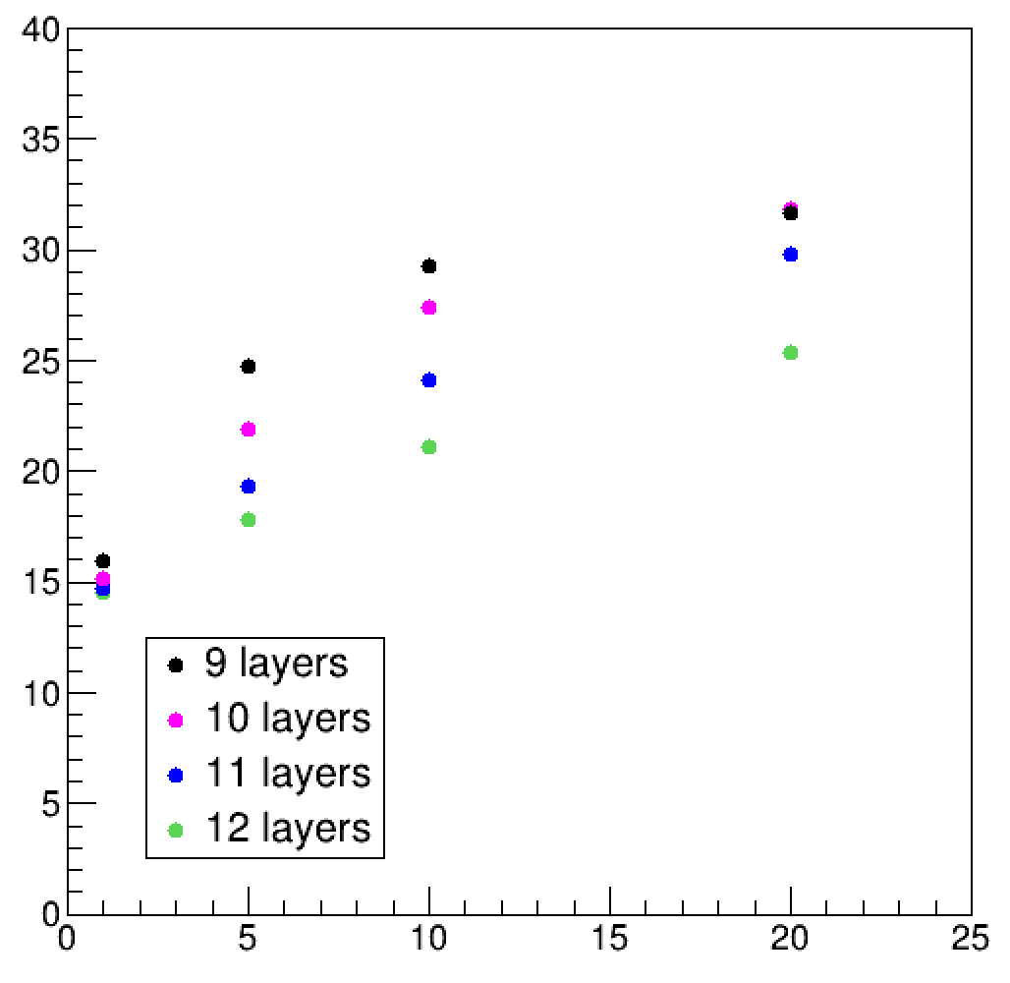
Comparison 1
As a function of layers
As a function of energy
Fraction (%)
Fraction (%)
Layers
Beam energy (GeV)
■
■
There is no clear difference for 1 GeV photon, but the fraction increases in the higher energy as the number of ScFi layers used decreases.
When the trigger condition is not applied, the fraction increases as the photon energy increases even in the 12 layers.
6/7
Notes:
24 33

Slide 7
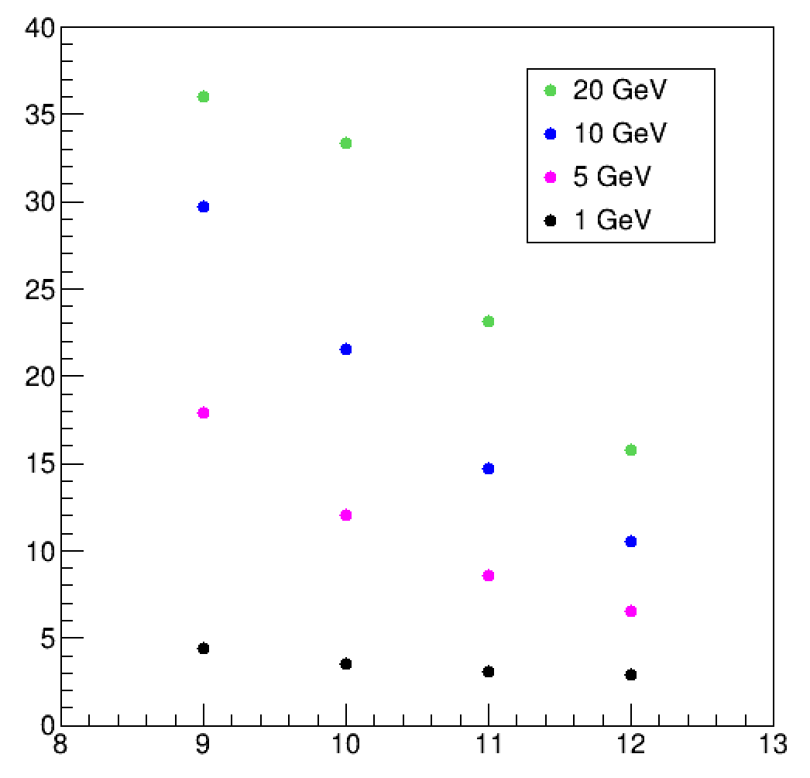
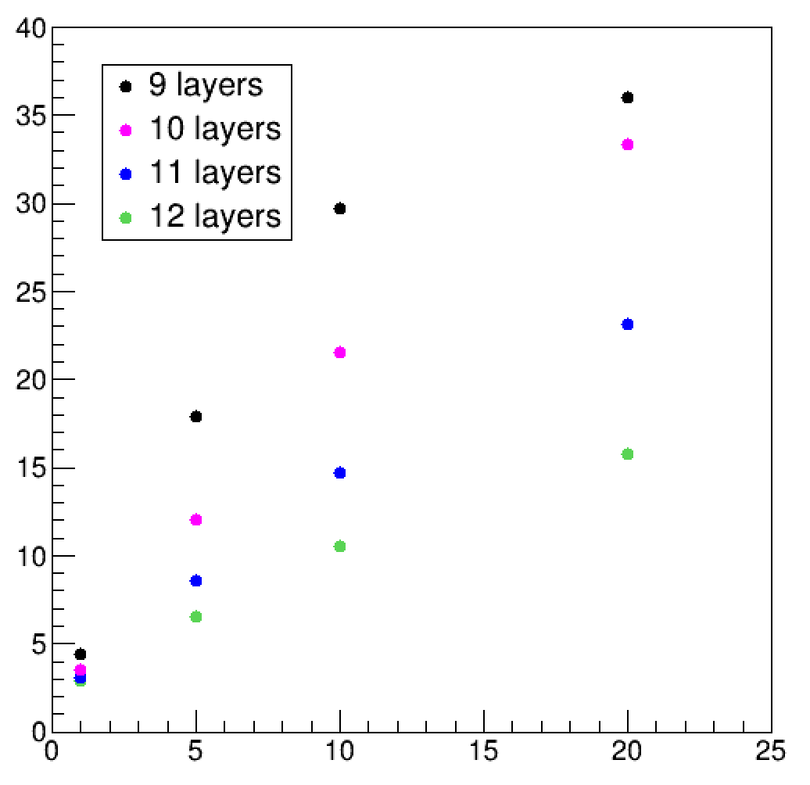
Comparison 2
As a function of layers
As a function of energy
Fraction (%)
Fraction (%)
Layers
Beam energy (GeV)
■
We can see clearer dependency if we consider only the asymmetric area.
7/7
Notes:
24 33

