Slide 1
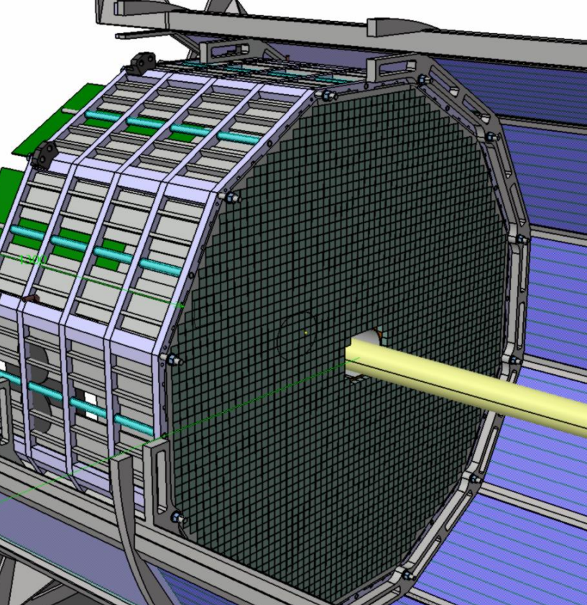
Backward EMCal (EEEMCAL)
Status June 2024
Tanja Horn, Carlos Munoz-Camacho

Slide 2


EEEMCAL Global Timeline
2015 – 2023 PWO crystal studies in collaboration with NPS project at JLab
  Test bench commissioning, calibration, and operation
  Beam tests at GeV scale
  Standalone simulation development
  Construct and commission the 1080 PWO crystal NPS calorimeter
2020/21 Start of EEEMCAL Mechanical Design based on NPS calorimeter
2023/24 Reviews and focus on readout/electronics test of engineering component
  May 2023 NSF MSRI proposal submitted – under review
  21 July 2023 Final Design Review – Crystals
  18 August – start dedicated EEEMCAL simulation meetings
  14 Sept 2023 Final Design Review – SiPM
  24 Oct 2023 – start dedicated EEEMCAL FEE meetings
  May 2024 - SiPM Irradiation at UCDavis
  Aug 2023 – May 2024: Carry out NPS experiment RG1 with 1080 PWO crystal calorimeter
  Start test bench setup for QA
  Oct 2024 – beam test at DESY with focus on readout chain and mechanical test engineering parts
End of 2024 or early 2025 – expect final design review

Slide 3
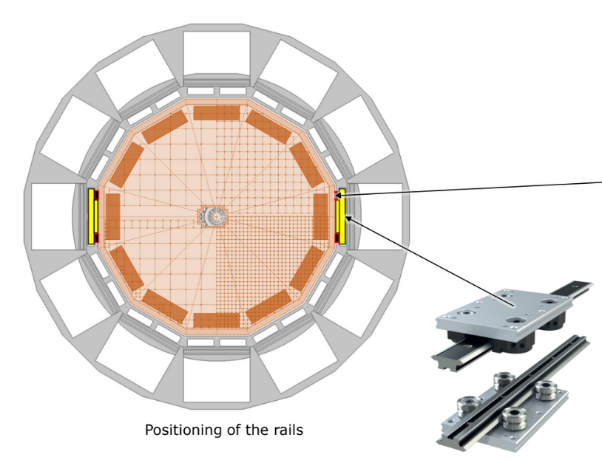
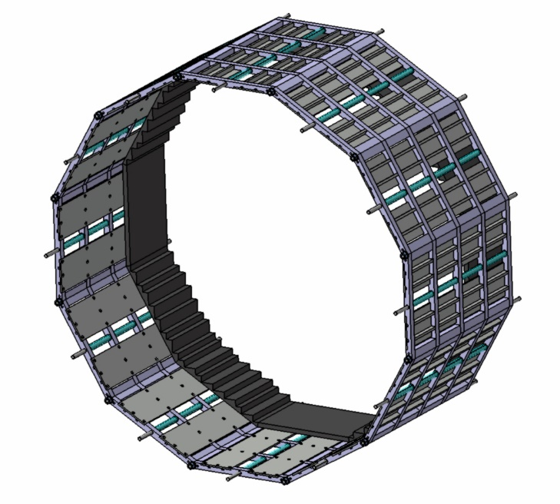
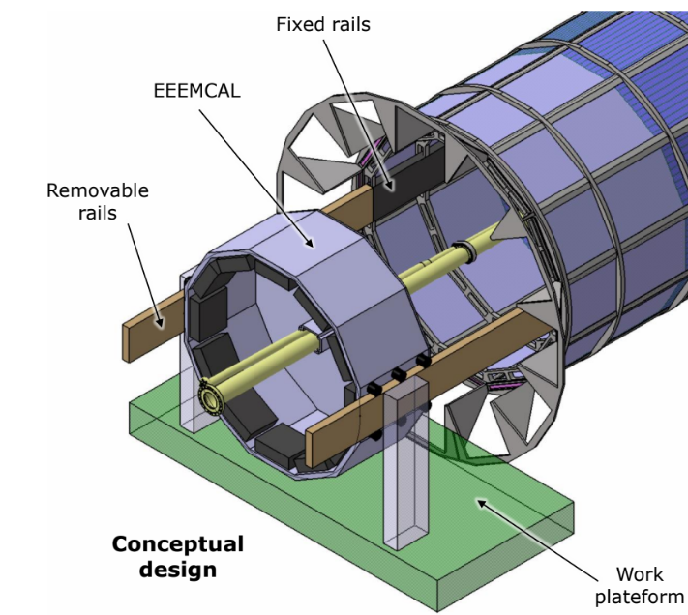
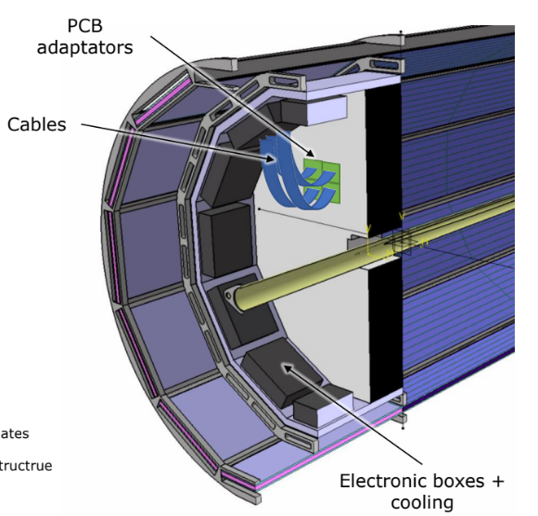
Design Progress
Advanced preliminary design of mechanical assembly and installation procedure
SiPM readout using short cables to electronics sitting behind the crystals (inside cooled boxes)

Slide 4
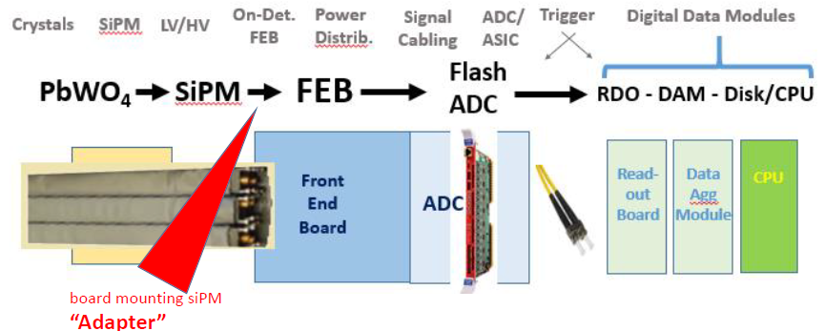
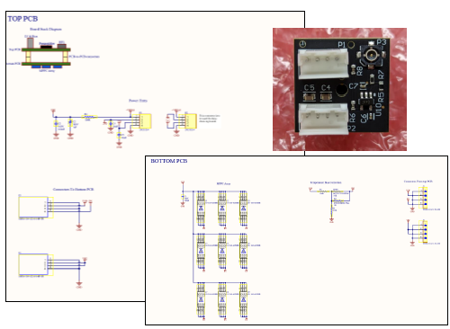
Integration of Electronics
FEB Choices
One could be JLab pre-amp board used in testing so far
Two Types of ADC Choices
“Discrete” ADC (e.g., fADC-like)
ASIC: HGCROC

Slide 5
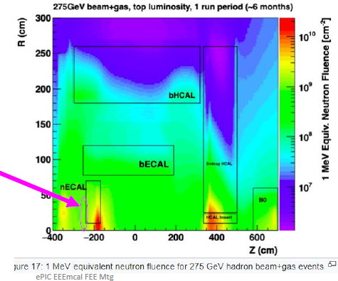
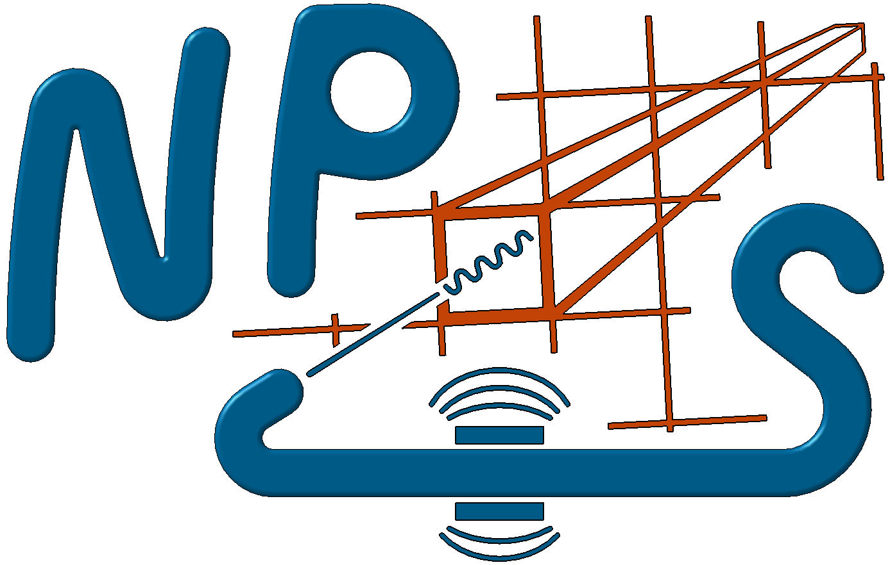
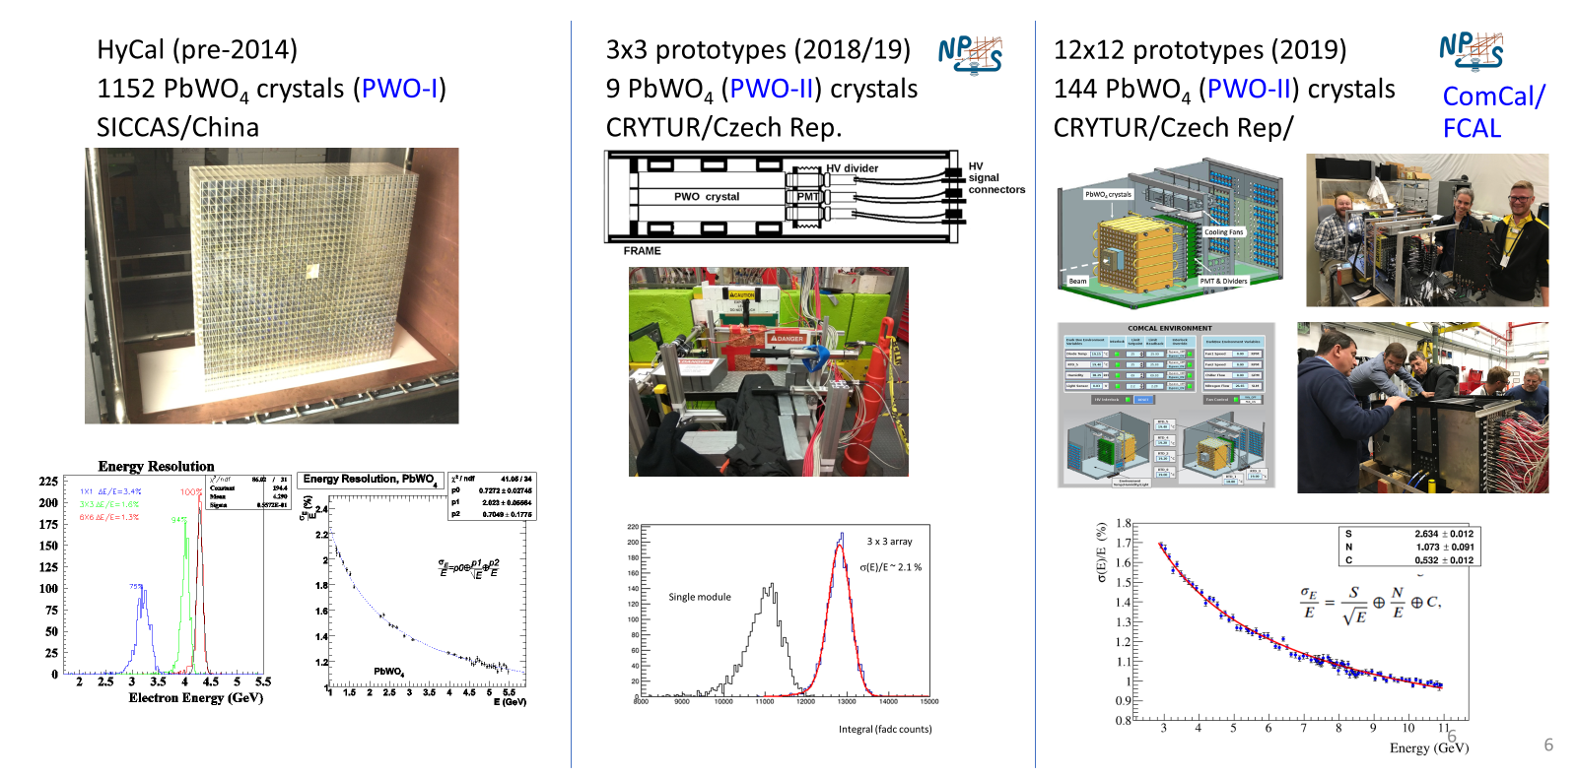
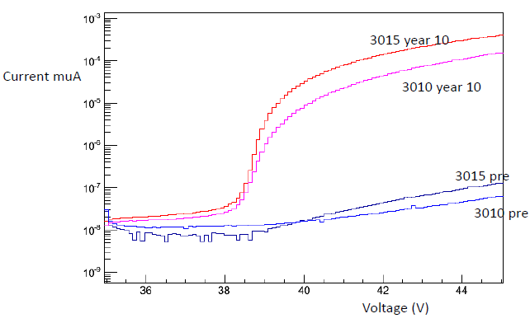
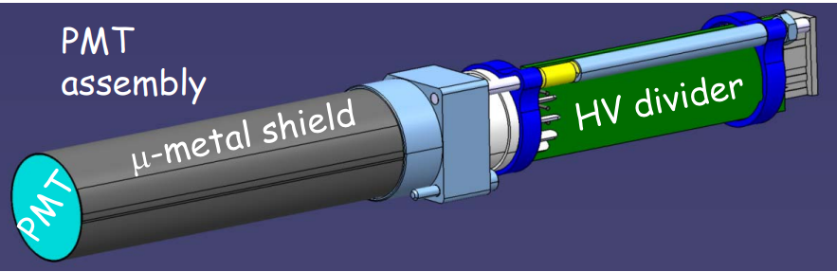
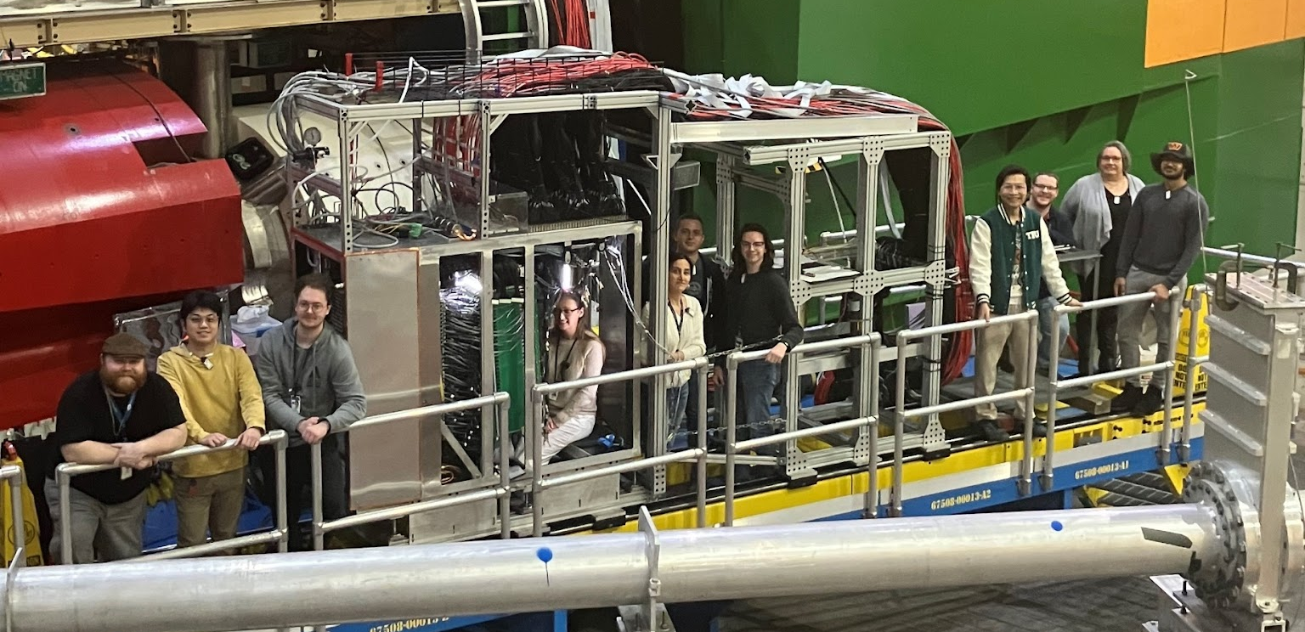
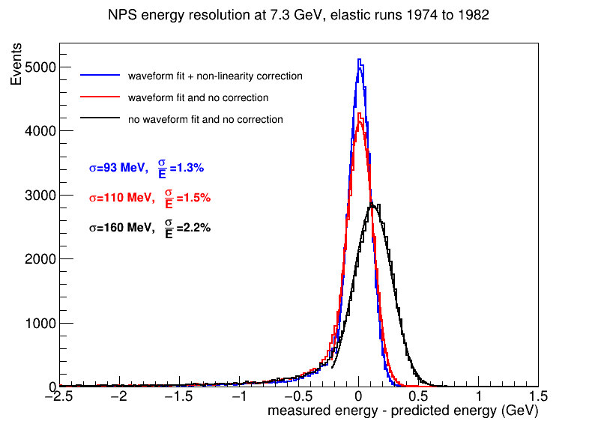
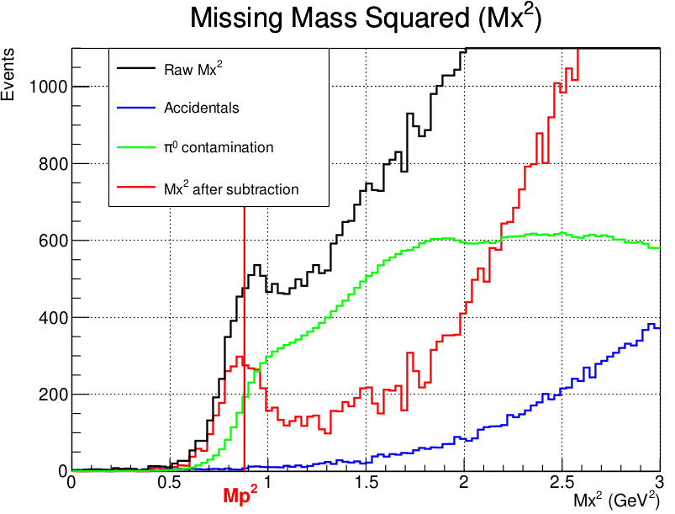
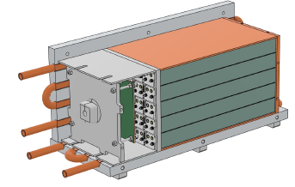
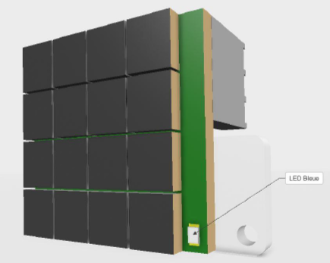
Test Beam – Results and Plans
SiPM Irradiation
UCDavis (Proton) Beam Energy 60 MeV
Selected dose rate for innermost crystals
Crystal test beam campaigns
JLab (EM) Beam Energy GeV scale
36x30 Neutral Particle Spectrometer (2023/24)
1080 PbWO4 (PWO-II) crystals
Crytur/Czech Rep.
No significant increase in dark current between SiPM models
Innermost SiPMs may need recovery mechanism
Crystal specifications - complete
Online results
Readout/Electronics/Cooling Prototype tests
DESY (EM) Beam Energy GeV scale: 28 Oct – 11 Nov, 2024
Overall Goals:
  test if ASIC gives comparable result with fADC
  what is the minimum energy that can be detected with both sets of electronics – may require follow up test at MAMI
  test the impact of mechanical structure on the detector performance.

Slide 6
EEEMCAL TDR “Red” Item Updates
Detector Design
  Beam test for testing engineering components: Crystal+SiPM readout module tests planned for 28 October – 11 November at DESY
  Three 5x5 detector prototypes will be used for easy interchangeability. Goals:
    Direct comparison PMT-SiPM
    Comparison ADC choices
    Mechanical structure
  Mechanical structure for prototype exists, but need to procure SiPMs and boards to instrument
    Working on identifying funding for these items through individual groups and possibly PED
Readout
  SiPM radiation tests completed (UCR, Ohio U., IU, BNL) – no significant difference between models, but increase in dark current requires planning for innermost devices
  Working on funding for SiPMs and board fabrication (will likely use vendor that has been used for previous tests)
  Test benches for QA being developed
FEB
  Plan to measure characteristics of both options at the DESY beam test
  With this information make decision on FEB for EEEMCAL

Slide 7
SiPM Selection for the Beam Test in October/November 2024
Device Size
Originally, the idea was to use larger SiPMs as this was thought to be easier for making a SiPM matrix and possibly more cost effective – current knowledge:
Topic | 3 mm x 3mm | 6mm x 6mm
Anode Capacitance | 530 pF | 2500 pF → combining into array further increases capacitance
Array config | 4x4 | 2x2
Cost | $53/SiPM | $125/SiPM
Radiation Hardness | TBC | TBC
Radiation hardness – based on information from Hamamatsu no major differences are expected. See analysis from the recent irradiation test for results from the measurement.
In general, a beam test with the different SiPM options would be best, but lead times for procurements may require an earlier decision

Slide 8
SiPM Selection for the Beam Test in October/November 2024
Pixel Size
Topic | 10um | 15um
PDE at 420 nm (%) | 17 | 32
Number of cells | 89984 | 39984
Activated sites/SiPM | 907 | 1588
INL at 15 GeV 100% coupling efficiency | 0.5% | 2.0%
Total activated cells | 14506 | 25204
Resolution (bit) | 14 | 15
INL at 15 GeV 20% coupling efficiency | 0.10% | 0.40%
Total activated cells | 2913 | 5163
Resolution (bit) | 12 | 13
Radiation Hardness | TBC | TBC
Originally, the idea was to use 10um SiPMs as EIC data are mainly taken at GeV scale where linearity (constant term) is more important than photostatistics. However, note that in EIC we have to detect the shower down to 100 MeV (5 MeV/block)
It would be good to understand nonlinearity even before combining SiPMs into an array.
Radiation hardness – see analysis of the recent irradiation test data
Note: lowest energy at DESY Oct/Nov. test may be 1 GeV
In general, a beam test with the different SiPM options would be best, but lead times for procurements may require an earlier decision

Slide 9
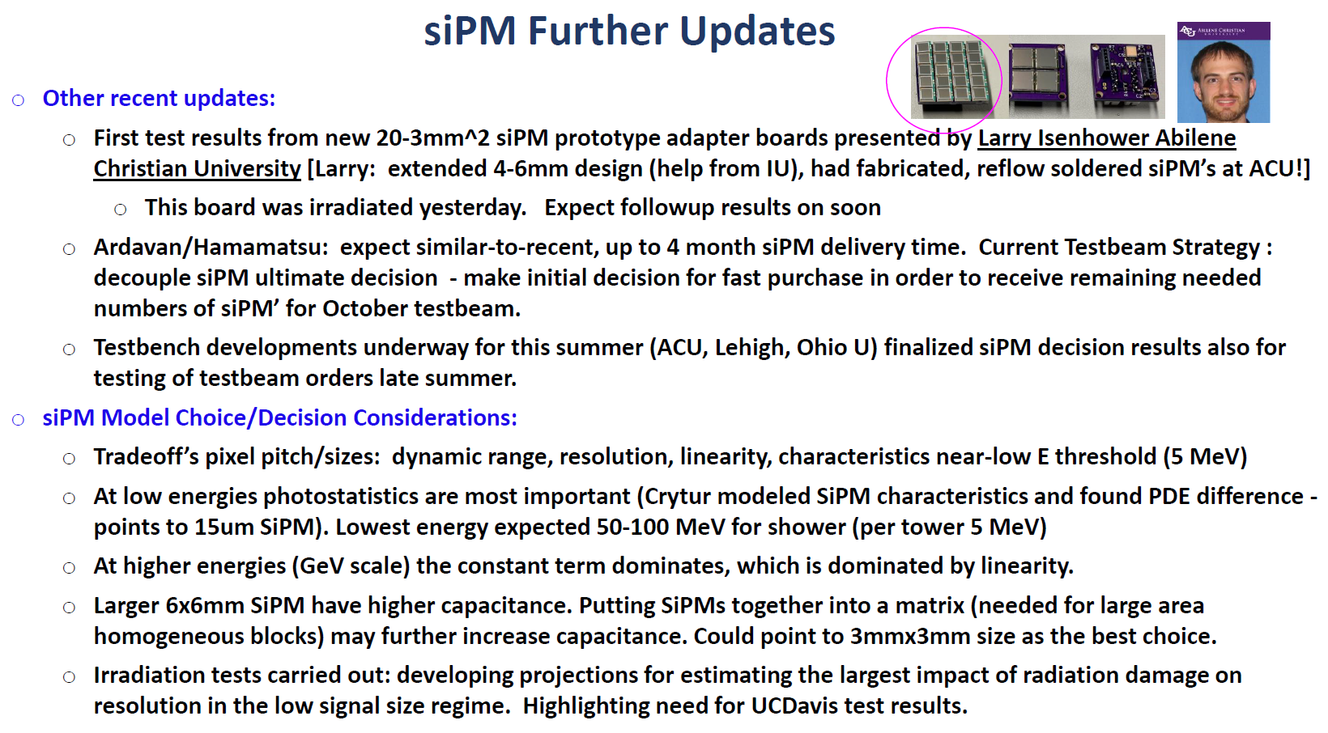

Slide 11
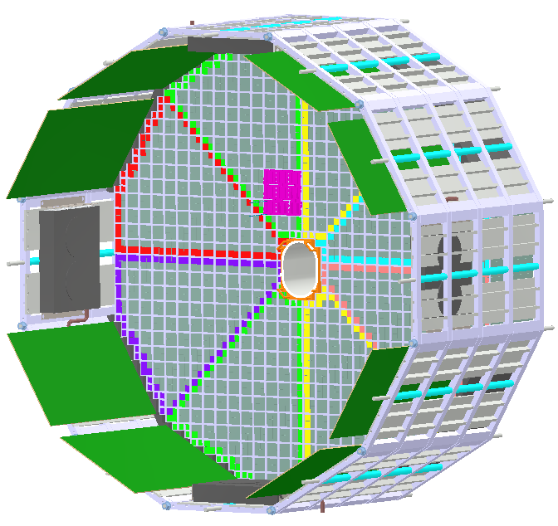








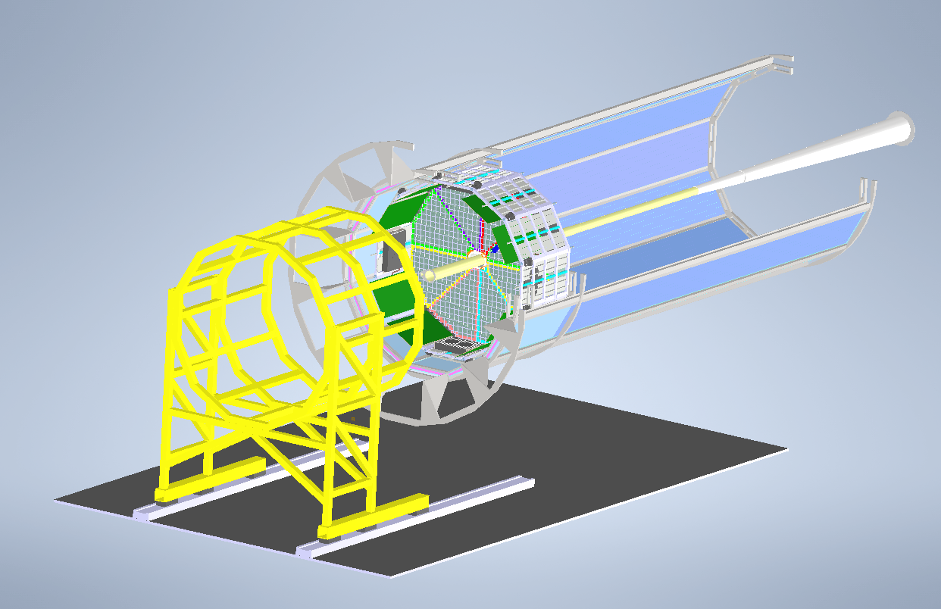





Consortium: Electromagnetic Precision Calorimetry

