Slide 1
ProtoDUNE News
Wenqiang Gu

Slide 2
ProtoDUNE HD status
Beam will be coming Wednesday June 19th
Beam experts have checked their setting for magnets and for beam monitors
Beam instrumentation group needs to tune the Cerenkov counters (a few days)
Plans for beam data taking will be discussed at the next Tuesday NP04 coordination meeting

Slide 3
On-going efforts from Wire-Cell team
Electronics response calibration (Karla)
Improved field response: data & MC comparison with CE response calibration (Wenqiang, Sergey+Slavic)
PDHD 3D imaging & deghosting with two views (Jay)
Integration of WireCell imaging/deghosting result in the standard ProtoDUNE reconstruction chain (Wenqiang, Jay)
Commissioning data & NF performance (Xuyang, Barnali)
DQM tools could be collaborated with Gabriela et al.

Slide 4
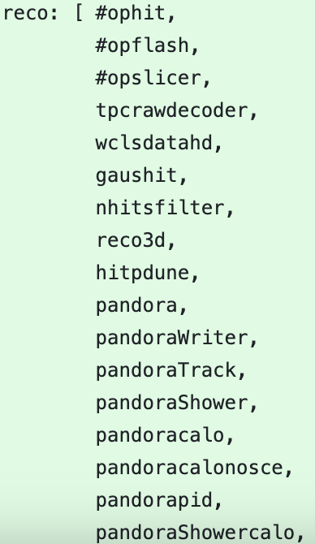
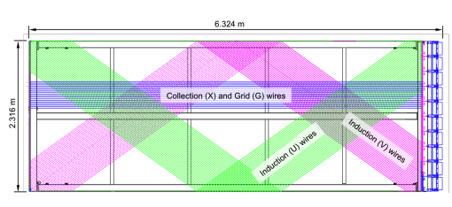
The standard ProtoDUNE reco chain
A gauss hit finder produces recob::Hits
Pandora tools can work more efficiently if the Hits could be associated with TPC & wire segment more clearly
Given a SpacePoint and its associated Hits in collection plane, one can clarify the TPC (i.e. face) for induction plane
(Induction) wire segment can also be determined with a best match to a SpacePoint
Wire-Cell Sigproc
SpacePointsSolver
Hit Disambiguation
Pandora reco and the corresponding dE/dx calorimetry, etc.

Slide 5
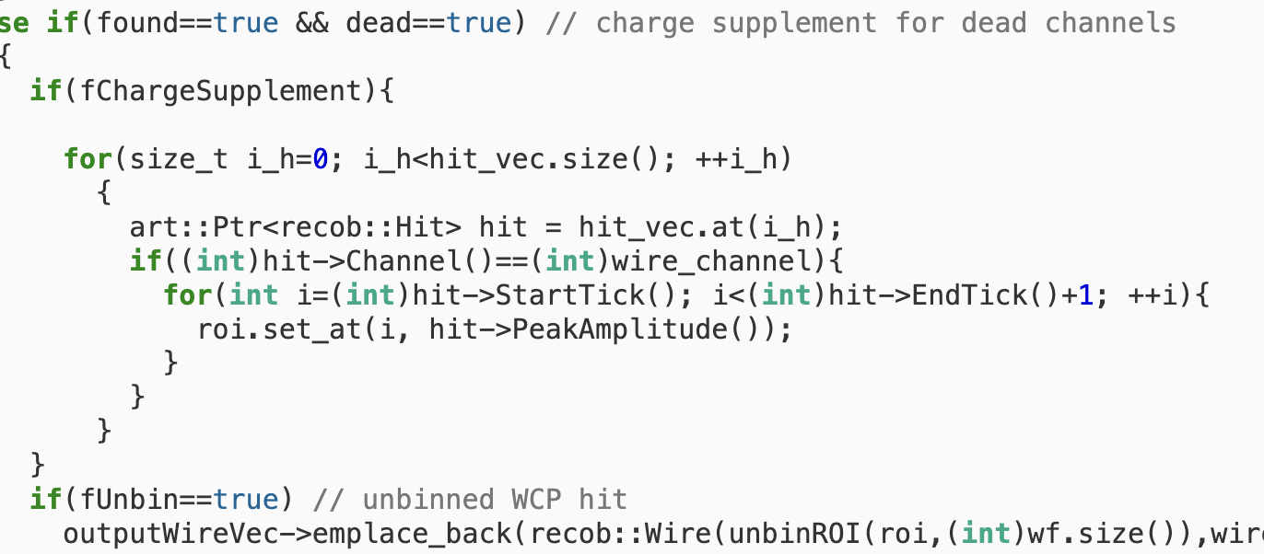
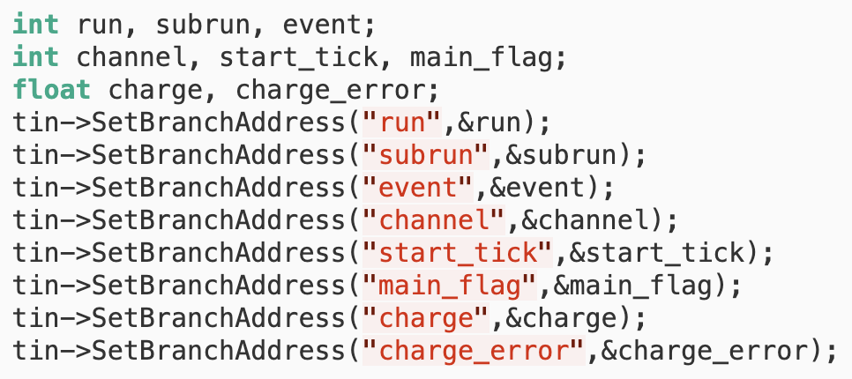
The WCP hybrid method in MicroBooNE
https://cdcvs.fnal.gov/redmine/projects/ubreco/repository/revisions/master/entry/ubreco/WcpPortedReco/ProducePort/WCPHybrid_module.cc
recob::Hit constructed from imaging result in merge.root
(Dead channels) fill recob::Wire with recob::Hits

Slide 6
How to integrate Wire-Cell imaging/deghosting in the ProtoDUNE reco chain?
Option 1: Replace SpacePointsSolver, re-develop the hit disambiguation algorithm in larsoft
Option 2: Fill “dead channels” in the collection plane with recob::Hits ported from WireCell imaging
The ProtoDUNE standard reco chain doesn’t need to change
Wire-Cell Sigproc
SpacePointsSolver
Hit Disambiguation
Pandora reco and the corresponding dE/dx calorimetry, etc.

