Slide 1
sPhenix Cryogenic Review
9/14/2016

Slide 2
sPhenix Cryogenics Requirements
Control temperature gradient to no more than 40K during cooldown/warmup
7.5 g/s of liquid helium supply flow to do forced feed to solenoid circuit.
Shield flow 4.5K vapor: 0.3 - 0.6 g/s.
Current lead cooling: 0.1 - 0.6 g/s. Ramp with current
Cooldown/warmup rate 300K to 4K in 7 days [3 weeks of 45K supply during RHIC 45K wave cooldown]
Ability to disconnect cryogenic lines to move the detector into assembly hall
500L phase separator/ reservoir
to ramp down magnet when cryogenic supply is lost
to remove heat leak from the long 4.5K supply transfer line
Hold at <100K during summer shutdown to limit thermal cycling on solenoid
Precool to 100K before RHIC run startup
Testing with 500L dewars:
Summer Shutdown Testing 4.5K in IP location
Summer Shutdown Testing 4.5K in assembly hall location
Summer Shutdown Testing 4.5K, short duration and low current test e.g. 4 hours, 1000A
Summer Shutdown Testing 4.5K, full current test 4650A

Slide 3
Control temperature gradient to no more than 40K during cooldown/warmup
COLD SUPPLY AND CAPACITY
RHIC: Cold helium: S header during RHIC 45K wave, during 4.5K wave
500L dewars during shutdown
LN2 supply during shutdown
WARMUP SOURCE AND CAPACITY
Gas heating capacity
Electric Heater
Ambient vaporizer
Source of gas flow
RHIC cold / with Heat exchanger
Local 1008B circulation compressor. Requires water at 20 GPM
HEAT EXCHANGER
To use RHIC cold supply during cooldown/warmup

Slide 4
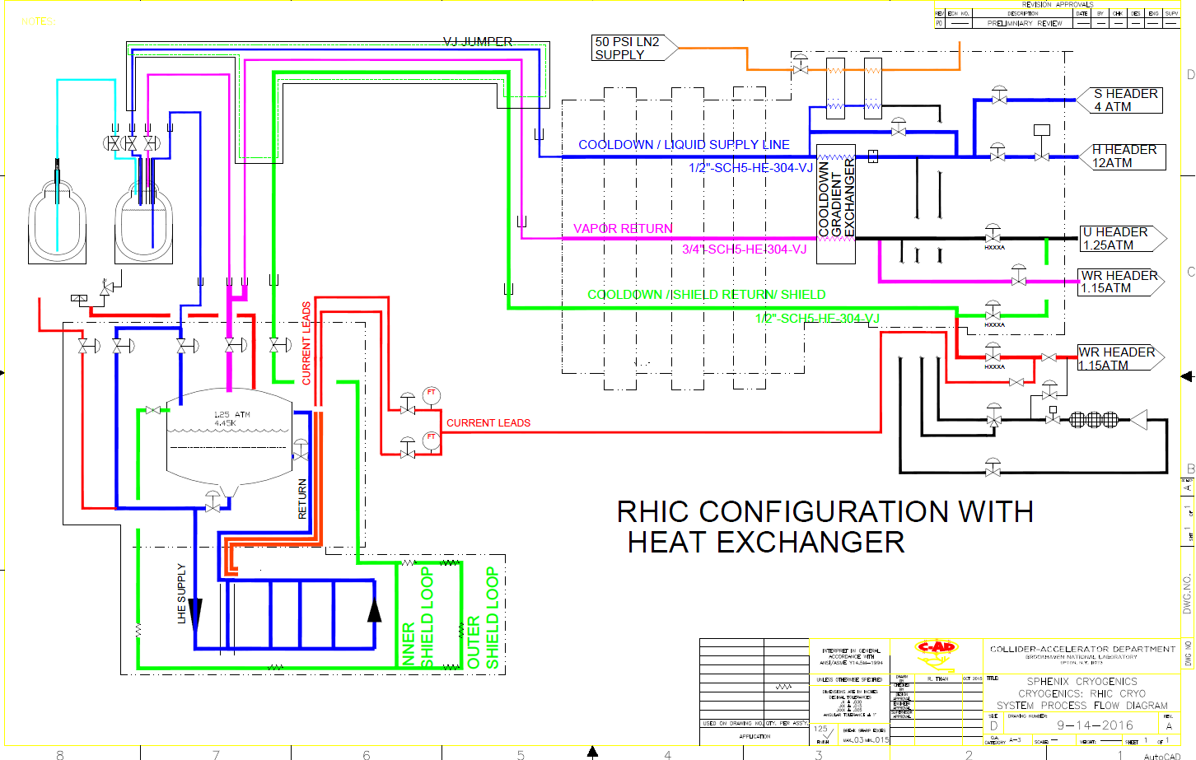

Slide 5
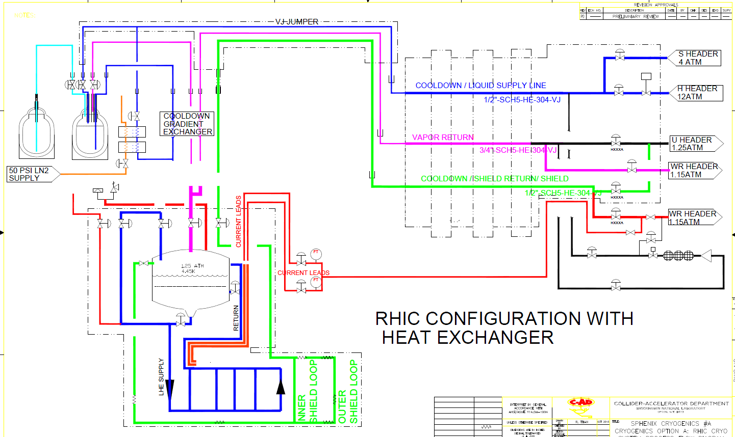

Slide 6
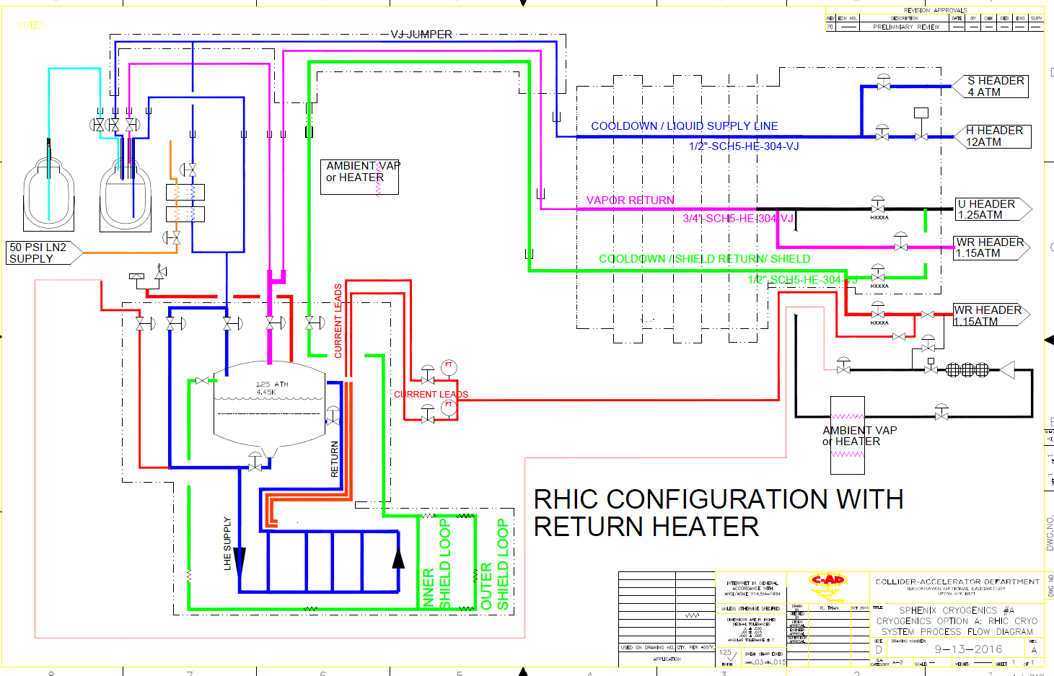

Slide 7
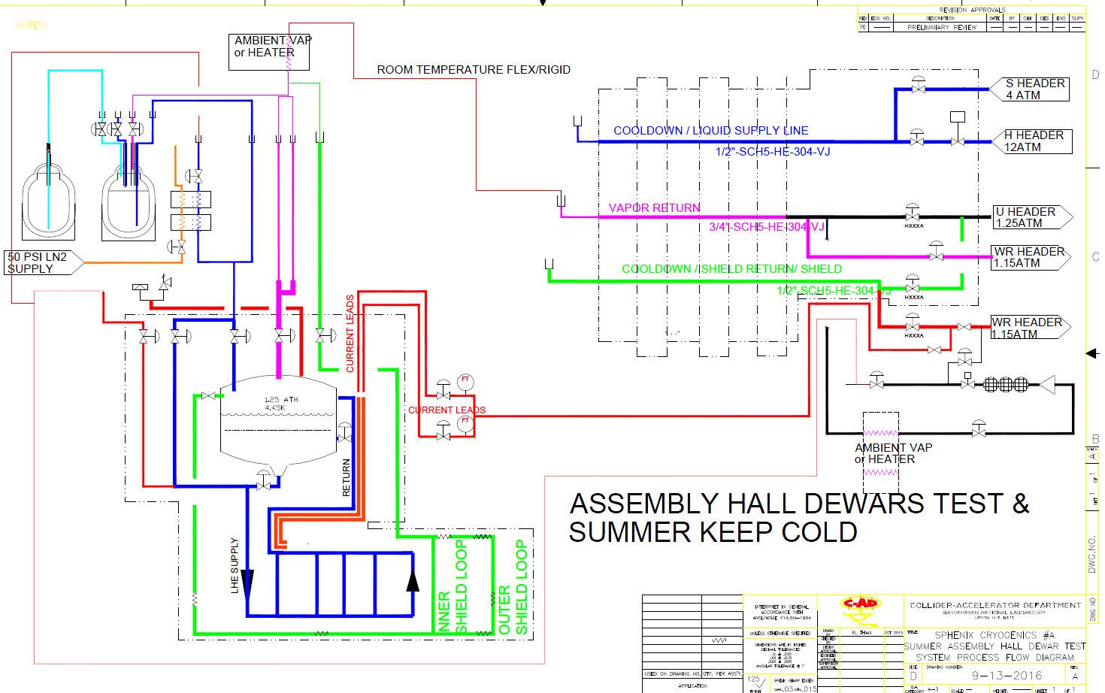

Slide 8
Cooldown Requirements without RHIC plant
LN2: ~4000 Gallons
LHe: ~ 5000 Liters
Small helium Compressor during summer
IP4 56MHz compressor in 1004E
e lens compressor in 1010 mezzanie
ERL 912/NSLS-1 install 1008B if room available
Return Heater
Allows summer testing with Dewars
Summer keep cold

Slide 9
Keep cold during summer shutdown
Helium circulation loop with LN2 feed ia transfer line and exchanger
PROs
300K – 100K cooldown and warmup independent from RHIC
CONS
Higher cost
LN2 FLOODED MODE Using cryocooler with condenser surface
CONS
No 300K – 100K cooldown/warmup with cryocooler
Pump and purge
PROs
All equipment will reside on platform. Air cooled compressor
More economical

Slide 10
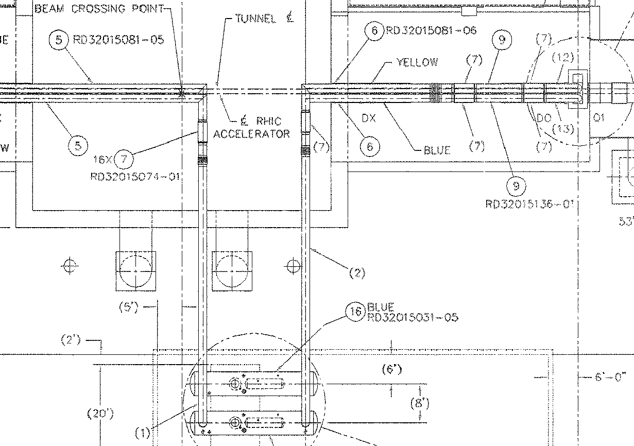
SPHENIX: MAGNET: Cryogenics System diagram: RHIC Interface Option

